Slide 1



The graphical brain and deep inference
Karl Friston
Abstract: This presentation considers deep temporal models in the brain. It builds on previous formulations of active inference to simulate behaviour and electrophysiological responses under deep (hierarchical) generative models of discrete state transitions. The deeply structured temporal aspect of these models means that evidence is accumulated over distinct temporal scales, enabling inferences about narratives (i.e., temporal scenes). We illustrate this behaviour in terms of Bayesian belief updating – and associated neuronal processes – to reproduce the epistemic foraging seen in reading. These simulations reproduce these sort of perisaccadic delay period activity and local field potentials seen empirically; including evidence accumulation and place cell activity. Finally, we exploit the deep structure of these models to simulate responses to local (e.g., font type) and global (e.g., semantic) violations; reproducing mismatch negativity and P300 responses respectively. These simulations are presented as an example of how to use basic principles to constrain our understanding of system architectures in the brain – and the functional imperatives that may apply to neuronal networks.
Key words: active inference ∙ cognitive ∙ dynamics ∙ free energy ∙ epistemic value ∙ self-organization

Slide 2

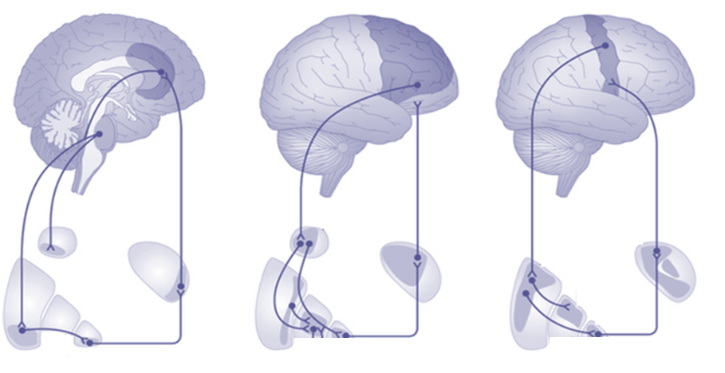
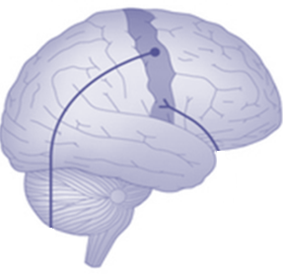

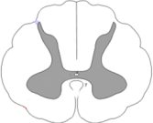
Limbic loops
Associative loops
Motor loops
Thalamocortical loops
Caudate
Thalamus
Thalamus
Putamen
Globus pallidum

Slide 3
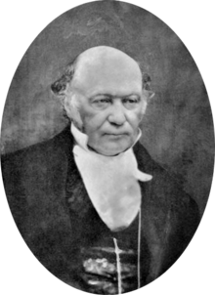
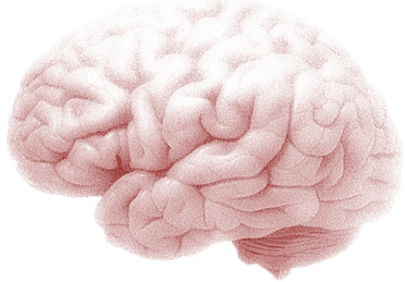
Active inference
Active inference and self-evidencing
Generative models and active inference
From principles to process theories
Some empirical predictions
Deep temporal models

Slide 4
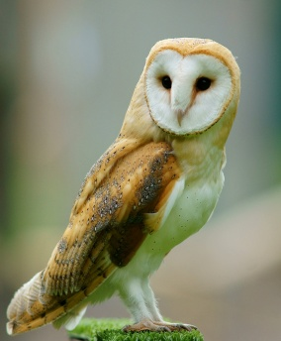

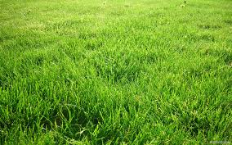
Imagine you are an owl – and you are hungry…

Slide 5
Optimal action depends on states of the world
Optimal action depends on beliefs about states
and subsequent action
Bellman’s Optimality Principle:
Optimal control theory
Dynamic programming
Deep reinforcement learning and expected utility
Bayesian decision theory
State-action policy iteration
MDP
….
Hamilton's Principle of least Action:
Free energy principle
Active inference
Artificial curiosity and intrinsic motivation
Optimal Bayesian design
Sequential policy optimisation
POMDP
….

Slide 6
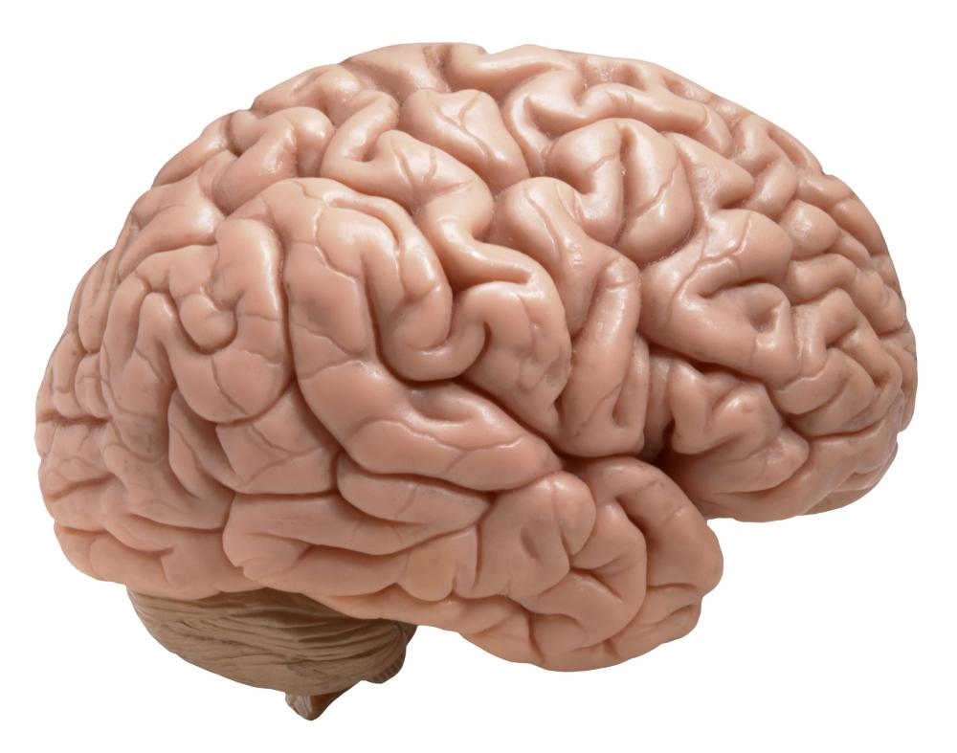
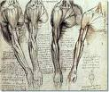

Active inference
Expected free energy maximisation
Policy selection
Risk
Ambiguity
External states
Markov blanket
Free energy maximisation
Perceptual inference
Complexity
Accuracy

Slide 7
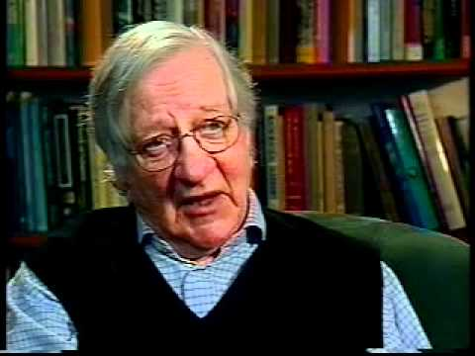
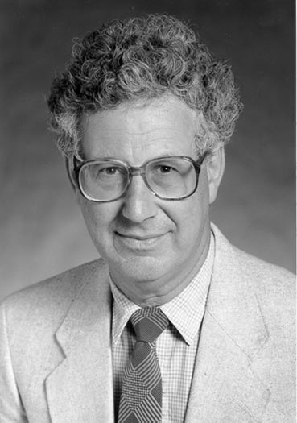
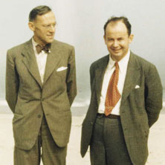
Active inference
Complexity
Accuracy
Perceptual inference
Evidence bound
Log evidence
Risk
Ambiguity
Policy selection
Intrinsic value
Extrinsic value
Bayesian surprise and Infomax
No prior beliefs or preferences:
KL or risk-sensitive control
No ambiguity (i.e., known states):
Expected utility theory
No uncertainty or risk:
Bayesian surprise
Mutual information
Divergence from prior preferences
Expected value

Slide 8


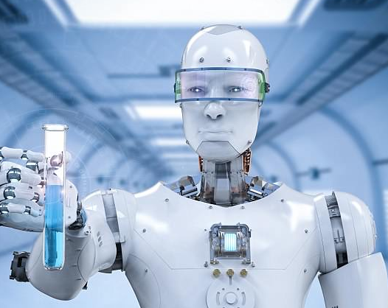
+
=
Bayes optimal decisions
Bayes optimal design
Active inference
+
=
Expected value
Information gain
Expected free energy

Slide 9
Overview
Active inference and self-evidencing
Generative models and active inference
From principles to process theories
Some empirical predictions
Deep temporal models

Slide 10

A (Markovian) generative model
Likelihood
Empirical priors – hidden states
Precision
– control states
Policy
Full priors
Hidden states
Approximate posterior

Slide 11
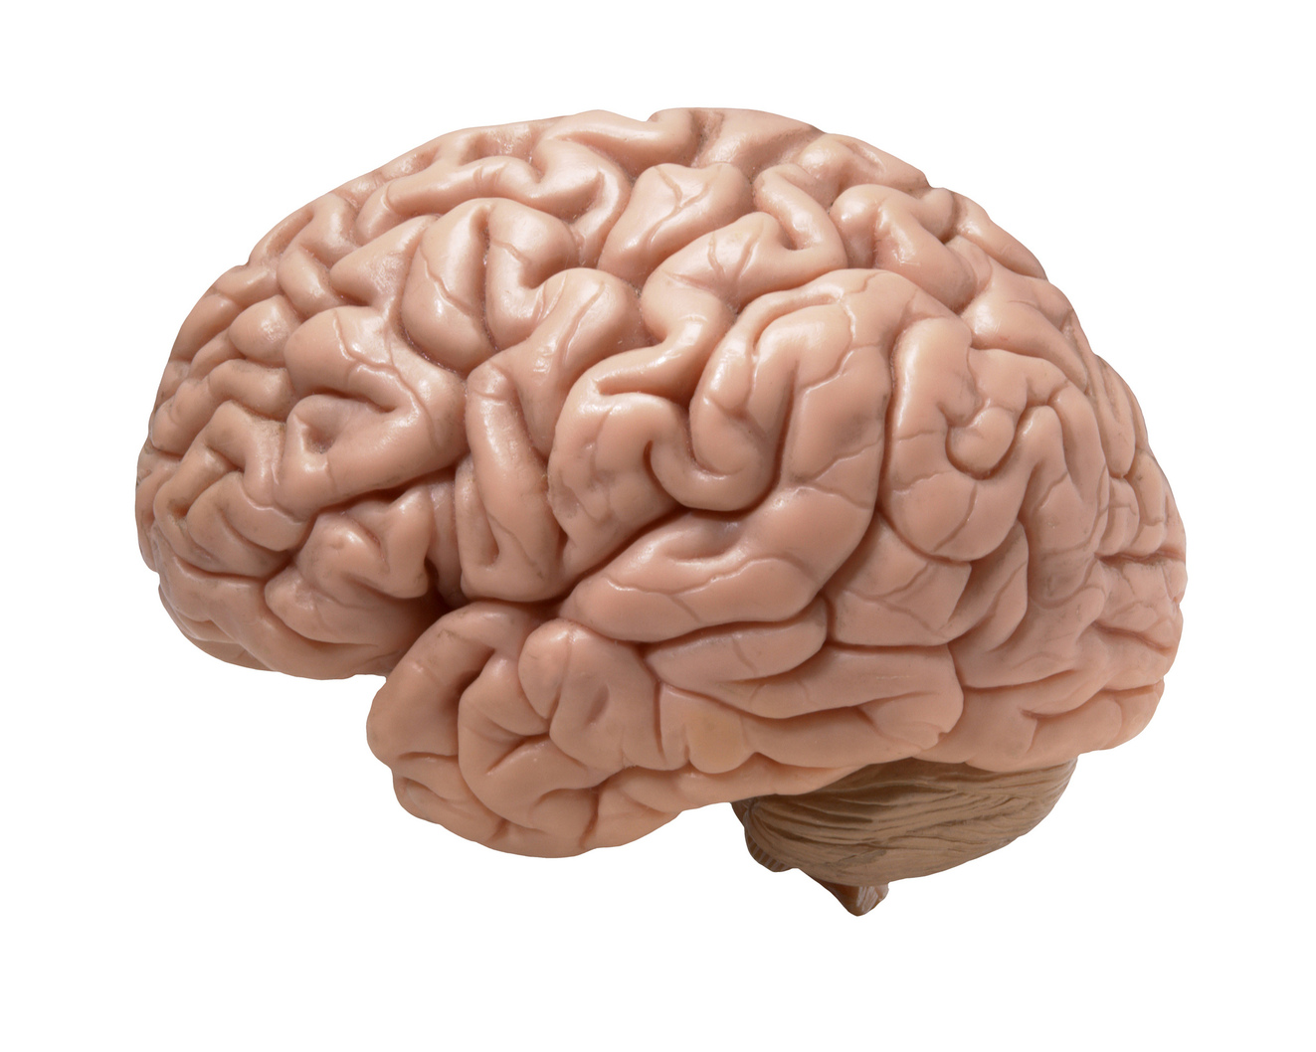
Belief updating
Perception
Policy selection
Precision
Functional anatomy
motor cortex
Learning
occipital cortex
prefrontal cortex
striatum
hippocampus
Action selection
VTA/SN

Slide 12
From models to graphs
Probabilistic graphical model
Generative model
1
2
3
Factors
(likelihood and empirical priors)
4
Approximate posterior
2
3
4
1
1
4
3
5
2
5
2
5
2
=
3
2
=
3
2
=
5
Belief updating
4
4
4
1
Outcome selection
Factor graph

Slide 13
Factors
(likelihood and priors)
Approximate posterior
Deep (diachronic) models
2
3
4
6
2
1
1
5
5
=
=
3
2
=
=
3
2
5
Belief updating
6
6
2
Outcome selection
=
3
2
=
3
2
=
=
=
=
4
4
4

Slide 14
Overview
Active inference and self-evidencing
Generative models and active inference
From principles to process theories
Some empirical predictions
Deep temporal models

Slide 15


Two-step maze task
Control states
Generative model
1 2 3 4
location
Hidden states
CS
location
context
Outcomes

Slide 16


From exploration and exploitation
(epistemic foraging)
Initial state and policy selection
2
US
Policy
4
US
6
8
10
5
10
15
20
25
30
Final outcome, performance and reaction times
4
2
Expected utility
CS
0
CS
-2
5
10
15
20
25
30
Learning (D)
2
4
Hidden state
6
8
5
10
15
20
25
30
Trial

Slide 17
US
Initial state and policy selection
2
Policy
4
6
8
10
5
10
15
20
25
30
Trial
Final outcome, performance and reaction times
CS
4
2
Expected utility
Belief updating
0
-2
5
10
15
20
25
30
State estimation (ERPs)
Perception
Policy selection
Precision
0.2
Response
0
-0.2
200
400
600
800
1000
1200
1400
Precision (dopamine)
1
0.5
Precision
0
-0.5
200
400
600
800
1000
1200
1400
Learning (D)
2
4
Hidden state
6
8
5
10
15
20
25
30
Learning

Slide 18
Overview
Active inference and self-evidencing
Generative models and active inference
From principles to process theories
Some empirical predictions
Deep temporal models

Slide 19

Expectations about the past (memory)
Unit responses
Firing rates
1
8
0.8
unit
0.6
Chosen option
Response
16
0.4
Unchosen
1
2
3
0.2
24
0
0.25
0.5
0.75
0.25
0.5
0.75
Expectations about the future (planning)
time (seconds)
time (seconds)
Evidence accumulation
Place cell activity

Slide 20

Repetition suppression and dopamine transfer
US
oddball
standard
CS
Simulated firing rates
8
unit
Difference waveform (MMN)
16
24
0.25
0.5
0.75
1
1.25
1.5
0.08
0.06
oddball
0.04
0.05
0.02
standard
Local field potentials
Response
LFP
0
-0.02
-0.05
-0.04
MMN
0.25
0.5
0.75
1
1.25
1.5
-0.06
50
100
150
200
250
300
350
time (seconds)
Time (ms)
0.5
Phasic DA responses
change in precision
0
-0.5
10
20
30
40
50
60
70
80
90
time (updates)

Slide 21
Overview
Active inference and self-evidencing
Generative models and active inference
From principles to process theories
Some empirical predictions
Deep temporal models

Slide 22
Deep models
Factors
(likelihood and
empirical priors)
Approximate posterior
2
1
2
3
4
6
5
5
=
5
=
=
3
2
=
=
3
2
=
1
4
4
4
5
Belief updating
6
6
6
2
1
5
=
=
=
=
=
=
Action selection
=
3
2
3
2
=
=
4
4

Slide 23
Limbic loops
Associative loops
Motor loops
Thalamocortical loops
Caudate
Thalamus
Thalamus
Putamen
Globus pallidum
Belief updating
Bayesian model averaging
Predictive coding
Action selection
Evaluation and Bayesian model selection

Slide 24




Hidden states
A deep model of reading
Outcomes
“flee, wait, feed & wait”
“wait, wait, wait & feed”
“wait, flee, wait & feed”
“flee, wait, feed & flee”
“wait, wait, wait & flee”
“wait, flee, wait & flee”
What (sentence)
2
3 4
2
3 4
2
3 4
2
3 4
2
3 4
2
3 4
2
3 4
2
3 4
2 3 4
2 3 4
Where (sentence)
Where (sentence)
What (word)
What (letter)
2
4
2
4
2
flee
feed
wait
5
2
3 4
2
3 4
Flip
Where (word)
Where (word)

Slide 25












Eye movements
flee WAIT feed WAIT
Narrative construction
Second level expectations
First level expectations

Slide 26
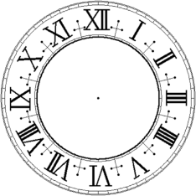

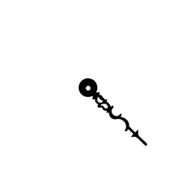
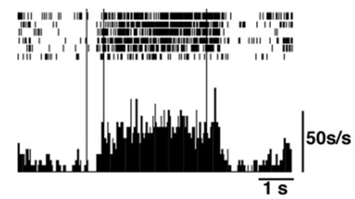

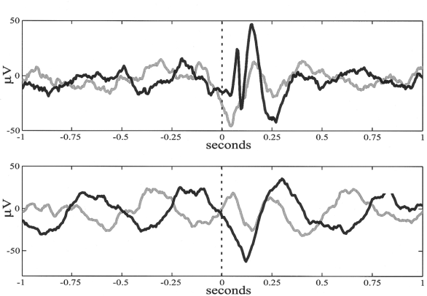









“flee, wait, feed & wait”
“wait, wait, wait & feed”
“wait, flee, wait & feed”
“flee, wait, feed & flee”
“wait, wait, wait & flee”
“wait, flee, wait & flee”
Unit responses (high-level)
Pre-saccadic delay period activity in prefrontal cortex
1
2
3
4
5
6
0.5
1
1.5
2
2.5
3
3.5
flee
feed
wait
Unit responses (low-level)
0.5
1
1.5
2
2.5
3
3.5
V2
Local field potentials
1
0.5
0
-0.5
-1
TE
0.25
0.5
0.75
1
1.25
1.5
1.75
2
2.25
2.5
2.75
3
3.25
3.5
Perisaccadic field potentials during active vision
Eye movements

Slide 27
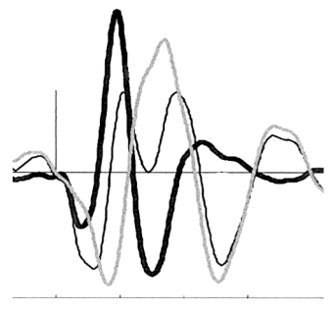
Local and global violations
Local deviation
Difference waveform
Local violation
1
N1
-0.4
-0.3
MMN
0.5
-0.2
First (lexical) level expectations
2
4
Depolarization
-0.1
0
0
Second (semantic) level expectations
feed
feed
0.1
-0.5
0.2
-1
0
100
200
300
400
0.3
0
100
200
300
400
N1
MMN
Old expectation
New expectation
1
Global deviation
Difference waveform
2
4
2
-0.3
feed
wait
0.5
-0.2
5
-0.1
Depolarization
P300
0
0
0.1
0
100
200
300
400
Global violation
-0.5
0.2
P300
0.3
-1
0
100
200
300
400
0.4
0
100
200
300
400

Slide 28
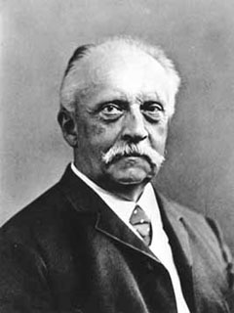
“Each movement we make by which we alter the appearance of objects should be thought of as an experiment designed to test whether we have understood correctly the invariant relations of the phenomena before us, that is, their existence in definite spatial relations.”
‘The Facts of Perception’ (1878) in The Selected Writings of Hermann von Helmholtz, Ed. R. Karl, Middletown: Wesleyan University Press, 1971 p. 384

Slide 29
Thank you
And thanks to collaborators:
Rick Adams
Ryszard Auksztulewicz
Andre Bastos
Sven Bestmann
Howard Bowman
Harriet Brown
Jean Daunizeau
Mark Edwards
Chris Frith
Thomas FitzGerald
Xiaosi Gu
Stefan Kiebel
James Kilner
Christoph Mathys
Jérémie Mattout
Rosalyn Moran
Dimitri Ognibene
Sasha Ondobaka
Thomas Parr
Will Penny
Cathy Price
Giovanni Pezzulo
Richard Rosch
Lisa Quattrocki Knight
Francesco Rigoli
Klaas Stephan
Philipp Schwartenbeck
And colleagues:
Micah Allen
Felix Blankenburg
Andy Clark
Peter Dayan
Ray Dolan
Allan Hobson
Paul Fletcher
Pascal Fries
Geoffrey Hinton
James Hopkins
Jakob Hohwy
Mateus Joffily
Henry Kennedy
Simon McGregor
Read Montague
Tobias Nolte
Anil Seth
Mark Solms
Paul Verschure
And many others

