Slide 1


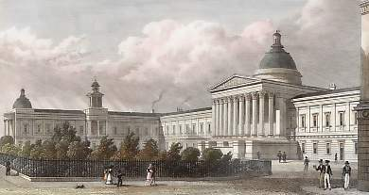
The Bayesian brain, free energy and psychopathology
Cambridge– May 23rd 2013
Karl Friston
Abstract
If we assume that neuronal activity encodes a probabilistic representation of the world that optimizes free-energy in a Bayesian fashion, then this optimization can be regarded as evidence accumulation or (generalized) predictive coding. Crucially, both predictions about the state of the world generating sensory data and the precision of (confidence in) those data have to be optimized. In other words, we have to make predictions (test hypotheses) about the content of the sensorium and predict our confidence in those hypotheses. I hope to demonstrate the metacognitive aspect of this inference using simulations of action observation and sensory attenuation - to illustrate the nature of active inference and promote discussion about its role in making inferences about self and others.

Slide 2

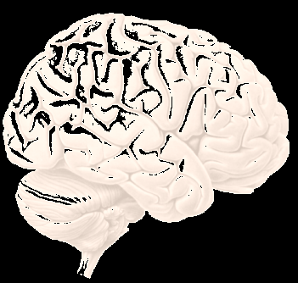
Active inference, predictive coding and precision
Precision and false inference
Simulations of :
  Auditory perception (and omission related responses)
  Handwriting (and action observation)
  Smooth pursuit eye movements (under occlusion)
  Sensory attenuation (and the force matching illusion)

Slide 3
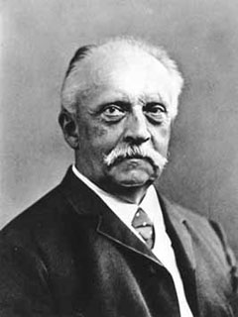
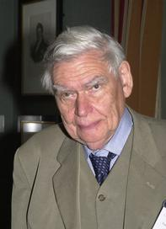
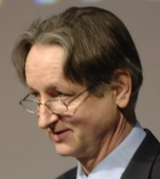
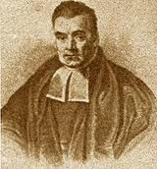

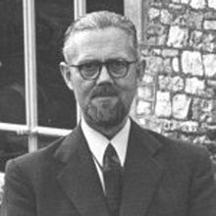
“Objects are always imagined as being present in the field of vision as would have to be there in order to produce the same impression on the nervous mechanism” - von Helmholtz
Hermann von Helmholtz
Richard Gregory
Geoffrey Hinton
From the Helmholtz machine to the Bayesian brain and self-organization
Thomas Bayes
Richard Feynman
Ross Ashby

Slide 4
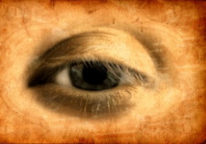
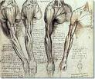
Action and perception minimise surprise
sensations – predictions
Prediction error
Change sensations
Change
predictions
Action
Perception

Slide 5
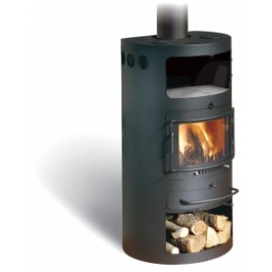
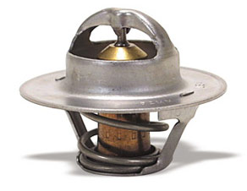
Action as inference – the “Bayesian thermostat”
Posterior distribution
Prior distribution
Likelihood distribution
20
40
60
80
100
120
temperature
Perception
Action

Slide 6
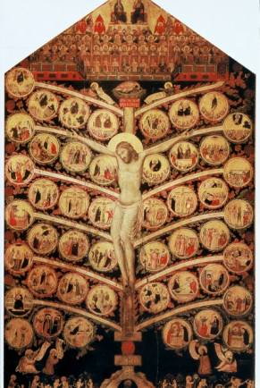
From models to perception
A simple hierarchy
Generative model
Descending
predictions
Model inversion (inference)
Expectations:
Ascending prediction errors
Predictions:
Prediction errors:

Slide 7

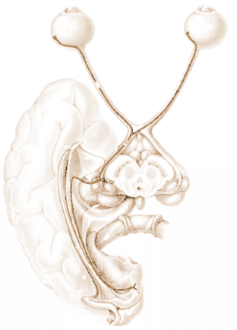
David Mumford
Predictive coding with reflexes
Action
oculomotor signals
reflex arc
proprioceptive input
pons
retinal input
Perception
Attention
Prediction error (superficial pyramidal cells)
frontal eye fields
geniculate
VTA
Top-down or backward predictions
Conditional predictions (deep pyramidal cells)
Bottom-up or forward prediction error
visual cortex

Slide 8
Prediction error can be reduced by changing predictions (perception)
Prediction error can be reduced by changing sensations (action)
Perception entails recurrent message passing in the brain to optimize predictions
Action fulfils descending predictions

Slide 9
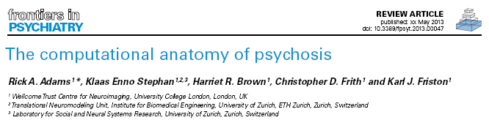
Decompensation
(trait abnormalities)
Attenuated violation responses
Loss of perceptual Gestalt
SPEM abnormalities
Psychomotor poverty
Resistance to illusions
Hallucinations
Delusions
+
Neuromodulatory failure (of sensory attenuation)
-
Compensation
(to psychotic state)

Slide 10
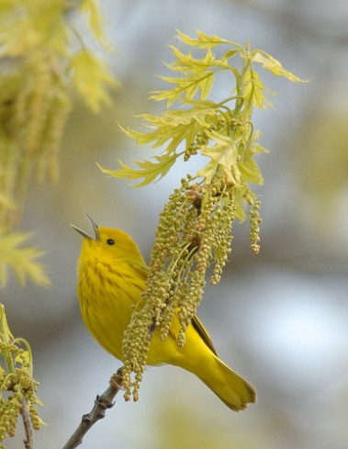
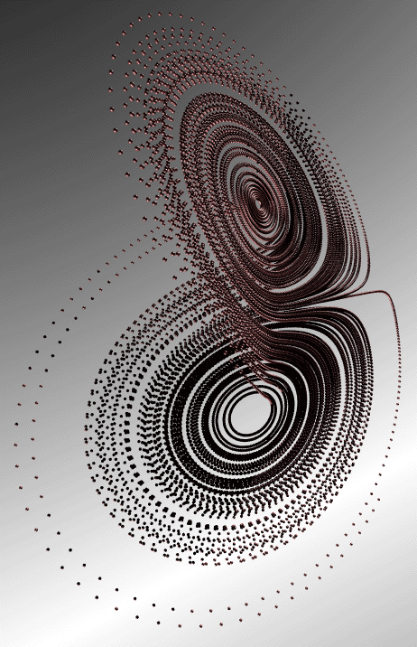
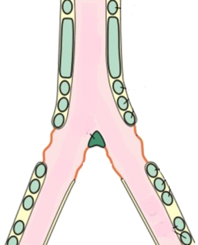
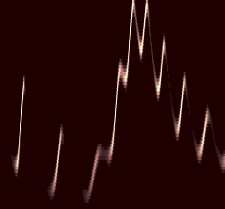
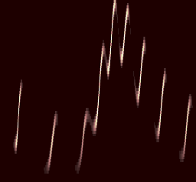

Neuronal hierarchy
Generative process (and model)
Syrinx
Model inversion
sonogram
percept
prediction error
10
8
6
Frequency (KHz)
Frequency (Hz)
4
LFP (micro-volts)
2
0
-2
-4
-6
0.5
1
1.5
500
1000
1500
2000
Time (sec)
peristimulus time (ms)

Slide 11
Omission related responses, MMN and hallucinosis
Reduced precision at second level
Compensatory reduction of sensory precision

Slide 12
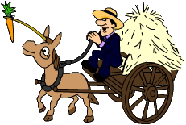
Action as inference – the “Bayesian thermostat”
Prior distribution
20
40
60
80
100
120
temperature
Perception:
Action:

Slide 13
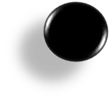
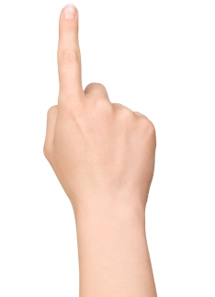
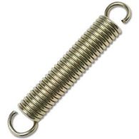
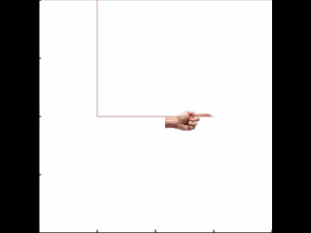
Heteroclinic cycle (central pattern generator)
Descending
proprioceptive predictions
action
observation
0.4
0.6
0.8
position (y)
1
1.2
1.4
0
0.2
0.4
0.6
0.8
1
1.2
1.4
0
0.2
0.4
0.6
0.8
1
1.2
1.4
position (x)
position (x)

Slide 14
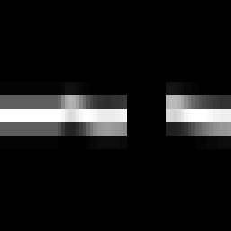
Angular direction of target in extrinsic coordinates
Smooth pursuit eye movements
Angular direction of gaze in extrinsic coordinates
Angular position of target in intrinsic coordinates
oculomotor signals
proprioceptive input
reflex arc
pons
retinal input
visual channels
time
Generative process
Generative model

Slide 15
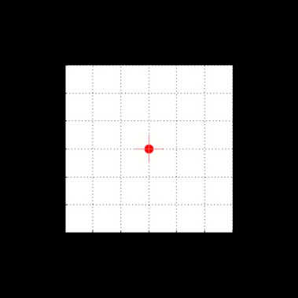
Eye movements under occlusion – and reduced precision
Angular position
2
1
eye
target
displacement (degrees)
0
-1
-2
eye (reduced precision)
500
1000
1500
2000
2500
3000
Angular velocity
50
40
30
velocity (degrees per second)
20
10
0
-10
-20
500
1000
1500
2000
2500
3000
time (ms)

Slide 16
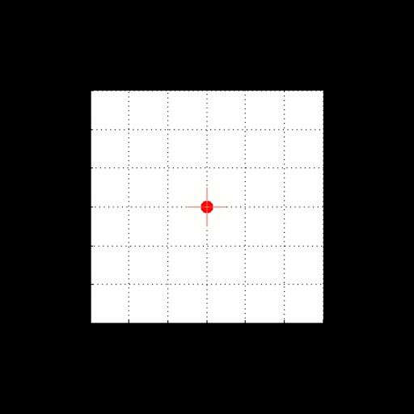
Paradoxical responses to violations
target and oculomotor angles
2
eye
1
target
displacement (degrees)
0
eye (reduced precision)
-1
-2
100
200
300
400
500
600
700
800
900
1000
time (ms)
target and oculomotor velocities
30
20
10
velocity (degrees per second)
0
-10
-20
-30
100
200
300
400
500
600
700
800
900
1000
time (ms)

Slide 17
Sensory attenuation, illusions and agency

Slide 18

Making your own sensations
Generative process
Generative model

Slide 19
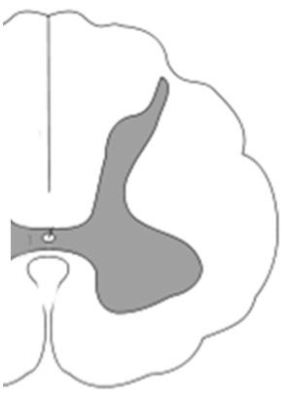
sensorimotor cortex
descending predictions
prefrontal cortex
descending sensory predictions
descending modulation
ascending prediction errors
thalamus
descending motor predictions
motor reflex arc

Slide 20
Self-made acts
prediction and error
hidden states
2
2
1.5
1.5
1
1
0.5
0.5
0
0
-0.5
-0.5
5
10
15
20
25
30
5
10
15
20
25
30
Time (bins)
Time (bins)
High sensory attenuation
hidden causes
perturbation and action
1
1
0.8
0.5
0.6
0.4
0.2
0
0
-0.2
-0.5
-0.4
-0.6
-0.8
5
10
15
20
25
30
5
10
15
20
25
30
Time (bins)
Time (bins)

Slide 21
and psychomotor poverty
prediction and error
hidden states
2
2
1.5
1.5
1
1
0.5
0.5
0
0
-0.5
-0.5
5
10
15
20
25
30
5
10
15
20
25
30
time
time
Failure of sensory attenuation
hidden causes
perturbation and action
1
1
0.8
0.5
0.6
0.4
0.2
0
0
-0.2
-0.5
-0.4
-0.6
-0.8
5
10
15
20
25
30
5
10
15
20
25
30
time
time

Slide 22
prediction and error
hidden states
prediction and error
hidden states
2
2
2
2
1.5
1.5
1.5
1.5
1
1
1
1
0.5
0.5
0.5
0.5
0
0
0
0
-0.5
-0.5
-0.5
10
20
30
40
50
60
-0.5
10
20
30
40
50
60
10
20
30
40
50
60
10
20
30
40
50
60
Time (bins)
Time (bins)
Time (bins)
Time (bins)
Sensory attenuation
Force matching illusion
hidden causes
perturbation and action
hidden causes
perturbation and action
2
2
1.5
1.5
1.5
1.5
1
1
1
1
0.5
0.5
0.5
0.5
0
0
0
0
-0.5
-0.5
-0.5
10
20
30
40
50
60
-0.5
10
20
30
40
50
60
10
20
30
40
50
60
10
20
30
40
50
60
Time (bins)
Time (bins)
Time (bins)
Time (bins)

Slide 23
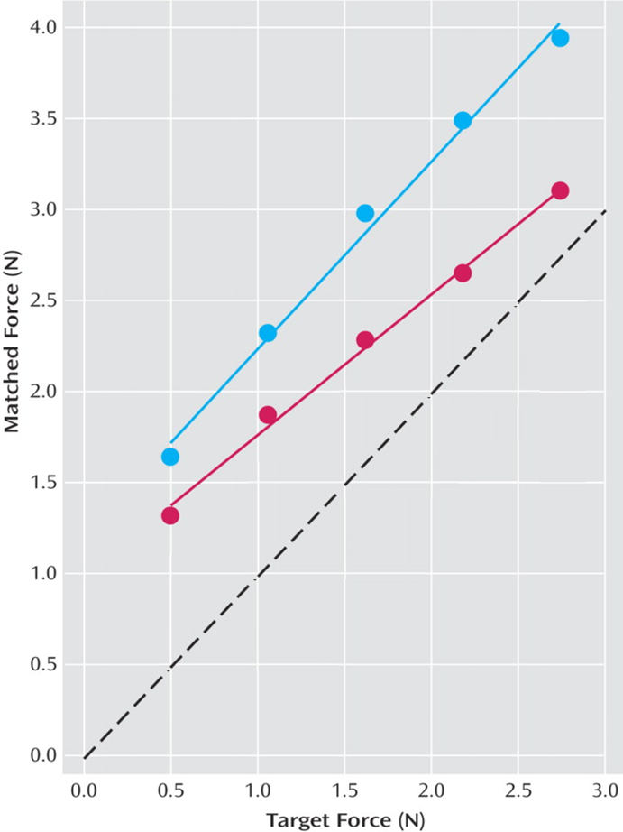
Failures of sensory attenuation, with compensatory increases in non-sensory precision
3
Simulated
Empirical (Shergill et al)
2.5
2
Self-generated(matched) force
Self-generated(matched) force
1.5
1
0.5
0
0
0.5
1
1.5
2
2.5
3
External (target) force
External (target) force

Slide 24
prediction and error
hidden states
3.5
3.5
3
3
2.5
2.5
2
2
1.5
1.5
1
1
0.5
0.5
0
0
-0.5
10
20
30
40
50
60
-0.5
10
20
30
40
50
60
Time (bins)
Time (bins)
Failure of sensory attenuation and delusions of control?
hidden causes
perturbation and action
3.5
3.5
3
3
2.5
2.5
2
2
1.5
1.5
1
1
0.5
0.5
0
-0.5
0
-1
10
20
30
40
50
60
-0.5
10
20
30
40
50
60
Time (bins)
Time (bins)

Slide 25
Schizophrenia: (dopamine) failure of proprioceptive attenuation
Autism: (oxytocin) failure of interoceptive attenuation
Depression: (serotonin) failure of exteroceptive attenuation
…
Attenuated violation responses
Loss of perceptual Gestalt
SPEM abnormalities
Psychomotor poverty
Resistance to illusions
Hallucinations
Delusions
+
Neuromodulatory failure (of sensory attenuation)
-

Slide 26
Thank you
And thanks to collaborators:
Rick Adams
Andre Bastos
Sven Bestmann
Harriet Brown
Jean Daunizeau
Mark Edwards
Xiaosi Gu
Lee Harrison
Stefan Kiebel
James Kilner
Jérémie Mattout
Rosalyn Moran
Will Penny
Lisa Quattrocki Knight
Klaas Stephan
And colleagues:
Andy Clark
Peter Dayan
Jörn Diedrichsen
Paul Fletcher
Pascal Fries
Geoffrey Hinton
James Hopkins
Jakob Hohwy
Henry Kennedy
Paul Verschure
Florentin Wörgötter
And many others

Slide 27
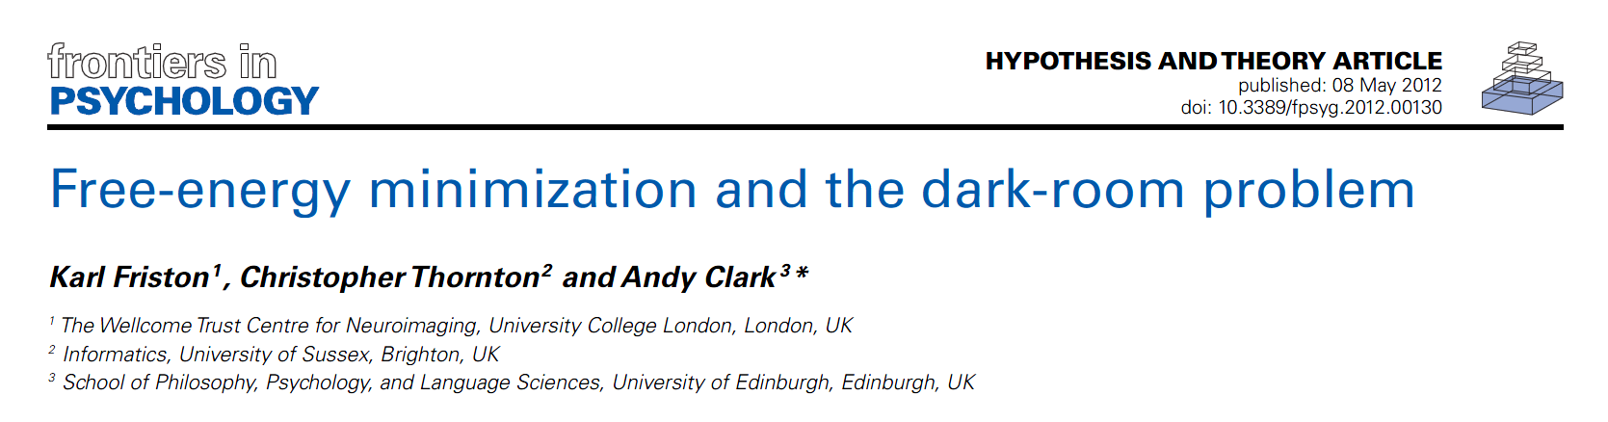

Searching to test hypotheses – life as an efficient experiment
Free energy principle
minimise uncertainty

Slide 28
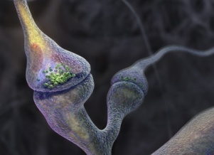
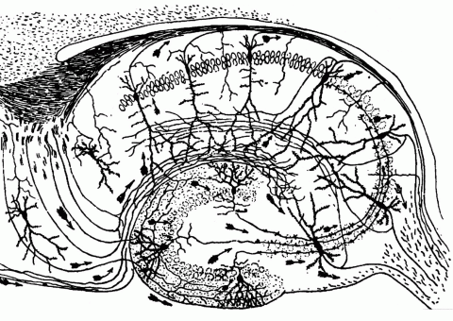
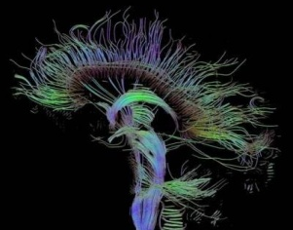
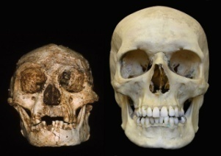
Time-scale
Free-energy minimisation leading to…
Perception and Action: The optimisation of neuronal and neuromuscular activity to suppress prediction errors (or free-energy) based on generative models of sensory data.
Learning and attention: The optimisation of synaptic gain and efficacy over seconds to hours, to encode the precisions of prediction errors and causal structure in the sensorium. This entails suppression of free-energy over time.
Neurodevelopment: Model optimisation through activity-dependent pruning and maintenance of neuronal connections that are specified epigenetically
Evolution: Optimisation of the average free-energy (free-fitness) over time and individuals of a given class (e.g., conspecifics) by selective pressure on the epigenetic specification of their generative models.

