Slide 1



Free Energy Workshop - 28th of October:
From the free energy principle to experimental neuroscience, and back
The Bayesian brain, surprise and free-energy
Karl Friston, Wellcome Centre for Neuroimaging, UCL
Abstract
Value-learning and perceptual learning have been an important focus over the past decade, attracting the concerted attention of experimental psychologists, neurobiologists and the machine learning community. Despite some formal connections; e.g., the role of prediction error in optimizing some function of sensory states, both fields have developed their own rhetoric and postulates. In work, we show that perception is, literally, an integral part of value learning; in the sense that it is necessary to integrate out dependencies on the inferred causes of sensory information. This enables the value of sensory trajectories to be optimized through action. Furthermore, we show that acting to optimize value and perception are two aspects of exactly the same principle; namely the minimization of a quantity (free-energy) that bounds the probability of sensations, given a particular agent or phenotype. This principle can be derived, in a straightforward way, from the very existence of biological agents, by considering the probabilistic behavior of an ensemble of agents belonging to the same class. Put simply, we sample the world to maximize the evidence for our existence

Slide 2
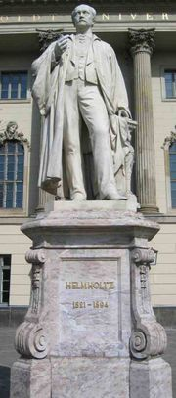
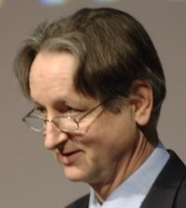
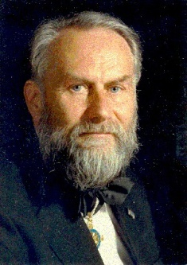
“Objects are always imagined as being present in the field of vision as would have to be there in order to produce the same impression on the nervous mechanism” - Hermann Ludwig Ferdinand von Helmholtz
Geoffrey Hinton
From the Helmholtz machine to the Bayesian brain and self-organization
Thomas Bayes
Richard Feynman
Hermann Haken

Slide 3

Overview
Ensemble dynamics Entropy and equilibria
Free-energy and surprise
The free-energy principle Action and perception
Hierarchies and generative models
Perception Birdsong and categorization
Simulated lesions
Action Active inference
Goal directed reaching
Policies Control and attractors
The mountain-car problem

Slide 4

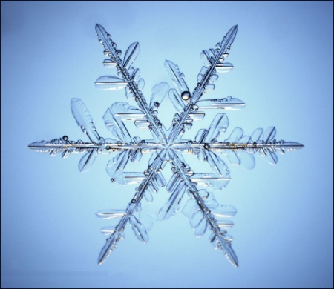



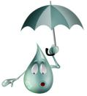
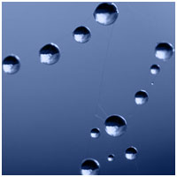
What is the difference between a snowflake and a bird?
Phase-boundary
temperature
…a bird can act (to avoid surprises)

Slide 5
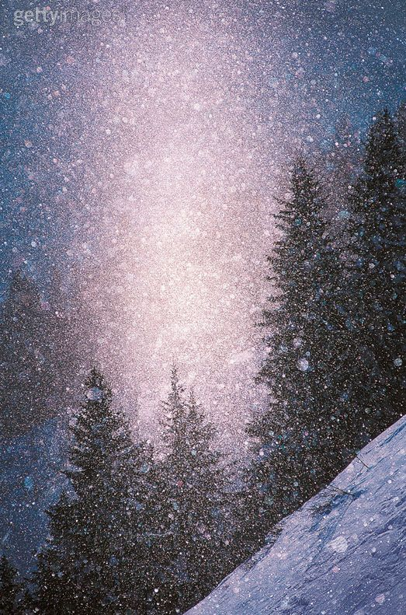
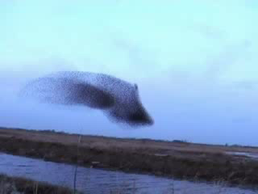
What is the difference between snowfall and a flock of birds?
Ensemble dynamics, clumping and swarming
…birds (biological agents) stay in the same place
They resist the second law of thermodynamics, which says that their entropy should increase

Slide 6
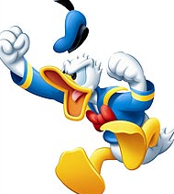

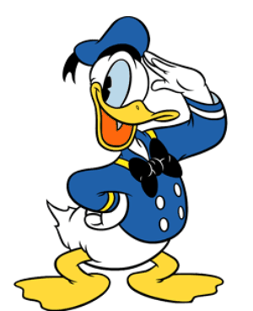
But what is the entropy?
…entropy is just average surprise
Low surprise (I am usually here)
High surprise (I am never here)
This means biological agents must self-organize to minimise surprise. In other words, to ensure they occupy a limited number of (attracting) states.

Slide 7
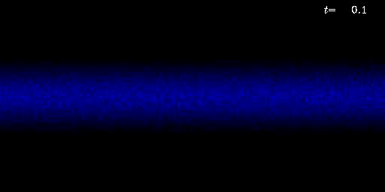
pH
transport
falling
temperature
Particle density contours showing Kelvin-Helmholtz instability, forming beautiful breaking waves. In the self-sustained state of Kelvin-Helmholtz turbulence the particles are transported away from the mid-plane at the same rate as they fall, but the particle density is nevertheless very clumpy because of a clumping instability that is caused by the dependence of the particle velocity on the local solids-to-gas ratio (Johansen, Henning, & Klahr 2006)
Self-organization that minimises the entropy of an ensemble density to ensure a limited repertoire of states are occupied (i.e., ensuring states have a random attracting set; cf homeostasis).

Slide 8
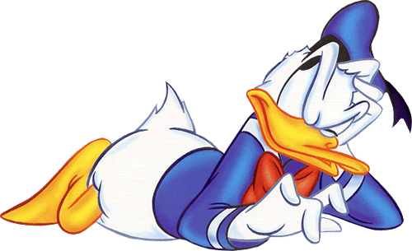
But there is a small problem… agents cannot measure their surprise
?
But they can measure their free-energy, which is always bigger than surprise
This means agents should minimize their free-energy. So what is free-energy?

Slide 9

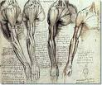
What is free-energy?
…free-energy is basically prediction error
sensations – predictions
= prediction error
where small errors mean low surprise

Slide 10
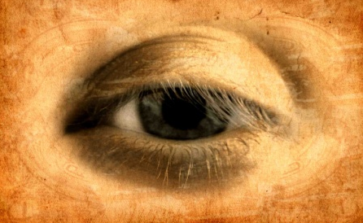
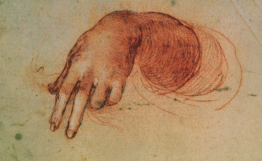
More formally,
Sensations
Action
External states in the world
Internal states of the agent (m)
Action to minimise a bound on surprise
Perception to optimise the bound

Slide 11
More formally,
Sensations
Action
External states in the world
Internal states of the agent (m)
Free-energy is a function of sensations and a recognition density over hidden causes
and can be evaluated, given a generative model comprising a likelihood and prior:
So what models might the brain use?

Slide 12
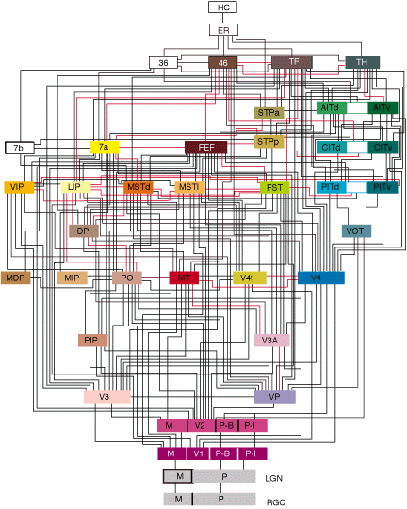
Hierarchal models in the brain
lateral
Backward
(modulatory)
Forward
(driving)

Slide 13
Hierarchal form
Prediction errors
Gibb’s energy: a simple function of prediction error
Likelihood and empirical priors
Dynamical priors
Structural priors

Slide 14
The recognition density and its sufficient statistics
Laplace approximation:
Perception and inference
Activity-dependent plasticity
Learning and memory
Synaptic activity
Synaptic efficacy
Functional specialization
Attentional gain
Enabling of plasticity
Synaptic gain
Attention and salience

Slide 15
How can we minimize prediction error (free-energy)?
sensations – predictions
Prediction error
Change sensory input
Change
predictions
Action
Perception
…prediction errors drive action and perception to suppress themselves

Slide 16
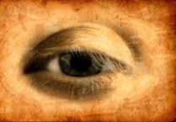
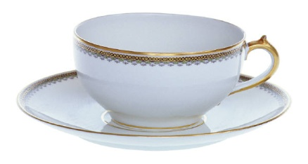
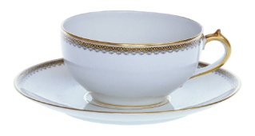
So how do prediction errors change predictions?
sensory input
Forward connections convey feedback
Prediction errors
Adjust hypotheses
Predictions
prediction
Backward connections return predictions
…by hierarchical message passing in the brain

Slide 17

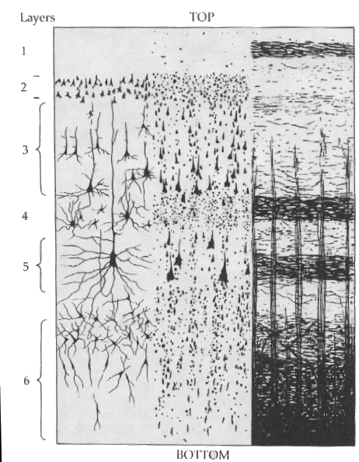

David Mumford
More formally,
Perception and message-passing
Forward prediction error
Backward predictions
Synaptic plasticity
Synaptic gain

Slide 18
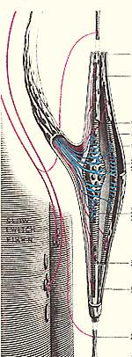
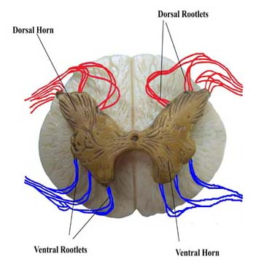
What about action?
predictions
Reflexes to action
dorsal root
sensory error
action
ventral horn
Action can only suppress (sensory) prediction error.
This means action fulfils our (sensory) predictions

Slide 19
Summary
Biological agents resist the second law of thermodynamics
They must minimize their average surprise (entropy)
They minimize surprise by suppressing prediction error (free-energy)
Prediction error can be reduced by changing predictions (perception)
Prediction error can be reduced by changing sensations (action)
Perception entails recurrent message passing in the brain to optimise predictions
Action makes predictions come true (and minimises surprise)
Perception Birdsong and categorization
Simulated lesions
Action Active inference
Goal directed reaching
Policies Control and attractors
The mountain-car problem

Slide 20
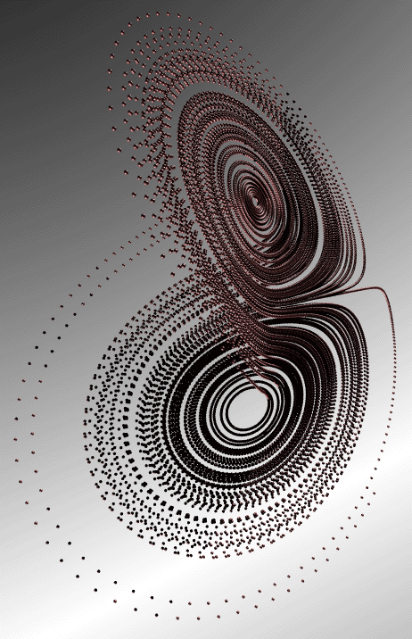
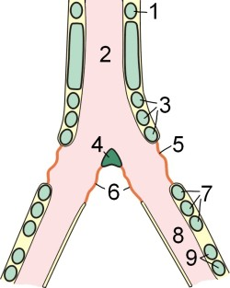
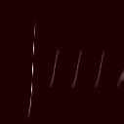

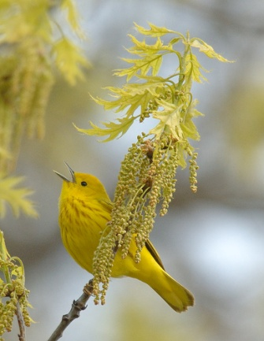
Making bird songs with Lorenz attractors
Vocal centre
Syrinx
Sonogram
Frequency
causal states
0.5
1
1.5
time (sec)
hidden states

Slide 21
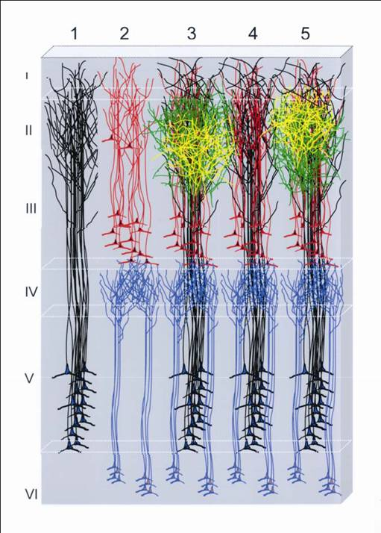
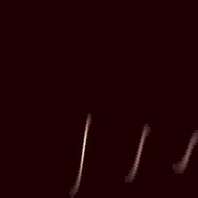
Perception and message passing
prediction and error
20
15
10
5
0
-5
10
20
30
40
50
60
Backward predictions
causal states
20
stimulus
15
5000
10
4500
5
Forward prediction error
0
4000
3500
-5
3000
hidden states
-10
10
20
30
40
50
60
2500
20
2000
0.2
0.4
0.6
0.8
15
time (seconds)
10
5
0
-5
10
20
30
40
50
60

Slide 22
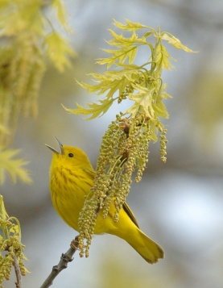
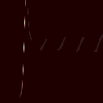
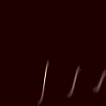
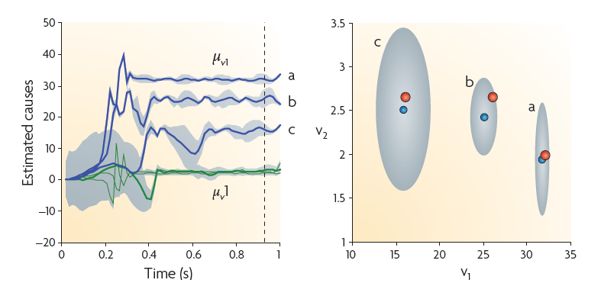
Perceptual categorization
Song a
Song b
Song c
Frequency (Hz)
time (seconds)

Slide 23


Hierarchical (itinerant) birdsong: sequences of sequences
Neuronal hierarchy
Syrinx
sonogram
Frequency (KHz)
0.5
1
1.5
Time (sec)

Slide 24
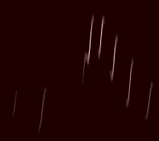
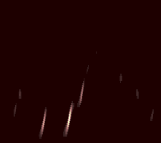

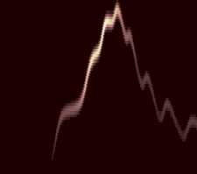

Simulated lesions and hallucinations
percept
LFP
60
40
Frequency (Hz)
20
LFP (micro-volts)
0
-20
-40
no top-down messages
LFP
60
40
no structural priors
20
Frequency (Hz)
LFP (micro-volts)
0
-20
-40
-60
no lateral messages
LFP
60
40
no dynamical priors
20
Frequency (Hz)
LFP (micro-volts)
0
-20
-40
0.5
1
1.5
-60
0
500
1000
1500
2000
time (seconds)
peristimulus time (ms)

Slide 25
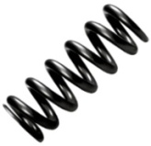
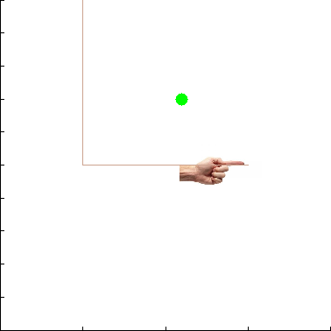
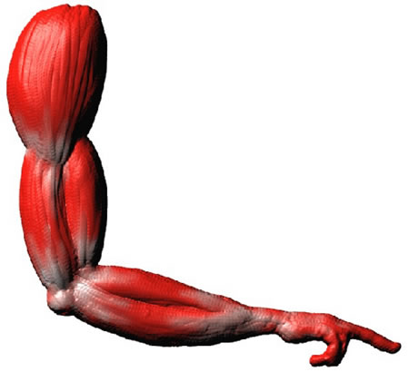
Action, predictions and priors
visual input
Descending predictions
proprioceptive input

Slide 26
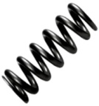
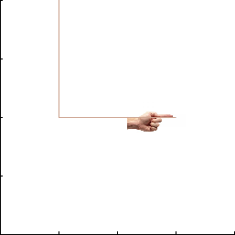
Itinerant behavior and
action-observation
hidden states
(Lotka-Volterra)
Descending predictions
action
observation
0.4
0.6
0.8
position (y)
1
1.2
1.4
0
0.2
0.4
0.6
0.8
1
1.2
1.4
0
0.2
0.4
0.6
0.8
1
1.2
1.4
position (x)
position (x)

Slide 27
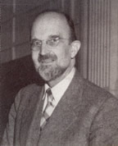
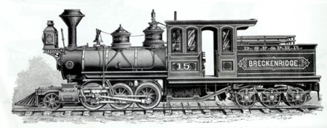
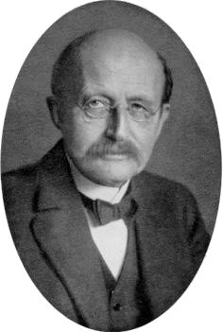
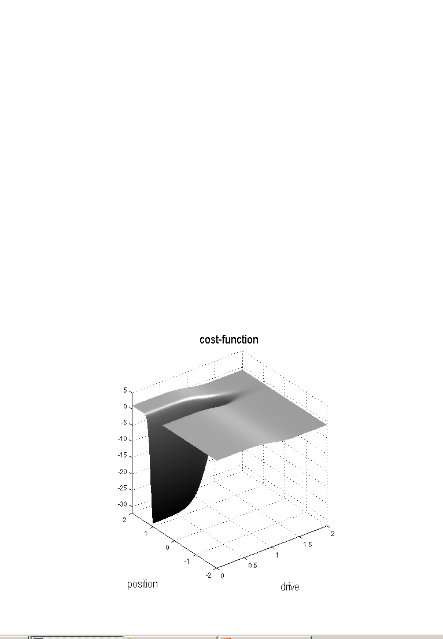
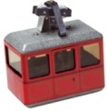
The mountain car problem
The environment
The cost-function
Adriaan Fokker
0.7
Max Planck
0.6
0.5
height
0.4
0.3
0.2
0.1
0
-2
-1
0
1
2
position
position
happiness
True motion
Policy (predicted motion)
“I expect to move faster when cost is positive”

Slide 28
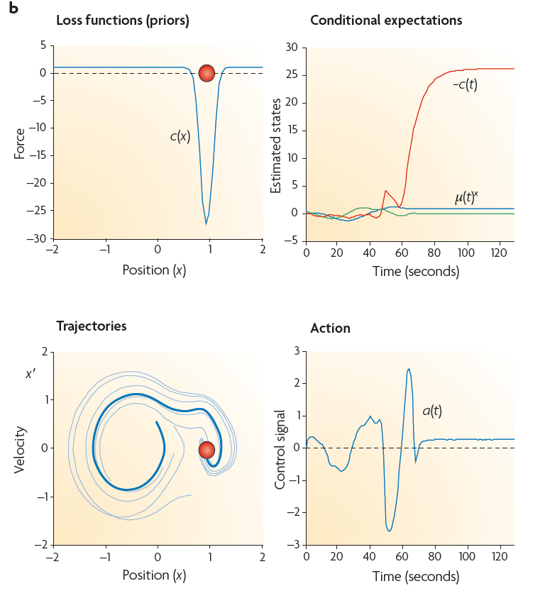
Exploring & exploiting the environment
With cost
(i.e., exploratory dynamics)

Slide 29
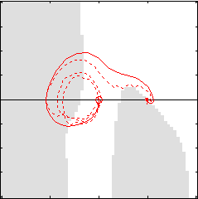
Policies and prior expectations
Using just the free-energy principle and itinerant priors on motion, we have solved a benchmark problem in optimal control theory (without learning).
If priors are so important, where do they come from?

Slide 30
Thank you
And thanks to collaborators:
Jean Daunizeau
Harriet Feldman
Lee Harrison
Stefan Kiebel
James Kilner
Jérémie Mattout
Klaas Stephan
And colleagues:
Peter Dayan
Jörn Diedrichsen
Paul Verschure
Florentin Wörgötter

Slide 31

…we inherit them
Darwinian evolution of virtual block creatures. A population of several hundred creatures is created within a supercomputer, and each creature is tested for their ability to perform a given task, such the ability to swim in a simulated water environment. The successful survive, and their virtual genes are copied, combined, and mutated to make offspring. The new creatures are again tested, and some may be improvements on their parents. As this cycle of variation and selection continues, creatures with more and more successful behaviours can emerge.
The selection of adaptive predictions

Slide 32
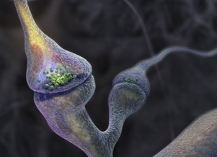
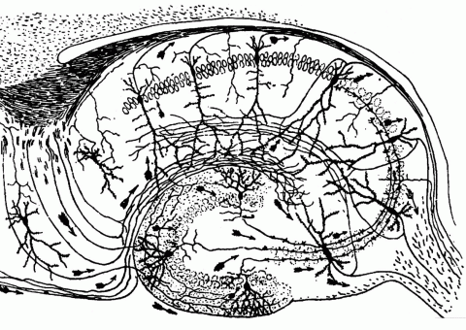
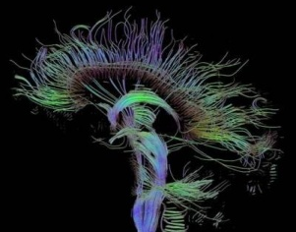

Time-scale
Free-energy minimisation leading to…
Perception and Action: The optimisation of neuronal and neuromuscular activity to suppress prediction errors (or free-energy) based on generative models of sensory data.
Learning and attention: The optimisation of synaptic gain and efficacy over seconds to hours, to encode the precisions of prediction errors and causal structure in the sensorium. This entails suppression of free-energy over time.
Neurodevelopment: Model optimisation through activity-dependent pruning and maintenance of neuronal connections that are specified epigenetically
Evolution: Optimisation of the average free-energy (free-fitness) over time and individuals of a given class (e.g., conspecifics) by selective pressure on the epigenetic specification of their generative models.

