Slide 1
Methods for Dummies
Second level Analysis (for fMRI)
Presented by:
Lucia Hernandez & Thomas von Rein
Expert:
Guillaume Flandin
Notes:
HI!

Slide 2
Overview of today’s talk
Recap of first level analysis
What is second level analysis?
Fixed vs. random effects
How do we analyse random effects?
Practical demonstration
Questions

Slide 3
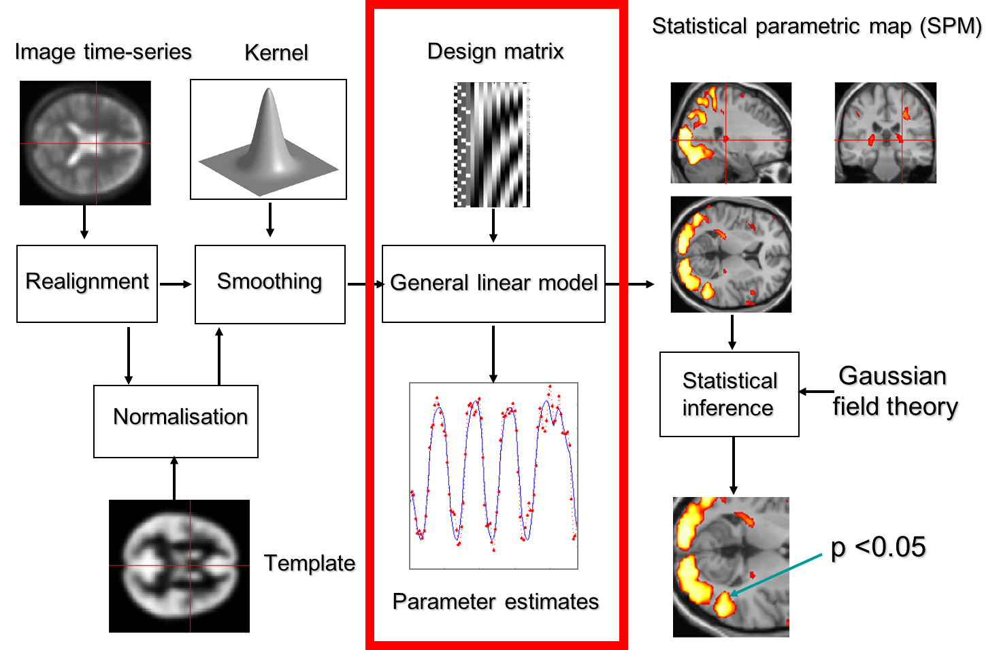

Slide 4
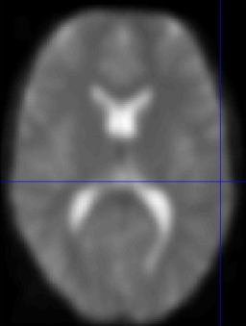
1st Level Analysis is “within subject”
β
ϵ
Y
⁼
X
^{x}
⁺
fMRI scans
Voxel time course
Time
Time
(e.g. TR = 3s)
Notes:
Series of scans over time, e.g. with a TR of 3s
Remember that Y = the activity in the voxel, X represents the variable(s) we use to predict the data – we specify X in the design matrix so that we can change our predictions between different trial types
Beta is our estimation of how much X affects Y – if the effect of X on Y Is significantly different from zero then we can say that X has predictive value.
Also, remember that using the above GLM, we can also incorporate other predictor variables, such as movement parameters, physiological functions – essentially reducing any known error and thereby increasing statistical power.
Record the BOLD signal from every voxel at each successive time-point
This produces a vector of responses from each voxel.
This is where first and second level analyses differ: first looks at within subject differences whereas 2nd is between subject.

Slide 5
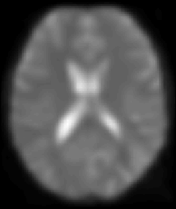
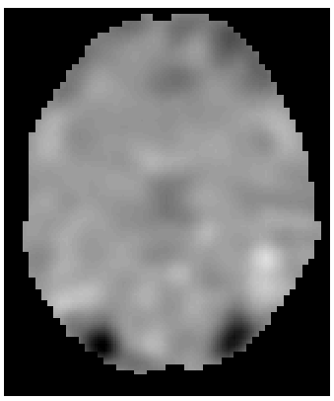
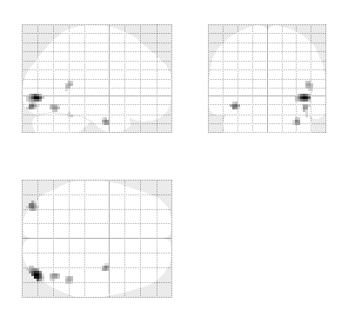
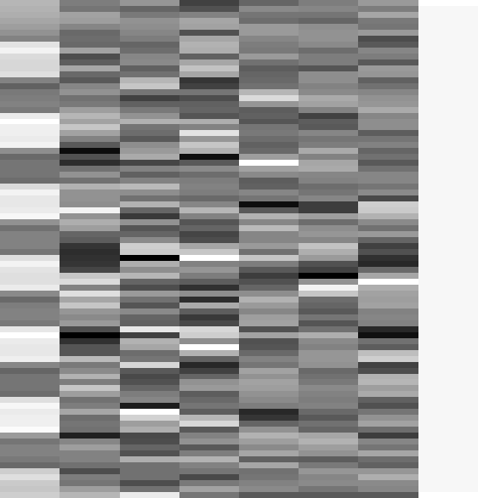
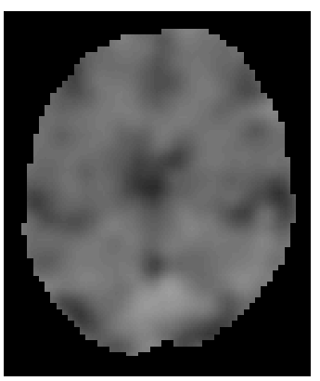
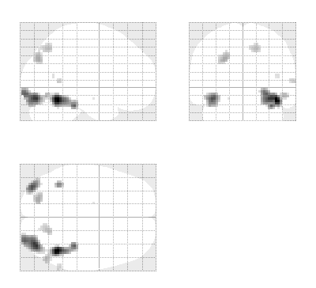
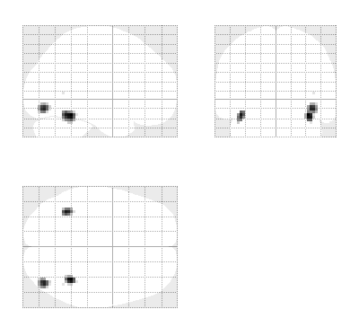
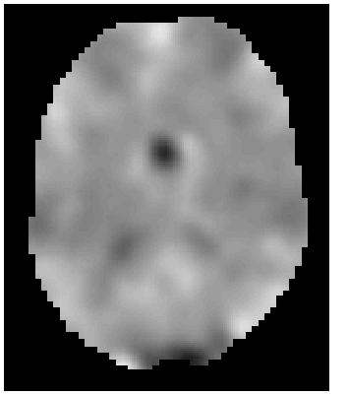
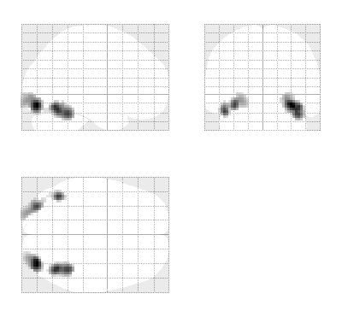
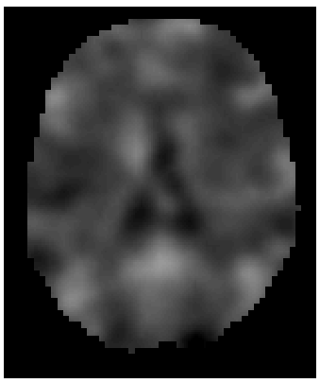
fMRI data
Design Matrix
Contrast Images
SPM{t}
Subject 1
Subject 2
…
Subject N
Notes:
Still first level analysis
Typically we have 1 design matrix for each subject. Using the design matrix we define the effect of interest for each subject with a contrast vector. So, for example, we might define X as 1 for famous faces and -1 for non-famous faces.
So from each participant, we can get a Maximum Intenstity Projection for our contrasts tested – we can see where, on average, each individual showed a significant difference in activation – and SPM12 will allow you to overlay this with structural images.
Important to remember- every single voxel was analysed individually to build this map – huge danger of multiple comparisons inflating alpha.

Slide 6
1st Level Analysis
Spatial preprocessing
Movement in scanner
Fitting to standard space (MNI)
Smoothing etc for statistical power
Notes:
So in first level analysis, we take each participant in turn, realigning, smoothing and standardising individuals’ scans so that we can identify regions of activation in relation to e.g. MNI space.
This enables us to compare the effects we see in one participant across other participants – and that’s where 2nd level analysis comes into play.

Slide 7
Overview of today’s talk
Recap of first level analysis
Second level analysis
Fixed vs. random effects
How do we analyse random effects?
Multiple conditions
Practical demonstration
Questions

Slide 8



Statistical parametric map (SPM)
Kernel
Design matrix
Realignment
Smoothing
General linear model
Statistical
inference
Gaussian
field theory
Normalisation
p <0.05
Template
Parameter estimates

Slide 9
2nd level analysis – “across subjects”
It isn’t enough to look just at individuals.
So, we need to look at which voxels are showing a significant activation difference between levels of X consistently within a group.
  Average contrast effect across sample
  Variation of this contrast effect
  T-tests
Notes:
Significant differences in activation between different levels of X, our predictor variable, are unlikely to be identical in all individuals.
To do this, we use 2nd level analysis – we try to see how often the effects we see in a single participant are observed across a group. This could be within our sample, but we almost always want to be able to say whether the effects are likely to be observable in the population generally.
To do this, we need to consider the average effect in our sample (this is the beta we talked about earlier), and consider how much variance there is.

Slide 10
Overview of today’s talk
Recap of first level analysis
What is second level analysis?
Fixed vs. random effects
How do we analyse random effects?
Practical demonstration
Questions

Slide 11
Fixed effects analysis
Each subject repeats trials many times.
The variation in responses for each level of the design matrix (X) for a given subject gives within-subject variance, σ_{w}².
Take the group effect size as the mean of responses across our subjects and analyse it with
respect to σ_{w}².
Notes:
Definition of fixed effects (briefly – why do we need to look at these two differently?)

Slide 12
When to use FFX
Only making conclusions about subjects
- not for population
E.g. case studies

Slide 13
When not to use FFX
Want to make inferences about the population.
FFX does not account for variation between subjects
Need to model the random effect of subject selection

Slide 14
Random effects analysis (RFX)
Synonymous with ‘mixed effects models’.
Sample is a set of individuals taken at random from the population.
To do this we need to consider the between subject variance, σ_{b}², as well as σ_{w}² – and estimate the likely variance of the population from which our sample is derived.
Notes:
This means that in order to generalise our findings to the wider population, we have to assume that our sample is representative of that population: in essence, that they are a random selection of individuals taken from that population. This is why it’s called random effects analysis.
So, we need to incorporate this assumption into our model: we need to incorporate between subject variance as well as within subject variance.

Slide 15
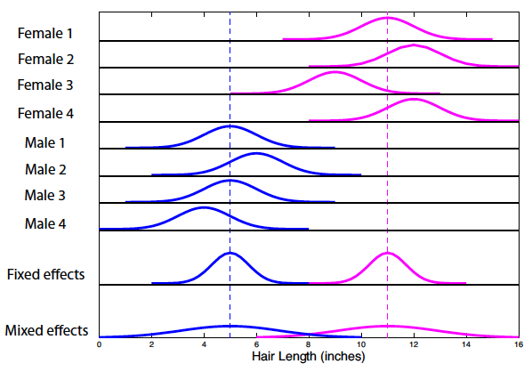
Interim summary: Fixed vs Random
(from Poldrack, Mumford and Nichol’s ‘Handbook of fMRI analyses’)
Notes:
– Fixed effects analysis. So with fixed effects we compare the group effect to the within-subject variability. It is not an inference about the population from which the sample is drawn. In the example here, we can see that if comparing males and females, in a FFX analysis, the mean is taken as the peak and the variance is the mean variance among individuals.
- Random effects analysis. With random effects we compare the group effect to the between-subject variability. It is an inference about the population from which the subjects were drawn. If Bob or Fred or Sophie came along and we gave them the same paradigm, we could be confident that they would also show the effect. If we look at the random effects part of the graph on the bottom row, we are estimating the variance of responses across the population – the variance is much greater. This means that our statistical tests are more conservative.
As a general point to note, because the between-subject variance is greater than the within subject variance, scanning time is best used in scanning more subjects rather than scanning individual subjects for longer.

Slide 16
Overview of today’s talk
Recap of first level analysis
What is second level analysis?
Fixed vs. random effects
How do we analyse random effects?
Practical demonstration
Questions

Slide 17
Random effects analysis (RFX) - Methods
Hierarchical
Summary statistics approach

Slide 18
Methods for Random Effects
Hierarchical
Most accurate method – gold standard
Set up a GLM containing parameters for the effects and variances at both the subject AND group levels, to all be estimated at the same time.
Estimates subject and group statistics via “iterative looping”
Computationally demanding
Notes:
Because it uses this process of iterative looping, it is computationally demanding. This type of procedure is used for example in epilepsy research where the number of seizures experienced in the scanner is not under experimental control and therefore highly variable across subjects.
Alternative is the summary statistics approach, which is quicker because it doesn’t rely on this iterative looping.
This is the typical type of model that is used by most statisticians working with behavioural data. For fMRI, which consist of time series in excess of 100 points for each of 100 000 or more voxels, computationally too difficult.

Slide 19
Methods for random effects
Summary statistics
1st level design for all subjects must be the SAME
Uses the same sample means as in the first level analysis
Gives exact same results as hierarchical model (when the within-subject variance is the same for all subjects)
Validity is undermined by presence of extreme outliers.
Notes:
For example, exactly the same number of trials etc
So…it’s less computationally demanding than a hierarchical approach
So…it’s a good approximation when they’re roughly the same
…this is what SPM uses as default.

Slide 20
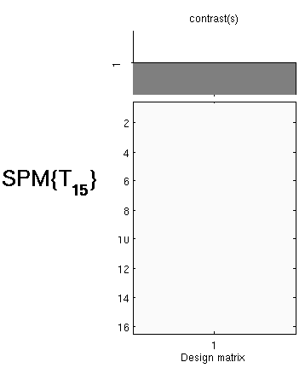
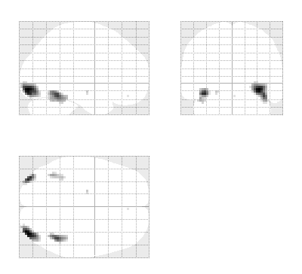
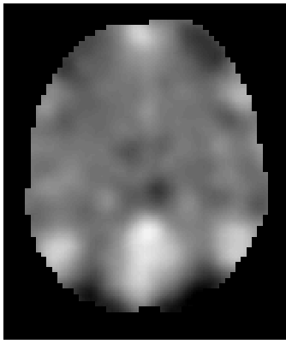
First level
Second level
fMRI data
Design Matrix
Contrast Images
One-sample t-test @ second level
Subject 1
…
Subject N
  Generalisability, Random Effects & Population Inference. Holmes & Friston, NeuroImage,1998.

Slide 21
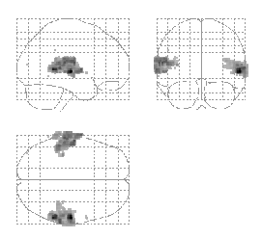

Robustness
Summary
statistics
Hierarchical
Model
Mixed-effects and fMRI studies. Friston et al., NeuroImage, 2005.
Notes:
Task involved listening to words.
Here, Professor Friston used a restrictive maps likelihood method for the hierarchical model, estimating within and between subject in a recursive fashion. It starts off with initial values as to what it thinks the effect size is, and then computes the group effect and then iterates between parameter estimates – eventually estimating the variance components.
What’s shown here on the glass brains is the results of an F contrast testing for the effect of words at the second level.
**Remel** in SPM

Slide 22
Summary
For fMRI data, usually preferable to use RFX analysis, not FFX
Hierarchical models provide gold standard for RFX , BUT computationally intensive
Summary statistics = robust method for RFX group analysis

Slide 23
Overview of today’s talk
Recap of first level analysis
What is second level analysis?
Fixed vs. random effects
How do we analyse random effects?
Practical demonstration
Questions

Slide 24
Linear contrasts
  Contrast vector multiplied by parameter estimates:
  c = [1 0] β = [β1 β2]
  COPE = 1 * β1 + 0 * β2
Group analyses
  Contrast of interest from each subject (β1 from each participant)
    2nd level t-test

Slide 25
Example
21 subjects
Design: 2 x 2 factorial
Emotion
 | Emotional | Neutral
Offender | Offender – emotional | Offender – neutral
Victim | Victim – emotional | Victim – neutral
Perspective

Slide 26
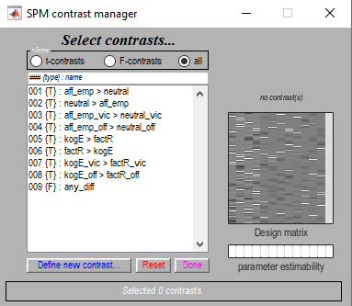
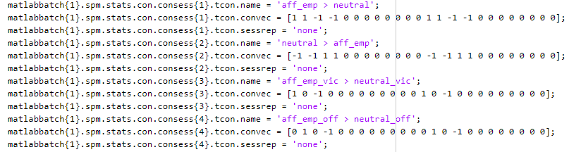
Example

Slide 27
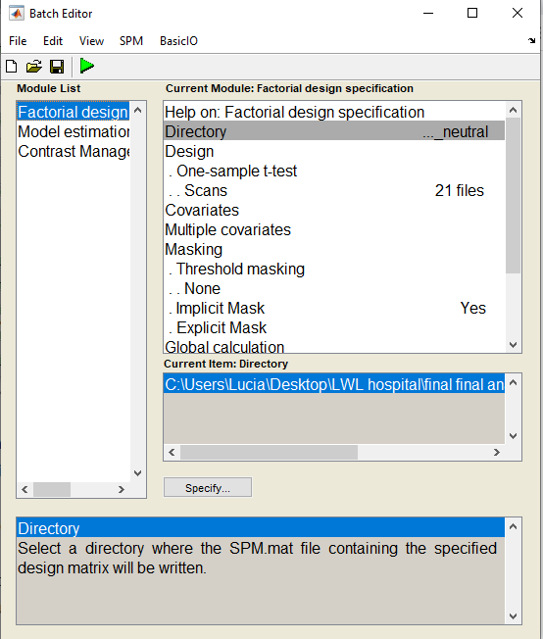
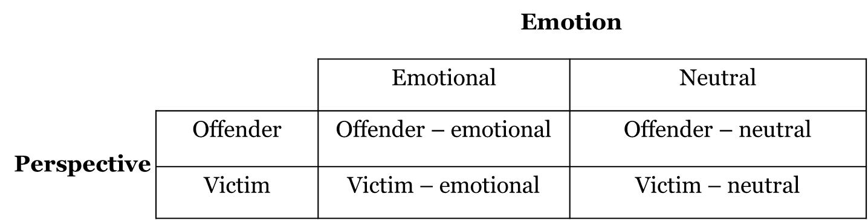
Example: one-sample t-test
Most basic test:
  Statistically appropriate way of simply “averaging the images”.
Scans:
    Select the corresponding contrast file from each subject’s first level folder.
      In this case con_0001.nii
Results:
  For a one-sample t-test the only relevant contrast is 1 (or -1).

Slide 28
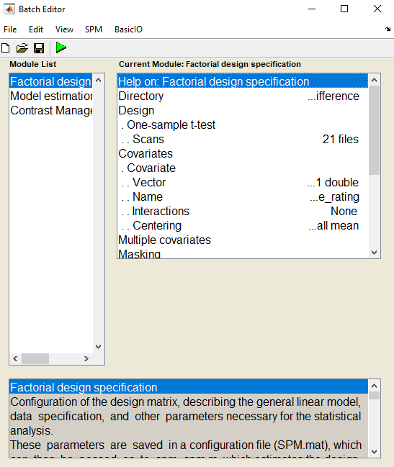
Example: covariates
Add Affective empathy rating

Slide 29
Example: two-sample t-test
Two-sample t-test:
  Compare two independently acquired data sets
    E.g. Emotion comparing victims vs. offenders
Group

Slide 30
Alternative tests
Paired t-test:
  Compare two dependent data sets
  E.g. multiple conditions of a task within a single subject
One-way ANOVA:
  Statistical comparison of more than 2 groups
    E.g. Victims vs offenders vs healthy controls

Slide 31
Resources
Previous MfD slides
Slides from Guillaume Flandin’s talk in Zurich, Feb 2014
Mumford, J. A., & Poldrack, R. A. (2007). Modeling group fMRI data. Social cognitive and affective neuroscience, 2(3), 251-257.
Friston, K. J., Stephan, K. E., Lund, T. E., Morcom, A., & Kiebel, S. (2005). Mixed-effects and fMRI studies. Neuroimage, 24(1), 244-252.
Poldrock, R. A., Mumford, J. A., & Nichols, T. E. (2011). Handbook of functional MRI data analysis. Cambridge University Press. https://doi.org/10.1017/CBO9780511895029

