Slide 1
Bayes for Beginners
MfD – 1st February 2023
Dorottya Hetenyi
Expert: Michael Moutoussis

Slide 2
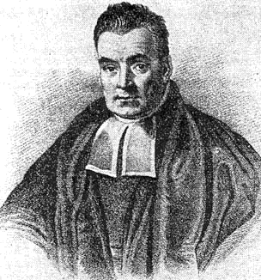
Bayesian Statistics
Prior Belief
&
New Information
Posterior Belief
=
Bayesian statistics is a mathematical procedure that applies probabilities to statistical problems. It provides people the tools to update their beliefs in the evidence of new data.
Can be used as model for the brain (Bayesian brain), history and human behaviour.
Can be used to compare evidence for multiple theories (Bayes Factor)

Slide 3
Probability
Probability is a number between 0 and 1
Forward problem – going from CAUSE → EFFECT P(effect | cause)
Inverse problem – going from EFFECT → CAUSE P(cause | effect)
There is always some uncertainty – use probability to quantify uncertainty
Probability of event A occurring: P(A) Probability of event B occurring: P(B)

Slide 4

Probability
Joint probability (hypothesis (H) & data (Y) is true):
P(H,Y) = P(H$∩$Y)
Notes:
Joint probability – simple two events happening together, the intersect is the high probability area – must sum to 1
Delete union

Slide 5
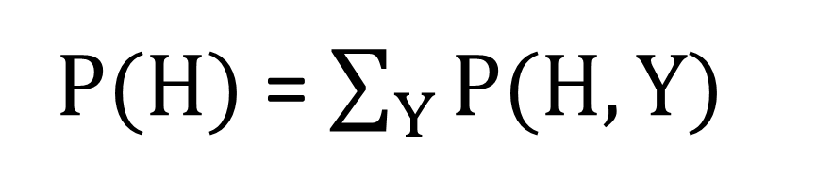
Marginal probability
Marginal probability of H - the probability distribution of H when the values of Y are not taken into consideration
Summing the joint probability distribution over all values of Y
P(H) = $\sum_{Y}{P(H,Y)}$
 |  | Data (Y)
 |  | 0 | 1
Hypothesis (H) | 0 | 0.5 | 0.1
 | 1 | 0.1 | 0.3 | P(H = 1) = 0.1 + 0.3 = 0.4

Slide 6
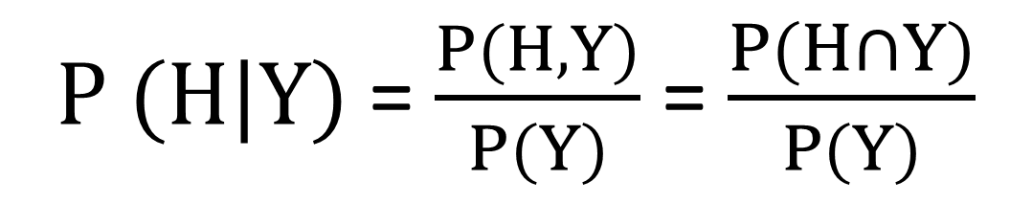
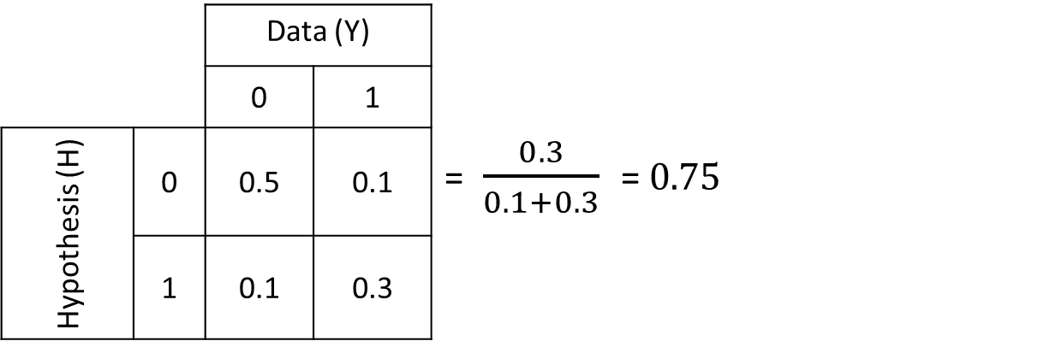
Conditional probability
Probability of the hypothesis (H) is true given the data (Y) - P(H|Y)
P (H|Y) = $\frac{P(H,Y)}{P(Y)}$ = $\frac{P(H∩Y)}{P(Y)}$
 |  | Data (Y)
 |  | 0 | 1
Hypothesis (H) | 0 | 0.5 | 0.1 | = $\frac{0.3}{0.1+0.3}$ = 0.75
 | 1 | 0.1 | 0.3

Slide 7
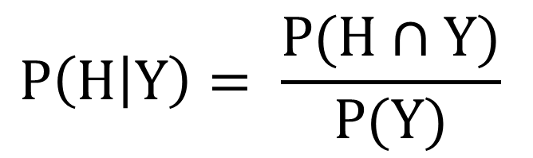
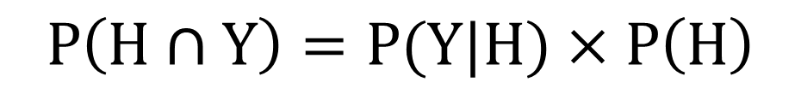

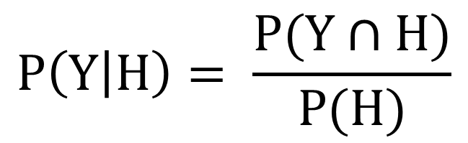
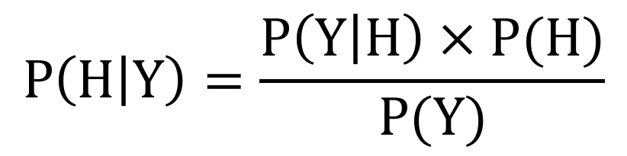
Derivation of Bayes’ Rule
$$P\left(H | Y\right)= \frac{P(H∩Y)}{P(Y)}$$
$$P\left(Y | H\right)= \frac{P(Y∩H)}{P(H)}$$
$$=\frac{P(H∩Y)}{P(H)}$$
$$P\left(H∩Y\right)=P(Y|H)×P\left(H\right)$$
$$P\left(H | Y\right)=\frac{P\left(Y | H\right)×P(H)}{P(Y)}$$

Slide 8
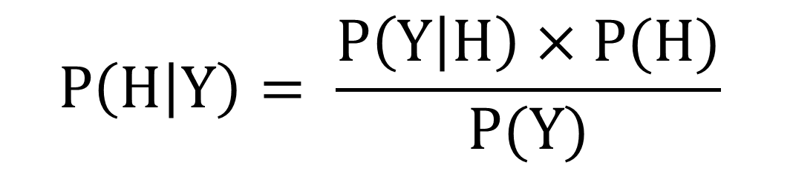
Bayes Theorem
Likelihood
What’s the probability of that I observe the data (Y) given of our hypothesis (H)
Probability of seeing the data (Y) if the hypothesis (H) is true
Prior
Pre-experimental knowledge of the parameter values
Probability of the hypothesis (H) is true, before seeing the data (Y)
Posterior
Updated “belief” based on the evidence observed
Probability of hypothesis (H) is true, after seeing the data (Y)
$$P\left(H | Y\right)= \frac{P\left(Y | H\right)×P(H)}{P(Y)}$$
Model
Marginal
likelihood
Probability of seeing the data (Y)
Normalisation term, makes sure the probabilities add to 1 in the posterior → posterior probability distribution will be a valid distribution

Slide 9
A very simple application of Bayes theorem
Somebody flips a coin
We don’t know whether the coin is fair or unfair
We are told only the outcome of each flip

Slide 10


A coin flipping model: priors
Hypothesis 1
The coin is fair: it has a 50% chance of being heads or tails
Hypothesis 2
The coin is unfair: it has a 100% chance of being heads
P(H1 = coin is fair) = 0.99
P(H2 = coin is unfair) = 0.01

Slide 11
First flip: Heads
P(H1|Y)
P(Y|H1)
P(H1)
P(coin is fair | result is heads) =
P(result is heads | coin is fair) x P(coin is fair)
P(result is heads)
P(Y)

Slide 12
First flip: Heads
P(Y|H1)
P(H1)
P(H1|Y)
P(coin is fair | result is heads) =
P(result is heads | coin is fair) x P(coin is fair)
P(result is heads)
P(Y)
P(coin is fair) = 0.99 → P(H1)
P(coin is unfair) = 0.01 → P(H2)
P(result in heads | coin is fair) = 0.5 → P(Y|H1)
P(result in heads | coin is unfair) = 1 → P(Y|H2)

Slide 13
First flip: Heads
P(Y,H1)
P(Y|H1)
P(result is heads, coin is fair)
P(result is heads | coin is fair) =
P(coin is fair)
P(H1)
P(result is heads) = P(result is heads, coin is fair) + P(result is heads, coin is unfair)
P(results is heads, coin is fair) = P(result is heads | coin is fair) x P(coin is fair)
P(results is heads, coin is unfair) = P(result is heads | coin is unfair) x P(coin is unfair)
P(result is heads) = 0.5 x 0.99 + 1 x 0.01 = 0.5050

Slide 14
First flip: Heads
P(coin is fair | result is heads) =
P(result is heads | coin is fair) x P(coin is fair)
P(result is heads)
0.5 x 0.99
=
=
0.9802
0.5050
This is the posterior!
The updated belief incorporating
the evidence we observed

Slide 15
Coin is flipped again
Coin is flipped a second time and it is heads again
Posterior from the last step becomes the prior for the next calculation

Slide 16
Second flip: Heads
P(coin is fair | result is heads) =
P(result is heads | coin is fair) x P(coin is fair)
P(result is heads)
P(coin is fair) = 0.9802 → new prior coin is fair
P(coin is unfair) = 1 - 0.9802 = 0.0198 → new prior coin is unfair
P(result is heads | coin is fair) = 0.5
P(result in heads | coin is unfair) = 1
P(result is heads) = P(result is heads, coin is fair) + P(result is heads, coin is unfair)
P(result is heads) = 0.5 x 0.9802 + 1 x 0.0198 = 0.5099

Slide 17
Second flip: Heads
P(coin is fair | result is heads) =
P(result is heads | coin is fair) x P(coin is fair)
P(result is heads)
0.5 x 0.9802
=
=
0.9612
0.5099
This is the new-new posterior!

Slide 18
A coin flipping model
This is one of the simplest applications of Bayes theorem
In this case, each event was totally independent of the last
However, the same maths can be scaled up for multiple possibilities, which can be interdependent

Slide 19
Bayesian Inference
Pros
Cons
The probability of hypotheses helps us make decisions.
By trying different priors we can see how sensitive our results are to the choice of prior.
It is easy to communicate a result framed in terms of probabilities of hypotheses.
Choosing a prior is subjective
Philosophical objections to assigning probabilities to hypotheses, as hypotheses do not constitute outcomes of repeatable experiments in which one can measure long-term frequency.

Slide 20
Bayesian vs. Frequentist Inference
Frequentist
Bayesian
Never uses or gives the probability of a hypothesis (no prior or posterior)
Confidence interval, p-value, power and significance
Does not require a prior
The parameter is a fixed variable (not random)
Define null hypothesis and report how unlikely the measurement is under the null hypothesis, with a cut off of alpha. Then decide to accept or reject (significance)
Uses probabilities for both hypotheses and data
Credible interval, prior and posterior.
Requires one to know or construct a ‘subjective prior’
The parameter is a random variable
Define hypothesis, report probability that the value you observe will be greater/small than this value. The hypothesis isn’t accepted or rejected, but its probability is updated with new evidence.

Slide 21
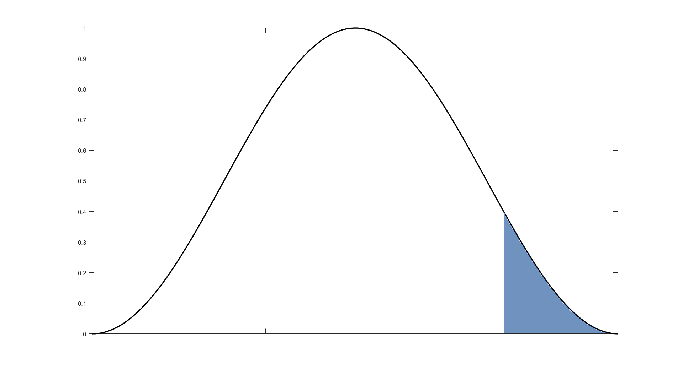
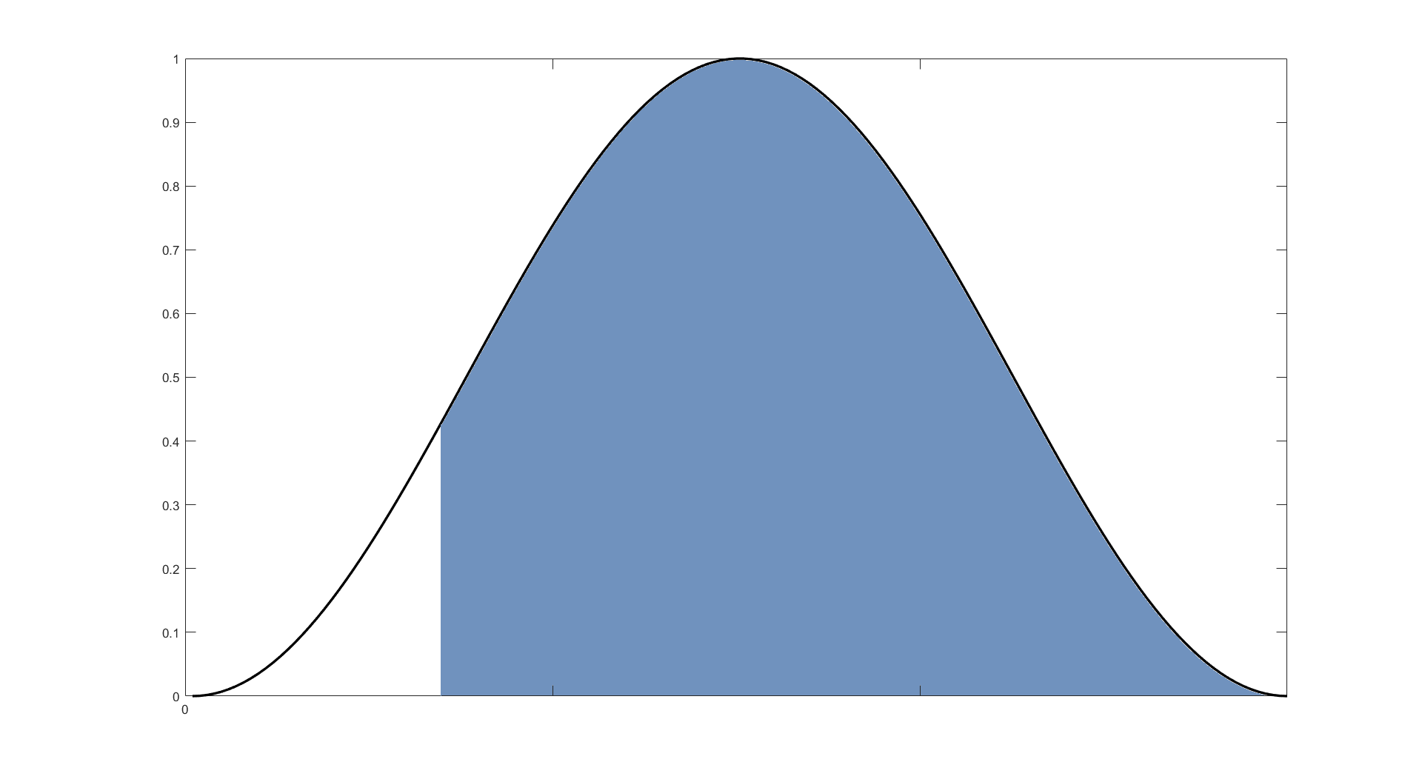

Bayesian vs. Frequentist Inference
Frequentist
Bayesian
P(t|H0)
P($θ$|Y)
P(t > t*|H₀)
P(H₀|Y)
t*
t = t(Y)
A cut-off point is defined to accept or reject the null hypothesis
“Significance” is not defined, only the probability that the hypothesis is true

Slide 22
Conclusion
Bayesian statistics is a mathematical procedure that applies probabilities to statistical problems. It provides people the tools to update their beliefs in the evidence of new data
Bayes theorem and Bayesian inference are based on conditional probability P(Hypothesis|Data)
Ultimate goal is to calculate the posterior probability density, which is proportional to the likelihood (of our data being correct) and our prior knowledge.

Slide 23
How prior knowledge influences our perception?
Brain as a prediction machine - match incoming sensory inputs with top-down expectations
Bayesian theories of perception prescribes how an agent should integrate prior knowledge and sensory information
Prior experiences influence perception (Hochstein et al., 2002; Kok et al., 2013, 2014)
Perception - as a process of probabilistic inference
Feedback from higher-order areas provides contextual priors- output (or ‘posterior’) from a higher level serves as an input (or ‘prior’) to a lower level – constant updates of incoming information ~ Predictive coding (Rao & Ballard, 1999)

Slide 24
Thank you so much for listening!
Thank you to our expert Michael,
to Peter Zeidman’s presentation on Bayes Inference (SPM MEG course 2022),
to previous MfD course slides.
Questions?

