Slide 1
DCM for fMRI: theory and practice
Presenter: Yan Wu
Expert: Peter Zeidman

Slide 2
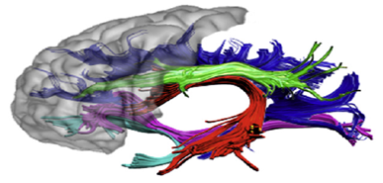





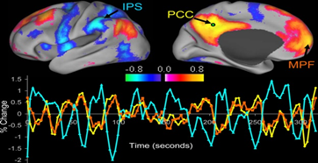
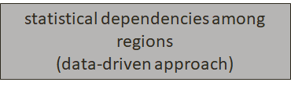
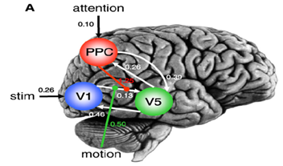

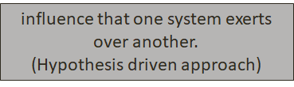
Types of connectivity
Notes:
Structural connectivity:
Anatomical layout of axons and synaptic connections which neural units interact directly with each other
Functional connectivity:
statistical dependencies among activity in different brain areas . You can find this through correlational analyses or ICA.
Effective connectivity:
to make statements about causal influence of one neuronal system over another at synaptic or neuronal population level.
Main difference between last 2: functional connectivity is descriptive whereas EC tries to make a claim about the directiveness of influences between neurons and neuronal populations.

Slide 3
DCM – what is it?
One of many ways of modelling effective connectivity
Introduced by Friston, Harrison & Penny (2003)
A framework for specifying models of effective connectivity, estimating their parameters and testing hypotheses (Zeidman et al, 2019)
Notes:
… this will make sense later
Model inversion: model inversion (i.e., estimation) is the process of ﬁnding the parameters that offer the best trade-off between accuracy and the complexity of the model.
Model comparison: In the second stage, hypotheses are tested by comparing the evidence for different models at single or group level.

Slide 4
DCM – key features
Dynamic
Causal
Uses hemodynamic forward model
  Neurophysiologically interpretable
Generative
Bayesian
Notes:
Dynamic: it’s all about rates of change, which we can use differential equations to describe
Causal: describe how dynamics in one area cause dynamics in another area, and how these interactions are modulated by experimental manipulations
DCM uses the hemodynamic forward model, which models how neuronal synaptic activity is transformed into measured response in fMRI.
Neurophysiologically interpretable - Hypotheses are constrained by the underlying biological model
Generative: models how the data was generated = based on given assumptions, which models is most likely to generate this signal?
Bayesian: each parameter is constrained by prior distribution

Slide 5
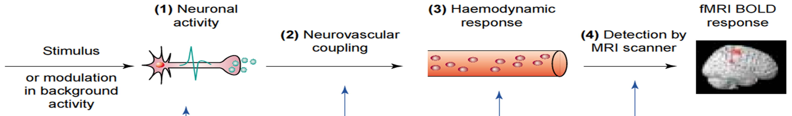
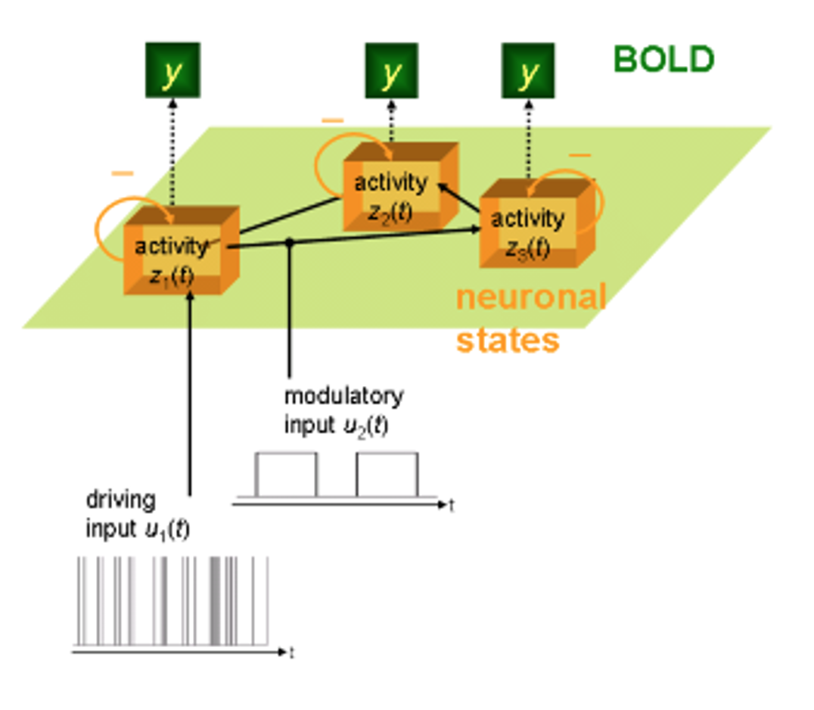
Brain as input-state-output system
State variables
Neuronal activities
Other neurophysiological variables.
Measured electromagnetic or hemodynamic responses
Inputs
Experimental manipulations/stimulus
Outputs
Context. E.g. attention
Notes:
To remind ourselves, we can think of the brain as a system with inputs …, states…, outputs...

Slide 6
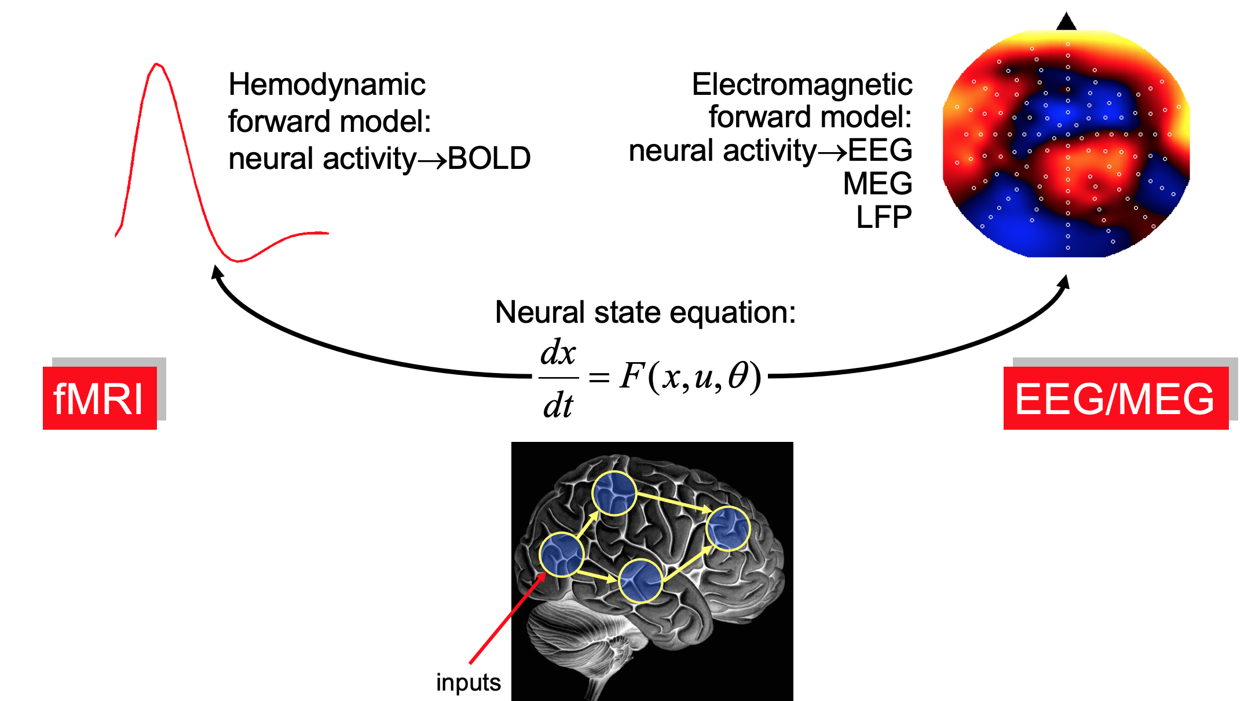
DCM is a generative model
Change in state over time
Parameters that define architecture and interactions at the neuronal level
Current state
External inputs
Notes:
But, the dynamics of the neural states are hidden from us. We can describe the hidden dynamics in terms of differential equations.
the temporal evolution of the state, or the change in state over time, is defined by: current state, external inputs such as the experimental conditions, parameters…
Towards the end, we will discuss how the modelled neuronal system can then be converted into an expected BOLD signal by converting the neural dynamics into hemodynamic responses. You can then fit the expected time series to the measured data

Slide 7
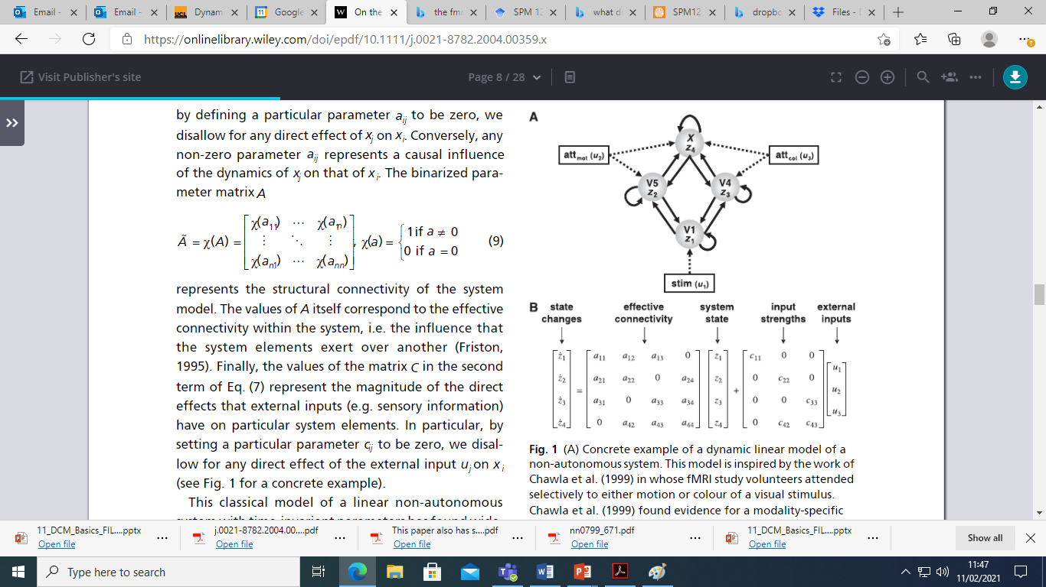
An example
X: higher cortical area - top down control of attention
fMRI study
Investigated how selective attention to motion and colour stimuli modulate activity in V5 (inferior temporal gyrus/sulcus) and V4 (fusiform gyrus)
Participants viewed stationary monochromatic dots in the scanner that intermittently changed colour or moved randomly. They were asked to discriminate between the sporadic target events.
V5: motion processing
V4: colour processing
V1: primary visual cortex where visual stimuli will enter
Chawla, D., Rees, G. and Friston, K.J., 1999. The physiological basis of attentional modulation in extrastriate visual areas. Nature neuroscience, 2(7), pp.671-676.
Stephan, K.E., 2004. On the role of general system theory for functional neuroimaging. Journal of anatomy, 205(6), pp.443-470.
Notes:
To explain the neural state equation, I will give an example.
fMRI study… [describe]
We want to model effective connectivity of 4 regions of interest. Higher cortical area at the top labelled X, area V4 involved in colour processing, V1 the primary visual cortex and V5 involved in motion processing. They have modelled with intrinsic connections within regions and extrinsic connections between regions, as well as external inputs that are stimuli or contextual (attention)
So, we know about the external inputs, we know about the anatomy, and

Slide 8
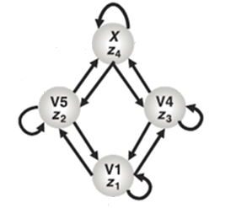
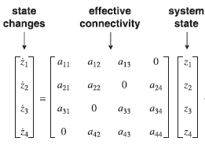

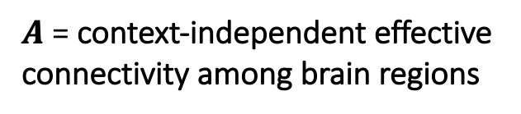
DCM – Linear model
If …
One state variable per region
Everything is linear
No propagation delays
Parameter A
$A$ = context-independent effective connectivity among brain regions
a₁₂
a₁₃
a₁₁
Notes:
If … [describe]
Then we can write the change in activity over time in one area as a linear combination of different influences.
Each region is represented by a single state variable, representing a coarse summary of overall synaptic activity in this region (the current neural state)- you can see V1 is represented by Z1
In the matrix below, Z1 with the dot above denotes derivative in time
We can describe the change of activity in each state variable as a linear combination of influences neatly displayed in this matrix
If we look at the first line of the matrix, the change in the neural state vector, Z1, over time is equal to firstly it’s own intrinsic connection, as well as the influence from Z2 and then from Z3 and the system state itself
This modelling of the effective connectivity is repeated for all other state variables
So that is our first parameter A – the effective connectivity among brain regions, the temporal evolution of each state vector is equal to the effective connectivity of the system and the system state itself

Slide 9
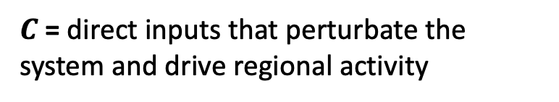
DCM – Linear model
Parameter C
c₁₁
$C$= direct inputs that perturbate the system and drive regional activity
Notes:
Now we move onto a second parameter C, again with the linear equation
DCM models how neural dynamics are driven by external perturbations that result from experimentally controlled manipulations- lets add those pertubations to the system. This is firstly done with direct inputs that drive regional activity
For area Z₁, we not only have the effective connectivity and state system exerting influence that we described before, but we can also model the influence that the experimental stimulus (visual stimulation) directly exerts onto the area. u.
This is again repeated for all other state variables
Now this most simple equation can be extended to the temporal evolution of each state vector being equal to the effective connectivity of the system and the system state itself PLUS the direct inputs from experimental stimuli

Slide 10
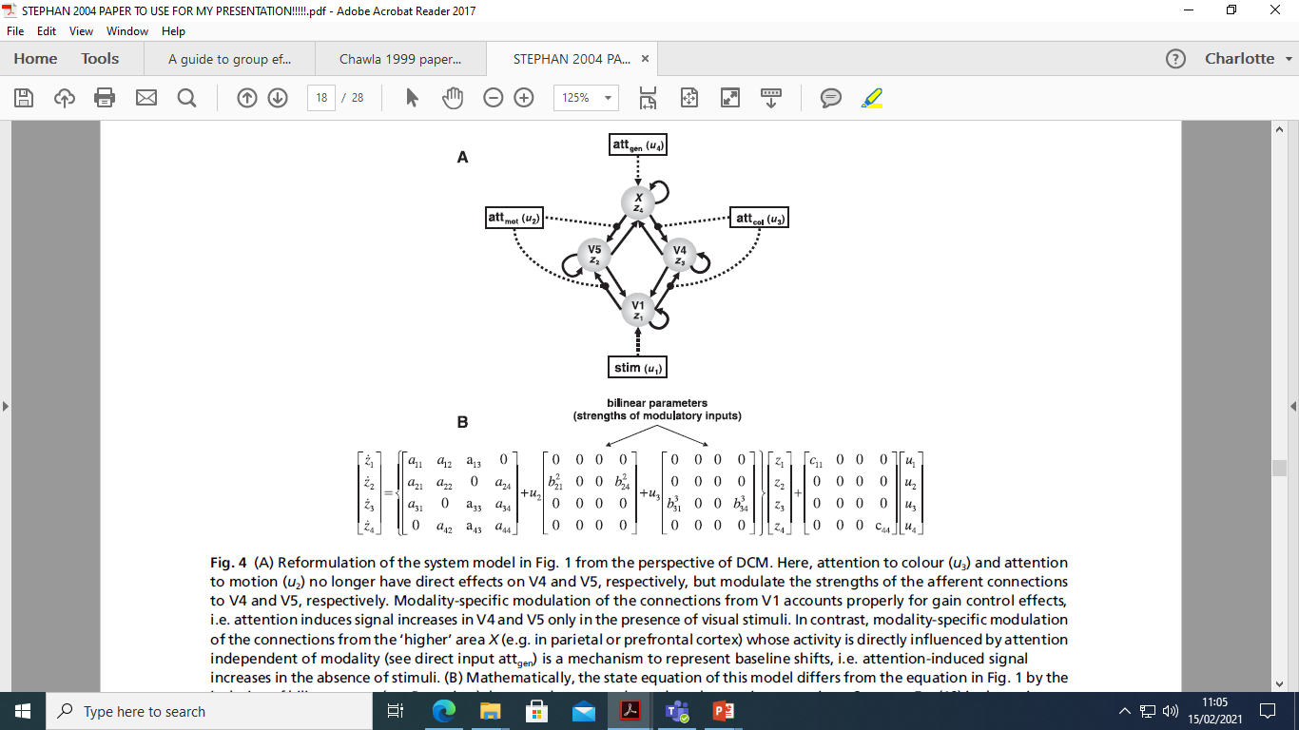

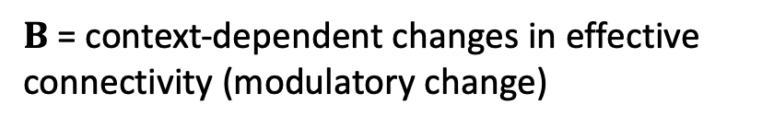
DCM – Bilinear model
Parameter B
b₂₄
$B$ = context-dependent changes in effective connectivity (modulatory change)
b₂₁
Notes:
However, cognitive neuroscientists are interested in how the coupling strength of a system changes with the input of our task stimuli
We can model this by slightly augmenting our equation
The attention to motion and colour no longer have direct influence on areas V5 and V4 but rather modulate the strength of the connections to the regions V5 and V4
We can express this mathematically in the matrix by adding another coupling matrix. Attention is on/off stimulus. If u₂ (attention to motion) is off, then everything remains as it was. If it is on with a value of 1, then we add the parameters to the coupling strength…
We are modelling additive changes to coupling strength as a function of our contextual variable which is the final parameter B

Slide 11
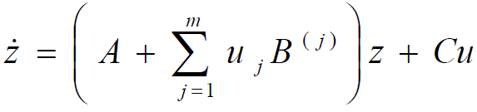
Bilinear neural state equation
𝑧 ̇ = change in the neural state over time
𝐴=effective connectivity in the absence of pertubations
𝐶 = direct influences on regions from external inputs (𝑢)
𝐵 = changes in coupling strength due to inputs (modulatory inputs)
u = inputs
It models ADDITIVE changes in connection strength as a function of some controlled variables
Notes:
So now we have the three parameters that underlie the bilinear neural state equation.
We have the change in the neural state over time as a function of effective connectivity in the absence of pertubations, the changes in coupling strength due to inputs (modulatory inputs) , direct influences on regions from external inputs
DCM is able to model ADDITIVE changes in connection strength as a function of some controlled variable- we add the extra element if modulation predicted to be exerted on that part of the system
If anyone asks:
m here is the number of experimental conditions.
Uj is the time series for when experimental condition j is presented to the subject versus at rest.. Because at times when none of the experimental conditions are happening- so at BL, the connectivity would be only A and then you add on to that the sum over all experimental conditions
B(j) is the B connectivity matrix specifically for condition j
= in summary it is the sum of the no of experimental conditions for when the jth input is on. So, the experimental stimulation there uj and the B(j) there is the B matrix connectivity specifically for condition j
(Notably, the distinction between “driving” and “modulatory” is neurobiologically relevant: driving inputs exert their effects through direct synaptic responses in the target area, whereas modulatory inputs change synaptic responses in the target area in response to inputs from another area (SPM manual).

Slide 12
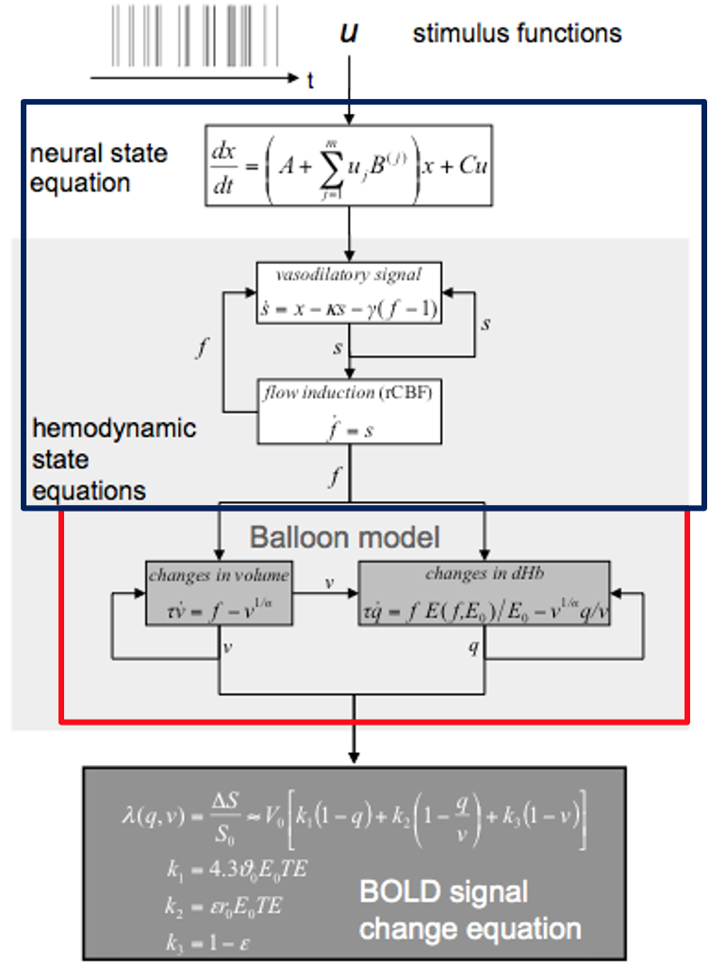
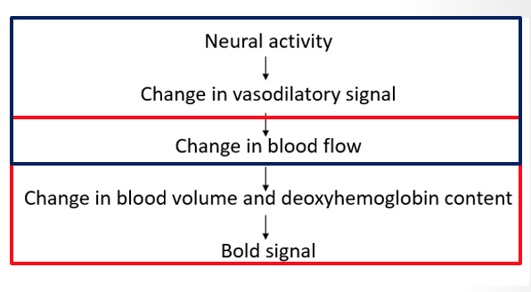

DCM uses hemodynamic forward model
Notes:
The DCM haemodynamic model predicts the fMRI timeseries one would expect to measure, given neural activity hypothesized.
Combining the neural and hemodynamic states gives the complete forward model.
I should mention that you choose the neural model in SPM but the hemodynamic forward model works out of the box, you don’t need to choose it.
3) The hemodynamic forward model is an extention of a previous model, called the Balloon model. For the hemodynamic forward model, the neural activity elicits a vasodilatory signal (widening of blood vessels) that leads to increases in blood flow and subsequently to changes in blood volume and deoxyhemoglobin content. The predicted BOLD signal y is a non-linear function of blood volume and deoxyhemoglobine content.
As you can see at the bottom of the slide, you augment the hemodynamic model with confounds X$0$ (e.g. drift) an error term at the end of the model that captures the noise

Slide 13
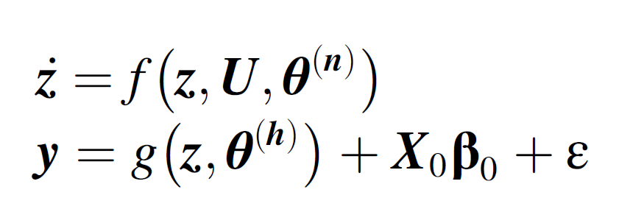
DCM – Framework for model specification
Full forward generative model with neural, hemodynamic and noise contributions
Notes:
So, DCM is a framework for model specification, and we now have a full forward generative model with neural, hemodynamic and noise contributions displayed below in the differential equations
We now have two more stages- model inversion and model comparison, which have been covered in previous lectures, so I won’t talk about it too much

Slide 14
DCM is Bayesian
Model specification:
  Relying on prior knowledge about connectivity parameters
  Our a priori beliefs about the range our parameters are ‘supposed’ to be:
    Empirical, principled, shrinkage
  We can specify different models for different hypotheses about our data
Bayesian model inversion/estimation:
  Compute the evidence for each model
  Free energy
  Important: trade off between model fit and complexity
Bayesian model comparison/selection:
  Compare models to find one with with highest model-evidence
  Report posterior or conditional inferences about the parameters of this optimal model
  Danger of overfitting protected by priors and model comparison
Notes:
Throughout all stages, DCM is Bayesian
DCMs are Bayesian in all aspects.
In model specification, which Each parameter is constrained by a prior distribution, which reflects empirical knowledge about the range of possible parameter values, principled considerations so, certain parameters cannot have negative values for example or a conservative attitude including “shrinkage” priors, so in the absence of evidence, the posterior density shrinks to zero
By specifying our model in the previous slides, we have set the priors
In the previous slides, we have specified just one model but if you have say 3 different hypotheses for your data, you can embody them in 3 different models that you specify
3a) The next stage is Bayesian Model Inversion, so the model can be inverted to fit the data and evidence is computed for each model
3b) You search for the setting of parameters in each model that offers the best fit to the data. The measure of the quality of the fit is the free energy, which includes the best trade off between how accurate the predicted time series fits the data and how complex the model is, which is how much the parameters have had to move from their prior values to fit the data.
3c) So for each model , SPM automatically tunes the connection strength to make the fit as good as possible to the data and to get the free energy as high as possible. The free energy of each model is the estimate of model evidence and thus is approximately equal to the probability of having seen the data given the model
4) Once you have gathered the evidence for all alternative models, you can use Bayesian model selection to evaluate the evidence with regard to each of the models considered for the same data, select the optimal model with the highest evidence. and report posterior or conditional inferences about the parameters of this optimal model. Simply by selecting the model with the highest free energy you automatically get the one with the best trade off.
5) Danger of overfitting, it is easy to construct complex models with excellent or even perfect fit, which are mechanistically meaningless and do not generalize- you protect yourself against overfitting by having your priors that stop that parameters from taking on unrealistic values and through Bayesian model comparison (because you’re choosing models with accuracy – complexity, you’re penalising the unnecessarily over complicated models ).

Slide 15
Practice

Slide 16
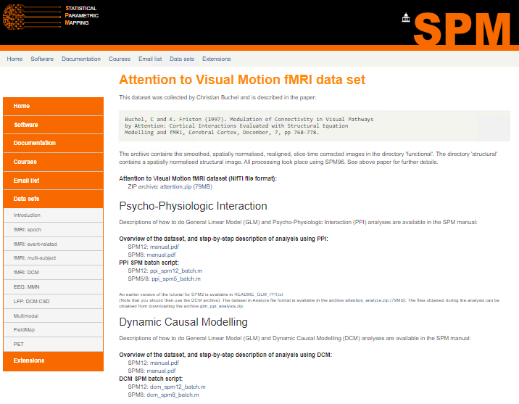
Notes:
There is a practice dataset available to download on the SPM website
Functional data has been preprocessed:
Realigned
Slice time corrected
Smoothed
Spatially normalised into MNI space
There is also a T1W structural image that has also been spatially normalised into MNI space.

Slide 17
Attention to motion in the visual system
Aim: Test the effect of attention to motion on visual processing
Stimuli:
  Dots (static or moving, with or without attention)
  Fixation
3 conditions:
  Photic: visual input
  Motion: moving dots
  Attention: attending to moving dots
Notes:
The aim of the study test the effect of attention to motion on visual processing.
Participants were shown visual stimuli consisting of dots on the screen. These dots can either be static or moving, and the participants can either be told to attend to the dots or not. There was also a baseline fixation condition where no visual stimulus was presented.
Overall there are 3 different conditions in the experimental design:
Photic: all conditions involving visual input
Motion: all conditions with moving dots
Attention: all conditions where participants attended to moving dots

Slide 18
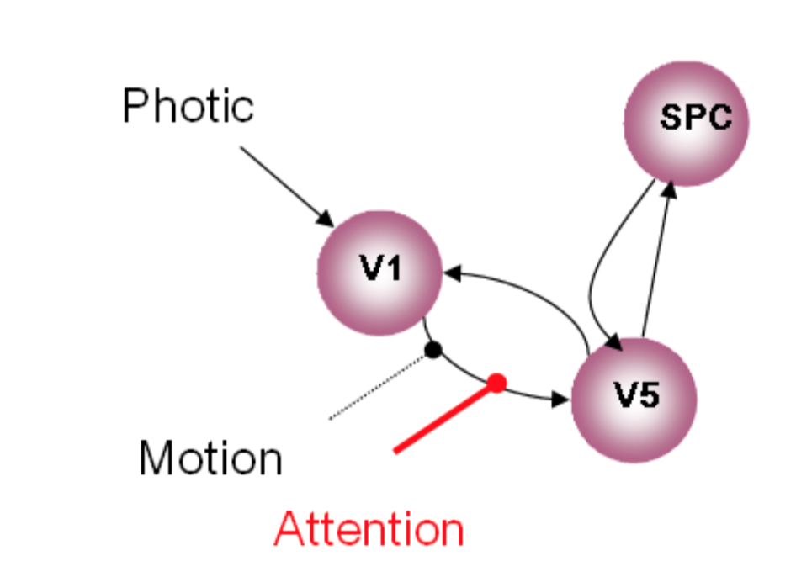
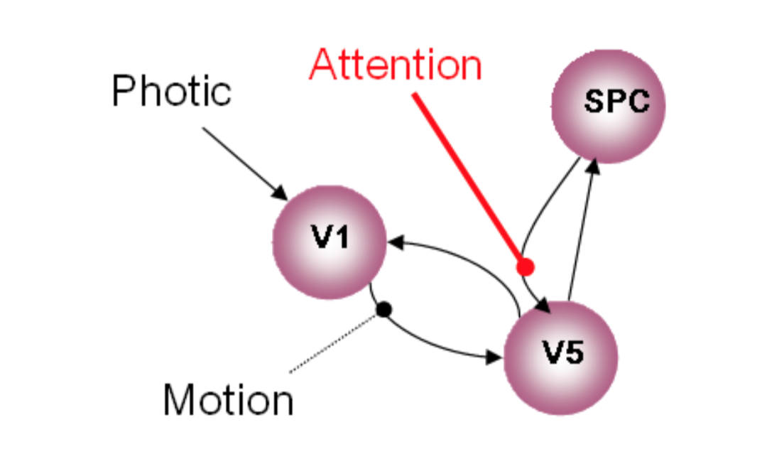
DCM hypothesised models
Hypothesis 1: Attention modulates the forward connection from V1 to V5
Hypothesis 2: Attention modulates the backward connection from SPC to V5
Notes:
So they want to look at the modulatory effect that attention to motion had on the effective connectivity between areas in the visual system.
They compared 2 different models.
In both models there are some intrinsic connections between different areas in the visual system. There are bidirectional connections between V1 and V5, and between V5 and the superior parietal cortex. But there are no connections between V1 and the SPC.
In both models, photic stimuli have a driving effect on V1, and motion modulates the connection from V1 to V5.
The models differ in the proposed modulatory effect of attention. So this is what they’re testing – the nature of the modulator effect of attention to motion.
Model 1: attention modulates the forward connection from V1 to V5
Model 2: attention modulates the backward connection from superior parietal cortex to V5.

Slide 19
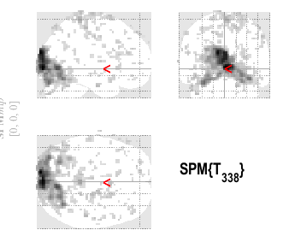
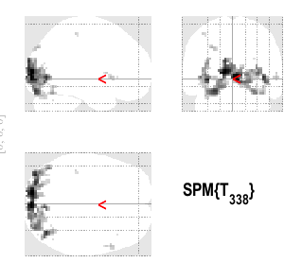
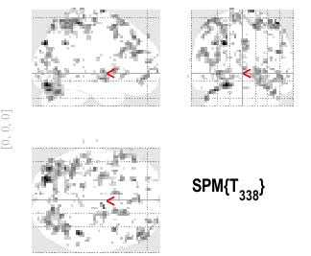
Step 1: Run GLM analysis
Photic
Motion
Attention
Notes:
In order to run the DCM analysis, first you need to have ran GLM analysis on the data, which I won’t go through as it was covered in a previous lecture.
For each contrast you will obtain an activation map, which you can view in the results section of SPM.

Slide 20
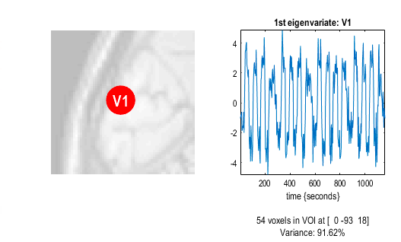
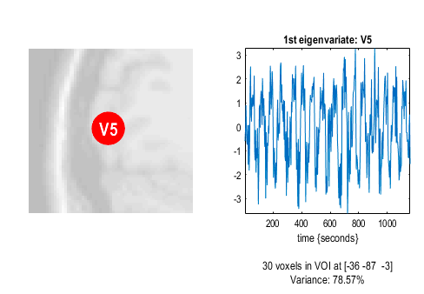
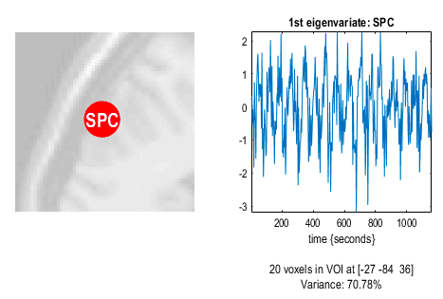
Step 2: Extract time courses for ROIs
Notes:
The next step is to define your ROIs and then extract a representative time course for each of them.

Slide 21
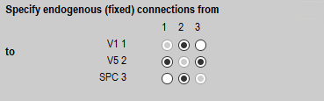
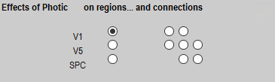
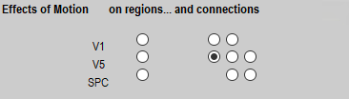
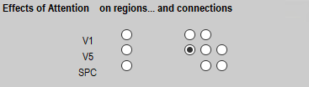
Step 3: Specify DCM
Notes:
Then you can specify the DCM models one by one.
You need to select the time courses of the brain regions that will be included in the model, and the factors that you want to include as inputs to the model.
Then you need to specify your first model, which you can see looks like this.
We start with the intrinsic connectivity – so the fixed connections, which is the A matrix This includes the bidirectional connectivity between V1 and V5, as well as between V5 and the SPC.
Next you specify the effects of each factor on the regions and connections. The first column corresponds to driving effects on regions (Parameter C). The second column corresponds to modulatory effects on connections (Parameter B from equation earlier).
Notice that according to this forward model, attention has a modulatory effect on the connection from V1 to V5.

Slide 22
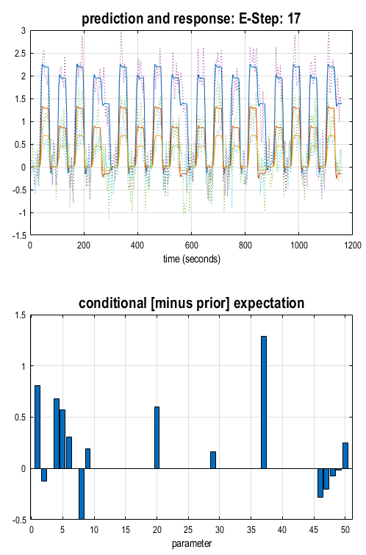
Step 4: Estimate DCM
Notes:
The you estimate the model with Bayesian model inversion: model inversion (i.e., estimation) is the process of ﬁnding the parameter values that offer the best trade-off between accuracy and the complexity of the model.
SPM will now estimate the evidence for your model.
Predicted data based on model = blue line, observed data = dotted line. If the model is good then the blue line should converge with the dotted line.

Slide 23
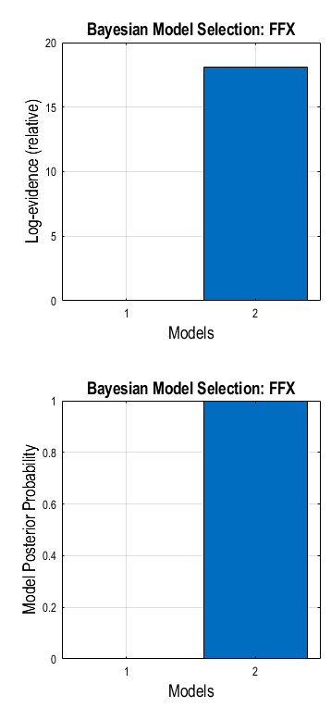
Step 5: Model comparison
H2: Backward
H1: Forward
H2: Backward
H1: Forward
Notes:
Then you want to compare the models to see which provides the best explanation for the data – Bayesian model comparison. In the second stage, hypotheses are tested by comparing the evidence for different models at single or group level.
Dynamic Causal Modelling --> Action drop down menu --> compare --> batch editor opens
Select the output directory
Data --> Subject --> input the models you would like to compare
Inference method --> FFX
The SPM output would look like this
You can see that there is higher log evidence for the second model, which is the forwards model, meaning you have stronger evidence to claim that the this model is correct
There is also higher posterior probability for the second model meaning you have stronger confidence to claim that this is the better model.

Slide 24
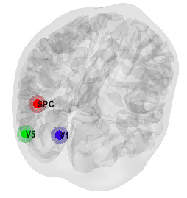
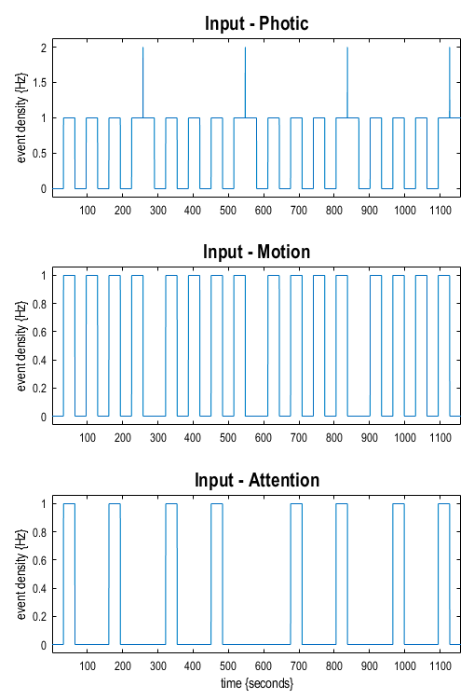
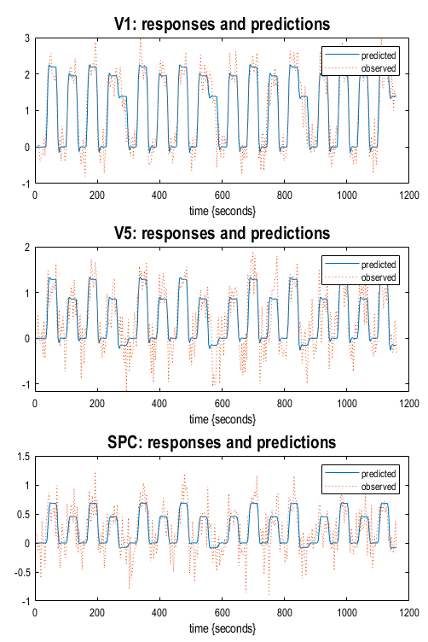
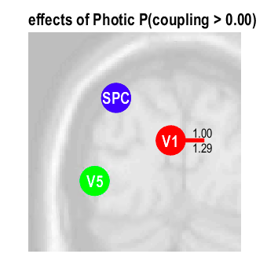
Step 6: Review results
Notes:
Finally, you can review your results.
Input = task design
Output = compare the predicted time course with the observed time course
Effects = of each of your conditions. Upper value = posterior probability (the closer to 1, the stronger evidence). Lower value = amplitude of the effect, in Hz (the higher the value, the stronger the effect). For example, you would have a high confidence to say that there is an 1.29 Hz effect of photic stimuli on V1.
Location of regions = nice diagram

Slide 25
Thank you!

