Slide 1
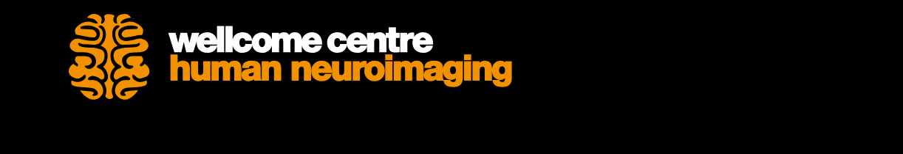

Anatomical MRI
Diffusion Tensor Imaging
Presenter: Dr. Michela Leocadi
Expert: Dr. Chris Lambert
Notes:
Good afternoon everyone, today I will talk about Diffusion Tensor Imaging, and the expert for today is Chris Lambert, who was also very useful in explaining me a few steps last week.

Slide 2
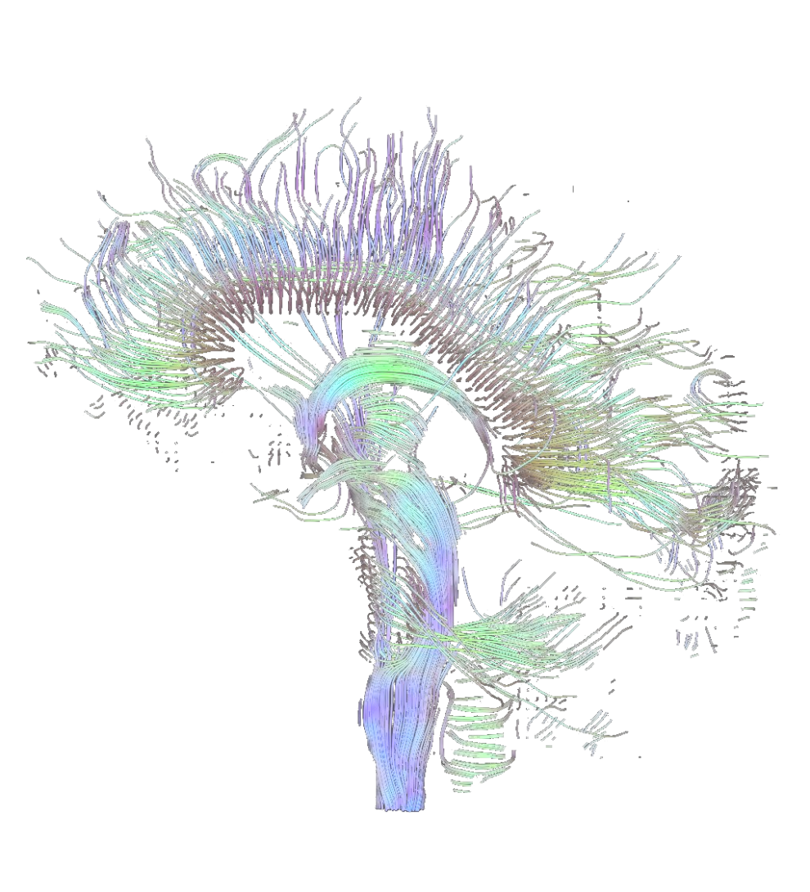
Overview
Theoretical concepts
Basic concepts
Diffusion weighting and MRI
The tensor model
Imaging of diffusivity
Problems in DTI
Practice
Structural connectivity in Mrtrix
Notes:
This is the general overview of my presentation.
I will start from a theoretical background, explaining the basic concepts of diffusion in general in the physical world, and then how this concept is applied to our brain, and how we study diffusion using MRI.
After that, I will explain one possible modelling of diffusion data, which is the ‘tensor model’, and then I will give you an overview of the main diffusivity measures that you can study, or that you usually find in research papers, and I will conclude this first part talking about the problems that we can face in DTI.
The second part of my talk is the practical bit, where I will show you an analysis that I’ve recently performed using Mrtrix.

Slide 3
Overview
Theoretical concepts
Basic concepts
Diffusion weighting and MRI
The tensor model
Imaging of diffusivity
Problems in DTI
Practice
Structural connectivity in Mrtrix
Notes:
But let’s first start with this first section.

Slide 4
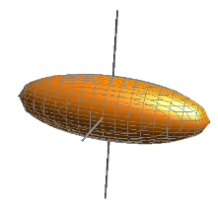
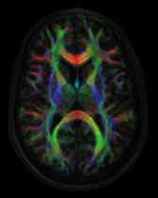
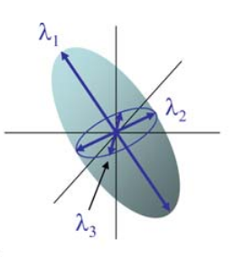
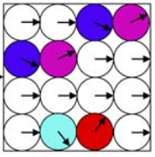
Basic concepts
Diffusion Tensor Imaging (DTI) is an anatomical magnetic resonance imaging (MRI) technique that measures macroscopic axonal organization in the brain by using the diffusion of water molecules to generate contrast in MR images.
It enables us to understand how information travels across the brain.
tensor
imaging
diffusion
Notes:
What is Diffusion Tensor Imaging (DTI)?
How information travels across the brain: differently from a standard anatomical image of the brain, using DTI we can also study the different connections in the brain

Slide 5
Basic concepts
Brownian Motion
Molecular diffusion refers to the random translational motion of molecules (also called Brownian motion) that results from the thermal energy carried by these molecules.
Molecules travel randomly in space over a distance that is statistically well described by a diffusion coefficient D.
Three random walks originating from
a common starting point (3D Gaussian distribution).
Source: COGNESTIC 2023 course (Dr Marta Correia)
D depends on the mass of the molecules, the temperature and viscosity of the medium.
Notes:
The first formal description of diffusion was made in 1827 by Robert Brown, a Scottish botanist.
An example of Brownian motion in our daily life can be pouring milk in a cup of tea: when you pour your milk, you notice that the molecules of milk have a random motion in tea, and this happens until you notice a consistent hue. Another example that will come in handy later on is pouring food dye in a pot of honey. As honey is denser, the diffusion of the dye will appear slow and also less random compared to the previous example, but you’d notice that it follows a certain direction.
In fact, the diffusion D depends on the mass of the molecules (honey is heavier than milk or tea for example), the temperature (imaging when you boil some water – in this case the molecules will travel faster), and viscosity (honey is more viscous than milk or tea). Therefore, the properties of the medium determine the speed of the Brownian Movement.
Figure: molecules travel freely in space, and when there is a free medium, there is no preferred direction and molecular displacement obey a 3D Gaussian distribution.
However, this would change when we want to study diffusion of molecules in our brain.

Slide 6
Basic concepts – in our brain
In a constrained environment, and during diffusion, water molecules move in brain tissues bouncing off, crossing or interacting with many tissue components, such as cell membranes, fibres and macromolecules.
The movement of water is impeded by these obstacles, and the diffusion displacement distribution is no longer Gaussian.
In biological tissues, obstacles modulate
the free diffusion process.
Source: Dr Marta Correia (COGNESTIC)
Notes:
This was the basic concept of diffusion.
But how does that apply to our brain?

Slide 7
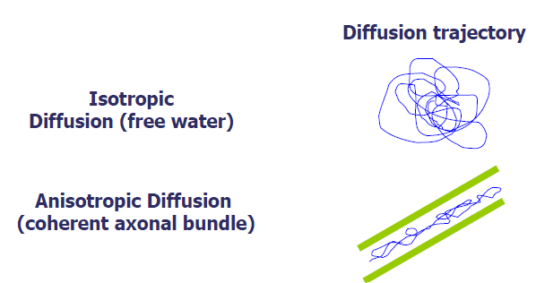
Diffusion weighting and MRI
Isotropic vs Anisotropic Diffusion
Source: COGNESTIC 2023
Notes:
Brownian Movement of the molecules is determined by the size and shape of the container.
Food dye dropped into a spherical bowl of water will diffuse randomly in all directions. Free diffusion (no obstacles) occurs equally in all directions. This is called isotropic diffusion
Food dye dropped into a cylindrical beaker, on the other hand, will quickly diffuse along the length of the beaker; the particles will soon run into the walls of the container, and be forced to move either up or down. Barriers can be many things (cell membranes, molecules, axons, etc), but in white matter the principal barrier is the myelin sheath of axons.
Bundles of axons provide a barrier to perpendicular diffusion and a path for parallel diffusion along the orientation of the fibres. This is termed anisotropic diffusion.

Slide 8
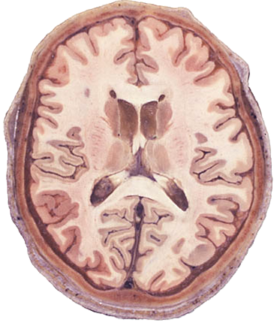
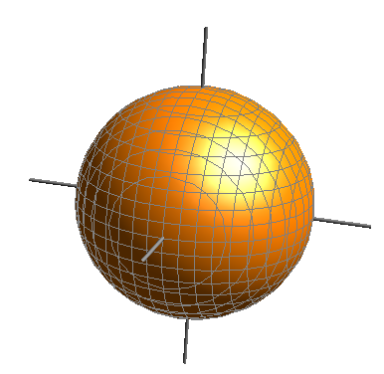

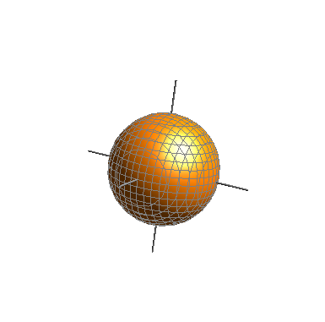
Diffusion weighting and MRI
Diffusion principle
CSF
Isotropic
High diffusivity
White matter
Anisotropic
High diffusivity
Grey matter
Isotropic
Low diffusivity
Notes:
Diffusivity (D) varies a lot in different tissues in our brain (grey and white matter, and CSF).
For example, CSF and WM have high diffusivity even though the shape of the medium is very different (imagine comparing diffusivity in white matter tracts and in the ventricles – in the ventricles water can move freely, while it is more constrained in white matter bundles), but only WM has anisotropic diffusion.
On the other hand, GM has low diffusivity because the GM volumes are small, and diffusion is isotropic, such as CSF.

Slide 9
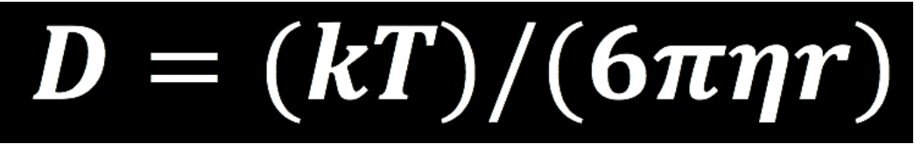
Diffusion weighting and MRI
Stokes-Einstein Equation
The diffusion coefficient, D, increases as the temperature (T) increases, and decreases with higher viscosity (symbolized by eta) and a higher particle radius (r). k stands for Boltzmann’s constant.
This diffusion coefficient plays a crucial role in how we acquire diffusion-weighted images.
Notes:
I mentioned earlier about a diffusion coefficient, D. I also mentioned how diffusion is impacted by temperature, viscosity, size of the medium, and shape.
The diffusion coefficient, D, increases as the temperature (T) increases, and decreases with higher viscosity (symbolized by eta) and a higher particle radius (r). k stands for Boltzmann’s constant. This diffusion coefficient will play a role in how we acquire diffusion-weighted images

Slide 10
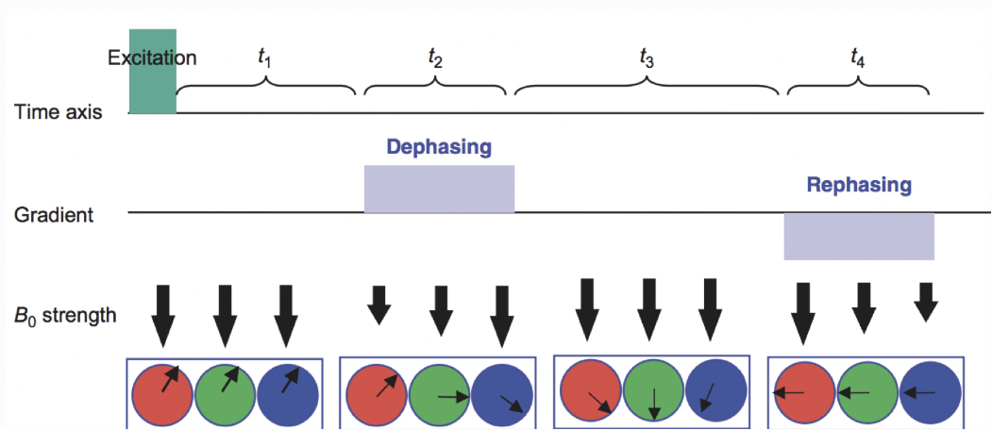
Diffusion weighting and MRI
Just as the T1 and T2 properties of the brain tissues could be used to create intensity differences in the images that are acquired (T1-weighted for anatomical scans, T2-weighted for functional scans), so could the diffusion of water lead to differences in the magnitude of the signal.
Mori et al., 2007
Notes:
The most commonly used diffusion sequence is a modification of the spin echo sequence called pulsed gradient spin echo (PGSE). In this sequence, the motion of spins is reflected in attenuation of the spin echo signal.
If we apply a magnetic gradient while scanning the brain, we could make the magnetic field stronger along one direction and weaker along the opposite direction. For example, let’s say that we made the magnetic field slightly weaker on the left side of the brain, and slightly stronger on the right side, with the field gradually increasing in strength as we move from left to right. Since the frequency of the spins of the hydrogen atoms is proportional to the strength of the magnetic field, we would expect the spins on the left side of the brain to be slightly slower than those on the right.
At this point, the spins would be out of phase with respect to each other; that is, they would be precessing at different rates depending on which part of the magnetic field they happen to be in. Because the protons are now out of phase, we call the gradient we just applied the Dephasing Gradient. If we applied an equal and opposite Rephasing Gradient - in other words, the magnetic field would be stronger on the left, and weaker on the right - the spins of the atoms would then be realigned with each other.
Figure from Mori, 2007. The red, green, and blue circles represent hydrogen atoms, and the arrows within the circles are the direction of the spins; imagine that they are all moving in the same direction around the circumference of the circle, and at the same rate. A Dephasing Gradient (middle row) is slightly weaker on the left, and slightly stronger on the right; as a result, when we turn off the gradient, the atoms are spinning out of phase with respect to each other. A Rephasing Gradient then applies an equal and opposite gradient, and in the end the atoms are spinning in the same direction and at the same rate.

Slide 11
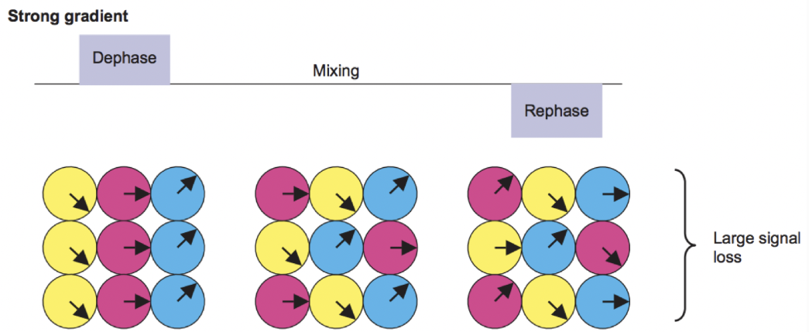
Diffusion weighting and MRI
A rephasing gradient would put the hydrogen atoms back into alignment with each other. This assumption is true, but only if the hydrogen atoms don’t move in between the turning on and off of the dephasing and rephasing gradients. If, on the other hand, they do move, then the rephasing gradient will not lead to a realignment of the hydrogen atoms. Rather, they will be out of alignment in proportion to how much they have diffused in the time between the gradients.
Mori et al., 2007
Notes:
Figure from Mori, 2007. The period of time between the gradients, which we will refer to as the mixing phase, allows the hydrogen atoms from different locations to mix with each other. This depends on factors such as the ambient temperature and how constrained the surrounding environment is - hydrogen atoms in a relatively unrestricted space (such as the ventricles) will diffuse more than those that are in a more restricted space. When the rephasing gradient is applied, the atoms are now spinning out of phase with respect to each other.

Slide 12
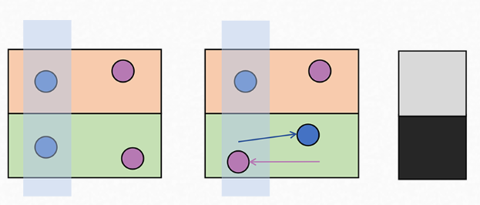
Diffusion weighting and MRI
Stationary spins return a high signal as they have been exposed to both dephasing and rephasing gradients
Stationary spins
(restricted diffusion)
Mobile spins
(free diffusion)
Mobile spins do not return a signal as they have been exposed to only one (or none) of the gradients
1. First diffusion gradient applied in a particular direction to dephase the spins.
2. Second diffusion gradient applied in same direction.
This rephases any spins that are still within the gradient field.

Slide 13
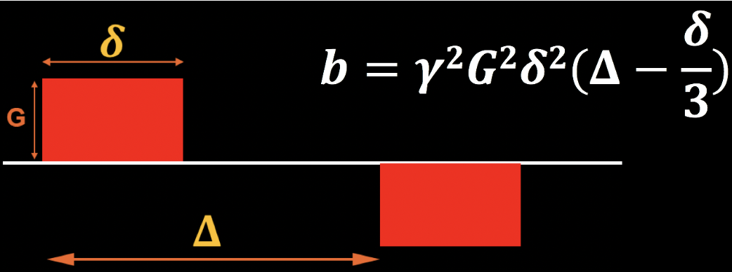
Diffusion weighting and MRI
Diffusion gradients are generated by the following parameters:
Magnitude of the diffusion gradient (G)
Time between gradients (𝚫)
Duration of the diffusion gradient (𝜹)
b-value
b-value
Notes:
How are diffusion gradients generated?
Note that the b-value is proportional to the magnitude of the gradient, duration of the gradient, and time between the gradients; if any of these parameters increase, the b-value increases as well.

Slide 14
The diffusion MRI signal
B values
When diffusion gradients are applied, the effects of diffusion are significantly amplified and become the dominant mechanism of tissue contrast.
A b-value is a factor that reflects the strength and the timing of the gradients used to generate DWI images.
The higher the b-value, the stronger the diffusion effect;
The "optimal" choice of b-value is not clearly defined and depends upon field strength, number of signals averaged, anatomical features, and predicted pathology.
Notes:
When diffusion gradients are applied, however, the effects of diffusion are significantly amplified and become the dominant mechanism of tissue contrast.

Slide 15
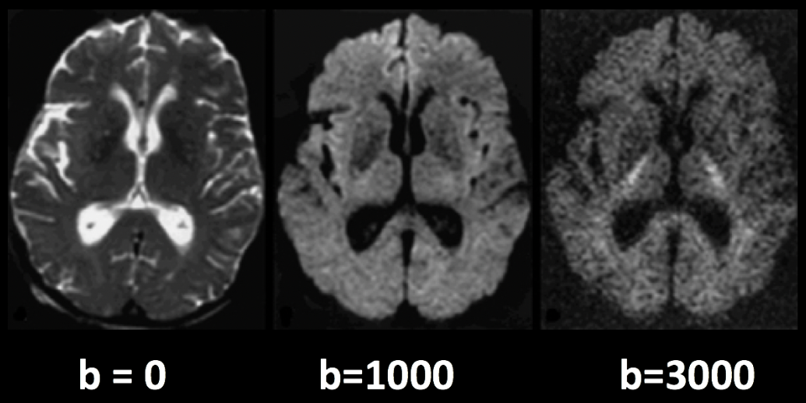
The diffusion MRI signal
Multi-shell acquisition
A diffusion-weighted image with a b-value of zero is virtually identical to a typical T2-weighted image - CSF is bright and grey matter is dark.
With increasing b-values, greater signal loss in specific parts of the brain → higher b-values make the image more susceptible to artifacts and current movements (eddies)
Notes:
Diffusion images that are acquired with more than one b-value are referred to as multi-shell acquisitions. This allows finer-grained distinctions in the orientation of the diffusion, since the image will show different amounts of signal loss at each b-value depending on the amount of diffusion.

Slide 16
The diffusion MRI signal
B-vectors
The directions of the applied gradients are called b-vectors (or bvecs)
When you download data from a diffusion-weighted scan, you have 2 .txt files:
.bvec
.bval
Example
We collect 40 diffusion-weighted images, and the first volume was acquired with b = 0, and the rest with b = 1000.
The bvals file would have 40 entries, with each bval corresponding to an individual volume in the diffusion-weighted image. The bvecs file, on the other hand, would have 40 triplets of numbers indicating the direction of the diffusion gradient for that volume in the x-, y-, and z-directions.
Notes:
One parameter you have control over is the number of directions you would like to scan with the gradients. For example, you could acquire 64 or 128 images, with each image having diffusion gradients applied from a slightly different direction. More directions leads to higher angular resolution, which allows you to make finer spatial distinctions about the direction of the diffusion. The trade-off, as with anything that increases resolution, is that more scans take more time.
If we know both the direction and the magnitude of the gradient, we can make an educated guess about the diffusion along that gradient depending on changes in the signal acquired from those voxels.

Slide 17

The tensor model
Gaussian Modelling of diffusion signal
The combination of bvals and bvecs allows us to construct something called a tensor, and fit it to each voxel of our diffusion-weighted image
Directions of the energy = eigenvectors
Magnitude of the energy = eigenvalues
The Diffusion signal observed at each voxel is a combination of eigenvectors and eigenvalues.
Calculate different properties of the diffusion
Notes:
This combination of bvals and bvecs allows us to construct something called a tensor and fit it to each voxel of our diffusion-weighted image. Think of a tensor as a model of forces that push along the x-, y-, and z-dimensions. Water flowing through a garden hose, for example, pushes against the boundaries of the tube, but primarily flows along the length of the hose. We call the directions of the energy eigenvectors, and the magnitude of the energy eigenvalues.
Applied to diffusion-weighted images, we use these same concepts to model the signal observed at each voxel as a combination of eigenvectors and eigenvalues. The eigenvectors indicate the direction of the diffusion, and the eigenvalues represent the magnitude of the diffusion. To bring back the garden hose example, the water’s force would have a high eigenvector and eigenvalue along the length of the tube; similarly, we can model the diffusion in each voxel of the brain as a combination of eigenvectors and eigenvalues. Once we calculate the combination of values that best represents the signal observed in the current voxel, we can use a number of different equations to calculate different properties of the diffusion at that voxel.

Slide 18
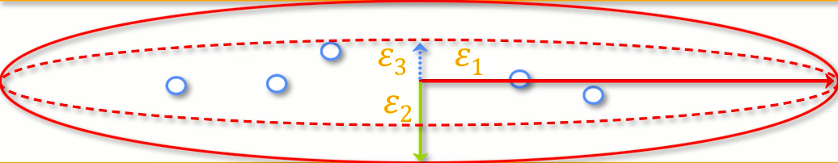
Imaging of diffusivity
Fractional anisotropy
Fractional anisotropy (FA) = weighted sum of the eigenvalues in each voxel
higher FA indicates greater diffusion along one of the directions
lower FA value indicates that there is either very little diffusion, or that the diffusion is unconstrained and going in each direction at random (as in, say, the ventricles of the brain).
Left/Right
Anterior/Posterior
Superior/Inferior
Notes:
Diffusivity can be studied using different measures:
Fractional anisotropy
If we find that the diffusion is greater along one of the dimensions, we can color-code it according to the direction. The convention in diffusion imaging is to represent diffusion along the x-axis in red, diffusion along the y-axis in green, and diffusion along the z-axis in blue. The image above summarizes this color-coding scheme.

Slide 19
Imaging of diffusivity
Other measures
Mean Diffusivity (MD) = average of the eigenvalues, calculated by summing the eigenvalues together and dividing them by 3. Useful for identifying brain pathologies such as edemas.
Axial Diffusivity (AD) = value of the largest eigenvalue.
Radial Diffusivity (RD) = average of the two smallest eigenvalues. Often used to analyse large fibre bundles oriented in the same direction, such as the corpus callosum.

Slide 20
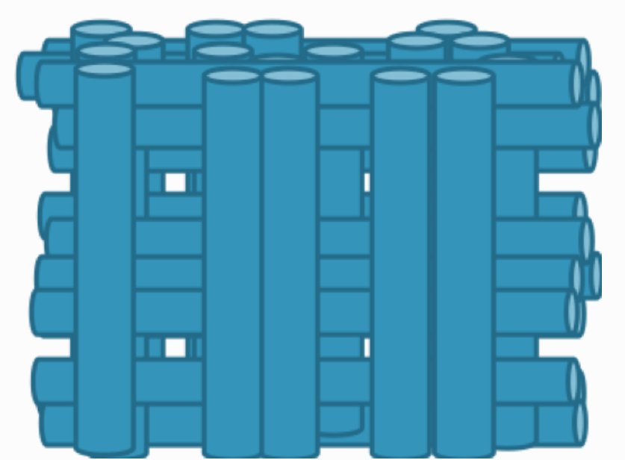
Problems in DTI
Crossing-fibers
The tensor fitting method is useful for analysing voxels that contain white matter tracts which travel in a single direction
If the voxels contain fibres that cross each other, the method can lead to spurious results → not able to estimate the direction and magnitude of the diffusion for each bundle of fibres separately.
Source: Andy’s Brain Book
Notes:
Although diffusion tensor imaging has been one of the most popular analysis methods since the beginning of diffusion-weighted imaging, it has been hindered by the Crossing-Fibers Problem. The tensor fitting method described above is useful for analyzing voxels that only contain white matter tracts that travel in a single direction. If, on the other hand, the voxel contains fibers that cross each other (which is the case for most parts of our brain), the method can lead to spurious results. To take the most extreme case, imagine that we have acquired a diffusion-weighted image for a single voxel, and that this voxel contains white matter fibers that cross at right angles with respect to each other. Since the tensor is constrained to generate a single solution in order to estimate all of its eigenvectors and eigenvalues, it is unable to estimate the direction and magnitude of the diffusion for each bundle of fibres separately. Instead, it will split the difference and conclude that there is no diffusion along any direction - in other words, the diffusion of the two tracts will cancel each other out.

Slide 21
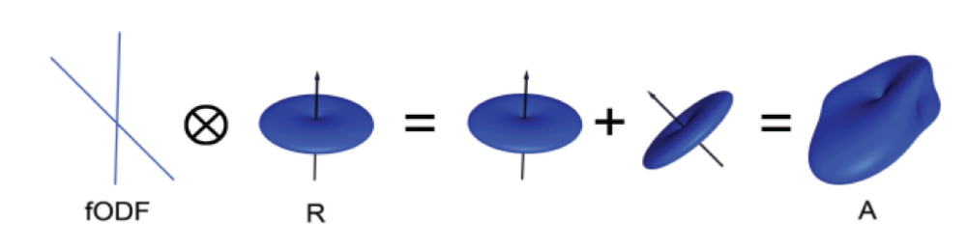
Problems in DTI
Constrained Spherical Deconvolution (CSD) – Tournier et al., 2004
CSD assumes that the diffusion signal is an average of the signal you would expect from multiple individual fibres crossing each other at different angles.
Notes:
With this method, the signal measured during a high angular resolution diffusion weighted imaging (HARDI) session can be expressed as the convolution, over spherical coordinates, of the response function (RF), representing the signal of a single coherently oriented population of fibers, with the fiber orientation distribution (FOD).
Instead of trying to find a single solution to a complex signal that is measured at each voxel, spherical deconvolution assumes that the diffusion signal is an average of the signal you would expect from multiple individual fibres crossing each other at different angles. A single fibre is therefore used as a basis function to deconvolve the more complex signal.
In order to understand this better, using as an example fMRI acquisition, the BOLD signal we acquire from a single voxel can be modelled as an average of several overlapping BOLD responses to events that occur closely together. In order to estimate the amount of BOLD activity for each individual event, we deconvolve the more complex signal into its individual parts. The basis function of a single Hemodynamic Response Function (HRF) allows us to estimate what combination of HRFs occurring at different times and with different magnitudes would look like, and we estimate the combination that leads to the observed signal.
Similarly with diffusion-weighted data, we acquire a diffusion signal in each voxel from many different angles in order to form a picture of both the direction of the diffusion and its magnitude. The signal is then deconvolved into a set of individual fibers oriented in different directions. Instead of a single diffusion number at each voxel, spherical deconvolution is used to generate a fiber orientation density function, or FOD. The function is represented as a shape with ovoid axes; and although the lobes of the axis that loads on to the predominant direction of diffusion become longer and bigger relative to the other axes, information about the direction and strength of diffusion along the other axes is still retained.

Slide 22
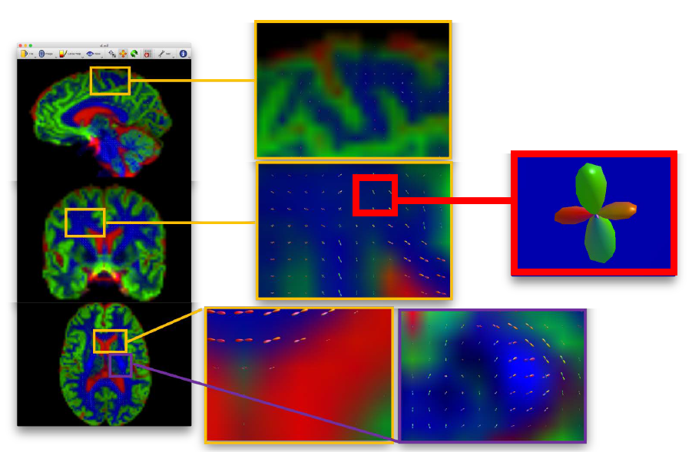
Problems in DTI
Left/Right
Anterior/Posterior
Superior/Inferior
Constrained Spherical Deconvolution (CSD)
Source: BATMAN Tutorial
Notes:
This is an example of how the problem of the crossing fibres can be overcome using constrained spherical deconvolution (CSD).
For example, we can have a look in parts of the brain where we know there must be crossing fibers.
You see that the colour changes if we zoom in, thus indicating that fibres show different directions in that specific location.

Slide 23
Overview
Theoretical concepts
Basic concepts
Diffusion weighting and MRI
The tensor model
Imaging of diffusivity
Problems in DTI
Practice
Structural connectivity in Mrtrix

Slide 24
Overview
Theoretical concepts
Basic concepts
Diffusion weighting and MRI
The tensor model
Imaging of diffusivity
Problems in DTI
Practice
Structural connectivity in Mrtrix
User documentation: https://mrtrix.readthedocs.io/en/dev/index.html
Notes:
This second part of my presentation is about a practical example on how we can use diffusion data to inform about the structural properties of the brain

Slide 25
Aim
In Huntington’s disease (HD), striatal and cortical hub connections appear selectively vulnerable early in the disease course.
Global network changes occur with loss of integration and increased segregation.
Aim was to study whether many years before predicted disease onset, people with HD showed subtle early differences in structural connectivity in selectively vulnerable regions.

Slide 26
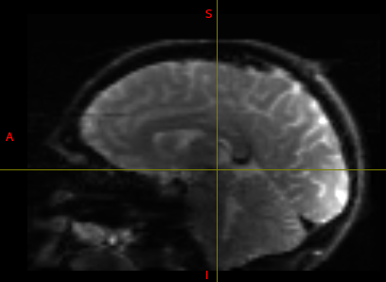
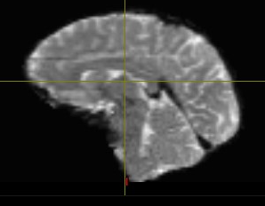
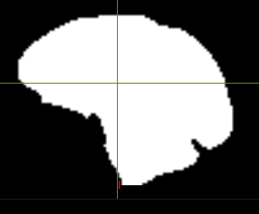
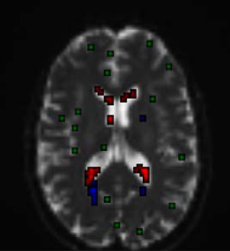
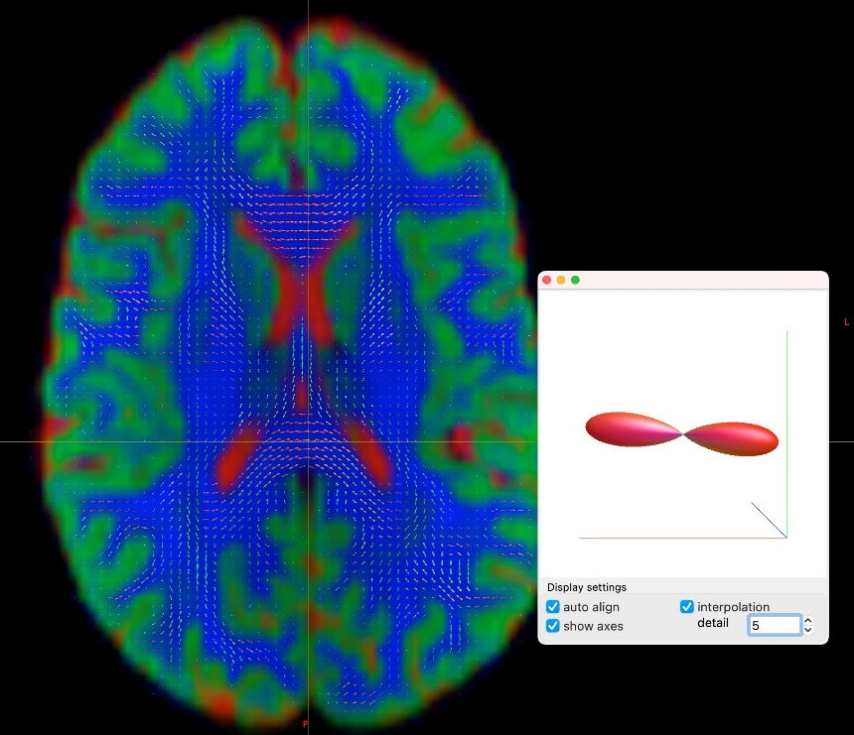
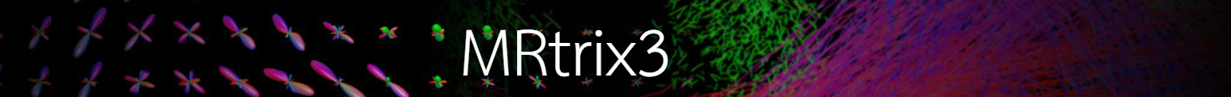
Preprocessing and MSMT-CSD
Bias field correction
(FSL)
‘dwibiascorrect’
Brain mask estimation
‘dwi2mask’
Preprocessing
Topup = susceptibility-induced distortions
Eddy = eddy-currents and movement
MSMT-CSD
Estimation of FOD
(MSMT-CSD)
‘dwi2fod msmt_csd’
Normalise
before
Tractography
‘mtnormalise’
Response function estimation
‘dwi2response’
Notes:
After acquisition, we started with the preprocessing of our data.
For preprocessing, we used TOPUP to correct for susceptibility-induced distortions, and EDDY to correct for eddy-currents and subjects' movement. After that, I applied bias field correction = Perform B1 field inhomogeneity correction for a DWI volume series.
Brain mask estimation: create a binary mask of the brain. Downstream analyses will be performed within that mask to improve biological plausibility of streamlines and reduce computation time.
Response function (RF) estimation: estimate orientation of the fibres in each voxel for each tissue: white matter (WM), grey matter (GM), and cerebrospinal fluid (CSF). We do this using CSD.
There are many voxels with so-called “partial volumes”, i.e. voxels containing both white and gray matter, or such with white matter and CSF. CSD will be flawed in such voxels. But we can improve our results in such regions if we estimate different RFs for different tissue types. This is best done with DW data with different b-values, since different tissue types are best sensitive for different b-values. This idea is at the core of so-called multi-shell multi-tissue CSD (MSMT; Jeurissen et al., 2014).
Normalise: correct for global intensity differences

Slide 27
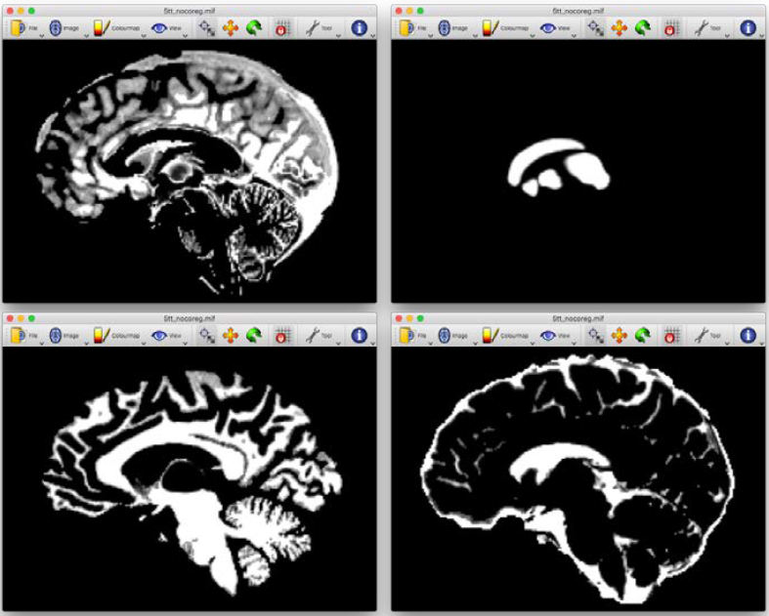
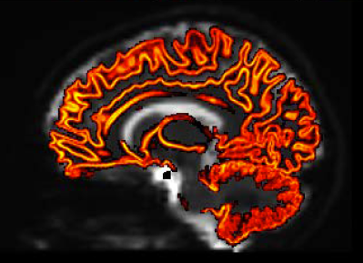
Whole-brain probabilistic tractography
Coregistration of T1 to diffusion space
Mask for streamline termination and ACT
‘5ttgen’
Using NiftyReg
Anatomical Constrained Tractography
Notes:
The purpose of this is to increase the biological plausibility of downstream streamline creation.
5ttgen = 5 tissue types: cortical grey matter, subcortical grey matter, white matter, CSF, and pathological tissue.
ACT has the advantage to be able to identify streamlines that end in the CSF for example, and rejecting them. In order to use ACT, we need a high-resolution T1

Slide 28
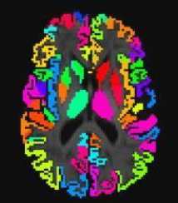
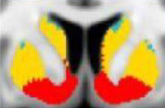
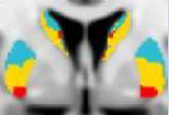
Registration to ROIs
Registration to a priori ROIs
3 striatal regions (L and R)
Oxford-GSK-Imanova Striatal Connectivity Atlas
Sensorimotor
Executive
Limbic
Registration
Cortical rich-club regions (L and R)
Superior Frontal
Precentral
Superior Parietal
Thalamus
Inferior Parietal
Rostral Middle Frontal
Notes:
In FSL → PCA (Matlab)
Probtrack X (omatrix2) → tractography image which summates the tracts (matrix of data)
Tutorial: The format of the data must be in betpostx

Slide 29
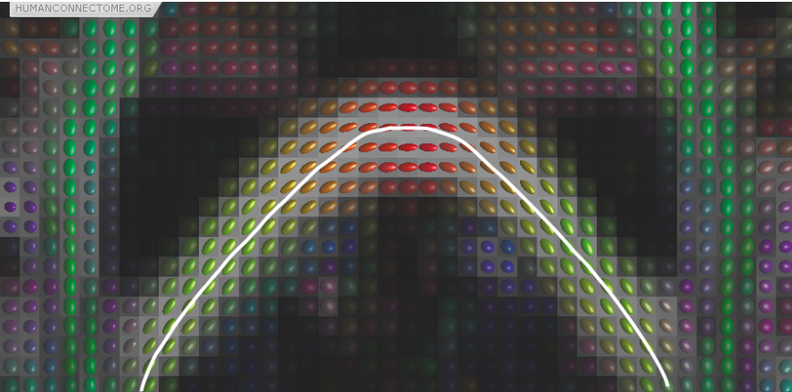
Tractography
Deterministic vs Probabilistic
Once we know the orientation of fibres at every point in the brain, we can reconstruct entire tracts, and therefore estimate brain connections.
We start at a seed location, and we then follow the preferred direction until we reach a new measurement.
Deterministic tractography
Notes:
Figure 1: Preferred diffusion directions are shown as the long axes of diffusion ellipsoids. The colour is a complementary way of coding the preferred direction where red denotes left-right, green denotes back-front and blue up-down (out of the image plane). The white line shows the streamline obtained by connecting up a set of pixels based on their preferred directions and is an example of deterministic tractography.

Slide 30
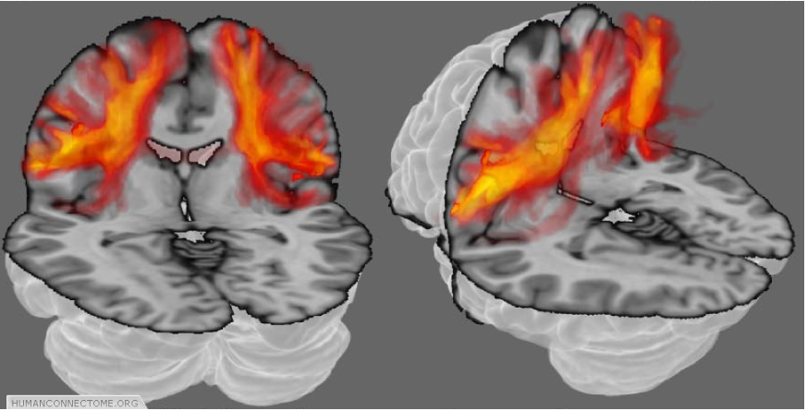
Tractography
Deterministic vs Probabilistic
Each voxel in the brain does not have just one connection, but many, and our measurements and our models are not perfect and can contain errors
Deterministic tractography can never account for uncertainty or for distributed connectivity
Probabilistic tractography estimates the ‘most likely’ fibre orientations, and connections are traced thousands of times, each time using a different orientation (according to their likelihood)
Probabilistic tractography
Notes:
The orange clouds show colour coded connectivity distributions determined by probabilistic tractography. Each voxel (point in space) is assigned a colour from a hot-iron scale where black (no color in this case) means that there is zero connection probability, red-hot indicates intermediate probability and white-hot indicates a high connection probability.

Slide 31
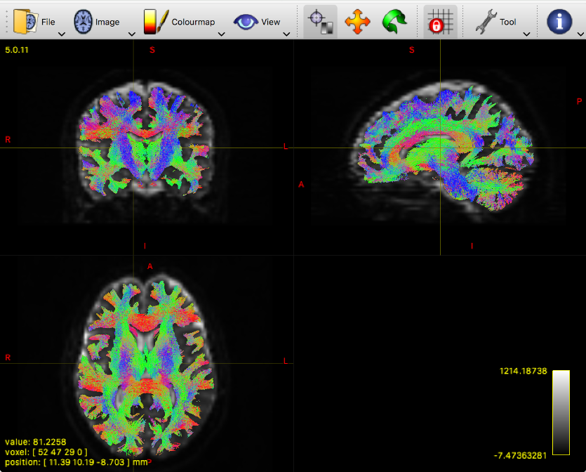
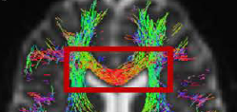
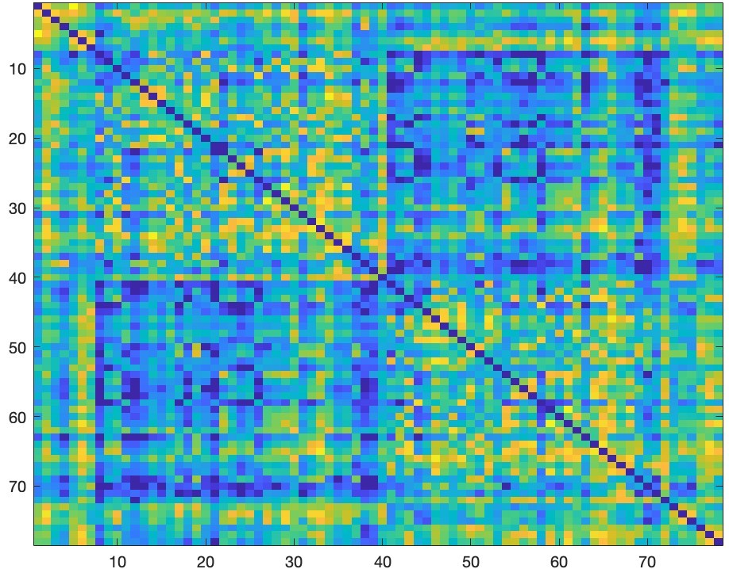
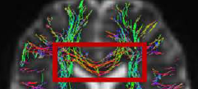
Connectome creation
Generation of 10 million streamlines
‘tckgen -act’
Reducing the number of streamlines
‘tcksift2’
Connectome matrix
‘tck2connectome’
Using
SIFT2
Notes:
Probabilistic tractography rather than deterministic
Tcksift2 (spherical-deconvolution informed filtering of tracks): One of the pitfalls of CSD is that the density of long tracks is overestimated compared to short tracks. If we have 2 tracks, a short and a long one, equally thick, the longer one will have more ‘hits’ during probabilistic streamline creation (because the probability of ‘hits’ is higher and more likely). Also, in regions where crossing fibres are expected, there would be an overestimation of tracks following the ‘main’ direction.
Tck2connectome: overlay the atlas-based parcellation onto the whole-brain tractogram and simply count how many streamlines from that region reach every other region.

Slide 32
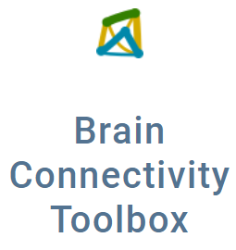

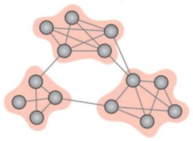
Graph theory measures
Local measures (connectivity strength)
L_limbic | L_executive | L_sensoriomotor | R_limbic | R_executive | R_sensorimotor
0.008795177 | 0.020381478 | 0.013010634 | 0.007645586 | 0.020561575 | 0.010816435
0.006957275 | 0.019527704 | 0.0112256 | 0.007456133 | 0.020376417 | 0.012803858
0.007712823 | 0.016458794 | 0.01306604 | 0.008550799 | 0.016749676 | 0.010860205
0.008611487 | 0.018259019 | 0.014467068 | 0.008964371 | 0.016183022 | 0.010414345
Sub 1
Sub 2
Sub 3
Sub 4
Global measures
Efficiency | Modularity
0.000552147 | 0.453708609
0.000557193 | 0.405677374
0.000563443 | 0.439894939
0.000560595 | 0.454443368
Sub 1
Efficiency
Sub 2
Sub 3
Sub 4
Modularity
Notes:
The global measures that we studied are:​
Global efficiency, which is considered a measure of brain integration, which refers to the potential of information transmission, which is determined as the average shortest path length across all pairs of nodes (see the picture). Average path length represents the average of shortest paths between brain regions in the network; increase in average path length represents loss of network integration, while a decrease indicates better integration and efficiency.​
Modularity, relates the number of within-network connections to all connections to quantify the strength of segregation into distinct networks. Higher values indicate stronger separation of networks, which indicates that the network is more segregated with less connections between different modules/clusters.

Slide 33
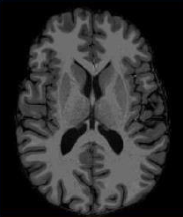
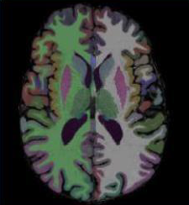
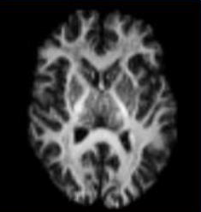
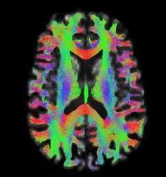
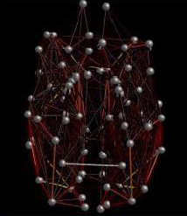
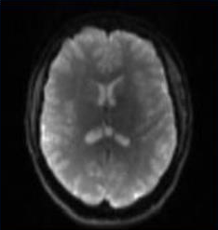
Overview of the Pipeline
T1 images
Parcellation of cortical / subcortical grey matter
Map FreeSurfer parcellation to striatal atlas
Warp to diffusion space
QC
FreeSurfer
Diffusion images
QC
Preprocessing + CSD
Create FODs
Tractography
Adapted from Scahill et al., Lancet Neurol 2020
Construct graph
Notes:
Now I will talk you through an analysis that I recently did which used both diffusion and anatomical images to study structural connectivity in a cohort of people with a neurological disease in comparison to healthy people.
We had an a priori hypothesis of studying connection strength in specific ROIs (rich club regions) and cortico-striatal regions using graph analysis because we knew that from the previous literature these regions might show some changes in our patients’ cohort. The final outputs I wanted to get in the end from my participants, were graph theory measures – both regional and global.
I used the T1 images to derive FreeSurfer parcellations of both cortical and subcortical grey matter as an anatomical reference for the diffusion data. In the case of the striatal regions, the parcellations were registered to an atlas, which is the Oxford-GSK-Imanova Striatal Connectivity Atlas, and then they were warped to diffusion space.
Diffusion images were preprocessed, and then CSD was used to solve the crossing fibres issue.
To get there, I needed to perform a structural connectivity analysis first using probabilistic tractography, ACT and CSD.
Striatal atlas: Oxford-GSK-Imanova Striatal Connectivity Atlas

Slide 34
Overview of the Pipeline
Connection strength (sum of its connection weights) of:
6 striatal regions
12 cortical rich club
Whole-brain network measures:
Modularity
Global efficiency
Construct graph

Slide 35
Pitfalls of Tractography
Anatomical accuracy of modern techniques is still limited
It can sometimes result in overly diffuse and less anatomically precise tracts, especially in regions with high uncertainty
The probabilistic nature of the results can make interpretation more complex, as it generates a probability map of possible pathways rather than a single, clear tract. This can complicate clinical decision-making and research conclusions
It can sometimes include false positive tracts (i.e., paths that do not exist) or miss true tracts (false negatives), especially in areas of low anisotropy or high anatomical complexity.

Slide 36
Thank you for your attention!
References
Previous MfD slides
BATMAN Tutorial: https://osf.io/fkyht/
COGNESTIC materials: https://imaging.mrc-cbu.cam.ac.uk/methods/COGNESTIC2023#diffusionmri1
Andy’s Brain Book: https://andysbrainbook.readthedocs.io/en/latest/
Thank you to the expert, Dr. Chris Lambert!

