Slide 1
PREPROCESSING: REALIGNING AND UNWARPING
Huaiyu Liu (Ted)
Lucy Core
Methods for Dummies
February 8, 2023

Slide 2
Contents
Realignment
What is fMRI?
What is realignment?
How to do realignment?
Example: SPM guide to realignment

Slide 3
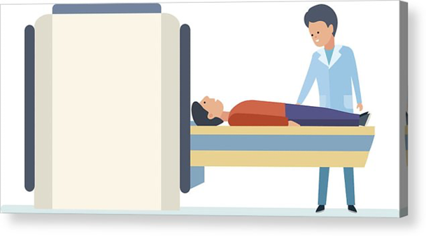
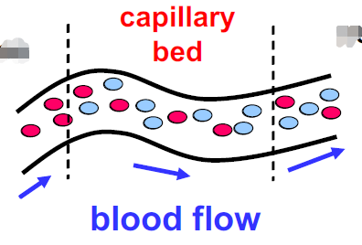
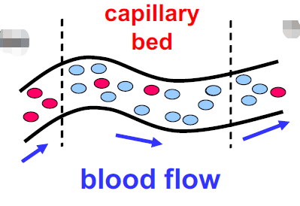
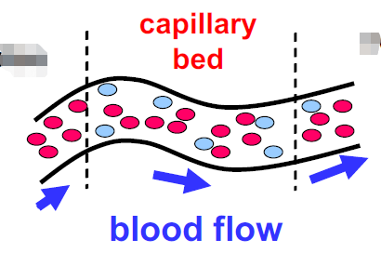
WHAT IS fMRI?
Functional Magnetic Resonance Imaging (fMRI)
https://www.youtube.com/watch?v=nvB9hAarzw4&list=PPSV
Detects subtle changes in blood flow in response to stimuli/actions
  Measures blood-oxygen level dependent (BOLD) signal
Notes:
Image taken from the 2019 MFD (R&U)

Slide 4
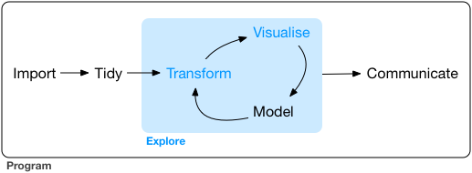
PREPROCESSING

Slide 5
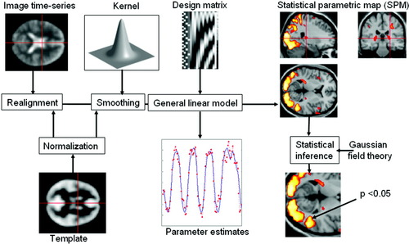
PREPROCESSING for fMRI
Price, Crinion and Friston, 2006
Notes:
https://onlinelibrary.wiley.com/doi/full/10.1002/jmri.20580

Slide 6
REALIGNMENT

Slide 7
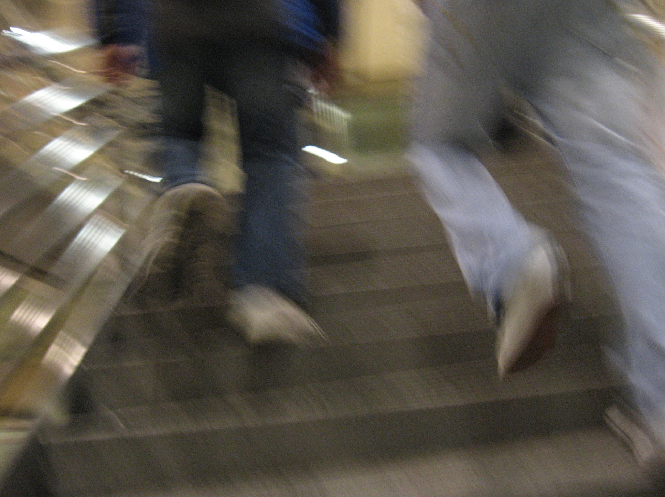
There are movements in the scanner
1. There is always head movements
2. Physiological: Heart beat, respiration, blinking
3. Means that the data from a single voxel may not
Correspond to the same place in the brain over time
4. Need to realign the data to a specified reference

Slide 8
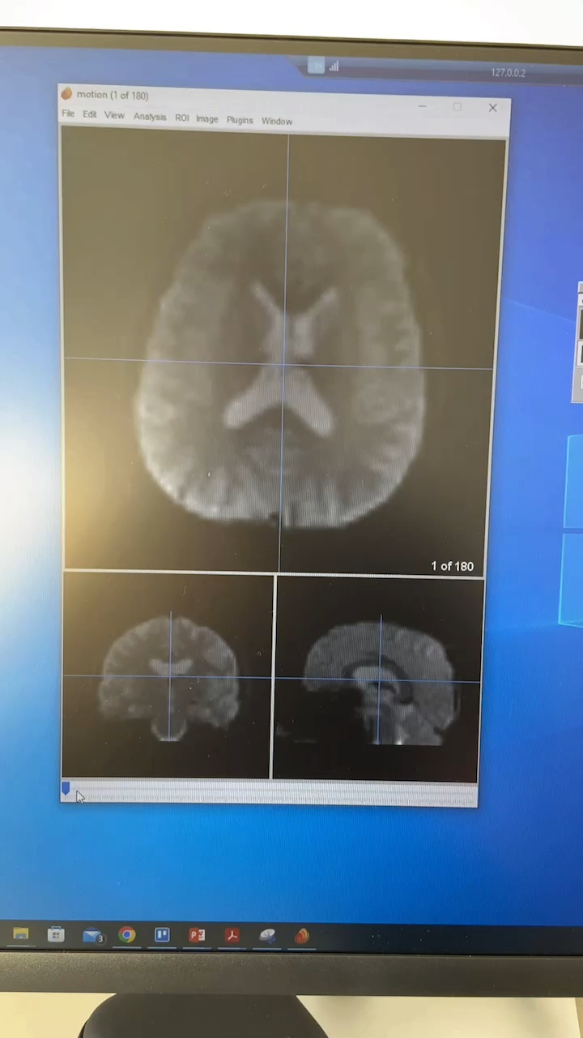
There are movements in the scanner
1. Means that the data from a single voxel may not
Correspond to the same place in the brain over time
2. Need to realign the data to a specified reference

Slide 9
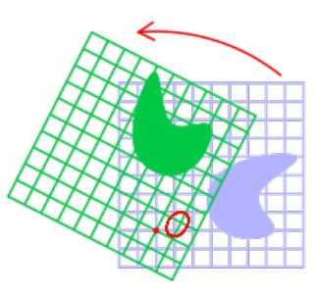
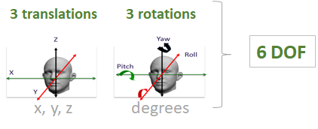
How does realignment work?
Rigid body transformation
Can be decomposed into 6 dimensions

Slide 10
Realignment procedures
1.Calculate position of brain for first slice (Reference Image)
2. How difference/similar between two images (Estimate transformation parameters)
3. Perform the transformation

Slide 11
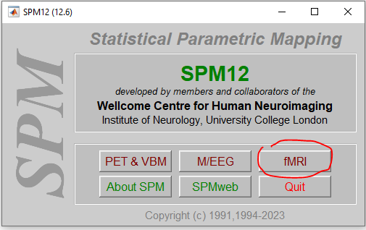
RIGID BODY TRANSFORMATION

Slide 12
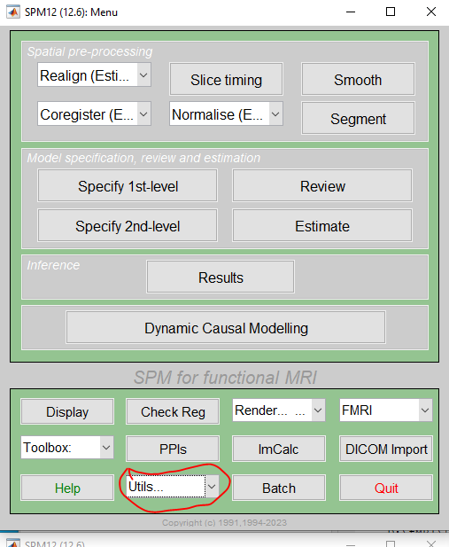

Slide 13
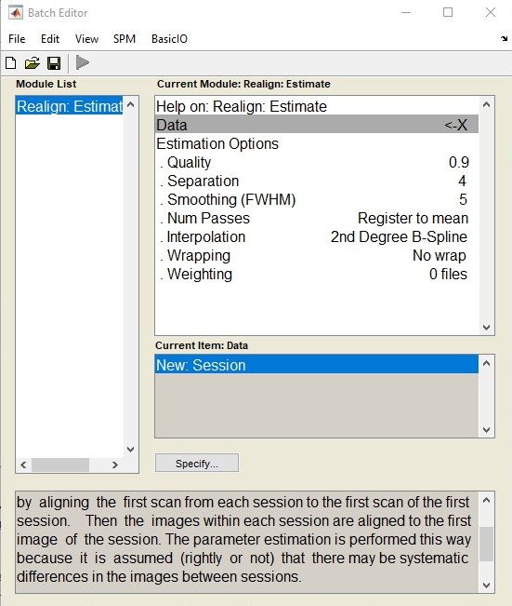
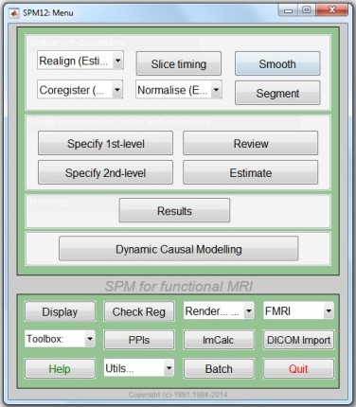

Slide 14
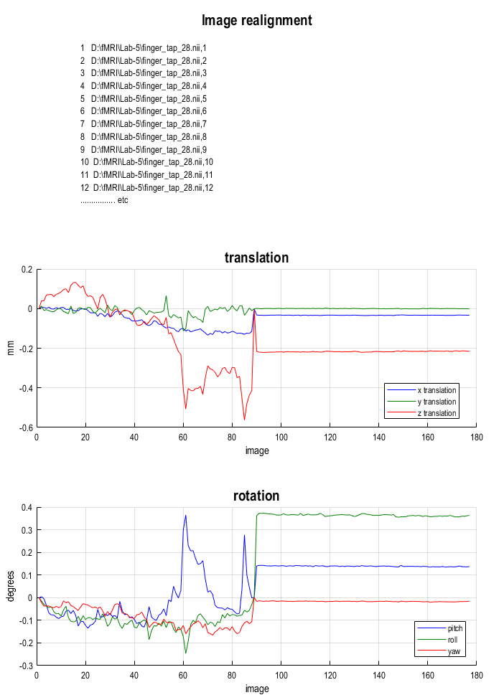
How much is too much?
Rule of thumb: movement larger than the minimum dimension of the voxel is “too much”

Slide 15
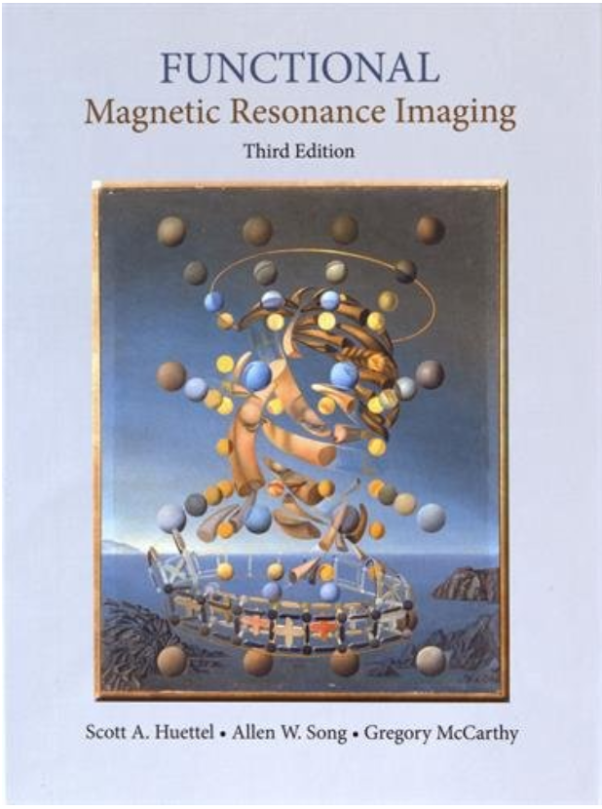

RESOURCES
https://www.fil.ion.ucl.ac.uk/spm/doc/spm12_manual.pdf#Chap:data:auditory
https://ucl.podia.com/view/courses/designing-and-analysing-fmri-experiments/1228405-week-0-getting-started/3741966-welcome
https://mriquestions.com/data-pre-processing.html

Slide 16
UNWARPING
Notes:
Lucy

Slide 17
Overview
Unwarping
Why is unwarping needed?
Heterogeneity in the magnetic field
What does unwarping do?
How do we unwarp?
Examples in SPM

Slide 18
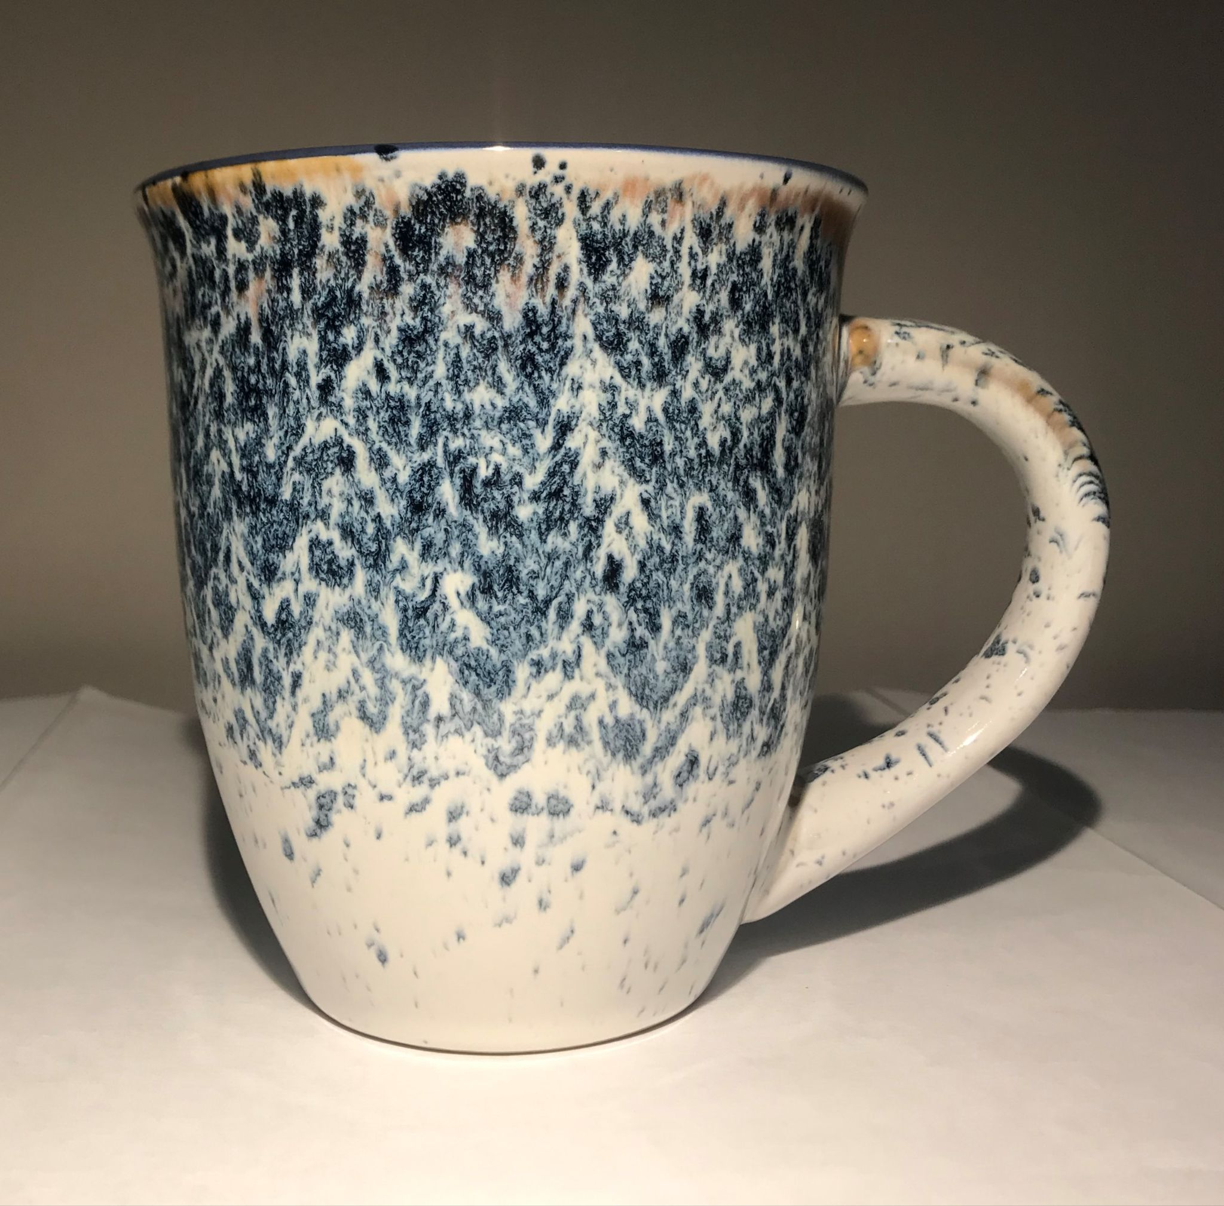
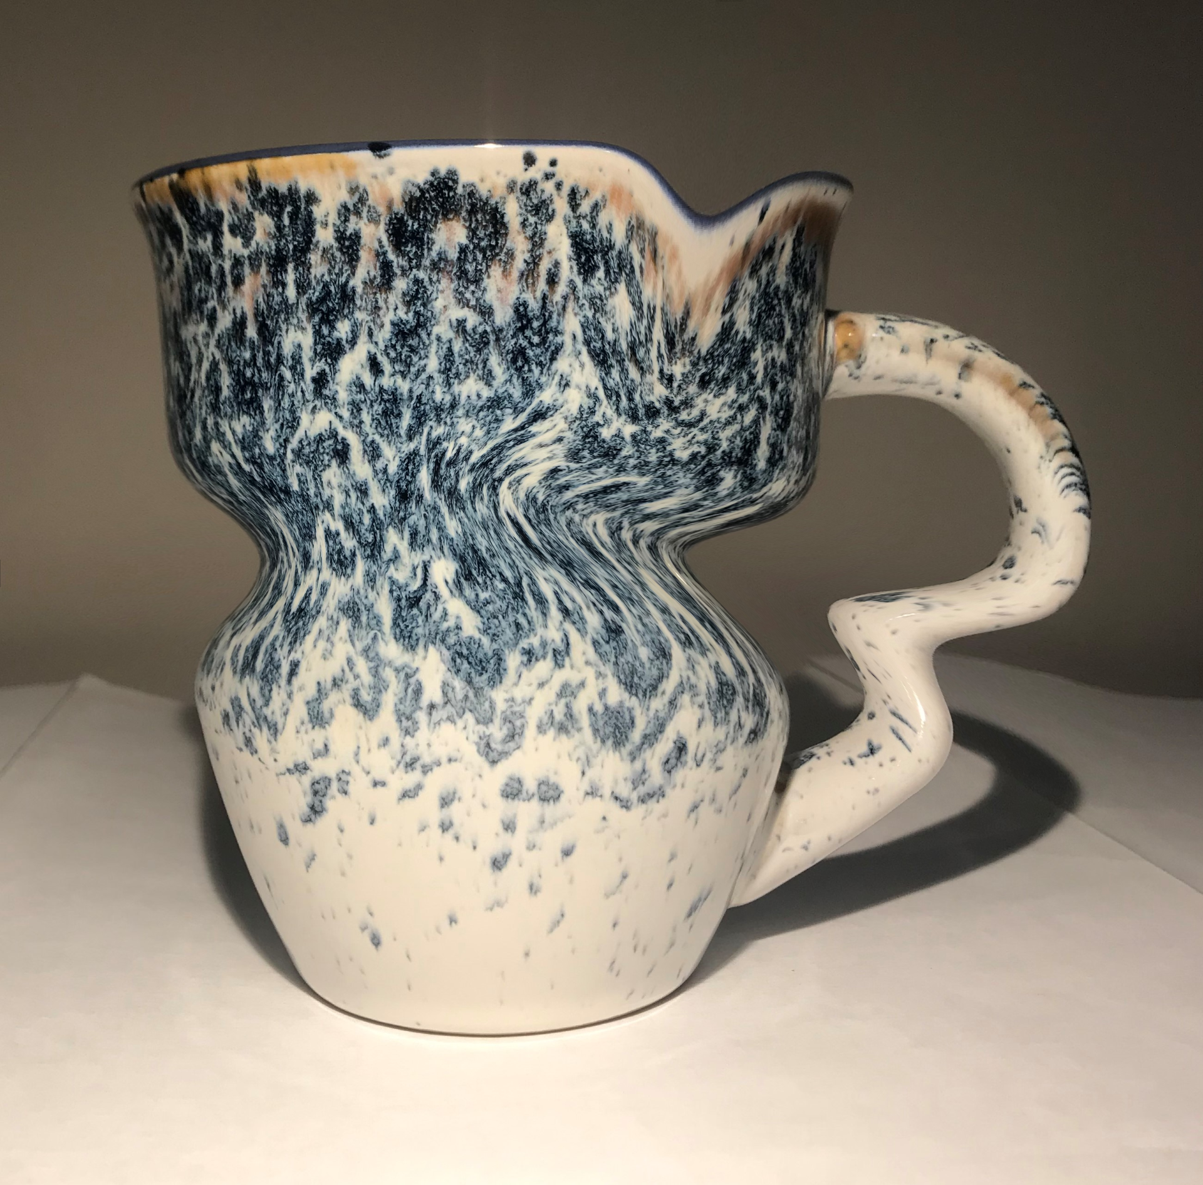
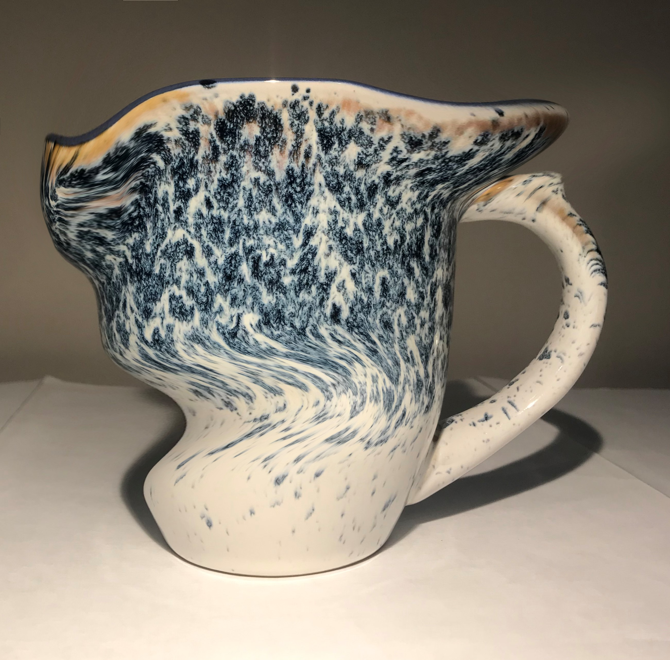
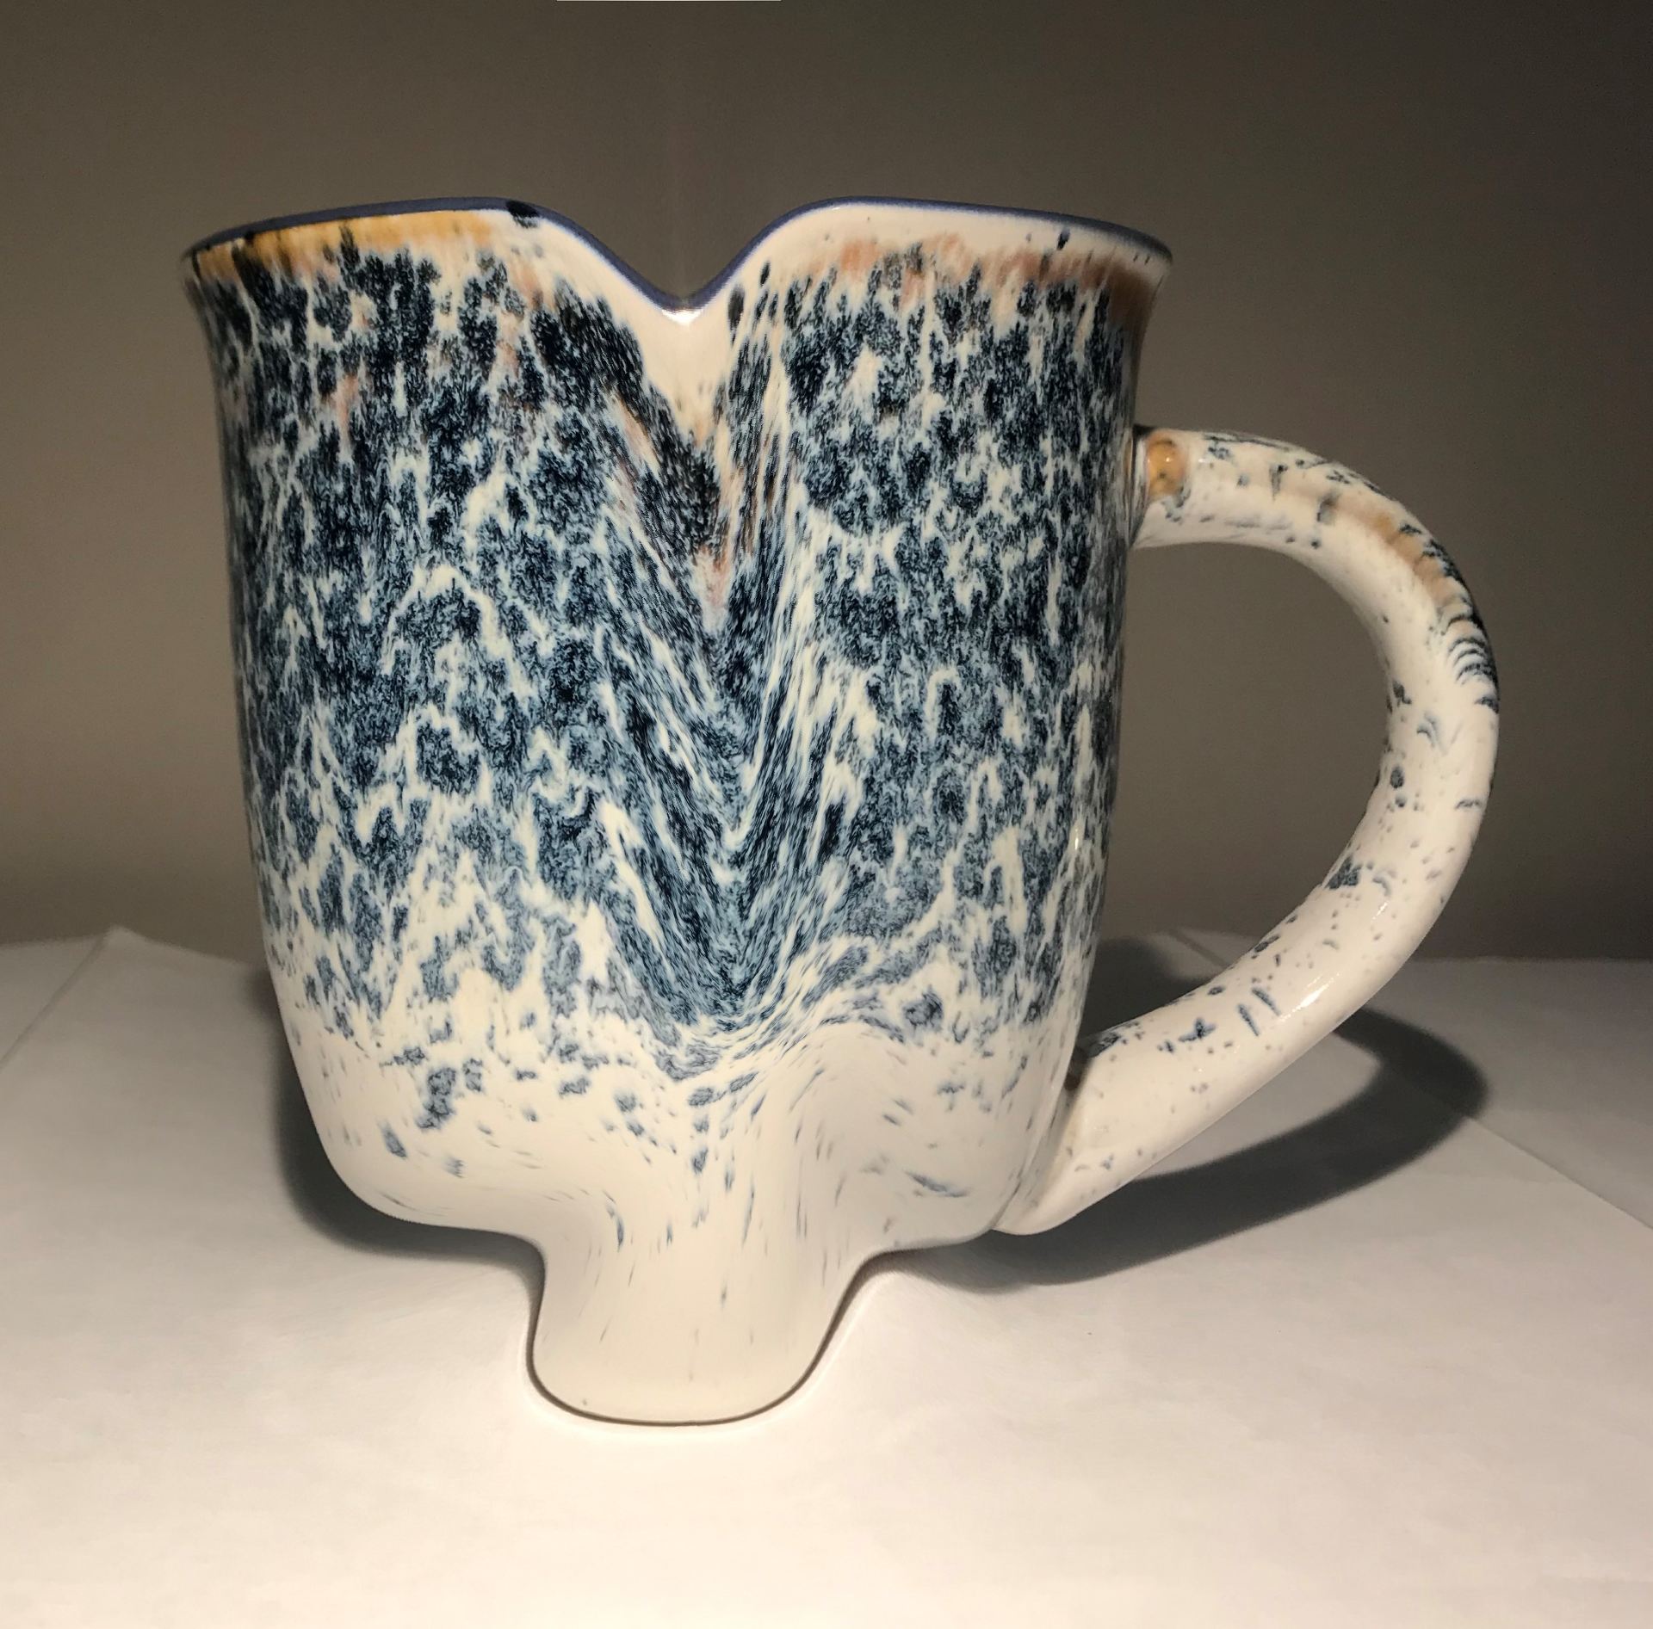
Why is Unwarping Needed?
2 types of distortions
  Static: geometric distortion within an image
  Dynamic: differences in distortion between multiple images
Unwarping aims to deal with the dynamic distortions in the images
Fig. : Distorted images cannot be realigned
Notes:
As Ted just explained, realigning only deals with rigid body transformations, so correcting for movement in the 6 directions, but as if the images were all fixed. It doesn’t account for the fact that the images might be distorted and that the distortion may be different from image to image.
There are two types of distortions, static and dynamic.
Static distortions refer to geometric or spatial distortions and they occur within the image. We’ll talk more about why they occur in the next slide.
Dynamic distortions refer to the different distortion in each image. They are caused by movement between scans means that the distortion for each image is different.
As you can see in the figure to the right, this mug is distorted in different ways across the images, so you can’t align them. The different shapes in each image are the static distortion and the difference in distortions across the images shows the dynamic distortion.
The goal of unwarping is to deal with the dynamic distortions from the images

Slide 19
Heterogeneity in the Magnetic Field
Known as B0
Occurs because different tissue types have different magnetic susceptibilities
Areas most affected are near where air and tissue meet (i.e., sinuses and ear canals)
  Anterior prefrontal cortex, orbitofrontal cortex, and lateral temporal lobes
Causes geometric/spatial distortions in the phase-encoded direction (anterior-posterior axis)
Causes signal dropout
Notes:
So why do static distortions, the geometric/spatial distortions within an image occur? The reason for this is heterogeneity in the magnetic field, which is also known as B0. The strength of the magnetic field is not uniform across the head because different tissue types have different magnetic susceptibilities.
The areas most affected are near where air and tissue meet, such as the sinuses or ear canals. Thinking about neuroanatomy, this means that the anterior prefrontal cortex, orbitofrontal cortex, and lateral temporal lobes are most vulnerable to this distortion.
Specifically, when gradients are applied to encode spatial information in the MRI image, the heterogeneity in the magnetic field results in errors in the location of the structures in the resulting images. This distortion occurs along the phase-encoding direction that’s used by the MRI pulse sequence, which is typically the anterior-posterior, or Y axis. The distortions also make it difficult to align function and structural data.
The heterogeneity in the magnetic field can also cause signal dropout in these particular brain regions. As the name suggests, signal dropout refers to a reduced signal. If we’re interested in these regions susceptible to dropout, we have to be careful to implement acquisition protocols that reduce the dropout and be careful during our analysis so we don’t conclude that a particular region is not involved in the task when actually there’s just no signal in that region because of dropout. This is just a little sidenote about another effect of the heterogeneity in the magnetic field

Slide 20
What does unwarping do?
Deals with dynamic distortion by optimsing the images so that each image in the series is distorted in the same way
Can only be used when the phase-encoded direction is aligned with the anterior-posterior axis
To deal with static distortion (i.e., undistort images to the true geometry), you need to use field maps (voxel displacement map)
Notes:
But back to unwarping, which aims to deal with the distortions.
Rather than removing the distortion, unwarping aims to optimize the images so that each image in the series is distorted in the same way. Therefore, it deals with the dynamic distortion
It is important to note that this function can only be used when the phase-encoded direction is aligned with the anterior-posterior axis
To deal with static distortions, in other words, to undistort the images to the true geometry, you also need to use a fieldmap which I’ll discuss in a little bit

Slide 21
How do we unwarp?
Estimate the subject motion from the realignment step
Find the derivative field, which describes the rate of change of deformation field
  The deformation field quantifies the static distortion, the deformation at each point in the image
Remove the change in deformation (dynamic distortion) and find an average deformation for all scans
Notes:
To perform unwarping, you use the estimate of the subject’s motion from the realignment step
Then, find the “derivative field”, which describes the rate of change of the “deformation field”. The derivative field can be thought of as the dynamic distortion. The deformation field quantifies the static distortion at each point in a single image.
By putting the subject motion and derivate field together, we can remove the change in deformation(or the dynamic distortion) and find an average deformation for all scans.

Slide 22
Field Maps
Characterizes the magnetic field heterogeneity (B0)
Requires acquisition of additional scans
Obtain images at two different echo times
Difference in phase between the images for the calculation of the local field heterogeneity
These values are used to create a map quantifying the distance each voxel has been shifted
Inverting this map allows you to determine the original location of the data in each voxel
Therefore, field maps = voxel displacement maps (VDM)
Notes:
As I said before, unwarping only deals with the dynamic distortion. To deal with static distortion, we have to use a fieldmap.
Fieldmaps characterize the magnetic field heterogeneity, or B0
Require the acquisition of additional scans
They generally work by obtaining images at two different echo times.
The difference in phase between the two images can be used to compute the local field heterogeneity
And these values can then be used to create a map quantifying the distance that each voxel has been shifted.
By inverting this map, you can determine the original location of the data in each voxel.
Therefore, field maps are voxel displacement maps since they tell you how much each voxel has been shifted due to the magnetic field heterogeneity

Slide 23
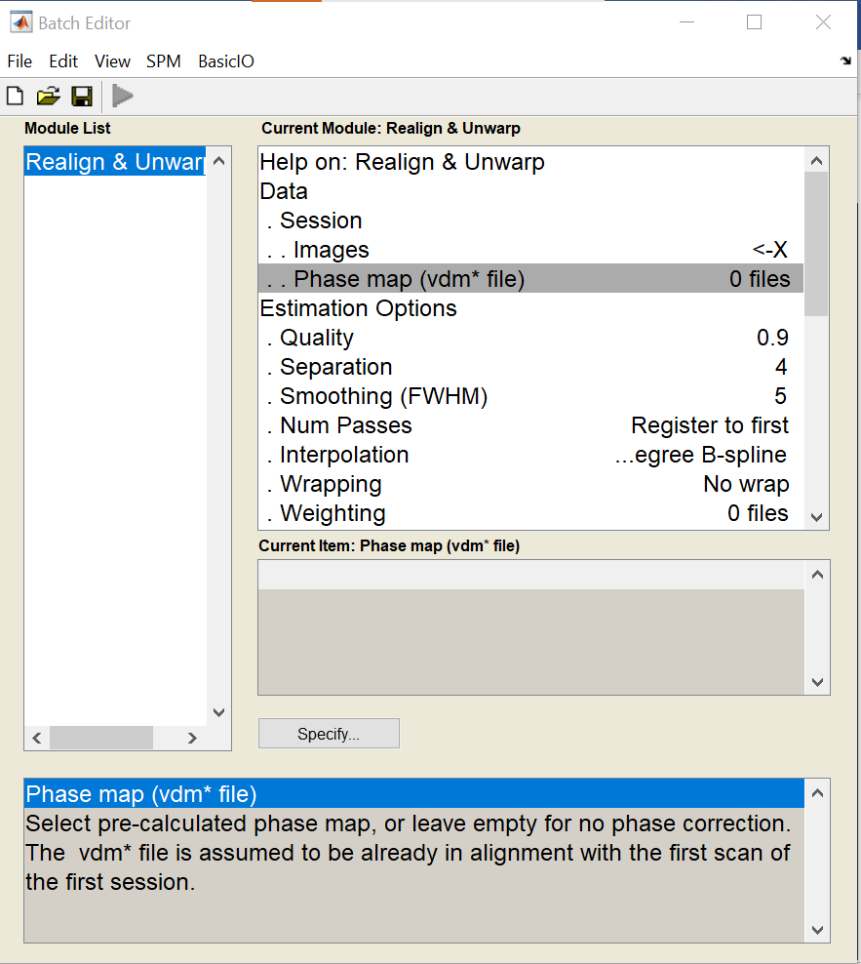
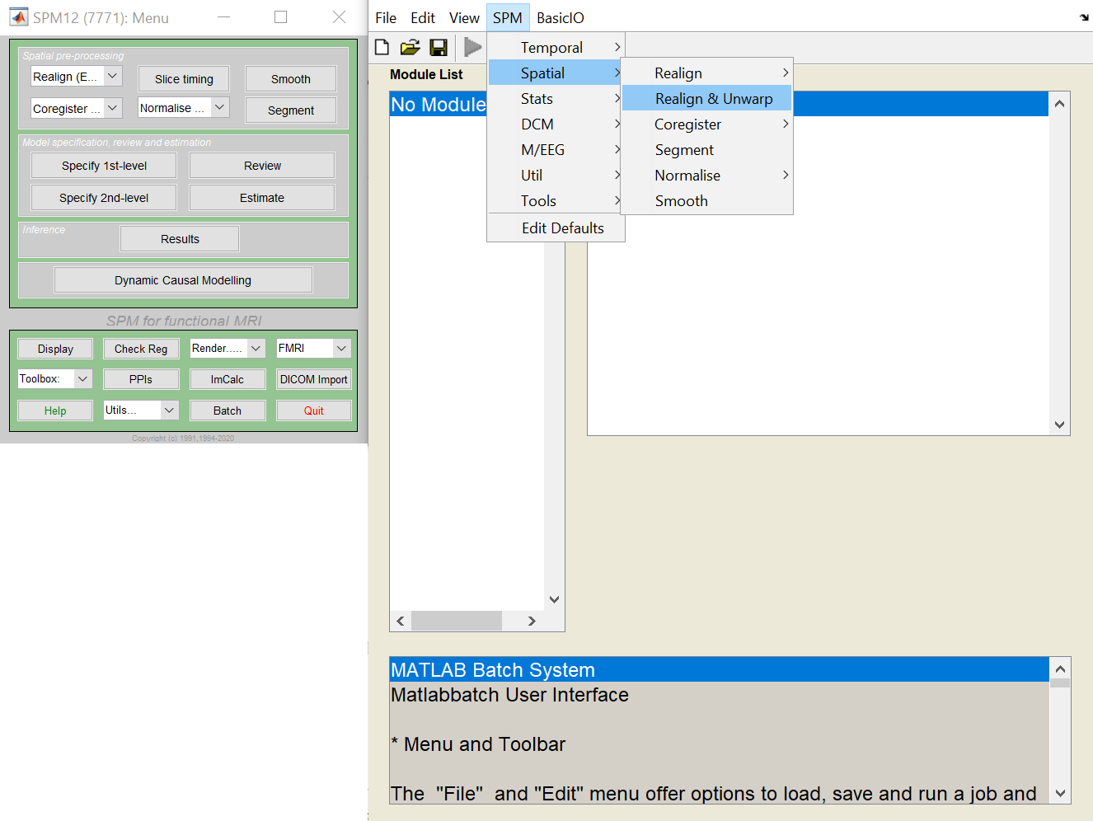
Realign & Unwarp in SPM
A detailed description can be found in SPM12 Manual, Chapter 3, Realign & Unwarp

Slide 24
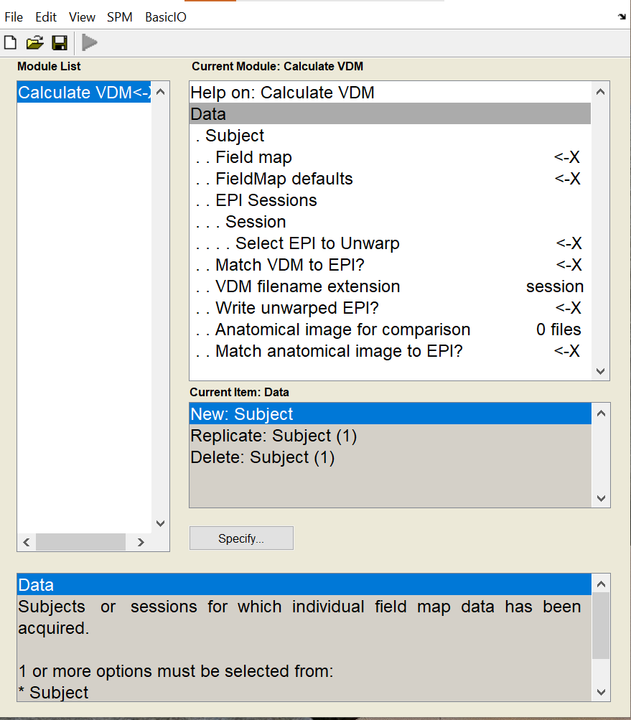
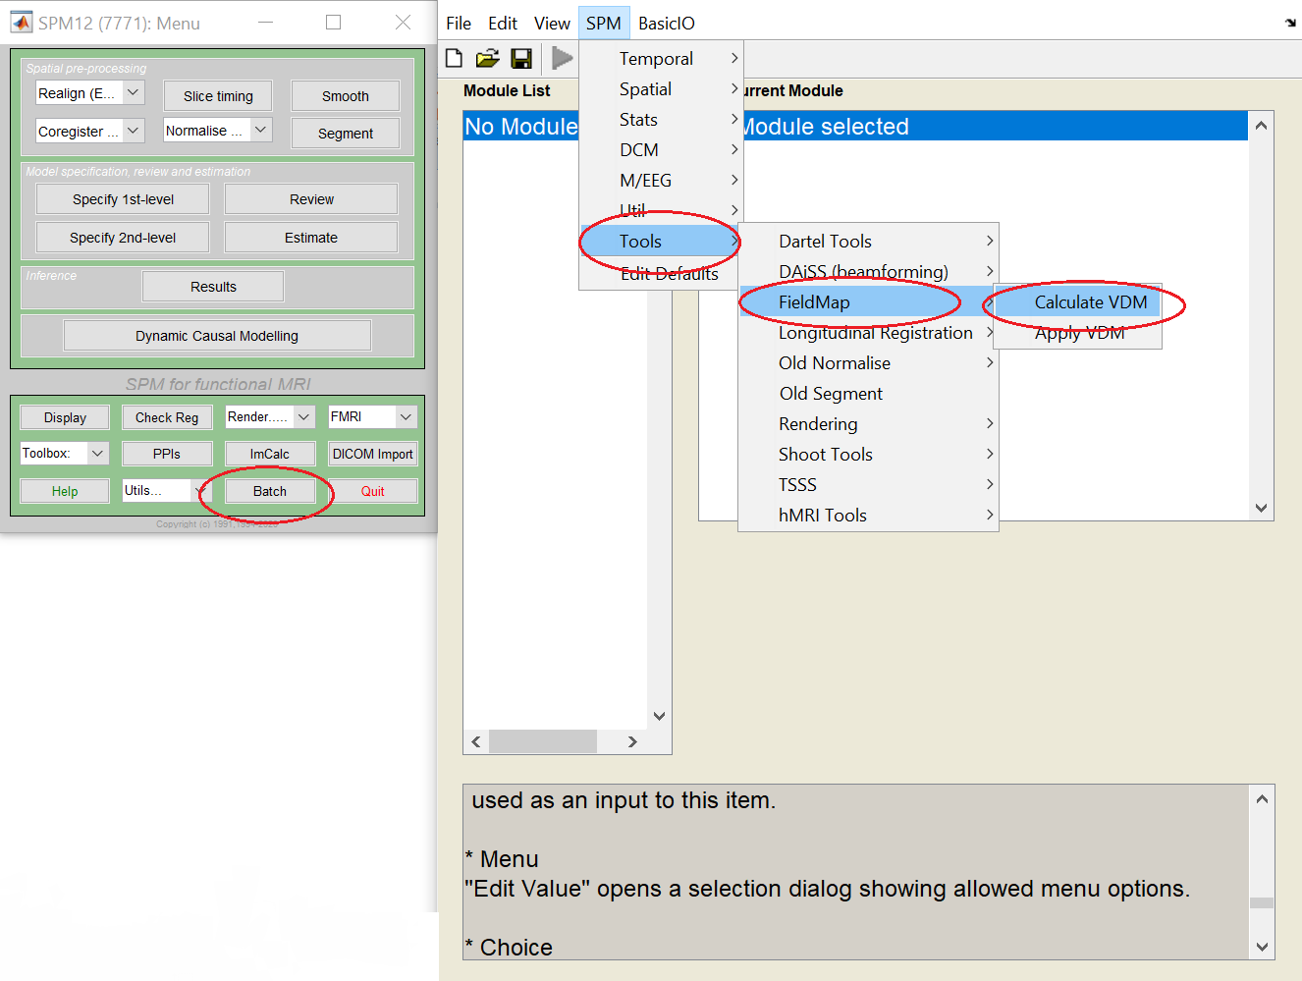
FieldMap Toolbox
Detailed descriptions can be found in the SPM12 Manual, Chapter 24, “FieldMap Toolbox”
Accessing VDM calculation in SPM
Inputs to Calculate VDM in SPM
Notes:
FieldMap toolbox allows for calculating the Voxel Displacement Map that can then be used in Realign & Unwarp toolbox. This allows joint static and dynamic distortion correction. VDM is calculated from the magnitude field map, and phase field map. Phase field map is obtained by subtraction of two phase images and is usually performed by the scanner software.

Slide 25
Useful Resources and References
https://www.fil.ion.ucl.ac.uk/spm/toolbox/unwarp/
https://www.fil.ion.ucl.ac.uk/spm/toolbox/fieldmap/
http://www.fil.ion.ucl.ac.uk/spm/doc/manual.pdf
Andersson JLR, Hutton C, Ashburner J, Turner R, Friston K (2001). Modelling geometric deformations in EPI time series. NeuroImage 13:90-919
Section 3.4 of Chapter 3 “Preprocessing fMRI dara” in Poldrack, Mumford and Nichols’ Handbook of fMRI Data Analyses

