Slide 1

Basis of the M/EEG signal
Methods for Dummies
02.05.2023
Arjun Ramaswamy & Yuxuan Dai

Slide 2

Overview
Introduction and History
Biophysical origin of M/EEG
Why do we use M/EEG?
Measurement of M/EEG

Slide 3
Part 1
Introduction and History
Biophysical origin of M/EEG
Why do we use M/EEG?
Measurement of M/EEG

Slide 4
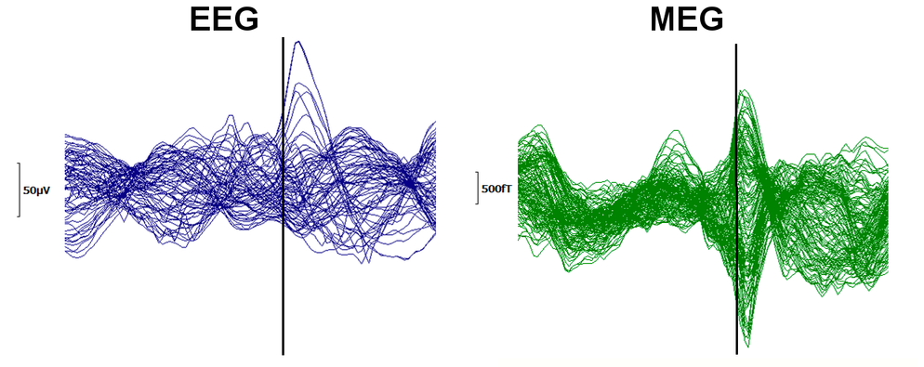
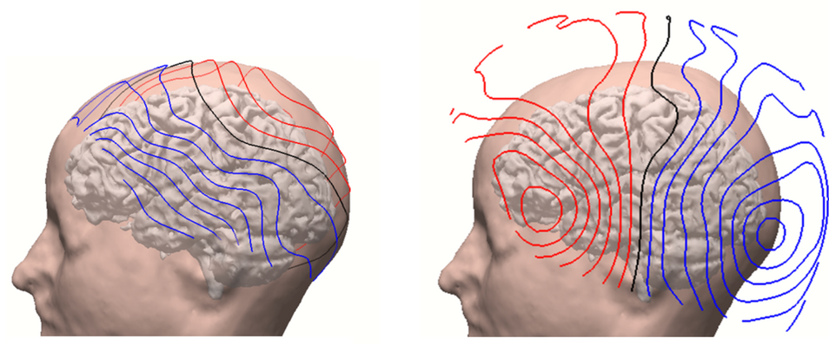
What is M/EEG
Electro
Electric
encephalon
gram
brain
picture
Magneto
Magnetic
Refers to the study of the electric and magnetic fields of the “encephalon” (the brain)
EEG: Measures differences in electric potentials on the scalp (Units: micro Volt)
MEG: Measures changes in magnetic flux density outside of the head (Units: femto Tesla)
EEG and MEG are the most powerful techniques to noninvasively study the electrophysiological dynamics of the brain (Cohen 2017)

Slide 5
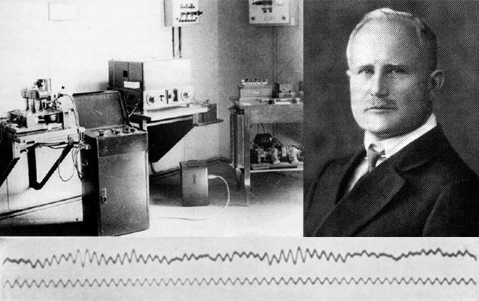
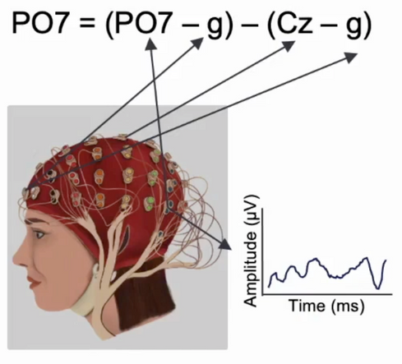
History of Human EEG
  In 1929, Hans Berger developed human EEG, the graphic representation of the difference in voltage between two different cerebral locations plotted over time
  He described the human alpha and beta rhythms
Example calculation:
PO - Parietal Occipital electrode number 7
Cz - Reference electrode (usually forehead)
g - ground electrode (usually the ears)
1929 - EEG Equipment (Left), Hans Berger (Right)
Notes:
The ground is used for common mode rejection. The primary purpose of the ground is to prevent power line noise from interfering with the small biopotential signals of interest. By design, amplifiers should not be affected by large changes in potential at both the active and reference sites. A ground electrode for EEG recordings is often placed on the forehead (but could be placed anywhere else on the body; the location of the ground on the subject is generally irrelevant).
The reference lead is the lead that connects the reference electrode; in EEG recordings, this electrode is usually placed at the ear or, in the case of “summed ears,” to a pair of electrodes, one at each ear. The measured electrical potential differences are ideally the voltage drops from the active electrode (connected to Vin+ on the amplifier) to the reference electrode (connected to Vin- on the amplifier).

Slide 6
Part 2
Introduction and History
Biophysical origin of M/EEG
Why do we use M/EEG?
Measurement of M/EEG

Slide 7
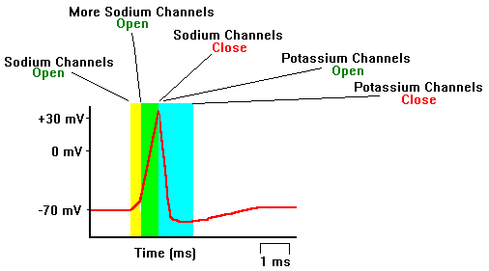
Biophysical origin - What is an action potential?
Rapid, transient, all-or-none current flow from the cell body to the axon terminal of a neuron is known as an action potential (AP)
To be registered by electrodes on the scalp many neurons would need to fire at the same time, which is unlikely given that action potentials lasts around ~1ms
APs are unlikely to contribute to M/EEG
  Action potentials are Biphasic and brief
  Too short
  APs produce electric quadropoles, which their intensity decline steeply with distance (1/r3).
Notes:
The resting potential tells about what happens when a neuron is at rest. An action potential occurs when a neuron sends information down an axon, away from the cell body. Neuroscientists use other words, such as a "spike" or an "impulse" for the action potential. The action potential is an explosion of electrical activity that is created by a depolarizing current. This means that some event (a stimulus) causes the resting potential to move toward 0 mV. When the depolarization reaches about -55 mV a neuron will fire an action potential. This is the threshold. If the neuron does not reach this critical threshold level, then no action potential will fire. Also, when the threshold level is reached, an action potential of a fixed sized will always fire...for any given neuron, the size of the action potential is always the same. There are no big or small action potentials in one nerve cell - all action potentials are the same size. Therefore, the neuron either does not reach the threshold or a full action potential is fired - this is the "ALL OR NONE" principle.
Action potentials are caused when different ions cross the neuron membrane. A stimulus first causes sodium channels to open. Because there are many more sodium ions on the outside, and the inside of the neuron is negative relative to the outside, sodium ions rush into the neuron. Remember, sodium has a positive charge, so the neuron becomes more positive and becomes depolarized. It takes longer for potassium channels to open. When they do open, potassium rushes out of the cell, reversing the depolarization. Also at about this time, sodium channels start to close. This causes the action potential to go back toward -70 mV (a repolarization). The action potential actually goes past -70 mV (a hyperpolarization) because the potassium channels stay open a bit too long. Gradually, the ion concentrations go back to resting levels and the cell returns to -70 mV.

Slide 8
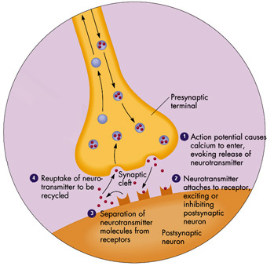
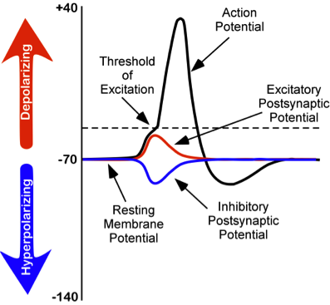
Biophysical origin - What is a post synaptic potential?
After an action potential, neurotransmitters are released
They bind to the receptors of a postsynaptic neuron
Monophasic
Sustained
Scalp EEG is a summation of synchronous, post-synaptic potentials which arise relatively slower than action potentials (~ 10ms).
EPSPs – Excitatory Post Synaptic Potentials
IPSPs – Inhibitory Post Synaptic Potentials
Notes:
Depending on whether the neurotransmitter is excitatory or inhibitory, electrical current flows from the postsynaptic cell to the environment, or the opposite
The membrane of the postsynaptic cell becomes depolarised (more likely to generate an action potential) or hyperpolarised (less likely to generate an action potential)
Excitatory Post-Synaptic Potential (EPSP): influx of positive Na+ ions at apical dendrites causes depolarization of the postsynaptic cell​
Inhibitory Post-Synaptic Potential (IPSP): influx of negative Cl- ions causes hyperpolarization of the postsynaptic cell
Contrary to action potentials, PSPs are longer in duration, can have different amplitudes and can be positive or negative amplitude
Note that you cannot tell from the EEG or MEG measurement whether you are recording EPSP or IPSP

Slide 9
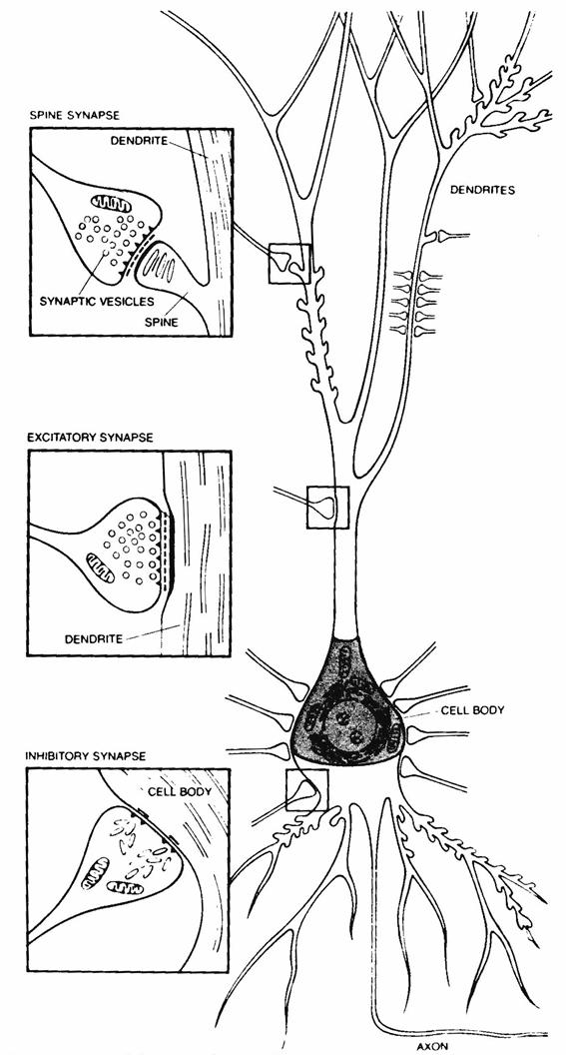
Biophysical origin – Neuronal Current
When an EPSP is generated in the dendrites of a neuron, Na⁺ flow inside the neuron’s cytoplasm creating a current sink.
The current completes a loop creating a dipole further away from the excitatory input (where Na⁺ flows outside the cell as passive return current), which can be recorded as a positive voltage difference by an extracellular electrode.
Large numbers of vertically oriented, neighboring pyramidal neurons create these field potentials.
Thus, EEG detects summed synchronous activity (PSPs) from many thousands of apical dendrites of neighbouring pyramidal cells (mainly).
-
+

Slide 10
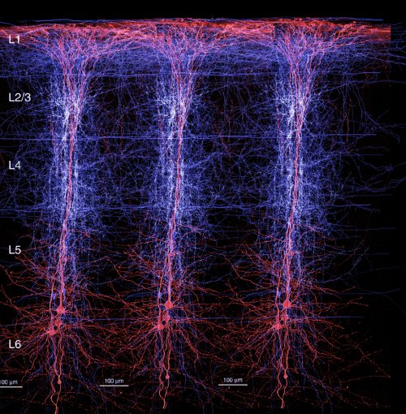
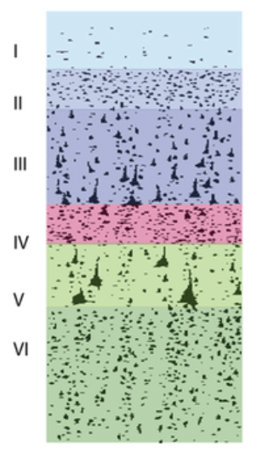
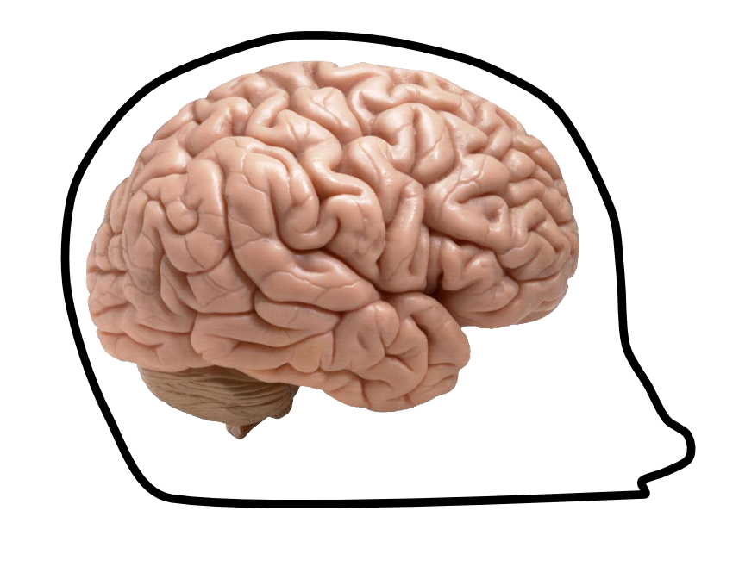
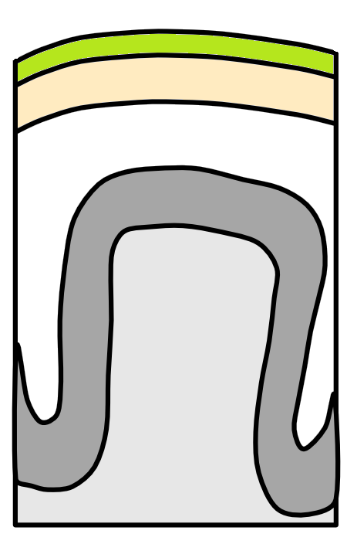
Biophysical origin - post synaptic potential (PSP)
Scalp
Skull
CSF
Spocter et al, (2017)
Cortex
White matter
Notes:
Pyramidal neurons, the major projection neurons in the cortex, make up majority of the EEG signal (particularly layers III, V and VI), because they are uniformly orientated with dendrites perpendicular to the cortical surface, long enough to form dipoles.
The EEG signal results mainly from the postsynaptic activity of the pyramidal neurons
The thalamus acts as the pacemaker ensuring synchronous rhythmic firing of pyramidal cells.
Activity from deep sources is harder to detect as voltage fields fall off as a function of the square of distance.

Slide 11
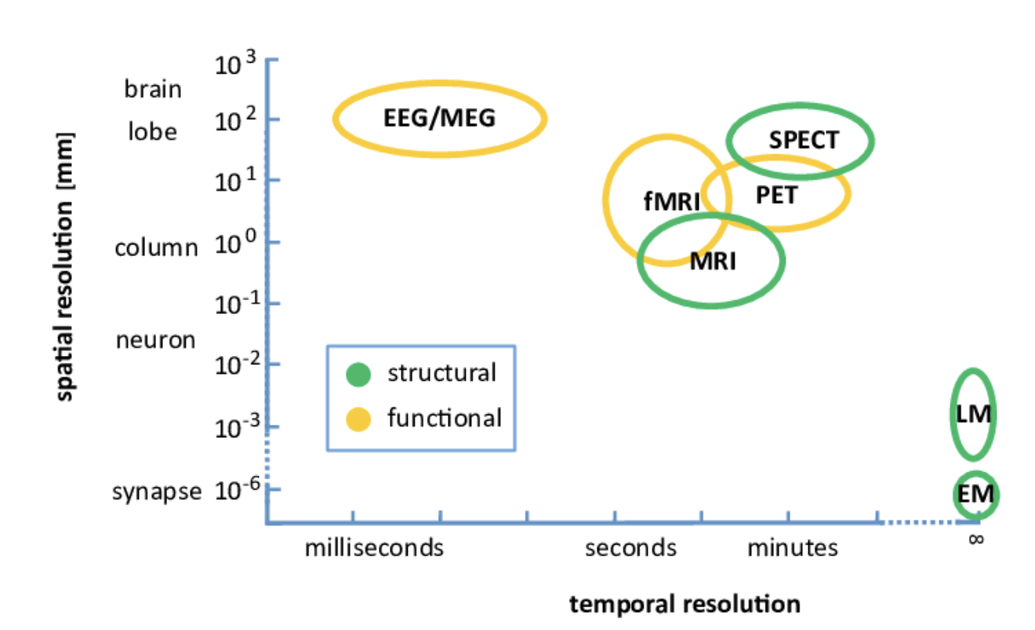
Across brain imaging modalities : spatial vs. temporal resolution

Slide 12
Part 3
Introduction and History
Biophysical origin of M/EEG
Why do we use M/EEG?
Measurement of M/EEG

Slide 13
Why do we use EEG
EEG is used to evaluate several types of brain disorders. When epilepsy is present, seizure activity will appear as rapid spiking waves on the EEG.
People with lesions of their brain, which can result from tumors or stroke, may have unusually slow EEG waves, depending on the size and the location of the lesion.
The test can also be used to diagnose other disorders that influence brain activity, such as Alzheimer's disease, certain psychoses, and a sleep disorder called narcolepsy.
The EEG may also be used to determine the overall electrical activity of the brain (for example, to evaluate trauma, drug intoxication, or extent of brain damage in comatose patients). The EEG may also be used to monitor blood flow in the brain during surgical procedures.

Slide 14
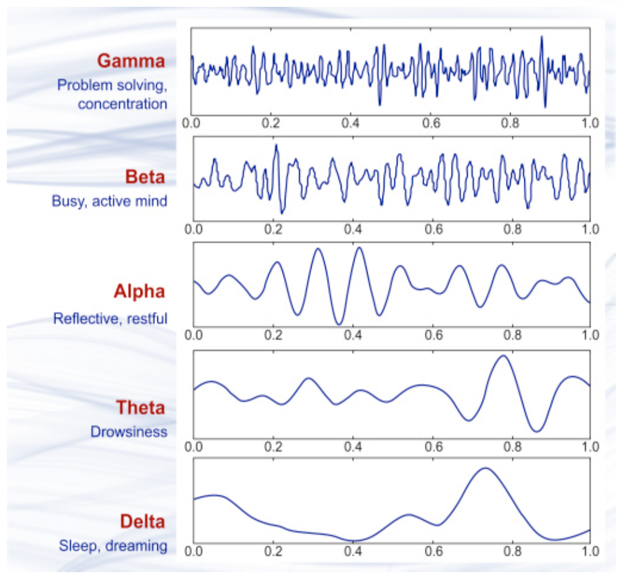
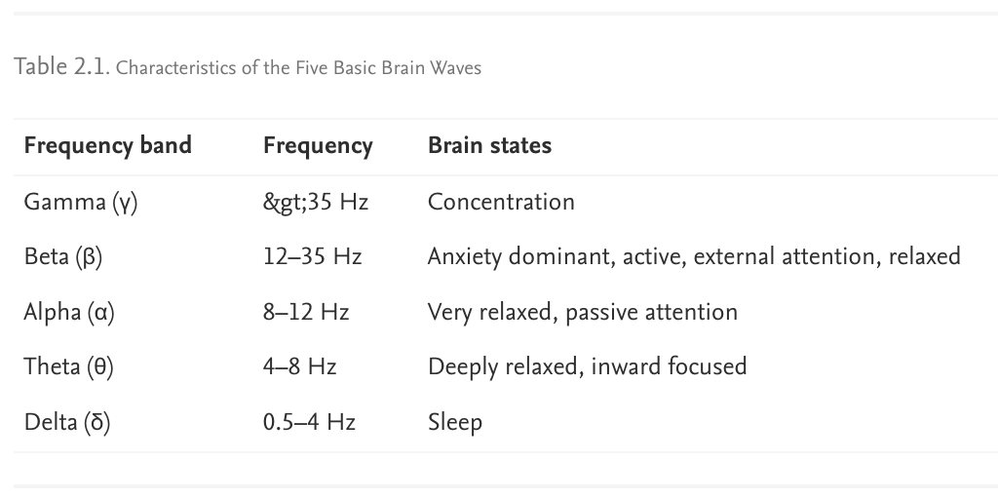
EEG Rhythms
Brain wave samples for different waveforms
Brain waves are oscillating electrical voltages in the brain measuring just a few millionths of a volt. There are five widely recognized brain waves, and the main frequencies of human EEG waves are listed below.

Slide 15
Part 4
Introduction and History
Biophysical origin of M/EEG
Why do we use M/EEG?
Measurement of M/EEG

Slide 16
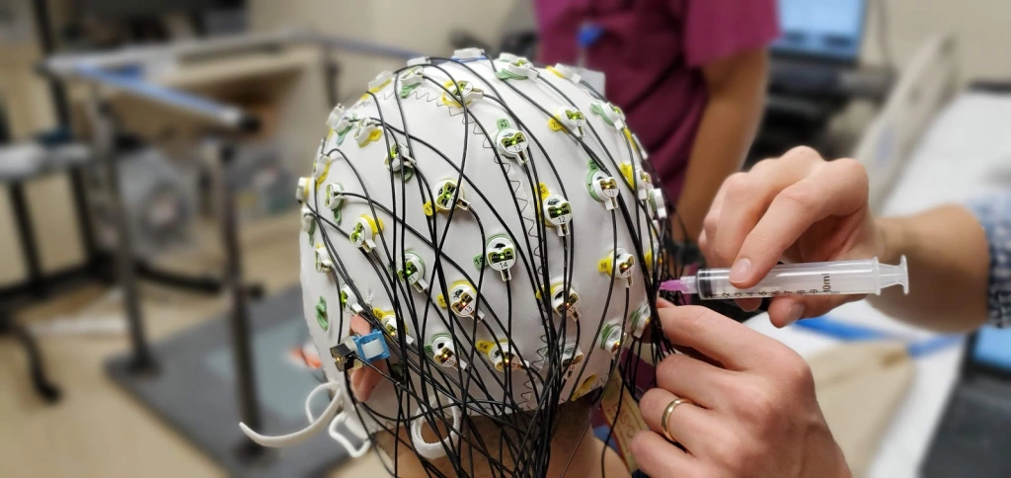
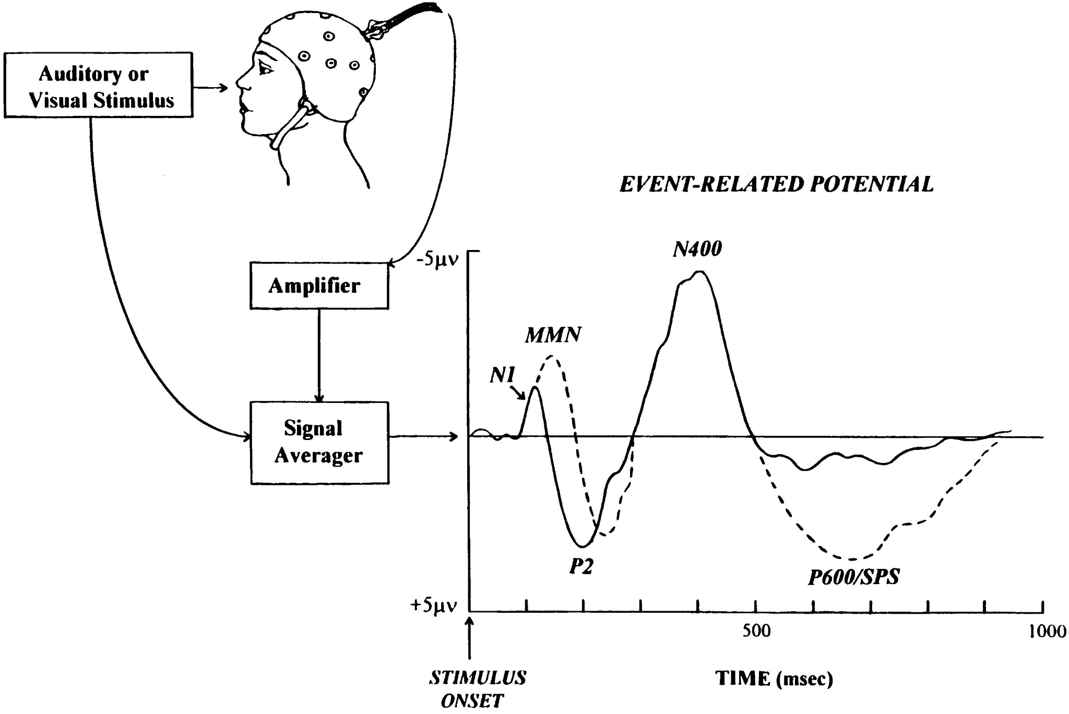
EEG Acquisition
Electrodes: Usually made of silver (or stainless steel) – active electrodes placed on the scalp using a conductive gel or paste. Signal-to-noise ratio (impedance) reduced by light abrasion. Can have 32, 64,128, 256 electrodes. More electrodes = richer data set. Reference electrodes (arbitrarily chosen “zero level”, analogous to sea level when measuring mountain heights) commonly placed on the midline, ear lobes, nose, etc.
Amplification: i.e. there is one amplifier per pair of electrodes. The amplifier amplifies the difference in voltage between these two electrodes, or signals (usually between 1000 and 100 000 times). This is usually the difference between an active electrode and the designated reference electrode.

Slide 17
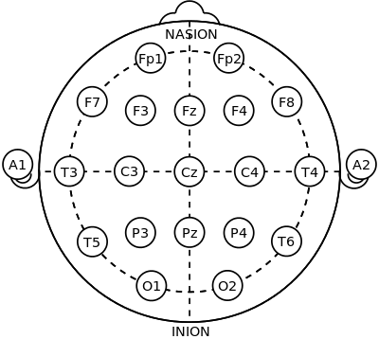
EEG Signal Detection
EEG records potential differences at the scalp using a set of active electrodes and a reference (ground) electrode.
The reference electrode is important as it eliminates noise from the amplifier circuit
The representation of the EEG channels is referred to as a montage
•Unipolar/Referential: potential difference between an electrode and a designated reference
•Bipolar: represents the difference between a pair of adjacent electrodes
Potential differences are amplified, filtered and digitized.
Notes:
Familiarity with the nomenclature of EEG is important prior to commencing interpretation. which demonstrates the standard International 10-20 electrode site placement strategy. The nomenclature “10-20” represents standard intervals of measurement of either 10 or 20 percent for positioning electrodes over the anterior–posterior dimension between the nasion (point at the bridge of the nose) and inion (prominent bump on the back of the head representing lowest point of the skull), and between the auricular (ear) positions. Each electrode site is represented with a letter and a given number. The letter represents which lobe of the brain the electrode site overlies (i.e., F is frontal, T is temporal, P is parietal, and O is occipital). Odd-numbered electrode sites are on the left side of head, even-numbered electrodes are on the right side, “z”-labeled sites are in the midline from anterior to posterior, and “A” or auricular sites are on the mastoid processes/ears.

Slide 18
Basis of MEG
Notes:
Familiarity with the nomenclature of EEG is important prior to commencing interpretation. which demonstrates the standard International 10-20 electrode site placement strategy. The nomenclature “10-20” represents standard intervals of measurement of either 10 or 20 percent for positioning electrodes over the anterior–posterior dimension between the nasion (point at the bridge of the nose) and inion (prominent bump on the back of the head representing lowest point of the skull), and between the auricular (ear) positions. Each electrode site is represented with a letter and a given number. The letter represents which lobe of the brain the electrode site overlies (i.e., F is frontal, T is temporal, P is parietal, and O is occipital). Odd-numbered electrode sites are on the left side of head, even-numbered electrodes are on the right side, “z”-labeled sites are in the midline from anterior to posterior, and “A” or auricular sites are on the mastoid processes/ears.

Slide 19
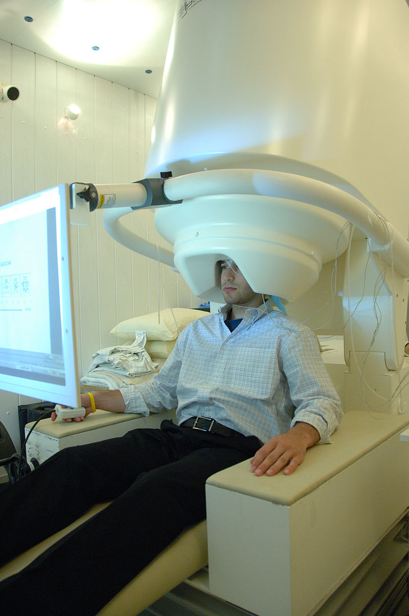
Intro to MEG
MEG stands for Magnetoencephalography
measure small magnetic fields produced by changes in the electrical activity within the brain
millisecond
direct and non-invasive
Magnetic field measurements are in the range of femto-tesla to pico-tesla
The magnetic field passes unaffected through brain tissue and the skull, so it can be recorded outside the head
Usages:
find the neuronal sources within the brain
clinical practice (epilepsy)
https://en.wikipedia.org/wiki/Magnetoencephalography
Notes:
MEG stands for Magnetoencephalography, which is a neuroimaging equipment that can measure small magnetic fields produced by changes in the electrical activity within the brain and therefore record brain signals. MEG is able to measure brain activity at millisecond-by-millisecond basis, has its own advantages of being a direct and non-invasive neuroimaging technique. The measurements scale of it is in the range of femto-tesla to pico-tesla. Unlike electrical signal, magnetic field can pass unaffectedly through brain tissue and the skull, so it can measure changes in magnetic flux density outside of the head and provide potentially better spatial resolution compared to EEG.
MEG has many different usages and is widely applied in fields like neuroscience or medicine. For example, it can be used to find the neuronal sources within the brain, or used for clinical practice, such as localising affected areas before surgery.

Slide 20
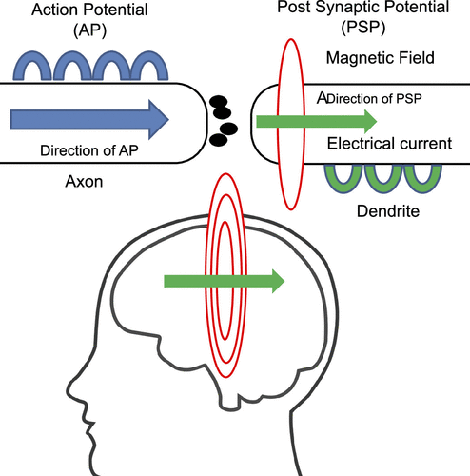
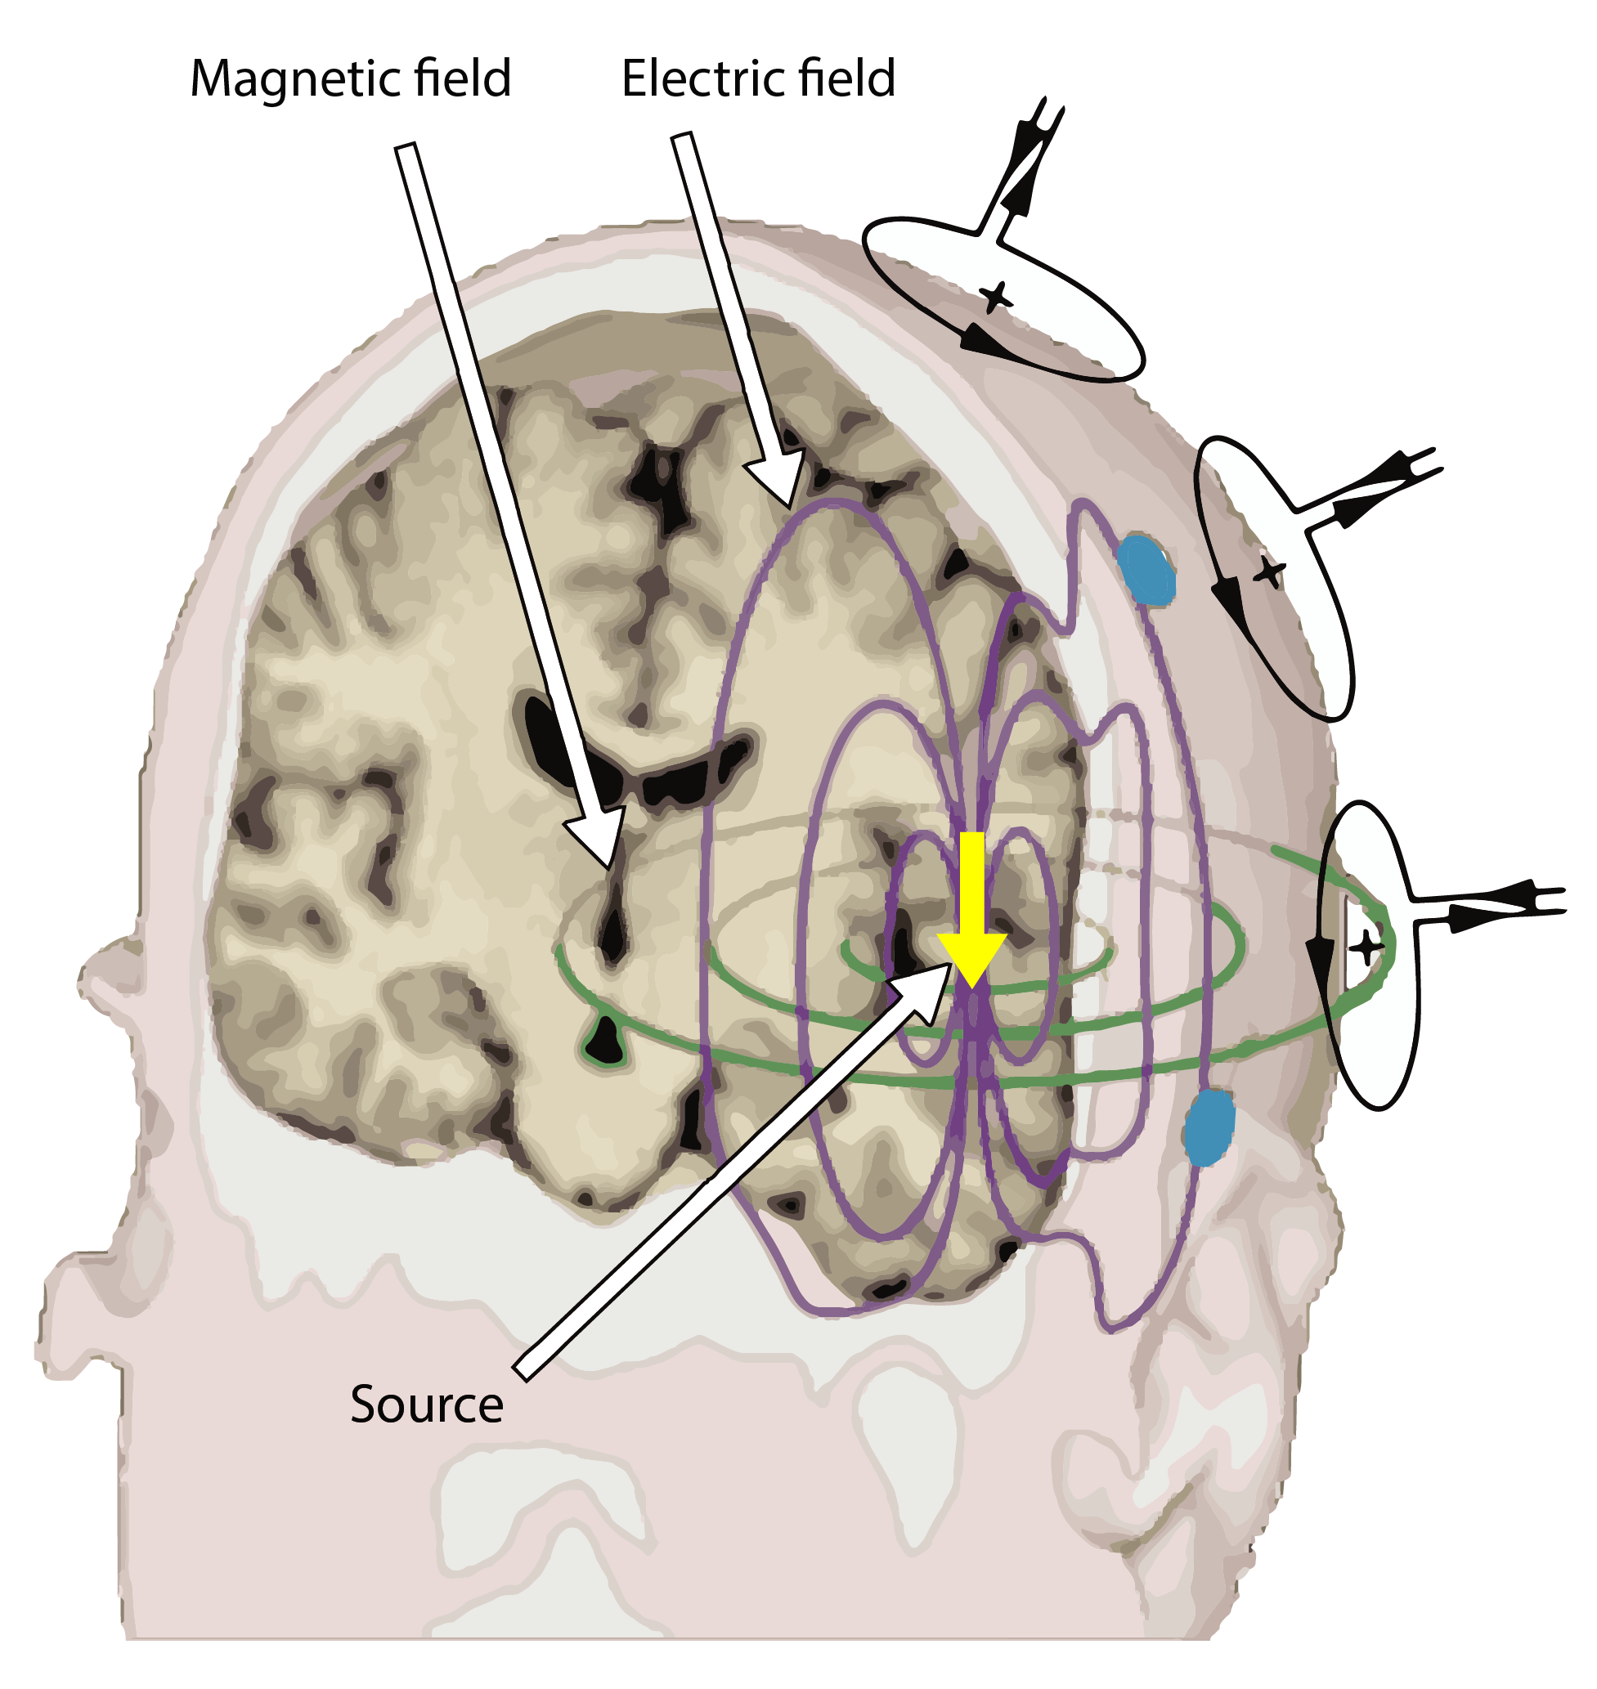
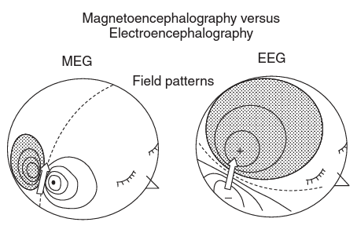
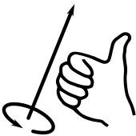
Biophysical origin of MEG
The basic physics principle: moving current creates a magnetic field based on the right hand rule
MEG magnetic field is not affected by the various properties of the scalp and head as it is with the EEG signal
right hand rule
Notes:
First we will talk about the biophysical origin of MEG. The basic physics principle of MEG measurements is actually quite simple: moving current can create a magnetic field based on the right hand rule. In previous section we already explained the mechanism of electrical current produced by neurons. If we recall the right hand rule again, magnetic field is generated perpendicular to electric field. The lower middle graph shows schematically the magnetic and electric fields caused by a current dipole in a head approximated as a spherical conductor. Both fields are dipolar but are rotated by 90° with respect to each other. Moreover, since magnetic field wouldn’t be distorted by scalp or skull, it is possible to record MEG signals outside the skull.

Slide 21
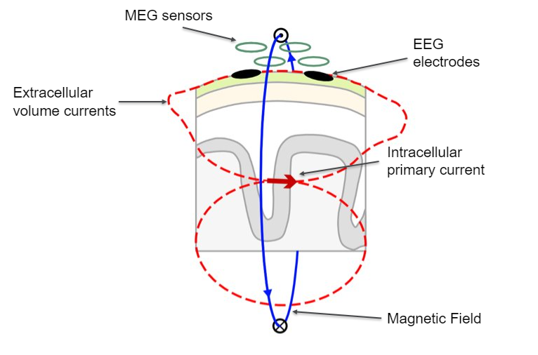
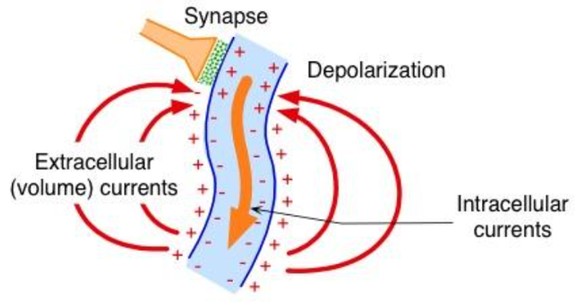
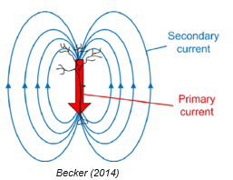
Primary vs. Secondary current
Magnetic fields are mainly induced by primary currents whereas electric fields are mainly sensitive to secondary (volume) currents
Magnetic field is generated perpendicular to electric field, from both the primary and secondary currents
Notes:
Same as EEG, MEG also measures the postsynaptic potential (PSP) of neurons instead of action potential, whereas it detects the magnetic fields mainly induced by intracellular currents. This is because intracellular currents are more concentric, indicating they’re capable of producing larger magnetic fields. Ion current goes out of neurons, and flows in the conductive brain. The extracellular current is called volume current or secondary current while the intracellular current, converted from the chemical energy stored in the cell, is called impressed current or primary current. Secondary currents are generated by the primary currents along the dendrites of neurons to complete the loop of ionic flow.
As electric fields are mainly sensitive to secondary (volume) currents, magnetic fields are mainly induced by primary currents. However, since both the primary and secondary currents can create magnetic field, which means MEG signal can come from both sources.

Slide 22
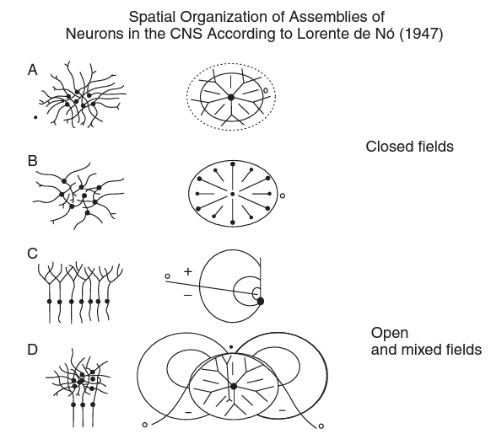
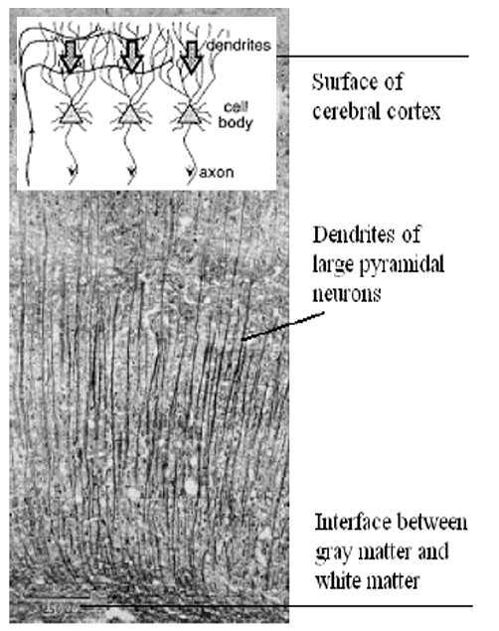
Geometry of neurons
Pyramidal cells!
A large number of neurons have to be active simultaneously to generate a measurable M/EEG signal
  ~ 50,000 neurons
Neurons that give the main contribution to the MEG or the EEG are those that form “open fields”
Notes:
However, magnetic field produced by single neuron is extraordinarily small, to generate a signal that is detectable, approximately 50,000 active neurons are needed.
Apart from the number of neurons, the geometry of the neuronal sources of electrical activity that gave rise to MEG signal should be taken into consideration. The neurons that give the main contribution to the MEG or the EEG are those that form “open fields”. And One of the most ideal candidates is pyramidal neurons. Arranged in palisades with the apical dendrites aligned perpendicularly to the cortical surface, pyramidal cells producing longitudinal intracellular currents flow along dendrites or axons, pyramidal cells generate coherent open magnetic fields when activated with a certain degree of synchrony. We may say that these neurons behave as “current dipoles” in wires, the activity of which can be detected by sensors placed at a small distance from the skull.

Slide 23
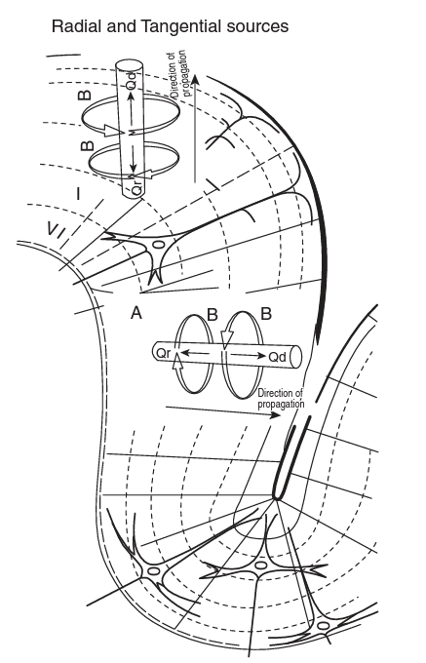
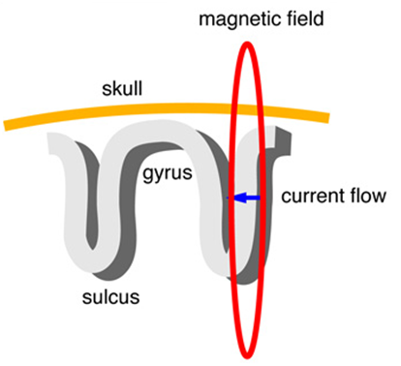
Radial vs. Tangential sources
MEG “sees” only those magnetic fields that have a component perpendicular to the skull.
sensitive to magnetic fields generated by neuronal currents that have a component oriented tangentially to the skull
less sensitive to radial dipoles
But in practice, only a small proportion (<1%) of cell populations are perfectly radial – i.e. on top of gyri
radial
tangential
Notes:
From neurons to larger nervous system structure, we need to also consider the folding of cortex. The fact that the cortex is folded, forming gyri and sulci, implies that some populations of neurons have apical dendrites that are perpendicular to the overlying skull, i.e., those that are at the top of a gyrus; whereas others are parallel to the skull, i.e., those that are on the wall of a sulcus. In fact, MEG “sees” only those magnetic fields that have a component perpendicular to the skull. It is sensitive to magnetic fields generated by neuronal currents that have a component oriented tangentially to the skull, but less sensitive to radial dipoles. Currents that are oriented perfectly radially to the skull do not generate a magnetic field outside the head, therefore “invisible” to MEG. Luckily, in practice, only a small proportion (<1%) of cell populations are perfectly radial – i.e. on top of gyri

Slide 24
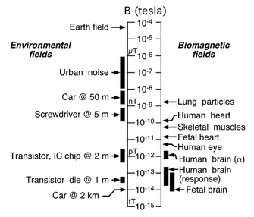
Measurement of MEG Signal
Magnetic fields created by the brain are extremely small!
  do not exceed a few hundred femto tesla (10⁻¹⁵ T)
  Earth's magnetic field: 10⁻⁴ ~ 10⁻⁵ T
  MRI: 1.5-3 T
Interfering noise
  electrical equipment
  urban environment
  participant’s heartbeat or muscle
Two basic issues:
  how to record these small magnetic fields
  how to shield out the earth's relatively stronger magnetic fields
Notes:
We mentioned before that magnetic field produced by single neuron is extraordinarily small. However, even with more than hundreds of thousands neurons firing synchronously, magnetic fields created by the brain are still extremely small. It do not exceed a few hundred femto tesla (10⁻¹⁵ T), while Earth's magnetic field is between 10⁻⁴ to 10⁻⁵ T. Moreover, there are various of external noise that can interfere the measurement. Such as electrical equipment, urban environment(like the subway), even participant’s own heartbeat or muscle movements. Thus, two basic issues have been proposed: one is how to record these small magnetic fields, the other is how to shield out the earth's relatively stronger magnetic fields

Slide 25
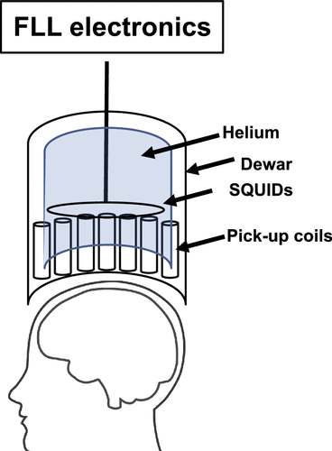
Measurement of MEG Signal: SQUIDS
superconducting quantum interference devices (SQUIDs)
SQUIDs are made from materials that become superconductors at extremely low temperatures, meaning that the material can conduct electricity without resistance
A highly sensitive magnetic field meter
> 300 SQUID sensors
Cryogenic
kept in a superconducting state by liquid helium at ∼4 K (approximately −269°C)
flux-locked loop
Notes:
To address the first issue, we introduce one special device called SQUID. SQUID stands for superconducting quantum interference device, which is an equipment made from materials that become superconductors at extremely low temperatures, meaning that the material can conduct electricity without resistance. It can be viewed as a highly sensitive magnetic field meter, capable of picking of small magnetic field changes produced by brain.
Each MEG typically contains more than 300 SQUID sensors. As a superconducting device, SQUID is cryogenic, kept in a superconducting state by liquid helium at ∼4 K (approximately −269°C)
A circuit diagram of the MEG instrument is shown on the left. Signal first was detected by pick-up coil, which is much larger in diameter than the SQUID to increase the efficiency of detection → Pick-up coils are linked to the SQUID by an input coil →SQUIDs then produce a small voltage current that can be detected through what is called a flux-locked loop (FLL) electronics system → The electrical output can then be transformed into a digital signal through optical cables.
??“Another feature that distinguishes the SQUID from a conventional superconductor is the presence of one or more Josephson junction (depending on the type of SQUID). The Josephson junction consists of two superconductors separated by an insulating barrier and is essential for the Josephson effect to occur inside the SQUID (13). ”??

Slide 26
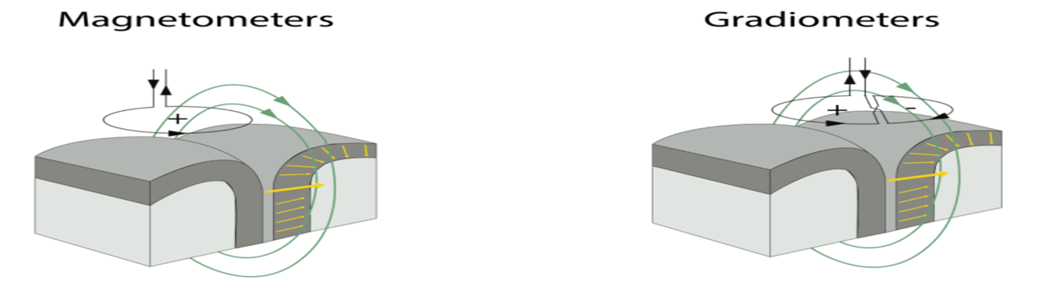
Measurement of MEG Signal: pick-up coils
provide the best signal and are most sensitive to shallow and deep brain sources but are more prone to picking up outside noise
less sensitive to outside noise
two types of gradiometers: axial and planar
  axial: sensitive at measuring deep sources (∼5 times the signal strength on 8-cm depth sources)
  planar: more sensitive at measuring the shallow sources
Notes:
There are two types of pick-up coils currently used in MEG systems: the magnetometer and the gradiometer. Among the two types of coils, magnetometers have superior sensitivity to detect shallow and deep sources but they are more prone to picking up outside noise. Thus, magnetometers are most optimal in settings with limited sources of outside noises (i.e., countryside laboratory with no traffic and electrical interference). In contrast, gradiometers are less sensitive to outside noise, which makes them the superior option in locations with a number of large-sized electronical devices (e.g., a busy hospital). There are also two types of gradiometers: axial and planar.

Slide 27
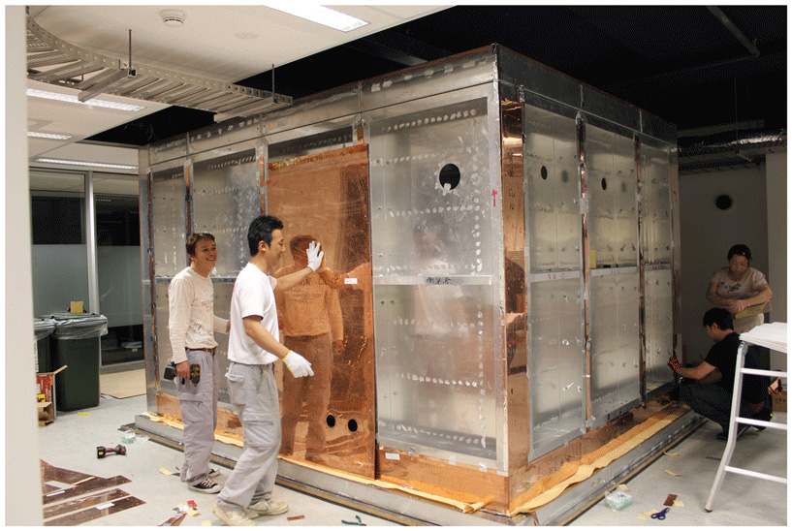
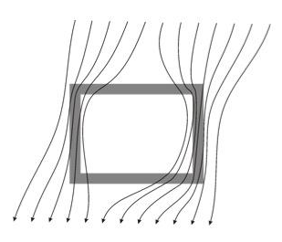
Magnetically shielded room (MSR)
The primary means of reducing external magnetic interference is to perform MEG recordings inside a magnetically shielded room (MSR)
Concentric shells of multiple layers of copper mu-metal and aluminium
external magnetic field “bends” around of MSR
Notes:
As for the other issue, to deal with the external magnetic noise, MEG is usually housed inside a magnetically shielded room. A typical MSR contains concentric shells of multiple layers of copper mu-metal and aluminium, capable of reducing both high-frequency and low-frequency noise. The conceptual graph shown at the lower right describes how external magnetic field “bends” around of MSR.

Slide 28
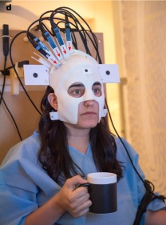
OPMs
A new generation of MEG
optically pumped magnetometers (OPMs) – also known as atomic magnetometers
Increased signal sensitivity
  closer to the scalp: not cryogenic
but…
  higher sensor noise
  less sensors
freedom of participant mobility during scanning
Boto et al. (2018)
Notes:
In the end, we want to quickly mention a new generation of MEG called OPM. OPM stands for optically pumped magnetometers, also known as atomic magnetometers, has overcome many of the limitations of SQUID-MEG systems. OPM-MEG is not cryogenic, which means it can be placed closer to the scalp, resulting in up to five times the sensitivity to cortical sources (albeit with an increased noise floor) compared to conventional SQUID systems. It’s also more portable compared to SQUID-MEG, allowing participants to move freely during the scanning process. Though sensors from OPM-MEG can also potentially increase signal sensitivity, they’re also much noisy compared to SQUID-MEG. Furthermore, OPM-MEG has less sensors compared to SQUID-MEG. Therefore, the comparison between OPM-MEG and SQUID-MEG can be controversial.

Slide 29
MEG vs. EEG
EEG | MEG
10 mV (easily detectable) | 10 fT (magnetic shielding required)
Secondary currents | Primary currents (dominantly) and secondary currents
Distortion by skull/scalp | Signal unaffected by skull/scalp
~1ms | ~1ms
Poor spatial resolution~1cm | Potentially good spatial resolution 2-3 mm
Moves with subject | Movement incompatible (cryogenic MEG)
Cheap, widely available | Expensive, limited availability
Sensitive to both tangential and radial sources (gyri and sulci) | Sensitive mainly to superficial tangential sources (cortical sulci)
Notes:
To summarize the content of today’s MfD, we would like to compare these two methods. First, from signal amplitude perspective, …; as for the measurement, …; If we look at the signal purity, …; For temporal and spatial resolution, …; In practice, EEG can move with subjects and is cheaper, whereas MEG is movement incompatible and highly expensive. EEG is sensitive to both tangential and radial sources (gyri and sulci) and can detect deep and shallow dipole, while MEG is sensitive mainly to superficial tangential sources.

Slide 30
Thank you for listening. We are happy to answer any questions!

Slide 31
References
https://en.wikipedia.org/wiki/Magnetoencephalography
http://web.mit.edu/kitmitmeg/whatis.html
https://ilabs.uw.edu/what-magnetoencephalography-meg/
Boto, E., Holmes, N., Leggett, J., Roberts, G., Shah, V., Meyer, S. S., Muñoz, L. D., Mullinger, K. J., Tierney, T. M., Bestmann, S., Barnes, G. R., Bowtell, R., & Brookes, M. J. (2018). Moving magnetoencephalography towards real-world applications with a wearable system. Nature, 555(7698), Article 7698. https://doi.org/10.1038/nature26147
Cohen, D. (1972). Magnetoencephalography: Detection of the Brain’s Electrical Activity with a Superconducting Magnetometer. Science, 175(4022), 664–666.
da Silva, F. H. L. (2010). Electrophysiological Basis of MEG Signals. In P. Hansen, M. Kringelbach, & R. Salmelin (Eds.), MEG: An Introduction to Methods (p. 0). Oxford University Press. https://doi.org/10.1093/acprof:oso/9780195307238.003.0001
Hämäläinen, M., Hari, R., Ilmoniemi, R. J., Knuutila, J., & Lounasmaa, O. V. (1993). Magnetoencephalography—Theory, instrumentation, and applications to noninvasive studies of the working human brain. Reviews of Modern Physics, 65(2), 413–497. https://doi.org/10.1103/RevModPhys.65.413
Kim, J. A., & Davis, K. D. (2021). Magnetoencephalography: Physics, techniques, and applications in the basic and clinical neurosciences. Journal of Neurophysiology, 125(3), 938–956. https://doi.org/10.1152/jn.00530.2020
Niedermeyer, E., & Silva, F. H. L. D. (Eds.). (2004). Electroencephalography: Basic Principles, Clinical Applications and Related Fields (5th edition). Lippincott Williams and Wilkins.
Robinson, S. (1999). Functional neuroimaging by Synthetic Aperture Magnetometry (SAM).
Singh, S. P. (2014). Magnetoencephalography: Basic principles. Annals of Indian Academy of Neurology, 17(Suppl 1), S107–S112. https://doi.org/10.4103/0972-2327.128676
https://www.ncbi.nlm.nih.gov/books/NBK390354/pdf/Bookshelf_NBK390354.pdf
https://journals.plos.org/plosone/article?id=10.1371/journal.pone.0093154
https://nobaproject.com/modules/neurons
https://faculty.washington.edu/chudler/ap.html
https://www.sciencedirect.com/topics/agricultural-and-biological-sciences/brain-waves
https://www.wikiwand.com/en/Hans_Berger
Aydin Ü, Vorwerk J, Küpper P, Heers M, Kugel H, Galka A, et al. (2014) Combining EEG and MEG for the Reconstruction of Epileptic Activity Using a Calibrated Realistic Volume Conductor Model. PLoS ONE 9(3): e93154. https://doi.org/10.1371/journal.pone.0093154

Slide 32
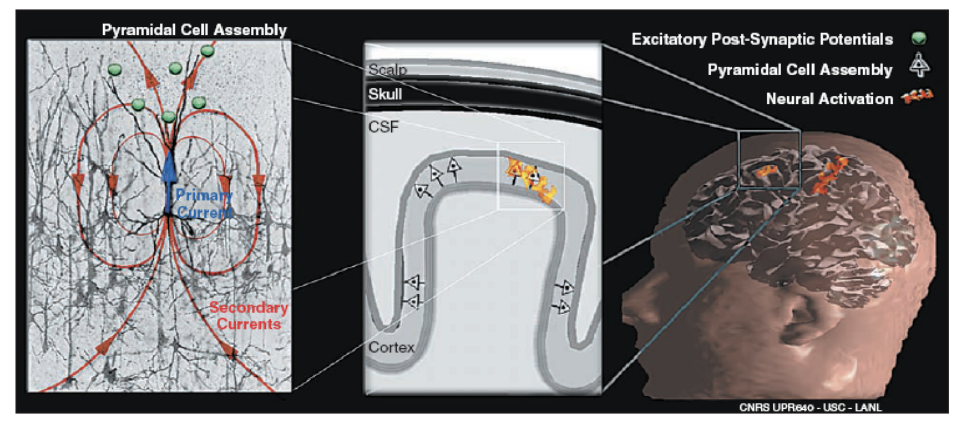
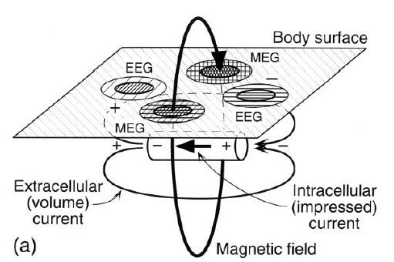
Biophysical origin – Dipoles and currents
EPSPs of parallel dendrites in cortical columns creates
  Primary current (what we want to know about)
  Secondary/volume currents
    Measured by EEG
    Influenced by intervening tissue
  Magnetic field perpendicular to primary current
    Measured by MEG
    Unaffected by intervening tissue
Notes:
MEG is sensitive to primary and volume currents • EEG is sensitive to volume currents
Magnetic fields are also created by volume currents, but approximately cancel and sum to zero. Assuming a spherical head, they would precisely sum to zero.

