Slide 1
1st Level Analysis: Design Matrix, Contrasts, General Linear Modelling
Presenters: Alan Jacob and Aygun Badalova
Expert: Dr. Guillaume Flandin

Slide 2



Spatial filter
Design matrix
Statistical Parametric Map
Realignment
Smoothing
General Linear Model
Statistical
Inference
RFT
Normalisation
Anatomical
reference
p <0.05
Parameter estimates
Source: L.M. Harrison, W. Penny, J. Daunizeau, K.J. Friston, Diffusion-based spatial priors for functional magnetic resonance images, NeuroImage
Notes:
The previous two presentations have already covered the pre-processing steps we need to let SPM carry out on our data, to put all our images into the same anatomical space.
This presentation covers the next step. Now, we are beginning our statistical analysis of the data. This step is looking at how data in our different experimental conditions can predict the fMRI data. This reflects a linear combination of multiple variables encoded with a design matrix. All of this is based on the General Linear Model, which estimates parameters voxel by voxel.
Now, we need to fit a model to the pre-processed data. In other words, how much BOLD activity there was for each condition within each voxel of the brain image.

Slide 3
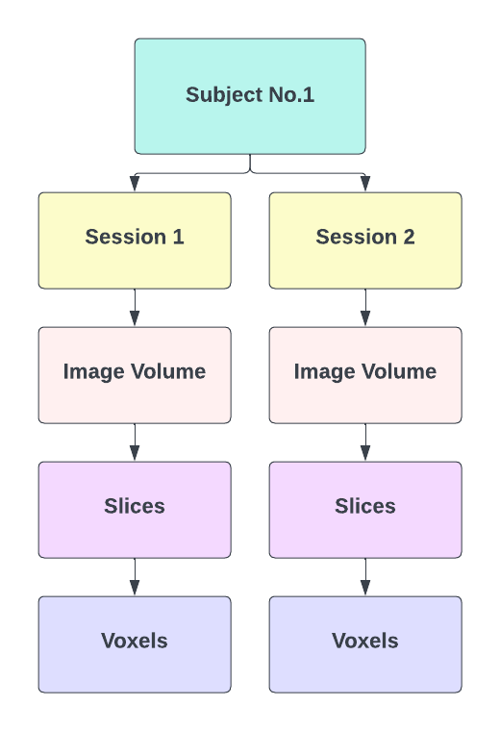
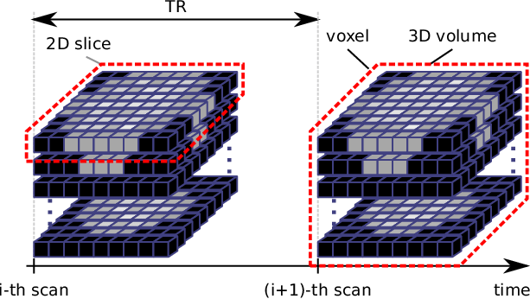
First level Analysis => Within Subjects Analysis
Notes:
Brain Data – Preprocessed swr* images
Swr* images(Normalized images) - Realigned, Warped to MNI space i.e. boundaries around brain expressed in MNI space or a specific coordinate system and smoothed using spatial filters.
In SPM, we analyse data from multiple subjects in two stages – 1st level and 2nd level. For each subject, we have collected data in sessions called scanning periods. For each session, we collect several 3D volumes of brain regions, organized in slices, which again consist of many voxels.
First, we do a within-subject analysis. So typically, we will have to do as many first-level analyses as we have participants, thus every analysis is run independently for each voxel in each subject. What we want from this step are contrast images (more about this later) for every single subject.
Thus, at this level (1st level) all we can conclude is that if the exact same person does the same task, would we expect to see the same activity.
In 2nd level analysis, it occurs between different subjects aka group-level analysis which will be discussed in the coming weeks.

Slide 4
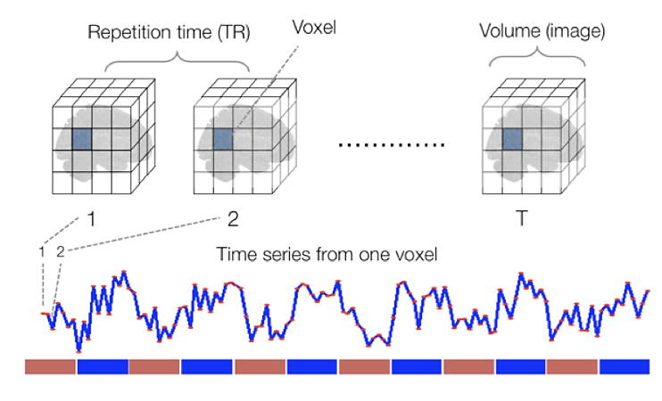
Voxel-wise Time series
Time series of each voxel capturing changes in the BOLD signal over the duration of the experiment
Source: Principles of fMRI by Tor D. Wager and Martin A. Lindquist
Notes:
In pre-processing we made sure that the each voxel is consistent over time by putting them in the same anatomical space. So for each voxel, we have a time-series of the changes in BOLD signal throughout the experiment. 1 time series = for 1 voxel.
We want to model the time series so that we can make an inference (later on) about the effect of interests, by testing hypothesis on this particular voxel. The effects we’re interested in, + noise or errors that are not fit by the model

Slide 5
Statistical Modelling of Brain Image Data
SPM – Mass Univariate Approach -> Same statistical analysis on every single voxel
Looking for a relationship between dependent variable Y and regressor X
General Linear Modelling to compute this relationship in the form below
Y = Xβ + ε
Notes:
First we want to model the data before we can make any inferences about it. SPM deals with this data using a mass-univariate statistical approach. All this means is that the statistical steps we use are the same for each and every voxel. So this data for the whole brain is our Y or dependent variable. For each voxel, we want to see whether our experimental manipulation e.g. condition (expressed as a regressor called X) has an effect on this brain activity, using a GLM.
Y – Bold Signal
X – Experimental conditions
The data we put into SPM is a single time-series on a voxel, which we want to transform into a single statistical value. SPM does this simultaneously at all of our voxels. The result we will get is a Statistical Parametric Map, with one of these statistics for each voxel.

Slide 6
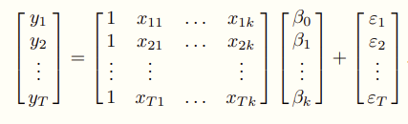
Mass Univariate Approach
Design Matrix -> Constants + Regressors
Y = Xβ + ε
BOLD signals
Constants
Regressors
Model Parameters
Residuals/Errors
Notes:
We want to model each and every voxel using the mass univariate approach. What we would then get in a similar way to the previous equation is rows and rows of these equations, one for each time point e.g. scans over time for the same voxel. So really our model contains matrices, of these equations. We can save ourselves from having to look at this horrible mess of equations by simply rewriting all of this as a simple, matrix model at the top, where:
Y stands for a matrix of BOLD signals for a single voxel. (AKA from our data files that we feed into SPM)
Our constant or intercept is simply the mean level of fMRI signal over time across all of our conditions. In SPM, this constant is included as a regressor automatically, so it is not shown in this equation explicitly.
All our regressors X makes up the so-called design matrix. We know this too (expected time course of reactions to our experimental conditions).
What we do not know:
The exact error in our model
The values of our parameters for each regressor. Luckily, SPM will estimate them for us.

Slide 7
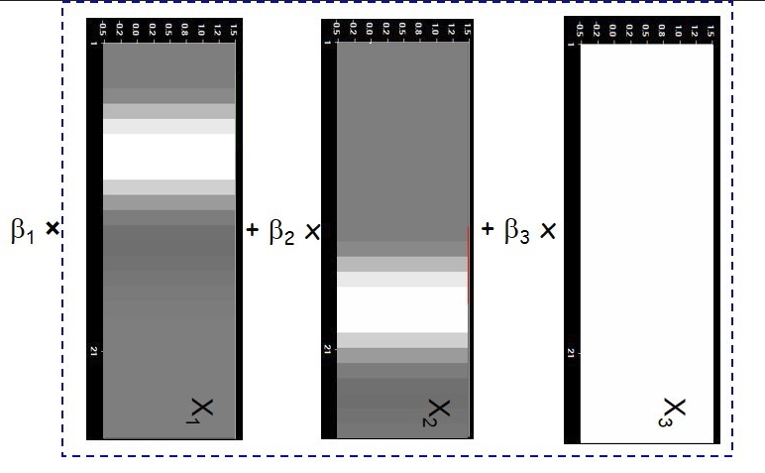
Design Matrix
Time
Regressors
Notes:
The Design Matrix is a neat graphical representation of your experimental design. It embodies all available knowledge about experimentally controlled factors and potential confounds.
Black - illustrates when the regressor is at its smallest value
White - illustrates when the regressor is at its largest value
Grey - illustrates when the regressor is at its intermediate value
Here we have 2 regressors which each predicting activity at different points in time (the white proportion) as well as a constant (all white – mean signal) and an error term which could represent any other factors not accounted for by our conditions (noise) which shows very varied activation.

Slide 8
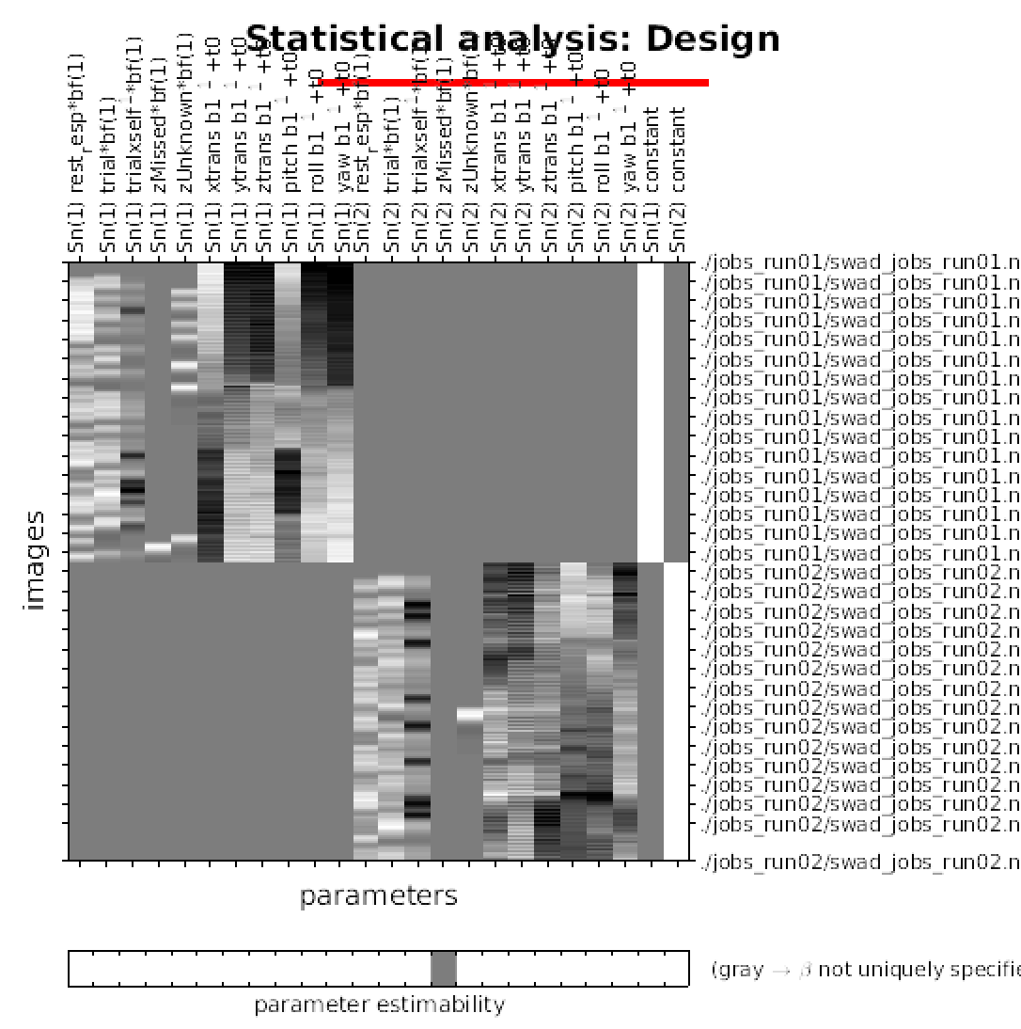
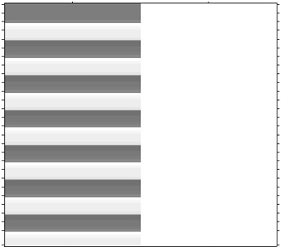
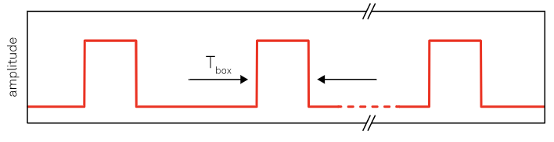
Design Matrix - SPM
Constant Regressor
Regressor
Source: Bold Insights, Bradley J Mattan
Notes:
We want SPM to know which bits of fMRI signal are associated with which experimental condition. We can represent our experimental condition with this kind of boxcar function modelling when the stimulus is “on” or “off”.
SPM visualises our Design Matrix as a grey-scale table where each row represents an observation, and each column represents a regressor. Take a simple block design, with a condition of listening to words, with periods of rest in between. The regressor column here is the column that codes for the listening condition. SPM visually codes for whether the condition is “on” or “off” by assigning a colour value (white vs. black). The white column is how SPM codes for our constant regressor, the mean BOLD signal level over time.
We are modelling the listening condition as a so-called boxcar function. In this function, the line goes “up” (i.e. where the condition is on) and “down” again (where the condition is off) in neat jumps. The constant is the mean signal over time, while the condition model shows where the signal deviates from the mean.

Slide 9
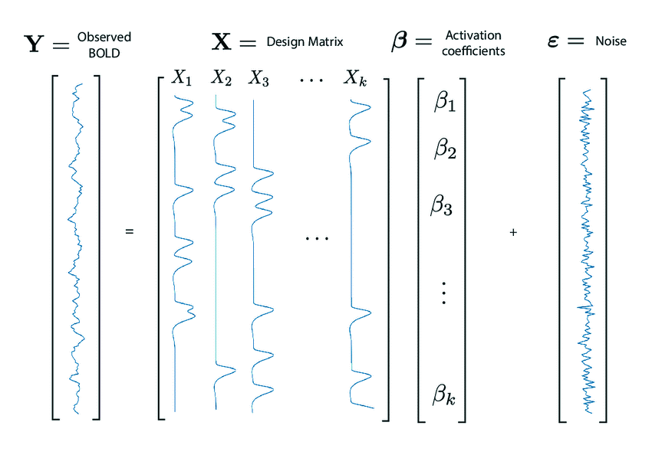
General Linear Model (GLM)
Y – fMRI time course in a particular voxel
X – Regressors
β – Regression coefficients
ε – Noise
Y = Constant + X * β + ε
Source:https://www.researchgate.net/publication/278826818_Feature_extraction_and_supervised_learning_on_fMRI_from_practice_to_theory
Notes:
We are trying to find a good way of PREDICTING the dependent variable (the fMRI signal), using everything we know about our own experimental manipulation and more general things that affect such a signal. Thus, this model simply tries to fit a line that describes the relationship between the dependent variable Y and the predictor variable, or regressor, X. If you remember that X is the experimental manipulation or condition we are using to predict the fMRI data (Y), in this example we have a boxcar function which represents a block design for example where a stimulus goes on and off. As mentioned before, we will fit this model to each voxel independently.
Y = this is the fMRI time course in a particular voxel, i.e. the intensity value of our voxel for a single scan/observation.
C = The intercept is a constant, and in our case, it is the mean level of fMRI signal over time, and across all conditions, for our particular voxel.
X = The regressor is a component of our model which explains the observed data Y to some degree.
B = The regressor comes with an associated parameter beta, which defines the contribution/weighting of X to the value of Y. As seen before, it can be viewed as the slope of our regression line.
Indicates how strong response was at each voxel
E = proportion of variance in Y which is not explained by regressor X
The GLM expresses the dependent variable Y in terms of a linear combination of some regressors X plus a well-defined error term. We want this linear combination of regressors to be able to explain all possible responses to our experiment, up to the level of error. The error is noise in the data, which explains some additional variance in our observed data, but has not been controlled by us in our experiment.
The result of our model is calculation the Beta parameters.

Slide 10
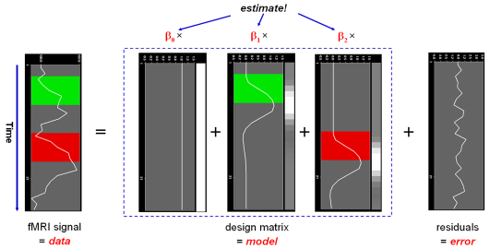
Example of GLM
Example Source: https://www.brainvoyager.com/bv/doc/UsersGuide/StatisticalAnalysis/TheGeneralLinearModel.html
Notes:
In summary, we want to include in our model:
Expected time course for our experimental conditions (called X1 here) – experimental conditions regressor
Expected time course for any potential confounds (X2) – nuisance regressor
Time course for a constant (X3), i.e. the mean level of fMRI signal over time
We specify our conditions and additional regressors in the design matrix, which should include everything we know about our conditions and confounds that may additionally affect our data.

Slide 11
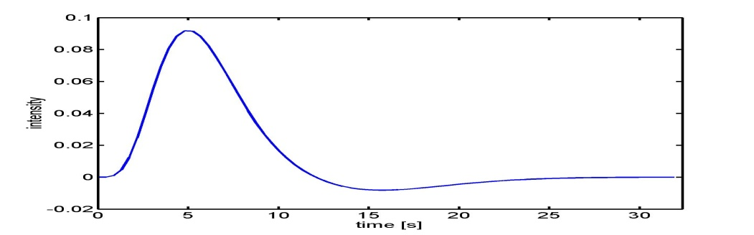
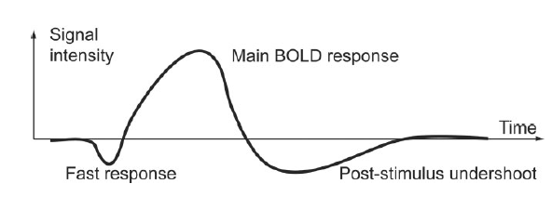
Issues with Current Data and HRF
BOLD response has a delayed and dispersed shape
So the box-car function used to model our data in previous steps won’t fit the actual data very well
Haemodynamic Response Function (HRF)
Notes:
If we try to model our data with a simple box-car function, where the signal simply reacts (it is either on of off) to a condition. The actual haemodynamic response function (HRF), however, doesn’t quite work like this.
As discussed in a previous lecture in fMRI we acquire a correlate of a neural activity – blood oxygenation levels. So if we see a spike in the neuronal response, what we measure is the release of oxygen to the neurons, the BOLD signal.
Haemodynamic response function = changes in the fMRI signal triggered by neuronal activity. It peaks at 4-6s post-stimulus, and goes back to baseline after 20-30s. So, as we have seen in a previous presentation, BOLD responses are delayed and dispersed (blurred). We need to adjust our model for this.
If all trials were of the same duration however, and that duration were below ~2s, then they can be effectively modelled as events (i.e, delta functions with zero duration). This is because, after convolution with the IR, a difference in the duration of a trial causes a difference in the scaling of the predicted response, but has little effect on its shape. Since it is the scaling of the predicted response that is being estimated in the statistical models discussed above, changing the duration of all trials simply changes the size of the resulting parameter estimates, with little effect on the statistical inferences.

Slide 12
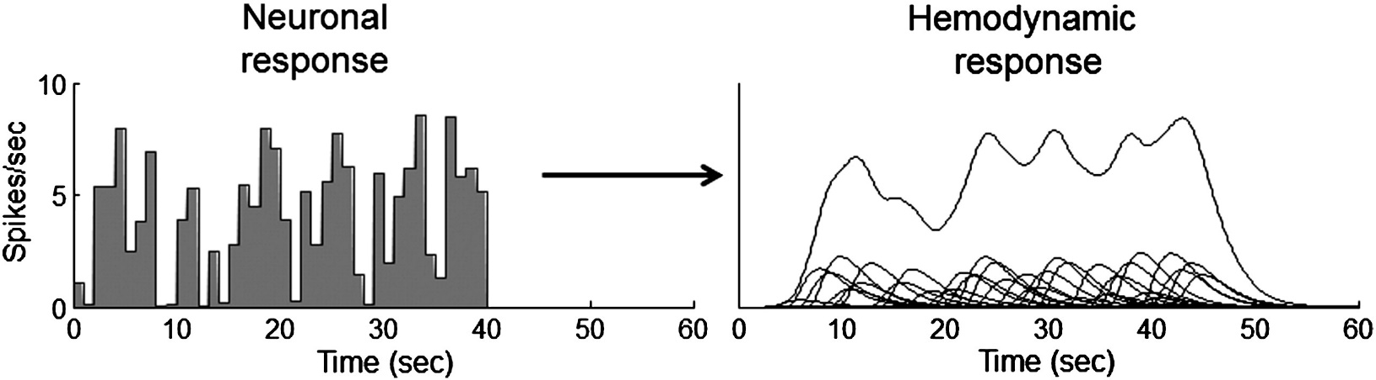
HRF Convolution
3 main steps:
Scaling - time-course of the output directly scales with the strength of the input.
Additivity - sum of inputs is equal to the sum of the hemodynamic responses.
Shift invariance - shifted in time hemodynamic response by the delay between the two inputs.
Notes:
We can model this using the HRF (If you mix your input function with the HRF, you can derive the expected BOLD response). We take into account by convolving the input function with the Hemondynamic response function and we can do that because this function is linear time-invariant and it does this by 3 steps: scales with the neuronal response, its additive meaning that two stimulation in time will lead to a reponse which is the sum of the two responses and it is shift invariant so a stimuli presented at later stage shift the response accordingly
Scaling
For a system operating in the time domain, scaling means that the time-course of the output directly scales with the strength of the input. If this system shows scaling, then when the input is scaled the shape of the output will always remain the same except that it is scaled by the same factor.
Additivity
The property of additivity states that given two inputs, the response to the sum of the inputs is equal to the sum of the responses to each of the inputs alone.
For the hemodynamic response, the additivity property is best illustrated for two neuronal responses that follow closely in time. If they fall within a few seconds of each other, the output hemodynamic response to the first input will still be ongoing when the hemodynamic response to the second input begins. The additivity principal says that this second hemodynamic response should simply add to the first response, without interacting in any way.
Shift Invariance
The additional property of shift invariance is also assumed in the linear transform model. Shift invariance means that the hemodynamic response to a later input neuronal response should look just like the response to an earlier, identical input, but shifted in time by the delay between the two inputs.
When a linear relationship is assumed between the stimulus onset and BOLD response such that if I present a stimulus every 2 seconds you would observe a BOLD signal every 2 seconds, then you can convolve the box car function to look more like a BOLD response. It is not linear if a second stimuli is presented too close to the first one, as likely influences the activity of the first. = Linear time-invariant system
On the bottom line we can see how actual neural response may be convolved into a HRF as here the sum of the HRFs on the bottom (of right figure) is taken to form the convolution of the higher line.

Slide 13

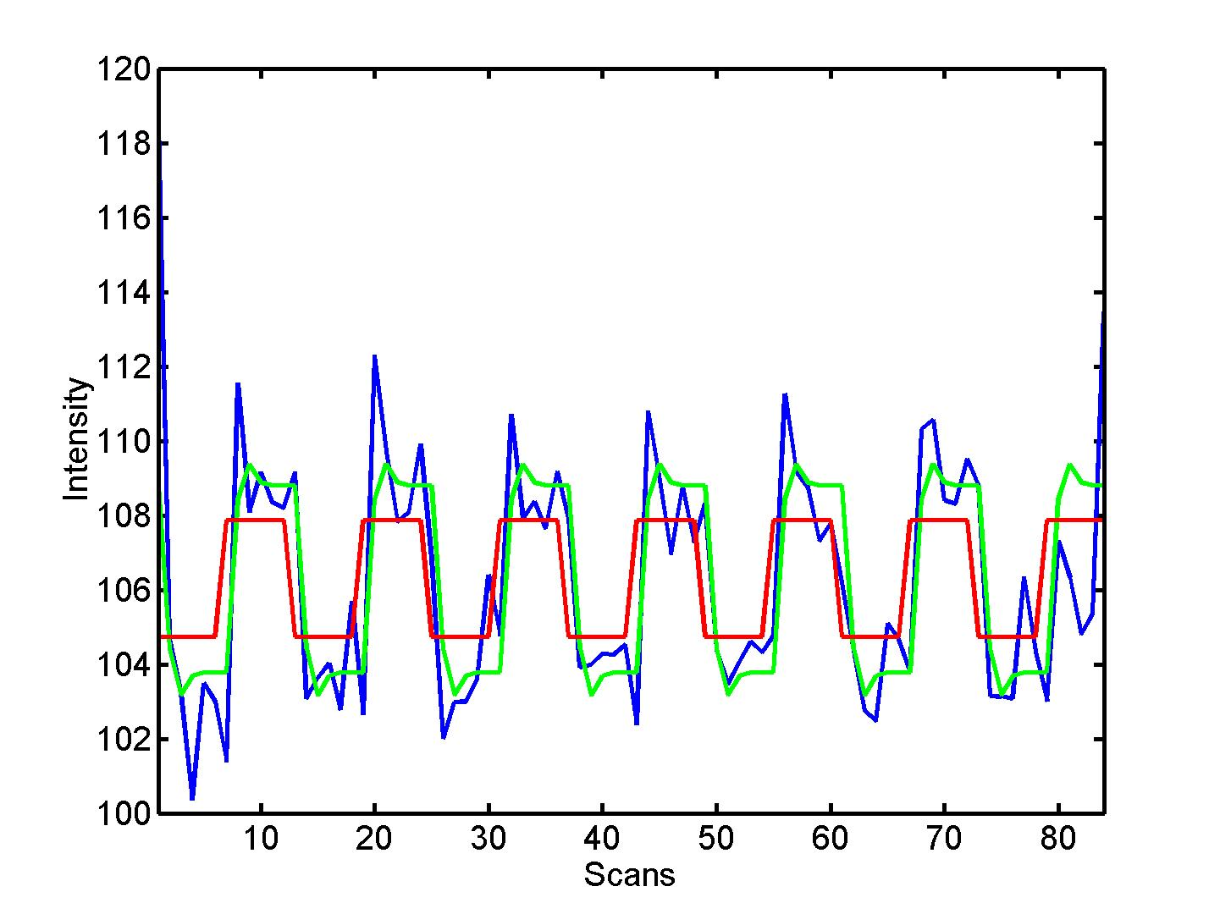

HRF Convolution in SPM
⊗ HRF
Notes:
Here is an example of a design matrix now convolved to match a HRF more closely. This is done by SPM. Now we get something that better shape our response. There is a slight delay, and also not completely flat which reflects some noise. This is more representative of the actual signal that is being recorded (i.e. Improve your model). On the right you can see the neuronal activity in blue and in red what would be predicted from a simple boxcar style model, but these two merged creates the green convolved function which accounts more closely for the shape of the HRF.

Slide 14
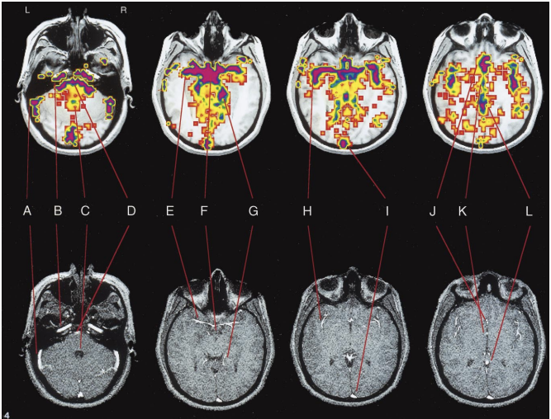
Problems with Noise in Image Data
Noise occurs due to:
Scanner
Subject’s physiology
Subject’s motion
Preprocessing helps partially but how to deal with remaining noise?
Dagli et al, Localization of cardiac-induced signal change in fMRI. Neuroimage 9
Notes:
Cardiac noise shown in the slide

Slide 15
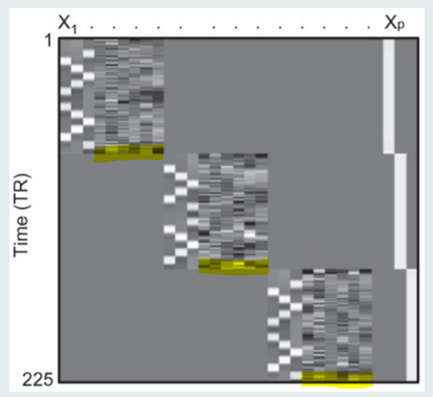
Solution I – Noise Regressors
Include Nuisance regressors (e.g. head motion) in Design Matrix.
  To explain additional variance and reduce noise of model
Regressors can be any hypothesised contributors in experiment
  Regressors of interest - intentionally manipulated
  Regressors not of interest - not manipulated, potential confound – e.g. head movement (6 regressors)
Image Source: Rita Bertani and Mansoureh Fahimi
Methods for Dummies 2021-22
Notes:
So what do we do with the remaining noise?
We can add regressors to our model that capture the expected signal associated with the noise, e.g. particular regressors to deal with motion artefacts, to explain some additional variance in our data, because the model doesn’t know how movement might happen over time for example.

Slide 16
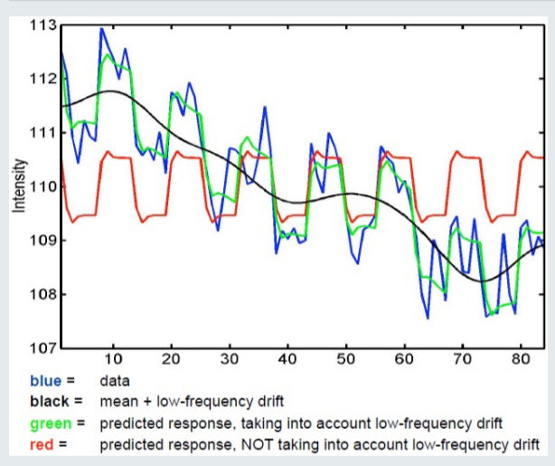
Solution II – High-Pass Filter
High-pass filter to filter out low frequencies
Over time slow signal drift in voxel intensity e.g. due to
scanner heating
By default, SPM filter leaves out signals lasting longer than 128 seconds
Image Source: Emily Thomas and Joao Santos
Methods for Dummies 2021-22
Notes:
Applying high-pass filter to increase signal to noise ratio
Scanner heats up over time → decrease in signal intensity – but this decrease has nothing to do with our task of interest!
This decrease in signal intensity affects mainly low frequencies
Assumption: most low frequencies in our signal are due to scanner heating up (noise)
Solution: in SPM, we select high-pass filter → low-frequencies are filtered out
Default high-pass filter in SPM filters out signals which last longer than 128 seconds
When using this filter, we need to accept that some task-relevant info may be filtered out as well

Slide 17
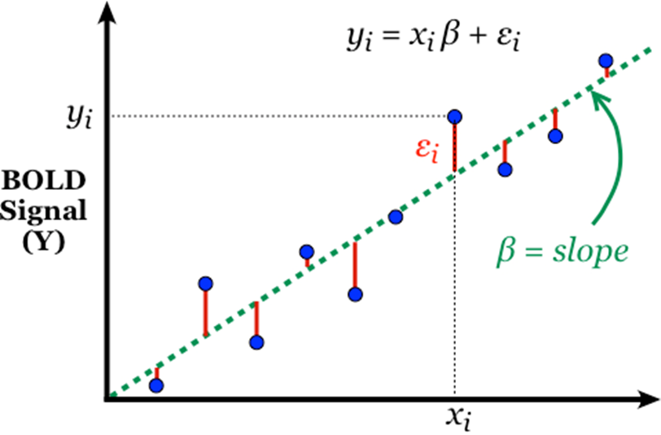
Beta Parameter Estimation
Once the design matrix is specified, SPM calculates the parameters (β) for each regressor
It is still just for 1 voxel, so data on the graph represents different observations in the time-series
Method – Ordinary Least Squares
  Minimizing the Sum of Squared Errors (SSE)
Image Source: Emily Thomas & Joao Santos
Methods for Dummies 2019/20
Notes:
Once we have specified our design matrix, SPM estimates our parameters, or slopes, such that our estimated slope best fits, or describes, the relationship between our regressors X and the observed data Y. The good thing is that our model for one voxel will fit the whole time-series (but with different parameter values for each voxel). This is the mass-univariate approach.
In order to estimate the parameters, we use the method of ordinary least squares. This means that we are estimating parameter values that will minimise the sum of squared errors (so the sum of the squared differences between the actual value and the predicted value).
The beta value for a specific voxel is the “slope” of the model fit and reflects the relationship between regressor X1 and the BOLD signal Y
And now we are ready to test our hypotheses!

Slide 18
Contrasts
To find if there is a significant activation in a particular voxel due to experiment conditions applied
Evaluates whether the experimental manipulation caused a significant change in the parameter weights such as β
Depend on the model specification and design of the experiment
Combination of β helps in finding the effects of stimuli in certain parts of the brain.
Based on β of interest, we can apply Null hypothesis, Alternative hypothesis and T-test to look for voxels having higher/lower β.
Notes:
Once we have the model we want to see if there is any significant activation in a particular brain region/voxel due to our experimental conditions. Asking this question means asking if any of parameter weights of interest we calculated with our model justify the signal changes.
In order to do that we use contrasts. So in general contrast specify effect of interest by weighting our parameters and selecting regressors of interest.

Slide 19


Contrast Definition
With :
C: contrast vector, entered manually when using SPM
Example of c : [1 0 0 0 0 0]
1 -> ON ; 0 -> OFF
c^{T}β: the linear combinaison of the estimated parameters
n: the number of parameters

Slide 20
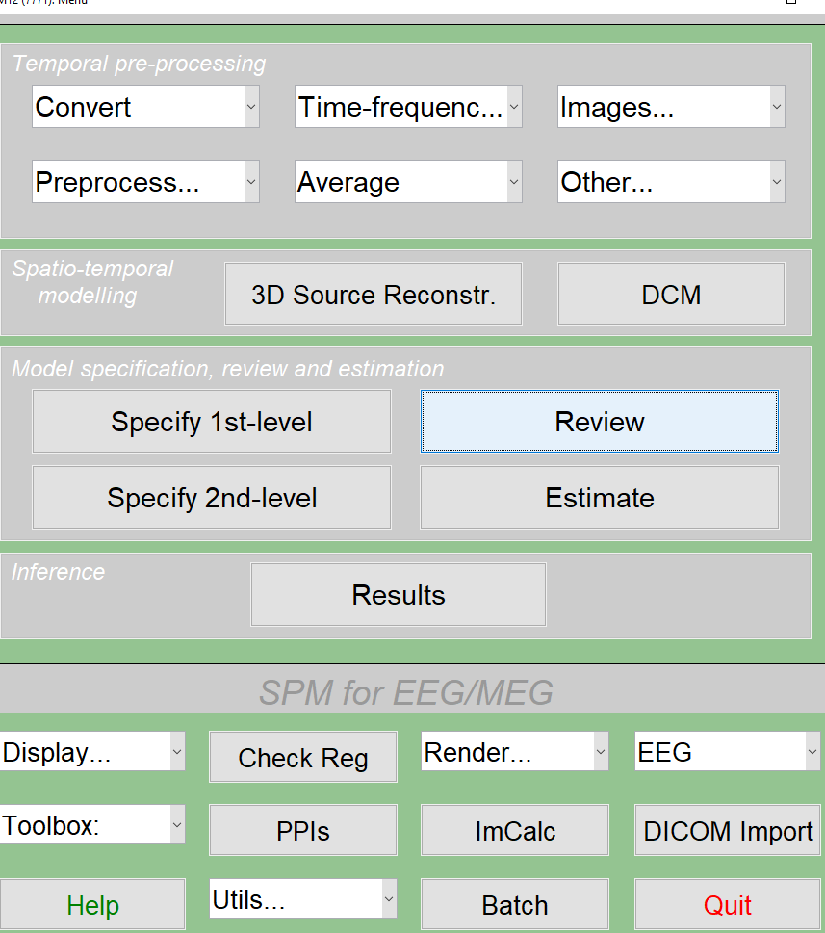
Running the First-Level Analysis
To begin, from the SPM GUI click on Specify 1st-Level
The first field that needs to be filled in is the Directory
Design new general linear model
Specify the model
Estimate the model

Slide 21
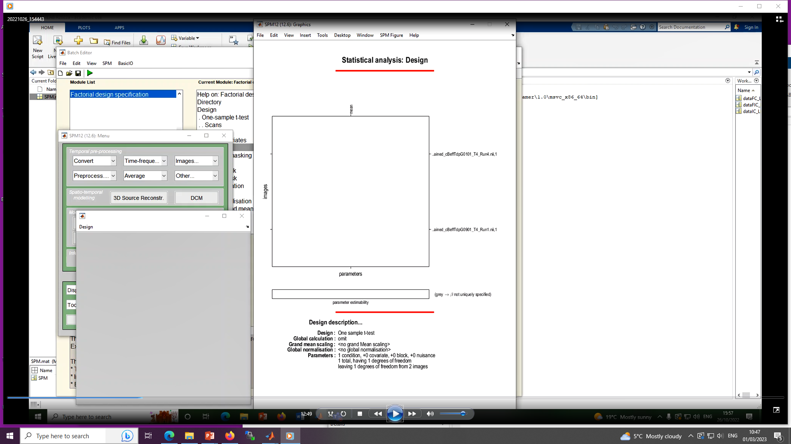

Slide 22
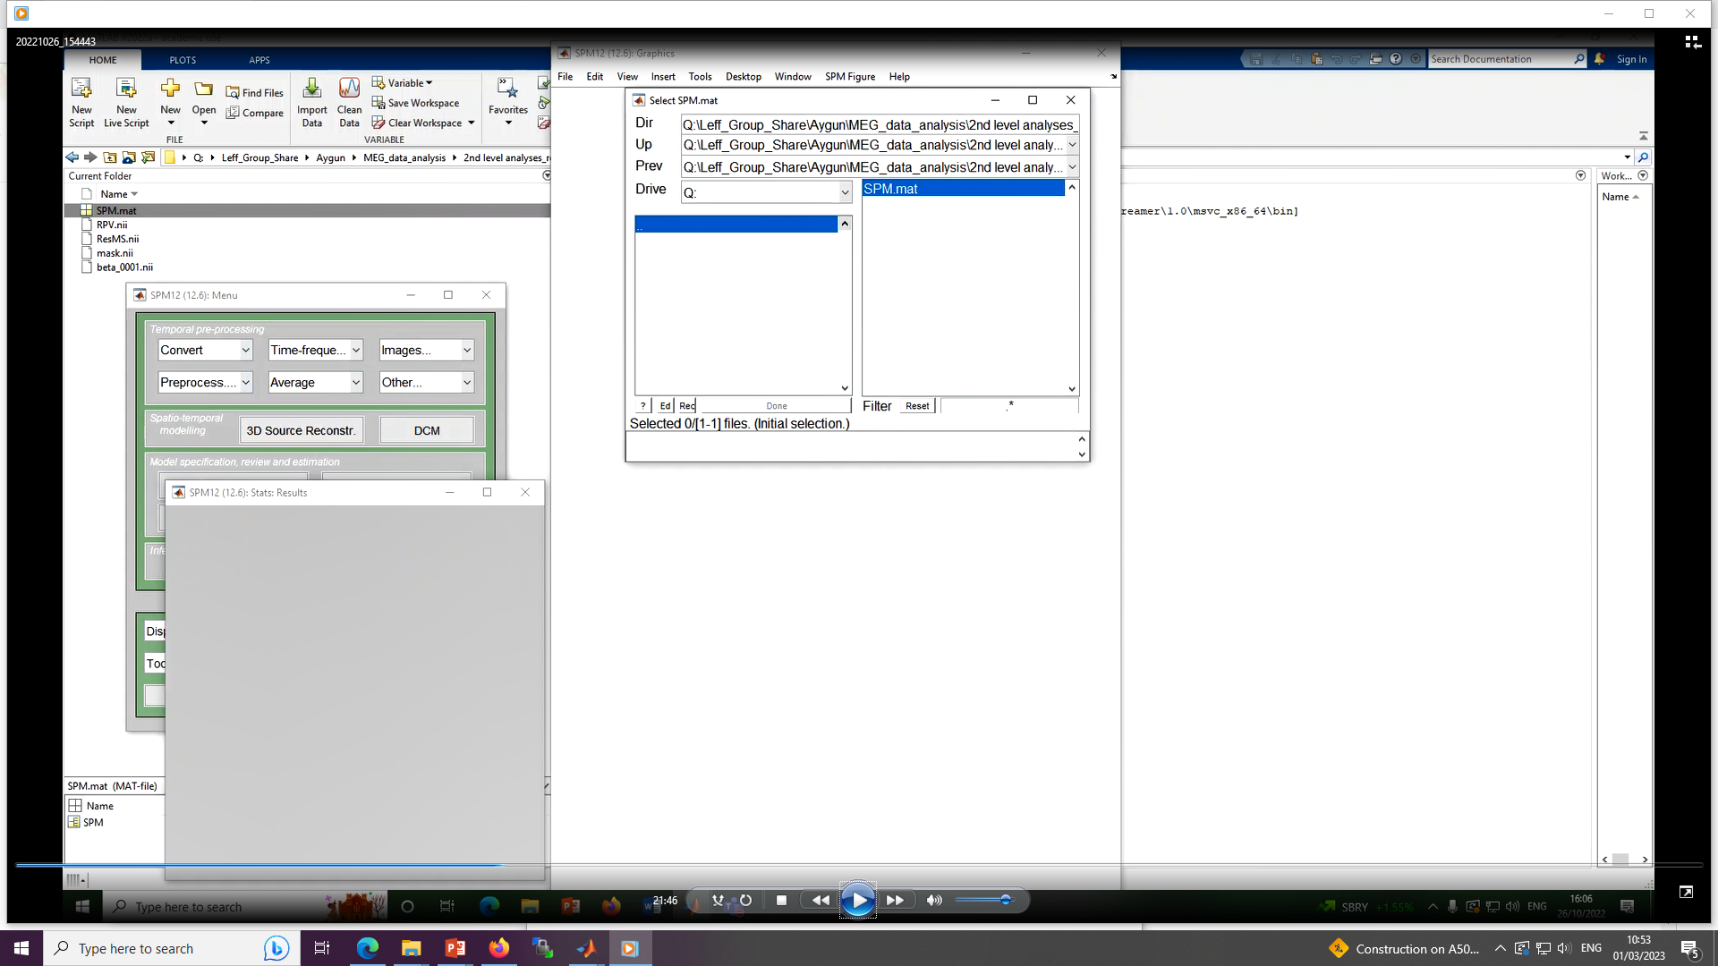

Slide 23
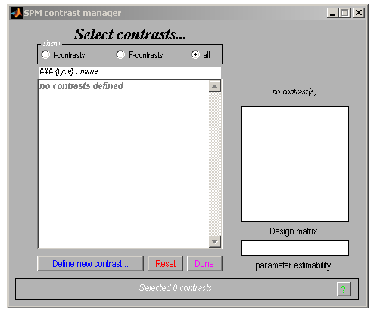
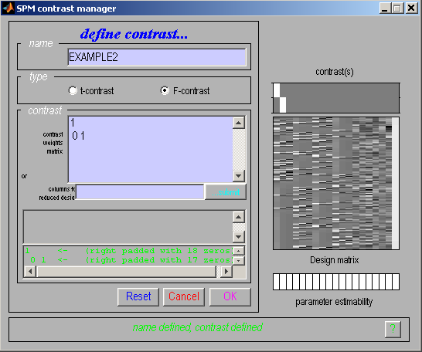

Slide 24
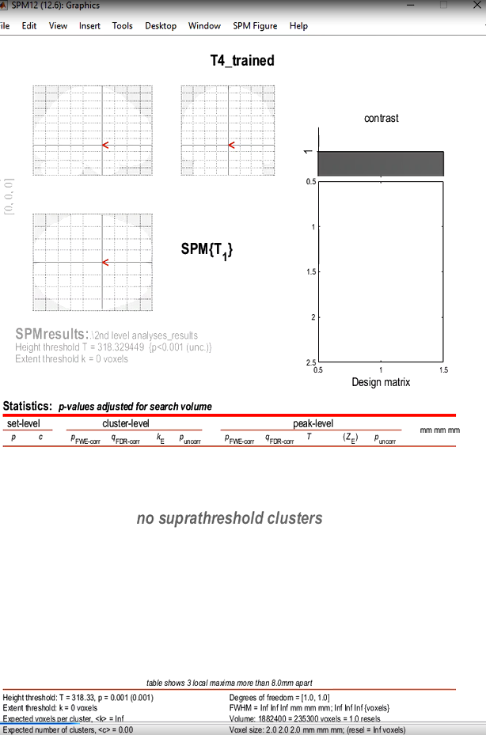
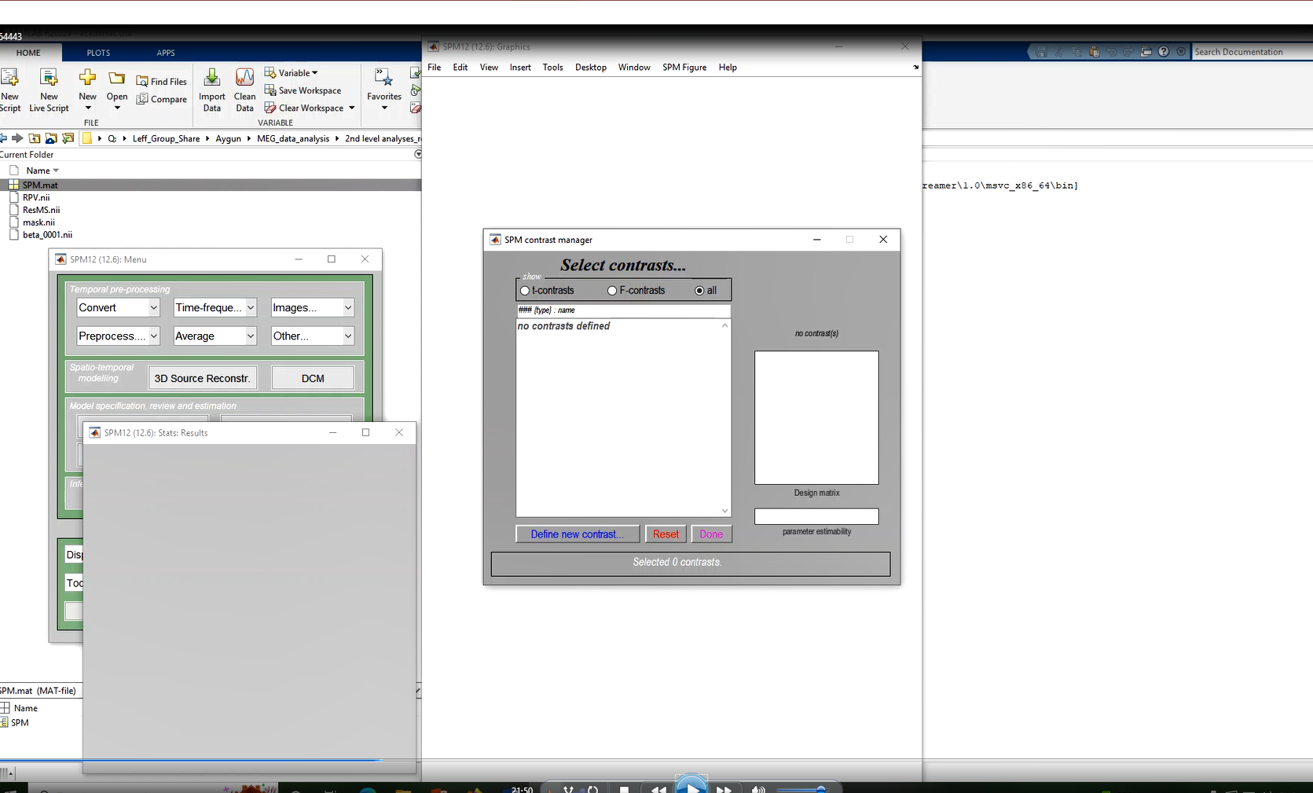
Notes:
We need to lower the threshold
Then we can see the Z score(which is not significant)
P value here

Slide 25
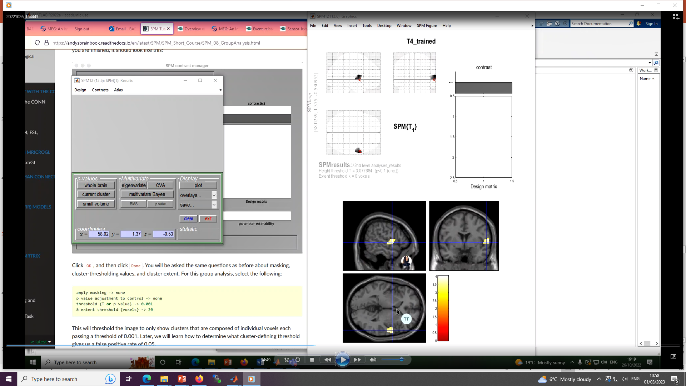
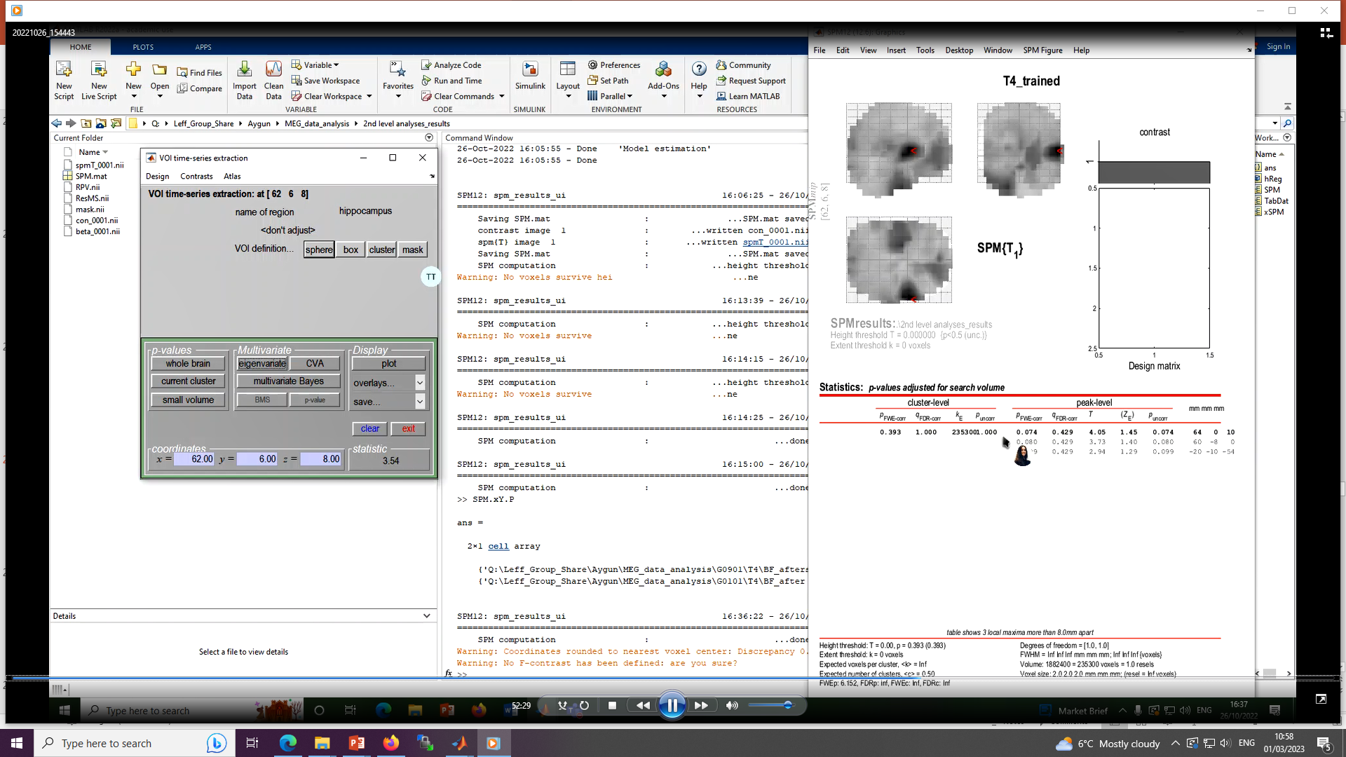
Notes:
This is when we want to see it in the brain.,
Overlay in GUI
So here we can see in righ-parecentral gyris.

Slide 26
Factorial design
Simple main effect
  A – B
  Simple main effect of trained items (vs. untrained ) [ 1 -1 0 0]
Main effect
  (A + B) – (C + D)
  The main effect of trained items(vs. untrained ) Main effect of training
  [ 1 1 -1 -1]
INTERACTION
  (A - B) – (C - D)
  The interaction effect of trained items (vs untrained items)
  [ 1 -1 -1 1]
Still, sum of the weights = 0 in each T contrast
A B C D
Trained items Untrained items
T1
T2
A B
C D
A B C D
A B C D

Slide 27
References
Previous MfD Slides
Guillaume Flandin’s SPM course slides
SPM12 Manual: http://www.fil.ion.ucl.ac.uk/spm/doc/manual.pdf (Ashburner et al., 2015)
Introduction to Statistical Parametric Mapping: http://www.fil.ion.ucl.ac.uk/spm/doc/intro/ (Friston, 2003)

Slide 28
Thank you.

