Slide 1
1st level analysis part 2: Basis Function, Parametric Modulation, and Correlated regressors
Methods for Dummies 2022-2023
Yongling Lin; Cian Xu
Expert: Guillaume Flandin

Slide 2
Overview
Recap of previous session
Basis Function
Parameteric Modulation
Correlated Regressors

Slide 3
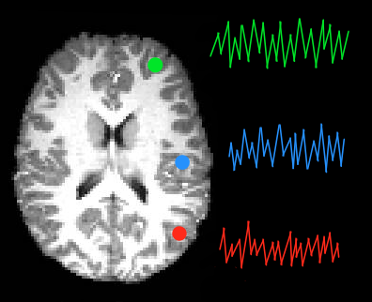
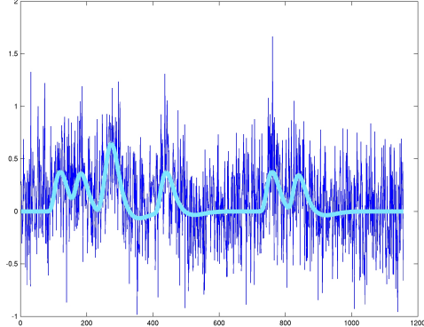
1st level analysis
Mass univariate approach: using the same statistical analysis on every single voxel
We are looking at the relationship between:
Y = dependent variable (BOLD signal)
X = regressor (experimental manipulation/condition)
Do this using a General Linear Model…
BOLD signal
Time
A voxel-wise time series of BOLD signal

Slide 4
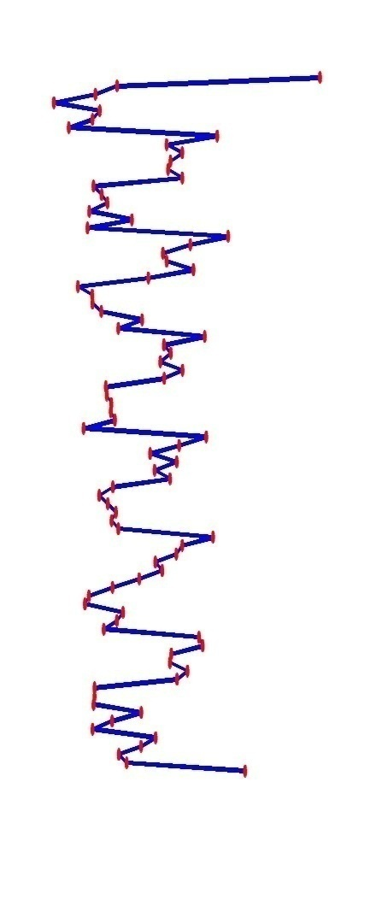
The General Linear Model
x
parameter
error (noise)
Time
defines the contribution of X to the value of Y - slope of our regression line
proportion of variance
in our data (Y) which is not explained by regressor/s (X)
BOLD signal
regressor
observed data – time course for a particular voxel
Mean signal over time for particular voxel
component of model which explains observed data to some degree

Slide 5
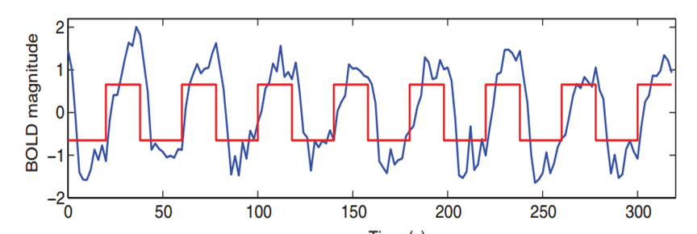
the box-car function won’t fit data
Notes:
The BOLD response has a delayed and dispersed shape
So the box-car function used to model our data in previous steps won’t fit the actual data very well
Haemodynamic response function (HRF)
On the right you can see the neuronal activity in blue and in red what would be predicted from a simple boxcar style model, but these two merged creates the green convolved function which accounts more closely for the shape of the HRF.

Slide 6
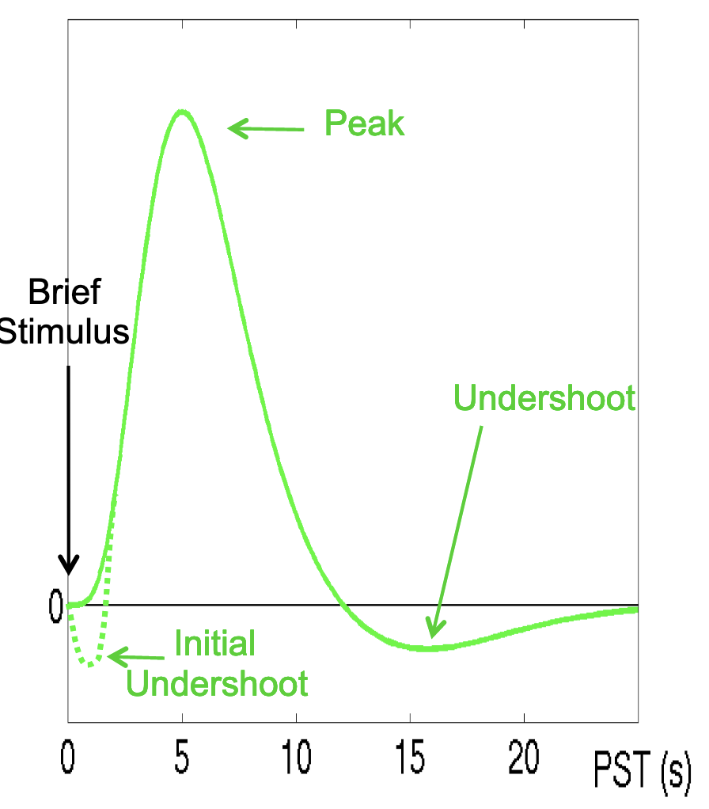
Haemodynamic Response
1990s empirical studies of BOLD signal
Stimulation caused increased BOLD signal
Characteristic pattern:
Similar in V1, M1, S1, …
However, possible variability between regions & subjects
Shape could be modelled by combining double Gamma functions
=> The “Canonical” Haemodynamic Response Function (HRF)

Slide 7
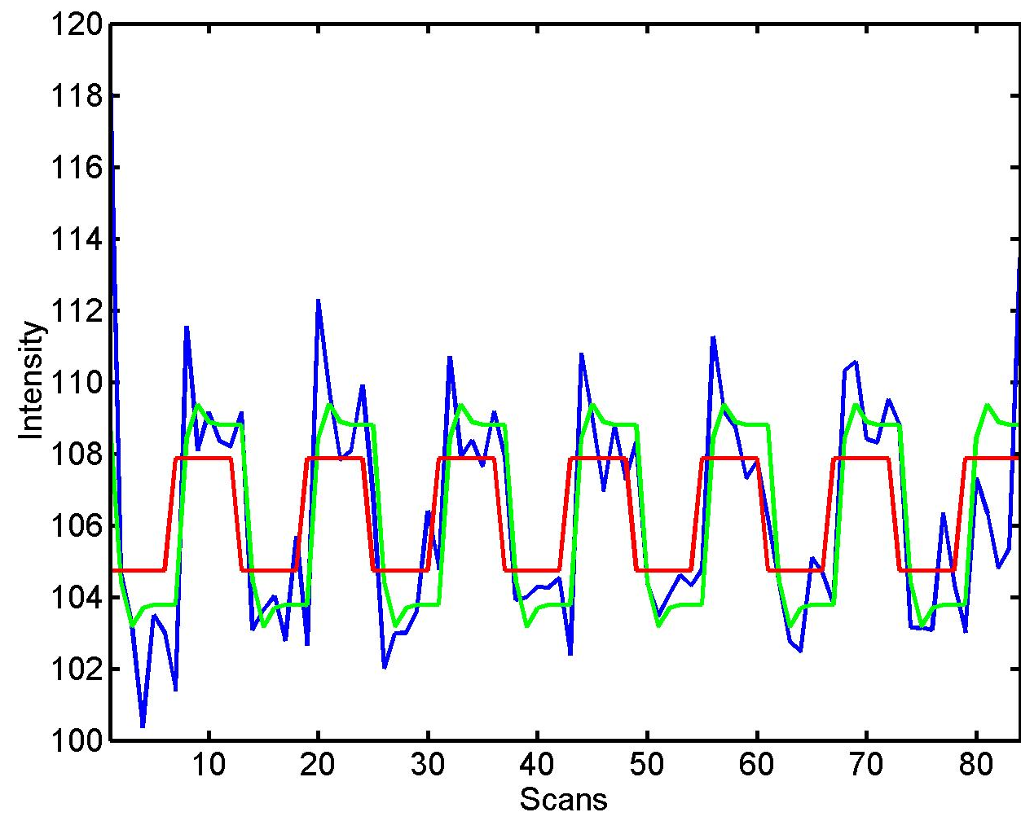
Convolution before general linear model
⊗ HRF
Notes:
The BOLD response has a delayed and dispersed shape
So the box-car function used to model our data in previous steps won’t fit the actual data very well
Haemodynamic response function (HRF)
On the right you can see the neuronal activity in blue and in red what would be predicted from a simple boxcar style model, but these two merged creates the green convolved function which accounts more closely for the shape of the HRF.

Slide 8
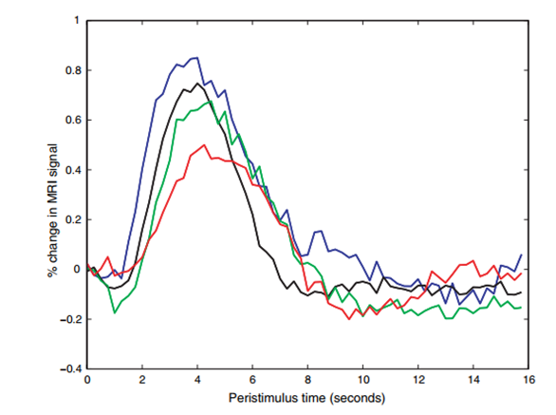
However… canonical HRF is rigid
The fitted data peaks too early
Notes:
The approach described previously assumed that the HRF could be accurately described using a single canonical response function. However, as was seen in
Figure 1.2, hemodynamic responses may differ substantially between individuals in their shape, time to peak, and other aspects. In addition, a number of studies have shown that the shape of the hemodynamic response also differs across different brain regions for the same individual. If we use the canonical HRF,then we are biased to only find responses that are similar to that function. On the other hand, if we use a more complicated model allowing for more flexibility in the shape of the HRF
by incorporating more parameters, we will have more variability in the estimates. This is what is often referred to as the bias-variance tradeoff.

Slide 9
2. Beyond the canonical HRF: create a set of basis function
Add flexibility with derivatives
The derivatives
Temporal: accounts for the delay in haemodynamic response to neural activity
Dispersion: models prolonged activation
See right: the peak in fitted model now matches the actual data
“Canonical” Haemodynamic Response Function (HRF) + TD + DD
=> The “informed” basis set

Slide 10
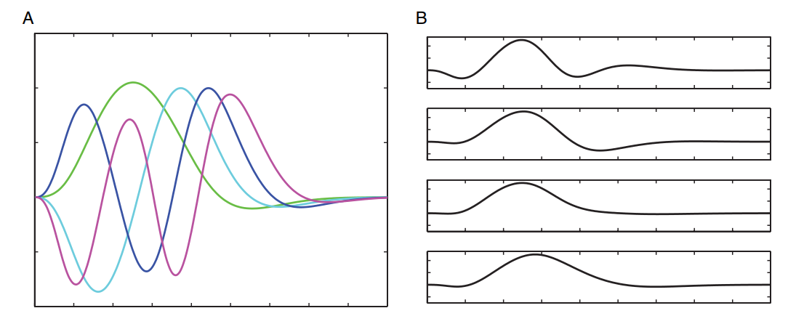
Flexible basis functions
①
Finite Impulse Response (FIR)
Consists of a series of impulse for each TR
Most flexible
Constrained basis sets
helps reduce the variability of the estimates
Notes:
FIR:
Each of the basis functions has an unit impulse that occurs at time ; otherwise it is equal to zero. Weighting each basis function with the corresponding value of the HRF at each time point , followed by a sum across all the functions gives the target HRF.
The FIR basis model makes no assumptions about the shape of the HRF–the weight applied to each basis function can take any value–which allows the model to capture a wide range of HRF profiles.
(Source: https://theclevermachine.wordpress.com/2012/12/16/fmri-in-neuroscience-modeling-the-hrf-with-fir-basis-functions/)
The flexibility of the FIR model to capture the shape of the HRF comes at the cost of an increase in the variability of the estimates. At one end of the spectrum there is the lower-bias, higher-variance FIR basis set and at the other end is the higher-bias, lower-variance canonical HRF basis function.
One approach to constructing a set of basis functions is to first generate a set of HRF shapes that are reasonable, say by varying some of the parameters outlined in
12 parameters that must be estimated for the FIR model, only 4 parameters must be estimated for this basis set, which helps reduce the variability of the estimates

Slide 11
“Informed” basis set is sufficient
Additional variability captured by…
+ Dispersion derivative
Design Matrix
Canonical HRF
+ Time derivative
FIR
The combination of Canonical HRF, TD, and DD was sufficient.
Little additional variability was captured by the FIR set.
Henson RNA, Rugg MD, Friston KJ (2001) The choice of basis functions in event-related fMRI. NeuroImage 13: 149
Notes:
The findings confirm that the canonical HRF alone may be insufficient to capture the range of possible BOLD impulse responses, in that significant additional variability was captured by including its partial derivatives (with respect to onset time and peak duration).
However, the combination of all three functions was sufficient, in that little additional variability was captured by the FIR set.

Slide 12
References of Basis Function
R. Henson. Chapter 10: Analysis of fMRItime series. Human Brain Function Ed 2.
D. Glaser, K. Friston, A. Mechelli, R. Turner and C.Price. Chapter 11. Haemodynamic modelling. Human Brain Function Ed 2.
Henson RN, Rugg MD, Friston KJ (2001) The choice of basis functions in event-related fMRI. NeuroImage 13: 149
C. Ruff. Lecture slides: Event-related fMRI: Modelling of hemodynamic timeseries. Link: https://www.fil.ion.ucl.ac.uk/spm/course/slides21-may/08_Event_Related_fMRI.pdf
Department of Psychology, McGil University, “Functional Data Analysis – The Basics of Basis Functions” https://www.psych.mcgill.ca/misc/fda/ex-basis-a1.html (last accessed 17 Jan 2022)
fMRI in neurosceicne modelling the HRF with FIR basis functions. Link: https://theclevermachine.wordpress.com/2012/12/16/fmri-in-neuroscience-modeling-the-hrf-with-fir-basis-functions/ (last accessed 17 Jan 2022)

Slide 13
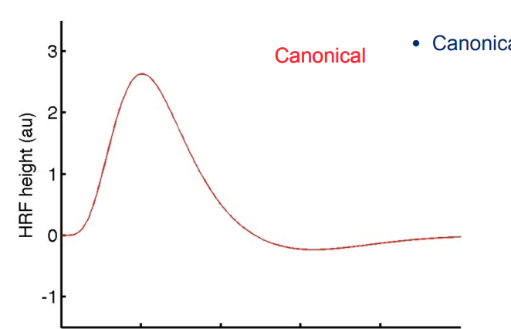
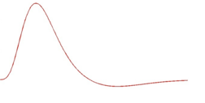
3. Parametric Modulation: Stimulus properties
Happy stimulus
Neural response
BOLD response
Predicted response
At time = t
t
t
+10
+15
+20
+25
4
Very happy stimulus
Predicted response
₊
t
t
+10
+15
+20
+25

Slide 14
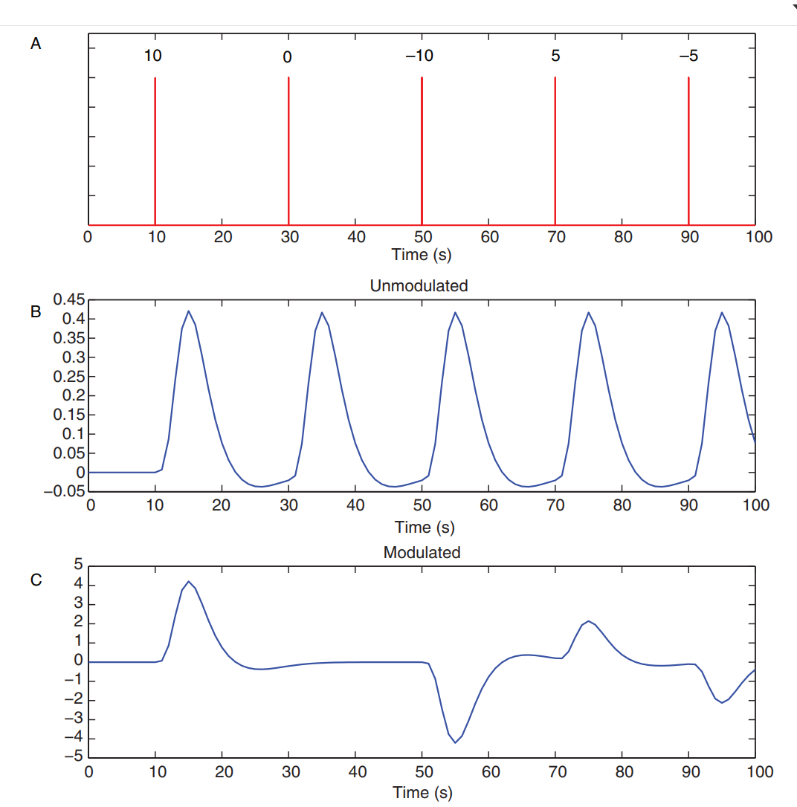
Parametric Modulation: Stimulus properties
How can we modulate (vary) the amplitude (parameter) of the expected BOLD response in our model, so that it fits the empirical data better?
Poldrack, R. A., Mumford, J. A., & Nichols, T. E. (2011). Handbook of functional MRI data analysis. Cambridge University Press.
Notes:
Panel A shows the timing of the stimuli, where the numbers above the stimuli correspond to the modulation value for that stimulus.
Panel B shows the unmodulated regressor, and Panel C shows the modulated regressor. Note that both the modulated and unmodulated regressors would be included in the linear
regression model
(It is important that the height values are demeaned prior to creating the regressor, in order to ensure that the parametric regressor is not correlated with the unmodulated regressor. )

Slide 15
Parametric Modulation: How?
At time = t, what is the BOLD response?
Constant/baseline activity
Did we show a face?
How happy was the face?
What can’t our model explain?
What can’t our model explain?
$Bold response\left(t\right)= β_{0}$(t) + $β_{1}X_{1}$(t) + $ε(t)$
${\text{+} β}_{2}X_{2}$(t) + $ε(t)$
Notes:
To create a parametric regressor, each onset’s stick function has a height reflecting the strength of the stimulus for that trial.

Slide 16
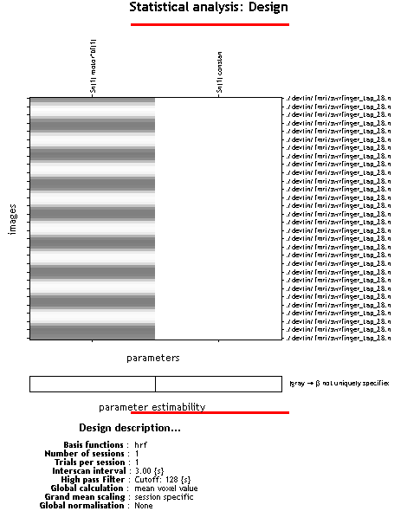
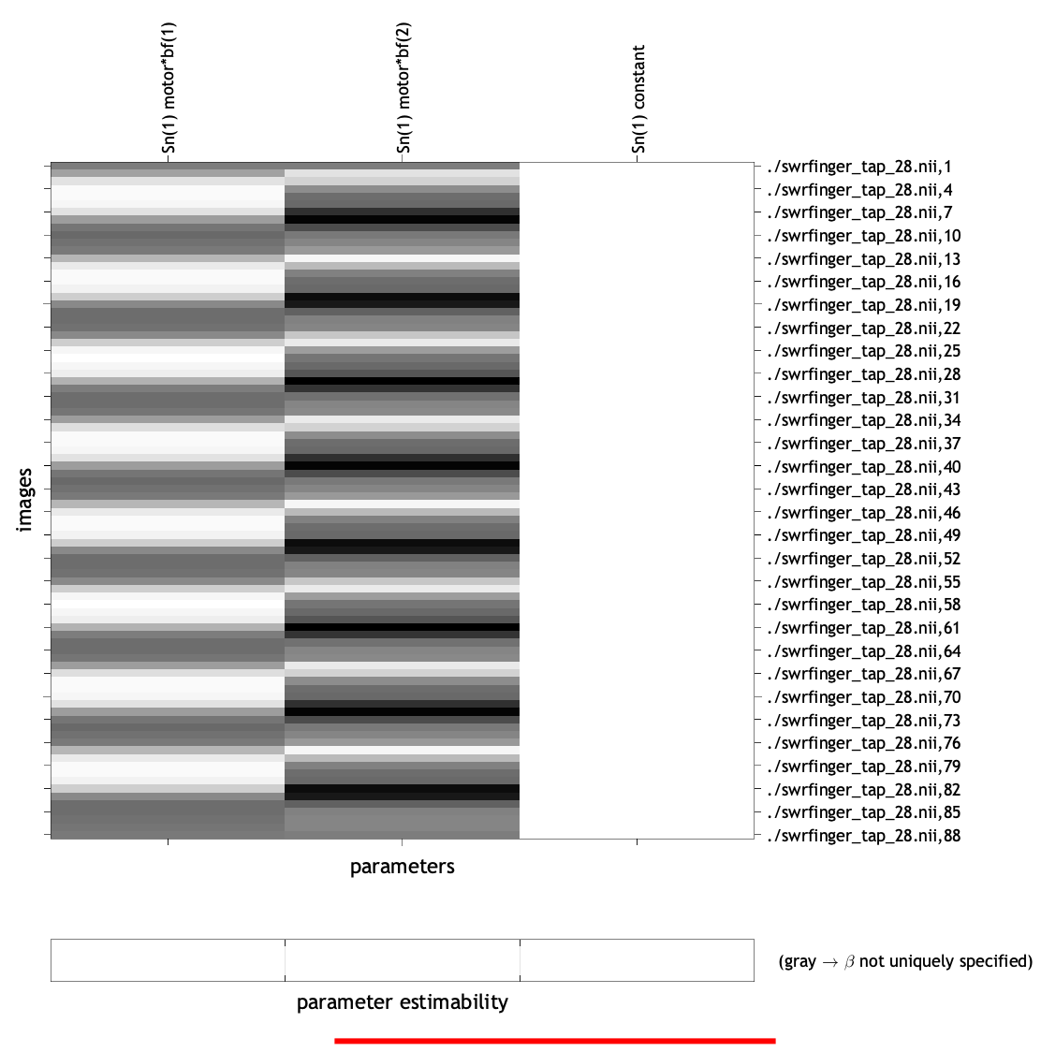
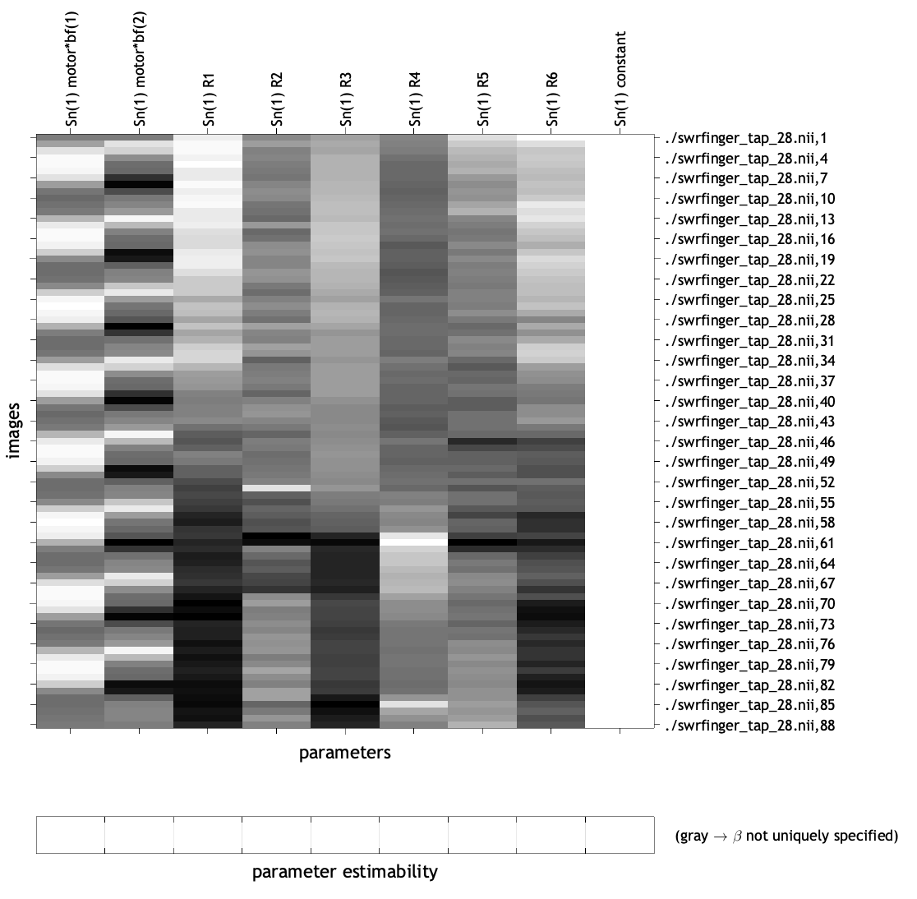
Correlated Regressors
Regressor 1
Regressor 2
Regressor 3

Slide 17
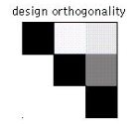
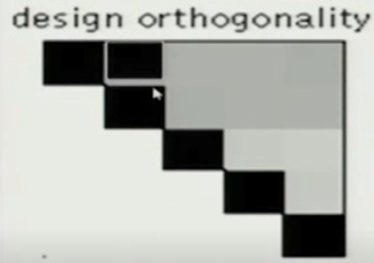
Optimal scenario
Regressor 2
Regressor 1
Regressor 3
No correlation between green, red and yellow

Slide 18
However, what if they are correlated?
Regressor 2
Regressor 2
Regressor 2
Regressor 1
Regressor 1
Regressor 1
Regressor 3
Regressor 3
Regressor 3
Regressor 2
Regressor 2
Regressor 2
Regressor 1
Regressor 1
Regressor 1
Regressor 3
Regressor 3
Regressor 3

Slide 19
Correlated Regressors
$$t_{1}$$
Predicted response
$X_{1}$(t)
$BOLD response\left(t\right)= β_{1}X_{1}$(t) + $ε(t)$
time
Predicted response
$BOLD response\left(t\right)= { β}_{2}X_{2}$(t) + $ε(t)$
$X_{2}$(t)
time
Predicted response
Predicted response
$BOLD response\left(t\right)= β_{1}X_{1}$(t) + ${ β}_{2}X_{2}$(t) + $ε(t)$
time
Predicted response
$BOLD response\left(t\right)= β_{1}X_{1}$(t) + ${ β}_{2}X_{2}$(t) + $ε(t)$
time

Slide 20
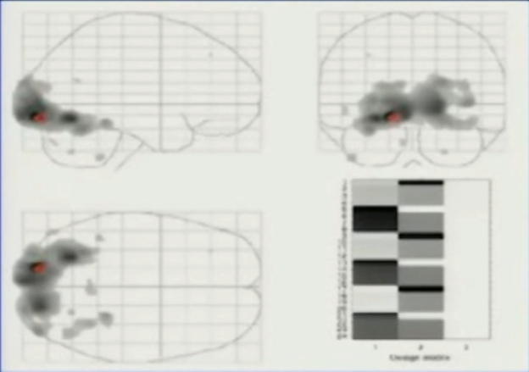
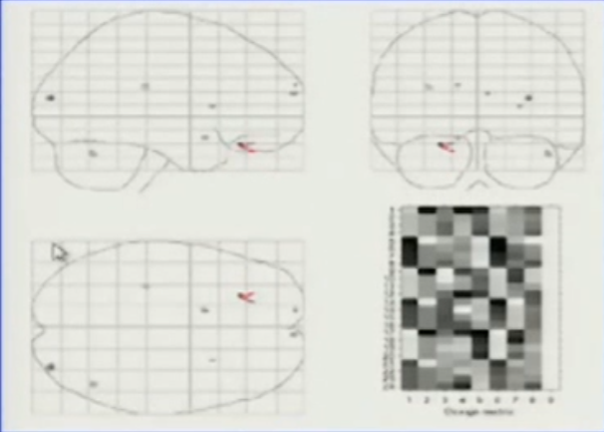
Example: Dots task
GLM
Y = β0 + β₁X₁ + β₂X₂ + ε
Y = BOLD response, X₁ = visual component X₂ = colour response
Confounds
X₁ may be confounded with X₂ due to their temporal dependence (eg. Button press and visual stimulus)
video display here
Regressor 2
Regressor 1
Activation disappeared !

Slide 21
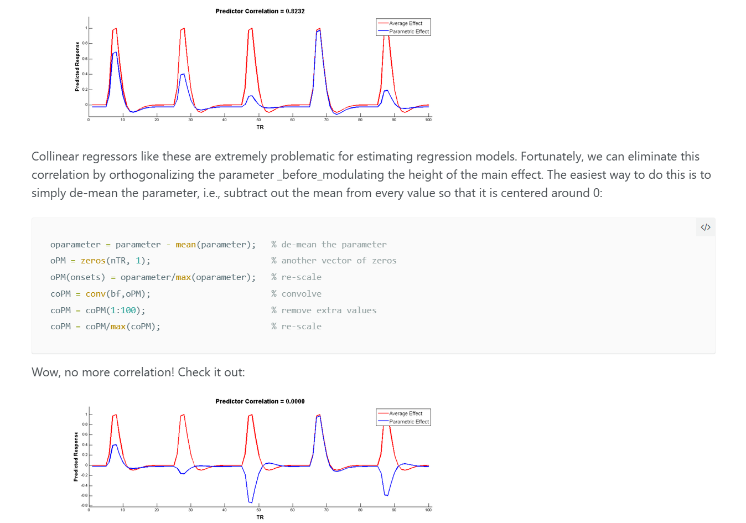

Slide 22
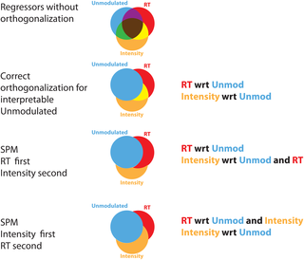
Conclusion
Do we care about correlation in the design?
Yes, always
Start with the experimental design: conditions should be as uncorrelated as possible
Use F tests to test for the overall variance explained by several (correlated) regressors

