Slide 1
Time-Frequency Analysis
Methods for Dummies

Slide 2
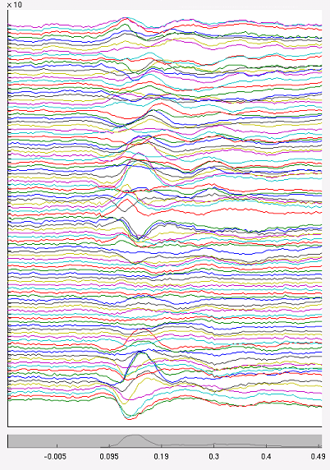
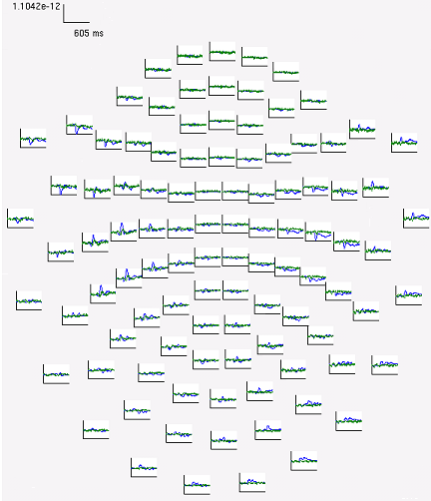
M/EEG Data
Time-varying modulation of signal amplitude
At each electrode or sensor
Notes:
So what do we have after we’ve run our Meg study and preprocessed the data?
We have data at every electrode (eeg) or sensor (meg) and at each of these sensors we have the signal amplitude varying over time
Explain plots

Slide 3
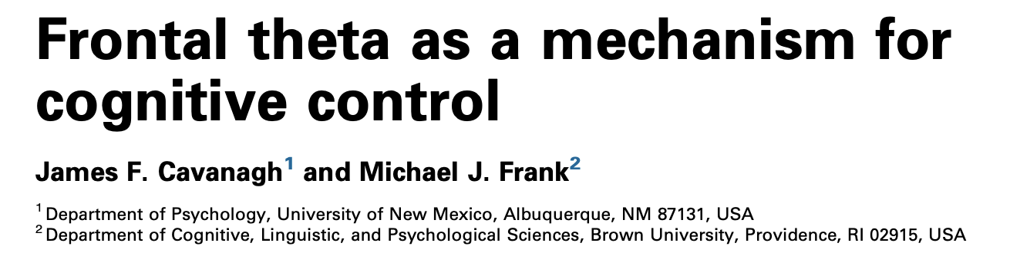
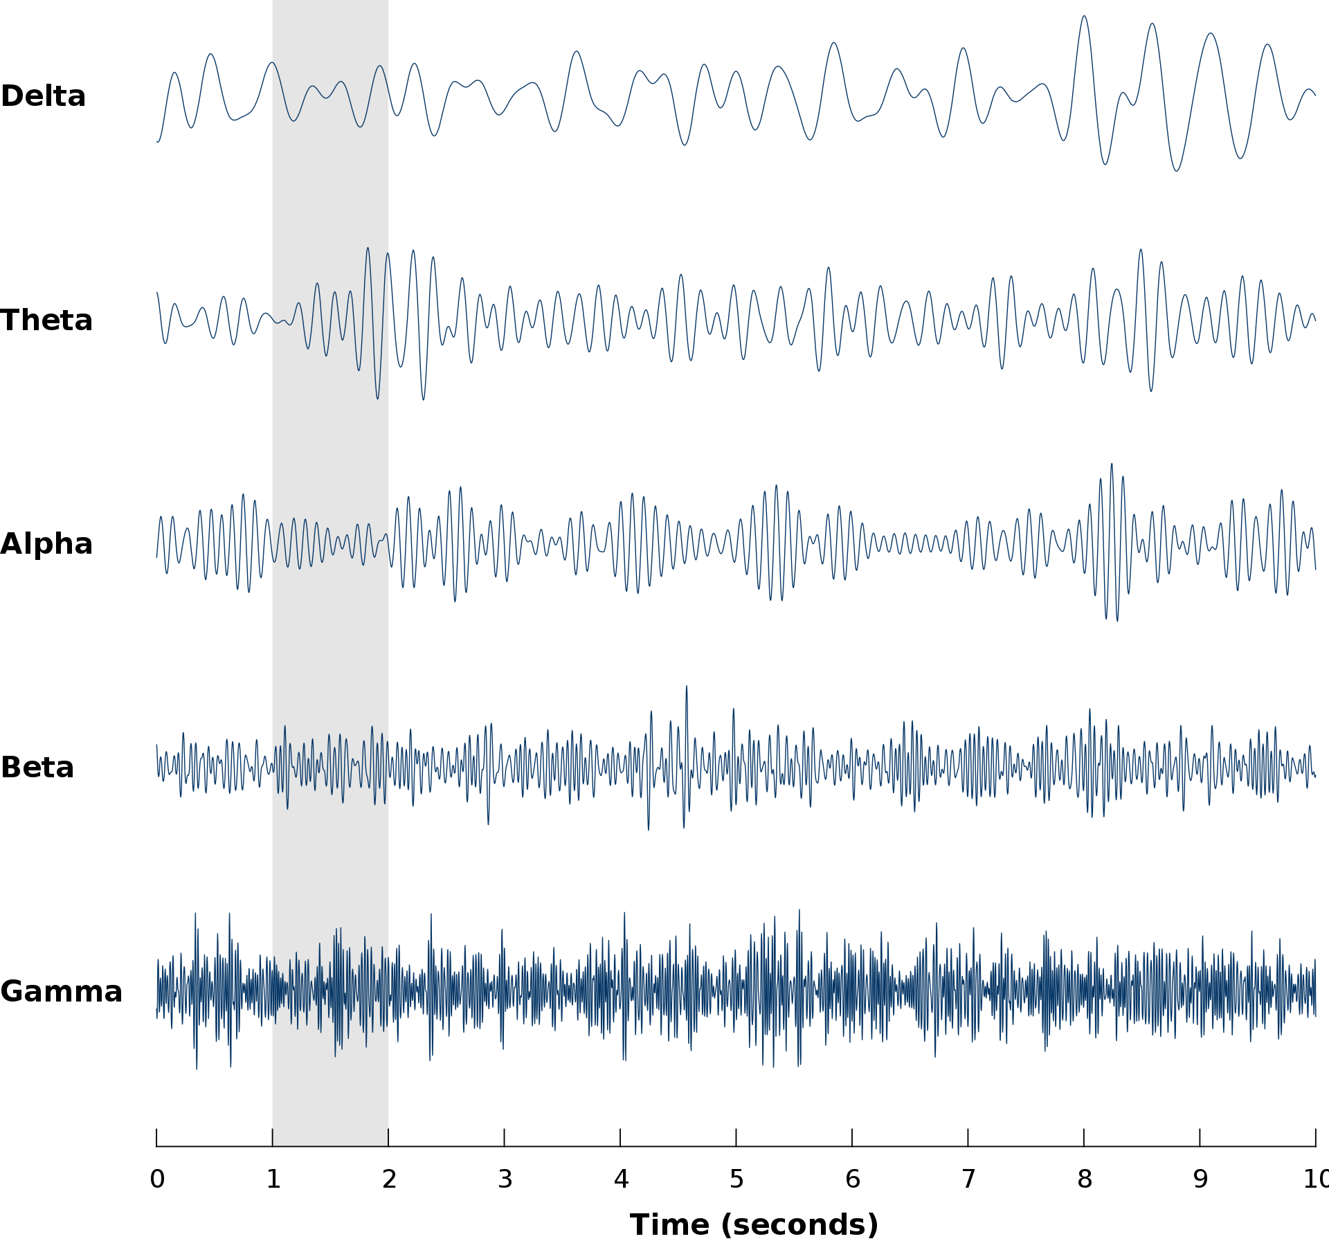
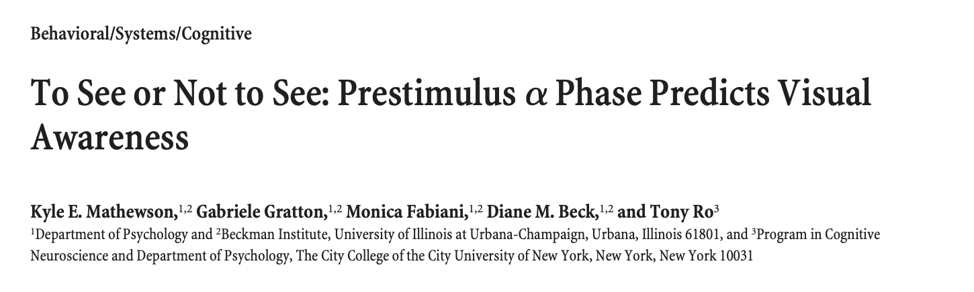
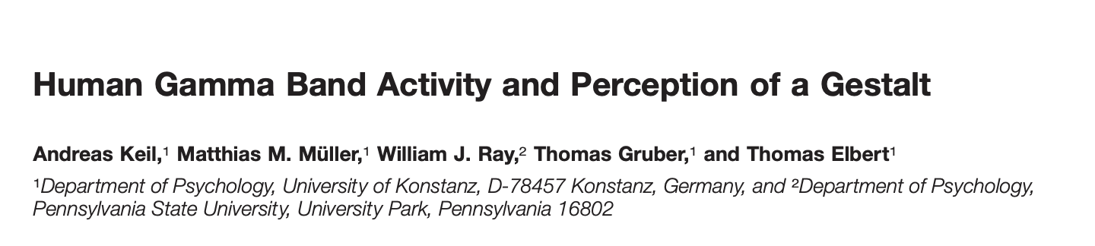
Frequency Bands
Notes:
As we saw last week, neural signals can typically be divvied up into different frequency bands, each underlying different cognitive effects
Here’s the picture we saw last week, and some example of how these different freqnecy bands appear in cognitive science literature
Introduce titles

Slide 4
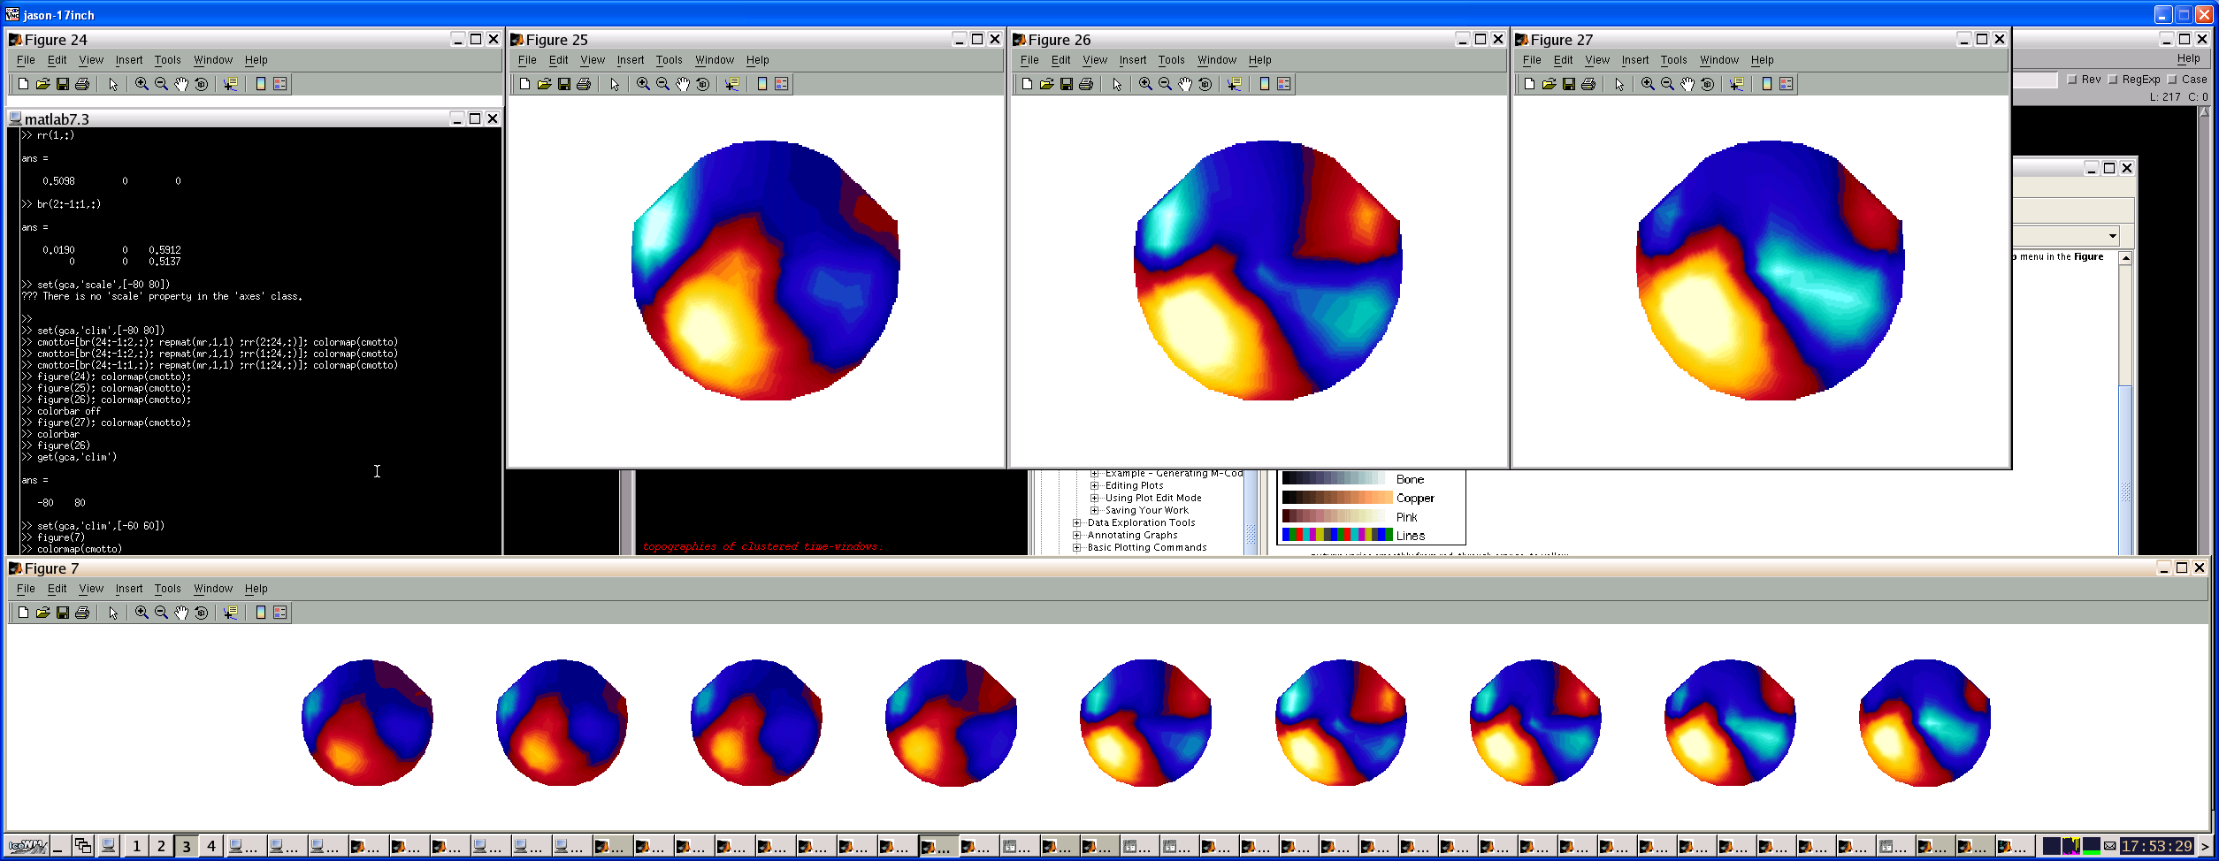
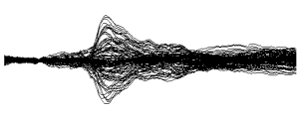
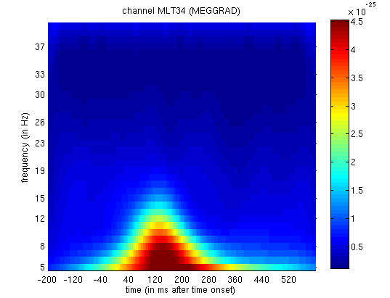
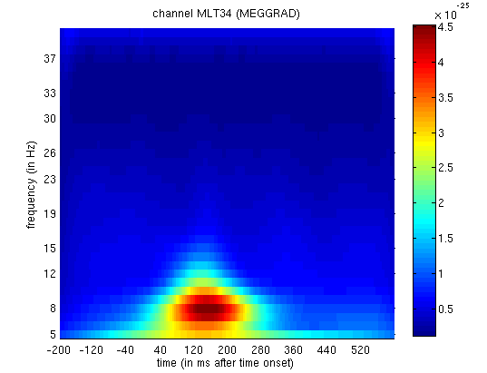

Different kinds of M/EEG Analyses
x
1D
2D
y
3D
time
frequency
time
time
When / at what frequency is there an effect in frequency?
When / where is there an effect in sensor-topography space/time?
When is there an effect in time?
Notes:
Given the nature and dimensions of MEG data, there’s a variety of different analyses you can do at the level of the sensors (i.e. before you perform source reconstruction as Bente will explain after me)
You can simply look at when an effect is happening in time, averaging over all the different sensor locations, or looking at individual sensors
Or, you can start to look at where an effect is happening in time, but also in what frequencies these effects may be specific to
Or you can look at the effects happening over time whilst taking into consideration the location of the sensors on the scalp to see when an effect is happening, but also where on the scalp this may be
So for this talk previous years have focused on doing group level statistical tests on analyses like this, but those stats are basically exactly the same as group level analyses in fMRI which we’ve already covered – so I’m just going to introduce these time x frequency analyses and explain how you can do them, just because I think it might be a little more interesting than covering the same ground twice

Slide 5
Time x Frequency Analysis
This is our end result – but how do we get here?
Notes:
So – in a time x frequency analysis, what we end up with is a 2d matrix like this. On the Y axis we have different frequencies of neural oscillations, and on the X axis we have the time. The color axis represents the power of a particular frequency and a particular time point
So the question is, if this is our end result – how do we get here?

Slide 6
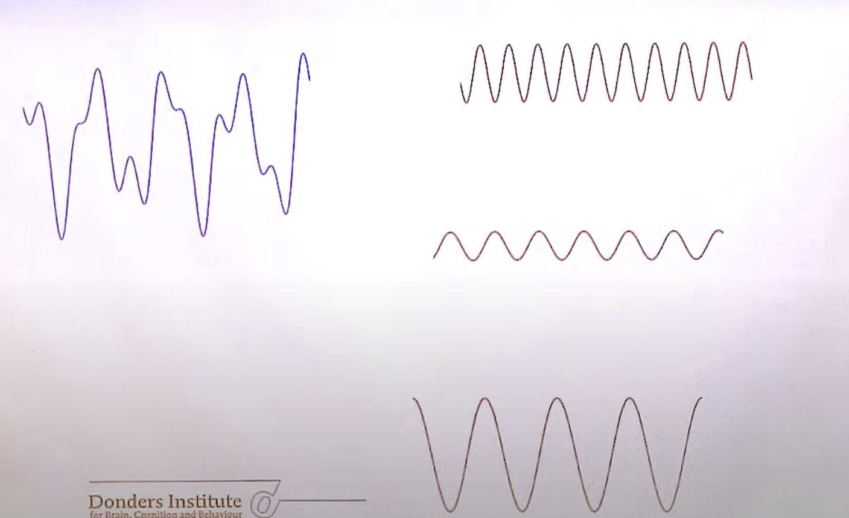
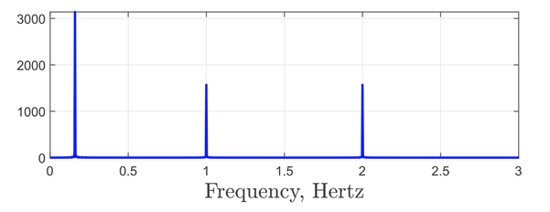
Fourier Transform
power
Notes:
It all starts with a fourier transform
So the idea behind a fourier transform is that we can decompose a raw signal into different sine and cosine waves with different frequencies, power, and phase
We’re not going to focus on the phase in this analysis, only frequency and power
So if you imagine that this is a neural signal at one sensor across a trial, so that would be the signal over time
A fourier transform will decompose this signal into a variety of pure sine and cosine waves with different frequencies
And it will be able to output the strength (or power) of each of these frequency waves in building up the original signal
So in this example, the low frequency wave has higher power than the other two, which means its contributing most to the raw signal

Slide 7
Important Feature of Fourier Transform
The ‘frequency resolution’ is defined by the length of the data segment
  Defined by Rayleigh Frequency: 1 / Time
So if our data window is 1s long
  1 / 1 = 1
    Can sample in steps of 1Hz (1Hz, 2Hz, 3Hz, etc…)
If our data window is 0.2s long
  1 / 0.2 = 5
    Steps of 5 Hz (5Hz, 10Hz, 15Hz…)
0s
1s
time
0.2s
Notes:
Now one important feature of a fourier transform that can potentially mess up our time x frequency analysis is the fact that
The resolution with which we can decompose our raw signal into individual frequencies is defined by the length of the data segment we’re looking at
And this is done according to the Rayleigh frequency: 1 over time
So to explain this a bit more concretely
If this is our neural signal we’re running our fourier transform over and its one second long
We can sample in steps of 1 Hz
But if the signal was only 0.2 seconds long, our resolution goes down and we’re only able to sample in steps of 5 Hz
So why is this important and how might it affect our frequency analyses?

Slide 8
Time/Frequency Trade Off
Rayleigh frequency means we have a trade off
  Between temporal resolution and frequency resolution
We can have a high temporal resolution, but this will limit our frequency resolution
  And vice versa
Notes:
So this Rayleigh frequency means we have to trade off between our temporal resolution and our frequency resolution
So if we want to examine the changes in different frequencies power at short time intervals, we have to accept that we wont be able to just focus on a very narrow frequency band
Or alternatively, if we want to really focus in one frequency, we have to accept that we cant see how the power of that frequency will change over fine-grained periods of time

Slide 9
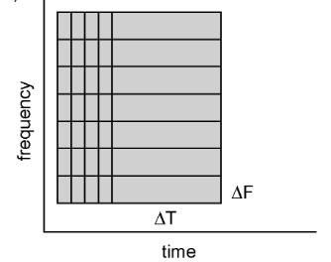
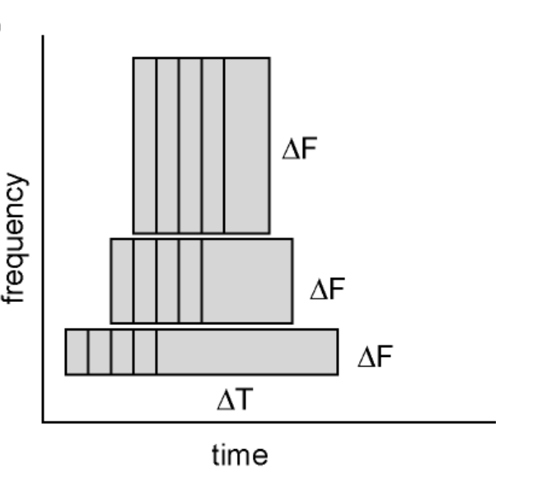
Calculate Time x Freq Plot
Move sliding window over Time x Freq plot
  Multiply each window by taper
    Estimate power at each frequency and time point
power
Notes:
Now in order to calculate the time frequency plot, you just select your time window, and the resolution of frequency you want (and remember these have to be compatible) and slide that window across the time * frequency matrix, performing a fourier transform at each point and calculating the power
What you can also do to help mitigate the issue of the time-frequency trade off is to use sliding windows that decrease in time as frequencies get higher
This gives you greater sensitivity to the more short-lived effects in higher frequencies. This does of course come with a cost of a reduced frequency resolution, but it may be that above a certain frequency you have less interest in fine grained disticntions in frequency
And you move that sliding window all over your data to generate a time x frequency plot

Slide 10
Significance Testing
Can then run second-level analysis in the same way as fMRI
  Huge multiple comparisons problem
    Testing at each channel, time-point, frequency
SPM uses RFT to correct for MC
  Up to 3 dimensions supported
Will find the times and frequencies where two groups or conditions differ
Notes:
This test may be one for channel, or you may average over all channels in this analysis here – which shows in condition A a significant amount of activity in the theta band around 400-600ms after stimulus onset, which wasn’t present in condition B

Slide 12
Spectral Leakage
We can only sample frequencies according to our frequency resolution
But what about frequencies not covered by this resolution?
  E.g. if we sample in steps of 1Hz (1Hz, 2Hz, 3Hz…), what happens to oscillations at 1.5Hz?
They ‘leak’ into other frequencies
Notes:
Well, if we can only smaple frequrncies in line with our frequency resolution
It raises the question of what happens to frequencies not covered by this resolution
So for instance if we’re sampling in steps of 1Hz, what does the fourier transform do with the neural signals oscillations at 1.5Hz, or 2.5 HZ and so on
Well, the problem is that they ‘leak’ into other frequencies

Slide 13
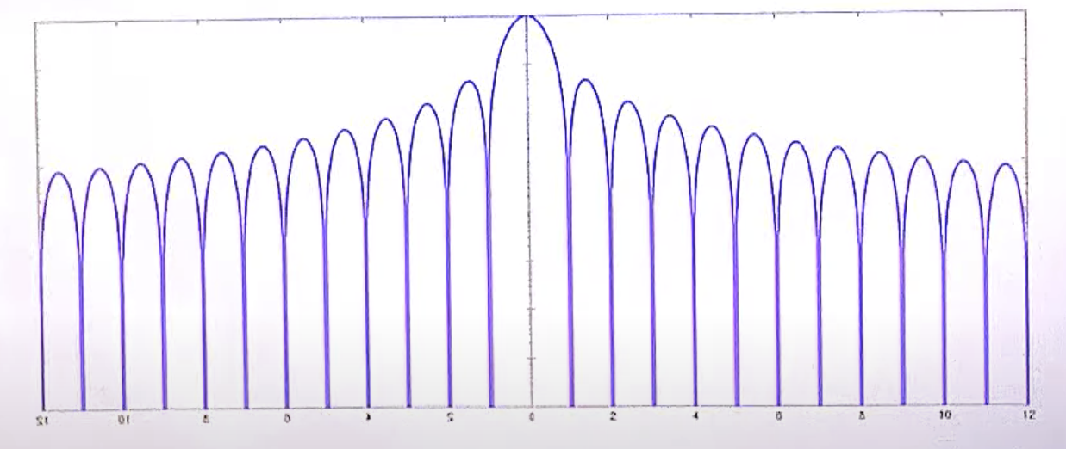
Spectral Leakage
Main Lobe
They ‘leak’ into other frequencies
We want:
  Reduced effect of ‘side lobes’
  Increased effect of the ‘main lobe’
  i.e. reduce the spectral leakage
Side Lobes
Notes:
Spectral leakage is explained in this plot here, and I shall try to explain it as best I can
Essentially the 0 mark here is a particular frequency during our fourier analysis
So lets say this middle point is 10Hz, and our fourier transform is trying to work out the power of this 10Hz signal
The Y axis is representing the contribution of other frequencies to the 10Hz power during the fourier analysis
And what you can see is that the contribution of frequencies that are within our 1 Hz frequency resolution (e.g. 11 Hz, 12 Hz, 13 Hz) are 0
This is because the fourier transform can measure the contribution of these frequencies on their own because it samples at those specific points
But, you can see that in between these frequencies, e.g at 10.5Hz, 11.5Hz etc. the contribution to the 10Hz signal is quite significant, and this goes up all the way to much higher and lower frequencies than the 10Hz the fourier transform is trying to measure, for example 21.5 Hz frequecneis are still contributing to our estimate of the power of a 10Hz signal
So, in an ideal world we would have a reduced effect of these side lobes
And a larger effect of the main lobe – which both amount to a reduction of the spectral leakage
The question then becomes – what causes these side lobes, and how do we get rid of them?

Slide 14
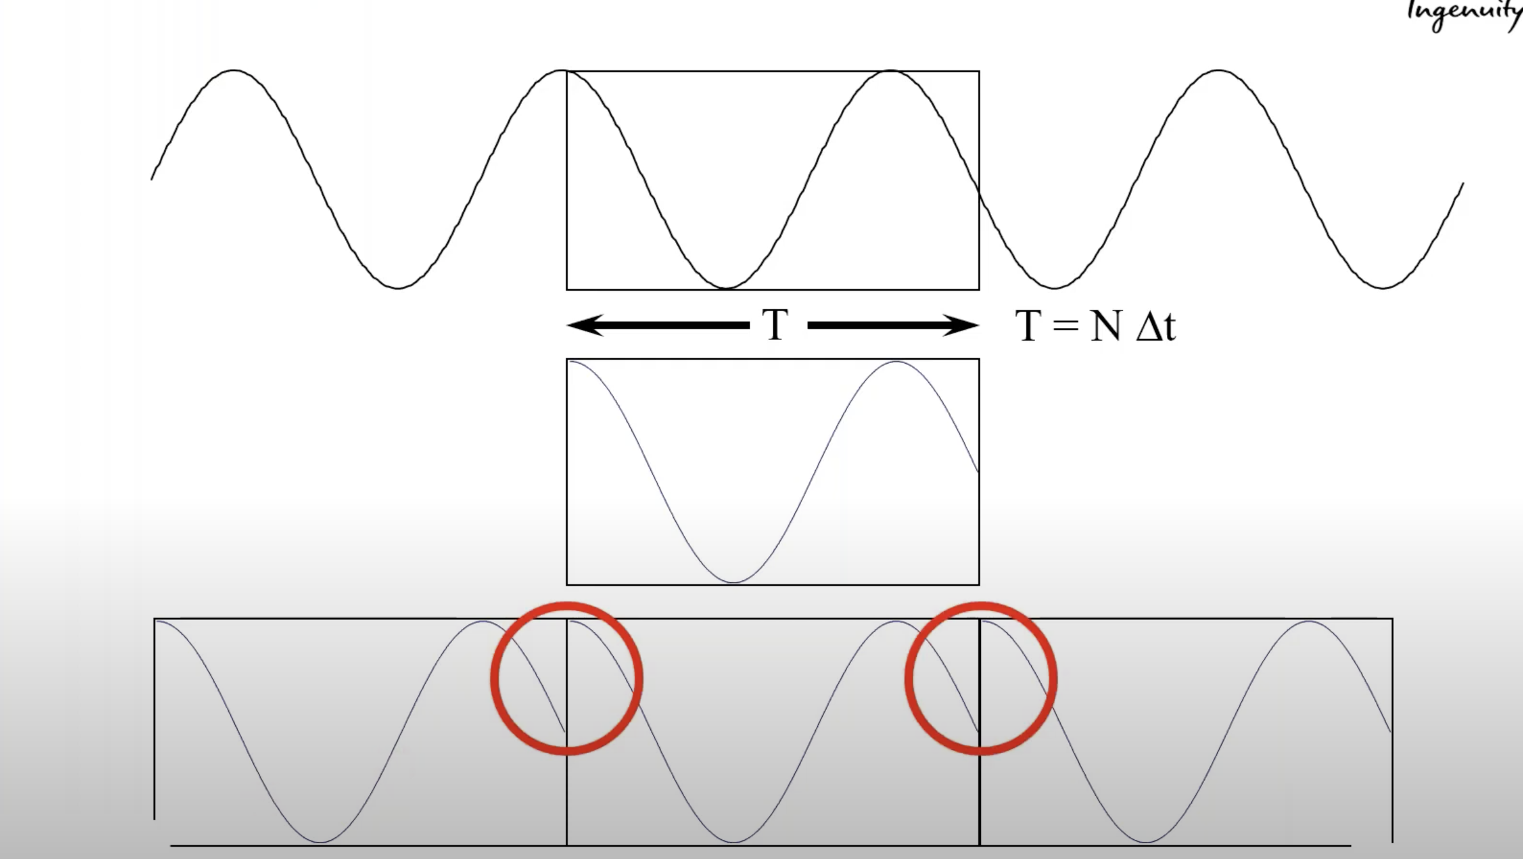
What causes these side lobes?
Notes:
Side lobes occur because the neural signals that we sample in our time window are not going to be perfect periodic
What this means is that when we cut out a section of our neural signal over time, the fourier transform treats it as a repeating signal with these really sharp changes in signal
And when these sharp transient changes get decomposed into frequencies in the foruier transform, they are decomposed into a wide range of low to high frequencies, which leak into the frequencies we can actually sample, and cause the large side lobes I showed you in the previous slide

Slide 15
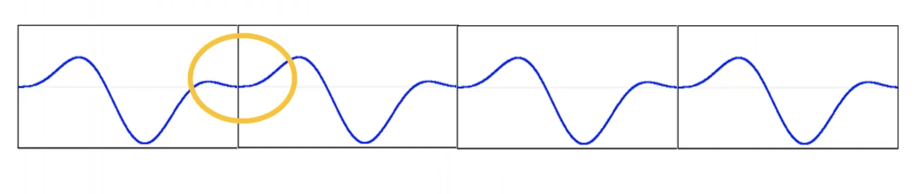
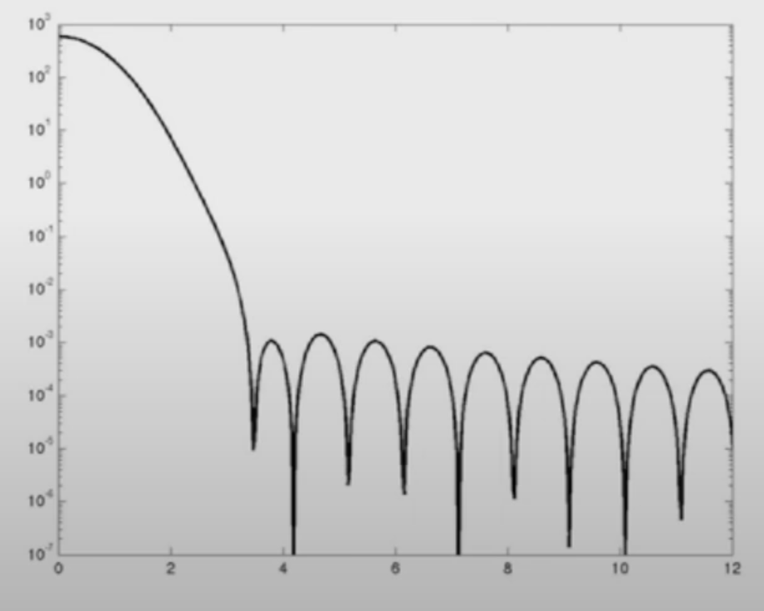
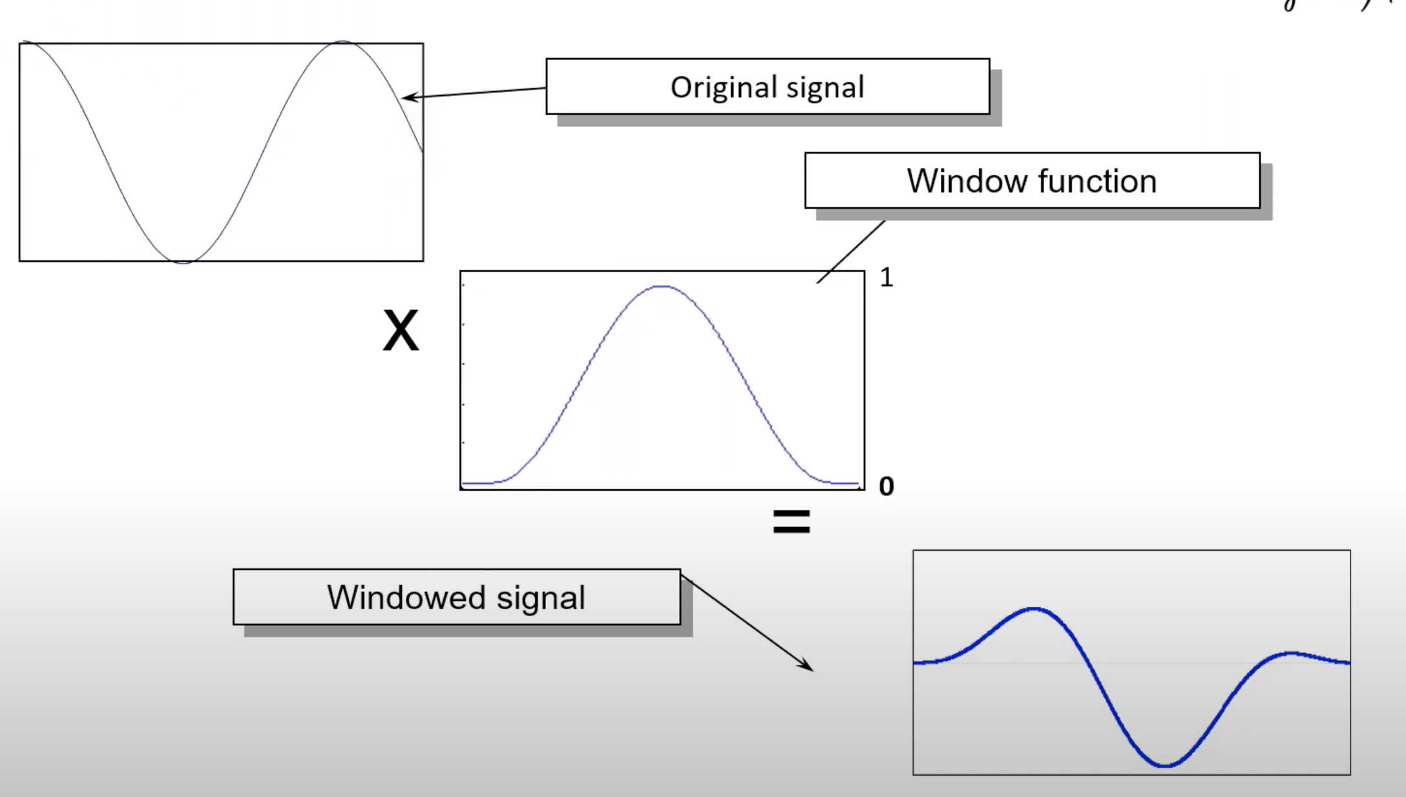
Tapering
Reduces impact of spatial leakage
Notes:
The way we solve this is through tapering, or windowing, where every time we select a time-snippet of our signal, we essentially just multiply the signal by a window function that makes the edges of the signal less extreme
This has the effect of removing the edge transients as shown in this image
And so the fourier transform doesn’t estimate such a wide variety of frequencies that aren’t actually part of our signal at these points
And if you take a look at the main lobe and side lobes after tapering, you see that the main lobe becomes a lot larger with respect to the side lobes, which indicates a reduction in spatial leakage

