Slide 1
M/EEG Source localisation

Slide 2
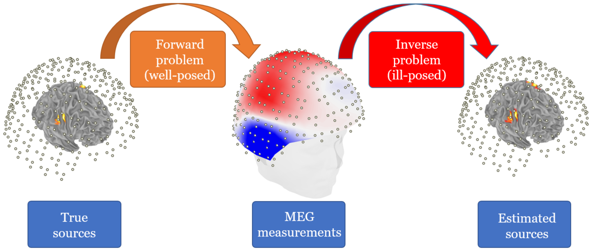
Is it possible to find the locus of electrical activity in the brain based on the map of recorded activity?

Slide 3
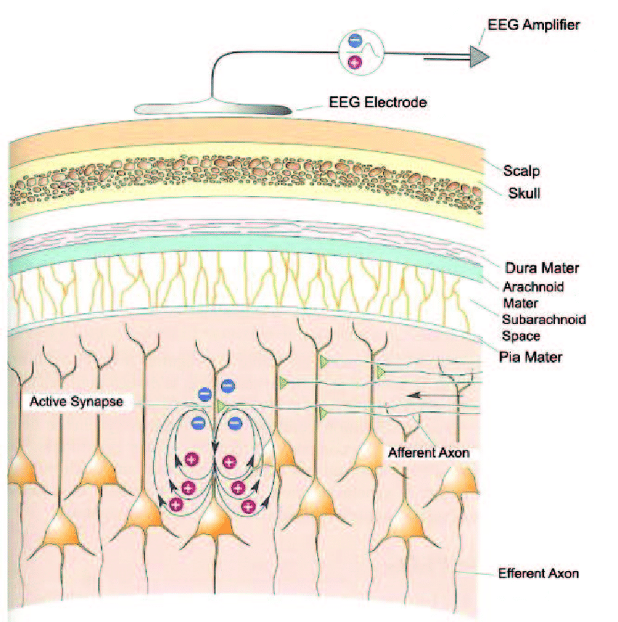
How do M/EEG signals arise?
Postsynaptic potentials on pyramidal cortical neurons
Synchronised activity propagates to scalp
Multiple regions are active, making it harder to infer location
Assumptions about this signal
EEG signal is generated by pyramidal neurons perpendicular to scalp
Large group signal can be picked up on by electrodes
Dendrites are parallel to each other in the cortical sheet

Slide 4
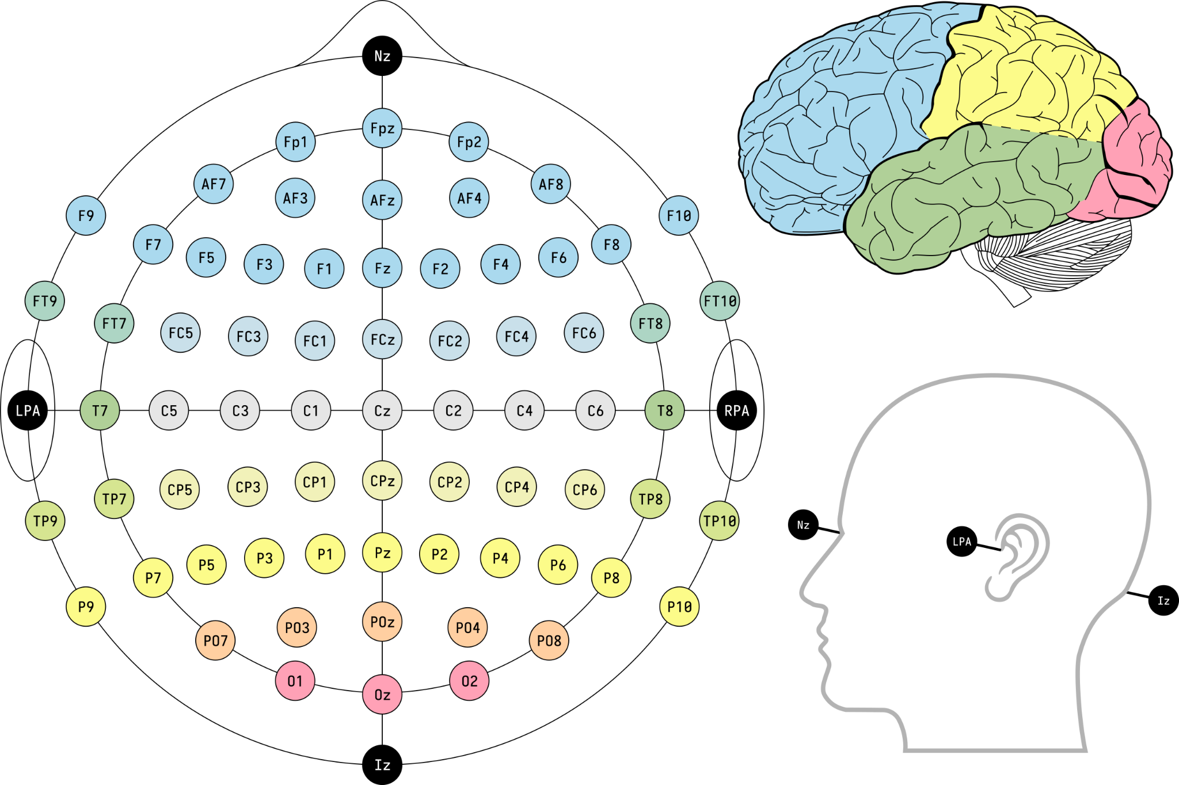
Issues
Skull thickness is not homogenous across the head
Head is not spherical
Propagation of signal is not homogenous
MEG vs EEG
MEG detects tangential, EEG also radial
Magnetic fields are not distorted by skull and CSF conductivity

Slide 5
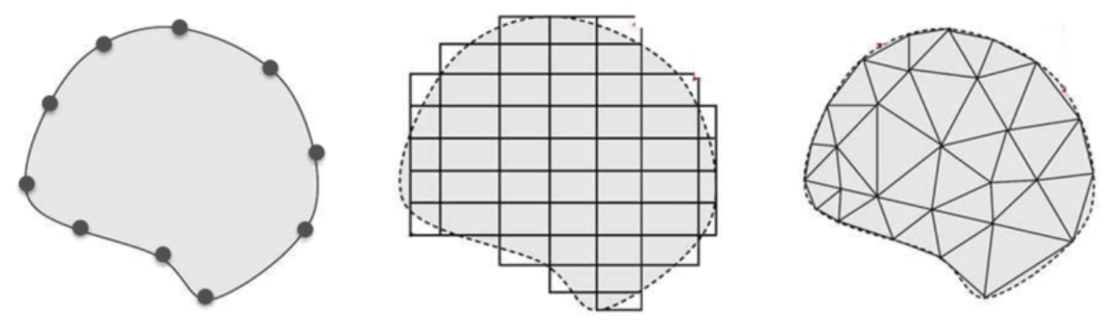
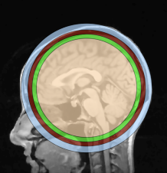
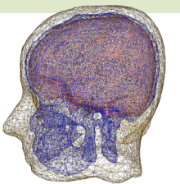
The head model
Simple head model - Analytical
Single layer sphere
Can be solved fast, but not accurately
Realistic head model - Numerical
Boundary element
Finite element
Represents head shape better, but computationally complex
Notes:
FEM: structure of triangles is much more complex; level of detail
Add about the differences of MEG/EEG because of absence scalp distortion
The boundary element method is the most popular and models the head as a mesh of triangles that represent the interface between air, scalp, skull and brain. The types of tissue are given conductivity values. The finite element method has been used to model tissue conductivity that is not homogenous, using the anatomical information provided by MRI to segment different brain tissues.

Slide 6
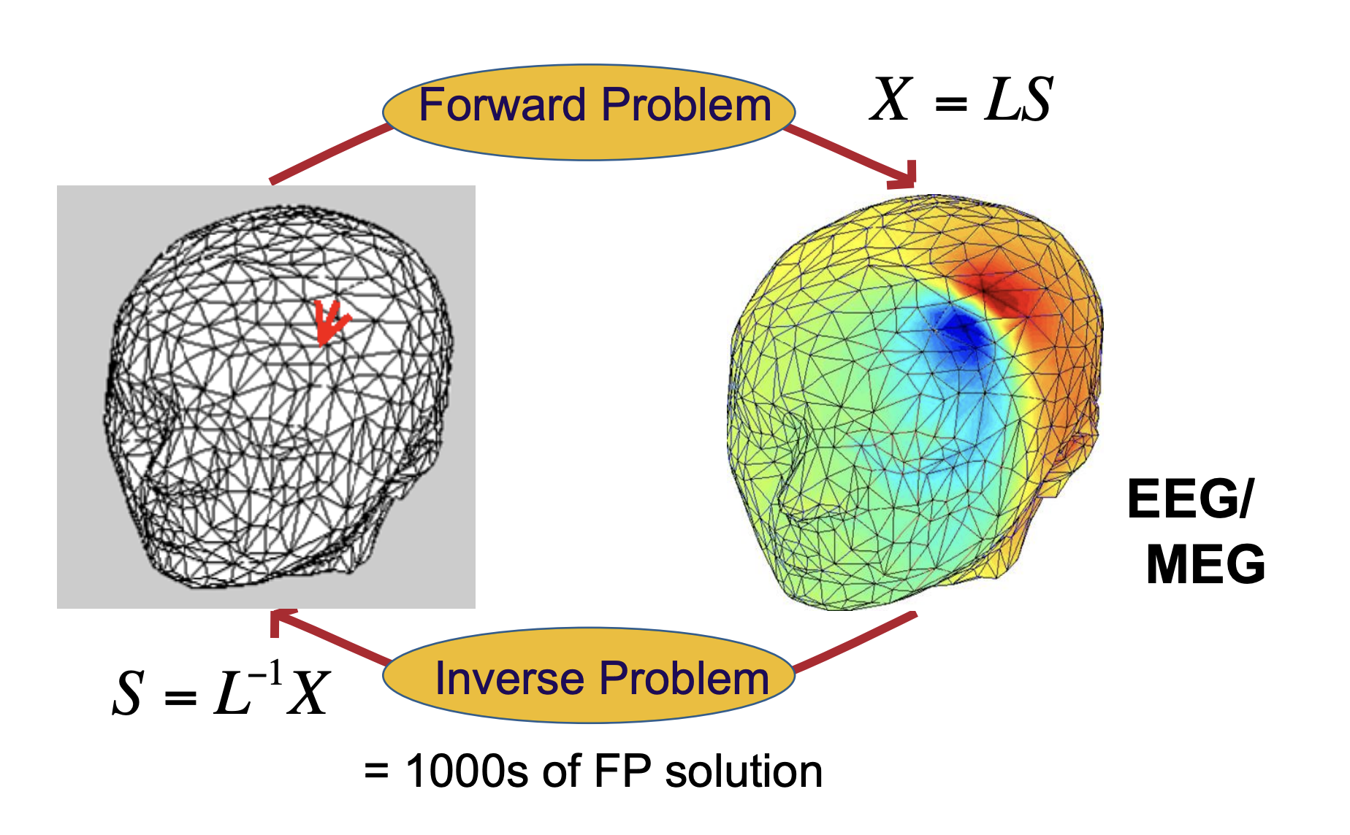
The forward and inverse problem
X: scalp recorded potentials
S: current density vector
L: head volume conductor
model
Notes:
A forward problem starts with the causes/source and then calculates the effects.
An inverse problem starts with the effects and then calculates the causes

Slide 7
The inverse problem
ill-posed: there are infinite solutions
The signal at a vector can be explained by an undefined combination of dipoles
Therefore, it needs constraints
Notes:
Important: explain how important the constraining is
A well-posed problem:
1. A solution exists.
2. The solution depends
continuously on the data.
3. The solution is unique

Slide 8
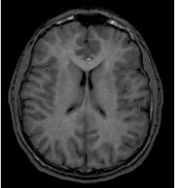
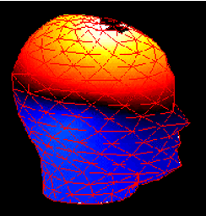
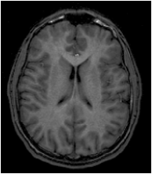


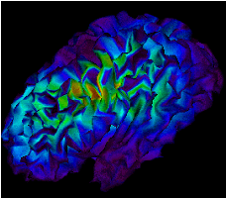
Solving the inverse problem
Anatomical constraints
Ill-posed inverse problem
Functional constraints
Notes:
Thus any a priori information about correlation between the dipole strengths at different locations can be used as a constraint, smoothness constraints, on the dipole orientations
1. Mathematic Constraints( e.g., minimum norm, maximum
smoothness, optimal resolution, temporal independence)
2. Anatomical Constraints (e.g., Normally use the subject’s MRI scan, if not, it is possible to use standardized MRI brain atlas (e.g., MNI) can be be warped to optimally fit the subject's anatomy based on the subject's digitized head shape.)
3. Functional Constraints (e.g., frequency band)

Slide 9
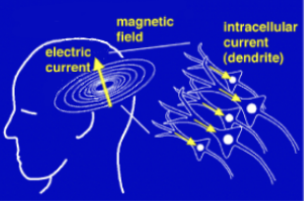
The models: Equivalent current dipole
Inverse model
Non-linear optimisation technique
Relies on two hypotheses:
Only a few sources are active simultaneously
These sources are focal
→ The observed scalp potential is explained by a few discrete current sources
The number of active locations is determined a priori

Slide 10
The models: Equivalent current dipole
Uses least square error criteria to optimise fitting
The drawbacks (noise, confidence intervals on parameters, models with different numbers of ECDs cannot be compared) can be solved using Bayesian techniques
A probabilistic model provides likelihood for the data
Notes:
Question: Some sources say that the equivalent current dipole needs Bayesian techniques, but others say that the linear optimisation techniques can use Bayesian techniques. Which one is correct?

Slide 11
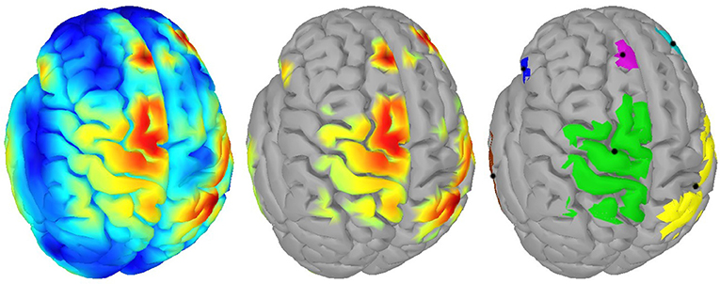
The models: image reconstruction
Inverse modeI
Linear optimisation techniques
Model fitting
  Minimise the sum of squares error between data and model by adjusting the model parameters
    dipole location, orientation, magnitude, time course

Slide 12
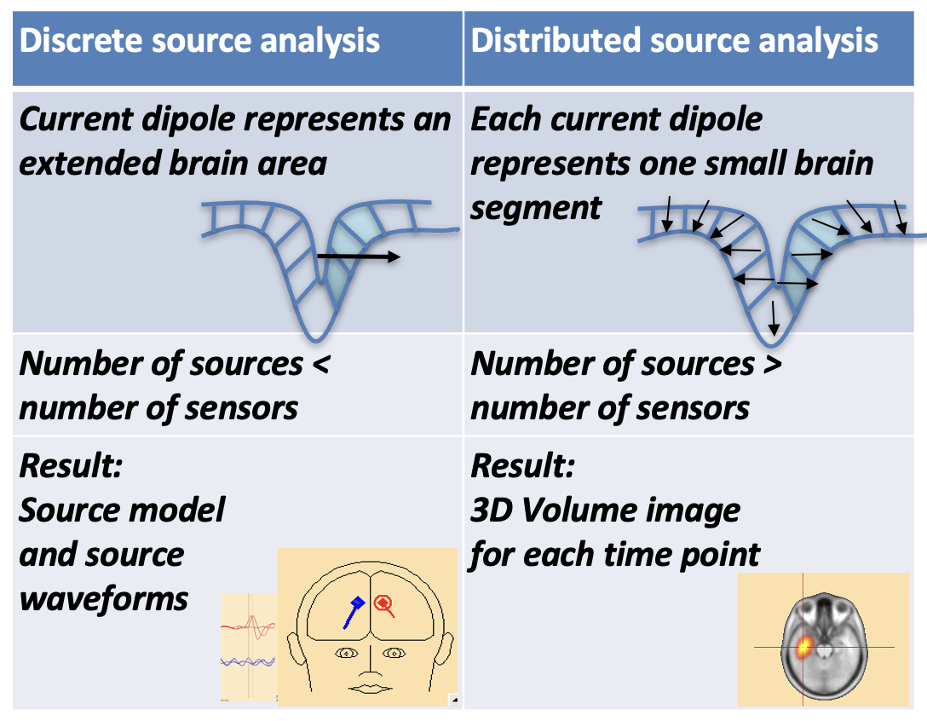
The models

Slide 13
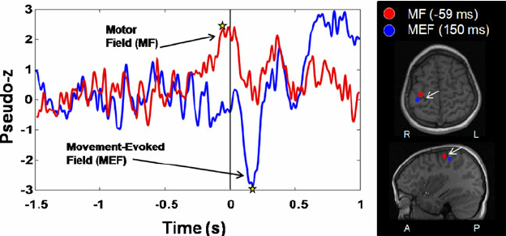
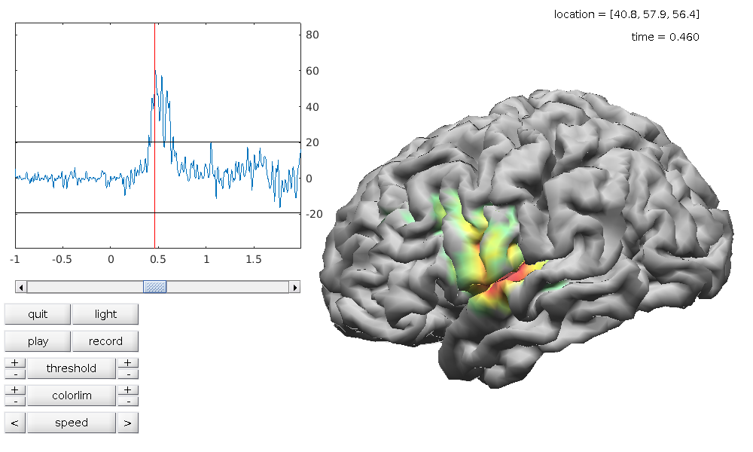
The models: Complex models
Minimum Norm
Minimise source power
Distribution of sources with minimum current that best explains measured data
Regularisation procedure
Beamformer
Links two spatial domains: channel and source
Scan through predefined source locations, computes weights (spatial filter) and compares
Reflects sensor contributions to location estimate
Notes:
The minimum norm estimation is an inverse method which makes use of the constraint of minimising source power. The MNE minimises the L2 norm, which is the square root of the sum of squared vector values. The MNE looks for a distribution of sources with the minimum (L2 norm) current that can give the best account of measured data. It uses a regularisation procedure that sets the balance between fitting the measured data (minimise residual) and minimising the contributions of noise.
The beamformer model provides a link between two spatial domains. There is a channel space in which measures are done, and a source space where we want to interpret the data. Beamforming is done by scanning through a set of predefined putative source locations, computing separately for each location a set of weights, a so-called spatial filter, and applying these weights to the measured sensory data to obtain the beamformer output for each location. Thus, the spatial filter reflects the individual sensor’s contribution to each location’s source estimate.

Slide 14
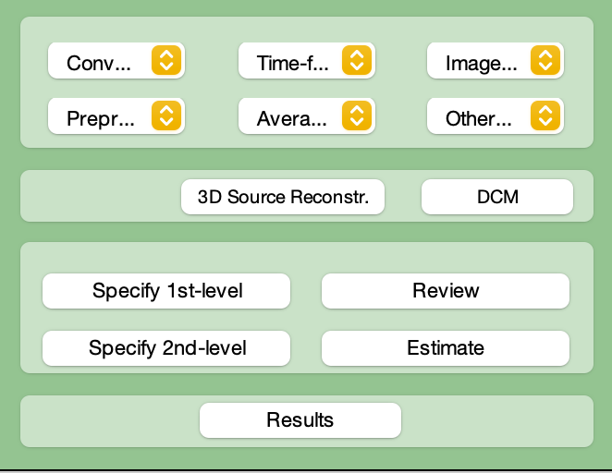
Source localisation in SPM12

Slide 15
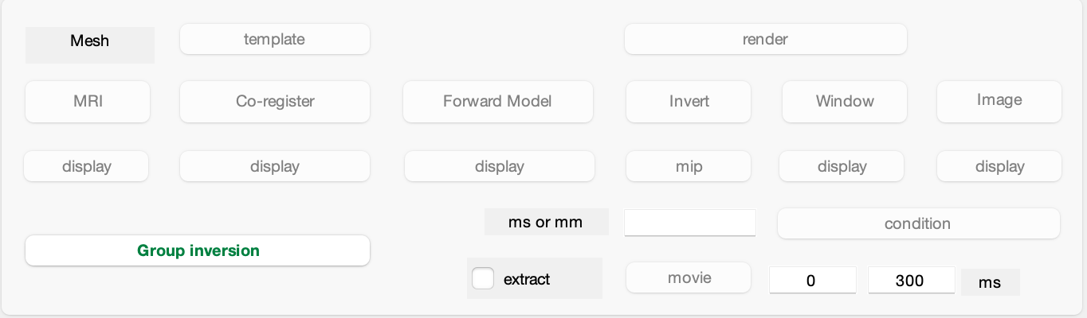
Step 1: Source space modelling
Preparing the model
MRI → creates boundaries in individual heads based on structural scan
Template → provides head model from SPM
Notes:
Creates cortical meshes describing the boundaries the head and locations of possible sources of M/EEG signal
Select 3D Source Reconstruction -> load dataset and name analysis
Select MRI -> select subject’s structural image
In the absence of a structural image, select Template and use SPM’s template head model based on MNI brain
For EEG, this transforms electrode positions to match the template head
For MEG, the template head is transformed to match the fiducials and headshape from MEG data

Slide 16
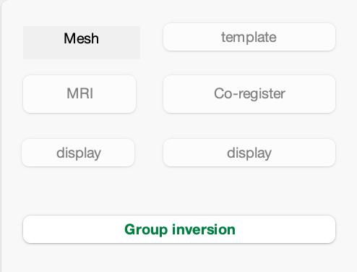
Step 2: Data coregistration
SPM needs to map the coordinate system with a structural MRI
  Landmark-based
  Surface matching

Slide 17
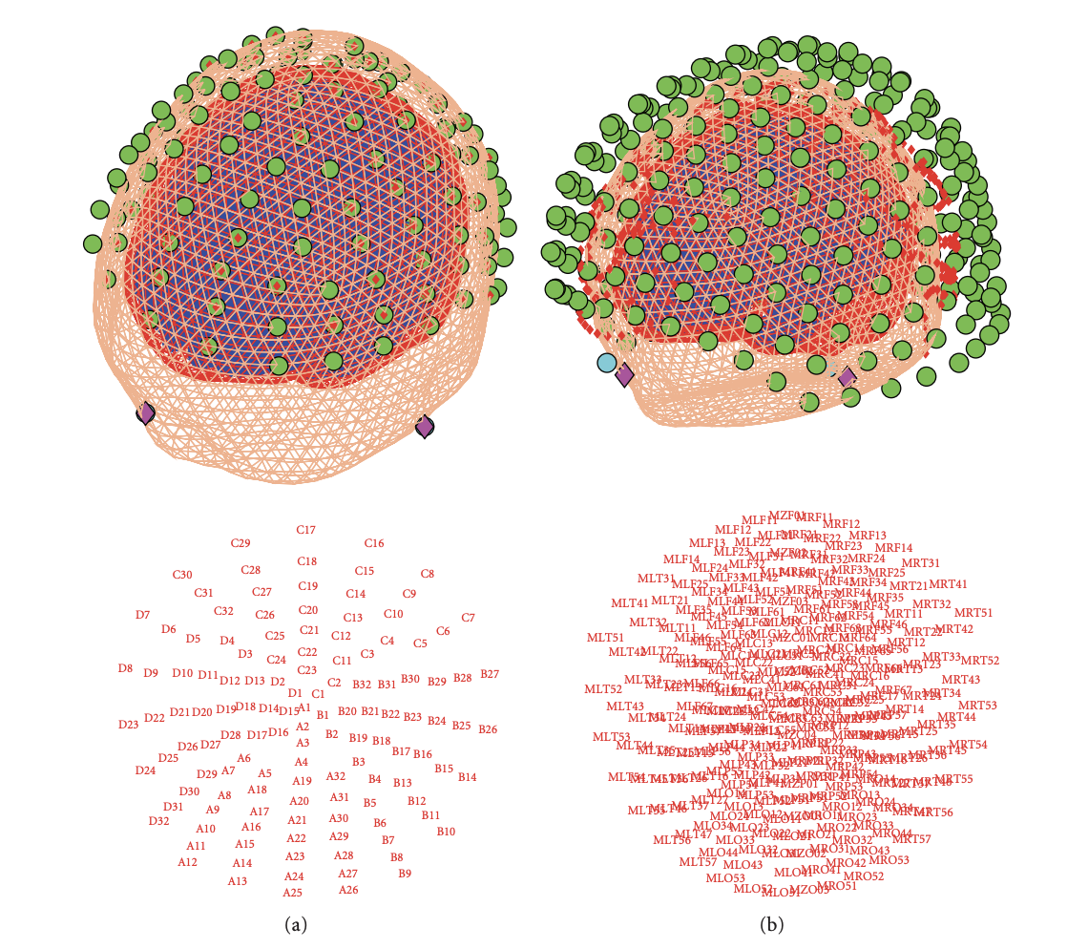
3D outcome
Sensor arrangement

Slide 18
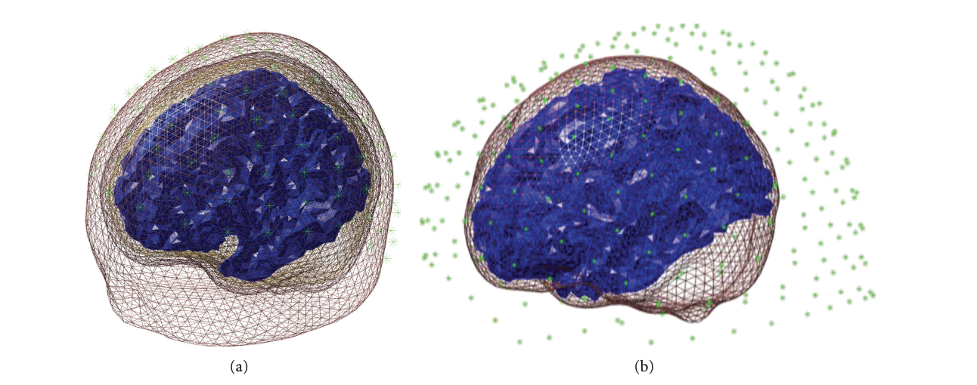
Step 3: Forward computation
Computes the effect each dipole on the cortical mesh would have on the sensors
  Lead fields: correspond to one mesh vertex
Choice of head models
Notes:
For each dipole on the cortical mesh, what effect would it have on the sensors?
Generates N (no. of sensors) x M (no. of mesh vertices) matrix
Each column is called a lead field and corresponds to one mesh vertex
Lead fields are computed using the forwinv toolbox
The computation makes assumptions about the physical properties of the head, and the ways to specify this are called forward models

Slide 19
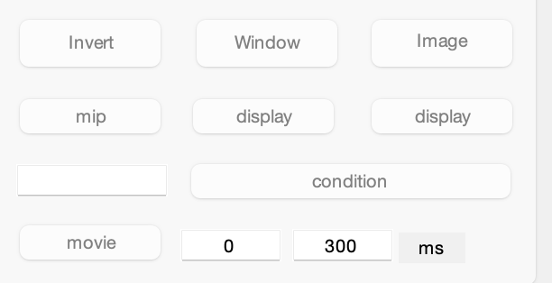
Step 4: Inverse reconstruction
Options for different methods
Imaging
  Bayesian approach
ECD
Set time window

Slide 20
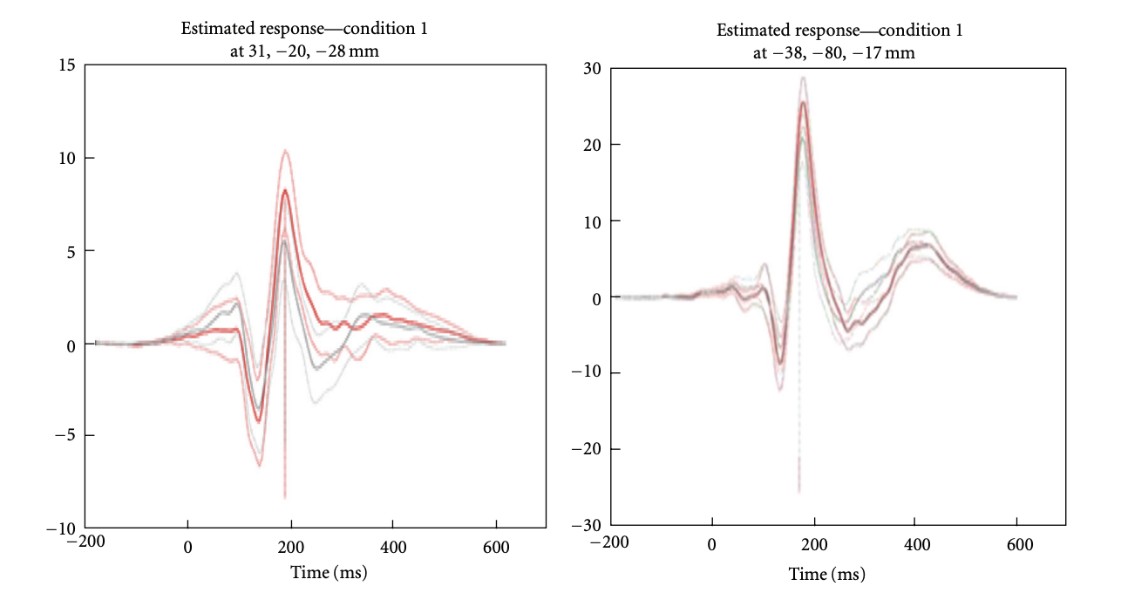
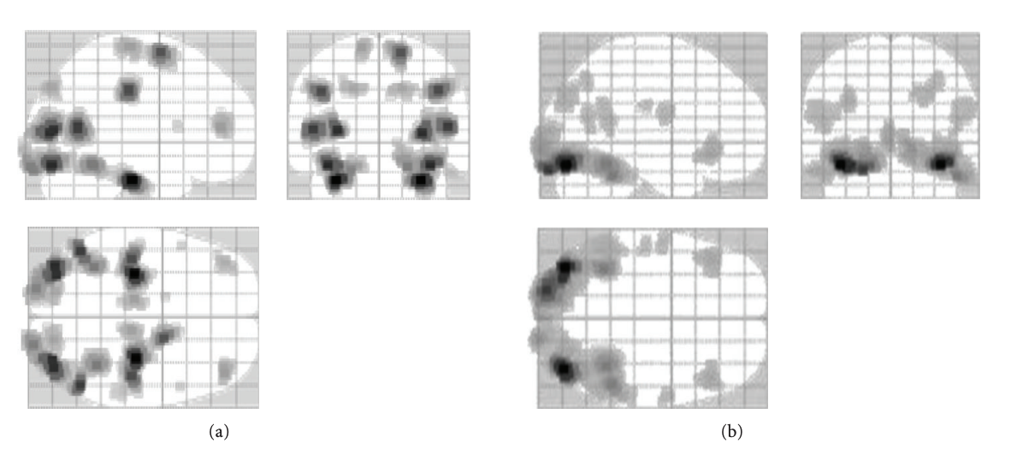
Step 5: Summarising the reconstructed response as image
Summary statistics over time and frequency
3D NIfTI images

Slide 21
References
Litvak, V., Mattout, J., Kiebel, S., Phillips, C., Henson, R., Kilner, J., Barnes, G., Oostenveld, R., Daunizeau, J., Flandin, G., Penny, W., & Friston, K. (2011). EEG and MEG data analysis in SPM8. Computational intelligence and neuroscience, 2011, 852961. https://doi.org/10.1155/2011/852961
Michel, C. M., & He, B. (2019). EEG source localization. Handbook of clinical neurology, 160, 85–101. https://doi.org/10.1016/B978-0-444-64032-1.00006-0
Muñoz-Gutiérrez, P. A., Giraldo, E., Bueno-López, M., & Molinas, M. (2018). Localization of Active Brain Sources From EEG Signals Using Empirical Mode Decomposition: A Comparative Study [Original Research]. Frontiers in Integrative Neuroscience, 12. https://doi.org/10.3389/fnint.2018.00055
Singh S. P. (2014). Magnetoencephalography: Basic principles. Annals of Indian Academy of Neurology, 17(Suppl 1), S107–S112. https://doi.org/10.4103/0972-2327.128676
Presentations from previous years
https://cfmriweb.ucsd.edu/ttliu/be280a_12/BE280A12_eeg5.pdf
Grech, R., Cassar, T., Muscat, J., Camilleri, K. P., Fabri, S. G., Zervakis, M., Xanthopoulos, P., Sakkalis, V., & Vanrumste, B. (2008). Review on solving the inverse problem in EEG source analysis. Journal of neuroengineering and rehabilitation, 5, 25. https://doi.org/10.1186/1743-0003-5-25

