Slide 1
Basis of the BOLD signal
Physics and physiology
Louise McDonald and Yen Yu
24 November 2010
2010

Slide 2
Aim
Explain physics of MRI and fMRI very simply
Proton spin
Magnets used in the scanner
Image formation
Contrasts, e.g. T₁, T₂, T₂*
Only use essential terminology
A few numbers
Very few subscripts
NO EQUATIONS!!
2010

Slide 3
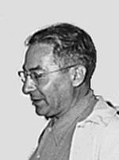
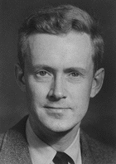
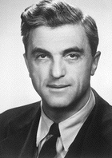
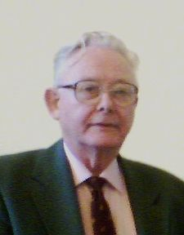
History
1924 – Pauli suggested that atomic nuclei might spin and therefore have magnetic properties
1937 – Rabi showed that atomic nuclei (in gases) can absorb energy from magnetic fields = magnetic resonance (MR)
1945 – Purcell and Bloch demonstrated MR in solids and liquids
1972-1976 – Lauterbur and Mansfield’s work led to localisation of MR signals in 3D using echoplanar imaging
Isidor Rabi
Nobel Prize 1944
Edward Purcell and Felix Bloch
Nobel Prize 1952
Paul Lauterbur and Peter Mansfield
Nobel Prize 2003
2010

Slide 4
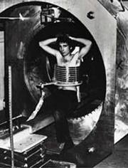
History
1st MR image of a human body in 1977
0.05T, 2 mins/voxel, 4h to get the image
2010

Slide 5
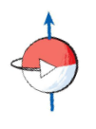
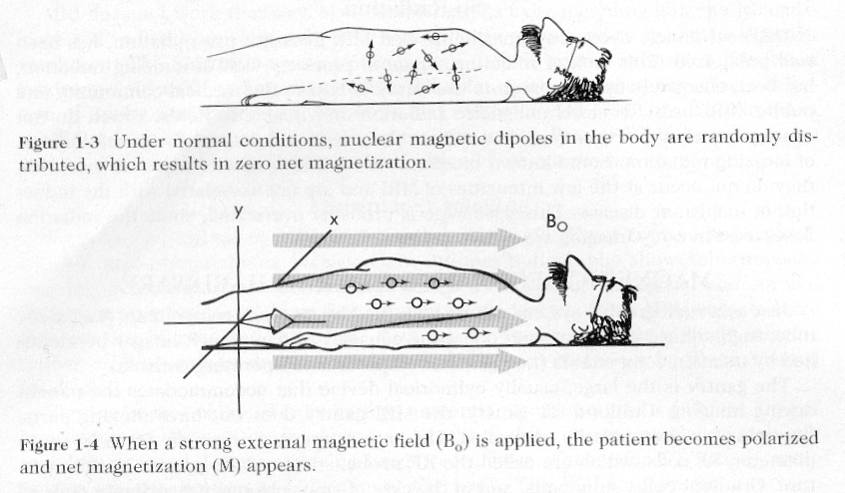
Protons and spin
Protons
Hydrogen nuclei
Very common in body tissue, which is about 80% water
Protons spin
Usually in random directions
Line up in magnetic fields
Millions of protons in a typical voxel; 100,000 or more voxels in a brain scan
Direction of
magnetic field
Proton spinning
(at rest)
2010

Slide 6
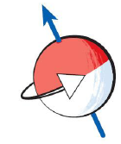
Proton spins
Proton spins are important
At rest, the axes of the spins align with the static magnetic field
After excitation, the axes of the spins precess about the magnetic field lines. (Precession frequency is 64MHz in a 1.5T magnetic field)
Direction of
magnetic field (B₀)
Proton spinning
(at rest)
Direction
of magnetic
field (B₁)
Direction of
magnetic field (B₀)
2010

Slide 7
What happens to protons in an MRI scan
When protons are at rest, MR signal cannot be detected
In order to detect an MR signal, you first need to excite the protons
The RF transmitter coil generates a magnetic field (B₁) at right angles to the static magnetic field (B₀)
The protons start to precess around the B₁ magnetic field
When the B₁ magnetic field is switched off, protons gradually go back to where they were
The relaxing protons emit a signal which can be detected by the RF receiver coil
Spin precession
Following excitation, the frequency of the precession of the proton spins is determined by the strength of the magnetic field
X, Y and Z gradient coils are used to apply gradients of magnetic field
This changes the local spin precession frequency and is used to determine proton spin locations
A typical sequence consists of: excitation-apply gradients-measure signal
2010

Slide 8
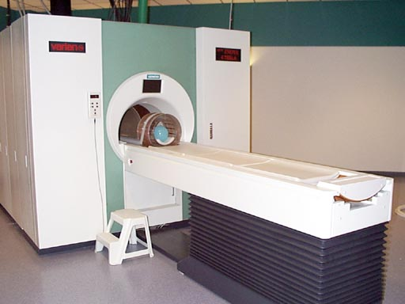
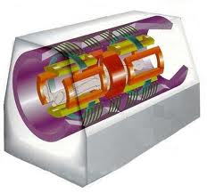
Magnets in the scanner
Gradient coils
4T magnet
Shimming coil
RF receiver coil
Gradient coil
(inside)
Radiofrequency
receiver coil
Static magnetic field coil
2010

Slide 9
Magnets in the scanner
Layers of magnetic coils in the scanner
Static magnetic field coil (B₀) – lines up proton spins
Shimming coils – make static magnetic field homogeneous
Radiofrequency coils – transmit (i.e. sends the B₁ field) and receive MR signal
X, Y, Z gradient coils – localise signal in 3D
2010

Slide 10
Sequence of events in an MRI scan
Static coil is on all the time
Shimming coil comes on before the start of scanning and maintains constant settings
throughout scanning
RF transmitter coil goes on and off during scanning
X, Y and Z gradient coils come on in various sequences and combinations
(details not shown here) after the RF transmitter coil is switched off and
they help to localise the MR signal in 3D
RF receiver coil collects MR signal with location
information when the RF transmitter coil is off
2010

Slide 11
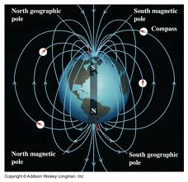
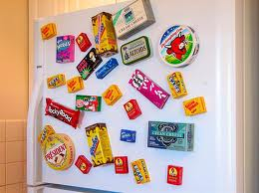
Static magnetic field
Very powerful – 1.5 Tesla or more
Earth’s magnetic field = 0.000031 T
Small fridge magnet = 0.005 T
Magnet in a car scrapyard = 1 T
2010

Slide 12
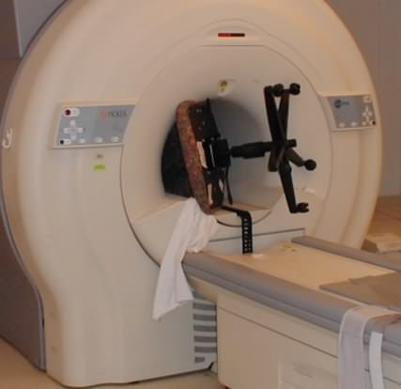
Static magnetic field
2010

Slide 13
Static magnetic field
On all the time
Creates a strong (ideally) homogenous magnetic field
Lines up proton spins, which is needed for other coils to work properly
2010

Slide 14
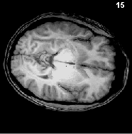
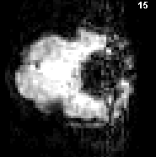
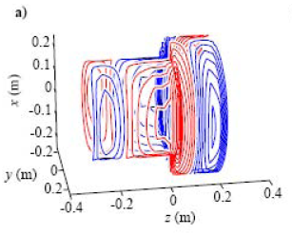
Shimming coil
MR needs a homogenous magnetic field
Magnetic fields often not homogenous, especially with a human inside them
Can cause artefacts in scan such as image distortions and drop outs
Shimming coil improves this
Shimming is done before the scan and the optimal settings are kept throughout the scan
sinuses
ear
canals
2010

Slide 15
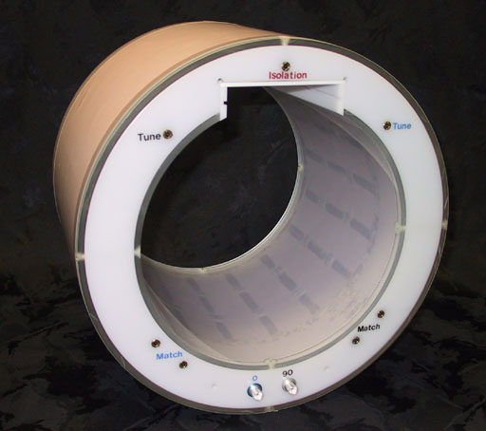
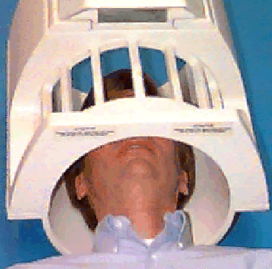
Radiofrequency (RF) coils
RF coils are used to excite/flip the spins (transmit) and measure signal (receive)
Transmit and receive can be done using the same or different coils.
One coil is located inside the bore (generally used for transmission) and one is located around the subject’s head (normally used to receive signal)
RF transmitter coil
RF receiver coil
2010

Slide 16
RF transmitter coil
At rest, the axis of the proton’s spin is aligned along B₀.
Switching on the RF transmitter coil flips the proton’s spin (flipping of the magnetization).
If it’s a short burst of excitation from the RF transmitter coil, the axis of the proton’s spin precesses about the RF field B₁
When the axis of the proton’s spin is flipped by 90º, it ends up in the horizontal plane (typical excitation).
With a longer burst of excitation from the RF transmitter coil, the axis of the proton’s spin points down (180º pulse, or inversion)
(RF transmitter
coil is off)
Proton spinning
(at rest)
Proton’s axis of spin flipped by 90°
Direction of magnetic
field (B₁) from the RF transmitter coil
Direction of
magnetic field (B₀)
from the static coil
Proton’s axis
of spin flipped
by 180°
2010

Slide 17
RF receiver coil
After protons have been flipped, the RF transmitter coil is turned off
Flipped protons gradually return to their ‘at rest’ spins
Take different amounts of time, depending on the tissue type
RF receiver coil detects this
This is the basis of the MR signal
(RF transmitter
coil is switched off)
Proton’s axis of spin flipped by 180°
Proton’s axis of spin
starts to realign with B₀
Direction of
magnetic field (B₀)
from the static coil
Proton spinning
(at rest)
2010

Slide 18
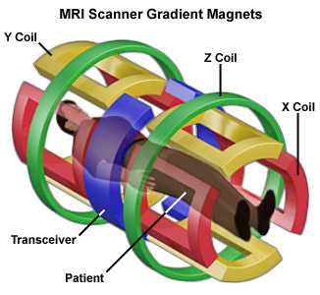
X, Y, Z gradient coils
RF receiver coil detects the MR signal but location information also needed
X, Y, Z gradient coils locate the MR signal in 3 dimensional space
Make the banging noise during scans
2010

Slide 19
X, Y, Z gradient coils
Precession frequency is determined by field strength
The field strength can be changed along a gradient in any direction
This creates systematic differences in precession frequency along the directions of the magnetic field gradients
The frequency response from the spins determines their location
Gradient directions:
X is horizontal (e.g. left to right)
Y is vertical
Z is horizontal (e.g. head to toe)
2010

Slide 20
X, Y, Z gradient coils
Change the strength of the magnetic field along a gradient in different directions
X gradient coil
increases magnetic field
with a gradient of up to 40 mT/m from left to right (in this example)
Z gradient coil
increases magnetic field
with a gradient of
up to 40 mT/m from head to toe
(in this example)
Y gradient coil
increases magnetic field with a gradient
of up to 40 mT/m from bottom to top
(in this example)
2010

Slide 21
Image formation
MR signals received by the RF coil are processed
Variations in MR signal come from how long it takes proton spins to flip back (relaxation) and whether they have flipped back completely before the next RF transmission pulse
Slices along z-axis
2010

Slide 22
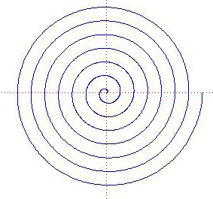
Image formation
Following excitation, gradient pulses are issued in various sequences and the MR signal is measured
Depending on the sequence in which the gradients are played out, different trajectories can be achieved in each 2D slice:
Straight lines =
echoplanar imaging
Spiral imaging
2010

Slide 23
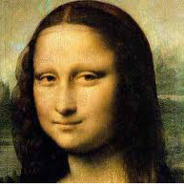
Image formation
Results in images of frequencies called k-space
Picture of the Mona Lisa in k-space
Picture of the Mona Lisa in real space
2010

Slide 24
Image formation
The signal is acquired in k-space. An image in real space is obtained using Fourier transforms
Inverse Fourier
transform
The same brain image in real space
Image of a brain in k-space
2010

Slide 25
Contrasts
The dynamics of the signal after excitation (T₁, T₂ relaxations) depend on the tissue properties
White and grey matter have different T₁ and T₂ relaxation times. As a result, the amount of signal from each tissue type can be tuned, leading to image contrast
The number of protons in each voxel (i.e. proton density) also affects the image contrast
2010

Slide 26
Contrasts
Types of contrast
T₁ – used for static, detailed images of brain
T₂ – used for static, detailed images of brain
T₂* – used for BOLD
Repetition time (TR), echo time (TE) and excitation flip angle all have an effect on image contrast.
2010

Slide 27
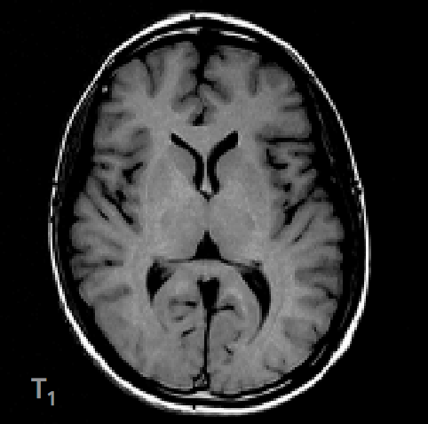
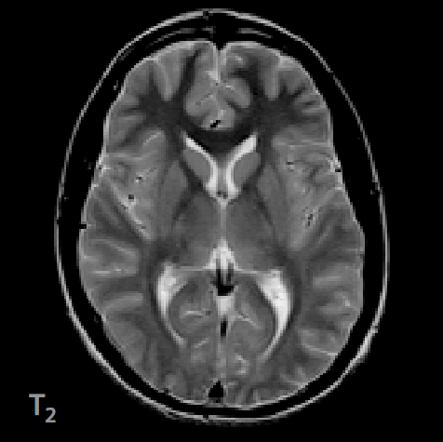
T₁ and T₂ contrasts

Slide 28
T₁ contrast
Good for anatomically detailed static images of brain
White matter lightest
Grey matter intermediate
Liquid, e.g. CSF, darkest
2010

Slide 29
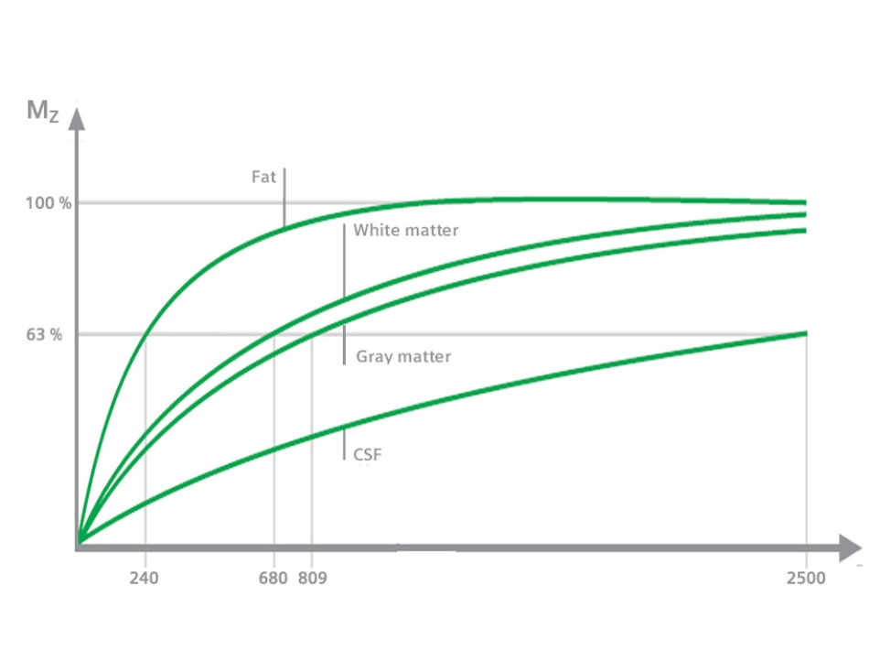
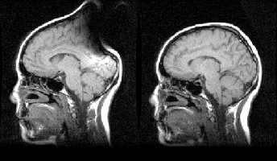
T₁ contrast
Slower than T₂. At 1.5T:
Grey matter 900ms
White matter 600ms
CSF 4000ms
Intermediate repetition time (TR)
Short echo time (TE) to avoid picking up T₂ contrast
More sensitive to artefacts than T₂ (T₁ uses gradient-echo imaging)
This subject was wearing a hair band with a ~2 mm copper clamp. Left: with hair band. Right: without.
Source: Jorge Jovicich
2010

Slide 30
T₂ contrast
Like a photographic negative of T₁
White matter darkest
Grey matter intermediate
Liquid, e.g. CSF, lightest
Used to image tumours and other pathologies
Related to T₂* which is important for BOLD
2010

Slide 31
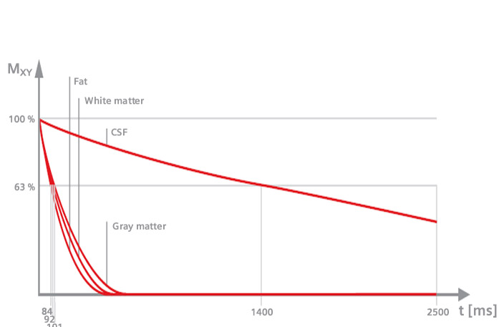
T₂ contrast
Faster than T₁. At 1.5T:
Grey matter 100ms
White matter 80ms
CSF 2000ms
Intermediate echo time (TE)
Long repetition time (TR) to avoid picking up T₁ signal
Less sensitive to artefacts than T₁ (T₂ uses spin-echo imaging)
2010

Slide 32
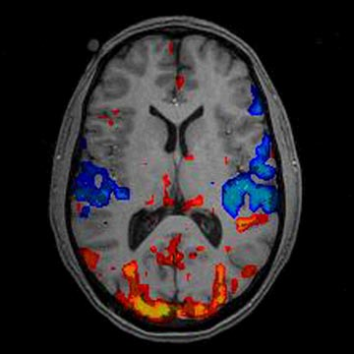
T₂* contrast
Similar to T₂
Liquid is brightest
Uses gradient-echo imaging
More sensitive to artefacts than T₂
Boring artefacts
Sinuses, ear canals
Interesting artefacts, aka data
Blood flow
sinuses
ear
canals
T₂* image
T₂* image superimposed
on a T₁ image
2010

Slide 33
Recipe for MRI
1) Put subject in big magnetic field (leave him there)
2) Transmit a magnetic field at a 90° angle into subject [about 3 ms]
3) Turn off 90° magnetic field
4) Receive MR signal re-transmitted by subject
Manipulate re-transmission with gradients of magnetic fields during this readout interval [10-100 ms]
5) Store measured MR signal data vs. time
Now go back to 2) to get some more data
6) Process raw data to reconstruct images
7) Allow subject to leave scanner (this is optional)
2010

Slide 34
Hold that thought ...
Main points for understanding BOLD signal
MRI scanners can distinguish between tissue types
e.g. white matter, grey matter, liquid
T₂* contrast is used for measuring BOLD signal
2010

Slide 35
Acknowledgments and references
Antoine for teaching me as much physics as anyone possibly could have
Yen for helping me to get rid of the worst mistakes in my first draft
Previous presenters on Methods for Dummies
Professor Jody Culham of University of Western Ontario for really useful slides and pictures (and to Lea Ernst for the link) http://psychology.uwo.ca/fmri4newbies/Tutorials.html
Huettel SA, Song WA, McCarthy G (2009) Functional Magnetic Resonance Imaging (2nd ed.). Sunderland (Mass.), USA: Sinauer Assoc.
2010

Slide 36
Another summary that might be useful
Magnetic field
Tissue protons align
with magnetic field
(equilibrium state)
RF pulses
Relaxation
processes
Protons absorb
RF energy
(excited state)
Spatial encoding
using magnetic
field gradients
Relaxation
processes
Protons emit RF energy
(return to equilibrium state)
MR signal
detection
Repeat
K-space
Fourier transform
IMAGE
2010

Slide 37
What happens to protons in an MRI scan (the real explanation)
When protons are at rest, MR signal cannot be detected. In order to detect an MR signal, you first need RF excitation
RF excitation/flipping the magnetization
RF excitation is used to flip the magnetization perpendicular to B₀.
When the RF is switched off, protons precess about the B₀ field and signal can be detected
Energy emitted by the protons when they precess
Spin precession
Following excitation, precession of the spins is determined by the strength of the magnetic field
Applying gradients of magnetic field changes the local spin precession frequency and is used to determine spin’s locations
A typical sequence consists of: excitation-apply gradients-measure signal
2010

