Slide 1
DCM for fMRI:
Theory & Practice
Peter Zeidman and Laura Madeley

Slide 2
Overview
Theory
  Why DCM?
  What DCM does
  The State Equation
Application
  Planning DCM studies
  Hypotheses
  How to complete in SPM

Slide 3
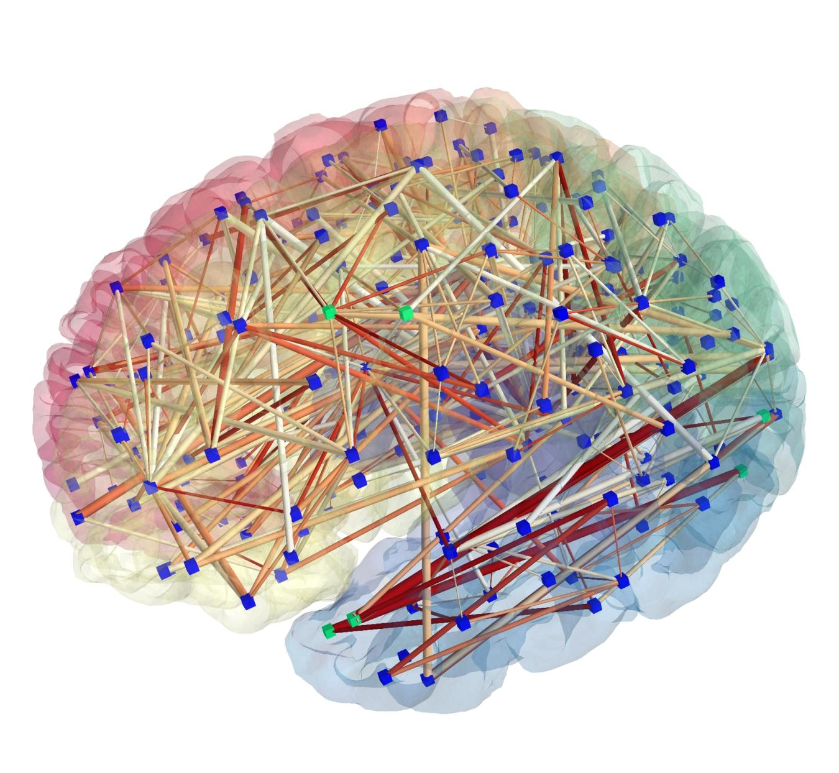
Brains as Systems
Source: http://public.kitware.com/ImageVote/images/17/
Notes:
DCM comes from General Systems Theory. Brain functions, such as memory, vision or decision making are the result of many interacting parts. Treating the brain as a system allows us to study these “emergent” functions, that can’t be understood by a normal SPM analysis.

Slide 4
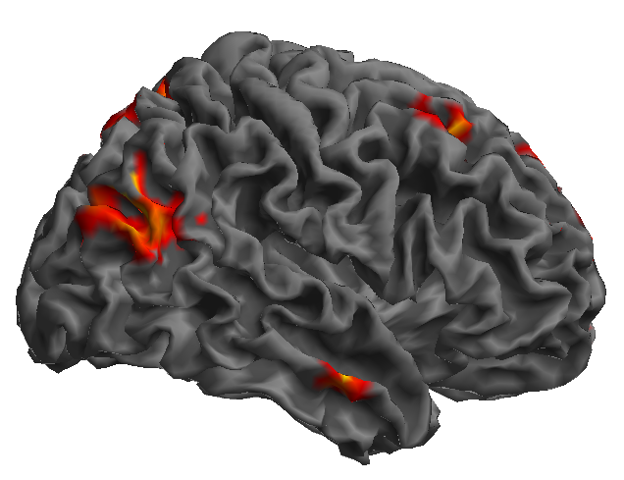
Brains as Systems
Blobs on Brains do not a network make
Notes:
Unlike the reporting of many papers, a set of regions isn’t enough to make a network. You need to know the connections between the regions.

Slide 5
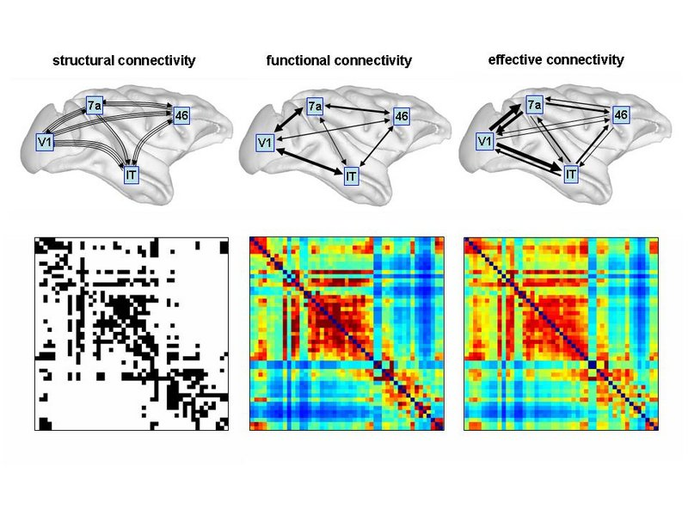
Taxonomy of Connectivity
Structural connectivity – the physical structure of the brain
Functional connectivity – the likelihood that 2 neuronal populations share associated activity
Effective connectivity – a union between structural and functional connectivity.

Slide 6
The Challenge
How to infer causality
especially with poor temporal resolution?

Slide 7
DCM Overview
Create a neural model to represent our hypothesis
Convolve it with a haemodynamic model to predict real signal from the scanner
Compare models in terms of model fit and complexity

Slide 8
The Neural Model
Recipe
z4
Z - Regions
z2
z3
z1
Notes:
Z are the regions of interest we include in the model

Slide 9
The Neural Model
Recipe
z4
Z - Regions
A - Average
Connections
z2
z3
z1
Notes:
A are the connections between regions, averaged over all tasks in our study

Slide 10
The Neural Model
Recipe
Attention
z4
Z - Regions
A - Average
Connections
B - Modulatory
Inputs
z2
z3
z1
Notes:
B are the modulatory inputs, which upregulate or downregulate the A connections, for example due to attention.

Slide 11
The Neural Model
Recipe
Attention
z4
Z - Regions
A - Average
Connections
B - Modulatory
Inputs
C - External
Inputs
z2
z3
z1
Notes:
C are the external inputs, for instance the timeseries of visually presented stimuli. We would usually create a set of models, in each one varying A, B or C according to the hypotheses we wish to test.

Slide 12
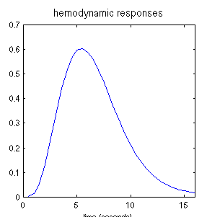
DCM Overview
Neural Model
Haemodynamic Model
4
2
3
x
=
1
e.g. region 2
Notes:
We combine the neural model (left) with the haemodynamic model (right) to give…

Slide 13
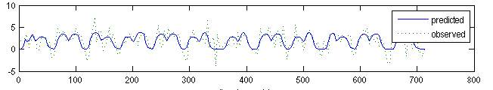
DCM Overview
=
Region 2 Timeseries
Notes:
A prediction for each region’s activity, shown here overlaid on the real signal’s timeseries from the fMRI scan.

Slide 14
Dynamical Systems
Less exciting example: interest
My bank gives me 3% interest on savings
How will it grow?
Notes:
Now we move onto the equation that governs DCM. To understand that, we need to know what a dynamic equation is. Here’s a very simple example.

Slide 15
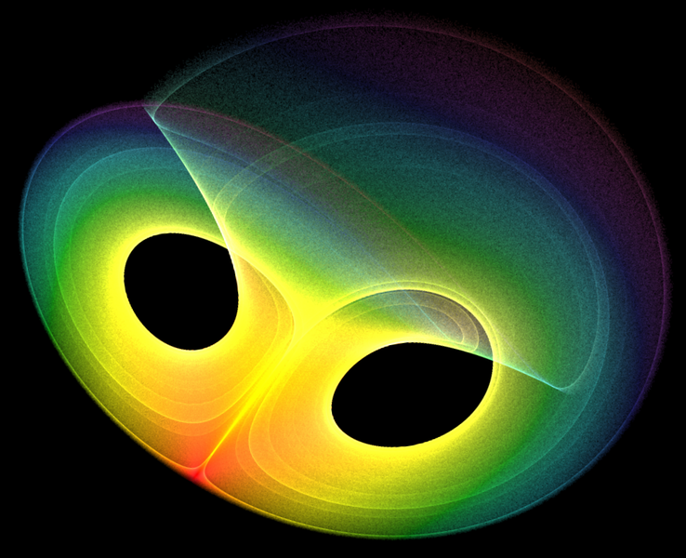
Dynamical Systems
The Lorentz Attractor – A Spatial Dynamical System
Notes:
And here’s the result of another dynamic equation, this time “evolving” in space rather than time (to see the equations, see http://en.wikipedia.org/wiki/Lorenz_attractor)

Slide 16
Dynamical Systems
We can represent a network as a matrix
From
z1
z2
=
To
z3
z1
z2
z3
(The A-Matrix)
Notes:
Before continuing, we need to know how a DCM is represented as a matrix.

Slide 17
Simplified Network Model
z1
z2
z3
Notes:
We’ll start with a simplified version of the DCM dynamic equation. The variable ‘z’ stores which regions are active, represented visually with a red circle. To find out how the activation moves round the network, we’ll use the dynamic equation shown.

Slide 18
Simplified Network Model
Notes:
Plugging in the numbers tells us that the activation spreads from region 1 to region 2.

Slide 19
Simplified Network Model
z1
z2
z1
z2
z3
z3
Notes:
The same thing visually – activation in this simple model travels from region 1 at timestep 0 to region 2 at timestep 1.

Slide 20
Simplified Network Model
Notes:
Running the equation again spreads the activity to regions 1 and 3.

Slide 21
Simplified Network Model
z1
z2
z1
z2
z3
z3

Slide 22
Simplified Network Model
{
{
Modulatory Inputs
External Inputs
The DCM State Equation
Notes:
The actual DCM state equation is the same as the simple network shown so far (top), with the addition of modulatory and external inputs.

Slide 23
Summary So Far
The Brain is a Dynamical System
The simple DCM “forward model” predicts neural activity
The software (SPM) combines it the haemodynamic model, to predict the fMRI timeseries
We compare models to choose the one best matching the real fMRI timeseries
Notes:
Over to Laura.

Slide 24
DCM Motivation
Dynamic Causal Modelling (DCM) needed due to a simple problem:
Cognitive neuroscientists want to talk about activation at the level of neuronal systems to hypothesize about cognitive processes
Imaging techniques do not generate data at this level, but give output relating to non-linear correlates e.g. fMRI haemodynamic response (BOLD signal)
It would be useful to be able to talk about causality in neuronal populations, since we know that signals propagate from some input through a system
DCM attempts to tackle these problems
Notes:
DCM was born out of a simple problem:
Cognitive neuroscientists often want to discuss activation in terms of neuronal systems in order to hypothesize about cognitive processes.
However imaging techniques do not generate data that relate to neuronal activity in a simple fashion – they give us information about non-linear, or stochastic, correlates of neural activity, such as the BOLD signal in fMRI
Moreover, we know certain properties of neuronal systems – for instance, that activation spreads in a wave-like fashion from some input through a given system. As such it would be useful to discuss directionality of the progression of activation between distributed neuronal populations.
DCM attempts to tackle these problems.

Slide 25
DCM History
Introduced in 2002 for fMRI data (Friston, 2002)
DCM is a generic approach for inferring hidden (unobserved) neuronal states from measured brain activity.
The mathematical basis and implementation of DCM for fMRI have since been refined and extended repeatedly.
DCMs have also been implemented for a range of measurement techniques other than fMRI, including EEG, MEG (to be presented next week), and LFPs obtained from invasive recordings in humans or animals.
Notes:
So, to introduce DCM for fMRI briefly:
It was first conceived here at UCL by Prof. Friston in 2002 and allows for inferences to be made about causal relationships between unobserved neuronal states in coupled neuronal ensembles.
This is done using a series of well-informed approximations on observed haemodynamic (BOLD) data, which allows us to consider the neuronal states underlying the BOLD signal, as well as the directional (i.e. causal) relationships between disparate neural populations, given a certain amount of prior knowledge about these regions and their systematic interactions.
Simply put, it allows us to estimate the causal architecture of coupled dynamic systems.
There are sibling techniques available for a range of data. This week we discuss DCM for fMRI, whilst next week we will be given a talk on DCM for EEG and MEG data.

Slide 26
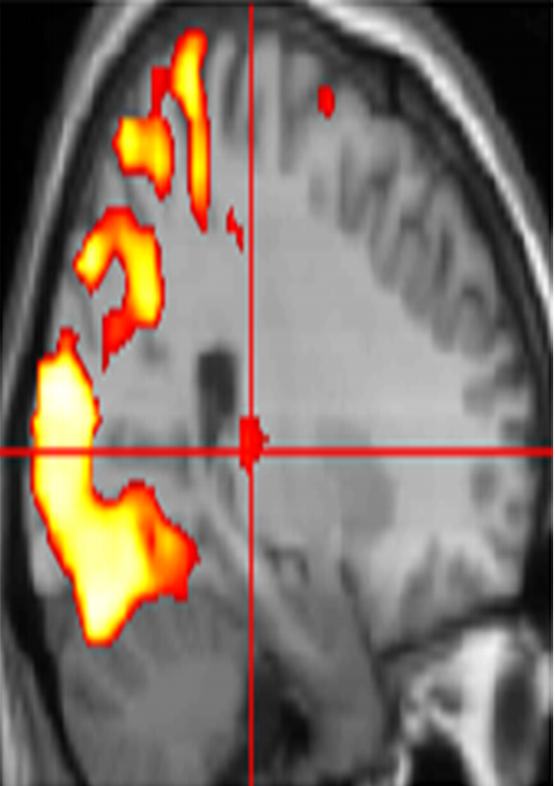
What do we want from fMRI studies?
Different Questions re brain function:
Functional specialisation
  Where is a stimulus processed?
  What are regionally specific effects?
    Normal SPM analysis (GLM)
2. Functional integration
  How does the system work?
  What are inter-regional effects?
  How do components of that system interact?
PMd
PMd
PMv
SMA
SMA
PMv
M1
M1

Slide 27
DCM: Basic idea
DCM allows you to model brain activity at the neuronal level (not directly accessible in fMRI) using a bilinear state equation. This takes into account the anatomical architecture of the system and the interactions within that architecture under different conditions of stimulus context
The modelled neuronal dynamics (z) are transformed into area-specific BOLD signals(y) by a hemodynamic forward model (more later)
The aim of DCM is to estimate parameters at the neuronal level so that the modelled BOLD signals are most similar to the experimentally measured BOLD signals

Slide 28
DCM: Methods
Rules of good practice
  10 Simple Rules for DCM (2010). Stephan et al. NeuroImage, 52
  Experimental design
  Model Specification
  Decision tree
DCM in SPM
  Steps within SPM
  Example
    attention to motion in the visual system (Büchel & Friston 1997, Cereb. Cortex, Büchel et al. 1998, Brain)
  http://www.fil.ion.ucl.ac.uk/spm/data/

Slide 29
DCM: Rules of good practice
Experimental design
  DCM is dependent on experimental perturbations
  Experimental conditions enter the model as inputs that either drive the local responses or change connection strengths.
  If there is no evidence for an experimental effect (no activation detected by a GLM) → inclusion of this region in a DCM is not meaningful.
  Use the same optimization strategies for design and data acquisition that apply to conventional GLM of brain activity:
      preferably multi-factorial (e.g. 2 x 2)
      one factor that varies the driving (sensory) input (eg static/ moving)
      one factor that varies the contextual input (eg attention / no attention)
Notes:
Stochastic unless
Define specific a priori hypothesis as precisely as possible
Requires neurological expertise
Look for convergent evidence
Which parameters are most relevant?
Intrinsic anatomical connections
Changes in effective connectivity/ connection strength?
Can DCM distinguish between Hypotheses?

Slide 30
DCM: Rules of good practice II
  Defining the model
  Model selection = determine which model, from a set of plausible alternatives, is most useful i.e., represents the best balance between accuracy and complexity.
  So....
    define models that are plausible & based on neuroimaging, electrophysiology, TMS, studies
    Use anatomical information and computational models to refine DCM
      model definition should be as transparent and systematic as possible
  How many plausible model alternatives exist?
    For small systems it is possible to investigate all possible connectivity architectures.
    With increasing number of regions and inputs, evaluating all possible models becomes practically impossible very rapidly.
    The map is not the territory.....
      Models are caricatures of complex phenomena, enabling testing of underlying mechanisms.
Notes:
given prior knowledge re system e.g.:
A model is a model
Model should be described clearly in any article.

Slide 31
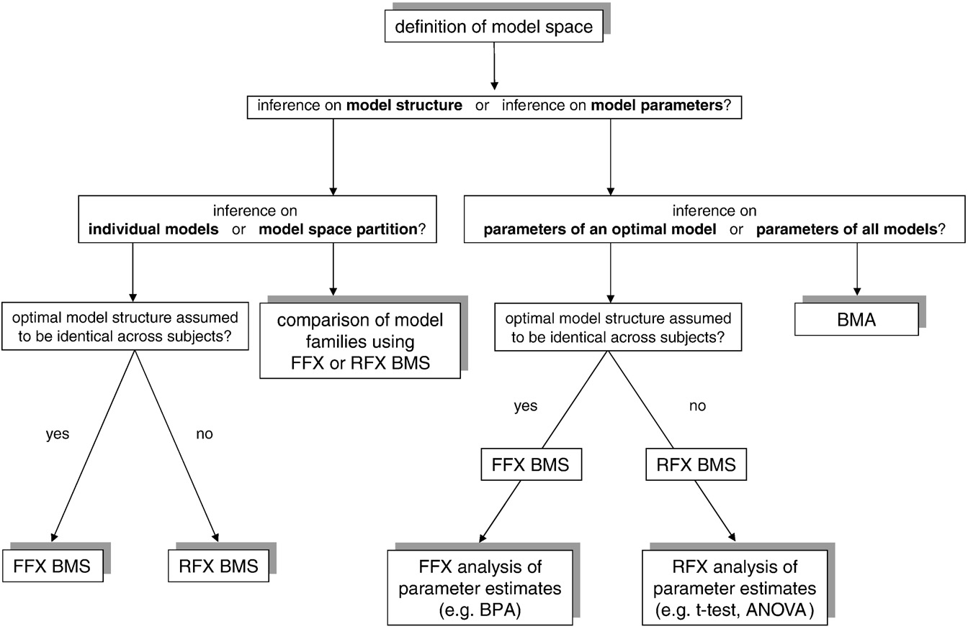
Fig. 1. This schematic summarizes the typical sequence of analysis in DCM, depending on the question of interest. Abbreviations: FFX=fixed effects, RFX=random effects, BMS=Bayesian model selection, BPA=Bayesian parameter averaging, BMA=Bayesian model averaging, ANOVA=analysis of variance.
10 Simple Rules for DCM (2010). Stephan et al. NeuroImage 52.
Notes:
In addition to comparing specific models, BMS can be used to test quantify the probability that the presence or the absence of a particular connections improves model performance, regardless of any other differences among the models considered.

Slide 32
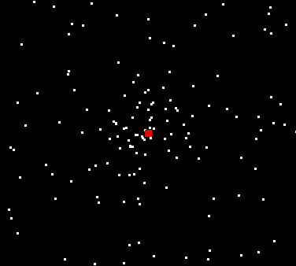
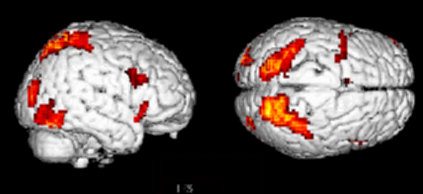
Attention to motion in the visual system
Stimuli 250 radially moving dots at 4.7 degrees/s
Pre-Scanning
5 x 30s trials with 5 speed changes (reducing to 1%)
Task - detect change in radial velocity
Scanning (no speed changes)
6 normal subjects, 4 x 100 scan sessions;
each session comprising 10 scans of 4 different
conditions
F A F N F A F N S .................
F - fixation point only
A - motion stimuli with attention (detect changes)
N - motion stimuli without attention
S - no motion
PPC
V3A
V5+
Attention – No attention
Büchel & Friston 1997, Cereb. Cortex
Büchel et al. 1998, Brain

Slide 33

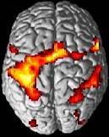
Practical steps of a DCM study - I
Definition of the model
  Structure: which areas,
  connections and inputs?
  Which parameters represent
  my hypothesis?
  What are the alternative
  models to test?
Defining criteria for inference:
  single-subject analysis: stat. threshold? contrast?
  group analysis: which 2nd-level model?
Conventional SPM analysis (subject-specific)
  DCMs fitted separately for each session
  → consider concatenation of sessions or
  adequate 2nd level analysis
Model 2:
attentional modulation
of V1→V5
Photic
PPC
0.85
0.70
1.36
0.84
V1
0.57
-0.02
V5
Motion
0.23
Attention

Slide 34
Practical steps of a DCM study - II
Extraction of time series, e.g. via VOI tool in SPM
  n.b anatomical & functional standardisation important for group analyses
Possible definition of a new design matrix, if the “normal” design matrix does not represent the inputs appropriately.
  DCM only reads timing information of each input from the design matrix, no parameter estimation necessary
Definition of model
  via DCM-GUI or directly
  in MATLAB

Slide 35
Practical steps of a DCM study - III
DCM parameter estimation
  Remember models with many regions & scans can crash MATLAB!
Model comparison and selection:
  Which of all models considered is the optimal one?
  → Bayesian model selection tool
Testing the hypothesis
Statistical test on
the relevant parameters
of the optimal model

Slide 36
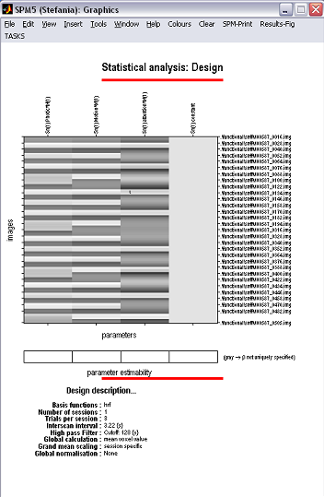
Specify design matrix & SPM analysis
Experimental design
  Sensory input factor
Photic
Motion
Attention
static
moving
Contextual factor
No attent
No motion/ no attention
Motion / no attention
Attent.
No motion/ attention
Motion / attention
Normal SPM regressors
DCM analysis regressors
    -Vision (photic)
    -motion
    -attention

Slide 37
Extraction of time series (VOIs definition)
1. DCM for a single subject analysis (i.e. no 2nd-level analysis intended):
determine representative co-ordinates for each brain region from the appropriate contrast (e.g. V1 from “photic” contrast )
Subject specific DCM, but results will eventually be entered into a 2nd-level analysis:
determine group maximum for the area of interest (e.g. from RFX analysis) in the appropriate contrast
in each subject, jump to local maximum nearest to the group maximum, using the same contrast and a liberal threshold (p<0.05, uncorrected)

Slide 38
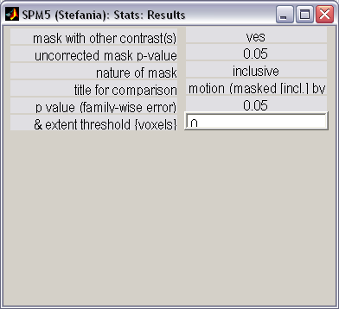
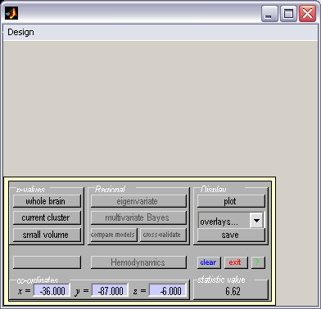
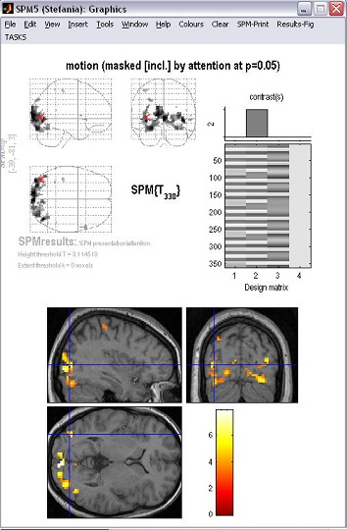
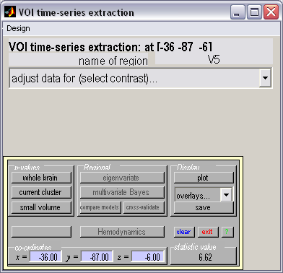
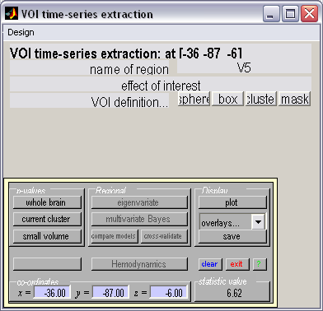
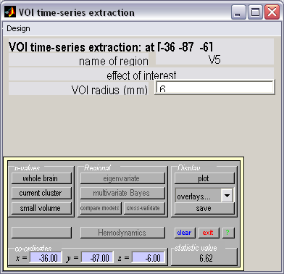
VOIs definition: V5
Contrast
Name
Co-ordinates

Slide 39
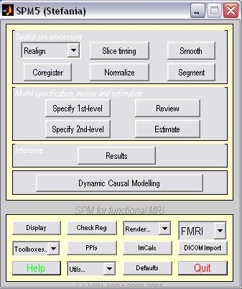
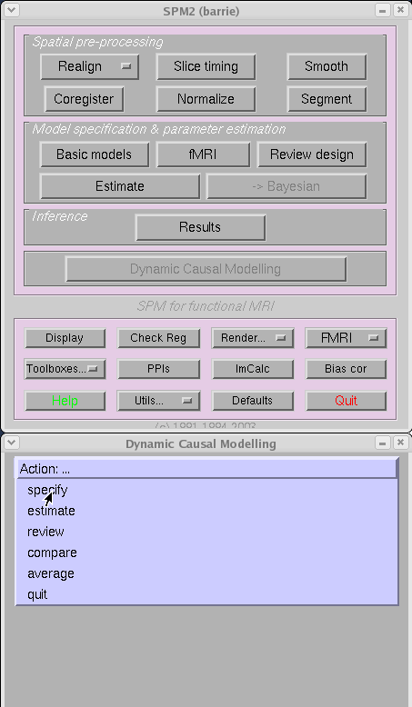
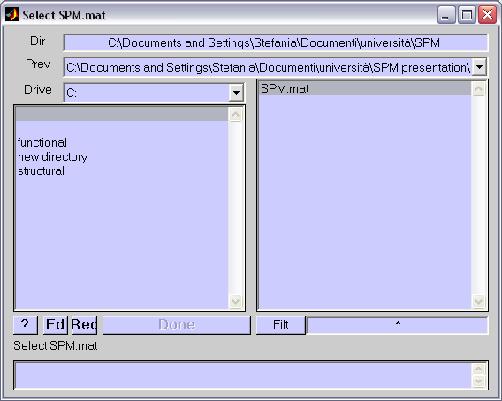
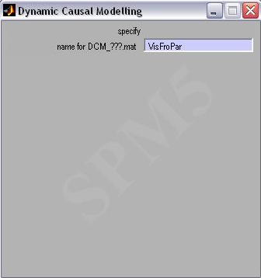
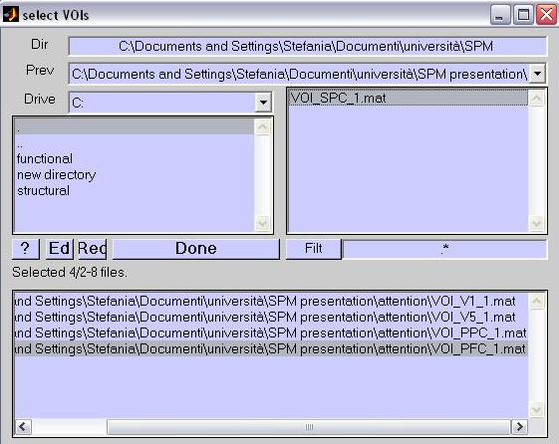
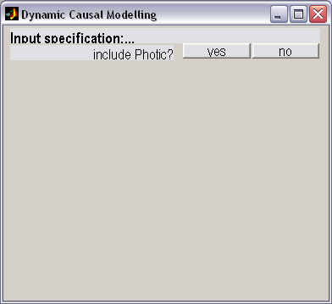


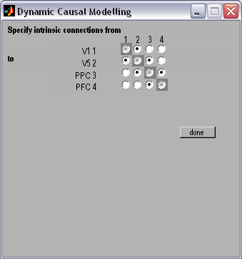
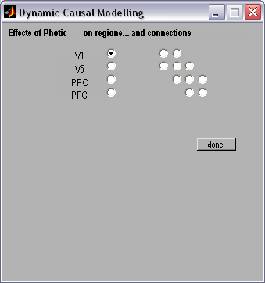
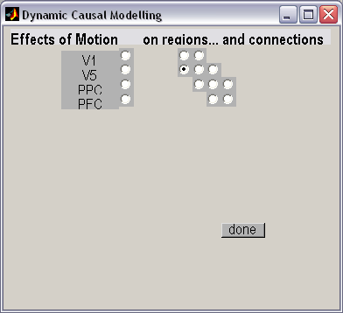
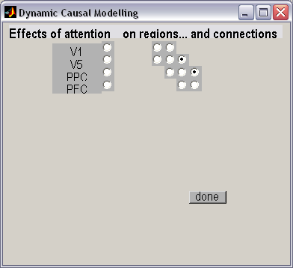
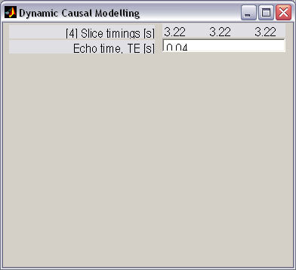
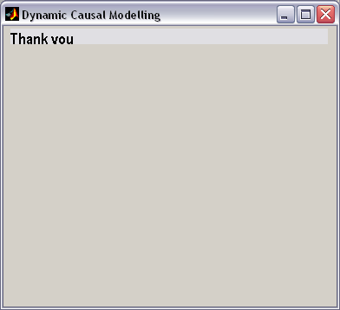
Definition of DCM
name
DCM button
In order!
In Order!!
In Order!!

Slide 40
Output
Average connectivity (A)

Slide 41
Modulation of connections (B)
Photic
Motion
Motion
Attention
Attention

Slide 42
Input (C)

Slide 43
Comparison of two simple models
Model 1:
attentional modulation
of PPC→V5
Model 2:
attentional modulation
of V1→V5
Attention
Photic
Photic
PPC
0.85
0.70
0.55
PPC
1.36
0.84
0.86
0.75
V1
1.42
0.89
V1
0.57
-0.02
V5
0.56
-0.02
Motion
0.23
V5
Attention
Motion

Slide 44
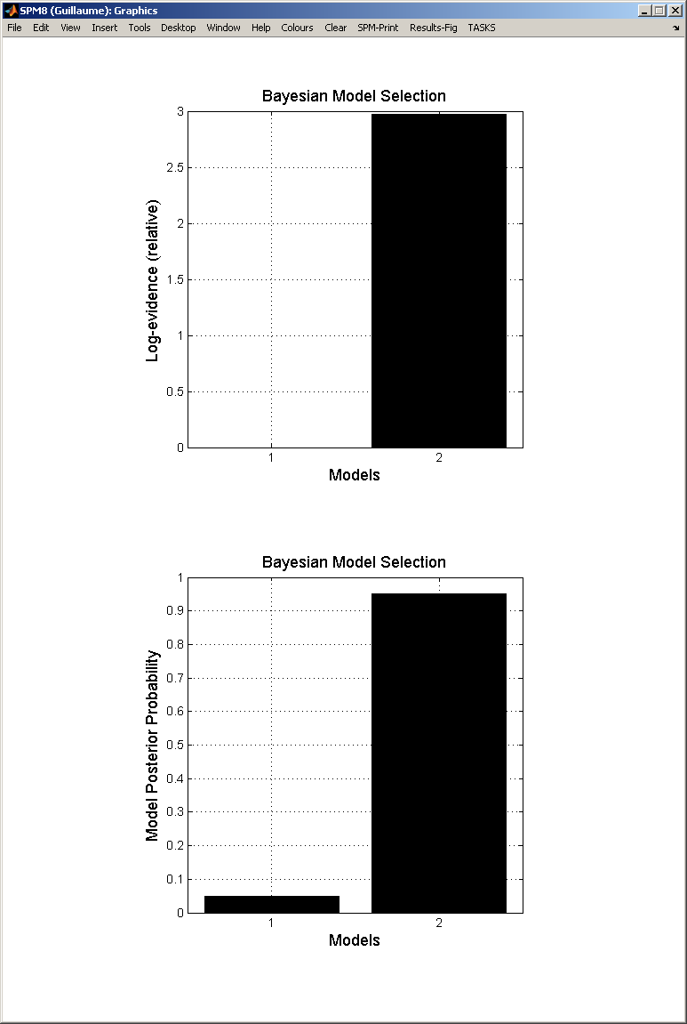
Models comparison and selection
Model 2
better than
model 1

Slide 45
SPM: Issues
What you cannot do with BMS
A DCM is defined for a specific data set. Therefore BMS cannot be applied to models that are fitted to different data
Cannot compare models with different numbers of regions, because changing the regions changes the data
Maximum of 8 regions with SPM8
Designed for sensory-driven studies

Slide 46
So, DCM….
enables one to infer hidden neuronal processes from fMRI data
tries to model the same phenomena as a GLM
  explaining experimentally controlled variance in local responses
  based on connectivity and its modulation
allows one to test mechanistic hypotheses about observed effects
is informed by anatomical and physiological principles.
uses a Bayesian framework to estimate model parameters
is a generic approach to modelling experimentally perturbed dynamic systems.
provides an observation model for neuroimaging data, e.g. fMRI, M/EEG
Should be planned for early in the experimental process

Slide 47
References
The first DCM paper: Dynamic Causal Modelling (2003). Friston et al. NeuroImage 19:1273-1302.
Physiological validation of DCM for fMRI: Identifying neural drivers with functional MRI: an electrophysiological validation (2008). David et al. PLoS Biol. 6 2683–2697
Hemodynamic model: Comparing hemodynamic models with DCM (2007). Stephan et al. NeuroImage 38:387-401
Nonlinear DCMs:Nonlinear Dynamic Causal Models for FMRI (2008). Stephan et al. NeuroImage 42:649-662
Two-state model: Dynamic causal modelling for fMRI: A two-state model (2008). Marreiros et al. NeuroImage 39:269-278
Group Bayesian model comparison: Bayesian model selection for group studies (2009). Stephan et al. NeuroImage 46:1004-10174
10 Simple Rules for DCM (2010). Stephan et al. NeuroImage 52.
Dynamic Causal Modelling: a critical review of the biophysical and statistical foundations. Daunizeau et al. Neuroimage (2010), in press
SPM Manual, SMP courses slides, last years presentations.

Slide 48
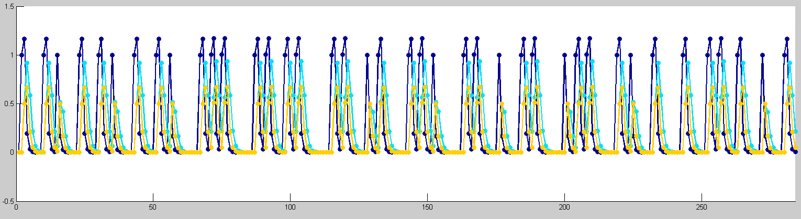
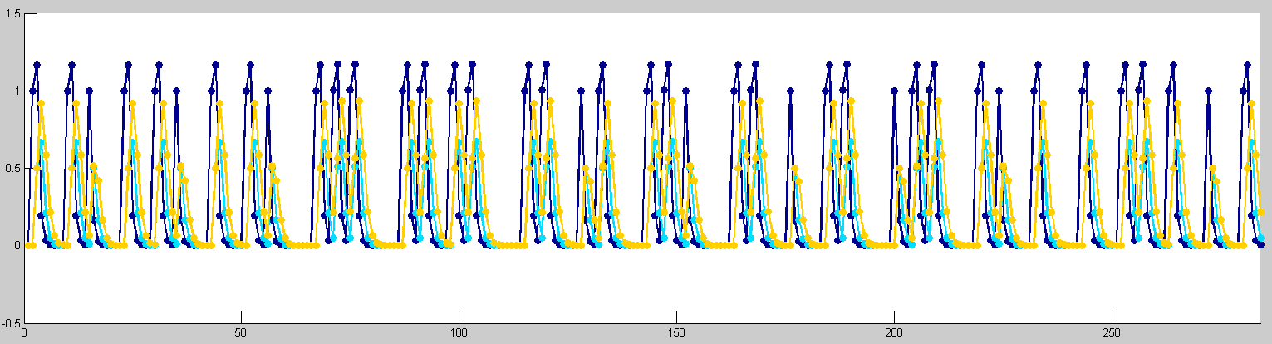
2
1
3
2
1
3

