Slide 1

fMRI Design & Efficiency
Patricia Lockwood & Rumana Chowdhury
MFD – Wednesday 12th 2011

Slide 2
Overview
Experimental Design
  Types of Experimental Design
  Timing parameters – Blocked and Event-Related & Mixed design

Slide 3
Main take home message of experimental design…
Make sure you’ve chosen your analysis method and contrasts before you start your experiment!

Slide 4
Why is it so important to correctly design your experiment?
Main design goal: To test specific hypotheses
We want to manipulate the participants experience and behaviour in some way that is likely to produce a functionally specific neurovascular response.
What can we manipulate?
  Stimulus type and properties
  Stimulus timing
  Participant instructions

Slide 5
Types of experimental design
Categorical - comparing the activity between stimulus types
Factorial - combining two or more factors within a task and looking at the effect of one factor on the response to other factor
Parametric - exploring systematic changes in brain responses according to some performance attributes of the task

Slide 6
Categorical Design
  Categorical design: comparing the activity between stimulus types
Example:
Stimulus: visual presentation of 12 common nouns.
Tasks: decide for each noun whether it refers to an animate or inanimate object.
goat
bucket

Slide 7
Factorial design combining two or more factors within a task and looking at the effect of one factor on the response to other factor
Simple main effects
e.g. A-B = Simple main effect of motion (vs. no motion) in the context of low load
Main effects
e.g. (A + B) – (C + D) = the main effect of low load (vs. high load) irrelevant of motion
Interaction terms
e.g. (A - B) – (C – D) = the interaction effect of motion (vs. no motion) greater under low (vs. high) load
MOTION NO MOTION
A B
C D
LOW
LOAD
HIGH

Slide 8
Factorial design in SPM
Main effect of low load:
(A + B) – (C + D)
Simple main effect of motion in the context of low load:
(A – B)
Interaction term of motion greater under low load:
(A – B) – (C – D)
A B C D
[1 1 -1 -1]
A B C D
[1 -1 0 0]
A B C D
[1 -1 -1 1]
Notes:
This contrast will test for crossover interactions as well as non-crossover interactions so remember to do post-hoc

Slide 9
Parametric design
= exploring systematic changes in brain responses according to some performance attributes of the task
Parametric designs use continuous rather than categorical design.
For example, we could correlate RTs with brain activity.

Slide 10
Overview
Experimental Design
  Types of Experimental Design
  Timing parameters – Blocked, Event-Related & Mixed Design

Slide 11
Experimental design based on the BOLD signal
A brief burst of neural activity corresponding to presentation of a short discrete stimulus or event will produce a more gradual BOLD response lasting about 15sec.
Due to noisiness of the BOLD signal multiple repetitions of each condition are required in order to achieve sufficient reliability and statistical power.
Notes:
Block & event related designs achieve this through different means

Slide 12
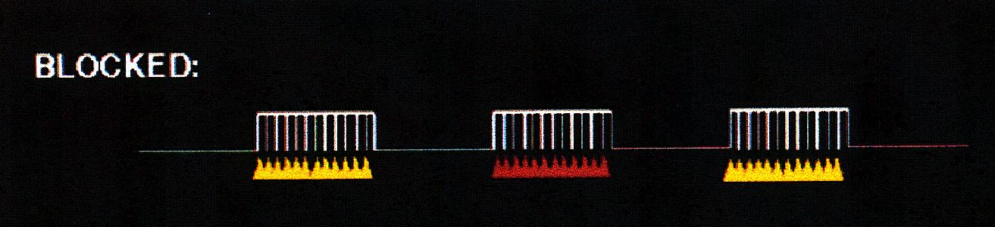
Blocked design
= trial of another type
(e.g., place image)
= trial of one type
(e.g., face image)
Multiple repetitions from a given experimental condition are strung together in a condition block which alternates between one or more condition blocks or control blocks

Slide 13
Advantages and considerations in Block design
The BOLD signal from multiple repetitions is additive
Blocked designs remain the most statistically powerful designs for fMRI experiments (Bandetti & Cox, 2000)
Can look at resting baseline e.g Johnstone & colleagues
Each block should be about 16-40sec
Disadvantages
Although block designs are more statistically efficient event related designs often necessary in experimental conditions
Habituation effects
In affective sciences their may be cumulative effects of emotional or social stimuli on participants moods
Notes:
The more repetitions, bigger and reliable the signal
Good signal to noise ratio, approximately 50% better than event related
Johnstone & colleagues found BOLD contrast in the amygdala showed greater test-retest reliability when calculated between responses to viewed fear faces and a passive fixation then fear faces and neutral faces
With blocks shorter then 20 secs statistical power advantage starts to disappear, with blocks longer than 40 sec the slow fluctuations of the BOLD signal start to compromise the relaibility of mean activation over a block

Slide 14
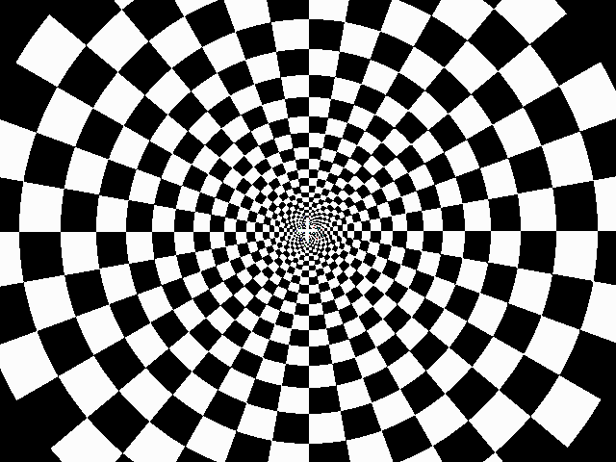
Event related design
time
In an event related design, presentations of trials from different experimental conditions are interspersed in a randomised order, rather then being blocked together by condition
In order to control for possible overlapping BOLD signal responses to stimuli and to reduce the time needed for an experiment you can introduce ‘jittering’ (i.e. use variable length ITI’s)

Slide 15
Advantages and considerations in Event-related design
Avoids the problems of habituation and expectation
Allows subsequent analysis on a trial by trial basis, using behavioural measures such as judgment time, subjective reports or physiological responses to correlate with BOLD
Using jittered ITIs and randomised event order can increase statistical power
Disadvantages
More complex design and analysis (esp. timing and baseline issues).
Generally have reduced statistical power
May be unsuitable when conditions have large switching cost

Slide 16
Mixed designs
More recently, researchers have recognised the need to take into account two distinct types of neural processes during fMRI tasks
1 – sustained activity throughout task (‘sustained activity’)
e.g. taking exams
2 – brain activity evoked by each trial of a task (‘transient activity’)
Mixed designs can dissociate these transient and sustained events (but this is actually quite hard!)

Slide 17
Study design and efficiency
Part 2
Rumana Chowdhury

Slide 18
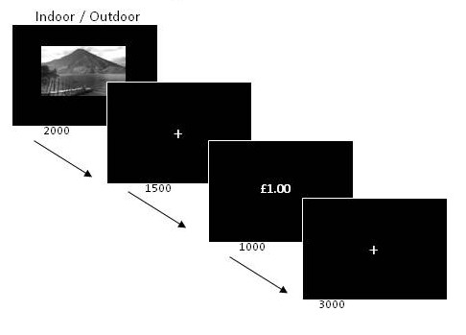
Background: terminology
Trials: replication of a condition
Trial may consist of ‘events’ (burst of neural activity) or ‘epochs’ (sustained neural activity)
ITI: time between onset of successive trials
SOA (stimulus onset asynchrony): time between the onset of components

Slide 19
Background: General Linear Model
β
Y
X
⁺
E
⁼
^{x}
Matrix of BOLD signals
(What you collect)
Design matrix
(This is what is put into SPM)
Matrix parameters
(These need to be estimated)
Error matrix
(residual error for each voxel)
Time
Time
Time
Regressors
Voxels
Voxels
Regressors
Voxels
Notes:
β = relative contribution that each regressor has, the larger the β value = the greater the contribution

Slide 20
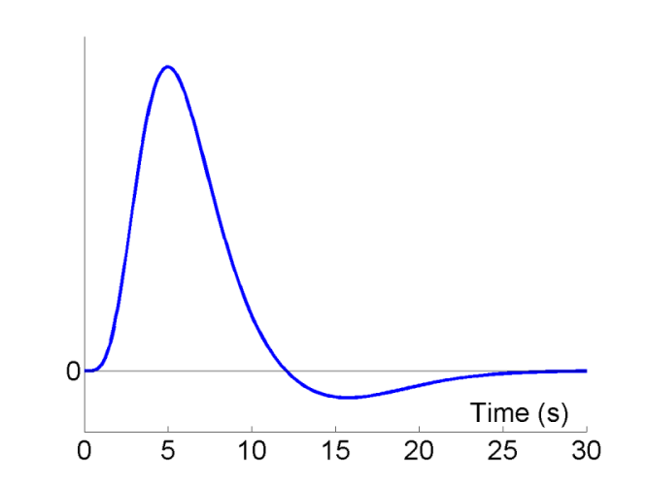
Background: BOLD impulse response
A BOLD response to an impulse (brief burst) of activity typically has the following characteristics:
  - A peak occurring at 4-6s
  - Followed by an undershoot from approximately 10-30s
Notes:
The basic concept of fMRI is to have the person
inside the scanner performing a series of cognitive tasks
(the paradigm, which contains epochs or events of interest
along with control epochs or events) whilst BOLD images
representing the brain are collected (Le Bihan et al., 1995).

Slide 21
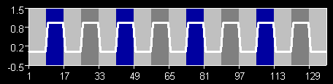
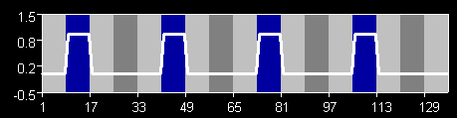
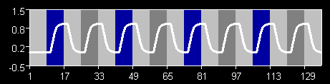
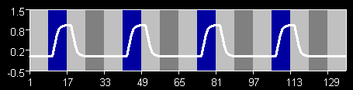
Predicted response
To obtain predicted fMRI time series:
Convolve stimulus with the haemodynamic response
PREDICTED ACTIVATION IN VISUAL AREA
PREDICTED ACTIVATION IN OBJECT AREA
BOXCAR
CONVOLVED
WITH HRF
[From fMRI for newbies]

Slide 22
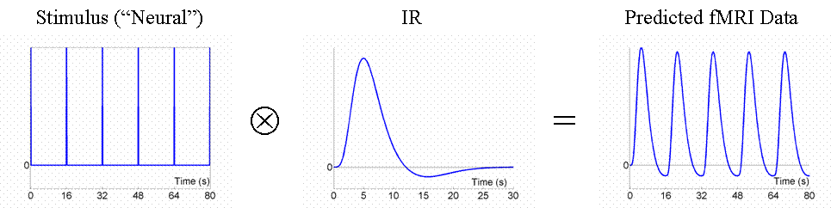
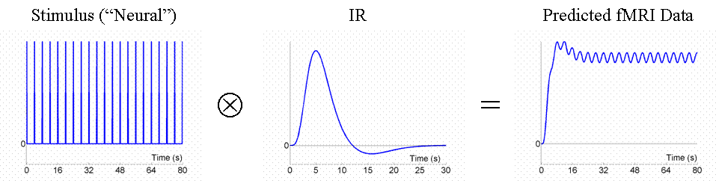
Fixed SOA 16s
Fixed SOA 4s: low variance, lose stimulus energy after filtering
Notes:
Fixed SOA 4s = doesnt go back to baseline, small oscillations around raised baseline, little variation

Slide 23
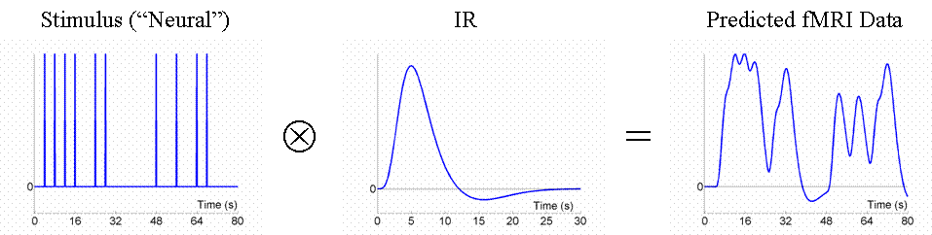
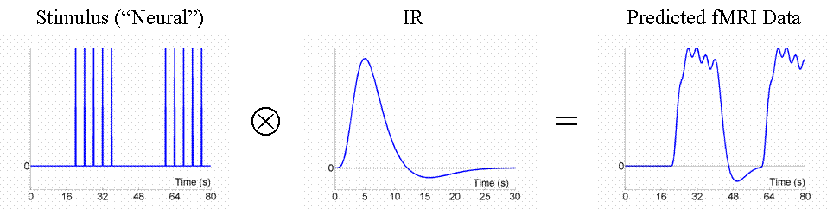
Random SOA minimum 4s e.g. event-related: larger variability in signal
Blocked, SOA 4s: larger variability in signal
Notes:
Random soa 4s = more variation, we know how it varies, so more efficient
Blocked ie vary so 5 stimuli 4s then 20s rest

Slide 24
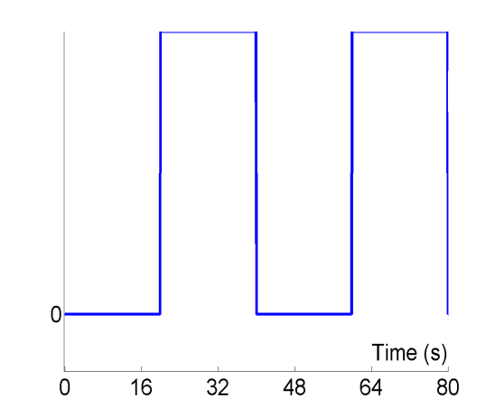
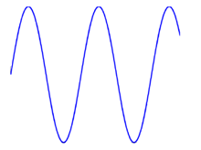
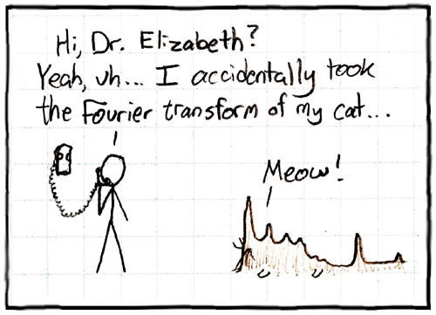
Fourier transform
Operation that decomposes a signal into its constituent frequencies
[←from XKCD]
Notes:
Ie representing a signal in frequency space
Way of summarising our data
frequency-domain graph shows how much of the signal lies within each given frequency band over a range of frequencies.

Slide 25
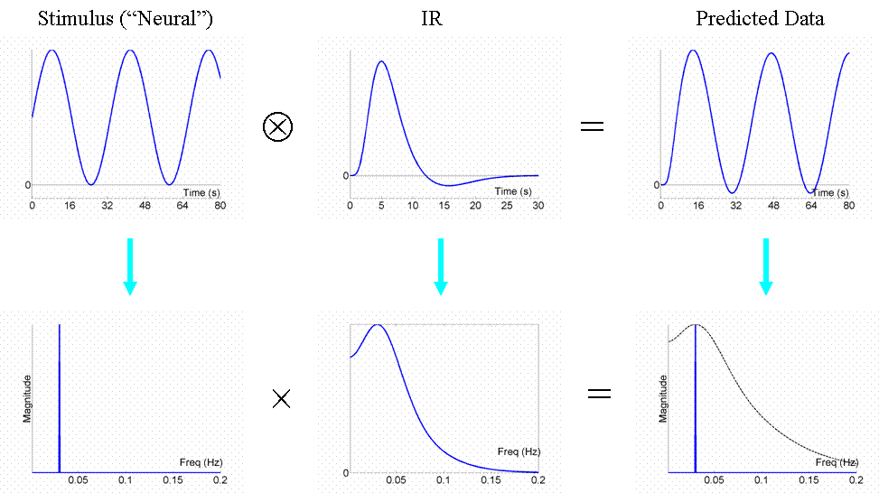
Most efficient design
Notes:
the optimal design would be to modulate the neural activity in a sinusoidal fashion (e.g, sinusoidally varying the luminance of a visual stimulus), with a frequency that matches the peak of the amplitude spectrum of the IR filter.
BOLD signal has 1 peak at a low frequency, so it allows low frequencies through

Slide 26
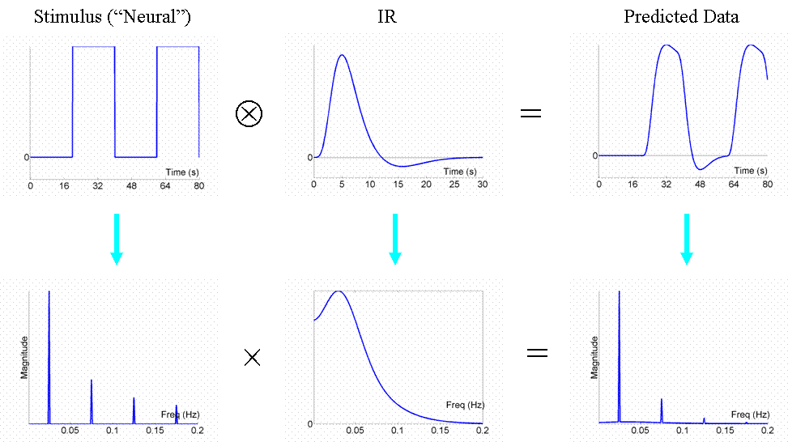
Fourier transform

Slide 27
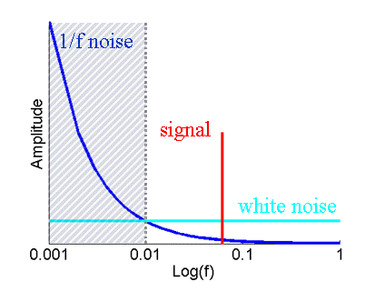
High pass filter
fMRI noise tends to have two components:
  Low frequency ‘1/f’ noise
  e.g. physical (scanner drifts);
  physiological [cardiac (~1 Hz);
  respiratory (~0.25 Hz)]
  Background white noise
SPM uses a highpass filter to maximise the loss of noise & minimise the loss of signal.
Apply highpass filter to the lowpass filter inherent in the IR to create a single ‘band-pass’ filter (or ‘effective HRF’).

Slide 28
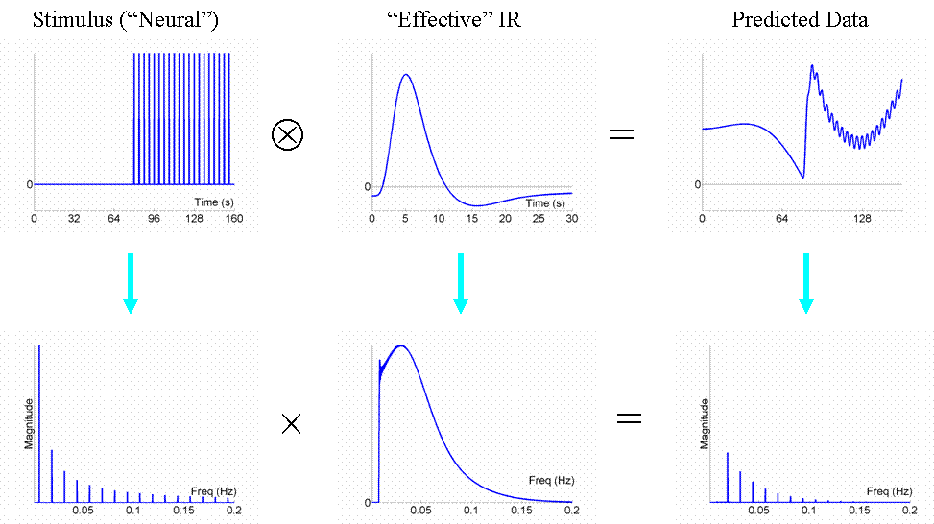
Here fundamental frequency is lower than highpass cutoff so most is lost
i.e. make sure block length is not too long (16s on, 16s off is optimal)
Notes:
Here HPF filters out v low freq (assume its noise) and BOLD filters out high frequency
So if have long block, main signal is filtered out

Slide 29
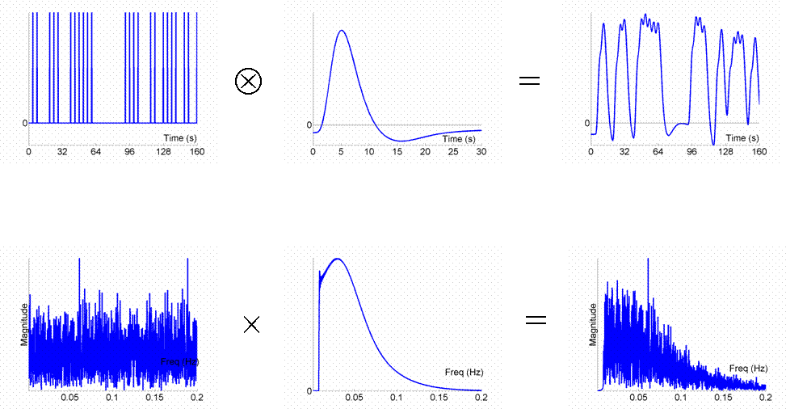
Randomised SOA – some low and high frequency lost but majority is passed
i.e. this is a reasonable design
Notes:
The effect of the randomised SOA is to "spread" the signal energy across a range of frequencies, as shown in Fig 10. Some of the high and low frequency components are lost to the effective IR bandpass filter, but much is passed, making it a reasonably efficient design

Slide 30
Efficiency equation
General Linear Model:
Y = X . β + ε
Data Design Matrix Parameters error
Efficiency is the ability to estimate β, given your design matrix (X) for a particular contrast (c)
  e (c, X) = inverse (σ² c^{T} Inverse(X^{T}X) c)
  All we can alter in this equation is c and X
Notes:
We can influence e (a priori) by the spacing and sequencing of
epochs/events in our design matrix
➔ e is specific for a given contrast!

Slide 31
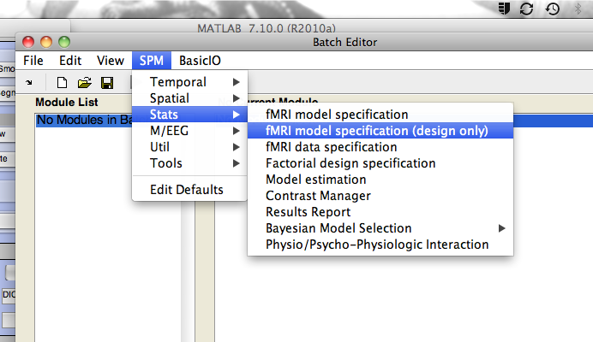
In SPM

Slide 32
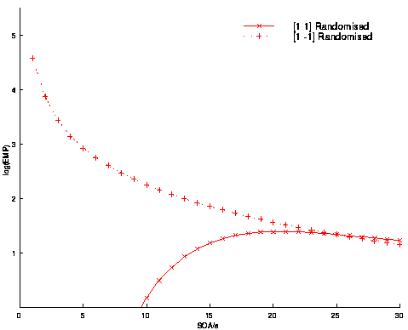
Timing
With randomised designs, optimal SOA for differential effect (A-B) is minimal SOA (>2 seconds, and assuming no saturation), whereas optimal SOA for main effect (A+B) is 16-20s
Differential Effect (A-B)
Common Effect (A+B)
4s smoothing; 1/60s highpass filtering
Notes:
Because A+B is comparing to baseline…

Slide 33
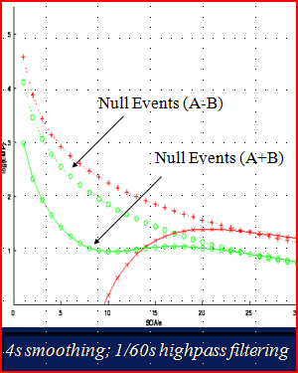
Timing: sampling & jitter
Jitter can also be used to introduce null events
Efficient for differential and main effects at short SOA
Notes:
Jitter – randomise SOA

Slide 34
Conclusions
From Rik Henson:
Do not contrast conditions that are far apart in time (because of low-frequency noise in the data).
Randomize the order, or randomize the SOA, of conditions that are close in time.
Also:
Blocked designs generally most efficient (with short SOAs, given optimal block length is not exceeded)
Think about both your study design and contrasts before you start!

Slide 35
References
http://imaging.mrc-cbu.cam.ac.uk/imaging/DesignEfficiency
Harmon-Jones, E. y Beer, J. S. (Eds.) (2009). Methods in social neuroscience. Nueva York: The Guilford Press.
Johnstone T et al., 2005. Neuroimage 25(4):1112-1123
Previous MfD slides
Thanks to our expert Steve Flemming

