Slide 1
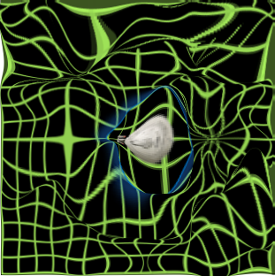
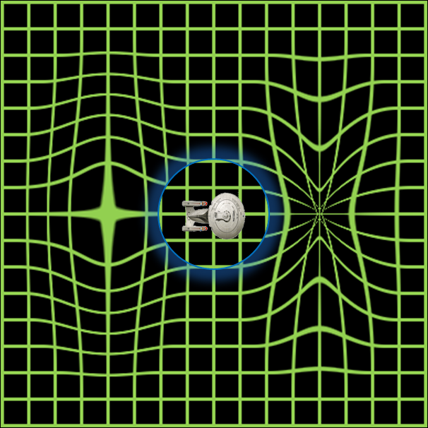
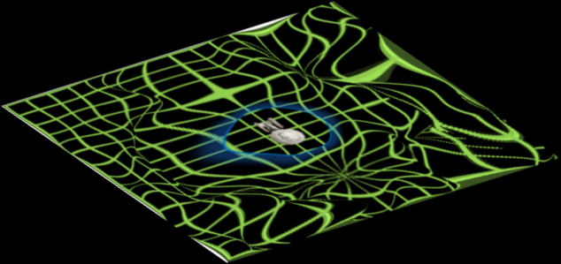
Realigning and Unwarping
MfD - 2010
Christian Lambert
Suz Prejawa

Slide 2
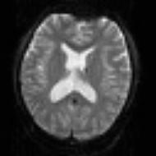



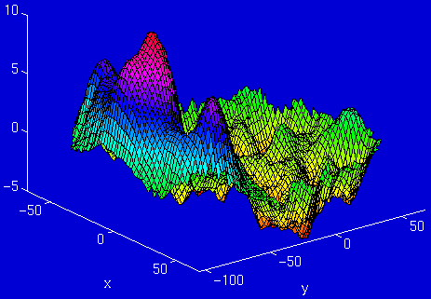
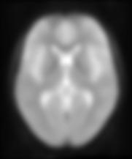
Overview of SPM Analysis
fMRI time-series
Statistical Parametric Map
Design matrix
Motion
Correction
Smoothing
General Linear Model
Spatial
Normalisation
Parameter Estimates
Anatomical Reference

Slide 3
Overview
Motion in fMRI
  Motion Prevention
  Motion Correction
Realignment – Two Steps
  Registration
  Transformation
Realignment in SPM
Unwarping

Slide 4
Motion in fMRI
We want to compare the same part of the brain across time
Subjects move in the scanner
Even small head movements can be a major problem:
  Movement artefacts add up to the residual variance and reduce sensitivity
  Data may be lost if sudden movements occur during a single volume
  Movements may be correlated with the task performed
Minimising movements is one of the most important factors for ensuring good data quality
Notes:
Even tiny head movements can induce major artefacts in your data, so motion correction is very important.
-The t-test that is used by SPM is based on the signal change relative to the residual variance. This signal is computed from the sum of squared differences between the data and the linear model to which it is fitted. Movement artefacts will add up to the residual variance and therefore reduce the sensitivity of your test.
-
-A lot of fMRI studies have paradigms in which the subject could be moving in a way that is correlated to the different experimental conditions, for example, when you would move your head each time you press a button. If you do not correct for this, these systematic differences might appear as activations in your data – resulting in false positives.
If movement uncorrelated with task, we lose sensitivity (may prevent us from finding activation)
If movement correlated with task, we lose specificity (may pose as false activations)

Slide 5
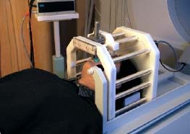
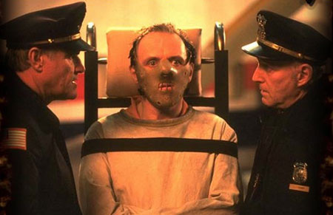
Motion Prevention in fMRI
  Constrain the volunteer’s head (soft padding)
  Give explicit instructions to lie as still as possible, not to talk between sessions, and swallow as little as possible
  Try not to scan for too long* – everyone will move after while!
  Make sure your subject is as comfortable as possible before you start.
Notes:
Padding
Expandable foam (Alpha Cradle)
Vacuum bags
Hammock
Bite bar
Contour masks
The more you can prevent movement, the better.

Slide 6
Realignment - Two Steps
Realignment (of same-modality images from same subject) involves two stages:
Registration
  Estimate the 6 parameters that describe the rigid body transformation between each image and a reference image
2. Transformation
  Re-sample each image according to the determined transformation parameters
Notes:
Each volume in the time-series is realigned
Using rigid-body registration
Assumes that brain shape doesn’t change
Least squares cost function
Realigned images must be resliced for analysis
Not necessary if they will be normalised anyway

Slide 7
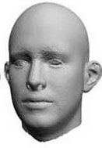
1. Registration
Each transform can be applied in 3 dimensions
Therefore, if we correct for both rotation and translation, we will compute 6 parameters
Translation
Rotation
Z
Roll
Yaw
Y
Pitch
X
Notes:
Rotation:
Pitch is rotation around the x axis up and down, like nodding ‘Yes’
Yaw is rotation around the z axis, side to side, like ‘No’
Roll is ration around the y axis, like ‘Maybe’

Slide 8
1. Registration
Operations can be represented as affine transformation matrices:
  x₁ = m_{1,1}x₀ + m_{1,2}y₀ + m_{1,3}z₀ + m_{1,4}
  y₁ = m_{2,1}x₀ + m_{2,2}y₀ + m_{2,3}z₀ + m_{2,4}
  z₁ = m_{3,1}x₀ + m_{3,2}y₀ + m_{3,3}z₀ + m_{3,4}
Rigid body transformations parameterised by:
Translations
Pitch
about X axis
Roll
about Y axis
Yaw
about Z axis
Notes:
Operations (translation and rotation) are performed by matrices
The order in which you perform the operations matters. In SPM it is done by:
Rotating about Z axis
Rotating about Y axis
Rotating about X axis
Then translating
Each of the operations can be performed by matrices and these matrices can be multiplied together

Slide 9
Realignment - Two Steps
Realignment (of same-modality images from same subject) involves two stages:
Registration
  Estimate the 6 parameters that describe the rigid body transformation between each image and a reference image
2. Transformation
  Re-sample each image according to the determined transformation parameters
Notes:
Realignment (of same-modality images from same subject) involves two stages:
1. Registration
Determining the 6 parameters that describe the rigid body transformation between each source image and the reference image
2. Transformation (reslicing)
Re-sampling each image according to the determined transformation parameters

Slide 10
2. Transformation
Reslice a series of registered images such that they match the first image selected onto the same grid of voxels
Various methods of transformation / interpolation:
  Nearest neighbour
  Linear interpolation
  B-Spline
Notes:
So, in the registration process each of the images are matched to the first image of the time series and a mean of these aligned images is generated. Then each of the individual images is matched to this mean image. At this point, the data can be resampled

Slide 11
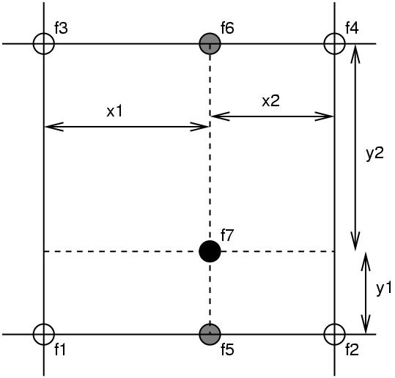
Simple Interpolation
Nearest neighbour
  Takes the value of the closest voxel
Tri-linear
  Weighted average of the neighbouring voxels
    f₅ = f₁ x₂ + f₂ x₁
    f₆ = f₃ x₂ + f₄ x₁
    f₇ = f₅ y₂ + f₆ y₁
Notes:
In the re-slicing or transformation step we need to take the value of the voxels from the original image and put it in our new, re-aligned image. There are a number of ways of doing this. The simplest one is to take the value of the nearest neighbour.
A rather better option is tri-linear interpolation (illustrated here in 2 dimensions, so it’s bi-linear interpolation) but it’s easier to explain.
The white circles represent original voxels (f1, f2, f3, f4) and the black circle (f7) represents the point we’re trying to sample
So, we take the weighted average intensity of these 2 values (f1 and f2) and we get f5
We also take the weighted average of f3 and f4 to get f6
Finally, we take the weighted average of f5 and f6 to get f7.
This would generalize into 3 dimensions
This method is not really optimal because by taking the weighted average of the neighbouring voxel we are introducing smoothness into the resampled image. It’s a bit messy and you will lose information.
There are better ways of doing interpolation, although such methods could be slower.

Slide 12
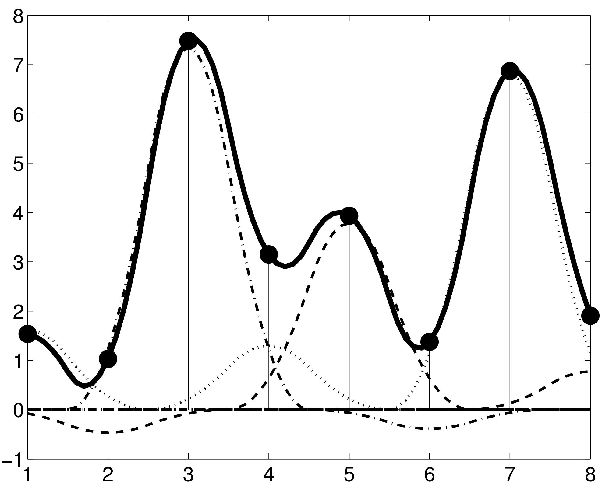
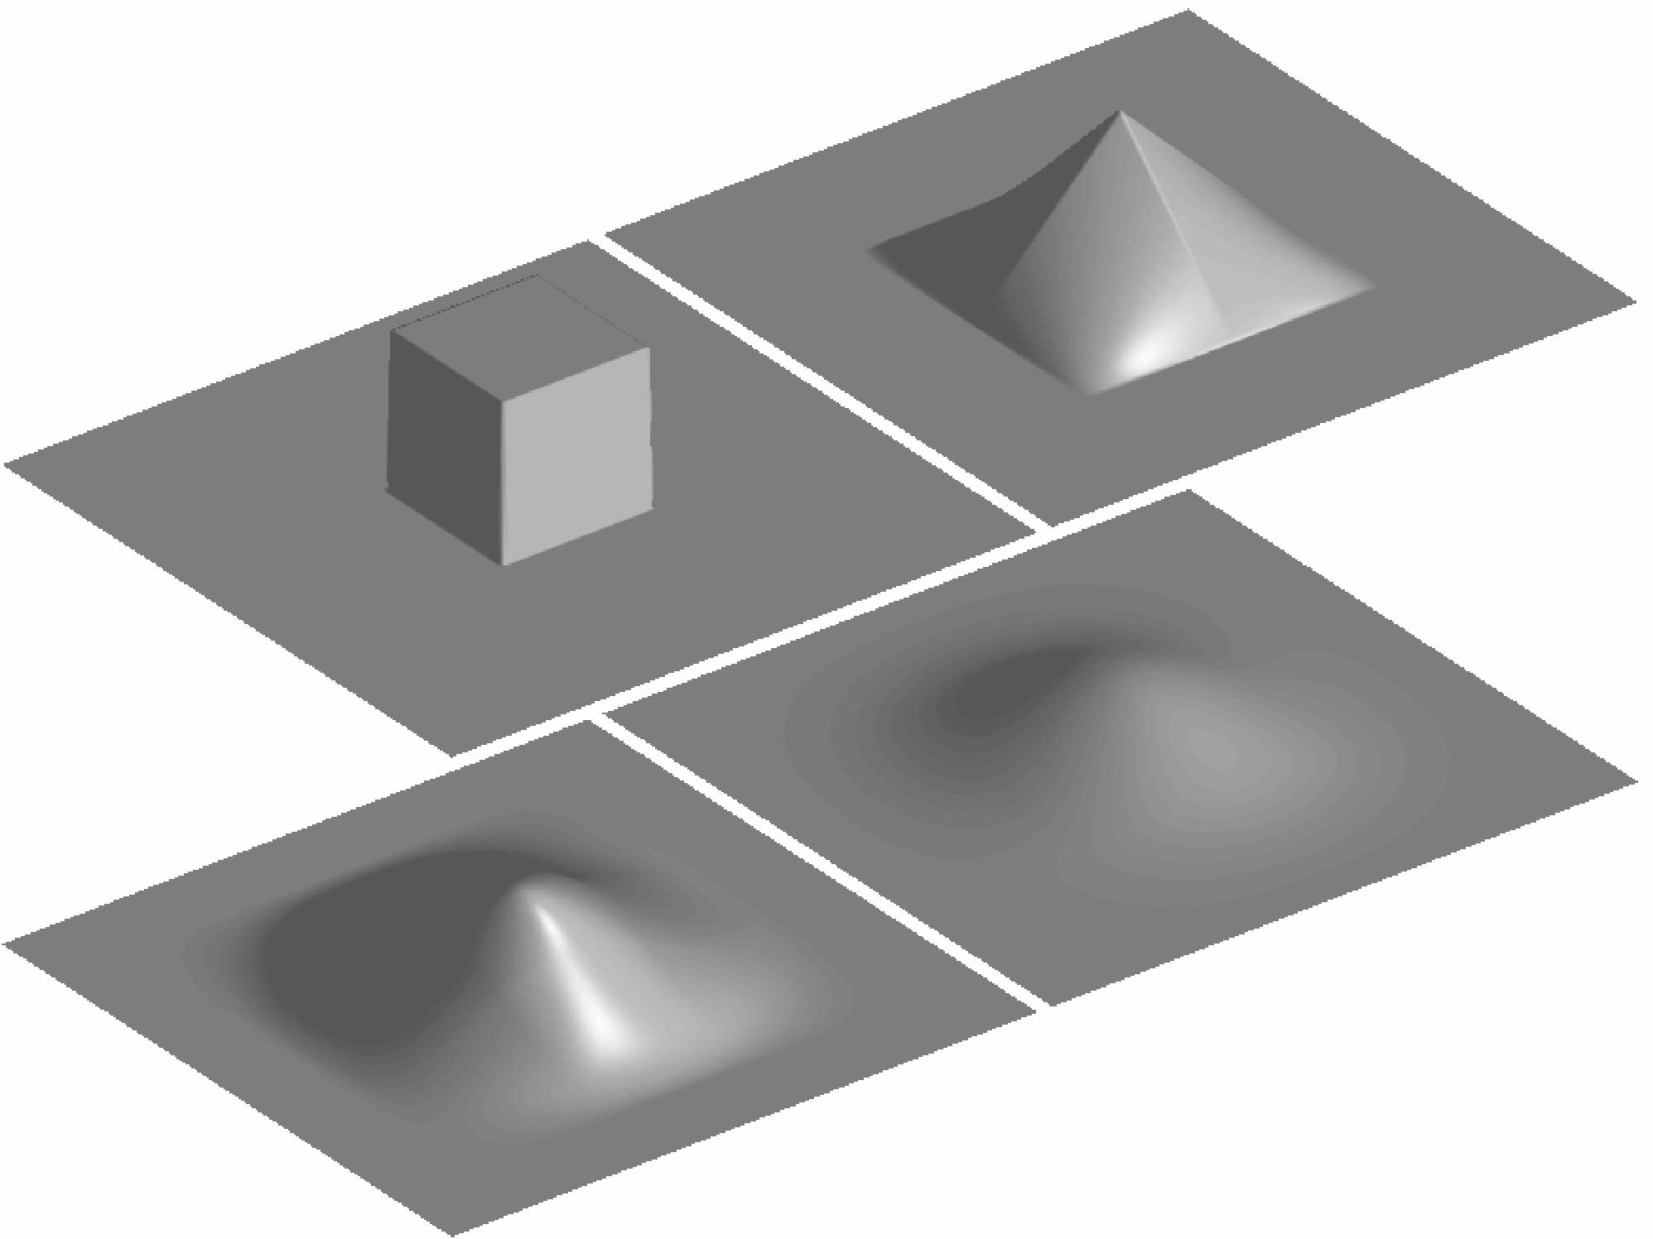
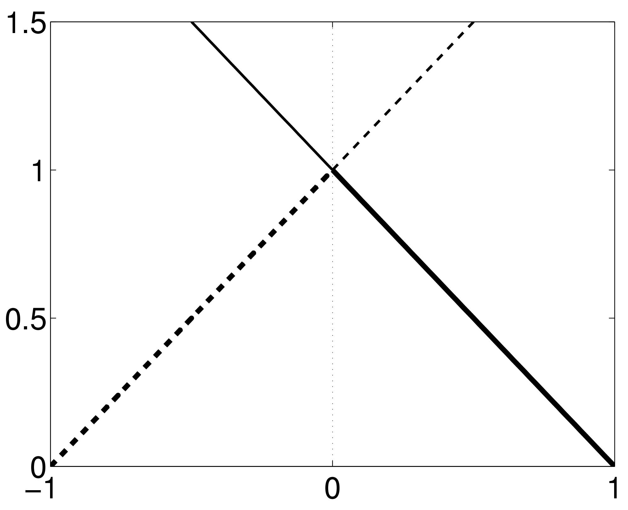
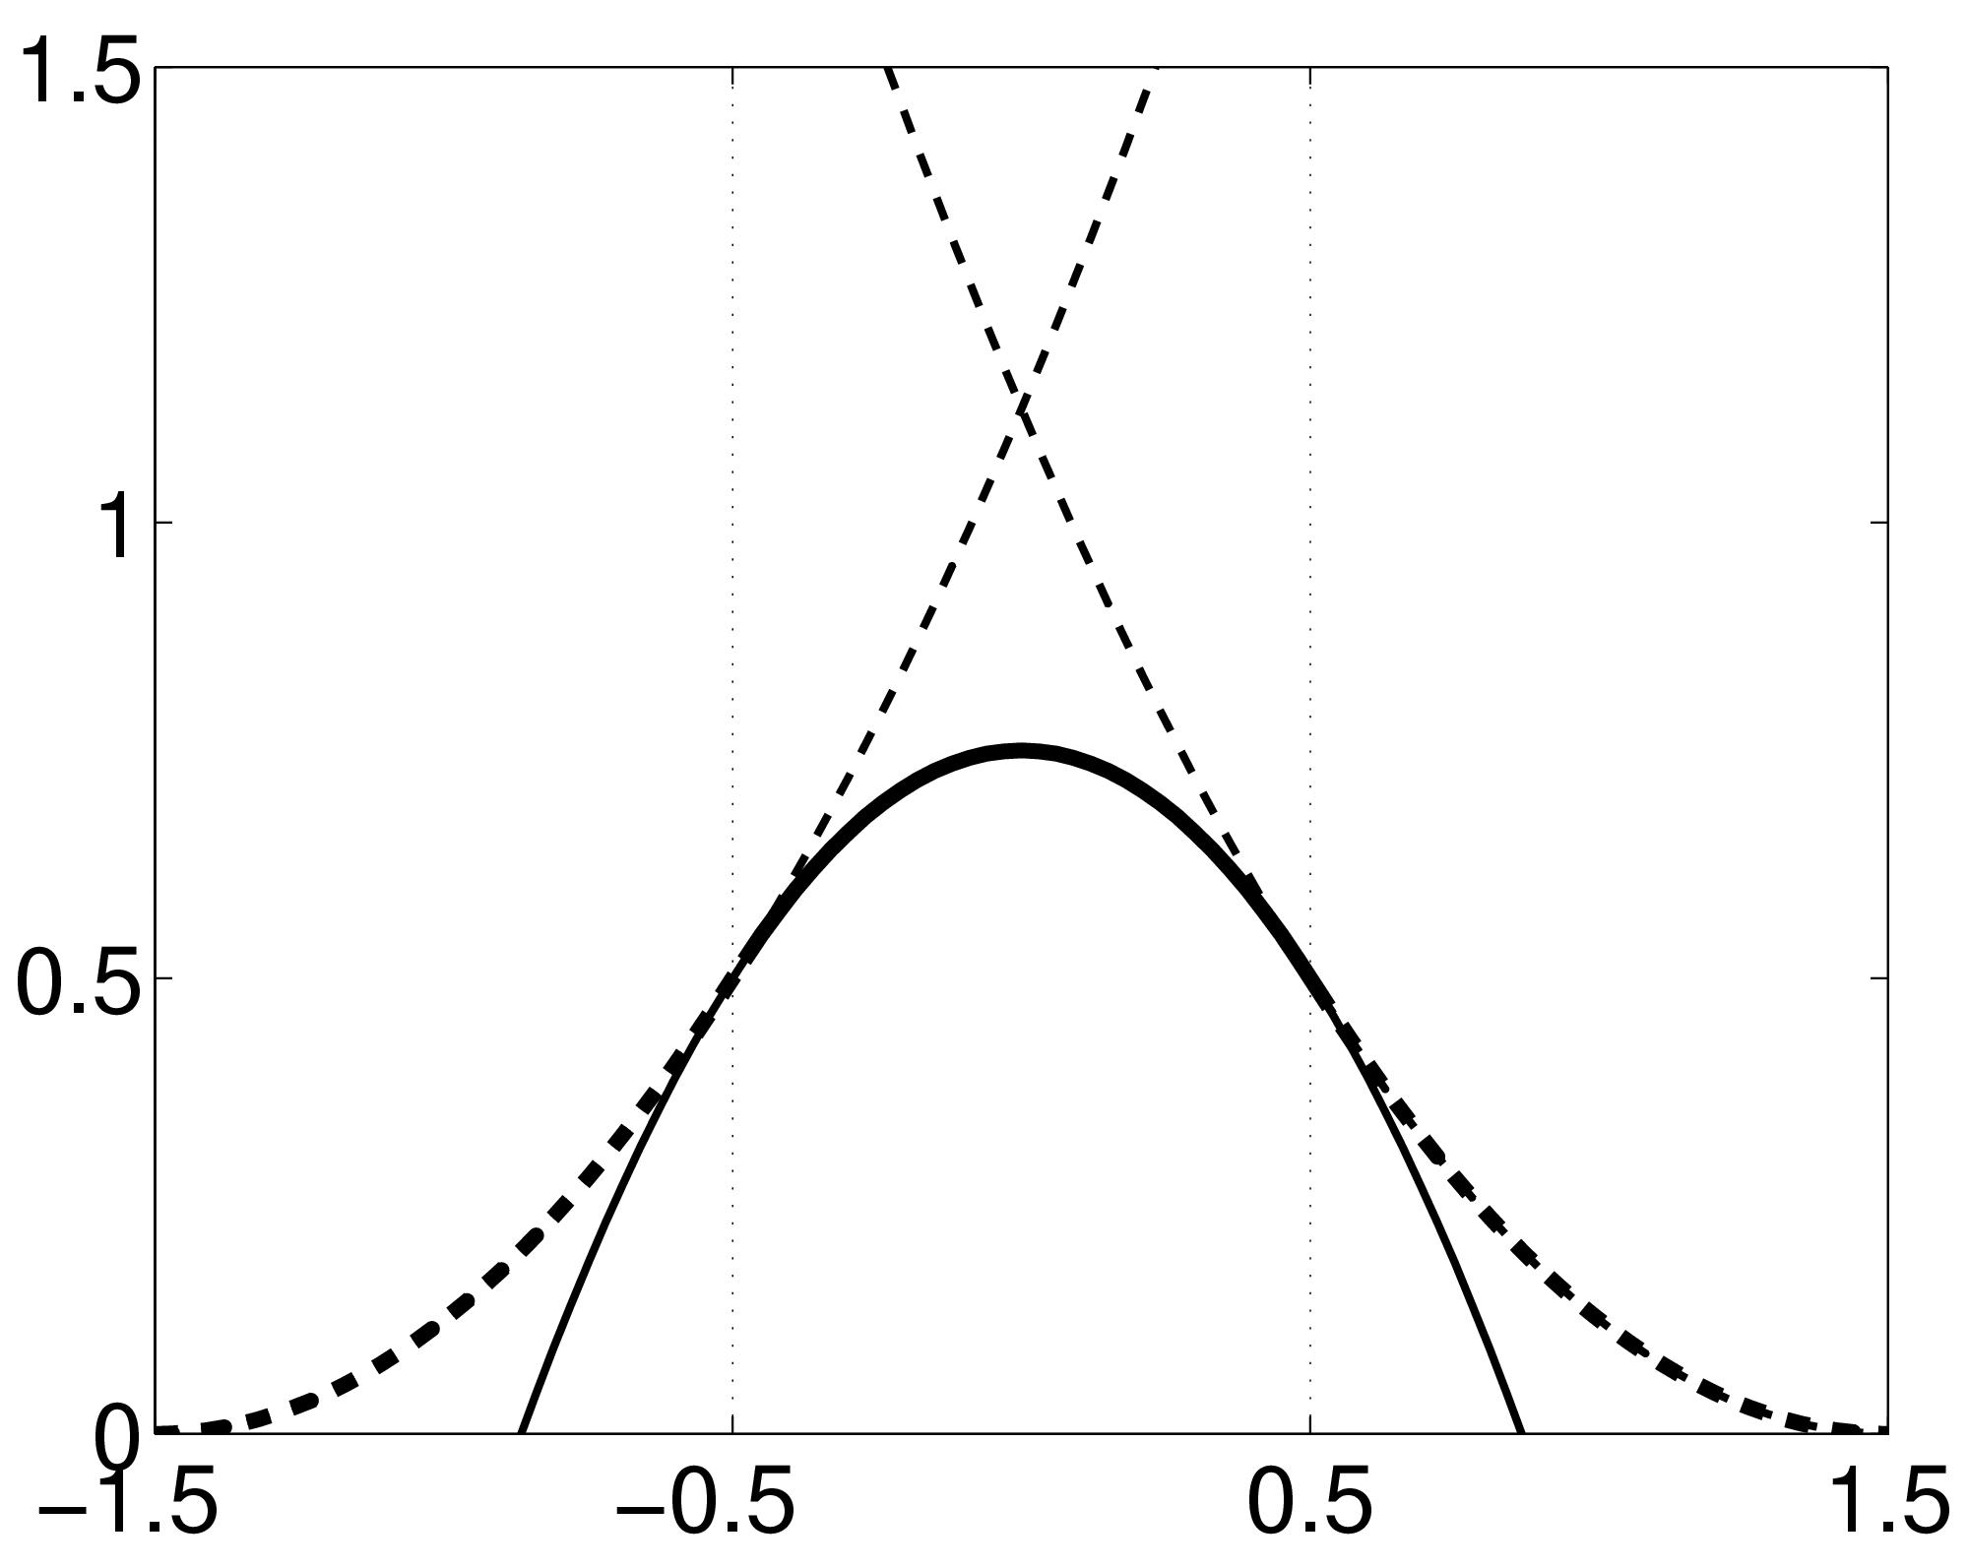
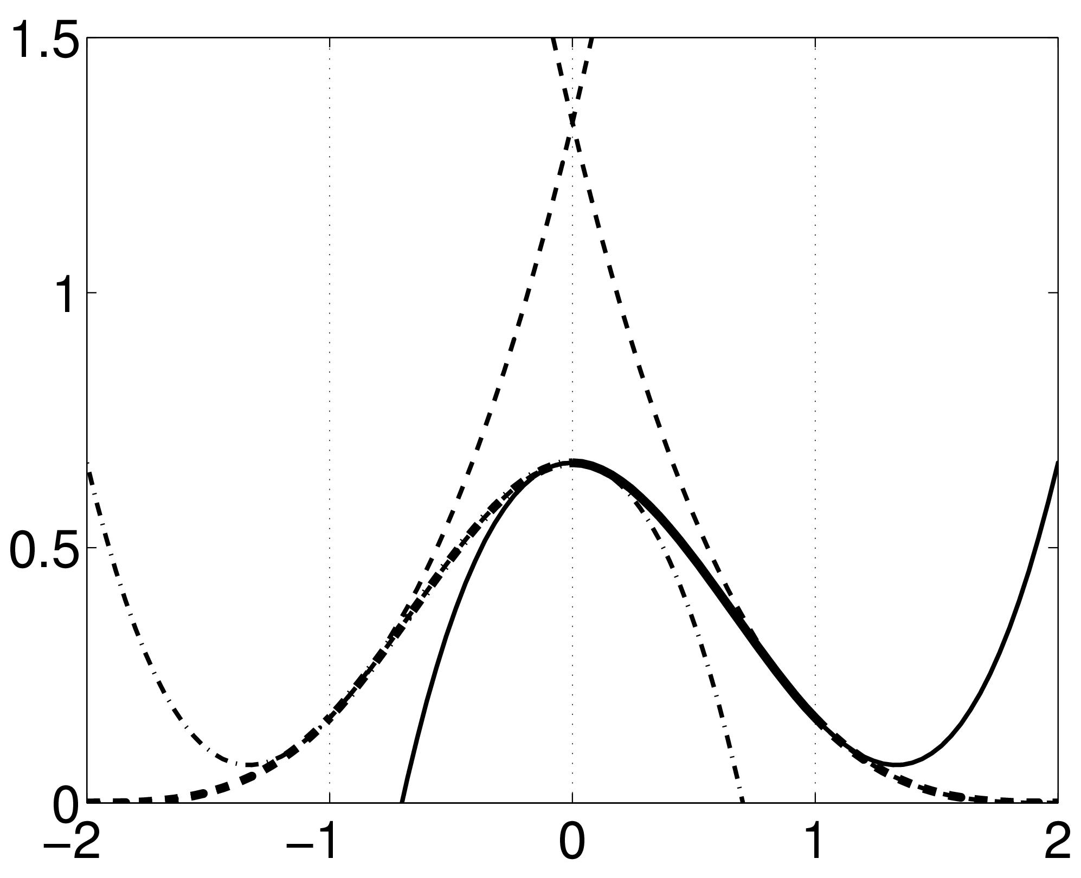
B-spline Interpolation
A continuous function is represented by a linear combination of basis functions
2D B-spline basis functions of degrees 0, 1, 2 and 3
B-splines are piecewise polynomials
B-spline interpolation with degrees 0 and 1 is the same as nearest neighbour and bilinear/trilinear interpolation.
Notes:
So, a better method of interpolation is B-spline. In this graph, the perpendicular thin lines represent the value of individual voxels in the original image and the black line is interpoling the smooth function between voxels. When we want to sample a new value, we just take the height of the black line. This black line consists of the linear combination of these gaussian shaped basis functions. There are a few options of B-spline interpolation in SPM. I’ll try to explain some:
We have a function that is a little triangle shape and this is a 1st degree b-spline, which is identical to a bilinear / tri-linear interpolation
2nd degree b-spline is slightly more sophisticated. This function consists of some polynomials that are stuck together. There’s a gaussian shape here which consists of a bit of this curve (left) a bit of the right curve and a bit of the top curve which are stuck together.
3rd degree b-spline uses a few more curves
This is how they would appear in 2D, there’s also a 3D version as well.

Slide 13
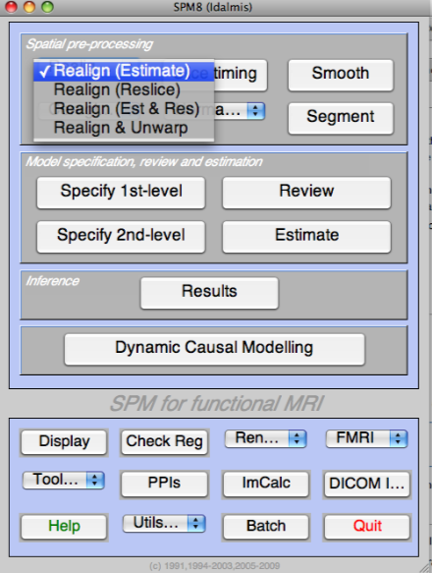
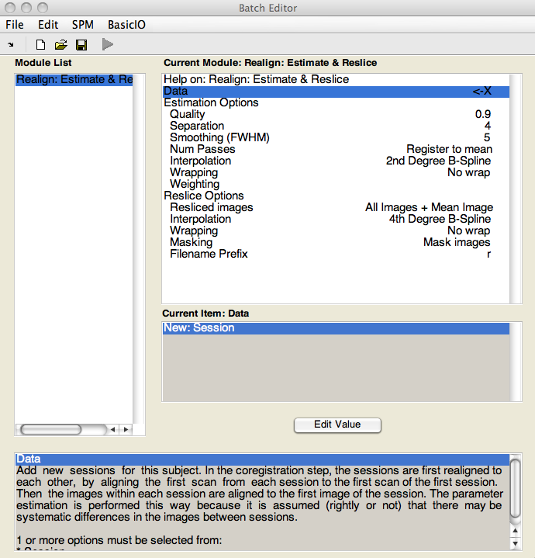
Realignment in SPM - Options

Slide 14
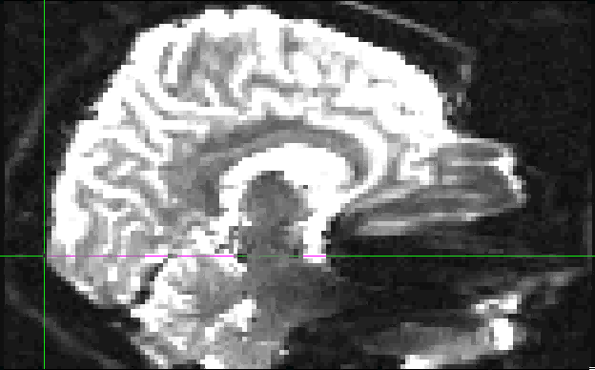
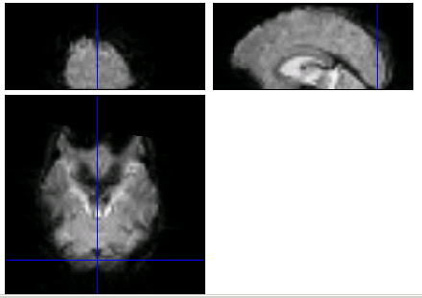
An Example of Movement…
Notes:
Here you see two images of the same brain. The one on top is only five scans earlier than the one at the bottom. Crosshair shows where we are looking now. You have to imagine the brain is tilted. In the top slice there is no brain in this part. In the slide down there is. The subject has shifted downward, or has been nodding. Here the same two images and you see the shift even more clear.
The aim of motion correction / realignment is to remove movement artifact in the fMRI time series

Slide 15
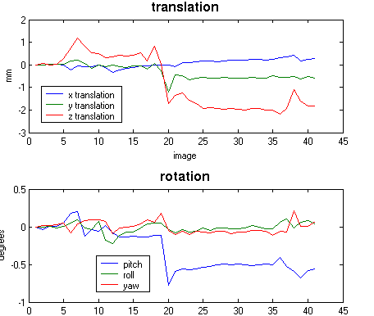
Realignment in SPM - Output
Notes:
These data were specifically made to see what happens when a person nods. The images you saw were 15 and 20, like three mm difference. Shift in y and z direction, and a clear pitch.

Slide 16
Residual Errors in Realigned fMRI
Even after realignment a considerable amount of the variance can be accounted for by effects of movement
This can be caused by e.g.:
  Movement between and within slice acquisition
  Interpolation artefacts due to resampling
  Non-linear distortions and drop-out due to inhomogeneity of the magnetic field
Incorporate movement parameters as confounds in the statistical model

Slide 17
References
SPM Website - www.fil.ion.ucl.ac.uk/spm/
SPM 8 Manual - www.fil.ion.ucl.ac.uk/spm/doc/manual.pdf
MfD 2007 slides
SPM Course Zürich2008 - slides by Ged Ridgway
SPM Short Course DVD 2006
John Ashburner’s slides - www.fil.ion.ucl.ac.uk/spm/course/slides09/

Slide 18

UNWARPING
Has nothing to do with Star Trek’s warp engines…
Suz Prejawa

Slide 19
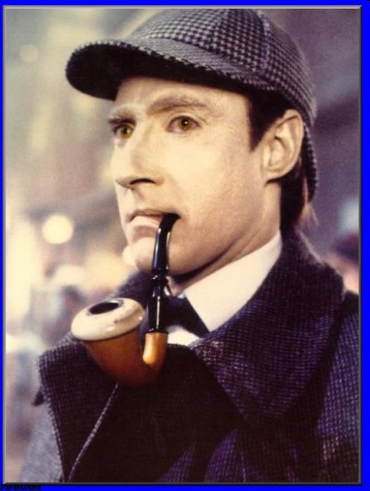
BUT
Data can help with your data

Slide 20
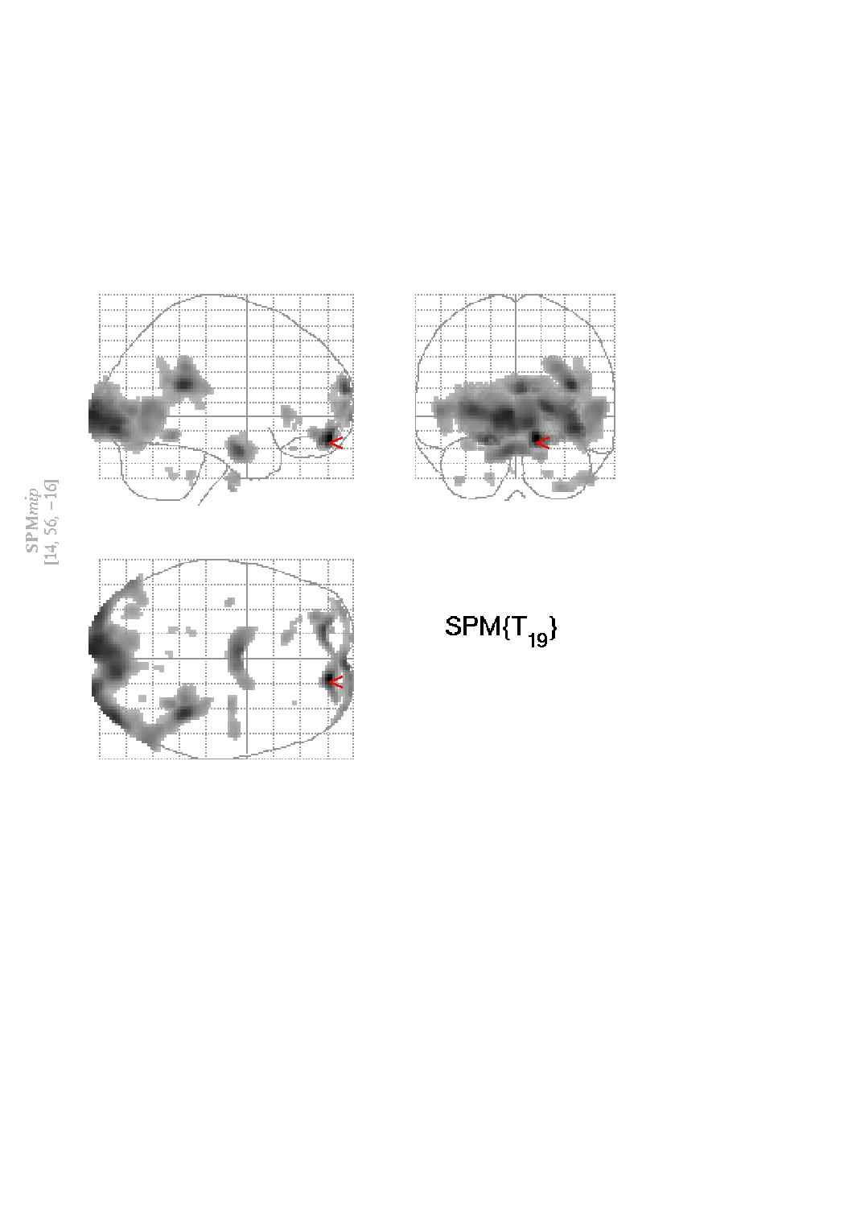
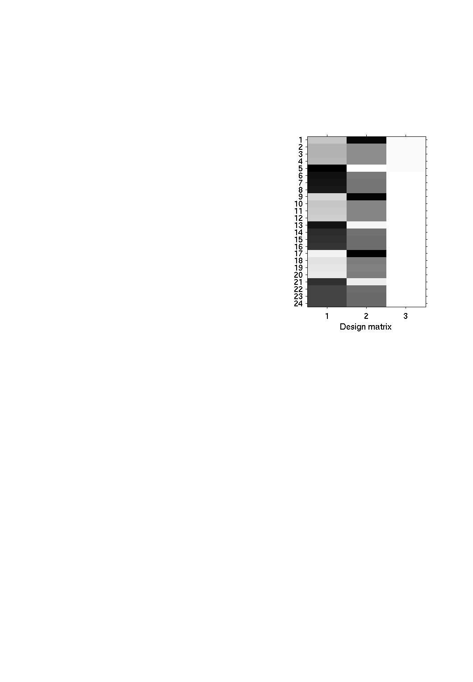
Pre-processing- what’s the point?
To reduce the introduction of false positives in your analysis
No correction
t_{max}=13.38
Notes:
Voxel-based analyses assume that the data from a particular voxel all derive from the same part of the brain.
Violations of this assumption will introduce artifactual changes in the voxel values that may obscure changes, or differences, of interest. E.g. if movement of the subject in the scanner pushes a voxel from an area of low to high signal, this may register as a false-positive ‘activation’.
So before analysing our fMRI data we need to undergo a number of preprocessing steps:
Realignment to ‘undo’ the effects of subject motion
Co-registration
Normalisation
Smoothing

Slide 21

Get a move on!
…when movement makes life difficult
In extreme cases, up to 90% of the variance in fMRI time-series can be accounted for by effects of movement after realignment.
This can be due to non-linear distortion from magnetic field inhomogeneities
Notes:
i.e. brain does not entirely fit the rigid-body assumption of realignment.

Slide 22
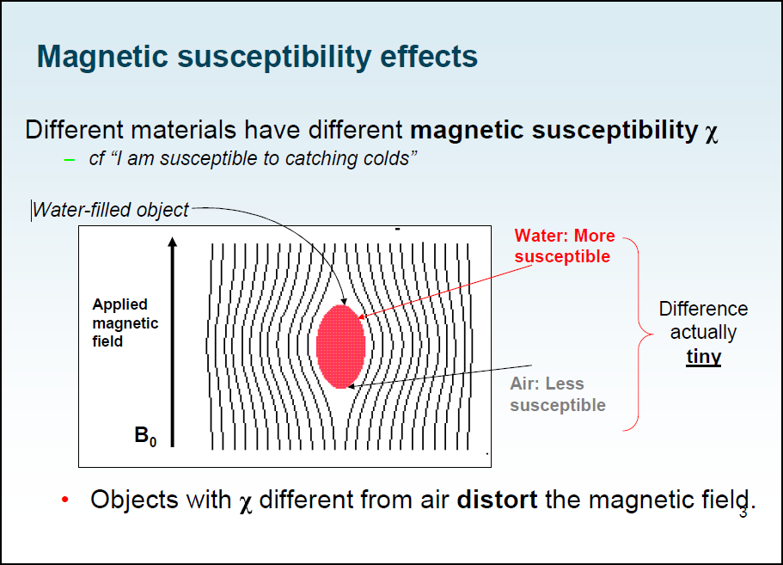
Magnetic Field Inhomogeneities- I
Notes:
Inhomogeneities:
the quality of being inhomogeneous
unregularity, irregularity - not characterized by a fixed principle or rate; at irregular intervals
Susceptibility: receptiveness
The slide is from Chloe Hutton’s ppt:
http://cast.fil.ion.ucl.ac.uk/documents/physics_lectures/Hutton_epi_distortion_300408.pdf

Slide 23
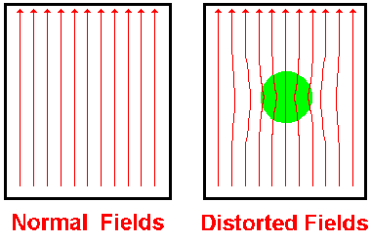
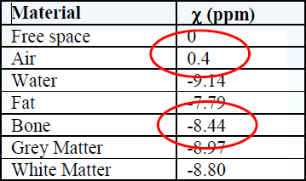
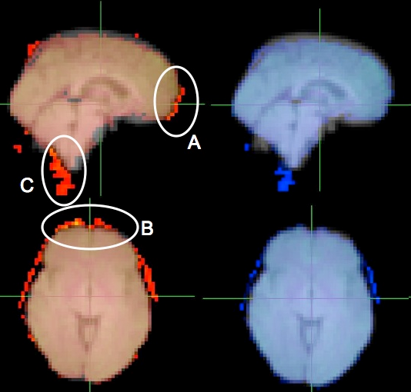
Magnetic Field Inhomogeneities- II
Different tissues have different magnetic susceptibilities
⇨ distortions in magnetic field
distortions are most noticeable near air-tissue interfaces
(e.g. OFC and anterior MTL)
Field inhomogeneities have the effect that locations on the image are ‘deflected’ with respect to the real object
Field inhomogeneity is measured in
parts per million (ppm)
with respect to the external field
Notes:
Figure 1 - The magnetic susceptibility of a substance is the measure of the extent to which the substance modifies the strength of the magnetic field passing through it.
There are different tissues in the brain and so this distortion effect will be inhomogeneous.
the degree of magnetization of a material in response to an applied magnetic field = magnetic susceptibility
4 brain image from http://www.cubric.cf.ac.uk/mri/analysis/correcting-image-distortions-in-epi-data/epi-unwarping-with-fieldmaps/
Images (right) show the typical effect of unwarping on EPI data. Original (red) and unwarped (blue) EPI images are overlaid on top of the fieldmap structural image. Original EPI shows stretching of data in the anterior direction near the frontal pole (A, B), and a movement of the cerebellum and spinal cord in the posterior direction (C). These are corrected in the unwarped version (blue)

Slide 24
Why is that important?
… Non-rigid deformation …
Knowing the location at which ¹H spins will precess at a particular frequency and thus where the signal comes from is dependent upon correctly assigning a particular field strength to a particular location.
If the field B₀ is homogeneous, then the image is sampled according to a regular grid and voxels can be localised to the same bit of brain tissue over subsequent scans by realigning, this is because the same transformation is applied to all voxels between each scan.
If there are inhomogeneities in B₀, then different deformations will occur at different points in the field over different scans, giving rise to non-rigid deformation.
B₀ Expect field strength to be B₀
here, so H atoms with signal associated
with resonant frequency ω₀ to be located
here.
In fact, because of inhomogeneity, they are
here.
Notes:
Chloe Hutton explains this step by step in the physics wiki:
http://cast.fil.ion.ucl.ac.uk/documents/physics_lectures/Hutton_epi_distortion_300408.pdf
So where precisely is the source?
In a homogeneous field we can locate a signal source consistently in exactly the same voxel, over and over again, in the same voxel, esp after we have realigned all slices to the same source image
But our field is WONKY!
Because of Magnetic Field Inhomogeneities-
Which means that the signal will NOT change linearly…

Slide 25
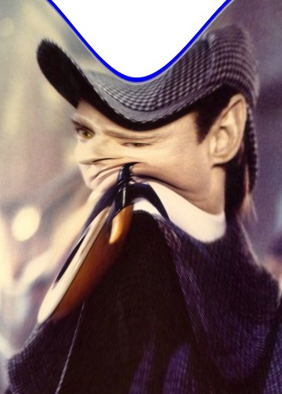
Data can help with your data
1) The image we obtain is a distorted image
2) There will be movements within the scanner.

Slide 26
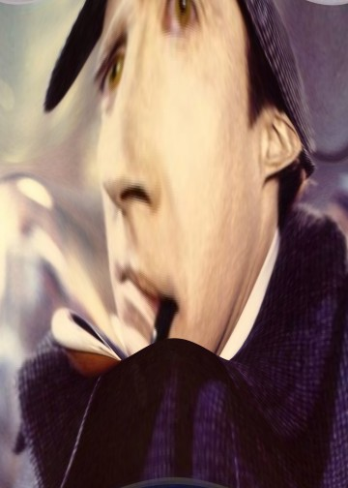
Data can help with your data!
The movements interact with the distortions.
Therefore changes in the image as a result of head movements do not really follow the rigid body assumption: the brain may not alter as it moves, but the images do.
Notes:
EPI is particularly sensitive to the effects of magnetic field inhomogeneities because it has long TR.
From: http://www.fil.ion.ucl.ac.uk/spm/toolbox/unwarp/#Rationale
EPI images are not particularly faithful reproductions of the object, and in particular there are severe geometric distortions in regions where there is an air-tissue interface (e.g. orbitofronal cortex and the anterior medial temporal lobes). In these areas in particular the observed image is a severely warped version of reality, much like a funny mirror at a fair ground. When one moves in front of such a mirror ones image will distort in different ways and ones head may change from very elongated to seriously flattened. If we were to take digital snapshots of the reflection at these different positions it is rather obvious that realignment will not suffice to bring them into a common space.
The situation is similar with EPI images, and an image collected for a given subject position will not be identical to that collected at another. Hence, even after a "successful" realignment there will be residual variance caused by the object having different shape at different time points. We call this effect susceptibility-by-movement interaction. "Unwarp" is predicated on the assumption that the susceptibility-by-movement interaction is responsible for a sizeable part of residual movem nt related variance.

Slide 27
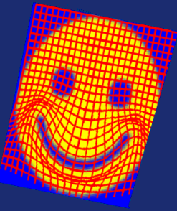
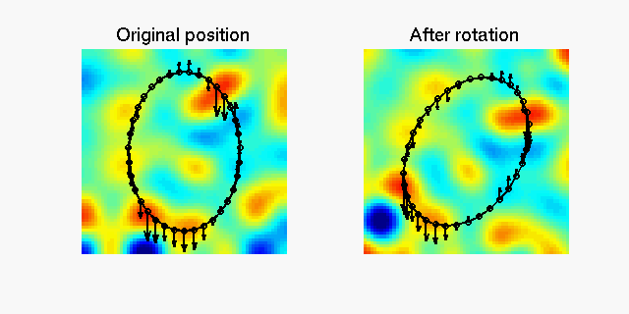
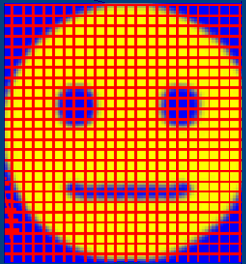
Susceptibility-by-motion interactions
Field inhomogeneities change with the position of the object in the field, so there can be non-rigid, as well as rigid distortion over subsequent scans.
The movement-by-inhomogeneity interaction can be observed by changes in the deformation field* over subsequent scans.
A deformation field indicates the directions and magnitudes of location deflections throughout the magnetic field (B0) with respect to the real object.
Vectors indicating distance & direction
The amount of distortion is proportional to the absolute value of the field inhomogeneity and the data acquisition time.

Slide 28
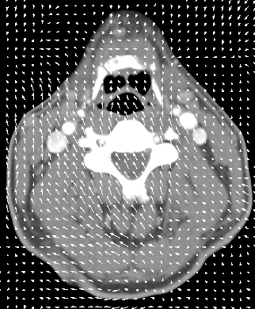
So here comes the good news!
With a FIELDMAP you can unwarp your scans (SPM toolbox!)
  a fieldmap measures field inhomogeneity (potentially per every scan) ⇨ captures deformation field
find the derivatives of the deformations with respect to subject movement
  for every scan, how exactly did my data warp/ how much did the deformation field change?
igl.stanford.edu/~torsten/ct-dsa.html
Notes:
Fieldmaps (taken during scan and implemented using SPM toolbox)
http://www.fil.ion.ucl.ac.uk/spm/toolbox/unwarp/#Rationale
Assume that we know how the deformations change when the subject changes position (i.e. we know the derivatives of the deformations with respect to subject position). That means that for a given time series and a given set of subject movements we should be able to predict the "shape changes" in the object and the ensuing variance in the time series. It also means that, in principle, we should be able to formulate the inverse problem, i.e. given the observed variance (after realignment) and known (esti ated) movements we should be able to estimate how deformations change with subject movement.
We have made an attempt at formulating such an inverse model, and at solving for the "derivative fields". A deformation field can be thought of as little vectors at each position in space showing how that particular location has been deflected. A "derivative field" is then the rate of change of those vectors with respect to subject movement. Given these "derivative fields" we should be able to remove the variance caused by the susceptibility-by-movement interaction. Since the underlying model is so re tricted we would also expect experimentally induced variance to be preserved. Our experiments have also shown this to be true. Indeed one particular experiment even indicated that in some cases the method will reintroduce experimental variance that had been obliterated by movement related variance.
In theory it should be possible to estimate also the "static" deformation field, yielding an unwarped (to some true geometry) version of the time series. In practice that doesn't really seem to work, hence the method deals only with residual movement related variance induced by the susceptibility-by-movement interaction.
Combined use with FieldMap
This means that the time-series will be undistorted to some "average distortion" state rather than to the true geometry. If one wants additionally to address the issue of anatomical fidelity one should combine Unwarp with a measured field-map. A field-map in the format that Unwarp expects can be created using the FieldMap toolbox.
The description above can be thought of in terms of a Taylor expansion of the field as a function of subject movement. Unwarp alone will estimate the first (and optionally second, see below) order terms of this expansion. It cannot estimate the zeroth order term (the distortions common to all scans in the time series) since that doesn't introduce (almost) any variance in the time series. The measured fieldmap takes the role of the zeroth order term. Refer to the FieldMap toolbox and the documents FieldMap.man and FieldMap_principles.man for a description of how to obtain fieldmaps in the format expected by Unwarp.
A deformation field indicates the directions and magnitudes of location deflections throughout the FOV with respect to the real object.

Slide 29
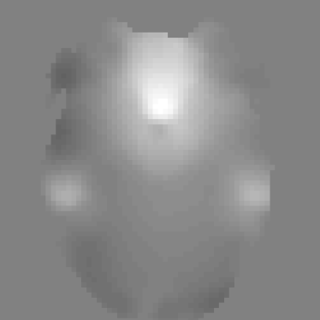
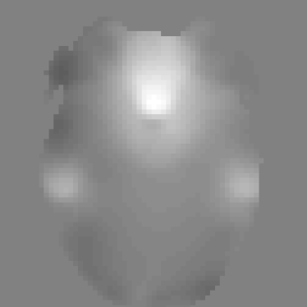
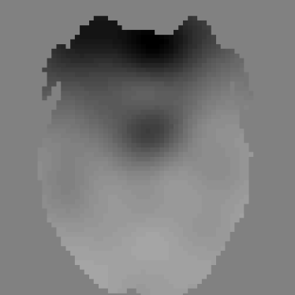
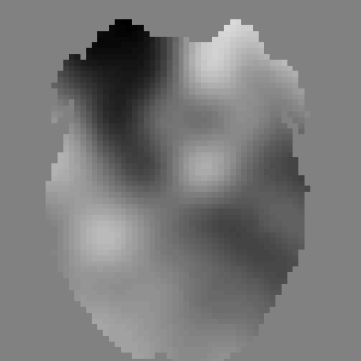
Unwarp can estimate changes in distortion from movement
Resulting field map at each time point
Measured field map
Estimated change in field wrt change in pitch (x-axis)
Estimated change in field wrt change in roll (y-axis)
0
=
0
+Δϕ
+Δθ
Using:
  distortions in a reference image (FieldMap)
  subject motion parameters (that we obtain in realignment)
  change in deformation field with subject movement (estimated via iteration)
To give an estimate of the distortion at each time point.
Notes:
From: www.fil.ion.ucl.ac.uk/~mgray/Presentations/Unwarping.ppt
Given the derivative of the field with respect to subject movement, and the movement parameters estimated from realignment, one can predict the non-rigid deformation in the scan series.
In practice, we know the non-rigid deformation (in terms of extra variance after realignment) and the subject movement (movement parameters)- so we can estimate the derivatives of the field B0 with respect to subject movement – thus estimate how the field is warped over the time series and ‘undo’ this using UNWARP.
Usually, rather than generating a statistical field map for every image in the EPI data set, we compute how one map is warped over subsequent scans.
29

Slide 30

Measure deformation field (FieldMap).
Estimate new distortion fields for each image:
estimate rate of change of the distortion field with respect to the movement parameters.
Unwarp time series
Estimate movement parameters
Δϕ
+Δθ

Slide 31
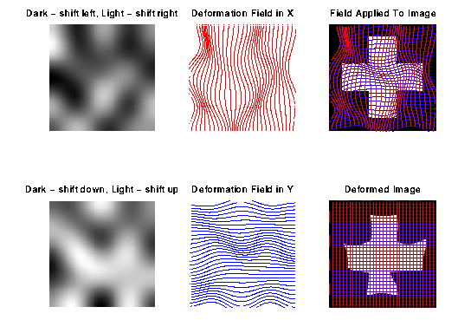
Applying the deformation field to the image
Once the deformation field has been
modelled over time, the time-variant
field is applied to the image.
effect of sampling a regular object over a curved surface.
The image is therefore re-sampled
assuming voxels, corresponding to
the same bits of brain tissue, occur
at different locations over time.

Slide 32
The outcome?
In the end what you get is resliced copies of your images (with the letter ‘u’ appended to the front) that have been
  realigned (to correct for subject movement) and
  unwarped (to correct for the movement-by-distortion interaction) accordingly*.
These images are then taken forward to the next preprocessing steps (next week!).
*NB. You can ‘realign’ and ‘unwarp’ separately if you prefer.

Slide 33
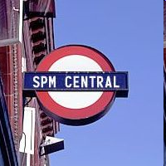
All very well, but how do I actually do this?
In scanner: acquire 1 set of fieldmaps for each subject
After scanning: convert fieldmaps into .img files (DICOM import in SPM menu)
Use fieldmap toolbox to create .vdm (voxel displacement map) files for each run for each subject.
* You need to enter various default values in this step, so check physics wiki for what’s appropriate to your scanner type and scanning sequence
4. Enter vdm* files with EPI images into ‘realign + unwarp step’. This realigns your images and unwarps them in one step.

Slide 34
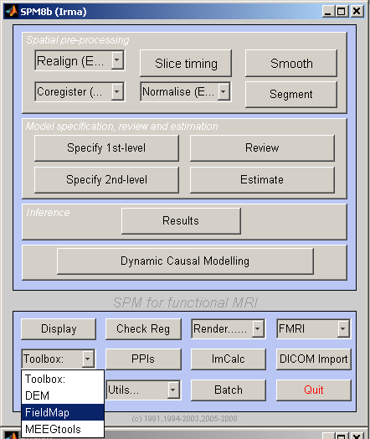
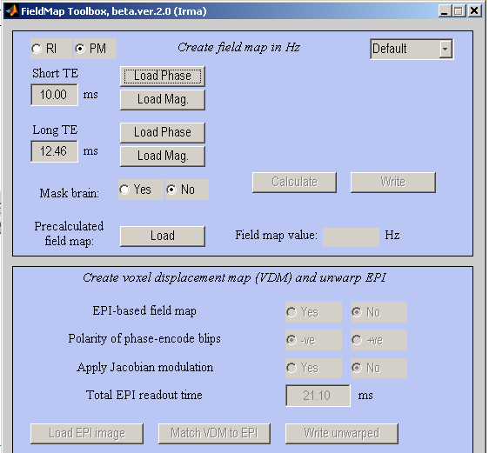
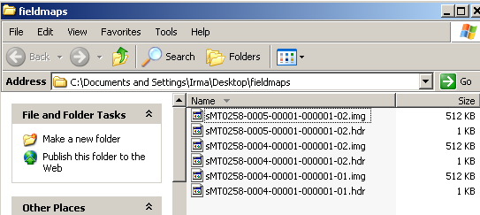
Step 2: fieldmap toolbox on SPM8
If using toolbox, you need to load the right phase and mag images.
phase: one for which there’s only one file with that series number
Mag: the first file of the two files with the same series number
Series number
Notes:
Your epi acquisitions from your various scan sessions/ blocks (eg, 100 acquisitions per block; 4 blocks in your experiment)

Slide 35
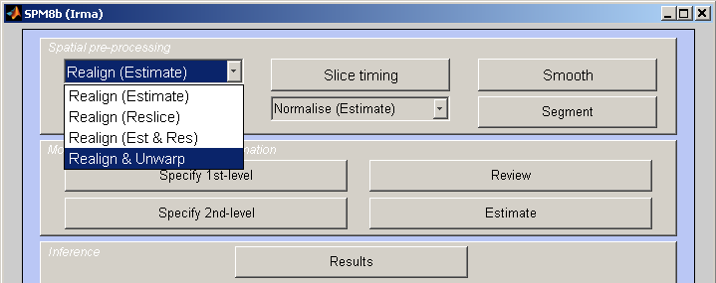
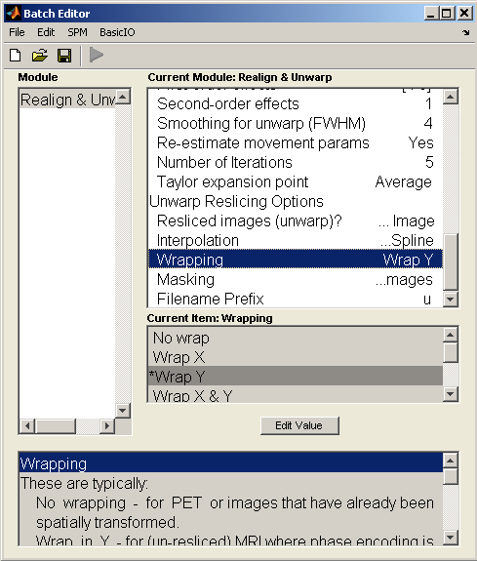
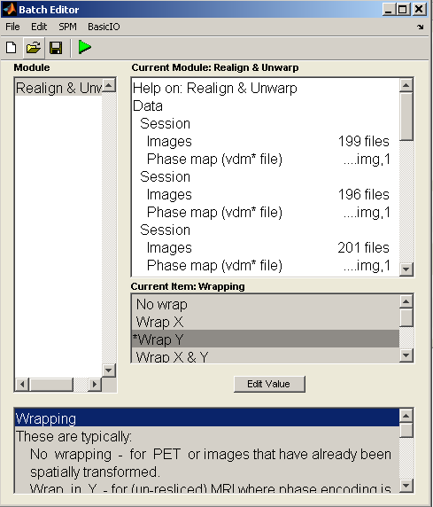

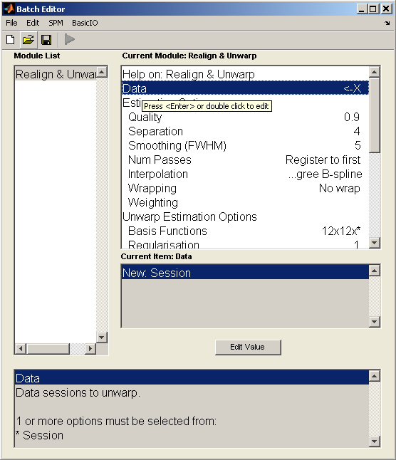
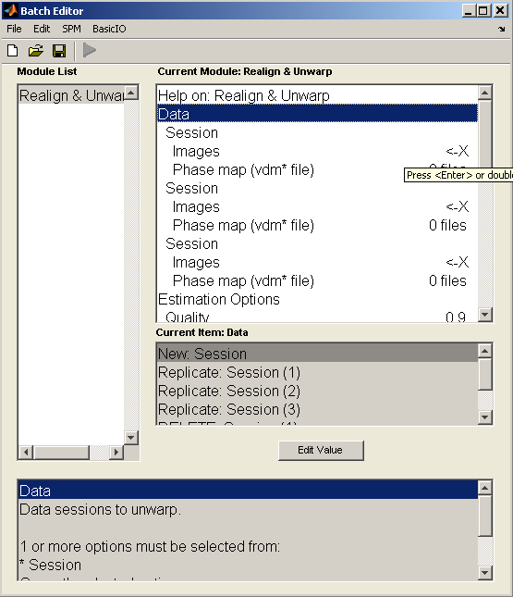
Realign + unwarp in spm8
Click ‘RUN’
Click on ‘new session’ as many times as your session numbers
‘images’ = EPI data fM*.img, ~100s images
‘phase map’ = vdm*.img
Do this for each session
The rest is probably default
Same goes for ‘Unwarp and reslicing options’

Slide 36
So hopefully you understand that...
Tissue differences in the brain distort the signal, giving distorted images
As the subject moves, the distortions vary
Therefore images do not follow the rigid-body assumption.
Unwarp estimates how these distortions change as the subject moves
Notes:
36

Slide 37
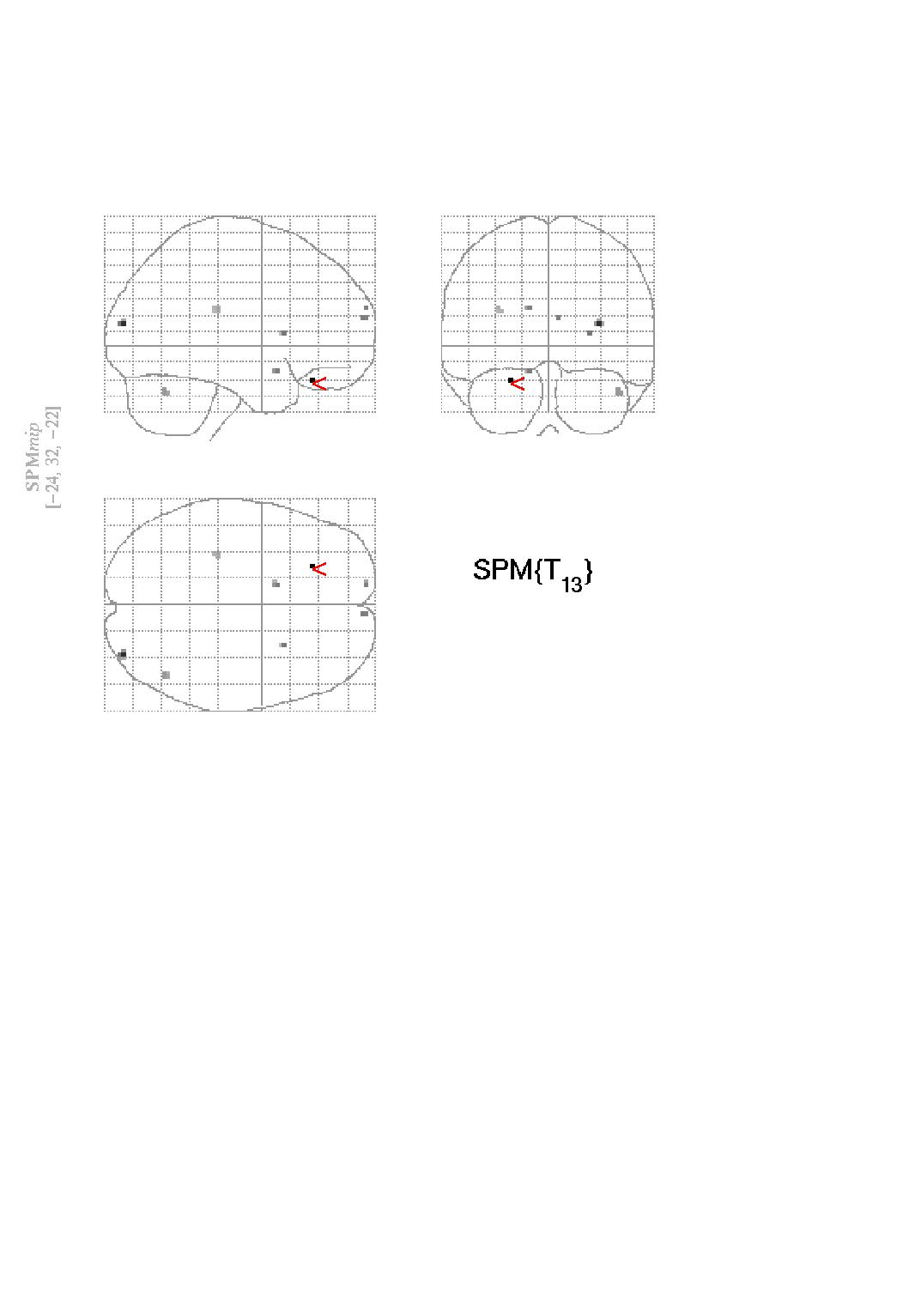
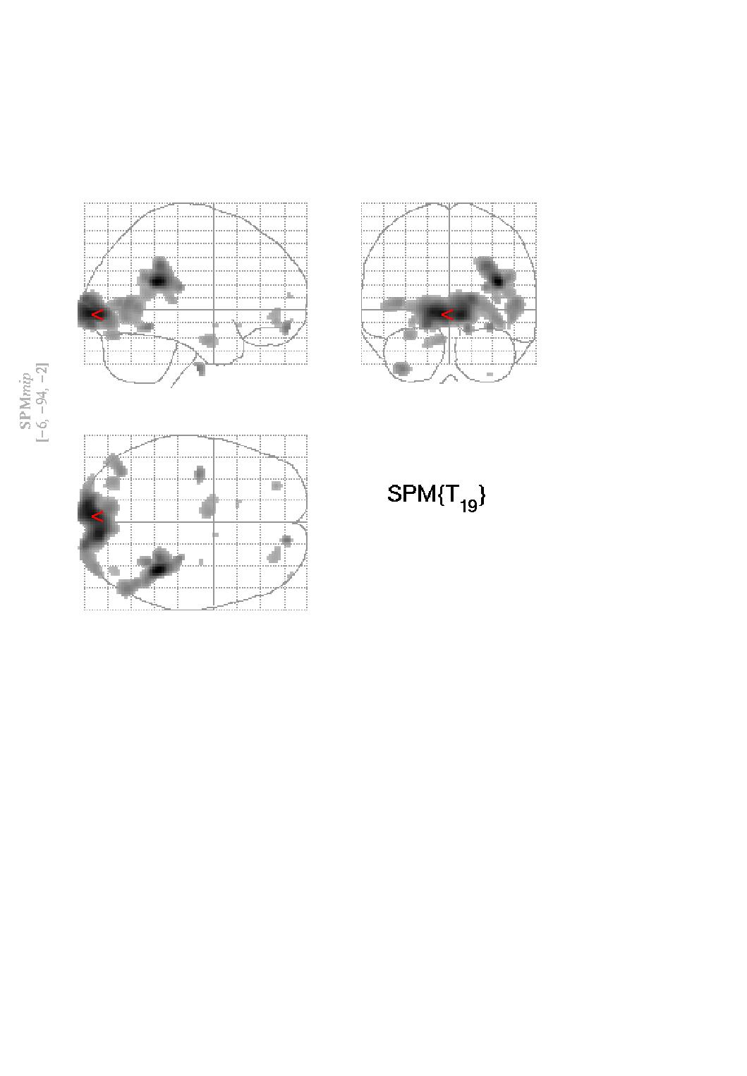
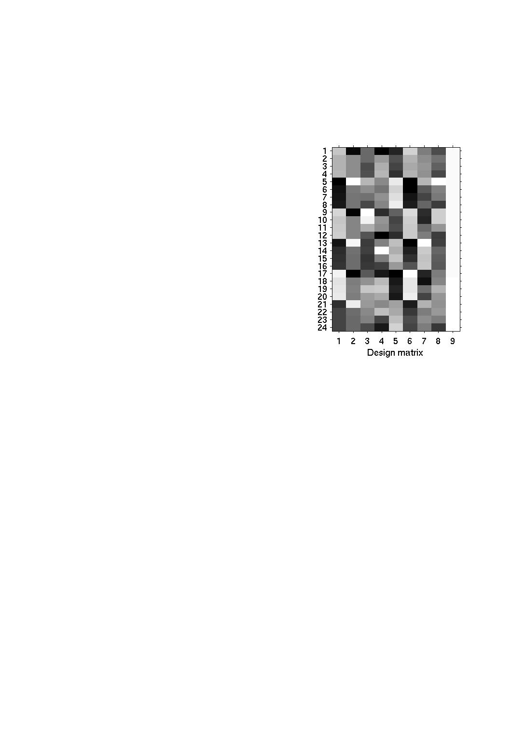
Advantages of incorporating this in pre-processing
One could include the movement parameters as confounds in the statistical model of activations.
However, this may remove activations of interest if they are correlated with the movement.
No correction
Correction by covariation
Correction by Unwarp
t_{max}=13.38
t_{max}=5.06
t_{max}=9.57

Slide 38

Practicalities
Unwarp is of use when variance due to movement is large.
Particularly useful when the movements are task related as can remove unwanted variance without removing “true” activations.
Can dramatically reduce variance in areas susceptible to greatest distortion (e.g. orbitofrontal cortex and regions of the temporal lobe).
Useful when high field strength or long readout time increases amount of distortion in images.
Can be computationally intensive… so take a long time
Notes:
38

Slide 39
References
Jezzard, P. and Clare, S. 1999. Sources of distortion in functional MRI data. Human Brain Mapping, 8:80-85
Andersson JLR, Hutton C, Ashburner J, Turner R, Friston K (2001) Modelling geometric deformations in EPI time series. Neuroimage 13: 903-919
Previous years MfD slides.
John Ashburner’s slides http://www.fil.ion.ucl.ac.uk/spm/course/#slides
This ppt: www.fil.ion.ucl.ac.uk/~mgray/Presentations/Unwarping.ppt
Physics WIKI
SPM website/ SPM manual
And Chloe Hutton.

