Slide 1
1st Level Analysis
Design Matrix , Contrasts & Inference
Methods for dummies 2011-12, Hikaru Tsujimura and Hsuan-Chen Wu

Slide 2


So far, we learned preprocessing, then what is next?
fMRI time-series
kernel
Design matrix
Motion
correction
Smoothing
General Linear Model
Spatial
normalisation
After realigning, filtering, spatial normalization, images are ready to be analyzed!
Standard
template

Slide 3
Outline
What is First Level Analysis?
Role of Design Matrix in analysis
Role of Contrast in analysis
How to Infer?

Slide 4
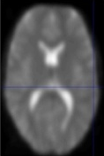
First level Analysis = Within Subjects Analysis
Time
Time
Time
Time
Run 1
Run 2
Run 1
Run 2
Subject 1
Subject n
First level
Second level
group(s)

Slide 5
Key in 1st Level Analysis
The GLM for fMRI:
β
⁺
ε
Y
X
⁼
^{x}
BOLD signal
Design Matrix
(Variables that explain the observed data (EV))
Relative Contribution
of X to the overall
data (These need to
be estimated)
Error (The difference between the observed data and that which is predicted by the model)

Slide 6
X = Design Matrix
Time
(n)
Regressors (m)

Slide 7
Regressors – represent hypothesised contributors in your experiment. They are represented by columns in the design matrix (1column = 1 regressor)
Regressors of Interest or Experimental Regressors – represent those variables which you intentionally manipulated. The type of variable used affects how it will be represented in the design matrix
Regressors of no interest or nuisance regressors – represent those variables which you did not manipulate but you suspect may have an effect. By including nuisance regressors in your design matrix you decrease the amount of error.
E.g. - The 6 movement regressors (rotations x3 & translations x3 ) or physiological factors e.g. heart rate

Slide 8
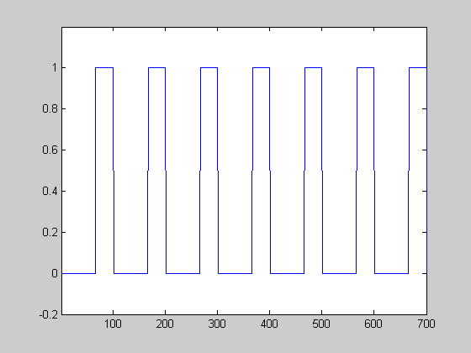
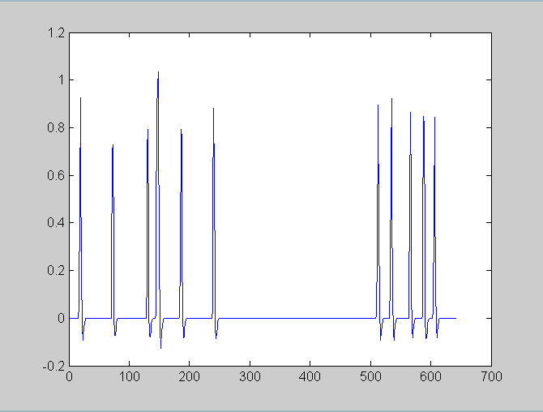
Designs
Block design Event- related design
Intentionally design events of interest into blocks
Retrospectively look at when the events of interest occurred. Need to code the onset time for each regressor

Slide 9
Regressors
A dark-light colour map is used to show the value of each regressor within a specific time point
Black = 0 and illustrates when the regressor is at its smallest value
White = 1 and illustrates when the regressor is at its largest value
Grey represents intermediate values
The representation of each regressor column depends upon the type of variable specified
Time
(n)
Regressors (m)

Slide 10
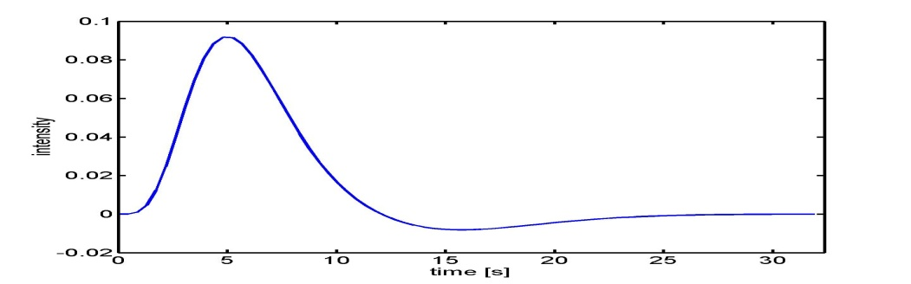
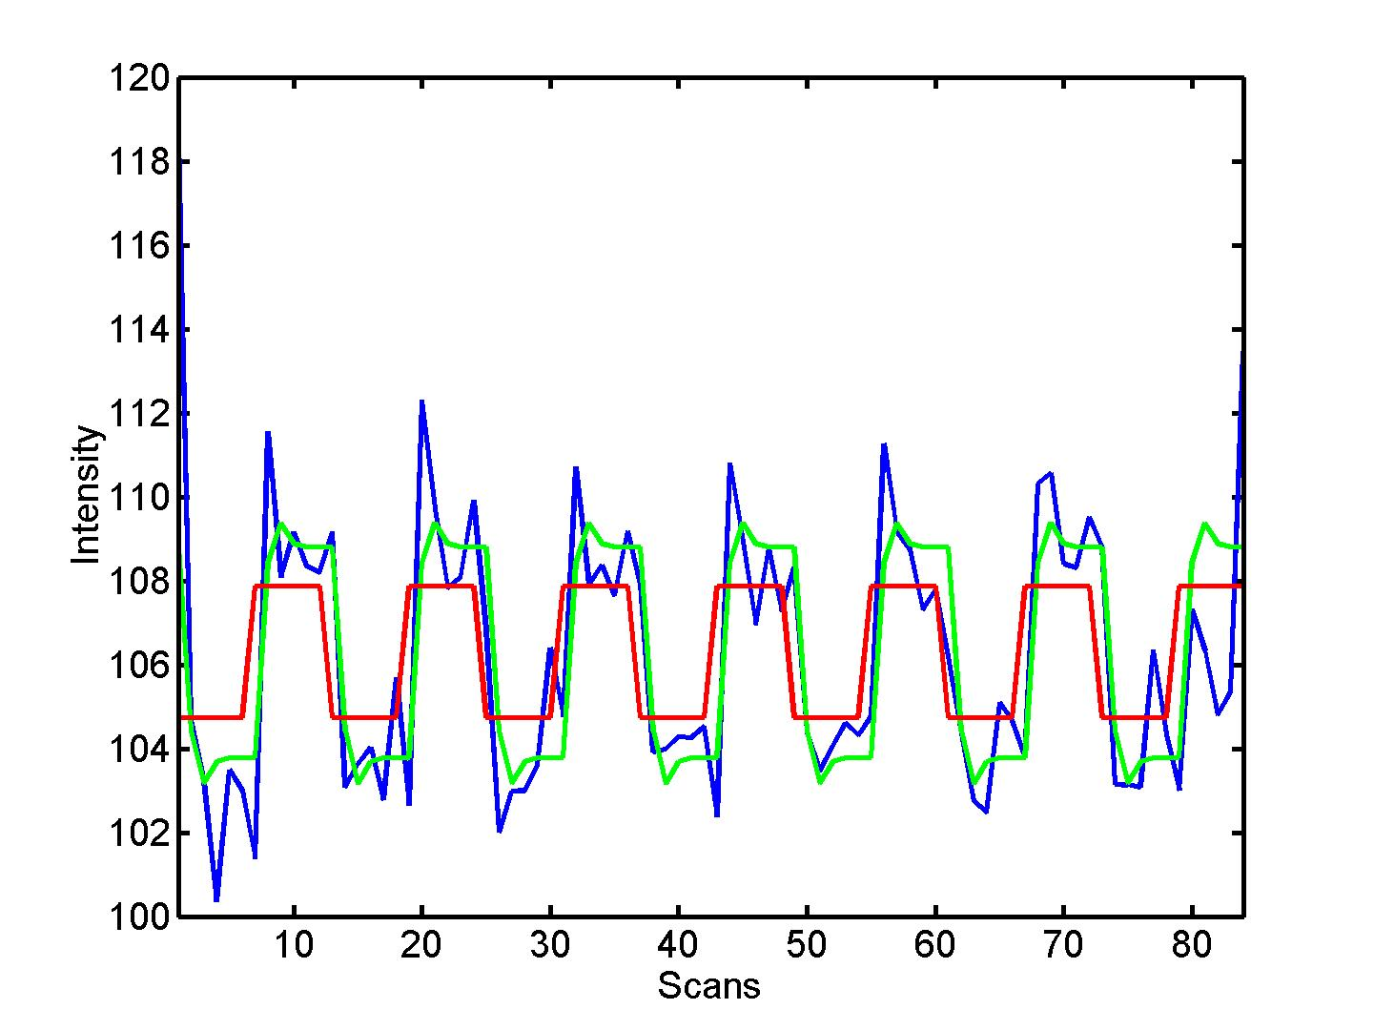



Modelling Haemodynamics
Changes in the bold activation associated with the presentation of a stimulus
Haemodynamic response function
Peak of intensity after stimulus onset, followed by a return to baseline then an undershoot
Box-car model is combined with the HRF to create a convolved regressor which matches the rise and fall in BOLD signal (greyscale)
Even with this, not always a perfect fit so can include temporal derivatives (shift the signal slightly) or dispersion derivatives (change width of the HRF response) *more later in this course
HRF Convolved

Slide 11
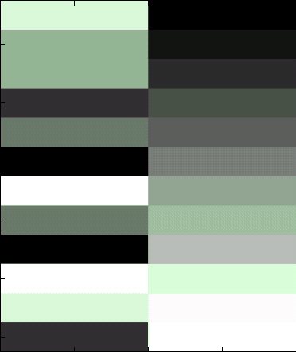
Covariates
What if you variable can’t be described using conditions?
E.g Movement regressors – not simply just one state or another
  The value can take any place along the X,Y,Z continuum for both rotations and translations
Covariates – Regressors that can take any of a continuous range of values (parametric)
Thus the type of variable affects the design matrix – the type of design is also important

Slide 12
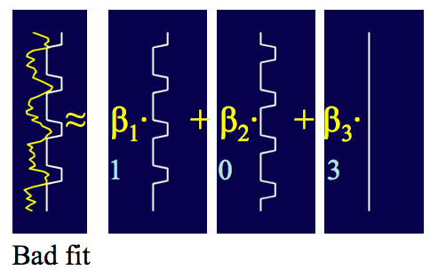
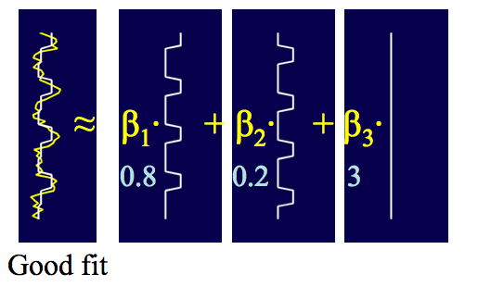
Finding the best fitting model:
These optimal fitting values are saved in beta image files for each EV. The residual signal variance in the voxel, unexplained by the model (within subject error) is saved in MSres image files.

Slide 13
Outline
Why do we need contrasts?
What are contrasts?
T contrasts
F contrasts
Factorial design

Slide 14
Why do we need contrasts?
Because fMRI provides no information about absolute levels of activation, only about changes in activation over time
Research hypotheses involve comparison of activation between conditions
Researcher constructs a design matrix consisting of a set of regressors, and then determines how strongly each of those regressors matches changes in the measured BOLD signal
  Regressors explain much of the BOLD signal have high magnitude parameter weights (larger β values), whereas regressors explain little of BOLD signal have parameter weights near zero
Y = X x β + ε
Matrix of BOLD signals
(What you collect)
Design matrix
(This is what is put into SPM)
Matrix parameters
(These need to be estimated)
Error matrix
(residual error for each voxel)

Slide 15
What are contrasts?
In GLM, β represents the parameter weight, or how much each regression factor contributes to the overall data
  β₀ reflects the total contribution of all factors that are held constant throughout the experiment (ex. the baseline signal intensity in each voxel for fMRI data)
The parameter matrix consists of parameters (β) for each regressor in each voxel
To test the hypotheses, researcher evaluates whether the experimental manipulation caused a significant change in those parameter weights
The form of the hypotheses determines the form of the contrast, or which parameter weights contribute to the test statistics
  c^{T}β is a linear combination of regression coefficients β

Slide 16


Contrasts
T contrasts
  Uni-dimensional (vectors)
  Directional
  Assess different levels of one parameter or compare combinations of different parameters
F contrasts
  Multi-dimensional (matrix)
  matrix of many T contrasts
  Non-directional
SPM multiplies the parameter weights by your chosen contrast weights, scale the resulting quantity by the residual error, and then evaluates the scaled value against a null hypothesis of zero
ex. c^{T} β = 1 x b1 + 0 x b2 + 0 x b3 + 0 x b4 + 0 x b5 + . . .

Slide 17
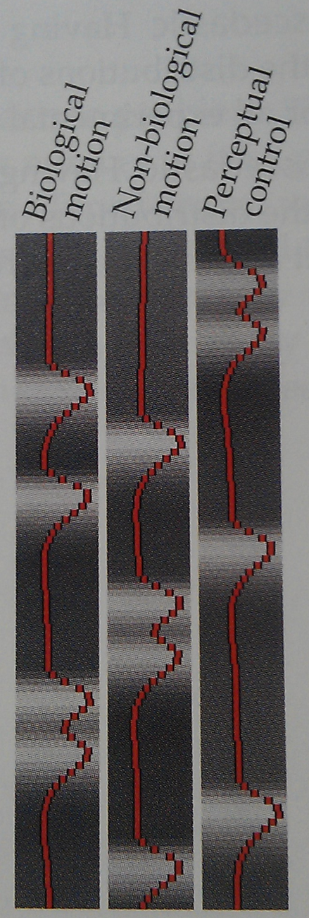
Example 1: T contrasts
Contrast 1: to identify voxels whose activation increased in response to the biological motion stimulus
Contrast 2: to identify voxels whose activation decreased in response to the biological motion stimulus
These contrasts use the parameter weight from the biological motion condition, but ignore the other conditions (by putting in zero)
However, these main effects of a condition lack experimental control..
Contrast 1: [ 1 0 0 ]
Contrast 2: [ -1 0 0 ]

Slide 18
T contrasts
H₀ : c^{T}β = 0
Experimental Hypotheses
  H₁: c^{T}β > 0 or c^{T}β < 0
Compare two regressors by following the subtractive logic (the direct comparison of two conditions that are assumed to differ only in one property, the independent variable)
T-test is a signal-to-noise measure
Contrast of estimated parameters
c^{T} β
T _{df} =
=
Variance estimate
SD (c^{T}β)

Slide 19
Example 1: T contrasts
Contrast 3: to test biological motion evokes increased activation compared with non-biological motion
Contrast 4: to test whether biological motion evokes greater activation than both other forms of motion
Contrast between conditions generally use weights that sum to zero, reflecting the null hypothesis that the experimental manipulation had no effect
Contrast 3: [ 1 -1 0 ]
Contrast 4 : [ 2 -1 -1 ]

Slide 20
F contrasts
H₀ : β₁ = β₂ = 0
Experimental Hypotheses
  H₁: at least one β ≠ 0
The F-test evaluates whether any contrast or any combination of contrasts explains a significant amount of variability in the measured data
Explained variability
F =
Error variance estimate

Slide 21
Example 1: F contrasts
Contrast 5: to test voxels exhibit significant increases in activation in respond to any of the three motion conditions
F-contrasts are combination of multiple T contrasts in different rows
Contrast 5: [ 1 0 0 ]
[ 0 1 0 ]
[ 0 0 1 ]

Slide 22
Example 2: T contrasts
Question: which brain region respond more Left than to Right button presses?
  c^{T} = [1 -1 0 ]
  c^{T} = [1 -1 0 ] ≠ c^{T}= [-1 1 0 ]
  β₀ reflects the total contribution of all factors that are held constant throughout the experiment (ex. the baseline signal intensity in each voxel for fMRI data)
  SPM subtracts the mean value from each regressor so the variance associated with the mean signal intensity is not assigned to any experimental condition
Left Right

Slide 23
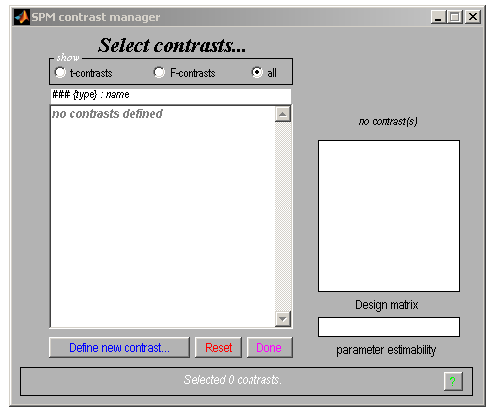
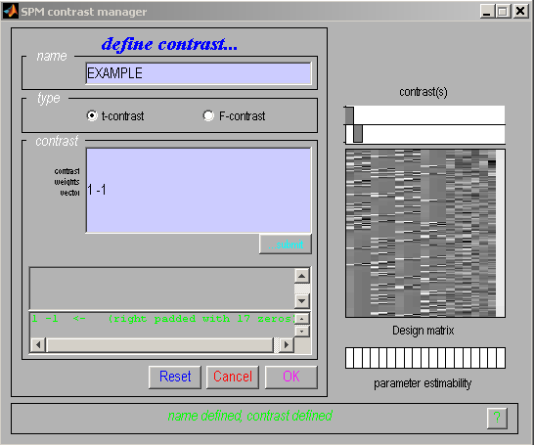

Slide 24
Example 2: T contrasts
Contralateral motor cortex responses
The contrast file
  con_*.img
  Files for 2nd level analysis
The T-map file
  spmT_*.img
  T value for each voxel
  The variances differ across brain regions
* = number in contrast manager

Slide 25
Example 2: F contrasts
Question: which brain region respond to Left and/or Right button presses?
  c^{T} = [1 0 0]
  [0 1 0]
  F contrast
    do not indicate the direction of any of the contrasts
    do not provide information about which contrasts drive significance
    only demonstrate that there is a significant difference exists among the conditions, to identify voxels that show modulation in response to the experimental task
Left Right

Slide 26
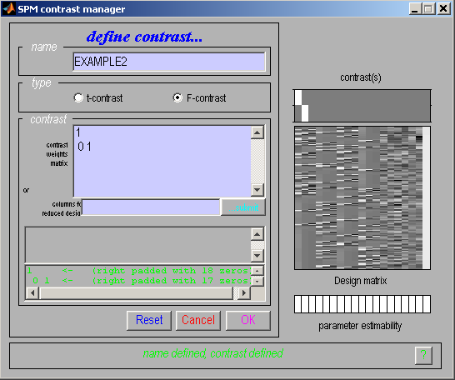

Slide 27
Example 2: F contrasts
Motor cortex responses on both sides
The F-map file
  spmF_*.img
  F value for each voxel
Extra-sum-square image
  ess_*.img
  Difference between regressors
* = number in contrast manager

Slide 28
Factorial design
Simple main effect
  A – B
  Simple main effect of motion (vs. no motion) in the context of low load
  [ 1 -1 0 0]
Main effect
  (A + B) – (C + D)
  The main effect of low load (vs. high load) irrelevant of motion
  Main effect of load
  [ 1 1 -1 -1]
INTERACTION
  (A - B) – (C - D)
  The interaction effect of motion (vs. no motion) greater under low (vs. high) load
  [ 1 -1 -1 1]
Still, sum of the weights = 0 in each T contrast
Motion No Motion
A B C D
A B
C D
Low load
High load
A B C D
A B C D

Slide 29
Example 3: Factorial design
Design
Motion
No Motion
High Medium Low
High Medium Low
IV 1 = Movement, 2 levels (Motion and No Motion)
IV 2 = Attentional Load, 3 levels (High, Medium or Low)

Slide 30
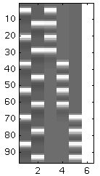
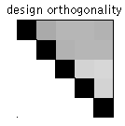
Example 3: Factorial design
Enable to test main effect
What about interactions? For example, Mh and Nm
In this design matrix, regressors are correlated and show overlapping variance
M N h m l
M N h m l
MN h ml

Slide 31
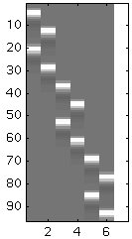
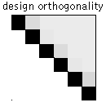
Example 3: Factorial design
M M M N N N
Enable to test main effects
Enable to test interactions
In this design matrix, regressors are not correlated and explain separate variance
  Make it orthogonal !!
h m l h m l
M M M N N N
h m l
h m l h m l
M
M
M
N
N
N
h
m
l
h
m
l
M
N
Mh
Mm
Ml
Nh
Nm
Nl

Slide 32
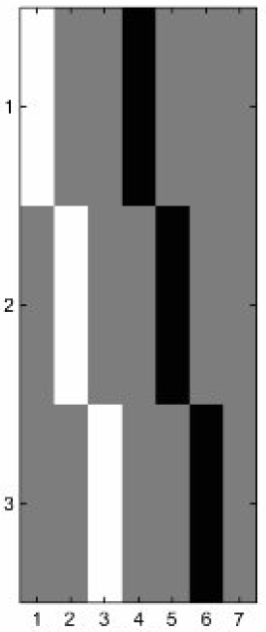
Example 3: Factorial design
M
h
M
m
M
l
N
h
N
m
N
l
Question:
Main effect – Movement ?
Mh – Nh [1 0 0 -1 0 0]
Mm – Nm [0 1 0 0 -1 0]
Ml – Nl [0 0 1 0 0 -1]
Main effect: Movement
(regardless of attention level)

Slide 33
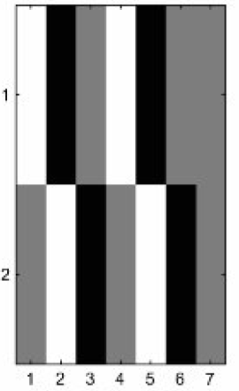
Example 3: Factorial design
M
h
M
m
M
l
N
h
N
m
N
l
Question:
Main effect – Attention ?
h > m in M N [1 -1 0 1 -1 0]
m > l in M N [0 1 -1 0 1 -1]
Main effect: Attention
(regardless of movement level)

Slide 34
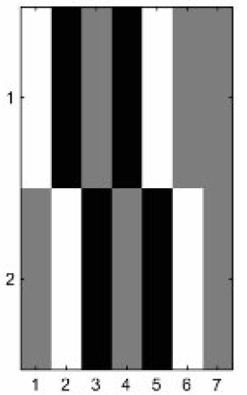
Example 3: Factorial design
M
h
M
m
M
l
N
h
N
m
N
l
Question: Interaction?
  Difference of difference
  (A-B)-(C-D) = A-B-C+D
h > m in M N [1 -1 0 -1 1 0]
m > l in M N [0 1 -1 0 -1 1]
Shows voxels where the attention manipulation elicits a brain response that is differ between each motion level

Slide 35
Resources
Huettel. Functional magnetic resonance imaging (Chap 10)
Previous MfD Slides
Rik Henson and Guillaume Flandin’s slides from SPM courses

