Slide 1

2nd level analysis in fMRI
Arman Eshaghi, James Lu
Expert: Ged Ridgway

Slide 2
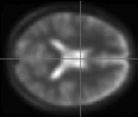



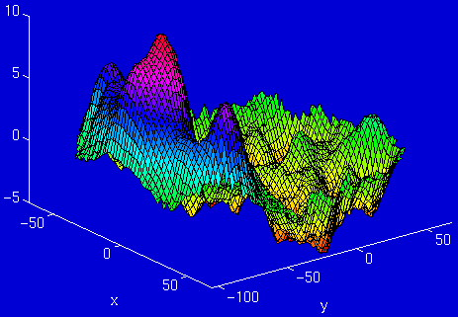
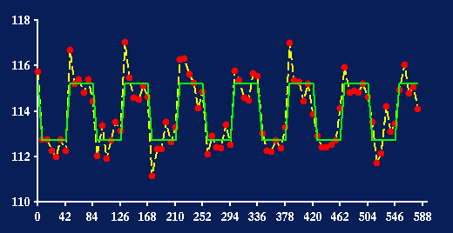
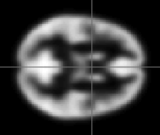
Where are we?
fMRI time-series
kernel
Design matrix
Statistical Parametric Map
Motion
correction
Smoothing
General Linear Model
Spatial
normalisation
Parameter Estimates
Standard
template

Slide 3
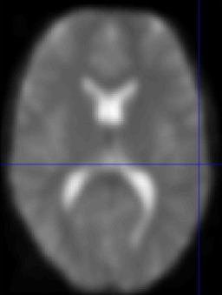
1st level analysis is within subject
β
Y
⁼
X
^{x}
⁺
E
Voxel time course
fMRI brain scans
Time
Time
(scan every 3 seconds)
Amplitude/Intensity

Slide 4
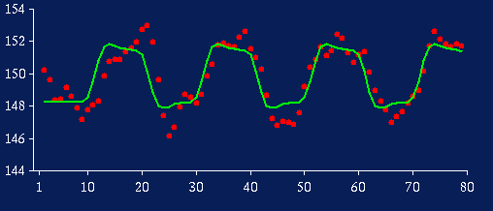
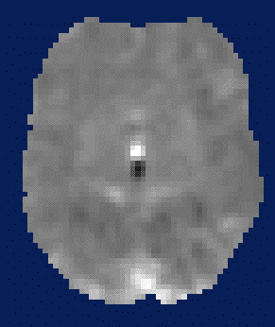
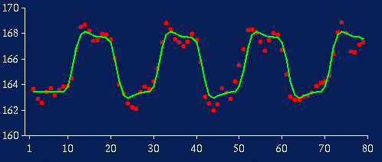
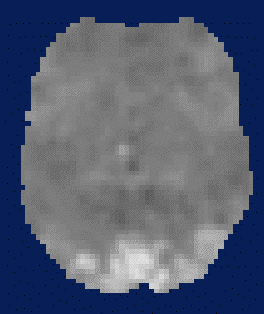
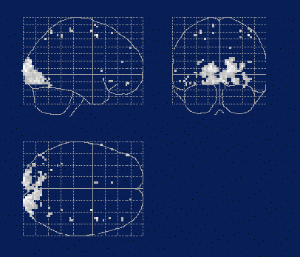
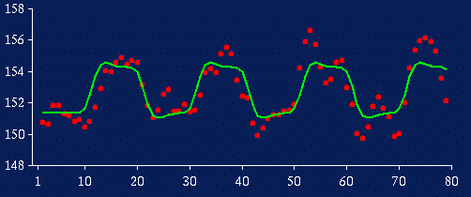
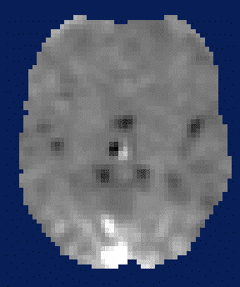
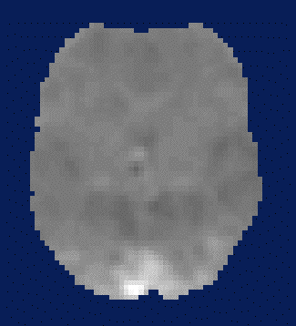
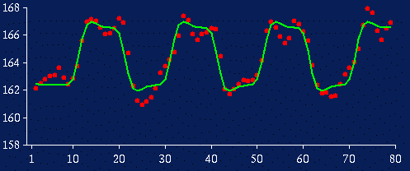
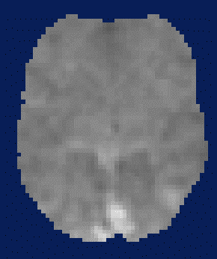
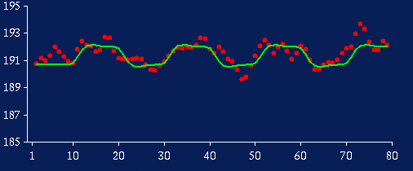
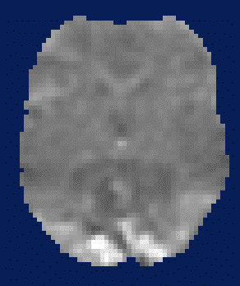
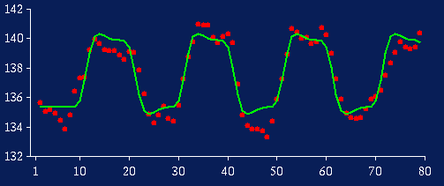
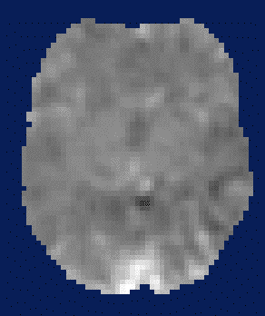
2nd- level analysis is between subject
1st-level (within subject)
2nd-level (between-subject)
β_{i}⁽¹⁾
β_{i}⁽²⁾
β_{i}⁽³⁾
contrast images of cβ_{i}
→
p < 0.001 (uncorrected)
β_{i}⁽⁴⁾
SPM{t}
β_{pop}
β_{i}⁽⁵⁾
With n independent observations per subject:
var(β_{pop}) = σ²_{b} / Ν + σ²_{w} / Nn
β_{i}⁽⁶⁾

Slide 5
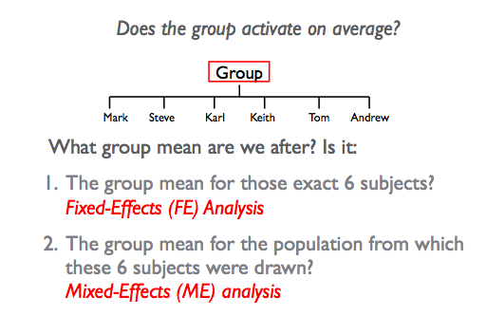
Group Analysis: Fixed vs Random
⬅ In SPM known as random effects (RFX)

Slide 6
Consider a single voxel for 12 subjects
Effect Sizes = [4, 3, 2, 1, 1, 2, ....]
s_{w} = [0.9, 1.2, 1.5, 0.5, 0.4, 0.7, ....]
Group mean, m=2.67
Mean within subject variance s_{w} =1.04
Between subject (std dev), s_{b} =1.07

Slide 7
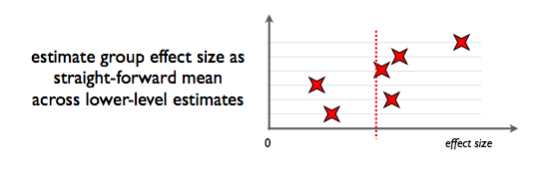
Group Analysis: Fixed-effects
Compare group effect with within-subject variance
NO inferences about the population
Because between subject variance not considered, you may get larger effects

Slide 8
FFX calculation
Calculate a within subject variance over time
s_{w} = [0.9, 1.2, 1.5, 0.5, 0.4, 0.7, 0.8, 2.1, 1.8, 0.8, 0.7, 1.1]
Mean effect, m=2.67
Mean s_{w} =1.04
Standard Error Mean (SEM_{W}) = s_{w} /sqrt(N)=0.04
t=m/SEM_{W}=62.7
p=10⁻⁵¹

Slide 9
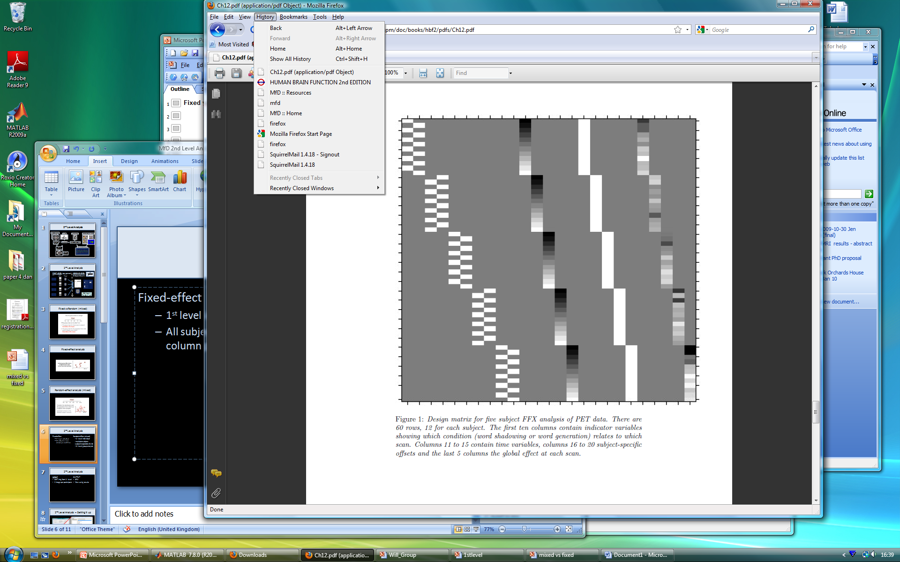
Fixed-effects Analysis in SPM
Fixed-effects
multi-subject 1st level design
each subjects entered as separate sessions
create contrast across all subjects
c = [ 1 -1 1 -1 1 -1 1 -1 1 -1 ]
perform one sample t-test
Subject 1
Subject 2
Subject 3
Subject 4
Subject 5
Multisubject 1st level : 5 subjects x 1 run each

Slide 10
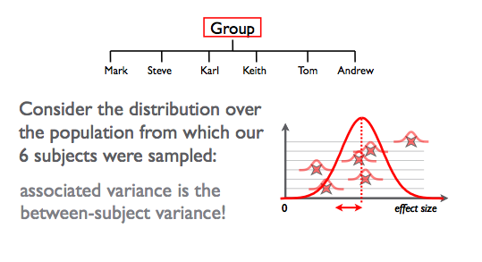
Group analysis: Random-effects
Takes into account between-subject variance
CAN make inferences about the population

Slide 11
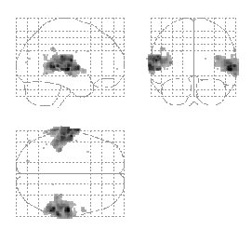

Methods for Random-effects
Hierarchical model
Estimates subject & group stats at once
Variance of population mean contains contributions
from within- & between- subject variance
Iterative looping ➔ computationally demanding
Summary statistics approach ⬅ SPM uses this!
1st level design for all subjects must be the SAME
Sample means brought forward to 2nd level
Computationally less demanding
Good approximation, unless subject extreme outlier

Slide 12
Random Effects Analysis- Summary Statistic Approach
For group of N=12 subjects effect sizes are
c= [3, 4, 2, 1, 1, 2, 3, 3, 3, 2, 4, 4]
Group effect (mean), m=2.67
Between subject variability (stand dev), s_{b} =1.07
This is called a Random Effects Analysis (RFX) because we are comparing the group effect to the between-subject variability.
This is also known as a summary statistic approach because we are summarising the response of each subject by a single summary statistic – their effect size.

Slide 13

Random-effects Analysis in SPM
Random-effects
1st level design per subject
generate contrast image per subject (con.*img)
images MUST have same dimensions & voxel sizes
con*.img for each subject entered in 2nd level analysis
perform stats test at 2nd level
NOTE: if 1 subject has 4 sessions but everyone else has 5, you need adjust your contrast!
contrast = [ 1 -1 1 -1 1 -1 1 -1 1 -1 ]
Subject #2 x 5 runs (1st level)
contrast = [ 1 -1 1 -1 1 -1 1 -1 1 -1 ]
contrast = [ 1 -1 1 -1 1 -1 1 -1 1 -1 ]
Subject #3 x 5 runs (1st level)
contrast = [ 1 -1 1 -1 1 -1 1 -1 1 -1 ]
Subject #4 x 5 runs (1st level)
Subject #5 x 4 runs (1st level)
contrast = [ 1 -1 1 -1 1 -1 1 -1 ] * (5/4)

Slide 14
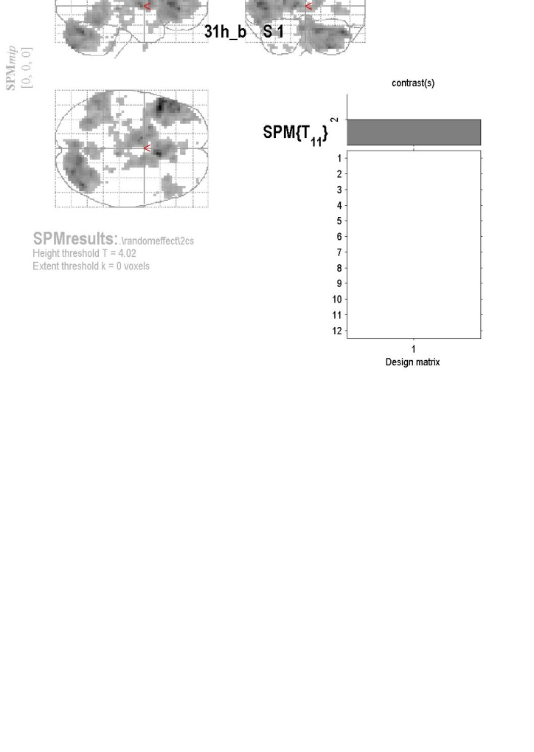
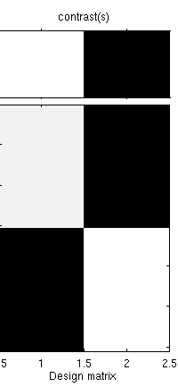
Stats tests at the 2nd Level
Choose the simplest analysis @ 2nd level : one sample t-test
  Compute within-subject contrasts @ 1st level
  Enter con*.img for each person
  Can also model covariates across the group
  - vector containing 1 value per con*.img,
If you have 2 subject groups: two sample t-test
  Same design matrices for all subjects in a group
  Enter con*.img for each group member
  Not necessary to have same no. subject in each group
  Assume measurement independent between groups
  Assume unequal variance between each group
1
2
3
4
5
6
7
8
9
10
11
12
1
2
3
4
5
6
7
8
9
10
11
12
Group 2 Group 1

Slide 15
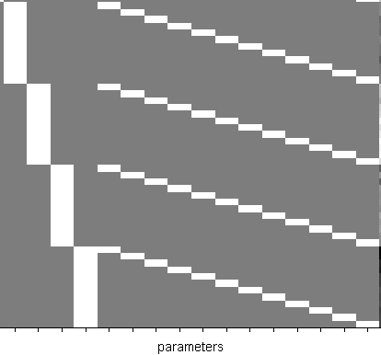
Stats tests at the 2nd Level
If you have no other choice: ANOVA
Designs are much more complex
e.g. within-subject ANOVA need covariate per subject ➔
BEWARE sphericity assumptions may be violated, need to account for
Better approach:
  generate main effects & interaction contrasts at 1st level
  c = [ 1 1 -1 -1] ; c = [ 1 -1 1 -1 ] ; c = [ 1 -1 -1 1]
  use separate t-tests at the 2nd level ➔
2x2 design
Ax Ao Bx Bo
Subject 1
Subject 2
Subject 3
Subject 4
Subject 5
Subject 6
Subject 7
Subject 8
Subject 9
Subject 10
Subject 11
Subject 12
One sample t-test equivalents:
A>B x>o A(x>o)>B(x>o)
con.*imgs con.*imgs con.*imgs
c = [ 1 1 -1 -1] c= [ 1 -1 1 -1] c = [ 1 -1 -1 1]

Slide 16
Setting up models for group analysis
Overview
  One sample T test
  Two sample T test
  Paired T test
  One way ANOVA
  One way ANOVA-repeated measure
  Two way ANOVA
  Difference between SPM and other software packages

Slide 17
Setting up second level models
Data vector = design matrix * parameters + error vector
Notes:
What data vector is, for example we have 10 subjects then we have 10 elements in an array or vector.

Slide 18
1-sample T Test
The simplest design that we start with
The question is:
  Does the group (we have just one group! In this case) have any significant activation?

Slide 19
1-sample T Test
Design matrix for 10 subjects
Xβ=
β
C=[1]

Slide 20
Two sample T-test in SPM
There are different ways of constructing design matrix for a two sample T-test
Example:
  5 subjects in group 1
  5 subjects in group 2
  Question: are these two groups have significant difference in brain activation?

Slide 21
Two sample T test intuitive way to do it!
Group 1 mean
Contrasts
(1 0)➔ mean group 1
(0 1) ➔ mean group 2
(1 -1) ➔ mean group 1 - mean group 2
(0.5 0.5) ➔ mean (group 1, group 2)
Group 2 mean

Slide 22
2 sample T test second way to do it
β₁
β₂
Group 1 mean
+
β₂
Group 2 mean

Slide 23
What’s the contrast for mean of group 1 being significantly different from zero

Slide 24
Group 2 mean different from zero
Mean G1 – Mean G2

Slide 25
What’s the contrast for “the mean of both groups different from zero”?
β₁ = G1 mean – G2 mean
β₂ = G1 mean
➔

Slide 26
Two sample T test, counterintuitive way to do it!
Contrasts:
(1 0 1) = mean of group 1
(0 1 1)=mean of group 2
(1 -1 0) = mean group 1 –mean group 2
(0.5 0.5 1)=mean (group1, group2)

Slide 27
Non estimable contrast (SPM)
Rank deficient (FSL)
Suppose we do this contrast:
C=[1 1 -1]

Slide 28
Paired T test
The model underlying the paired T test model is just an extension of two sample T test
It assumes that scans come in pairs
One scan in each pair
Each pair is a group
The mean of each pair is modeled separately

Slide 29
For example let the number of pair be 5, then you’ll have 10 observations. First observations will be included in the first group and the second observations will be modeled in the second group
Paired T-test
  Regressors will always be
    “number of pairs” + 2
      First two columns will model each group (first and second observations)

Slide 30
Paired T test- SPM way to do it
H_{o}=β₁<β₂
C=[-1 1 0 0 0 0 0]

Slide 31
Paired T Test-FSL-Freesurfer way to do it
H₀: Paired difference = 0
C=[1 0 0 0 0 ]

Slide 32
There is another way to do paired T test and that’s when you model pairs at the first level and do a one sample t test at the second level

Slide 33
ANOVA
Factorial designs are mainstay of scientific experiments
Data are collected for each level/factor
They should be analyzed using analysis of variance
They are being used for the analysis in PET, EEG, MEG, and fMRI
  For PET analysis ANOVA is usually being done at first level

Slide 34
fMRI and factorial design
Factorial designs are cost efficient
ANOVA is used in second level
ANOVA uses F-tests to assess main effects and also interaction effects based on the experimental design
The level of a factor is also sometimes referred to as a ‘treatment’ or a ‘group’ and each factor/level combination is referred to as a ‘cell’ or ‘condition’. (SPM book)

Slide 35
One way between subject ANOVA
Consider a one-way ANOVA with 4 groups and each group having 3 subjects, 12 observations in total
SPM rule
  Number of regressors = number of groups

Slide 36
One way between subject ANOVA-SPM
G1
H_{0:} G1=G2=G3=G4
G2
G3
G4
Mean of all

Slide 37
One way between subject ANOVA
G1
This design is non-estimable
We could omit the last column
G2
G3
G4
Mean of all

Slide 38
One way ANOVA
H₀= G1-G2
C=[1 -1 0 0]

Slide 39
One way ANOVA
H₀= G1=G2=G3=G4=0
c=

Slide 40
One way within subject ANOVA-SPM
Consider a within subject design with 5 subjects each subject with 3 measurements
How would the design matrix look like?

Slide 41
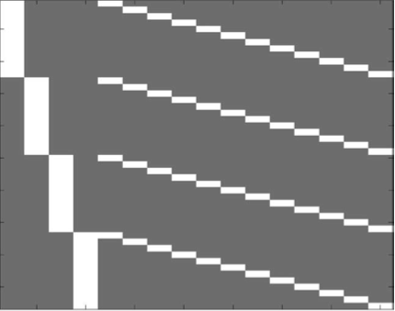
5 subjects each subject with 3 measurements
The first 3 columns are treatment effects and
Other columns are subject effects
Contrast for group 1 different than 0
C=[1 0 0 0 0 0 0 0]
Contrast for group 3 > group 1
C=[-1 0 1 0 0 0 0 0]

Slide 42
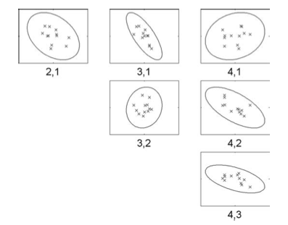
Non-sphericity
Due to the nature of the levels in an experiment, it may be the case that if a subject responds strongly to level i, he may respond strongly to level j. In other words, there may be a correlation between responses.
The presence of non-spherecity makes us less assured of the significance of the data, so we use Greenhouse-Geisser correction.
Mauchly’s sphericity test

Slide 43
Two Way within subject ANOVA
It consist of main effects and interactions. Each factor has an associated main effect, which is the difference between the levels of that factor, averaging over the levels of all other factors. Each pair of factors has an associated interaction. Interactions represent the degree to which the effect of one factor depends on the levels of the other factor(s). A two-way ANOVA thus has two main effects and one interaction.

Slide 44
2x2 ANOVA example
12 subjects
We will have 4 conditions
  A₁B₁
  A₁B₂
  A₂B₁
  A₂B₂
A1 represents the first level of factor A, so on so forth

Slide 45
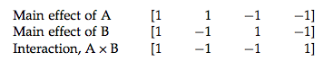
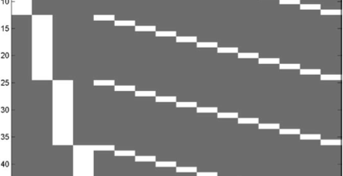
2x2 ANOVA
The rows are ordered all subjects for cell A1B1, all for A1B2 etc
Difference of different levels of A, averaged
Over B ➔ main effect of A

Slide 46
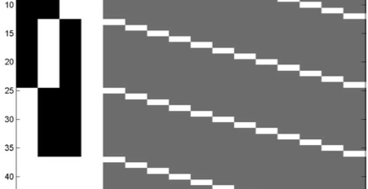
Design matrix for 2x2 ANOVA, rotated
White ➔ 1
Gray ➔ 0
Black ➔ -1
Interaction effect
Subject effects
Main effect A
Main effect B

Slide 47
2x2 ANOVA model
Main effect of A
  [1 0 0 0]
Main effect of B
  [0 1 0 0]
Interaction, AXB
  [0 0 1 0]

Slide 48
Mumford rules for One way ANOVA-FSL
Number of regressors for a factor = Number of levels – 1
Factor with 4 levels
  X_{i}=
    1 if subject is from level i
    -1 if case from level 4
    0 otherwise

Slide 49
One way ANOVA-FSL
Group mean
G1=β₁+β₂
G2=β₁+β₃
G3=β₁+β₄
G1=β₁-β₂₋β₃₋β₄

Slide 50
One way ANOVA
H0= G1 mean = 0
C= (1 1 0 0)

Slide 51
Is group 1 different from 4?
Contrast for group 1 is:
(1 1 0 0)
Contrast for group 4 is
(1 -1 -1 -1)
Contrast for G1-G4 will be
(0 2 1 1)

Slide 52
2 Way ANOVA-FSL
Mumford rules:
  Setting up design matrix ➔
  X_{i} =
    1 if case from level I
    -1 if case from level n
    0 otherwise
A has 3 levels, so 2 regressors
B has 2 levels, so 1 regressors

Slide 53
Two Way ANOVA-FSL
Main factor A effect
A
B
AB

Slide 54
Two way ANOVA-FSL Freesurfer
Interaction effect
Just test the last two columns!

Slide 55
Two Way ANOVA
A1B1? Cell mean

Slide 56
The End

