Slide 1

DCM for ERP/ERF
A presentation for
Methods for Dummies
By
Ashwini Oswal and Elizabeth Mallia

Slide 2
Dynamic Causal Models (DCM)
Used:
To infer the brain states, or even better, the architecture of the underlying neuronal dynamics, which is causing the observed data.
Data:
From EEG or MEG – ERP/ERF
Notes:
Data in the form of ERPs/ERFs. So what we are doing is indirectly recording these brain states.

Slide 3
Obtaining the data
EVOKE a response
by manipulating an environment
and recording the response using MEG/EEG.

Slide 4
Obtaining the data
EVOKE a response
by manipulating an environment
and recording the response using MEG/EEG.
Introduce a perturbation

Slide 5
Obtaining the data
EVOKE a response
by manipulating an environment
and recording the response using MEG/EEG.
Acoustic environment
Introduce a perturbation

Slide 6
Obtaining the data
Example:
If we are manipulating the acoustic environment we introduce/embed deviant sounds into a stream of repeated, or standard sounds.

Slide 7
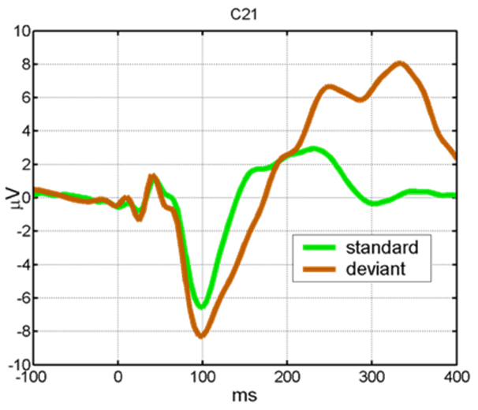
Obtaining data
Data reflects the response to:
standard sounds = standard response
deviant sound = deviant response
Notes:
We will obtain data that reflects the response to the standard sounds = standard response; and data that reflects the response to the deviant sound = deviant response

Slide 8
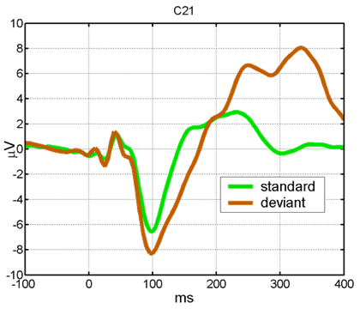
The response = ERP/ERF
Each response reflects effective connectivity (causal architecture of interactions) in response to the environment at that time.
Notes:
So we have a standard response and a deviant response.

Slide 9
The response = ERP/ERF
Each response reflects effective connectivity (causal architecture of interactions) in response to the environment at that time.
Comparing the 2 ERPs/ERFs we can estimate and make inferences about stimulus-specific coupling among cortical regions.
Notes:
So we have a standard response and a deviant response.

Slide 10

A hypothetical hypothesis…!
A hypothesis might be:
The difference between the evoked responses for standards and deviants, is caused by stimulus-specific changes in connectivity, in a fronto-temporal network
Notes:
In this type of experiment a hypothesis might be…

Slide 11
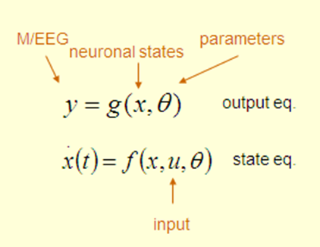
What we’ll actually be doing is..
Inferences about the causal architecture of the neuronal dynamics
To do this we are going to use DCM – we are going to place our data (y) into this model.
Notes:
We are going to make inferences about the causal architecture of the neuronal dynamics, and to do this we are going to use DCM – we are going to place our data (y) into this model.

Slide 12
But before we go to our DCM model let us look at what it is based on, i.e. what we are assuming when using this model.

Slide 13
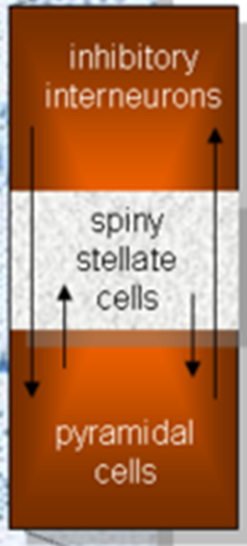
Modeling the activity of the cortical source
The Jansen and Rit (1995) model emulates the MEG/EEG activity of a cortical source using three neuronal subpopulations.
Each source is described in terms of the average post-membrane potentials and mean ﬁring rates

Slide 14
A population of excitatory pyramidal (output) cells receives inputs from inhibitory and excitatory populations of interneurons, via intrinsic connections (which are confined to the cortical sheet).
Notes:
Each subpopulation has
its own (intrinsic) dynamics, described by the neural mass
equations and has intrinsic (i.e., within-source) connections
with the other two subpopulations

Slide 15
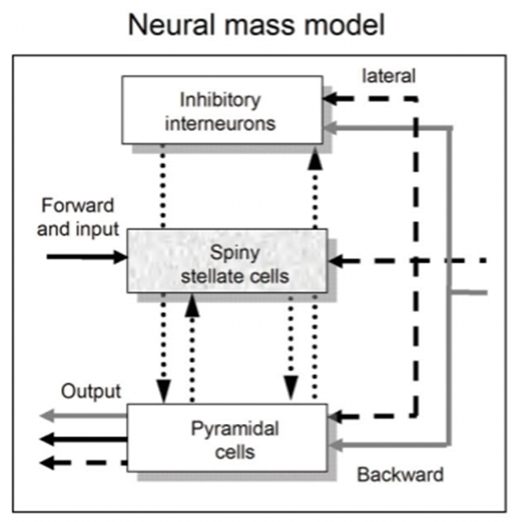
DCM rests on neural mass models
A model that explains the effect of different connections in the cortical region of our source output.
David et al., 2006
Notes:
Outputs are those components of neuronal responses that can be detected by MEG/EEG, sensors. In our model, these components are depolarizations of a ‘neural mass’ of pyramidal cells. Inputs correspond to experimental manipulations.

Slide 16
DCM rests on neural mass models
A model that explains the effect of different connections in the cortical region of our source output.
Derived from experimental studies of monkey visual cortex.
Notes:
Outputs are those components of neuronal responses that can be detected by MEG/EEG, sensors. In our model, these components are depolarizations of a ‘neural mass’ of pyramidal cells. Inputs correspond to experimental manipulations.

Slide 17
DCM rests on neural mass models
A model that explains the effect of different connections in the cortical region of our source output.
Derived from experimental studies of monkey visual cortex.
Notes:
Outputs are those components of neuronal responses that can be detected by MEG/EEG, sensors. In our model, these components are depolarizations of a ‘neural mass’ of pyramidal cells. Inputs correspond to experimental manipulations.

Slide 18
Assumptions
Three types of connections:
forward connections that originate in agranular layers and terminate in layer 4
backward connections that connect agranular layers
lateral connections that originate in agranular layers and target all layers.
Notes:
Assuming the neural mass model we assume that..
…Excitatory pyramidal cells and inhibitory interneurons are considered to occupy agranular layers and receive backward and lateral inputs

Slide 19
Notes:
Outputs are those components of neuronal responses that can be detected by MEG/EEG, sensors. In our model, these components are depolarizations of a ‘neural mass’ of pyramidal cells. Inputs correspond to experimental manipulations.

Slide 20

Assumptions
Three types of connections:
forward connections
backward connections
lateral connections
These long-range or extrinsic cortico-cortical connections are excitatory and comprise the axonal processes of pyramidal cells.
Notes:
Assuming the neural mass model we assume that..
…Excitatory pyramidal cells and inhibitory interneurons are considered to occupy agranular layers and receive backward and lateral inputs

Slide 21

Assumptions
Three types of connections:
forward connections
backward connections
lateral connections
These long-range or extrinsic cortico-cortical connections are excitatory and comprise the axonal processes of pyramidal cells.
The depolarization of the pyramidal cell populations gives rise to M/EEG responses
(Thalamic connections are not considered but thalamic output is modelled as a function operating on the input.)
Notes:
Assuming the neural mass model we assume that..
…Excitatory pyramidal cells and inhibitory interneurons are considered to occupy agranular layers and receive backward and lateral inputs

Slide 22
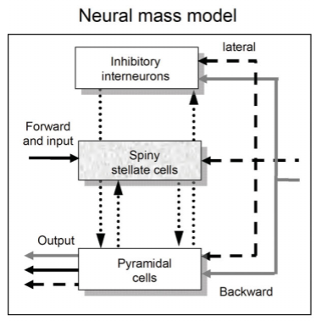
Excitatory interneurons : spiny stellate cells found predominantly in layer four and in receipt of forward connections.
Excitatory pyramidal cells and inhibitory interneurons are considered to occupy agranular layers and receive backward and lateral inputs.
Notes:
Within this model, excitatory interneurons can be regarded as spiny stellate cells found predominantly in layer four and in receipt of forward connections. Excitatory pyramidal cells and inhibitory interneurons are considered to occupy agranular layers and receive backward and lateral inputs.

Slide 23

It is important to build a plausible model on which to base the experimental hypothesis, i.e. the model that is giving rise to the observed ERPs/ERFs.
For example:

Slide 24
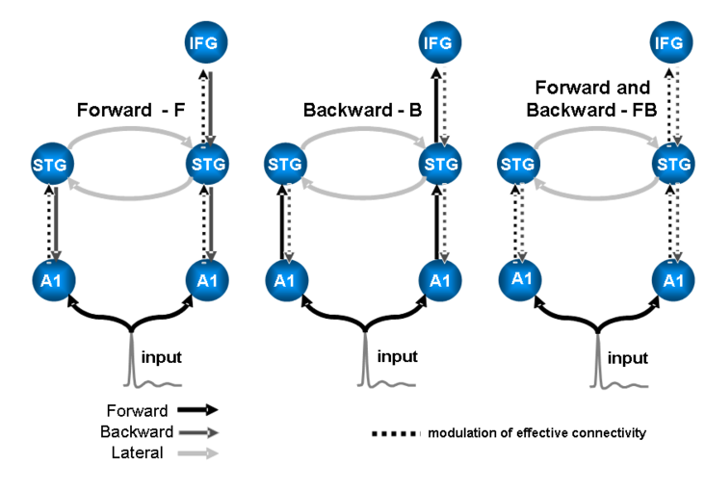
Notes:
Model specification. Sources are connected with forward (dark grey), backward (grey) or lateral (light grey) connections. A1: primary auditory cortex, STG: superior temporal gyrus, IFG: inferior temporal gyrus. Three different models were tested within the same architecture, allowing for repetition-related changes in forward F, backward B and forward and backward FB connections, respectively. The broken lines indicate the connections that were allowed to change, adapted from (Garrido et al., 2007).

Slide 25
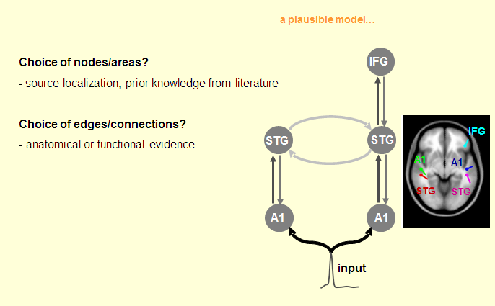
Building a plausible model to test
From previous DCM for ERP/ERF presentation

Slide 26
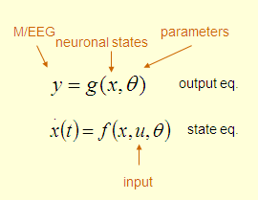
The DCM
DCM is specified in terms of its state equations and an observer or output equation
Where:
x are the neuronal states of cortical areas
u are exogenous inputs
y is the output of the system

Slide 27
DCM : Spatiotemporal model
It describes the data both in space (i.e., the sensors) and time
The parameters of the neuronal model include things like the connectivity strength and propagation delays among sources and various synaptic rate constants.
The spatial parameters comprise the location and orientation of equivalent current dipoles

Slide 28
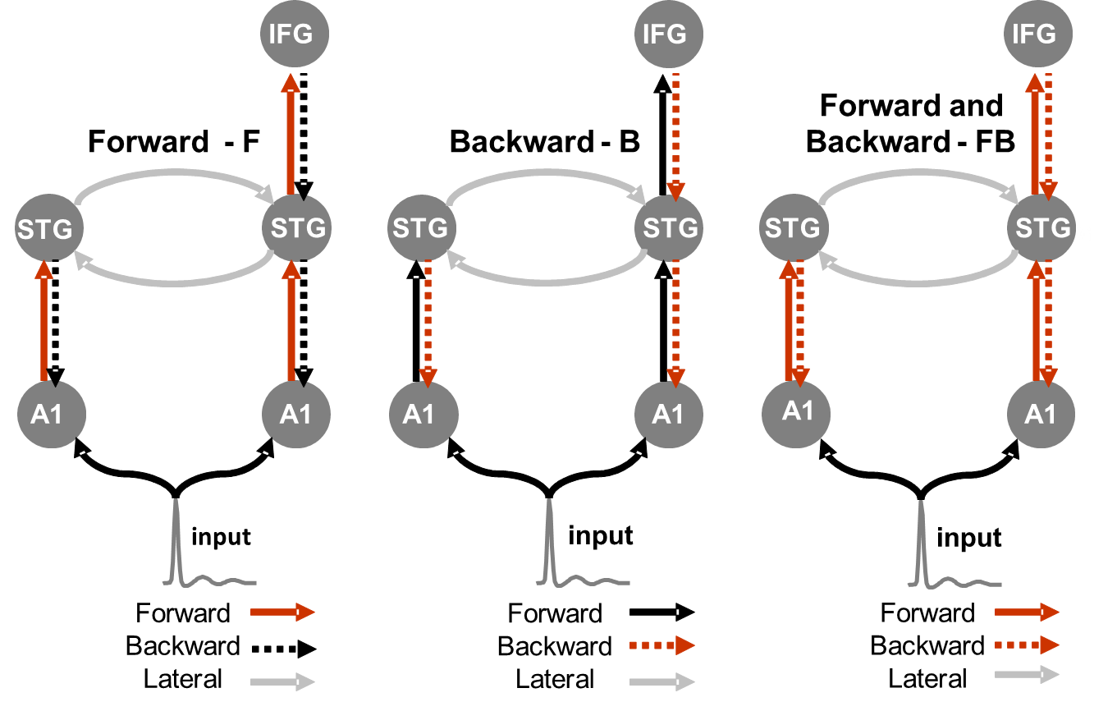

Which model best describes the data?

Slide 29





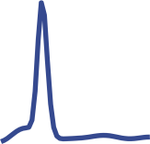
DCM output (from previous slides)
IFG
Forward and Backward
reconstructed responses at source level
-
FB
0.93 (55%)
1.41 (99%)
STG
STG
coupling changes
probability that a change occured
1.74 (96%)
2.41 (100%)
5.40 (100%)
4.50 (100%)
A1
A1
input
Forward
Backward
standard
Lateral
deviant

Slide 30
Which model to choose?
This is addressed with Bayesian model comparison using an approximation to the model evidence.
This is the probability of the data given a specific model and is also known as the integrated or marginal likelihood (Friston et al., 2003).
Bayesian model comparison is used to decide which model, amongst a set of competing models, best explains the data (Penny et al., 2004).
This evidence-based approach accounts for model complexity and enables comparisons of M/EEG models with different parameters (e.g., with different numbers of sources or connections).

Slide 31
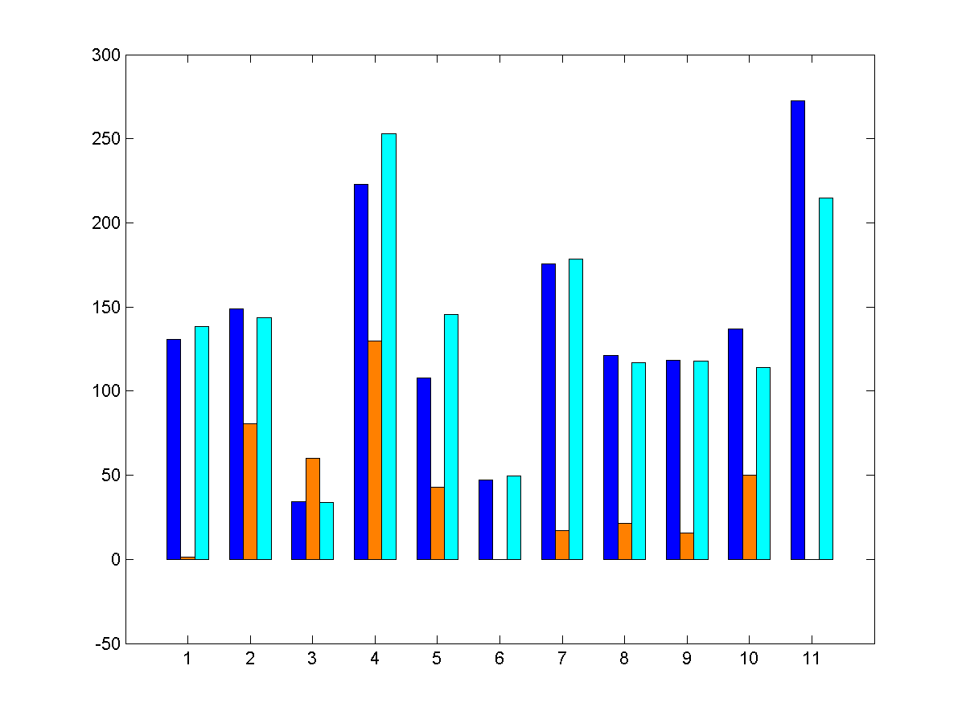
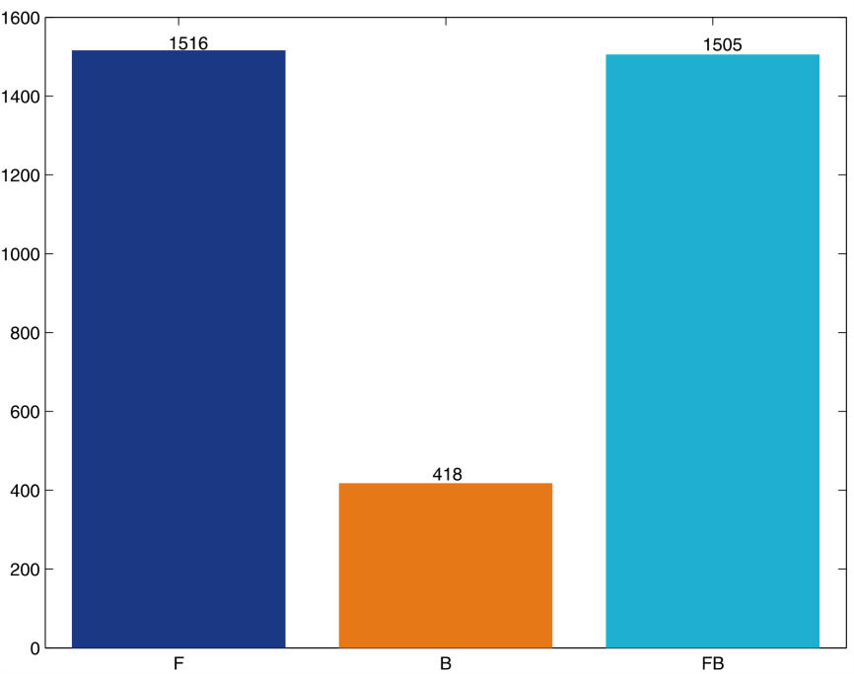
Adapted
Penny et al., 2004
Bayesian Model Comparison
DCM.F
log-evidence
(log-evidence normalized to the null model)
add up log-evidences for group analysis
subjects
Forward (F)
Backward (B)
Forward and Backward (FB)

Slide 32
DCM for MEEG practice
Use the previously mentioned principles to run through an example of how to perform DCM in SPM8
Example from SPM8 manual and previous MFD slides

Slide 33
MMN
standards
deviants
Paradigm
pseudo-random auditory sequence
80% standard tones – 500 Hz
20% deviant tones – 550 Hz
time
DCM:
1) Models the difference between two evoked responses …
ERPs from the two
conditions
4
standards
3
deviants
MMN
2) … as a modulation of some of the inter-aereal connections.
2
V
1
μ
0
-1
-2
-3
-4
-100
-50
0
50
100
150
200
250
300
350
400
ms

Slide 34
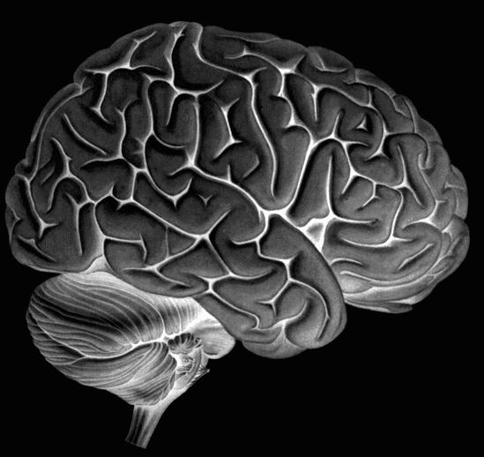
A physiologically plausible model
May be based on prior evidence
In the case of MMN
Assumed Sources:
Left A1
Right A1
Left STG
Right STG
Right IFG
STG
IFG
A1

Slide 35
A physiologically plausible model
MMN could be generated by a temporofrontal network (Doeller et al. 2003; Opitz et al. 2002).
“We argue that the right IFG mediates auditory deviance detection in case of low discriminability between a sensory memory trace and auditory input. This prefrontal mechanism might be part of top-down modulation of the deviance detection system in the STG.”

Slide 36
An overview of the idea
Potential models
Generation of predicted data
Depolarisation of
pyramidal cells
Spatial model
Sensor data

Slide 37
Optimisation
Data
6
Observed (adjusted) 1
4
2
0
We need to estimate the extrinsic connectivity parameters and their modulation from data.
Predicted data
-2
-4
6
Predicted
input
-6
4
-8
0
50
100
150
200
250
2
time (ms)
0
Optimisation of model parameters
Using Expectation Maximisation
algorithm
-2
-4
-6
-8
0
50
100
150
200
250
time (ms)

Slide 38
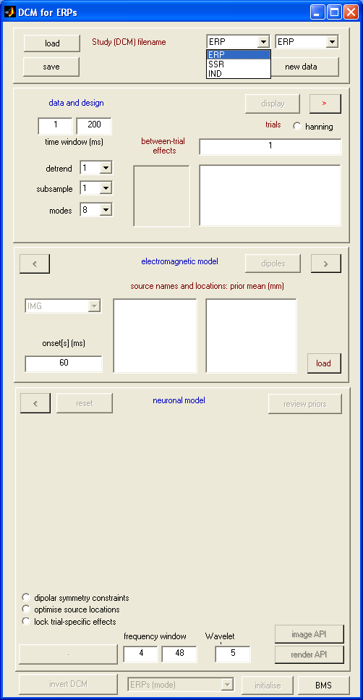
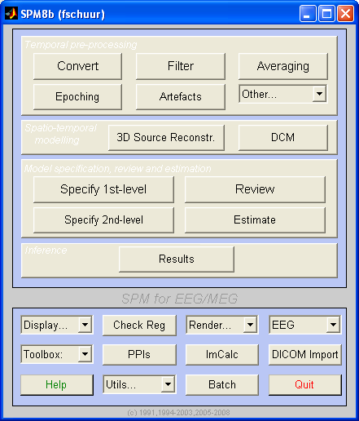
DCM for ERPs
Type spm eeg……..

Slide 39
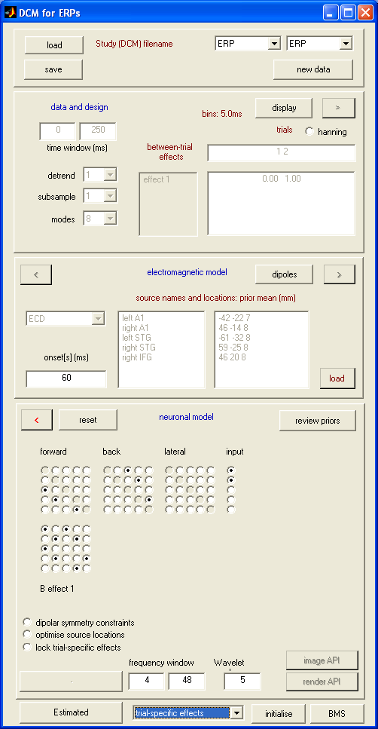
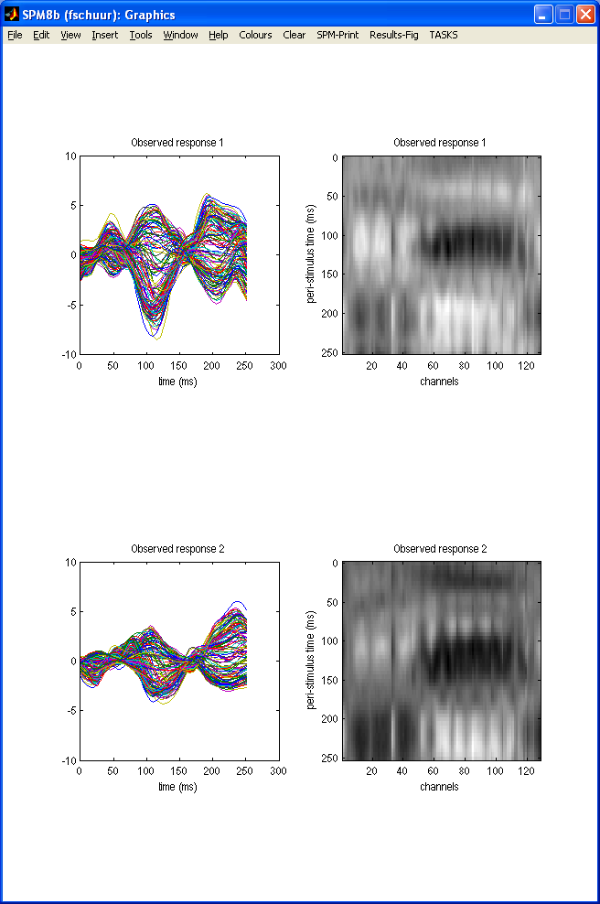
Choose time window
Choose nr. of components
Notes:
Model between trial effects
Data must be spm format
To reduce amount of data: projection to sub-space, modes is factors you extract that you keep (the more the more information but the more data, later vectors carry only little additional information)

Slide 40
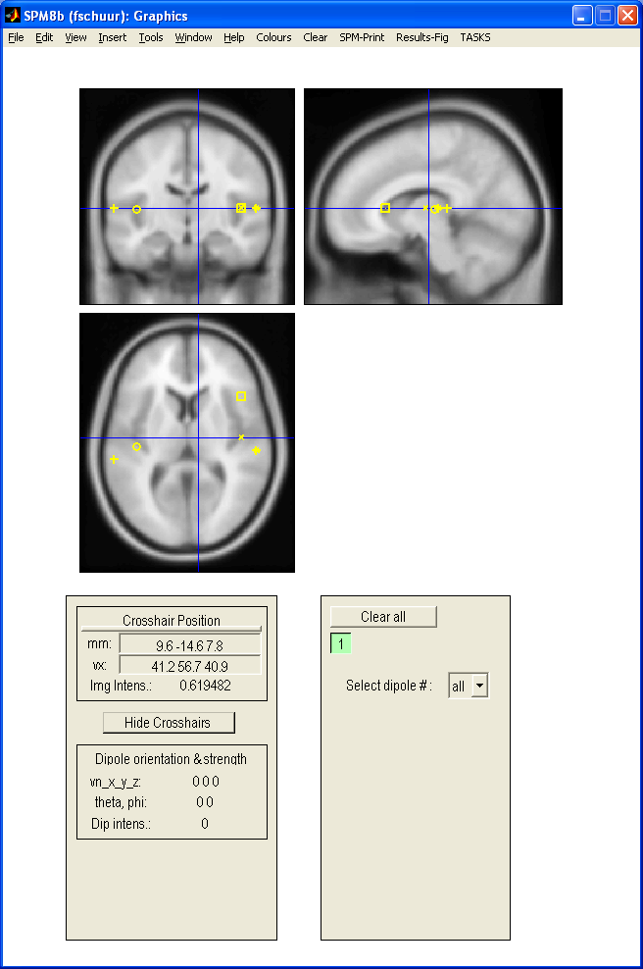
How to spatially model ER
Sources’ coordinates
Onset time for modelling
Source names
Notes:
Animated
Tight priors on location but not orientation (can compensate up to a certain extent for inaccuracies)
Early responses are not modelled because the propagation of the stimulus impulse through the input nodes causes a delay
For modelling first response only A matrix is used, for second the modulation (B-matrix)

Slide 41
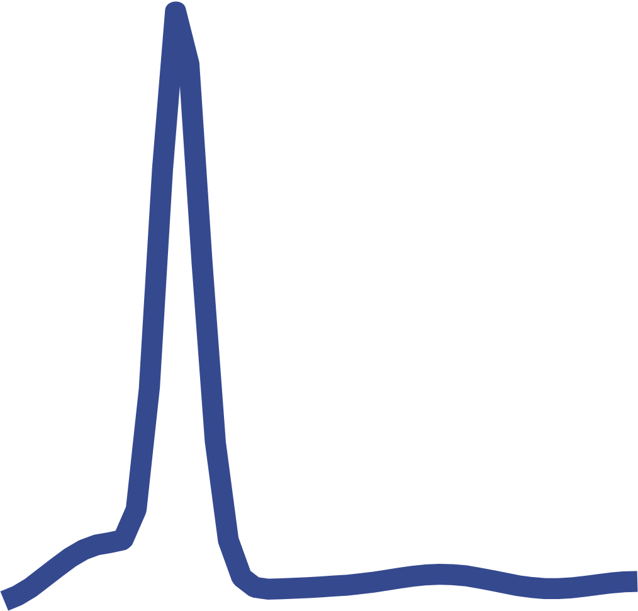
IFG
STG
STG
A1
A1
input
e.g. from left A1 to left STG
modulation of
effective connectivity
Specify extrinsic connections
Input
to
Modulatory effect
Intrinsic connections
from
Invert DCM
Notes:
Intrinsic connections: modelled by H which reflects the max. post synaptic potential

Slide 42
What we need to know
The best model for the observed data
The coupling parameters of this model

Slide 43
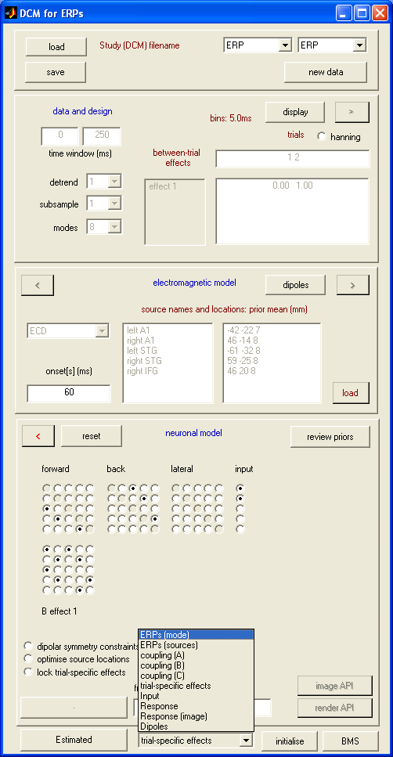
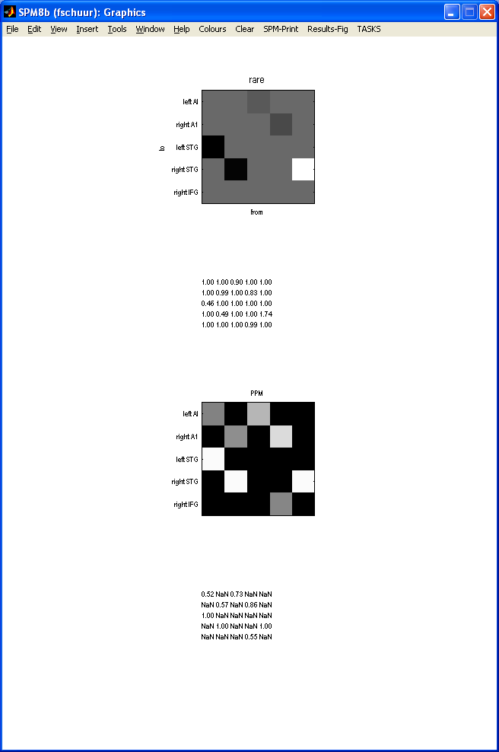
Coupling B
Posterior means for gain modulations
Probability ≠ prior means

Slide 44
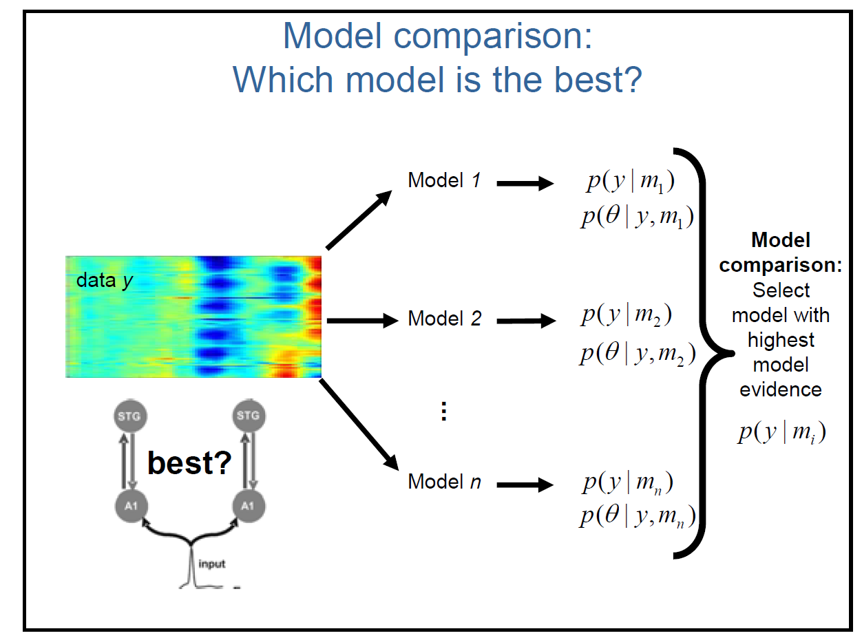

Slide 45
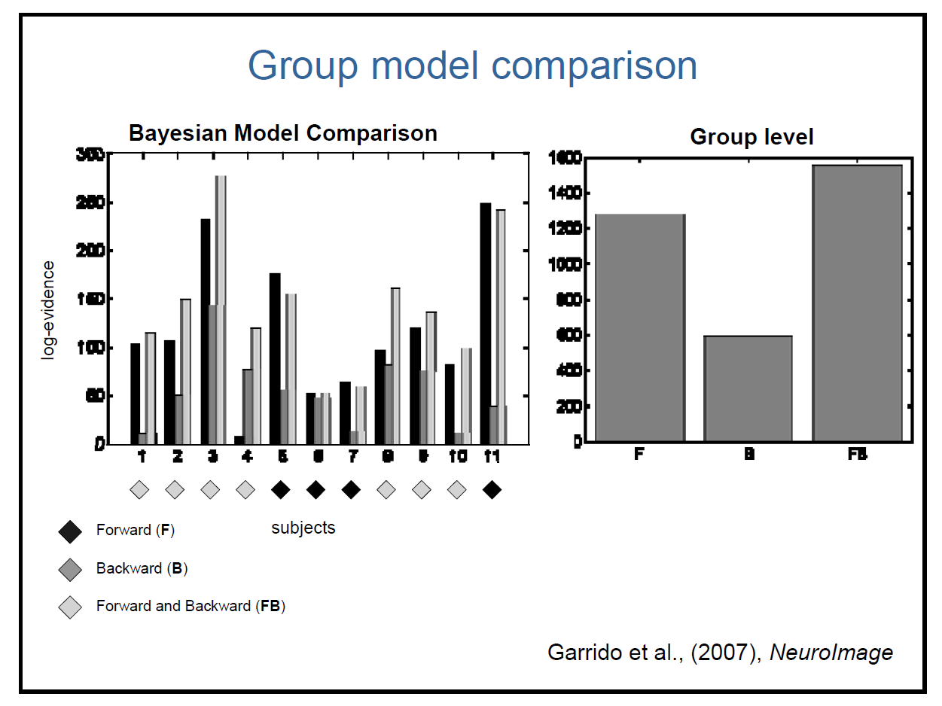

Slide 46
NB
It is ok to compare many different models
Ensure that the models are physiologically plausible

Slide 47
DCM Refresher
Dynamic Causal Modeling (DCM)
Used to infer the causal architecture of coupled or distributed dynamical systems, such as we find in the brain.
It is a Bayesian model comparison procedure that rests on comparing models of how data were generated.

Slide 48
References
Previous MfD slides
Kiebel, Garrido, Moran, Chen, Friston,(2009) Dynamic Causal Modeling for EEG and MEG. Human Brain Mapping 30:1866–1876.
Marreiros, Stephan, Friston, (2010). Dynamic Causal Modeling http://www.scholarpedia.org/article/Dynamic_causal_modeling

Slide 49
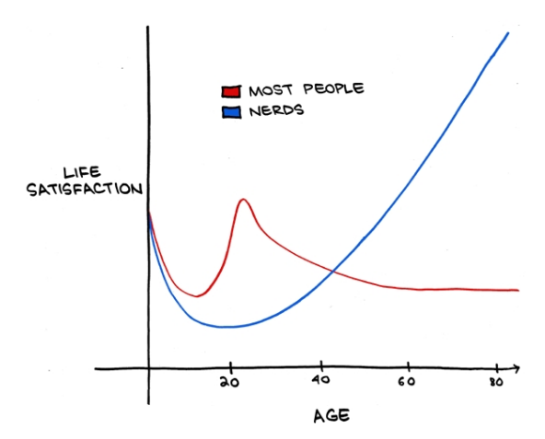
Thank you

