Slide 1
t-tests, ANOVA & Regression
Andrea Banino & Punit Shah

Slide 2
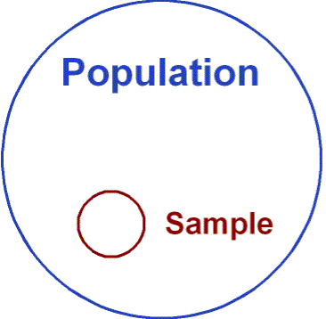
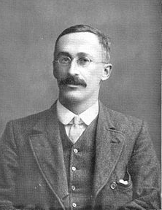
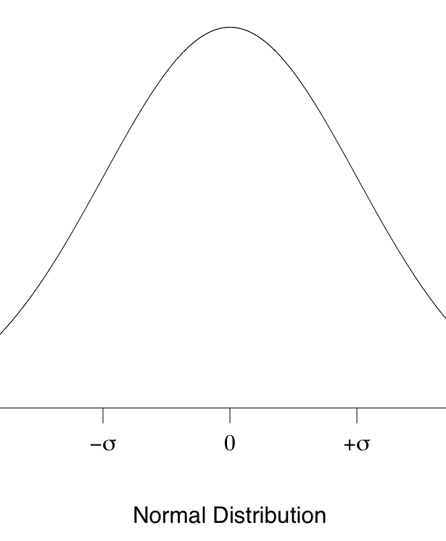
Background: t-tests
Samples vs Populations
Descriptive vs Inferential
William Sealy Gosset (‘Student’)
Distributions, probabilities and P-values
Assumptions of t-tests

Slide 3
P-values
P values = the probability that the observed result was obtained by chance
  i.e. when the null hypothesis is true
α level is set a priori (Usually .05)
If p < .05 level then we reject the null hypothesis and accept the experimental hypothesis
  95% certain that our experimental effect is genuine
If however, p > .05 level then we reject the experimental hypothesis and accept the null hypothesis

Slide 4
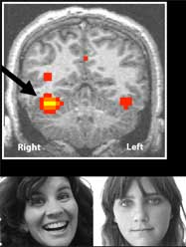
Research Example
Is there different activation of the FFG for faces vs objects
Within-subjects design:
Condition 1: Presented with face stimuli
Condition 2: Presented with object stimuli
Hypotheses
          H₀ ₌ There is no difference in activation of the FFG during face vs object stimuli
          H_{A =}There is a significant difference in activation of the FFG during face vs object stimuli

Slide 5
Results- How to compare?
Mean BOLD signal change during object stimuli = +0.001%
Mean BOLD signal change during facial stimuli = +4%
Great- there is a difference, but how do we know this was not just a fluke?

Slide 6
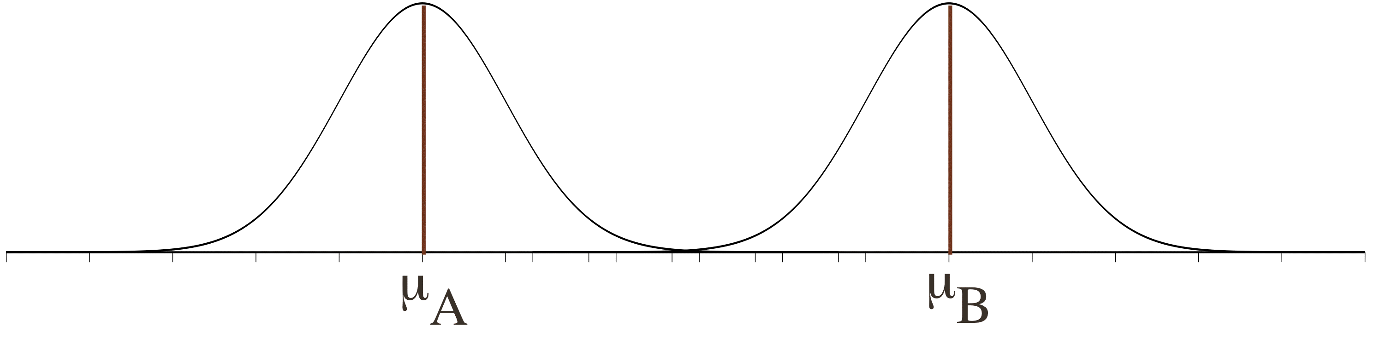
Compare the mean between 2 conditions (Faces vs Objects)
H₀: μ_{A} = μ_{B} (null hypothesis)- no difference in brain activation between these 2 groups/conditions
H_{A}: μ_{A} ≠ μ_{B} (alternative hypothesis) = there is a difference in brain activation between these 2 groups/conditions
if 2 samples are taken from the same population, then they should have fairly similar means
⇨ if 2 means are statistically different, then the samples are likely to be drawn from 2 different populations, i.e they really are different
BOLD response
Condition 1 (Objects)
Condition 2 (Faces)

Slide 7
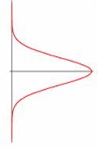
Calculating t
t = differences between sample means / standard error of sample means
The exact equation varies depending on which type of t-test used
* Independent Samples t-test
BOLD response
Condition 1
(Objects)
Condition 2 (Faces)

Slide 8

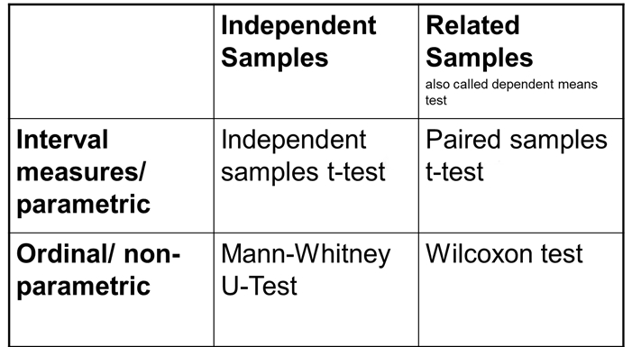

Types of t-test & Alternatives
1 Sample t-test (sample vs. hypothesized mean)
2 Sample t-test (group/condition 1 vs group/condition 2)

Slide 9
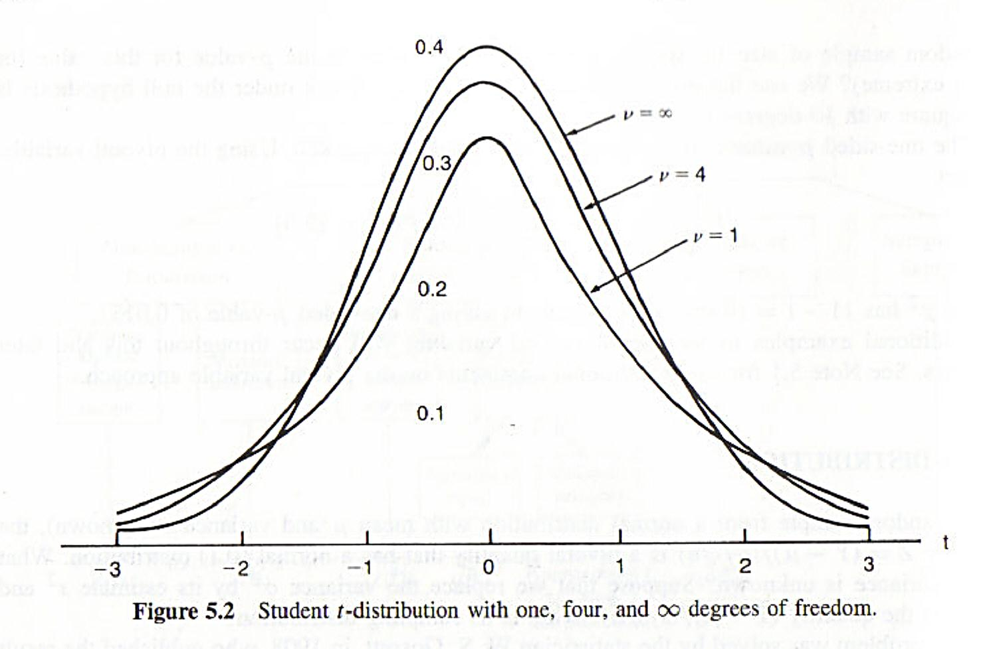
Degrees of Freedom ( df )
The number of ‘entities’ that are free to vary when estimating t
n – 1 (for paired sample t)
Larger sample or no.
of observations = more df
Putting it all together…
t (df) = t= t-value,
p = p-value

Slide 10
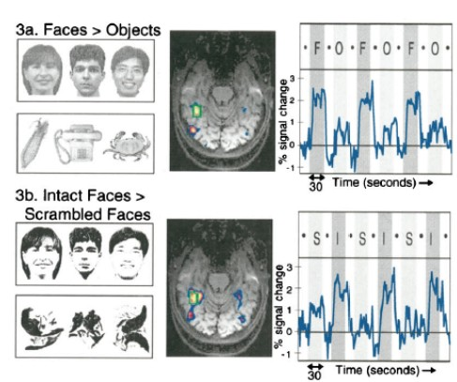


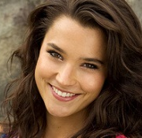

Application to fMRI?
Subtraction / Multiple subtraction Techniques
compare the means and standard deviations
between various conditions
each voxel considered an ‘n’ –
so Bonferroni correction is made for
the number of voxels compared
Time

Slide 11



How are t-tests/ANOVA relevant to fMRI?
Image time-series
Spatial filter
Design matrix
Statistical Parametric Map
Realignment
Smoothing
General Linear Model
Statistical
Inference
RFT
Normalisation
Anatomical
reference
p <0.05
Parameter estimates

Slide 12
GLM and fMRI
Y = X . β + ε
Observed data:
Y is the BOLD signal at various time points at a single voxel
Design matrix:
Several components which explain the observed data, i.e. the BOLD time series for the voxel
Parameters:
Define the contribution of each component of the design matrix to the value of Y
Estimated so as to minimise the error, ε, i.e. least sums of squares
Error:
Difference between the observed data, Y, and that predicted by the model, Xβ.

Slide 13
t-tests in Statistical Parametric Mapping
GLM: Y= X β + ε
2nd level analysis
β₁ is an estimate of signal change over time attributable to the condition of interest (face vs object)
Set up contrast (c^{T}) 1 0 for β₁: 1xβ₁+0xβ₂+0xβ_{n}/s.d
Null hypothesis: c^{T}β=0 No significant effect at each voxel for condition β₁
Contrast 1 -1 : Is the difference between 2 conditions significantly non-zero?
t = c^{T}β/sd[c^{T}β]
t-tests are simple combinations of the betas; they are either positive or negative (b1 – b2 is different from b2 – b1)

Slide 14
T test - one dimensional contrasts – SPM {t }
A contrast = a weighted sum of parameters: c´ ´ b
c’ = 1 0 0 0 0 0 0 0
b₁ > 0 ?
Compute 1xb₁ + 0xb₂ + 0xb₃ + 0xb₄ + 0xb₅ + . . .= c’b
c’ = [1 0 0 0 0 ….]
b₁ b₂ b₃ b₄ b₅ ....
divide by estimated standard deviation of b₁
contrast of
estimated
parameters
c’b
T =
T =
variance
estimate
s²c’(X’X)⁻c
SPM{t}

Slide 15
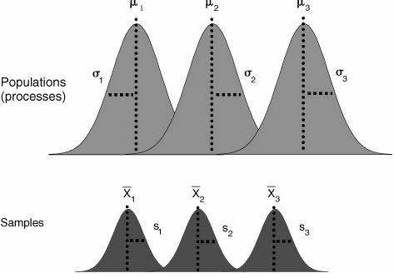
ANOVA- Analysis of Variance
More that 2 groups and/or conditions- e.g. objects, faces and bodies
  Do this without inflating the Type I error rate
  Still compares the differences in means between groups/conditions but it uses the variance of data to calculate if means are significantly different (H_{A})
  Tests the null hypothesis
  that the means are the
  same via the F- test
  Extra assumptions

Slide 16

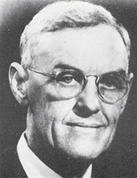

How? The F- statistic
F-ratio = MS_{M} / MS_{R}
By comparing the variance (SST =SSM +SSR)
SST (variability between scores)
SSM (variability explained by model)
SSR (variability due to individual difference)
F- ratio
  Magnitude of the difference between
  the different conditions
  p-value associated with F is probability
  that differences between groups could
  occur by chance if null-hypothesis
  is correct
  need for post-hoc testing / planned
  contrasts (ANOVA can tell you if
  there is an effect but not where)
÷df M
÷df R

Slide 17
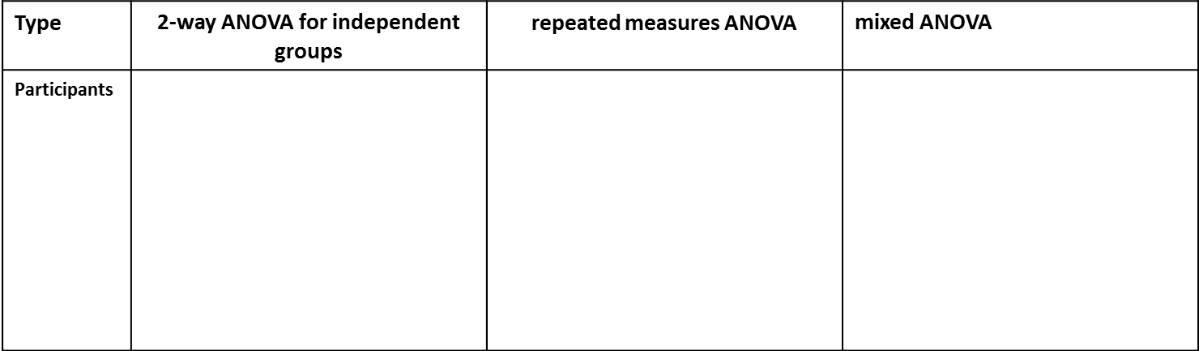
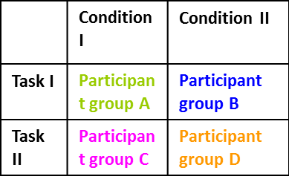
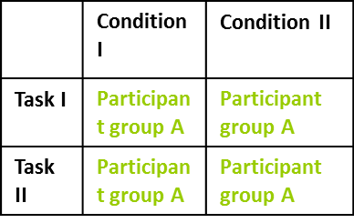
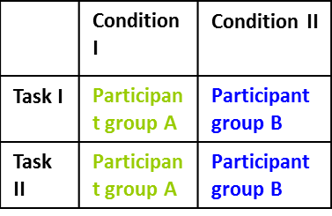
Different types of ANOVA
One- way Repeated measures / between groups ANOVA- One Factor, 3+ levels
2 way (_ x _) ANOVA and even 3 way ANOVA
- Two or more factors and many levels:

Slide 18
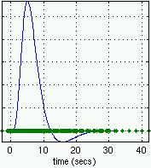
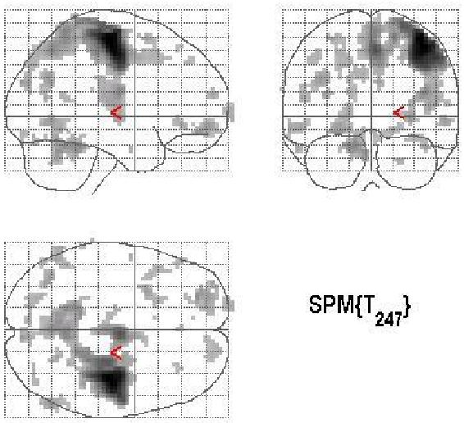

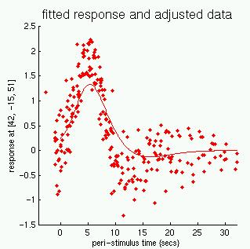

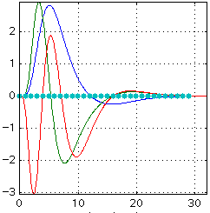
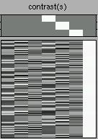
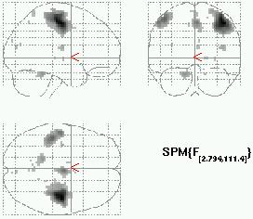
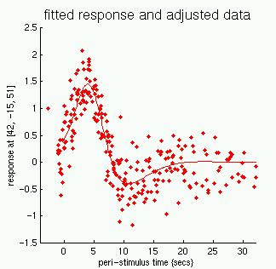
Convolution
model
Design and
contrast
SPM(t) or
SPM(F)
Fitted and
adjusted data
Application to fMRI

Slide 19
PART 2
Correlation
- How much linear is the relationship of two variables? (descriptive)
Regression
- How good is a linear model to explain my data? (inferential)

Slide 20
Correlation:
How much depend the value of one variable on the value of the other one?
Y
Y
Y
X
X
X
high positive correlation
poor negative correlation
no correlation
Notes:
Scatterplot
DEPENDENCE
In statistics, dependence refers to any statistical relationship between two random variables or two sets of data.
Correlation refers to any of a broad class of statistical relationships involving dependence.
There are several correlation coefficients, often denoted ρ or r, measuring the degree of correlation. The most common of these is the Pearson correlation coefficient, which is sensitive only to a linear relationship between two variables

Slide 21
How to describe correlation (1):
Covariance
The covariance is a statistic representing the degree to which 2 variables vary together
(note that S_{x}² = cov(x,x) )

Slide 22
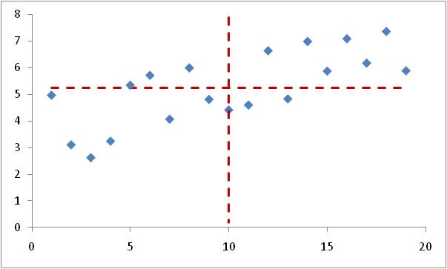
cov(x,y) = mean of products of each point deviation from mean values
Geometrical interpretation: mean of ‘signed’ areas from rectangles defined by points and the mean value lines

Slide 23
sign of covariance =
sign of correlation
Y
Y
Y
X
X
X
Positive correlation: cov > 0
Negative correlation: cov < 0
No correlation. cov ≈ 0

Slide 24
How to describe correlation (2):
Pearson correlation coefficient (r)
r is a kind of ‘normalised’ (dimensionless) covariance
r takes values fom -1 (perfect negative correlation) to 1 (perfect positive correlation). r=0 means no correlation
(S = st dev of sample)
Notes:
It is obtained by dividing the covariance of the two variables by the product of their standard deviations
The Pearson correlation is +1 in the case of a perfect positive (increasing) linear relationship (correlation), −1 in the case of a perfect decreasing (negative) linear relationship (anticorrelation),[5] and some value between −1 and 1 in all other cases, indicating the degree of linear dependence between the variables. As it approaches zero there is less of a relationship (closer to uncorrelated). The closer the coefficient is to either −1 or 1, the stronger the correlation between the variables.
If the variables are independent, Pearson's correlation coefficient is 0, but the converse is not true because the correlation coefficient detects only linear dependencies between two variables

Slide 25
Pearson correlation coefficient (r)
Problems:
It is sensitive to outliers
Limitations:
r is an estimate from the sample, but does it represent the population parameter?

Slide 26
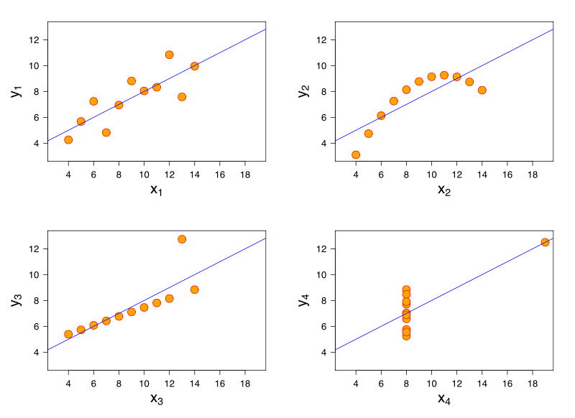
They all have r=0.816 but…
They all have the same regression line:
y = 3 + 0.5x
Notes:
The image on the right shows scatterplots of Anscombe's quartet, a set of four different pairs of variables created by Francis Anscombe.[12] The four y variables have the same mean (7.5), standard deviation (4.12), correlation (0.816) and regression line (y = 3 + 0.5x). However, as can be seen on the plots, the distribution of the variables is very different. The first one (top left) seems to be distributed normally, and corresponds to what one would expect when considering two variables correlated and following the assumption of normality. The second one (top right) is not distributed normally; while an obvious relationship between the two variables can be observed, it is not linear. In this case the Pearson correlation coefficient does not indicate that there is an exact functional relationship: only the extent to which that relationship can be approximated by a linear relationship. In the third case (bottom left), the linear relationship is perfect, except for one outlier which exerts enough influence to lower the correlation coefficient from 1 to 0.816. Finally, the fourth example (bottom right) shows another example when one outlier is enough to produce a high correlation coefficient, even though the relationship between the two variables is not linear.
These examples indicate that the correlation coefficient, as a summary statistic, cannot replace visual examination of the data. Note that the examples are sometimes said to demonstrate that the Pearson correlation assumes that the data follow a normal distribution, but this is not correct

Slide 27
But remember:
Not causality
Relationship not a prediction
Notes:
The conventional dictum that "correlation does not imply causation" means that correlation cannot be used to infer a causal relationship between the variables.[11] This dictum should not be taken to mean that correlations cannot indicate the potential existence of causal relations. However, the causes underlying the correlation, if any, may be indirect and unknown. Consequently, establishing a correlation between two variables is not a sufficient condition to establish a causal relationship (in either direction).
a correlation can be taken as evidence for a possible causal relationship, but cannot indicate what the causal relationship

Slide 28
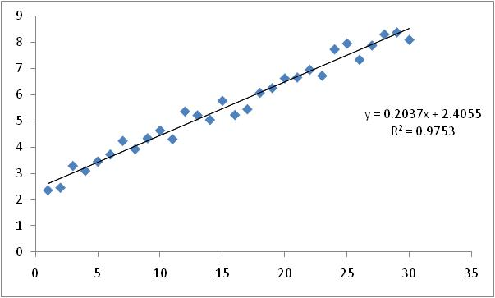
Linear regression:
- Regression: Prediction of one variable from knowledge of one or more other variables
How good is a linear model (y=ax+b) to explain the relationship of two variables?
If there is such a relationship, we can ‘predict’ the value y for a given x. But, which error could we be doing?
(25, 7.498)

Slide 29
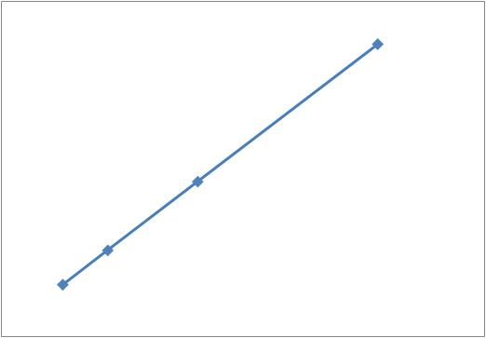
Preliminars:
Lineal dependence between 2 variables
Two variables are linearly dependent when the increase of one variable is proportional to the increase of the other one
Δy
Δx

Slide 30
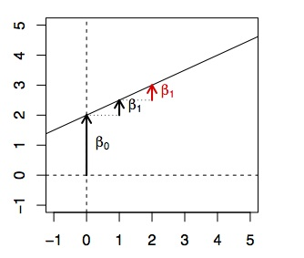
The equation y= β₁x+β₀ that connects both variables has two parameters:
‘β₁’ is the unitary increase/decerease of y (how much increases or decreases y when x increases one unity) - Slope
‘β₀’ the value of y when x is zero (usually zero) - Intrercept

Slide 31
Fiting data to a straight line (o viceversa):
Here, ŷ = ax + b
  ŷ : predicted value of y
  β₁: slope of regression line
  β₀: intercept
ŷ = β₁x + β₀
ε _{i}
= ŷ_{i}, predicted
= y_{i} , observed
ε_{i} = residual
  Residual error (ε_{i}): Difference between obtained and predicted values of y (i.e. y_{i}- ŷ_{i})
Best fit line (values of b and a) is the one that minimises the sum of squared errors (SS_{error}) Σ(y_{i}- ŷ_{i})²
Notes:
Assumption:
Linearity: the model predictions are unbiased (mean of εi is 0)
Normality: εi is Normally distributed
Homoscedasticity: εi has constant variance σ2
Independence: εi is independent of εj (for all i,j)

Slide 32
Adjusting the straight line to data:
Minimise Σ(y_{i}- ŷ_{i})² , which is Σ(y_{i}-ax_{i}+b)²
Minimum SS_{error} is at the bottom of the curve where the gradient is zero – and this can found with calculus
Take partial derivatives of Σ(y_{i}-ax_{i}-b)² respect parametres a and b and solve for 0 as simultaneous equations, giving:
This calculus can allways be done, whatever is the data!!
Notes:
If r = 1 the observations lie on the linear regression line ( perfect positive correlation) the slope is sy/sx which is the variation of yi relative to the variation of xi.
If r = 0 x and y are independent and n very large r will be close to 0 and the regression line will be y(x)=media di y it makes sense because if they are independent x doesn't predict y

Slide 33
How good is the model?
We can calculate the regression line for any data, but how well does it fit the data?
Total variance = predicted variance + error variance: S_{y}² = S_{ŷ}² + S_{er}²
Also, it can be shown that r² is the proportion of the variance in y that is explained by our regression model
r² = S_{ŷ}² / S_{y}²
Insert r²S_{y}² into S_{y}² = S_{ŷ}² + S_{er}² and rearrange to get:
S_{er}² = S_{y}² (1 – r²)
From this we can see that the greater the correlation the smaller the error variance, so the better our prediction

Slide 34
Is the model significant?
i.e. do we get a significantly better prediction of y from our regression equation than by just predicting the mean?
F-statistic:
And it follows that:
complicated
rearranging
s_{ŷ}²
r² (n - 2)²
F
=
=......=
(df_{ŷ},df_{er})
s_{er}²
1 – r²
r (n - 2)
t_{(n-2)} =
√1 – r²
So all we need to know are r and n !!!

Slide 35
Generalization to multiple variables
Multiple regression is used to determine the effect of a number of independent variables, x₁, x₂, x₃ etc., on a single dependent variable, y
The different x variables are combined in a linear way and each has its own regression coefficient:
y = β₀ + β₁x₁+ β₂x₂ +…..+ β_{n}x_{n} + ε
The a parameters reflect the independent contribution of each independent variable, x , to the value of the dependent variable, y
i.e. the amount of variance in y that is accounted for by each x variable after all the other x variables have been accounted for

Slide 36
Geometric view, 2 variables:
‘Plane’ of regression: Plane nearest all the sample points distributed over a 3D space:
y = β₀ + β₁x₁+β ₂x₂ + ε -> Hyperplane
y
ε
x₂
x₁
ŷ = β₀ + β₁x₁+ β₂x₂

Slide 37
Last remarks:
Relationship between two variables doesn’t mean causality
(e.g suicide - icecream)
Cov(x,y)=0 doesn’t mean x,y being independents
(yes for linear relationship but it could be quadratic,…)
Notes:
Pag 123 causality
Cov(x,y)=0 If the variables are independent, Pearson's correlation coefficient is 0, but the converse is not true because the correlation coefficient detects only linear dependencies between two variables

Slide 38
References
Field, A. (2009). Discovering Statistics Using SPSS (2nd ed). London: Sage Publications Ltd.
Various MfD Slides 2007-2010
SPM Course slides
Wikipedia
Judd, C.M., McClelland, G.H., Ryan, C.S. Data Analysis: A Model Comparison Approach, Second Edition. Routledge;
Slide from PSYCGR01 Statistic course - UCL (dr. Maarten Speekenbrink)

