Slide 1
Introduction to Connectivity: resting-state and PPI
Dana Boebinger & Lisa Quattrocki Knight
Methods for Dummies 2012-2013

Slide 2
Resting-state fMRI

Slide 3
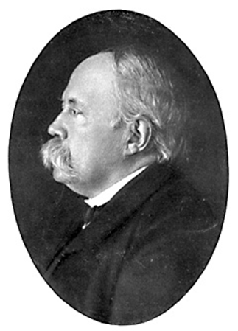
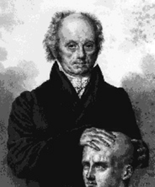
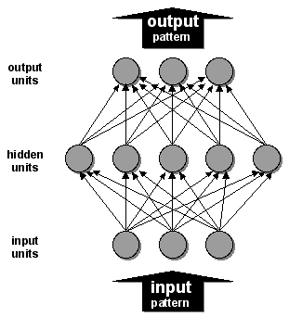
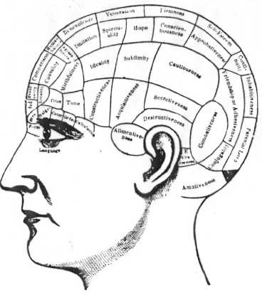
Background
Localisationism
Functions are localised in anatomic cortical regions
Damage to a region results in loss of function
Globalism
The brain works as a whole, extent of brain damage is more important than its location
History:
Functional Segregation
Functions are carried out by specific areas/cells in the cortex that can be anatomically separated
Connectionism
Networks of simple connected units
Functional Segregation
Different areas of the brain are specialised for different functions
Functional Integration
Networks of interactions among specialised areas

Slide 4
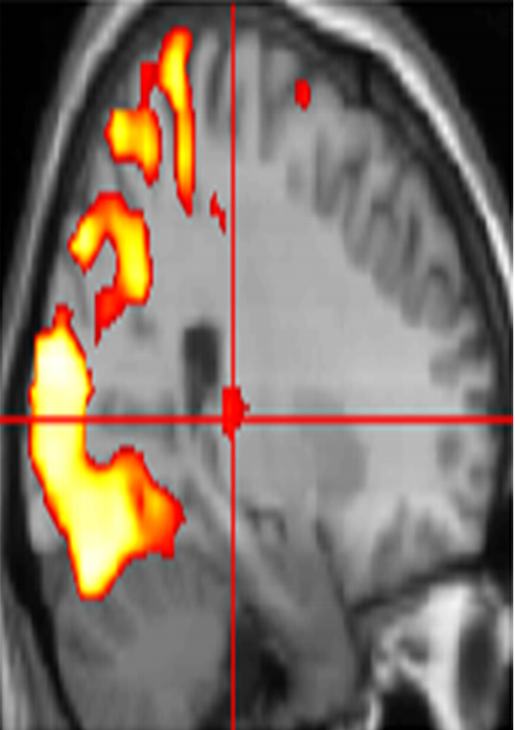
Systems analysis in functional neuroimaging
Functional Segregation
Specialised areas exist in the cortex
Functional Integration
Networks of interactions among specialised areas
Analyses of regionally specific effects
Identifies regions specialized for a particular task.
Univariate analysis
Analysis of how different regions in a neuronal system interact (coupling).
Determines how an experimental manipulation affects coupling between regions.
Univariate & Multivariate analysis
Functional connectivity
Effective connectivity
Standard SPM
Adapted from D. Gitelman, 2011

Slide 5
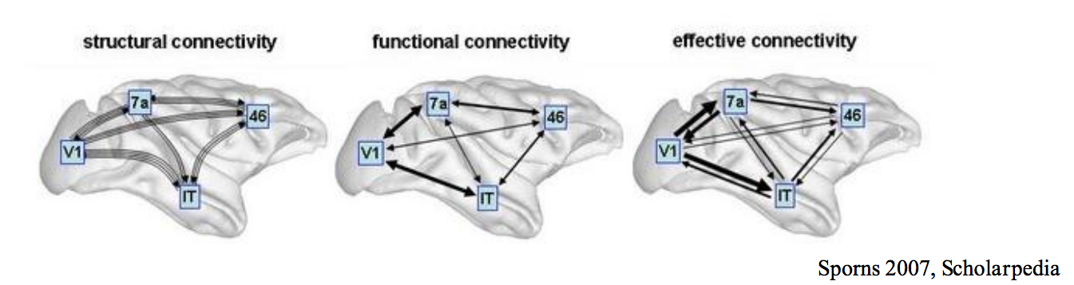
Types of connectivity
Anatomical/structural connectivity presence of axonal connections
example: tracing techniques, DTI
Functional connectivity statistical dependencies between regional time series
Simple temporal correlation between activation of remote neural areas
Descriptive in nature; establishing whether correlation between areas is significant
example: seed voxel, eigen-decomposition (PCA, SVD), independent component analysis (ICA)
Effective connectivity causal/directed influences between neurons or populations
  The influence that one neuronal system exerts over another (Friston et al., 1997)
  Model-based; analysed through model comparison or optimisation
  examples: PPIs - Psycho-Physiological Interactions
  SEM - Structural Equation Modelling
DCM - Dynamic Causal Modelling
Static Models
Dynamic Model
Sporns, 2007

Slide 6
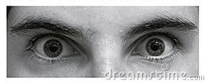
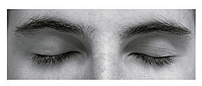
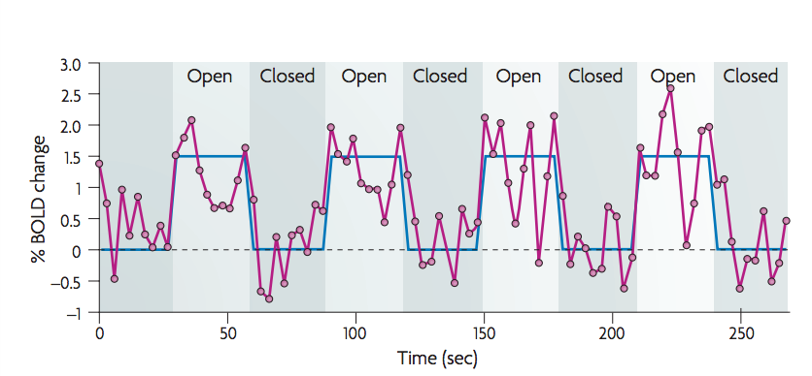
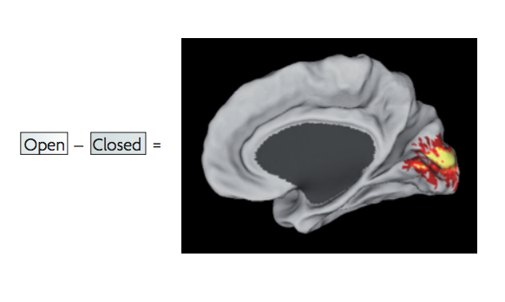
Task-evoked fMRI paradigm
task-related activation paradigm
  changes in BOLD signal attributed to experimental paradigm
  brain function mapped onto brain regions
“noise” in the signal is abundant → factored out in GLM
Fox et al., 2007

Slide 7
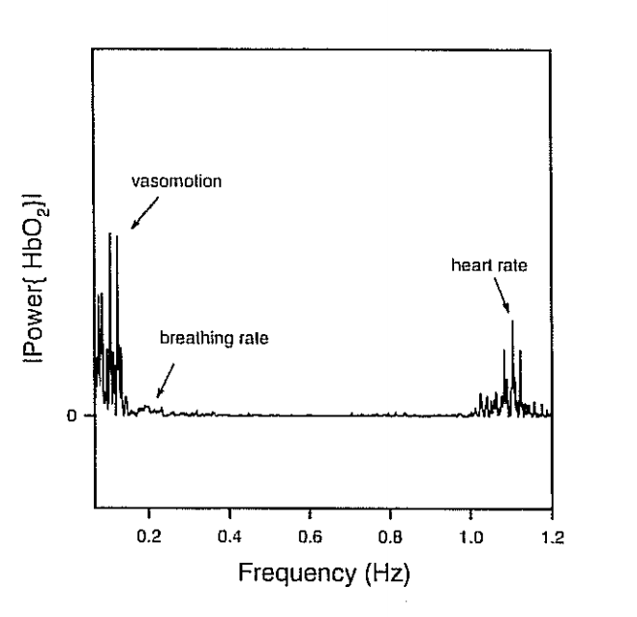
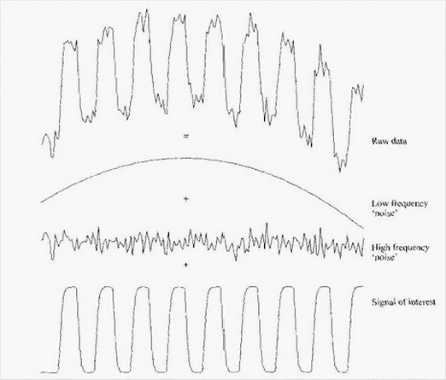
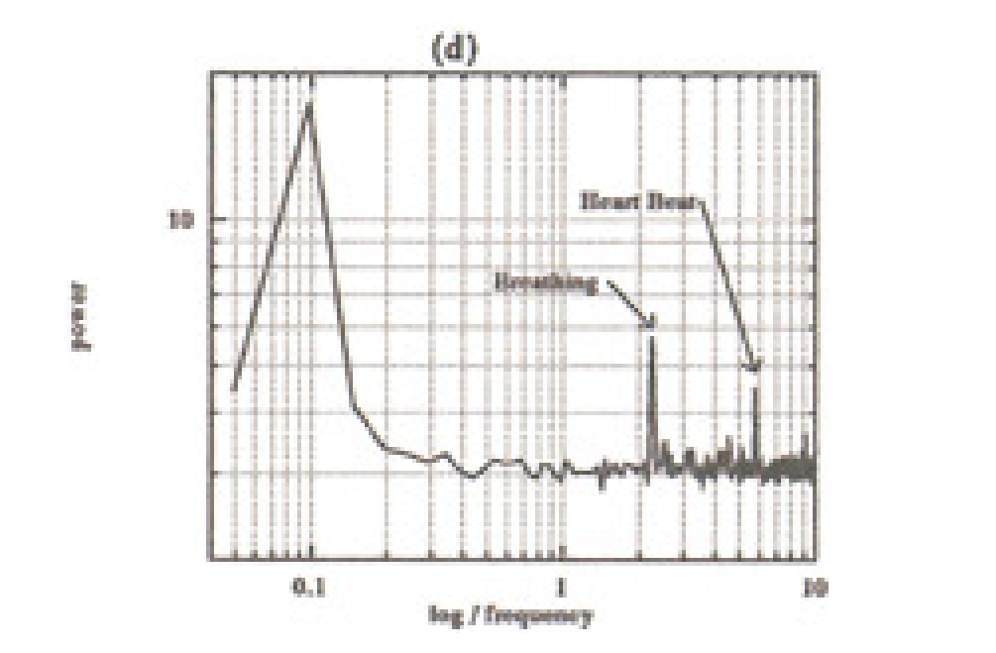
Spontaneous BOLD activity
the brain is always active, even in the absence of explicit input or output
  task-related changes in neuronal metabolism are only about 5% of brain’s total energy consumption
what is the “noise” in standard activation studies?
  physiological fluctuations or neuronal activity?
  peak in frequency oscillations from 0.01 – 0.10 Hz
  distinct from faster frequencies of respiratory and cardiac responses
< 0.10 Hz
Elwell et al., 1999
Mayhew et al., 1996

Slide 8
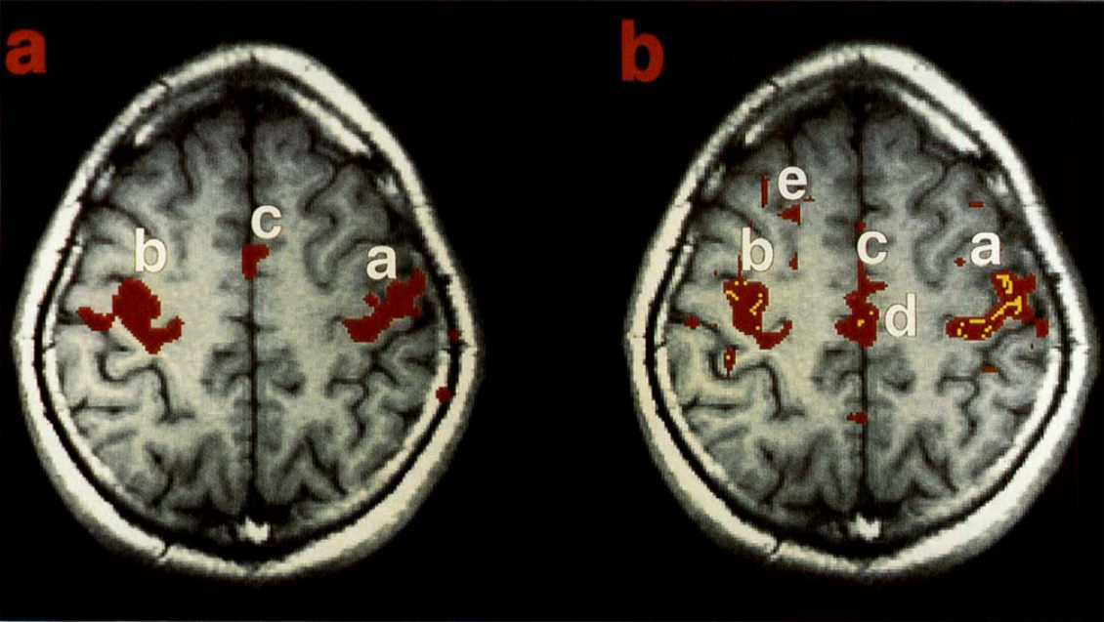
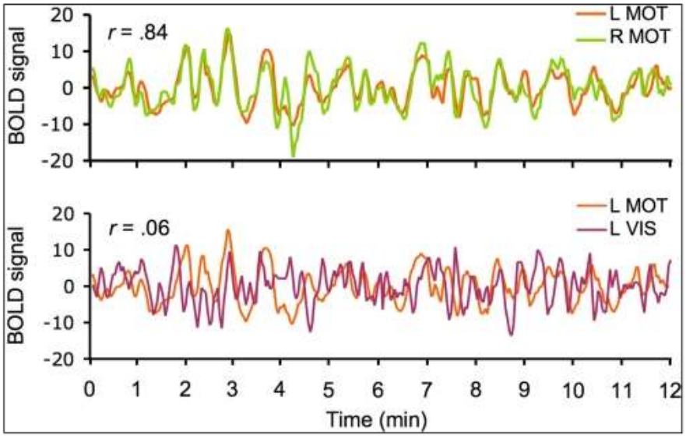
Spontaneous BOLD activity
occurs during task and at rest
  intrinsic brain activity
resting-state networks
  correlation between spontaneous BOLD signals of brain regions known to be functionally and/or structurally related
neuroscientists are studying this spontaneous BOLD signal and its correlation between brain regions in order to learn about the intrinsic functional connectivity of the brain
Biswal et al., 1995
Van Dijk et al., 2010

Slide 9
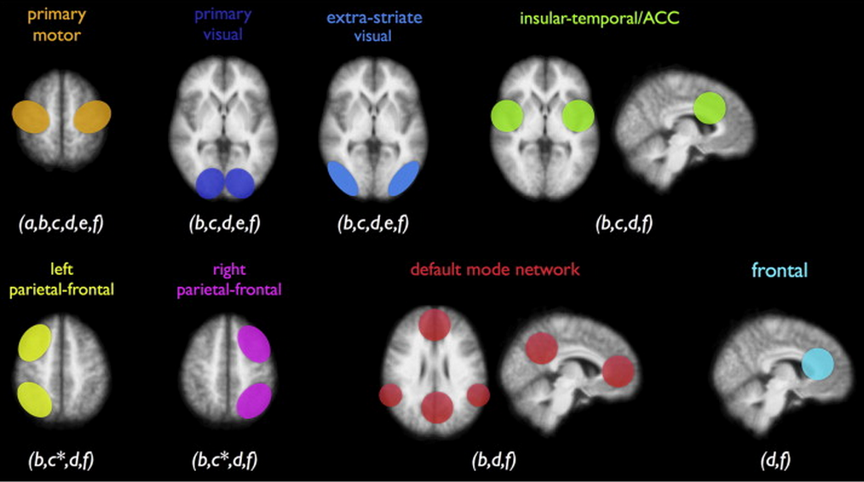
Resting-state networks (RSNs)
multiple resting-state networks (RSNs) have been found
  all show activity during rest and during tasks
  one of the RSNs, the default mode network (DMN), shows a decrease in activity during cognitive tasks

Slide 10
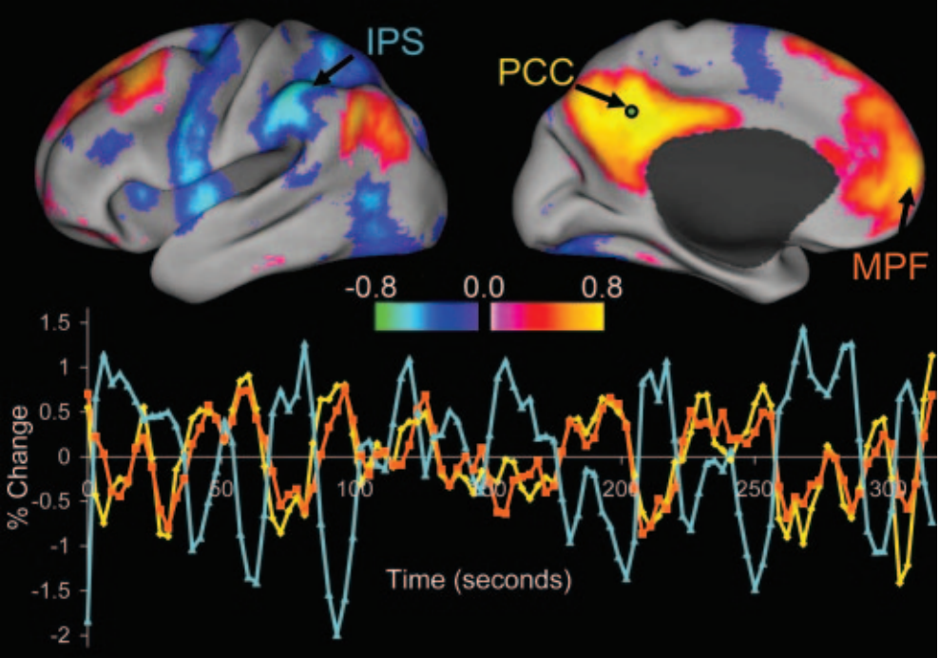
RSNs: Inhibitory relationships
default mode network (DMN)
  decreased activity during cognitive tasks
  inversely related to regions activated by cognitive tasks
task-positive and task-negative networks
Fox et al., 2005

Slide 11
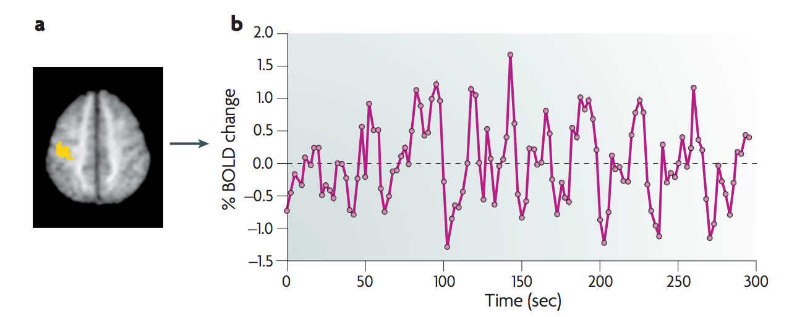
Resting-state fMRI: acquisition
resting-state paradigm
  no task; participant asked to lie still
  time course of spontaneous BOLD response measured
less susceptible to task-related confounds
Fox & Raichle, 2007

Slide 12
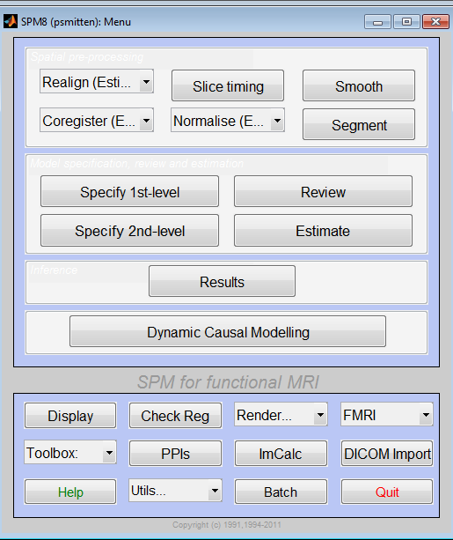
Resting-state fMRI: pre-processing
…exactly the same as other fMRI data!

Slide 13
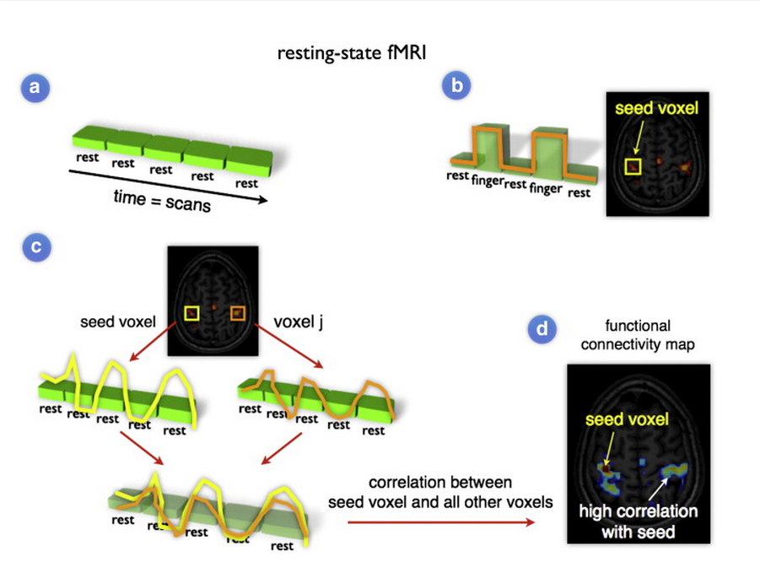
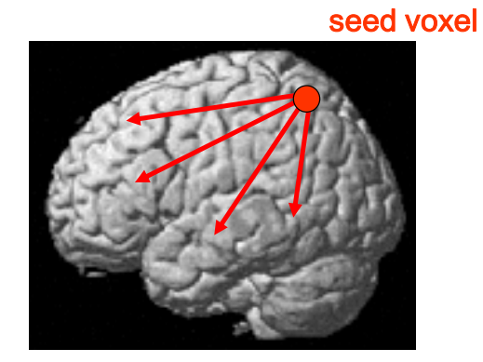
Resting-state fMRI: Analysis
van den Heuvel & Hulshoff Pol, 2010
Marreiros, 2012
model-dependent methods: seed method
  a priori or hypothesis-driven from previous literature

Slide 14
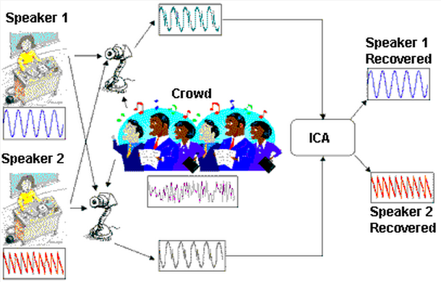
Resting-state fMRI: Analysis
model-free methods: independent component analysis (ICA)
http://www.statsoft.com/textbook/independent-components-analysis/

Slide 15
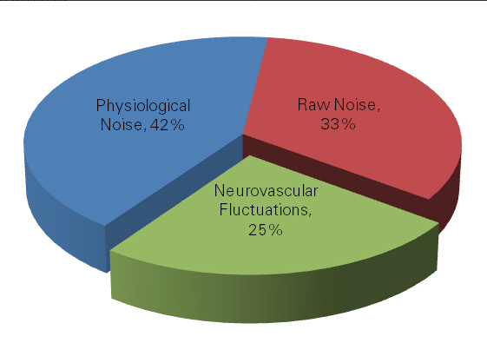
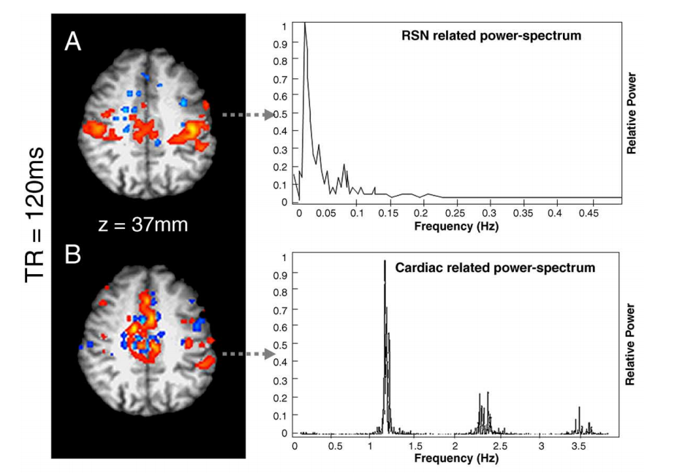
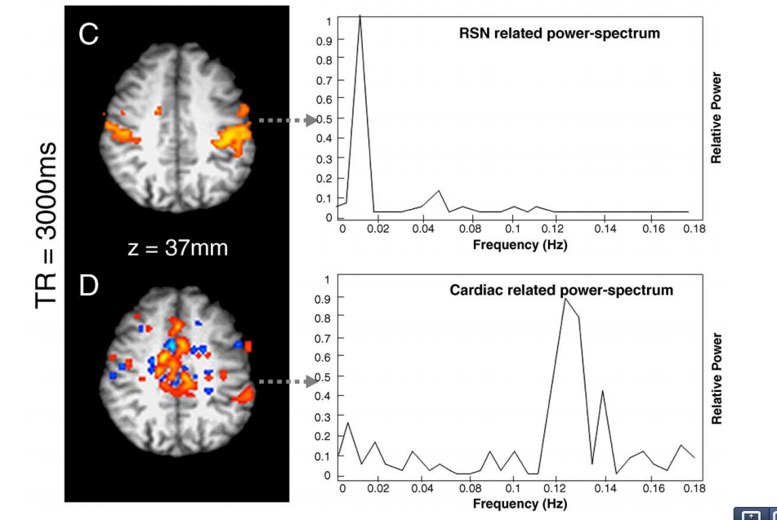
Resting-state fMRI: Data Analysis Issues
accounting for non-neuronal noise
  aliasing of physiological activity → higher sampling rate
  measure physiological variables directly → regress
  band pass filter during pre-processing
  use ICA to remove artefacts
Kalthoff & Hoehn, 2012

Slide 16
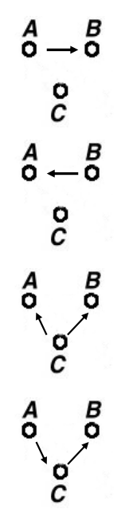
Pros & cons of functional connectivity analysis
Pros:
  free from experimental confounds
  makes it possible to scan subjects who would be unable to complete a task (i.e. Alzheimer’s patients, disorders of consciousness patients)
  useful when we have no experimental control over the system of interest and no model of what caused the data (i.e. sleep, hallucinations, etc.)
Cons:
  merely descriptive
  no mechanistic insight
  usually suboptimal for situations where we have a priori knowledge / experimental control
  → Effective connectivity
Marreiros, 2012

Slide 17
Psychophysiological Interactions

Slide 18
Introduction
Effective connectivity
PPI overview
SPM data set methods
Practical questions

Slide 19
Functional Integration
Functional connectivity
Temporal correlations between spatially remote areas
Based on correlation analysis
MODEL-FREE
Exploratory
Data Driven
No Causation
Whole brain connectivity
Effective connectivity
The influence that one neuronal system exerts over another
Based on regression analysis
MODEL-DEPENDENT
Confirmatory
Hypothesis driven
Causal (based on a model)
Reduced set of regions
Adapted from D. Gitelman, 2011

Slide 20
Correlation vs. Regression
Correlation
Continuous data
Assumes relationship between two variables is constant
Uses observational or retrospective data
Pearson’s r
No directionality
Linear association
Regression
Continuous data
Tests for influence of an explanatory variable on a dependent variable
Uses data from an experimental manipulation
Least squares method
Tests for the validity of a model
Evaluates the strength of the relationships between the variables in the data
Adapted from D. Gitelman, 2011

Slide 21
Psychophysiological Interaction
Measures effective connectivity: how psychological variables or external manipulations change the coupling between regions.
A change in the regression coefficient between two regions during two different conditions determines significance.

Slide 22
PPI: Experimental Design
Key question: How can brain activity be explained by the interaction between psychological and physiological variables?
Factorial Design (2 different types of stimuli; 2 different task conditions)
Plausible conceptual anatomical model or hypothesis:
  e.g. How can brain activity in V5 (motion detection area) be explained by the interaction between attention and V2(primary visual cortex) activity?
Neuronal model

Slide 23
PPIs vs Typical GLM Interactions
A typical interaction: How can brain activity be explained by the interaction between 2 experimental variables?
Y = (S₁-S₂) β₁ + (T₁-T₂) β₂ + (S₁-S₂)(T₁-T₂) β₃ + e
Interaction term = the effect of Motion vs. No Motion under Attention vs. No Attention
E.g.
Task
1. Attention
2. No Att
Motion
T₁ S₁
T₂ S₁
1. Motion
Stimulus
T₁ S₂
T₂ S₂
2. No Motion
No Motion
No Att
Att
Load

Slide 24
PPIs vs Typical Interactions
Y = (S₁-S₂) β₁ + (T₁-T₂) β₂ + (S₁-S₂)(T₁-T₂) β₃ + e
Y = (V2) β₁ + (T₁-T₂) β₂ + [V2* (T₁-T₂)] β₃ + e
Physiological Variable:
V2 Activity
Psychological Variable:
Attention – No attention
Interaction term: the effect of attention vs no attention on V2 activity
PPI:
Replace one main effect with neural activity from a source region (e.g. V2, primary visual cortex)
Replace the interaction term with the interaction between the source region (V2) and the psychological vector (attention)

Slide 25
PPIs vs Typical GLM Interactions
Y = (V₂) β₁ + (Att-NoAtt) β₂ + [(Att-NoAtt) * V2] β₃ + e
Physiological Variable:
V2 Activity
Psychological Variable:
Attention – No attention
Interaction term: the effect of attention vs no attention on V2 activity
Test the null hypothesis: that the interaction term does not contribute significantly to the model:
H₀: β₃ = 0
Alternative hypothesis:
H₁: β₃ ≠ 0
Attention
V5
activity
No Attention
V1 activity

Slide 26
Interpreting PPIs
Two possible interpretations:
  The contribution of the source area to the target area response depends on experimental context
    e.g. V2 input to V5 is modulated by attention
  Target area response (e.g. V5) to experimental variable (attention) depends on activity of source area (e.g. V2)
    e.g. The effect of attention on V5 is modulated by V2 input
attention
1.
V2
V5
V1
attention
2.
Mathematically, both are equivalent, but one may be more neurologically plausible
V1
V5
V2

Slide 27
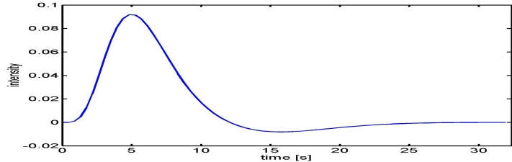
PPI: Hemodynamic vs neuronal model
We assume BOLD signal reflects underlying neural activity convolved with the hemodynamic response function (HRF)
  HRF basic function
- But interactions occur at NEURAL LEVEL
(HRF x V2) X (HRF x Att) ≠ HRF x (V2 x Att)

Slide 28
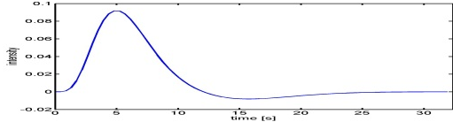
PPI: Hemodynamic vs neuronal
BOLD signal in V2
SOLUTION:
Deconvolve BOLD signal corresponding to region of interest (e.g. V2)
Calculate interaction term with neural activity:
  psychological condition x neural activity
Re-convolve the interaction term using the HRF
Neural activity in V2
Psychological variable
x
Neural activity in V1 with
Psychological Variable reconvolved
  HRF basic function
Gitelman et al. Neuroimage 2003

Slide 29
PPIs in SPM
Perform Standard GLM Analysis with 2 experimental factors (one factor preferably a psychological manipulation) to determine regions of interest and interactions
Define source region and extract BOLD SIGNAL time series (e.g. V2)
  Use Eigenvariates (there is a button in SPM) to create a summary value of the activation across the region over time.
  Adjust the time course for the main effects

Slide 30
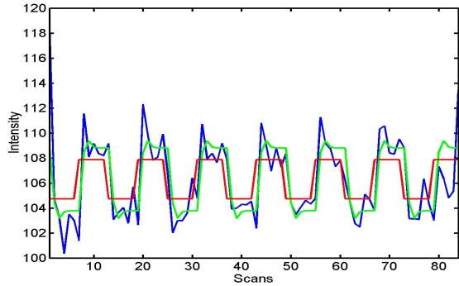


PPIs in SPM
Form the Interaction term (source signal x experimental treatment)
  Select the parameters of interest from the original GLM
      Psychological condition: Attention vs. No attention
      Activity in V2
  Deconvolve physiological regressor (V2)→ transform BOLD signal into neuronal activity
  Calculate the interaction term V2x (Att-NoAtt)
  Convolve the interaction term V2x (Att-NoAtt) with the HRF
  Neuronal activity
  HRF basic function
BOLD signal

Slide 31
PPIs in SPM
4. Perform PPI-GLM using the Interaction term
  Insert the PPI-interaction term into the GLM model
Y = (Att-NoAtt) β₁ + V2 β₂ + (Att-NoAtt) * V2 β₃ + β_{i}Xi + e
H₀: β₃ = 0
  Create a t-contrast [0 0 1 0] to test H₀
Determine significance based on a change in the regression slopes between your source region and another region during condition 1 (Att) as compared to condition 2 (NoAtt)

Slide 32
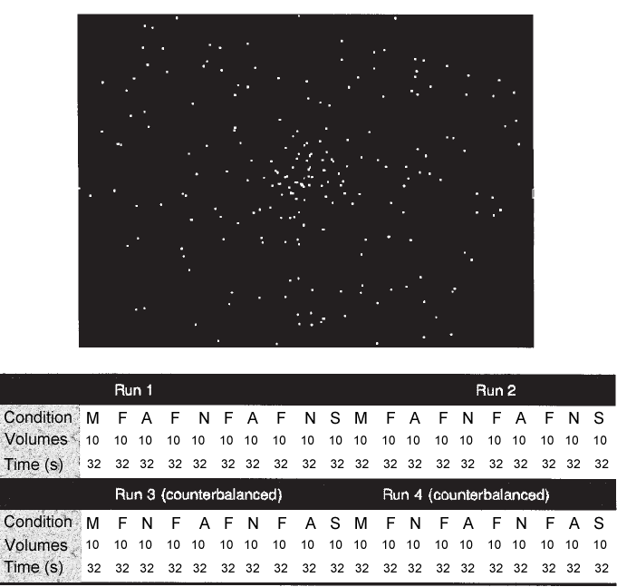
Data Set: Attention to visual motion
Stimuli:
S_{M} = Radially moving dots
S_{S} = Stationary dots
Task:
T_{A} = Attention: attend to speed of the moving dots (speed never varied)
T_{N} = No attention: passive viewing of moving dots
Buchel et al, Cereb Cortex, 1997
Adapted from D. Gitelman, 2011

Slide 33
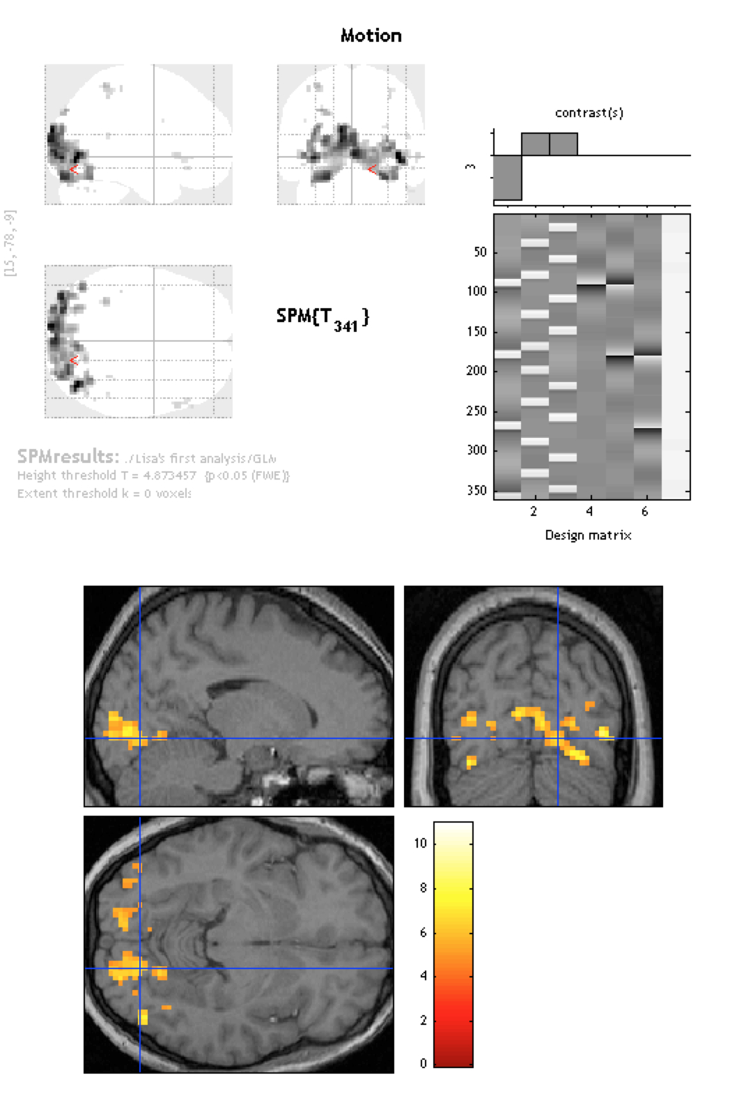
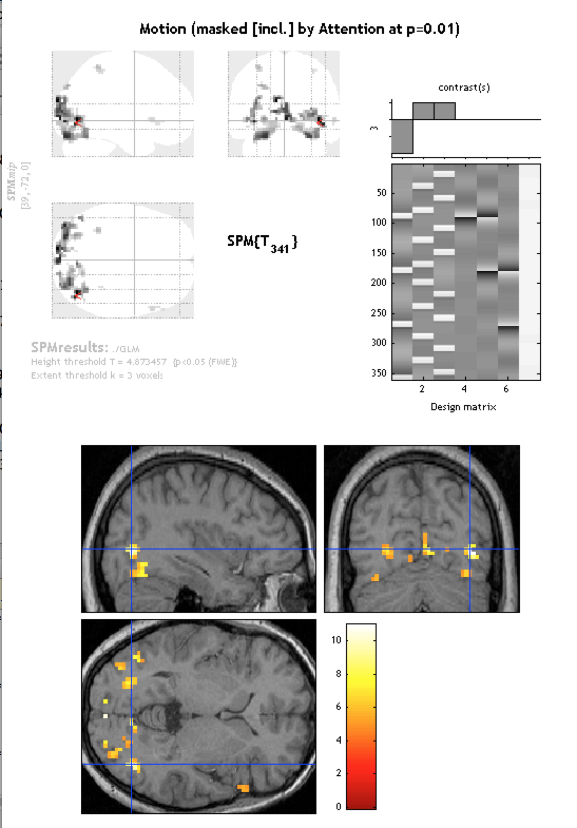
Standard GLM
A. Motion
B. Motion masked by attention

Slide 34
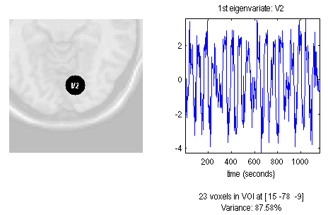
Extracting the time course of the VOI
Display the results from the GLM.
Select the region of interest.
Extract the eigenvariate
Name the region
Adjust for: Effects of Interest
Define the volume (sphere)
Specify the size: (radius of 6mm)

Slide 35
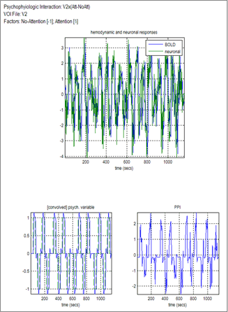
Create PPI variable
Select the VOI file extracted from the GLM
Include the effects of interest (Attention – No Attention) to create the interaction
No-Attention contrast = -1;
Attention contrast = 1
Name the PPI = V2 x (attention-no attention)
BOLD
neuronal
VOI eigenvariate
PPI: Interaction (VOI x Psychological variable)
Psychological vector

Slide 36
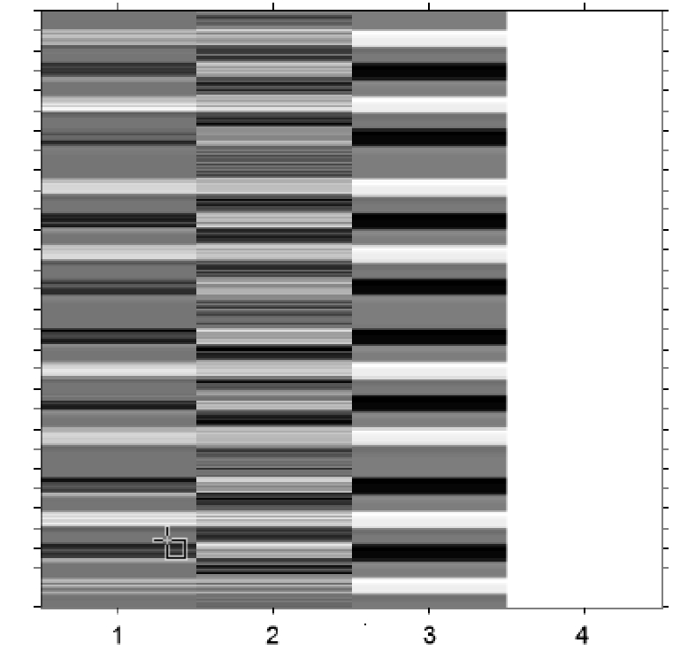
PPI - GLM analysis
V2 x (Att-NoAtt)
V2 time course
  PPI-GLM Design matrix
  PPI-interaction ( PPI.ppi )
  V2-BOLD (PPI.Y)
  Psych_Att-NoAtt (PPI.P)
Att-NoAtt

Slide 37
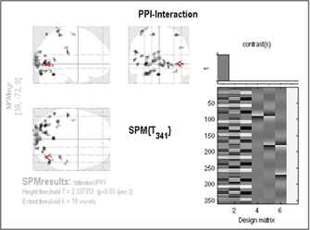
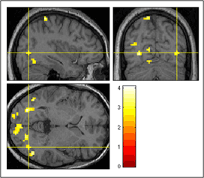
PPI results

Slide 38
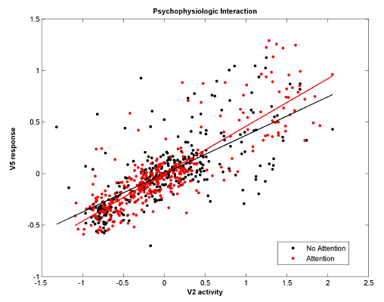
PPI plot

Slide 39
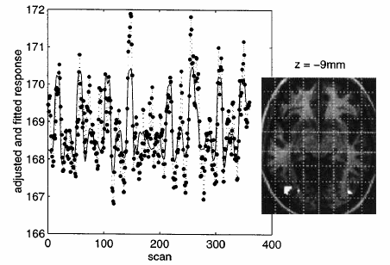
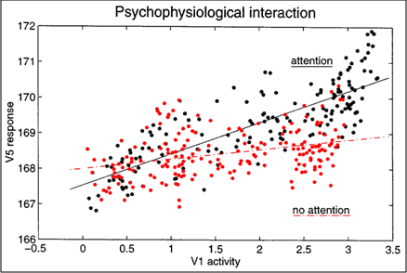
Psychophysiologic interaction
Friston et al, Neuroimage, 1997
Two possible interpretations
  Attention modulates the contribution of V2 to the time course of V5 (context specific)
  Activity in V2 modulates the contribution attention makes to the responses of V5 to the stimulus (stimulus specific)

Slide 40
Two mechanistic interpretations of PPI’s
Stimulus driven activity in V2
Stimulus driven activity in V2
Experimental factor (attention)
Experimental factor
(attention)
T
T
Response in region V5
Response in region V5
  Attention modulates the contribution of the stimulus driven activity in V2 to the time course of V5 (context specific)
  Activity in V2 modulates the contribution attention makes to the stimulus driven responses in V5 (stimulus specific)
Adapted from Friston et al, Neuroimage, 1997

Slide 41
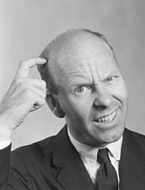
PPI directionality
Source
Target
?
Source
Target
Although PPIs select a source and find target regions, they cannot determine the directionality of connectivity.
The regression equations are reversible. The slope of A → B is approximately the reciprocal of B → A (not exactly the reciprocal because of measurement error)
Directionality should be pre-specified and based on knowledge of anatomy or other experimental results.
Adapted from D. Gitelman, 2011

Slide 42
PPI vs. Functional connectivity
PPI’s are based on regressions and assume a dependent and independent variables (i.e., they assume causality in the statistical sense).
PPI’s explicitly discount main effects
Adapted from D. Gitelman, 2011

Slide 43
PPI: notes
Because they consist of only 1 input region, PPI’s are models of contributions rather than effective connectivity.
PPI’s depend on factorial designs, otherwise the interaction and main effects may not be orthogonal, and the sensitivity to the interaction effect will be low.
Problems with PPI’s
  Proper formulation of the interaction term influences results
  Analysis can be overly sensitive to the choice of region.
Adapted from D. Gitelman, 2011

Slide 44
Pros & Cons of PPIs
Pros:
  Given a single source region, PPIs can test for the regions context-dependent connectivity across the entire brain
  Simple to perform
Cons:
  Very simplistic model: only allows modelling contributions from a single area
  Ignores time-series properties of data (can do PPI’s on PET and fMRI data)
    Inputs are not modelled explicitly
    Interactions are instantaneous for a given context
Need DCM to elaborate a mechanistic model
Adapted from D. Gitelman, 2011

Slide 45
The End
Many thanks to Sarah Gregory!

Slide 46
References
previous years’ slides, and…
Biswal, B., Yetkin, F.Z., Haughton, V.M., & Hyde, J.S. (1995). Functional connectivity in the motor cortex of resting human brain using echo-planar MRI. Magnetic Resonance Medicine, 34(4), 537-41.
Buckner, R. L., Andrews-Hanna, J. R., & Schacter, D. L. (2008). The brain’s default network: anatomy, function, and relevance to disease. Annals of the New York Academy of Sciences, 1124, 1–38. doi:10.1196/annals.1440.011
Damoiseaux, J. S., Rombouts, S. A. R. B., Barkhof, F., Scheltens, P., Stam, C. J., Smith, S. M., & Beckmann, C. F. (2006). Consistent resting-state networks, (2).
De Luca, M., Beckmann, C. F., De Stefano, N., Matthews, P. M., & Smith, S. M. (2006). fMRI resting state networks define distinct modes of long-distance interactions in the human brain. NeuroImage, 29(4), 1359–67. doi:10.1016/j.neuroimage.2005.08.035
Elwell, C. E., Springett, R., Hillman, E., & Delpy, D. T. (1999). Oscillations in Cerebral Haemodynamics. Advances in Experimental Medicine and Biology, 471, 57–65.
Fox, M. D., & Raichle, M. E. (2007). Spontaneous fluctuations in brain activity observed with functional magnetic resonance imaging. Nature reviews. Neuroscience, 8(9), 700–11. doi:10.1038/nrn2201
Fox, M. D., Snyder, A. Z., Vincent, J. L., Corbetta, M., Van Essen, D. C., & Raichle, M. E. (2005). The human brain is intrinsically organized into dynamic, anticorrelated functional networks. Proceedings of the National Academy of Sciences of the United States of America, 102(27), 9673–8. doi:10.1073/pnas.0504136102
Friston, K. J. (2011). Functional and effective connectivity: a review. Brain connectivity, 1(1), 13–36. doi:10.1089/brain.2011.0008
Greicius, M. D., Krasnow, B., Reiss, A. L., & Menon, V. (2003). Functional connectivity in the resting brain: a network analysis of the default mode hypothesis. Proceedings of the National Academy of Sciences of the United States of America, 100(1), 253–8. doi:10.1073/pnas.0135058100
Greicius, M. D., Supekar, K., Menon, V., & Dougherty, R. F. (2009). Resting-state functional connectivity reflects structural connectivity in the default mode network. Cerebral cortex (New York, N.Y. : 1991), 19(1), 72–8. doi:10.1093/cercor/bhn059
Kalthoff, D., & Hoehn, M. (n.d.). Functional Connectivity MRI of the Rat Brain The Resonance – the first word in magnetic resonance.
Marreiros, A. (2012). SPM for fMRI slides.
Smith, S. M., Miller, K. L., Moeller, S., Xu, J., Auerbach, E. J., Woolrich, M. W., Beckmann, C. F., et al. (2012). Temporally-independent functional modes of spontaneous brain activity. Proceedings of the National Academy of Sciences of the United States of America, 109(8), 3131–6. doi:10.1073/pnas.1121329109
Friston KJ, Buechel C, Fink GR et al. Psychophysiological and Modulatory Interactions in Neuroimaging. Neuroimage (1997) 6, 218-229
Buchel C & Friston KJ. Assessing interactions among neuronal systems using functional neuroimaging. Neural Networks (2000) 13; 871-882.
Gitelman DR, Penny WD, Ashburner J et al. Modeling regional and neuropsychologic interactions in fMRI: The importance of hemodynamic deconvolution. Neuroimage (2003) 19; 200-207.
http://www.fil.ion.ucl.ac.uk/spm/data/attention/
http://www.fil.ion.ucl.ac.uk/spm/doc/mfd/2012/
http://www.fil.ion.ucl.ac.uk/spm/doc/manual.pdf
http://www.neurometrika.org/resources
Graphic of the brain is taken from Quattrocki Knight et al., submitted.
Several slides were adapted from D. Gitelman’s presentation for the October 2011 SPM course at MGH

Slide 47
PPI Questions
How is a group PPI analysis done?
  The con images from the interaction term can be brought to a standard second level analysis (one-sample t-test within a group, two-sample t-test between groups, ANOVA’s, etc.)
Adapted from D. Gitelman, 2011

