Slide 1

2nd level analysis
Camilla Clark, Catherine Slattery
Expert: Ged Ridgway
Notes:
My name is Camilla Clark and Catherine and I will be covering the second level of analysis today.

Slide 2
Summary of the story so far
Level one vs level two analysis (within group)
Fixed effects vs. random effects analysis
Summary statistic approach for RFX vs. hierarchical model
Multiple conditions
  ANOVA
  ANOVA within subject
pressing buttons in SPM
Notes:
I will discuss the difference between first and second level analysis, the types of 2nd level group analysis including fixed and random effects; and summary statistic and hierarchical models within the random effects analysis and Catherine will cover t-tests, ANOVA and practicalities.

Slide 3
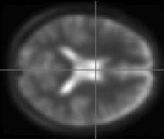



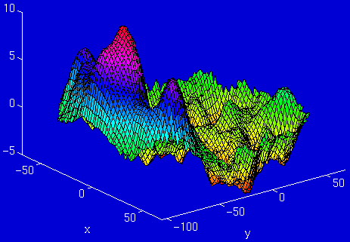
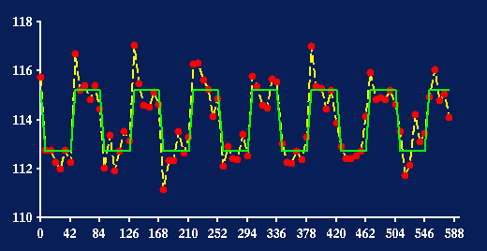
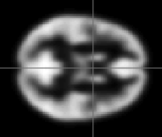
Where are we?
fMRI time-series
kernel
Design matrix
Statistical Parametric Map
Motion
correction
Smoothing
General Linear Model
Spatial
normalisation
Parameter Estimates
Standard
template
Notes:
The Statistical Parametric Mapping approach is voxel based. Images are realigned, spatially normalised into a standard space and smoothed. Parametric statistical models are assumed at each voxel in the image of every subject, using the General Linear Model GLM. This describes the data in terms of experimental and confounding effects, and residual variability. For fMRI the GLM is used in combination with a temporal convolution model. Classical statistical inference is used to test hypotheses that are expressed in terms of GLM parameters using an image whose voxel values are statistics, also known as a Statistical Parametric Map, showing the t values which have a significant non zero effect.

Slide 4
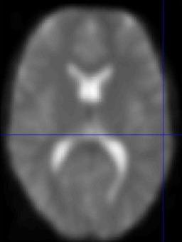
1st level analysis is within subject
β
Y
⁼
X
^{x}
⁺
E
Voxel time course
fMRI brain scans
Time
Time
(scan every 3 seconds)
Amplitude/Intensity
Notes:
The main difference between first and second level analysis is that first level analysis looks at within subject differences whereas 2nd level analysis is between subject.

Slide 5
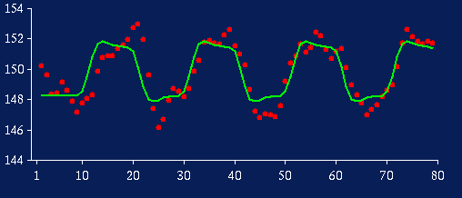
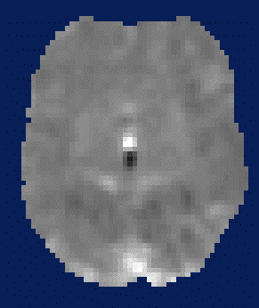
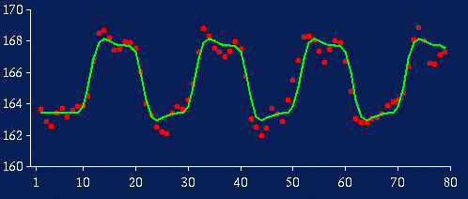
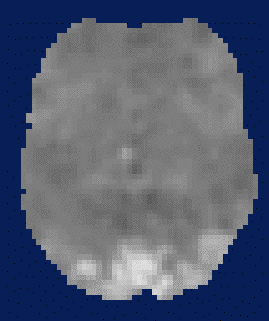
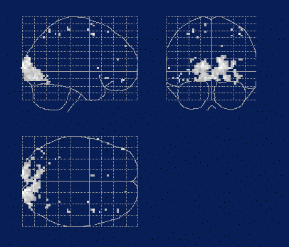
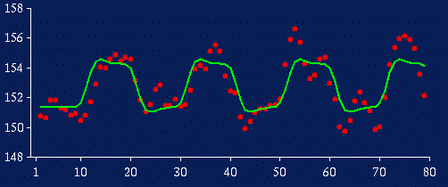
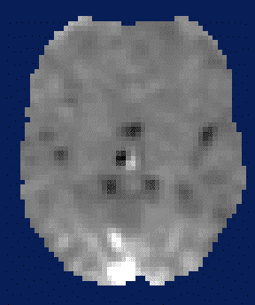
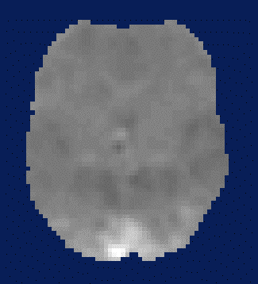
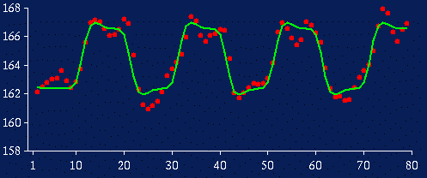
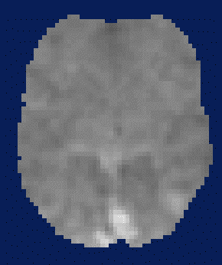
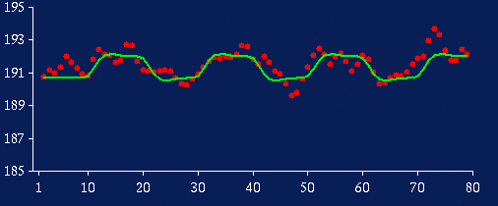
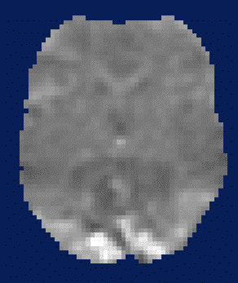
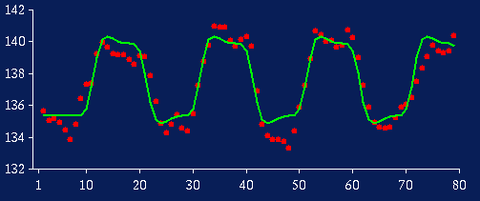
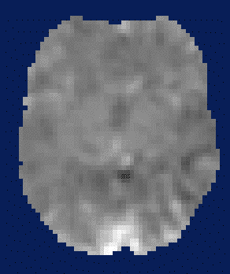
2nd- level analysis is between subject
1st-level (within subject)
2nd-level (between-subject)
β_{i}⁽¹⁾
β_{i}⁽²⁾
β_{i}⁽³⁾
contrast images of cβ_{i}
→
p < 0.001 (uncorrected)
β_{i}⁽⁴⁾
SPM{t}
β_{pop}
β_{i}⁽⁵⁾
With n independent observations per subject:
var(β_{pop}) = σ²_{b} / Ν + σ²_{w} / Nn
β_{i}⁽⁶⁾
Notes:
Let us start with these contrasts on the left. Beta values related to size of effect. These beta images are linearly combined to create contrast images within the first level of analysis. You need one contrast image for each patient and each control at the end of the first level analysis. By doing that you are collapsing over intra/within-subject variability because each subject is represented in an image; the image-to-image residual variability is now between subject variance alone.

Slide 6
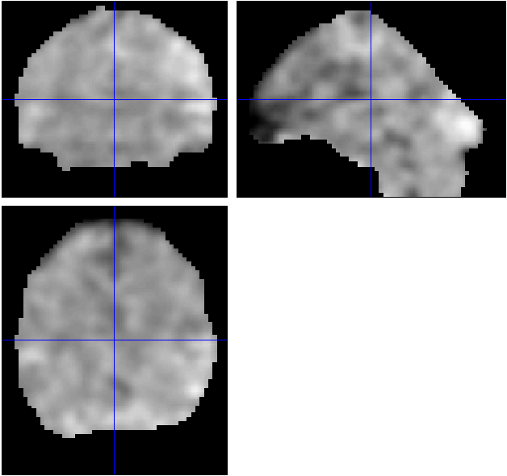
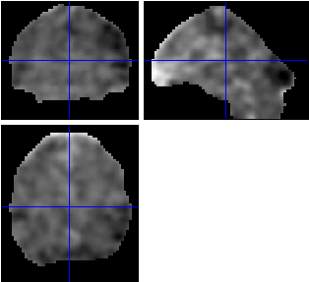
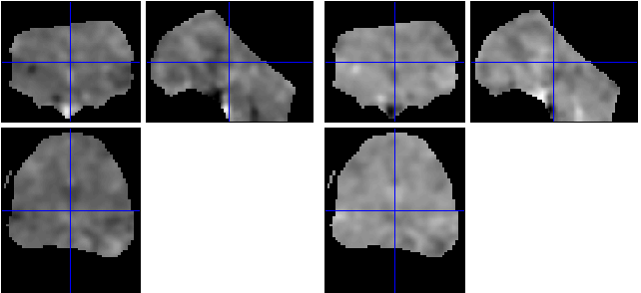
Relationship between 1st & 2nd levels
1st-level analysis: Fit the model for each subject. Typically, one design matrix per subject
Define the effect of interest for each subject with a contrast vector.
The contrast vector produces a contrast image containing the contrast of the parameter estimates at each voxel.
2nd-level analysis: Feed the contrast images into a GLM that implements a statistical test.
Contrast 1
Contrast 2
Subject 1
Con image for contrast 1 for subject 1
Con image for contrast 2 for subject 1
Subject 2
Con image for contrast 1 for subject 2
Con image for contrast 2 for subject 2
You can use checkreg button to display con images of different subjects for 1 contrast and eye-ball if they show similar activations
Notes:
At the end of the first level analysis there should be one design matrix per subject. The effect of interest for each subject is defined with a contrast vector used to produce a contrast image. The contrast images represent spatially distributed images of the weighted sum of the parameter estimates for that particular contrast, for example it could be a difference image for activation-rest. These contrast images are then fed into a general linear model that implements a statistical test to look at the specific effects and how they interact.

Slide 7
Similarities between 1st & 2nd levels
Both use the GLM model/tests and a similar SPM machinery
Both produce design matrices.
The rows in the design matrices represent observations:
  1st level: Time points; within-subject variability
  2nd level: subjects; between-subject variability
The columns represent explanatory variables (EV):
  1st level: All conditions within the experimental design
  2nd level: The specific effects of interest
Notes:
Both use the general linear model and both have design matrices as their output. However the rows and columns in the design matrix represent different values. The rows in the design matrix are observations; at the first level they are the time points which refer to acquisition times of volumes and the canonical HRF’s variability over time whereas at the second level rows represent subjects and inter subject variability. Columns represent explanatory variables; at the first level all the conditions within the experimental design are included whereas at the second level it is only the specific effects you are interested in.

Slide 8
Similarities between 1st & 2nd levels
The same tests can be used in both levels (but the questions are different)
.Con images: output at 1st level, both input and output at 2nd level
There is typically only one 1st-level design matrix per subject, but multiple 2nd level design matrices for the group – one for each category of test (see below).
For example:
2 X 2 design between variable A and B.
We’d have three design matrices (entering 3 different sets of con images from 1st level analyses) for
main effect of A
main effect of B
interaction AxB.
B1
B2
A1
1
2
A2
3
4
Notes:
The same tests are used at each level but it is the questions asked that are different. Con images are output only at first level and input and output at second level. At the first level there is typically only one first level design matrix per subject but at the second level there is one design matrix for each category of test, for example in a 2x2 matrix there would be three design matrices produced. One for a main effect of A, one for a main effect of B and one for the interaction between A and B.

Slide 9
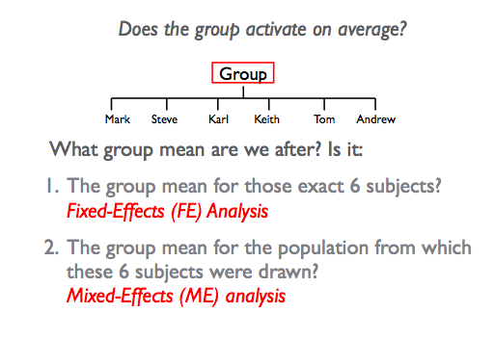
Group Analysis: Fixed vs Random
⬅ In SPM known as random effects (RFX)
Notes:
When we are looking at between subject differences we need to know how our results can be related to the group from which the population is drawn. In order for inferences from the study group to be valid for the sample population that you are interested in, the sample group should be representatively drawn from the study population. But there are different methods of analysing the data with different implications to the results. The main models are called fixed or random (also known as mixed). The choice depends on whether you want to generalize your findings beyond the subjects you have studied in the sample group. Fixed effects analysis is if the effects are fixed for that subject and that subject group so cannot be generalised. Random effects is where the effects could apply to any subject drawn at random from your population ie. the experimental factors are fixed whereas the subjects drawn or subject factors are random.

Slide 10
Consider a single voxel for 12 subjects
Effect Sizes = [4, 3, 2, 1, 1, 2, ....]
s_{w} = [0.9, 1.2, 1.5, 0.5, 0.4, 0.7, ....]
Group mean, m=2.67
Mean within subject variance s_{w} =1.04
Between subject (std dev), s_{b} =1.07
Notes:
If we begin by looking a bit closer at these time series for visual stimulation. On the x axis is time and on the y axis is the strength of the bold signal for the subjects. The red dots are the individual acquisition points during the scan. The green line is the fit of the model. The difference between the peak and trough is the size of the effect. The effect size is recorded per subject, looking at the contrast of each voxel.
The group mean is the average effect size. This is used to specify a null hypothesis at each voxel (e.g. there is no activation in 1 condition as compared to another condition).

Slide 11
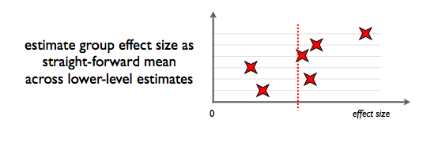
Group Analysis: Fixed-effects
Compare group effect with within-subject variance
NO inferences about the population
Because between subject variance not considered, you may get larger effects
Notes:
Fixed effects computes the overall subject variability by comparing the group effect to within subject variability. Within subject and therefore between scan variance is usually much smaller than between subject differences and therefore you may find larger effects.

Slide 12
FFX calculation
Calculate a within subject variance over time
s_{w} = [0.9, 1.2, 1.5, 0.5, 0.4, 0.7, 0.8, 2.1, 1.8, 0.8, 0.7, 1.1]
Mean effect, m=2.67
Mean s_{w} =1.04
Standard Error Mean (SEM_{W}) = s_{w} /sqrt(N)=0.04
t=m/SEM_{W}=62.7
p=10⁻⁵¹
Notes:
The time series from all subjects is cancatenated into one design matrix. If 50 subjects had 12 scans each it would be as if one subject had 600 scans in order to get the mean effect of all the subjects. Going from between to within subject variability meaning you cannot generalise from these results. The model tries to assess the quality of the fit of the linear model. 0.5 would be indicative of a good fit whereas 2.1 would be a poorer fit. The mean effect and then the mean overall within subject variability are calculated. The standard error of the mean looks at the difference between the data and the prediction of the model, adds them up across the time series and divides them by n which is the number of data points/ scans, in this case it is 600. As we are dividing by a very large number the t statistic becomes very large and the p statistic becomes very small. This means the inference about the mean is very strong but is a spuriously overconfident result. This is called the fallacy of classical inference. With enough subjects you will always get a significant result even if the effect is tiny. Therefore this is not recommended in neuroimaging as you are effectively using 1000’s of points. Whereas it would be useful if you only have a few subjects, for example in case studies.

Slide 13
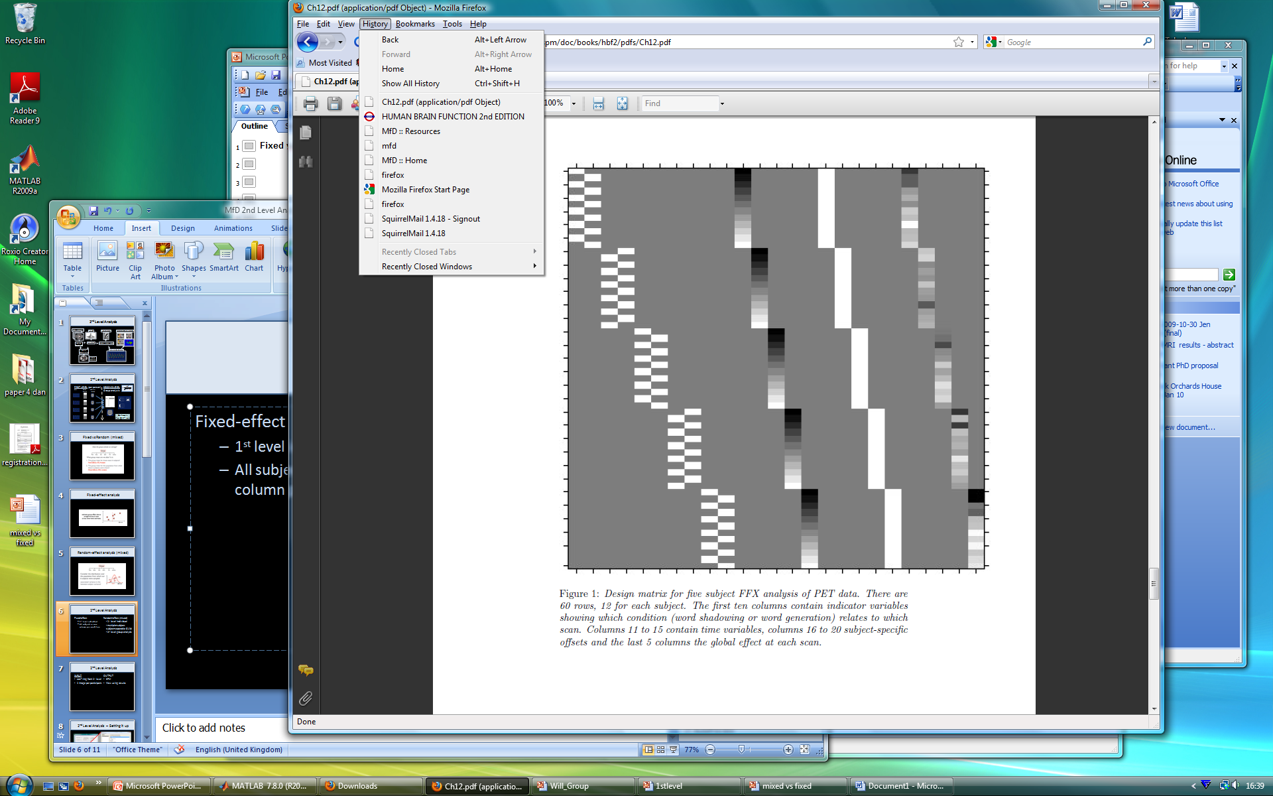
Fixed-effects Analysis in SPM
Fixed-effects
multi-subject 1st level design
each subjects entered as separate sessions
create contrast across all subjects
c = [ 1 -1 1 -1 1 -1 1 -1 1 -1 ]
perform one sample t-test
Subject 1
Subject 2
Subject 3
Subject 4
Subject 5
Multisubject 1st level : 5 subjects x 1 run each
Notes:
Each subject is then entered as a separate session before contrast images are generated across all subjects before proceeding to a one sample t test.

Slide 14
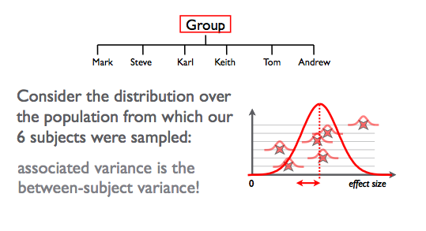
Group analysis: Random-effects
Takes into account between-subject variance
CAN make inferences about the population
Notes:
Any variability on this distribution of subject effects is attributable to between subject variance. Here subjects are treated as the random variable allowing results to be applicable to the study population.

Slide 15
Methods for Random-effects
Hierarchical model
Estimates subject & group stats at once
Variance of population mean contains contributions
from within- & between- subject variance
Iterative looping ➔ computationally demanding
Summary statistics approach ⬅ SPM uses this!
1st level design for all subjects must be the SAME
Sample means brought forward to 2nd level
Computationally less demanding
Good approximation, unless subject extreme outlier
Notes:
Now we will look in a bit more detail at the two methods that can be used for random effects. The first and gold standard method is a hierarchical model where the variance of the population mean contains contributions from within and between subject variance. At each level, distribution of parameters is given by the level above. What we don’t know is the exact distribution and variance of the parameters so we estimate the effect size and variance at the level of the subject and the group simultaneously. It is computationally more demanding because it works by using iterative loops. It is used for epilepsy research where the number of seizures/trials is not under experimental control and highly variable over subjects.
The alternative is the summary statistics approach which is quicker because it does not iterate back and forth. The results are only exactly the same as the hierarchical model if for each session or subject the variances are the same and the number of and design of the trials at the first level is the same.

Slide 16
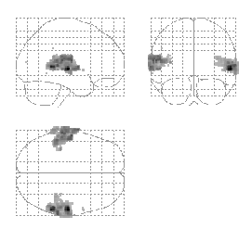

RFX:Auditory Data
Summary
statistics
Hierarchical
Model
Friston et al. (2004) Mixed effects and fMRI studies, Neuroimage
Notes:
This paper on auditory data uses a restrictive maps likelihood to do the hierarchical model estimating the within and between subject variance in a recursive fashion. It starts off with initial values as to what it thinks the effect size is and then computes the group effect and then iterates between parameter estimates eventually estimating the variance components.
It is an output of Remel in SPM. The output images are shown. This tends to be the approach for random effects analysis in brain imaging and you can see the results are identical in this case to the summary statistics approach which partitions the first from the second level of analysis.

Slide 17
Random Effects Analysis- Summary Statistic Approach
For group of N=12 subjects effect sizes are
c= [3, 4, 2, 1, 1, 2, 3, 3, 3, 2, 4, 4]
Group effect (mean), m=2.67
Between subject variability (stand dev), s_{b} =1.07
This is called a Random Effects Analysis (RFX) because we are comparing the group effect to the between-subject variability.
This is also known as a summary statistic approach because we are summarising the response of each subject by a single summary statistic – their effect size.
Notes:
The random effects part refers to the fact we are comparing the group effect to the between subject variability whereas the summary statistic approach refers to a single number or summary statistic which quantifies this random effect size. It gives an indication of whether the summed groups are behaving similarly or there are sub populations behaving differently in response to the stimuli.

Slide 18

Random-effects Analysis in SPM
Random-effects
1st level design per subject
generate contrast image per subject (con.*img)
images MUST have same dimensions & voxel sizes
con*.img for each subject entered in 2nd level analysis
perform stats test at 2nd level
NOTE: if 1 subject has 4 sessions but everyone else has 5, you need adjust your contrast!
contrast = [ 1 -1 1 -1 1 -1 1 -1 1 -1 ]
Subject #2 x 5 runs (1st level)
contrast = [ 1 -1 1 -1 1 -1 1 -1 1 -1 ]
contrast = [ 1 -1 1 -1 1 -1 1 -1 1 -1 ]
Subject #3 x 5 runs (1st level)
contrast = [ 1 -1 1 -1 1 -1 1 -1 1 -1 ]
Subject #4 x 5 runs (1st level)
Subject #5 x 4 runs (1st level)
contrast = [ 1 -1 1 -1 1 -1 1 -1 ] * (5/4)
Notes:
The random effects analysis tries to take an average of the averages across subjects, however we want to avoid some subjects obtaining significant results over others simply because they have had more sessions. Let us assume the first four patients had five sessions and the last one had four. We must adjust for this in our analysis. Therefore we could divide by the number of sessions; ie. the first four by 5 and the last one by 4. However we would be left with non integer numbers, therefore it is convention to scale up the values to integers. We end up therefore timesing all the contrasts by 5. This leaves the first four unchanged and the last one being multiplied by 5/4. Either way we choose to do the scaling will be no different as in the second level of analysis we use a ratio for the t statistic and so how much you scale by cancels out.

Slide 19
RFX: SS versus Hierarchical
The summary stats approach is exact if for each session/subject:
Within-subject variances the same
First-level design (eg number of trials) the same
Other cases: Summary stats approach is robust against typical violations (SPM book 2006 , Mumford and Nichols, NI, 2009).
Might use a hierarchical model in epilepsy research where number of seizures is not under experimental control and is highly variable over subjects.
Notes:
If we do 20 experiments that are the same, if the within subject variance is the same and the first level design is the same the results should be the same between the two techniques of hierarchical and summary statistic. If these conditions are not met, on average the results produced will not be the same. Mumford and Nichols have shown the summary statistics approach is robust in practical imaging situations however if the within subject variance or first level design are very different we would suggest the hierarchical model. One example of this is in epilepsy research where the number of trials are not under experimental control and therefore the hierarchical model is preferable.

Slide 20
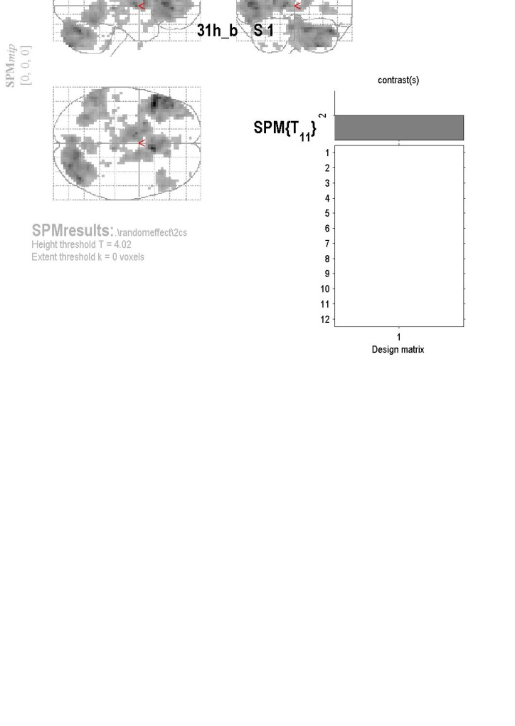
Stats tests at the 2nd Level
Choose the simplest analysis at 2nd level : one sample t-test
  Compute within-subject contrasts @ 1st level
  Enter con*.img for each person
  Can also model covariates across the group
  - vector containing 1 value per con*.img,
  T test using summary statistic approach to do
  random effects analysis.

Slide 21
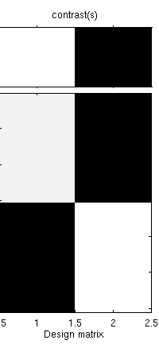
If you have 2 subject groups: two sample t-test
  Same design matrices for all subjects in a group
  Enter con*.img for each group member
  Not necessary to have same no. subject in each group
  Assume measurement independent between groups
  Assume unequal variance between each group
1
2
3
4
5
6
7
8
9
10
11
12
1
2
3
4
5
6
7
8
9
10
11
12

Slide 22
Multiple conditions, different subjects
Condition 1 Condition 2 Condition3
(placebo) (drug 1) (drug 2)
Sub1 Sub13 Sub25
Sub2 Sub14 Sub26
... ... ...
Sub12 Sub24 Sub36
- ANOVA at second level.
- If you have two conditions this is a two-sample (unpaired) t-test.

Slide 23
Multiple conditions, same subjects
Condition 1 Condition 2 Condition3
Sub1 Sub1 Sub1
Sub2 Sub2 Sub2
... ... ...
Sub12 Sub12 Sub12
ANOVA within subjects at second level.
This is an ANOVA but with average subject effects removed. If you have two conditions this is a paired t-test.

Slide 24
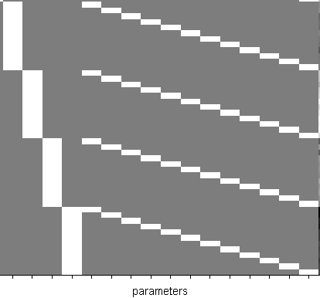
ANOVA: analysis of variance
Designs are much more complex
e.g. within-subject ANOVA need covariate per subject ➔
BEWARE sphericity assumptions may be violated, need to account for.
Subject 1
Subject 2
Subject 3
Subject 4
Subject 5
Subject 6
Subject 7
Subject 8
Subject 9
Subject 10
Subject 11
Subject 12

Slide 25
Better approach:
  generate main effects & interaction contrasts at 1st level
  c = [ 1 1 -1 -1] ; c = [ 1 -1 1 -1 ] ; c = [ 1 -1 -1 1]
  use separate t-tests at the 2nd level ➔
One sample t-test equivalents:
A>B x>o A(x>o)>B(x>o)
con.*imgs con.*imgs con.*imgs
c = [ 1 1 -1 -1] c= [ 1 -1 1 -1] c = [ 1 -1 -1 1]

Slide 26
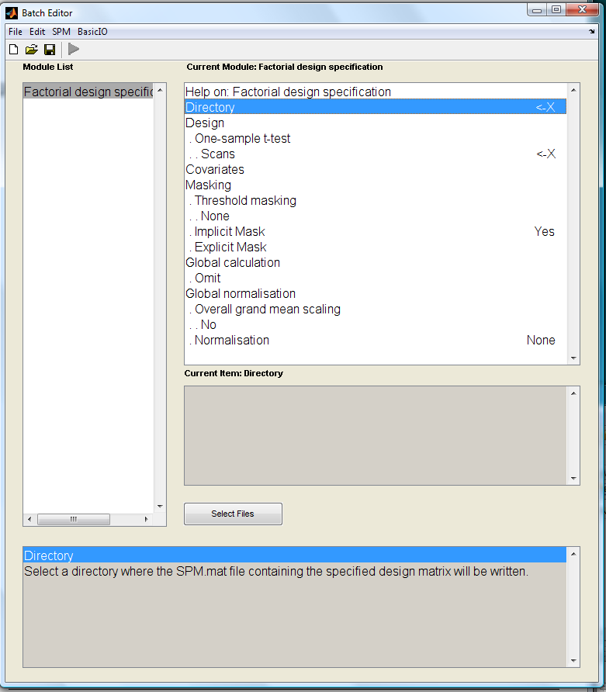
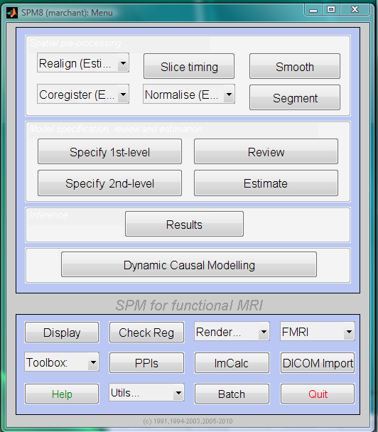
SPM 2nd Level: How to Set-Up

Slide 27
SPM 2nd Level: Set-Up Options
Directory
- select directory to write out SPM
Design
- select 1st level con.*img
- several design types
- one sample t-test
- two sample t-test
- paired t-test
- multiple regression
- one way ANOVA (+/-within subject)
- full or flexible factorial
- additional options for PET only
- grand mean scaling
- ANCOVA

Slide 28
SPM 2nd Level: Set-Up Options
Covariates
- covariates & nuisance variables
- 1 value per con*.img
Masking
Specifies voxels within image which are to be assessed
- 3 masks types:
- threshold (voxel > threshold used)
- implicit (voxels >0 are used)
- explicit (image for implicit mask)

Slide 29
SPM 2nd Level: Set-Up Options
Global calculation ⬅ for PET only
Global normalisation ⬅ for PET only
Specify 2nd level Set-Up
↓
Save 2nd level Set-Up
↓
Run analysis
↓
Look at the RESULTS

Slide 30
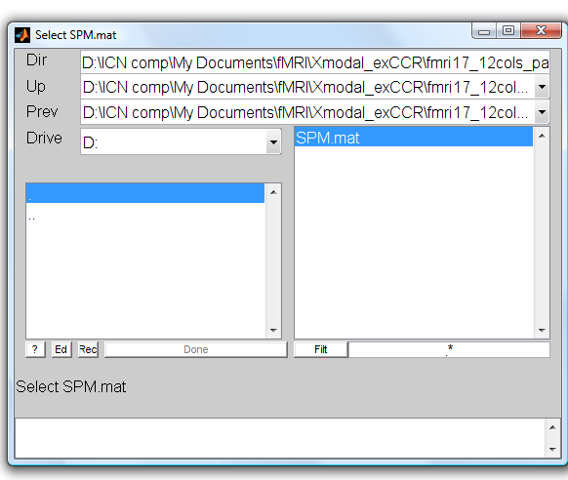
SPM 2nd Level: Results
Click RESULTS
Select your 2nd Level SPM
Click RESULTS
Select your 2nd Level SPM

Slide 31
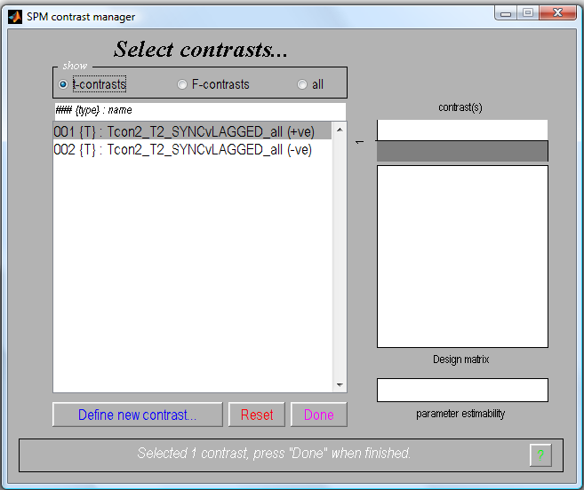
SPM 2nd Level: Results
2nd level one sample t-test
Select t-contrast
Define new contrast ….
  c = +1 (e.g. A>B)
  c = -1 (e.g. B>A)
Select desired contrast
1 row per con*.img

Slide 32
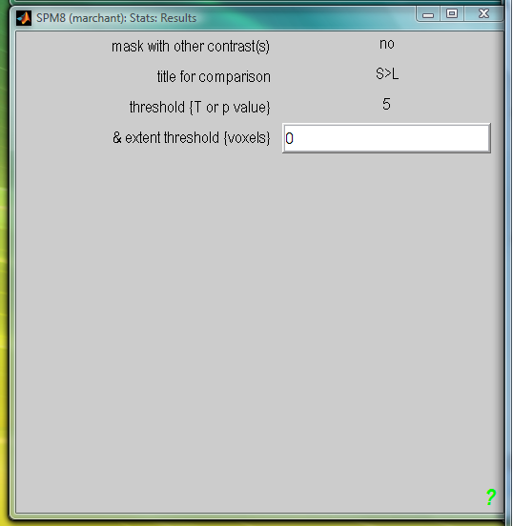
SPM 2nd Level: Results
Select options for displaying result:
  Mask with other contrast
  Title
  Threshold (p_{FWE}, p_{FDR} p_{UNC})
  Size of cluster

Slide 33
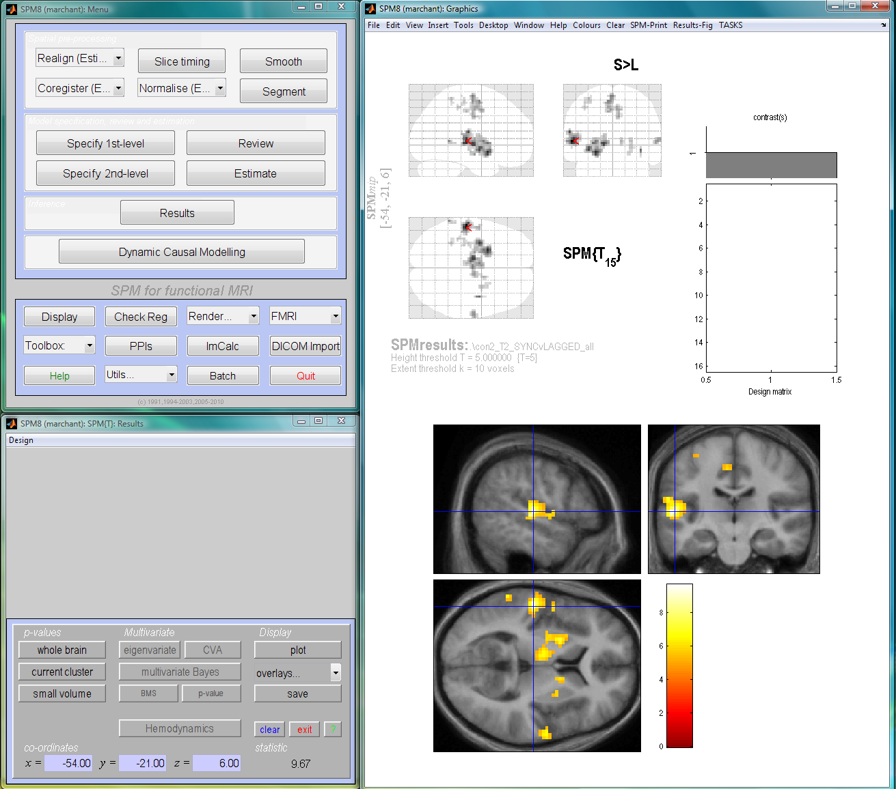
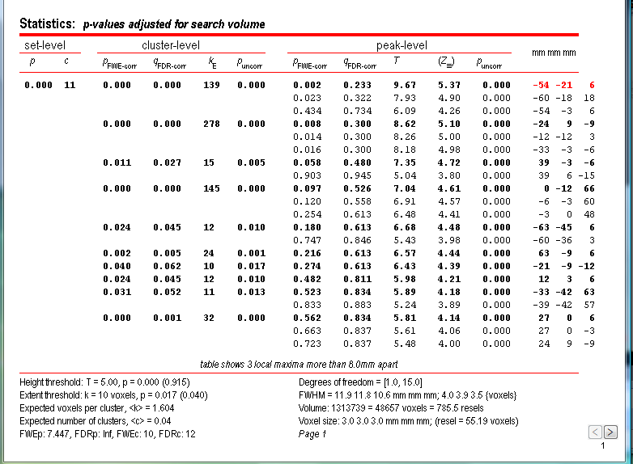
SPM 2nd Level: Results
Here are your results…
Now you can view:
Table of results [whole brain]
  Look at t-value for a voxel of choice
  Display results on anatomy [ overlays ]
    SPM templates
    mean of subjects
  Small Volume Correct
    significant voxels in a
    small search area ↑ p_{FWE}
1 row per
con*.img

Slide 34
Summary
Group Inference usually proceeds with RFX analysis, not FFX. Group effects are compared to between rather than within subject variability.
Hierarchical models provide a gold-standard for RFX analysis but are computationally intensive (spm_mfx). Available from GUI in SPM12.
Summary statistics are a robust method for RFX group analysis (SPM book, Mumford and Nichols, NI, 2009)
Can also use ‘ANOVA’ or ‘ANOVA within subject’ at second level for inference about multiple experimental conditions.

Slide 35
Thank you
Resources:
Previous MFD slides
SPM videos from 2011
Will Penny’s slides 2012
SPM manual
Special thanks to Ged Ridgway

