Slide 1
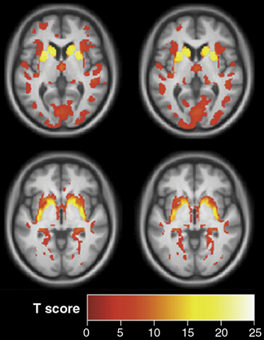
Voxel Based Morphometry
Methods for Dummies 2013
Elin Rees & Peter McColgan

Slide 2
Contents
General idea
Pre-Processing
  Spatial normalisation
  Segmentation
  Modulation
  Smoothing
Statistical analysis
  GLM
  Group comparisons
  Correlations
Longitudinal fluids
Interpretation
Issues
  Multiple comparisons
  Controlling for TIV
  Global or local change
  Interpreting results
Summary

Slide 3
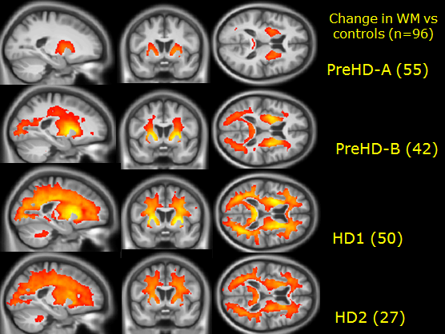
General Idea
Uses Statistical Parametric Mapping software
‘Unbiased’ technique
Pre-processing to align all images
Parametric statistics at each point within the image
  Mass-univariate
Statistical parametric map showing e.g.
  differences between groups
  regions where there is a significant correlation with a clinical measure

Slide 4
Pre-Processing: Unified Segmentation
= iterative tissue classification + normalisation + bias correction
Segmentation:
    Models the intensity distributions by a mixture of Gaussians, but using tissue probability map (TPM) to weight the classification
    TPM = priors of where to expect certain tissue types
    Affine registration of scan to TPM
Normalisation:
  The transform used to align the image to the TPM used to normalise the scan to standard (TPM) space
    parameters calculated but not applied
  Corrects for global brain shape differences
Bias correction:
  Spatially smoothes the intensity variability, which is worse at higher field strengths

Slide 5
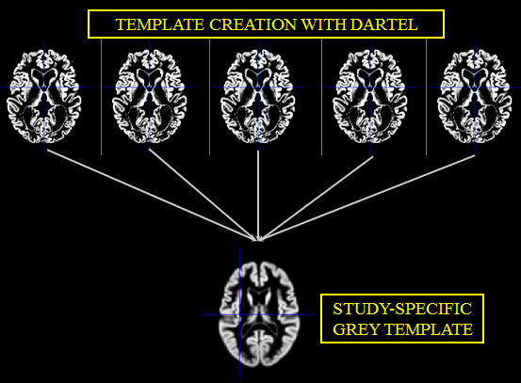
DARTEL
= Diffeomorphic Anatomical Registration using Exponentiated Lie algebra registration
Registration of GM segmentations to a standard space
    1) Applies affine parameters into TPM space
    2) Additional non-linear warp to study specific space
Study-specific grey matter template
Constructs a flow field so one image can slowly ‘flow’ into another
Allows for more precise inter-subject alignment
Involves prior knowledge e.g. stretches, scales, shifts and warps

Slide 6
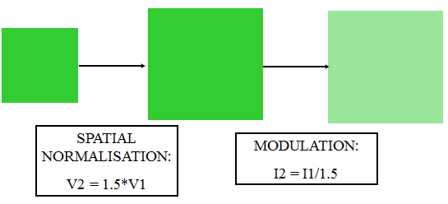
Pre-Processing: Modulation
Spatial normalisation removes differences between scans
Modulation of segmentations puts this information back
Rescaling the intensities dependent on the amount of expansion/contraction - if not much change needed, not much intensity change
E.g.
Native = 1 1
Unmodulated warped = 1 1 1 1
Modulated = 2/3 1/3 1/3 2/3
= lower in the middle where imaged stretched but total is preserved.

Slide 7
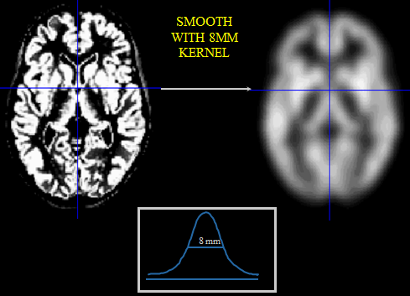
Pre-Processing: Smoothing
Gets rid of roughness and noise to produce data in a more normal distribution
Removes some registration errors
Kernel defined in terms of FWHM (full width at half maximum) of filter
7-14mm kernel
Analysis is most sensitive to effects that match the shape and size of the kernel
  Match Filter Theorem
Kernel takes weighted average of the surrounding intensities
Smaller kernels mean results can be localised to a more precise region
Less smoothing needed if DARTEL used
In an ideal world this would not be needed

Slide 8
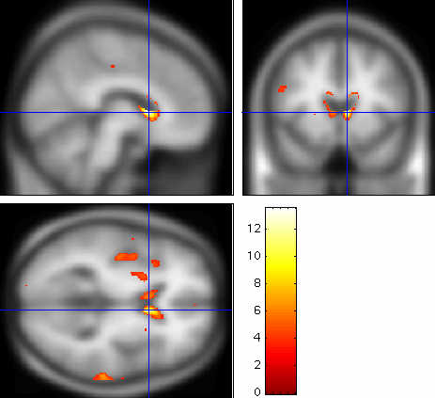
Results
Voxel-wise (mass-univariate) independent statistical tests for every single voxel
Group comparison:
  Regions of difference between groups
Correlation:
  Region of association with test score

Slide 9
Statistical Analysis
Test group differences in e.g. grey matter BUT
  which covariates e.g. age, gender etc.?
  which search volume?
  what threshold?
  correction for multiple comparisons?
Ridgeway et al. 2008: Ten simple rules for reporting voxel-based morphometry studies
  Multiple methodological options available
  Decisions must be clearly described
Henley et al. 2009: Pitfalls in the Use of Voxel-Based Morphometry as a Biomarker: Examples from Huntington Disease

Slide 10
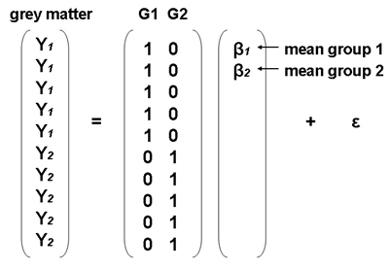
Statistical Analysis
GLM
Y = Xβ + ε
Intensity for each voxel (V) is a function
that models the different things that
account for differences between scans:
V = β₁(Subject A) + β₂(Subject B) + β₃(covariates) + β₄(global volume) + μ + ε
V = β₁(test score) + β₂(age) + β₃(gender) + β₄(global volume) + μ + ε

Slide 11
Statistical Analysis
SPM
Mass univariate independent
statistical tests for every voxel
~ 1000,000
Regions of significantly less grey
matter intensity between
subjects and controls
Regions showing a significant
correlation with test score or
clinical measure

Slide 12
Statistical Analysis
Multiple Comparisons
Introducing false positives when dealing with one than one statistical comparison
One t-test with p < .05
  a 5% chance of (at least) one false positive
3 t-tests, all at p < .05
  All have 5% chance of a false positive
  So actually you have 3 x 5% chance of a false positive
  = 15% chance of introducing a false positive

Slide 13
Statistical Analysis
How big is the problem?
In VBM, depending on your resolution
  1000000 voxels
  1000000 statistical tests
do the maths at p < .05!
  50000 false positives
So what to do?
  Bonferroni Correction
  Random Field Theory/ Family-wise error
  False Discovery Rate
  Small Volume Correction

Slide 14
Statistical Analysis
Bonferroni-Correction (controls false positives at individual voxel level):
  divide desired p value by number of comparisons
  .05/1000000 = p < 0.00000005 at every single voxel
Not a brilliant solution (false negatives)
Added problem of spatial correlation data from one voxel will tend to be similar to data from nearby voxels

Slide 15
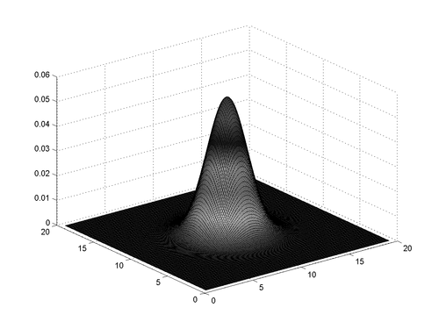
Statistical Analysis
Family Wise Error (FWE)
  Probability that one or more of the significance tests results is a false positive within the volume of interest
SPM uses Gaussian Random Field Theory (GRFT)
  GRFT finds right threshold for a smooth
  statistical map which gives the required
  FWE. It controls the number of false
  positive regions rather than voxels
  Allows multiple non-independent tests

Slide 16
Statistical Analysis
False Discovery Rate
Controls the expected proportion of false positives among suprathreshold voxels only
Using FDR, q<0.05: we expect 5% of the voxels for each SPM to be false positives (1,000 voxels)
Bad: less stringent than FWE so more false positives
Good: fewer false negatives (i.e. more true positives)
More lenient may be better for smaller studies

Slide 17
Statistical Analysis
Small Volume Correction
Hypothesis driven and ideally based on previous work
Place regions of interest over particular structures
Reduces the number of comparisons
Increases the chance of identifying significant voxels in a ROI

Slide 18
Other Issues in VBM
Controlling for total intracranial volume (TIV)
Uniformly bigger brains may have uniformly more GM/ WM
brain A brain B
Differences without accounting for TIV
brain A brain B
differences after TIV has been “covaried out” (Differences uniformally distributed with hardly any impact at local level)

Slide 19
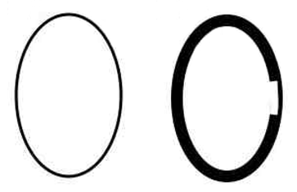
Other Issues in VBM
Global or local change
With TIV: greater volume in A relative to B only in the thin area on the right-hand side
Without TIV: greater volume in B relative to A except in the thin area on the right-hand side
Including total GM or WM volume as a covariate adjusts for global atrophy and looks for regionally-specific changes

Slide 20
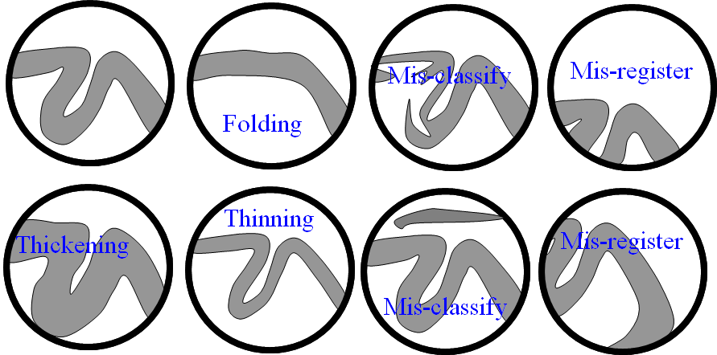
Other Issues in VBM
Interpretation

Slide 21
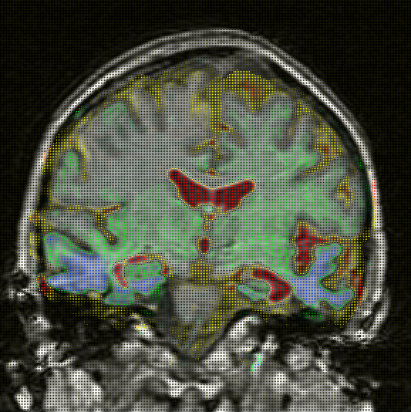
Other Issues in VBM
Longitudinal Analysis:
Fluid Registration
  Baseline and follow-up
  image are registered together
  non-linearly
  Voxels at follow-up are
  warped to voxels at baseline
  Represented visually as
  a voxel compression map
  showing regions of contraction
  and expansion
contracting
expanding

Slide 22
Limitations
Small volume structures: Hippocampus and Caudate, issues with normalisation and alignment
VBM in degenerative brain disease:
normalisation, segementation and smoothing
of atrophied scans

Slide 23
Summary
Advantages
  Fully automated: quick and not susceptible to human error and inconsistencies
  Unbiased and objective
  Not based on regions of interests; more exploratory
  Picks up on differences/ changes at a global and local scale
  Has highlighted structural differences and changes between groups of people as well as over time
Disadvantages
  Data collection constraints (exactly the same way)
  Statistical challenges
  Results may be flawed by preprocessing steps
  Underlying cause of difference unknown
  Interpretation of data- what are these changes when they are not volumetric?

Slide 24
Questions ?

