Slide 1
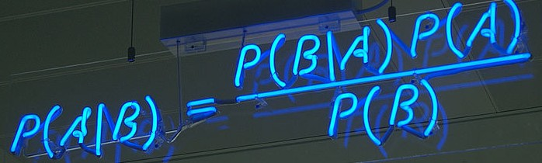
Bayes for beginners
Claire Berna
Lieke de Boer
Methods for dummies
27 February 2013

Slide 2
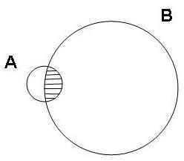
Bayes rule
Given marginal probabilities p(A), p(B),
and the joint probability p(A,B), we can write the conditional probabilities:
p(A,B)
p(B|A) =
p(A)
p(A,B)
p(A|B) =
p(B)
This is known as the product rule.
Eliminating p(A,B) gives Bayes rule:
p(A|B) p(B)
p(B/A) =
p(A)

Slide 3
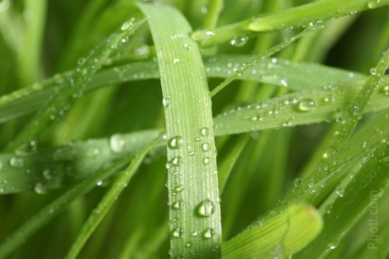
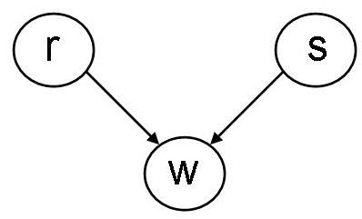
Example:
The lawn is wet : we assume that the lawn is wet because it has rained overnight: How likely is it? p(w|r) : Likelihood
p(w|r) p(r)
p(r|w) =
What is the probability that it has rained overnight
given this observation? p(r|w): Posterior:
How probable is our hypothesis given the observed evidence?
p(w)
P(r): Prior: Probability to rain on that day. How probable was our hypothesis before observing the evidence?
p(w) : Marginal: how probable is the new evidence under all possible hypotheses?

Slide 4
Example:
p(w|r) p(r)
p(r|w) =
p(w)
p(w=1|r=1) p(r=1)
p(r=1|w=1) =
p(w=1)
The probability p(w) is a normalisation term and can be found by marginalisation.
p(w=1) = ∑ p(w=1, r)
r
= p(w=1,r=0) + p(w=1,r=1)
= p(w=1|r=0)p(r=0) + p(w=1|r=1)p(r=1)
p(w=1 | r=1) = 0.95
p(w=1 | r=0) = 0.20
        p(r = 1) = 0.01
This is known as the sum rule
p(w=1|r=1) p(r=1)
p(r=1|w=1) =
= 0.046
p(w=1|r=0)p(r=0) + p(w=1|r=1)p(r=1)

Slide 5
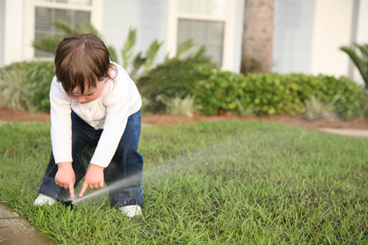
Did I Leave The Sprinkler On ?
A single observation with multiple potential causes (not
mutually exclusive). Both rain, r , and the sprinkler, s, can
cause my lawn to be wet, w.
p(w, r , s) = p(r )p(s)p(w|r,s)
Generative model

Slide 6
Did I Leave The Sprinkler On ?
The probability that the sprinkler was on given i’ve seen the lawn is wet is given by Bayes rule
=
p(w=1|s=1) p(s=1)
p(s=1|w=1) =
p(w=1)
p(w=1|s=1) p(s=1)
p(w = 1, s = 1) + p(w = 1, s = 0)
where the joint probabilities are obtained from marginalisation and from the generative model: p(w, r , s) = p(r ) p(s) p(w|r,s)
p(w = 1, s = 1) = ∑1 p(w = 1, r , s = 1) = p(w=1, r=0, s=1) + p(w=1, r=1, s=1)
r=0
= p(r=0) p(s=1) p(w=1|r=0, s=1) + p(r=1) p(s=1) p(w=1|r=1, s=1)
p(w = 1, s = 0) = ∑1 p(w = 1,r , s = 0) = p(w=1, r=0, s=0) + p(w=1, r=1, s=0)
r=0
= p(r=0) p(s=0) p(w=1|r=0, s=0) + p(r=1) p(s=0) p(w=1|r=1, s=0)

Slide 7
Numerical Example
Bayesian models force us to be explicit about exactly what it is we believe.
        p(r = 1) = 0.01
        p(s = 1) = 0.02
        p(w = 1|r = 0, s = 0) = 0.001
        p(w = 1|r = 0, s = 1) = 0.97
        p(w = 1|r = 1, s = 0) = 0.90
        p(w = 1|r = 1, s = 1) = 0.99
These numbers give
        p(s = 1|w = 1) = 0.67
        p(r = 1|w = 1) = 0.31

Slide 8
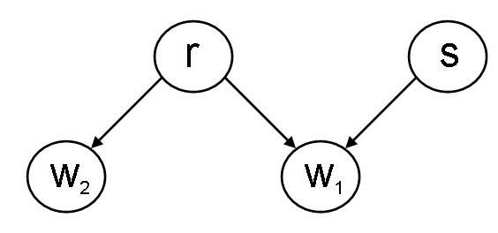

Look next door
Rain r will make my lawn wet w1 and nextdoors w2
whereas the sprinkler s only affects mine.
p(w1, w2, r, s) = p(r ) p(s) p(w1|r,s) p(w2|r )

Slide 9
After looking next door
Use Bayes rule again
with joint probabilities from marginalisation
p(w1 = 1, w2 = 1, s = 1) = ∑1 p(w1 = 1, w2 = 1, r , s = 1)
r=0
p(w1 = 1, w2 = 1, s = 0) =∑1 p(w1 = 1;w2 = 1; r ; s = 0)
r=0
p(w1=1, w2=1, s=1)
p(s=1|w1=1, w2=1) =
p(w1 = 1, w2 = 1, s = 1) + p(w1 = 1, w2 = 1, s = 0)

Slide 10
Explaining Away
Numbers same as before. In addition
    p(w2 = 1|r = 1) = 0.90
Now we have
    p(s = 1|w1 = 1, w2 = 1) = 0.21
    p(r = 1|w1 = 1, w2 = 1) = 0.80
The fact that my grass is wet has been explained away by
the rain (and the observation of my neighbours wet lawn).

Slide 11
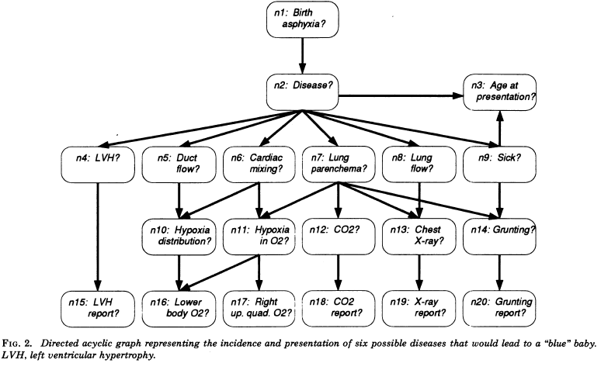
The CHILD network
Probabilistic graphical model for newborn babies with congenital heart disease
Decision making aid piloted at Great Ormond Street hospital (Spiegelhalter et al. 1993).

Slide 12
Bayesian inference in neuroimaging
When comparing two models
A > B ?
When assessing the inactivity of a brain area
P(H₀)

Slide 13
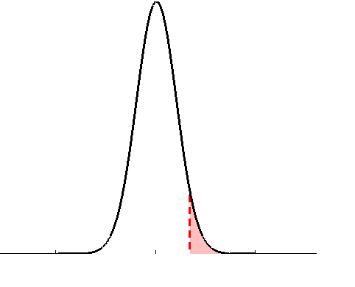
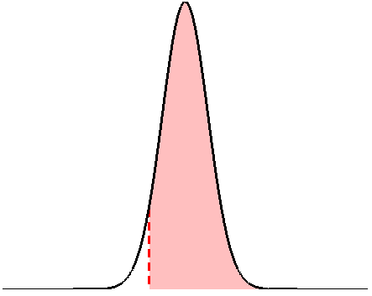
Assessing inactivity of brain area
• define the null, e.g.:
• invert model (obtain posterior pdf)
• estimate parameters (obtain test stat.)
• define the null, e.g.:
• apply decision rule, i.e.:
• apply decision rule, i.e.:
if
then reject H0
if
then accept H0
classical approach
Bayesian PPM

Slide 14
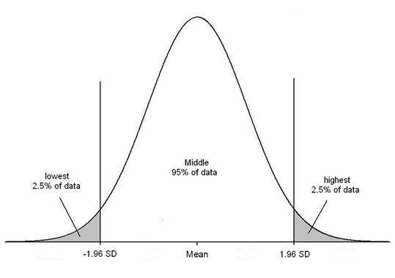

Bayesian paradigm
likelihood function
GLM: y = f(θ) + ε
From the assumption:
noise is small
Create a likelihood function with a fixed θ:

Slide 15
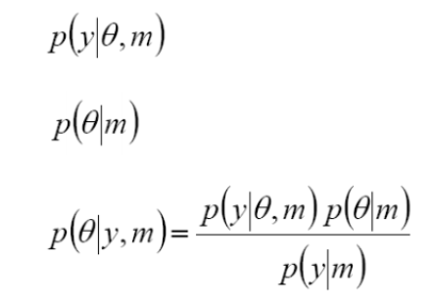
So θ needs to be fixed...
priors
Probability of θ, depends on:
  model you want to compare
  data
  previous experience
Likelihood:
Prior:
Bayes' rule:

Slide 16
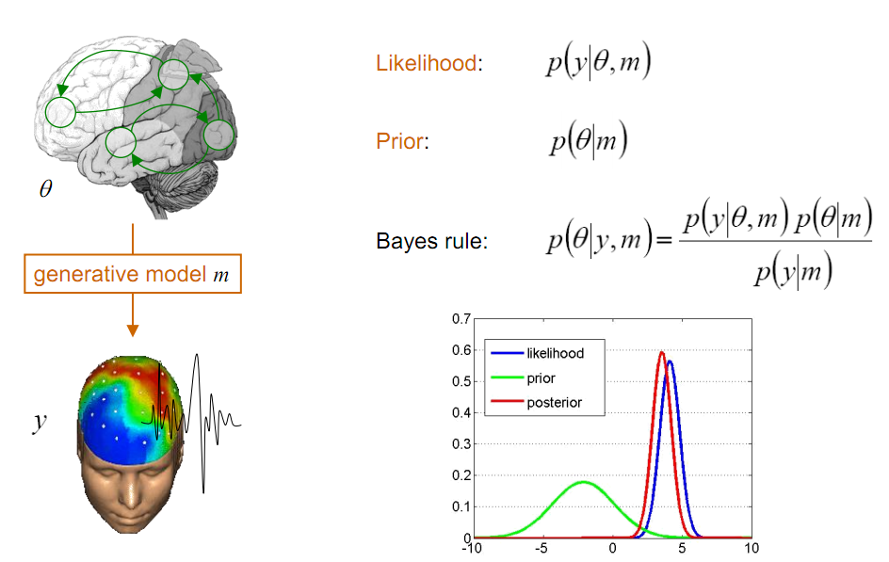
Bayesian inference
Precision = 1/variance
Notes:
From Jean Daunizeau
Precision weighting
combining
16

Slide 17
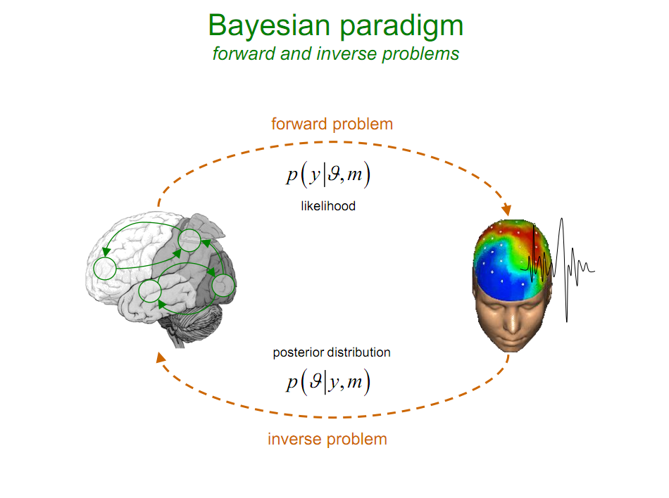
Bayesian inference
forward/inverse problem
likelihood
p(y|θ)
p(θ|y)
posterior distribution
Notes:
From Jean Daunizeau
Given my model whats the probability of pobserving data
LNE axmple
17

Slide 18
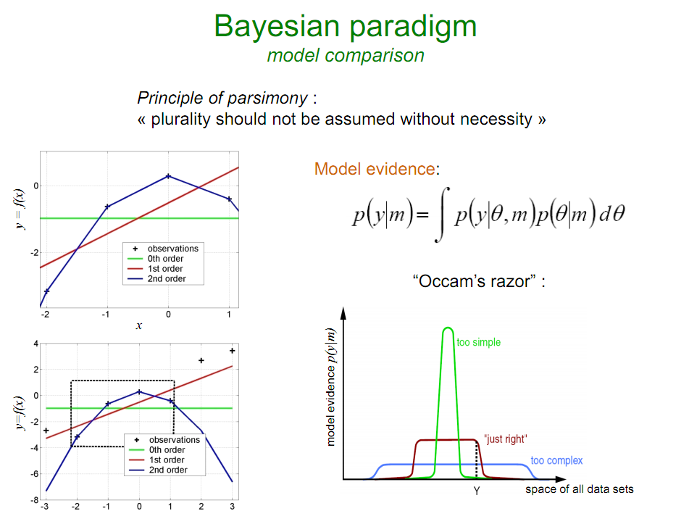
Bayesian inference
Occam's razor
‘The hypothesis that makes the fewest assumptions should be selected’
‘Plurality should not be assumed without necessity’
Notes:
Complicated models penalised under bayes ie both how well model fits data and how ‘simple’ it is
From Jean Daunizeau
18

Slide 19
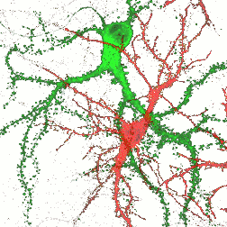
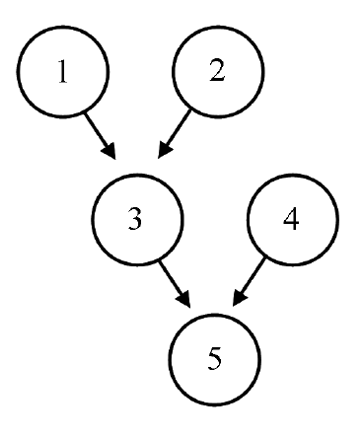
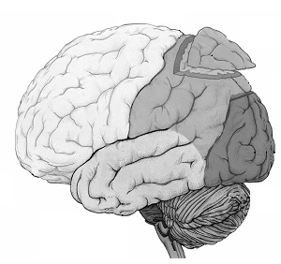
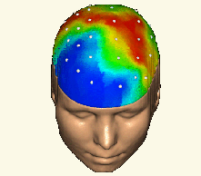
Bayesian inference
Hierarchical models
hierarchy
causality

Slide 20
References:
- Will Penny’s course on Bayesian Inference, FIL, 2013
http://www.fil.ion.ucl.ac.uk/~wpenny/bayes-inf/
- J. Pearl (1988) Probabilistic reasoning in intelligent systems.
San Mateo, CA. Morgan Kaufmann.
Previous MfD presentations
Jean Daunizeau’s SPM course a the FIL
Thanks to Ged for his feedback!

