Slide 1
Methods for Dummies 2013
Issues with analysis and interpretation
- Type I/ Type II errors & double dipping -
Madeline Grade & Suz Prejawa

Slide 2
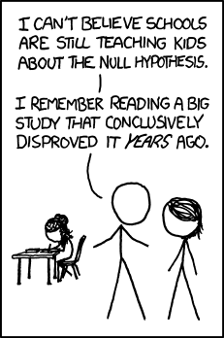
Review: Hypothesis Testing
Null Hypothesis (H₀)
  Observations are the result of random chance
Alternative Hypothesis (H_{A})
  There is a real effect contributing to activation
Test Statistic (T)
P-value
  probability of T occurring if H₀ is true
Significance level (α)
  Set a priori, usually .05
XKCD

Slide 3
 |  | True physiological activation?
 |  | Yes | No
Experimental finding? | Yes | H_{A} | Type I Error “False Positive”
 | No | Type II Error “False Negative” | ☺ H₀

Slide 4
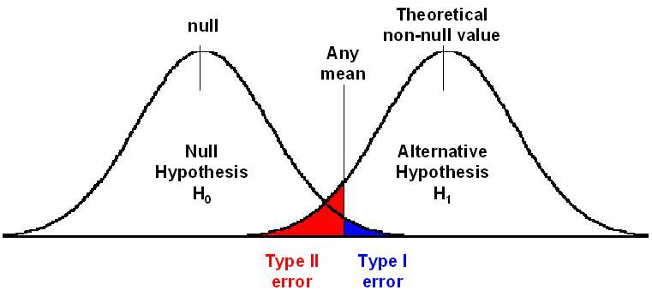
Type I/II Errors

Slide 5
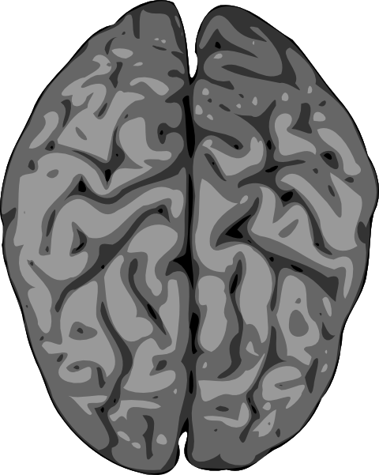
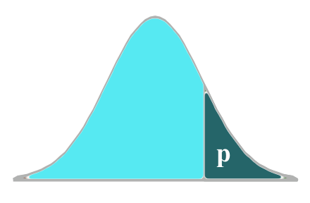
Not just one
t-test…

Slide 6
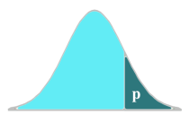
60,000 of them!

Slide 7
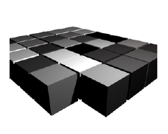
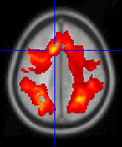
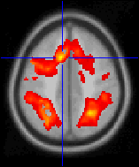
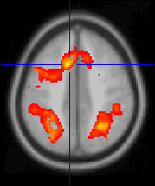
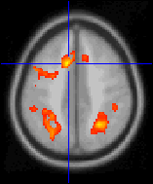
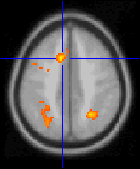
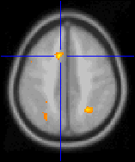
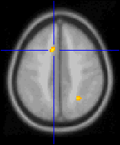
Inference on t-maps
Around 60,000 voxels to image the brain
60,000 t-tests with α=0.05
→ 3000 Type I errors!
Adjust the threshold
t > 0.5
t > 1.5
t > 2.5
t > 3.5
t > 4.5
t > 5.5
t > 6.5
t > 0.5
2013 MFD
Random Field Theory

Slide 8
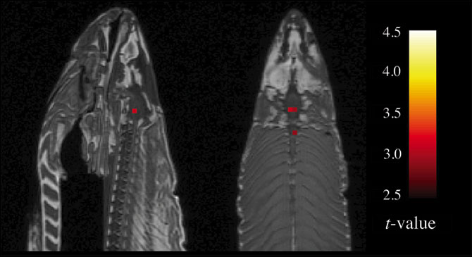
Type I Errors
  Bennett et al. 2010
“In fMRI, you have 60,000 darts, and so just by random chance, by the noise that’s inherent in the fMRI data, you’re going to have some of those darts hit a bull’s-eye by accident.” – Craig Bennett, Dartmouth
Notes:
This was mentioned in the Random Field Theory lecture, but I am bringing it up again to hammer home the point! This paper makes a point about the value of the multiple comparisons correction. It does NOT prove that fMRI is worthless or shouldn’t be used.

Slide 9
Correcting for Multiple Comparisons
Family-wise Error Rate (FWER)
  Simultaneous inference
  Probability of observing 1+ false positives after carrying out multiple significance tests
  Ex: FEWR = 0.05 means 5% chance of Type I error
  Bonferroni correction
  Gaussian Random Field Theory
Downside: Loss of statistical power
Notes:
Bonferroni: assumes that each test is independent and calculates probability of type I error by dividing alpha (0.05) by # of statistical tests performed
Gaussian field theory: calculates probability of type I error when imaging data are spatially smoothed
Statistical power: probability of rejecting H0 when it is false…ie the probability of not committing a Type II error

Slide 10
Correcting for Multiple Comparisons
False Discovery Rate (FDR)
  Selective inference
  Less conservative, can place limits on FDR
  Ex: FDR = 0.05 means at maximum, 5% of results are false positives
Greater statistical power
May represent more ideal balance
Notes:
Bonferroni: assumes that each test is independent and calculates probability of type I error by dividing alpha (0.05) by # of statistical tests performed
Gaussian field theory: calculates probability of type I error when imaging data are spatially smoothed
Statistical power: probability of rejecting H0 when it is false…ie the probability of not committing a Type II error

Slide 11
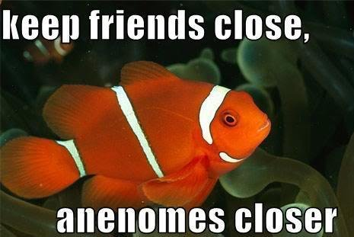
Salmon experiment with corrections?
No significant voxels even at relaxed thresholds of FDR = 0.25 and FWER = 0.25
The dead salmon in fact had no brain activity during the social perspective-taking task

Slide 12
Not limited to fMRI studies
“After adjusting the significance level to account for multiple comparisons, none of the identified associations remained significant in either the derivation or validation cohort.”

Slide 13
How often are corrections made?
Percentage of 2008 journal articles that included multiple comparisons correction in fMRI analysis
  74% (193/260) in NeuroImage
  67.5% (54/80) in Cerebral Cortex
  60% (15/25) in Social Cognitive and Affective Neuroscience
  75.4% (43/57) in Human Brain Mapping
  61.8% (42/68) in Journal of Cog. Neuroscience
Not to mention poster sessions!
  Bennett et al. 2010

Slide 14
“Soft control”
Uncorrected statistics may have:
  increased α (0.001 < p < 0.005) and
  minimum cluster size (6 < k < 20 voxels)
This helps, but is an inadequate replacement
Vul et al. (2009) simulation:
  Data comprised of random noise
  α=0.005 and 10 voxel minimum
  Significant clusters yielded 100% of time
Notes:
Intensity/cluster thresholding can be used instead, but it is not an adequate replacement

Slide 15
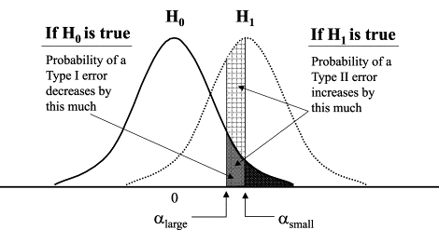
Effect of Decreasing α on Type I/II Errors

Slide 16
Type II Errors
Power analyses
  Can estimate likelihood of Type II errors in future samples given a true effect of a certain size
May arise from use of Bonferroni
  Value of one voxel is highly correlated with surrounding voxels (due to BOLD basis, Gaussian smoothing)
FDR, Gaussian Random Field estimation are good alternatives w/ higher power

Slide 17
Don’t overdo it!
Unintended negative consequences of “single-minded devotion” to avoiding Type I errors:
  Increased Type II errors (missing true effects)
  Bias towards studying large effects over small
  Bias towards sensory/motor processes rather than complex cognitive/affective processes
  Deficient meta-analyses
  Lieberman et al. 2009
Notes:
http://www.ncbi.nlm.nih.gov/pmc/articles/PMC2799956/

Slide 18
Other considerations
Increasing statistical power
  Greater # of subjects or scans
  Designing behavioral tasks that take into account the slow nature of the fMRI signal
Value of meta-analyses
  “We recommend a greater focus on replication and meta-analysis rather than emphasizing single studies as the unit of analysis for establishing scientific truth. From this perspective, Type I errors are self-erasing because they will not replicate, thus allowing for more lenient thresholding to avoid Type II errors.”
  Lieberman et al. 2009

Slide 19

It’s All About Balance
Type I Errors
Type II
Errors
Notes:
Ultimately, avoiding Type I/II errors is all about balance! Must consider the desired statistical power, type and purpose of study, in considering whether to do a multiple comparisons correction (and within that, FWER vs FDR) or intensity/cluster thresholding.

Slide 20
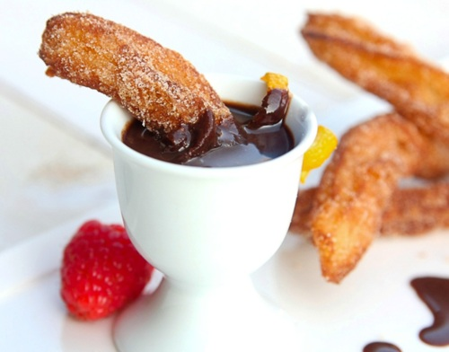
Double Dipping
Suz Prejawa

Slide 21
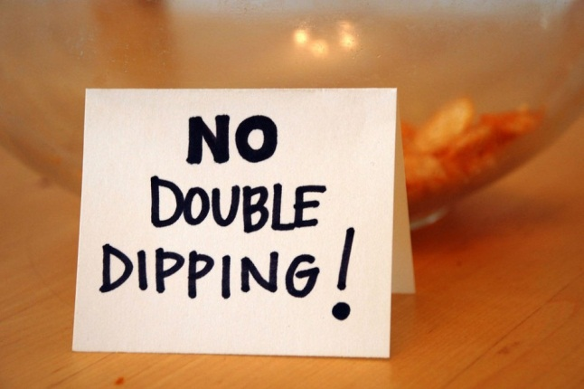

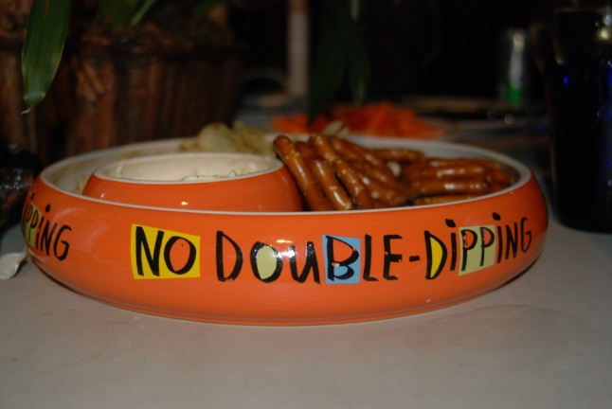
Double Dipping – a common stats problem
Auctioneering: “the winner’s curse”
Machine learning: “testing on training data”
“data snooping”
Modeling: “overfitting”
Survey sampling: “selection bias”
Logic: “circularity”
Meta-analysis: “publication bias”
fMRI: “double dipping”
“non-independence”
Notes:
From: Ed Vul
www.stat.columbia.edu/~martin/Workshop/Vul.ppt

Slide 22
Double Dipping – a common stats problem
Auctioneering: “the winner’s curse”
Machine learning: “testing on training data”
“data snooping”
Modeling: “overfitting”
Survey sampling: “selection bias”
Logic: “circularity”
Meta-analysis: “publication bias”
fMRI: “double dipping”
“non-independence”
Notes:
From: Ed Vul
www.stat.columbia.edu/~martin/Workshop/Vul.ppt

Slide 23
Kriegeskorte et al (2009)
Circular Analysis/ non-independence/ double dipping:
“data are first analyzed to select a subset and then the subset is reanalyzed to obtain the results”
“the use of the same data for selection and selective analysis”
“… leads to distorted descriptive statistics and invalid statistical inference whenever the test statistics are not inherently independent on the selection criteria under the null hypothesis
Nonindependent selective analysis is incorrect and should not be acceptable in neuroscientific publications*.”
* It is epidemic in publications- see Vul and Kriegeskorte

Slide 24
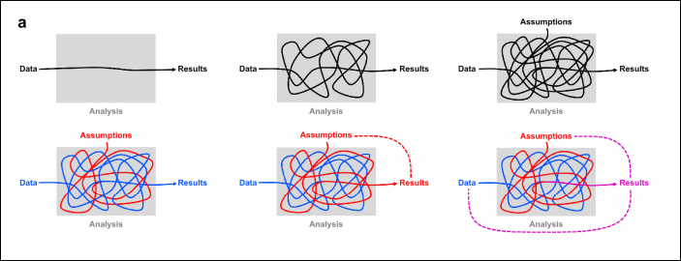
Kriegeskorte et al (2009)
results reflect data indirectly: through the lens of an often complicated analysis, in which assumptions are not always fully explicit
Assumptions influence which aspect of the data is reflected in the results- they may even pre-determine the results.
Notes:
Intuitive diagrams for understanding circular analysis. (a) The top row serves to remind us that our
results reflect our data indirectly: through the lens of an often complicated analysis, whose assumptions are not
always fully explicit.
The bottom row illustrates how the assumptions (and hypotheses) can interact with the data
to shape the results. Ideally (bottom left), the results reflect some aspect of the data (blue) without distortion
(although the assumptions will determine what aspect of the data is reflected in the results). But sometimes
(bottom center) a close inspection of the analysis reveals that the data get lost in the process and the
assumptions (red) predetermine the results. In that case the analysis is completely circular (red dotted line).
More frequently in practice (bottom right), the assumptions tinge the results (magenta). The results are then
distorted by circularity, but still reflect the data to some degree (magenta dotted lines).

Slide 25
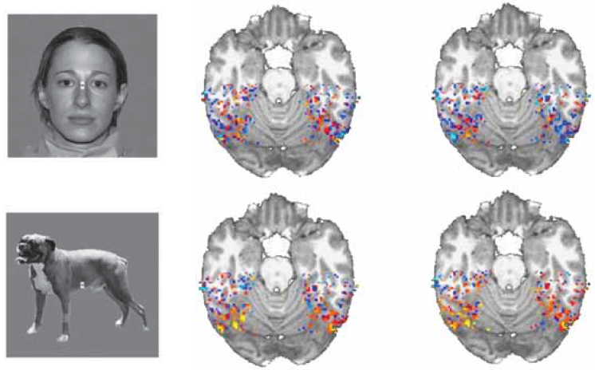
Example 1: Pattern-information analysis
TASK
(property judgment)
Simmons et al. 2006
“Animate?”
“Pleasant?”
STIMULUS
(object category)
Notes:
Fig. 2 | Example 1: Data selection can bias pattern-information analysis. (a) In order to assess to what
extent human inferior-temporal activity patterns reflect bottom-up sensory signals and top-down task constraints,
we measured activity patterns with fMRI while subjects viewed object images of different categories and judged
either whether the object shown was “animate” (task 1) or whether it was “pleasant” (task 2).
2
(b) We selected
all inferior-temporal voxels for which any two-sided t test contrasting two conditions was significant at p<0.001
(uncorrected for multiple tests). We then cleanly divided the data by using odd runs for training and even runs
for testing. We used a linear classifier to determine whether the activity pattern would allow us to decode the
stimulus category (light gray bars) and the judgment task (dark gray bars). Results (top left) suggested that both
stimulus and task can be decoded with high accuracy, significantly above chance. However, application of the
same analysis to Gaussian random data (top right), also suggested high decoding accuracies significantly
above chance. This shows that spurious effects can appear when data from the test set is used in the initial
data-selection process. Such spurious effects can be avoided by performing selection using data independent of
the test data (bottom row). Error bars indicate +/-1 across-subject standard error of the mean. For details on
experiment and analysis, see Example 1: Pattern-information analysis.

Slide 26
Pattern-information analysis
define ROI by selecting ventral-temporal voxels for which any pairwise condition contrast is significant at p<.001 (uncorr.)
perform nearest-neighbor classification
based on activity-pattern correlation
use odd runs for training
and even runs for testing

Slide 27
Results
stimulus
(object category)
task
(judged property)
1
decoding accuracy
chance level
0.5
0

Slide 28
Where did it go wrong??
define ROI by selecting ventral-temporal voxels for which any pairwise condition contrast is significant at p<.001 (uncorr.)
⇨ based on all data sets
perform nearest-neighbor classification
based on activity-pattern correlation
use odd runs for training
and even runs for testing

Slide 29

!
?
fMRI data
data from Gaussian
random generator
task
stimulus
1
1
decoding accuracy
chance level
0.5
0.5
using all data
to select ROI voxels
0
0
1
1
using only
training data
to select ROI voxels
0.5
0.5
0
0
... cleanly independent training and test data!

Slide 30
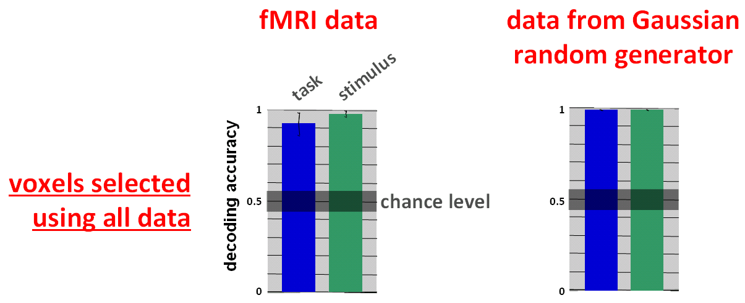
Conclusion for pattern-information analysis
The test data must not be used in either...
training a classifier or
defining the ROI
continuous weighting
binary weighting

Slide 31

Happy so far?

Slide 32
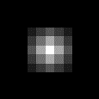
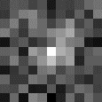


Example 2: Regional activation analysis
Simulated fMRI experiment
Experimental conditions: A, B, C, D
“Truth”: a region equally active for A and B, not for C and D (blue)
Time series: preprocessed and smoothed, then whole brain search on entire time-series (FWE-corrected):
contrast [A > D] ⇨ identifies ROI (red) = skewed/ “overfitted”
now you test within (red) ROI (using the same time-series) for [A > B]
….and
overfitted
ROI
⇨
true region
⇨

Slide 33
Where did it go wrong??
ROI defined by contrast favouring condition A* and using all time-series data
Any subsequent ROI search using the same time-series would find stronger effects for A > B (since A gave you the ROI in the first place)
* because the region was selected with a bias towards condition A when ROI was based on [A>D] so any contrast involving either condition A or condition D would be biased. Such biased contrasts include A, A-B, A-C, and A+B

Slide 34
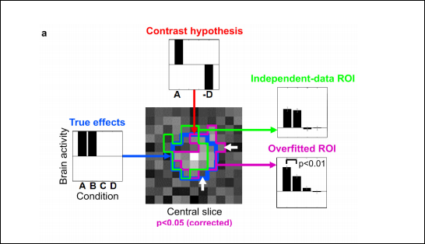
Saving the ROI- with independence
Independence of the selective analysis through independent test data (green) or by using selection and test statistics that are inherently independent. […] However, selection bias can arise even for orthogonal contrast vectors.
Notes:
Example 2: ROI definition can bias activation analysis. A simulated fMRI block-design experiment
demonstrates that nonindependent ROI definition can distort effects and produce spuriously significant results,
even when the ROI is defined by rigorous mapping procedures (accounting for multiple tests) and highlights a
truly activated region. Error bars indicate +/- 1 standard error of the mean. (a) The layout of this panel matches
the intuitive diagrams of Fig. 1a: The data in Fig. 1a correspond to the true effects (left); the assumptions to the
contrast hypothesis (top), and the results to ROI-average activation analyses (right). A 100-voxel region (blue
contour in central slice map) was simulated to be active during conditions A and B, but not during conditions C
and D (left). The t map for contrast A-D is shown for the central slice through the region (center). When
thresholded at p<0.05 (corrected for multiple tests by a cluster threshold criterion), a cluster appears (magenta
contour), which highlights the true activated region (blue contour). The ROI is somewhat affected by the noise in
the data (difference between blue and magenta contours). The noise pushes some truly activated voxels below
the threshold and lifts some nonactivated voxels above the threshold (white arrows). This can be interpreted as
overfitting. The bar graph for the overfitted ROI (bottom right, same data as used for mapping) reflects the
activation of the region during conditions A and B as well as the absence of activation during conditions C and
D. However, in comparison to the true effects (left) it is substantially distorted by the selection contrast A-D (top).
In particular, the contrast A-B (simulated to be zero) exhibits spurious significance (p<0.01). When we use
independent data to define the ROI (green contour), no such distortion is observed (top right).

Slide 35

Does selection by an orthogonal contrast vector ensure unbiased analysis?
A note on orthogonal vectors
c_{selection}=[1 1]^{T}
c_{test}=[1 -1]^{T}
orthogonal contrast vectors ⇔
ROI-definition contrast: A+B
ROI-average analysis contrast: A-B

Slide 36

Does selection by an orthogonal contrast vector ensure unbiased analysis?
A note on orthogonal vectors II
– No, there can still be bias.
not sufficient
still not sufficient
The design and noise dependencies matter.
design
noise dependencies

Slide 37
To avoid selection bias, we can...
...perform a nonselective analysis
OR
...make sure that selection and results statistics are independent under the null hypothesis,
because they are either:
inherently independent
or computed on independent data
e.g. whole-brain mapping
(no ROI analysis)
e.g. independent contrasts

Slide 38
Generalisations (from Vul)
Whenever the same data and measure are used to select voxels and later assess their signal:
  Effect sizes will be inflated (e.g., correlations)
  Data plots will be distorted and misleading
  Null-hypothesis tests will be invalid
  Only the selection step may be used for inference
If multiple comparisons are inadequate, results may be produced from pure noise.
Notes:
From: Ed Vul
www.stat.columbia.edu/~martin/Workshop/Vul.ppt

Slide 39
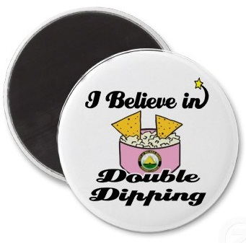
So… we don’t want any of this!!

Slide 40
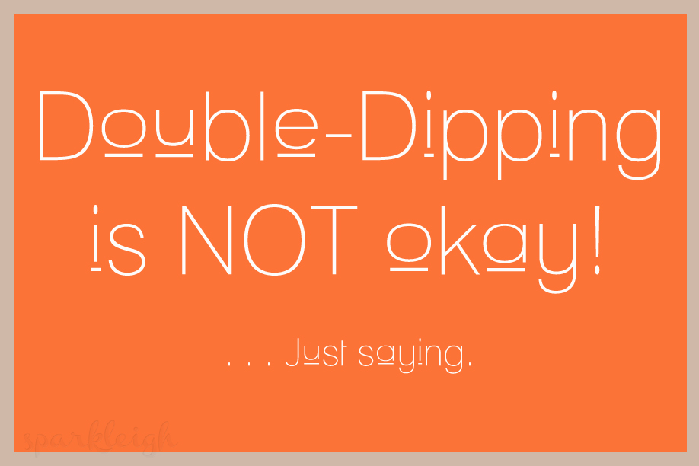
Because …

Slide 41
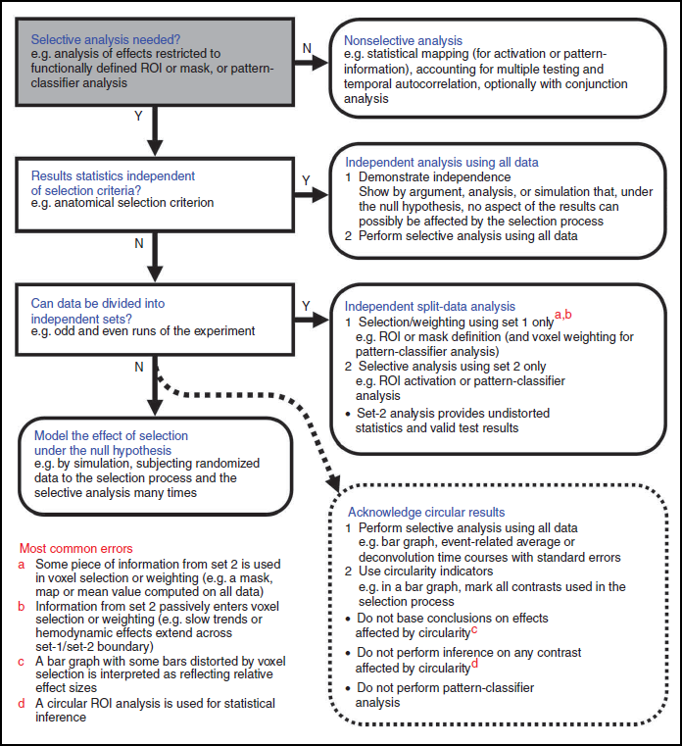
And if you are unsure…
… ask our friends Kriegeskorte et al (2009)…
Notes:
A policy for noncircular analysis. This
flow diagram suggests a procedure for choosing an
appropriate analysis that avoids the pitfalls of
circularity. Considering the most common errors
(bottom left, red-letter references) can help to
recognize circularity in assessing a given
analysis. We first consider performing a
nonselective analysis only. If selective analysis is
needed and we can demonstrate that the results
are independent of the selection criterion under
the null hypothesis, then all data are used for
selective analysis. If we cannot demonstrate
this, then a split-data analysis can serve to
ensure independence (for details, see
Supplementary Discussion).

Slide 42

QUESTIONS?

Slide 43
References
MFD 2013: “Random Field Theory” slides
“Neural Correlates of Interspecies Perspective Taking in the Post-Mortem Atlantic Salmon: An Argument for Proper Multiple Comparisons Correction.” Bennett, Baird, Miller, Wolford, JSUR, 1(1):1-5 (2010)
“Puzzlingly High Correlations in fMRI Studies of Emotion, Personality, and Social Cognition.” Vul, Harris, Winkielman, Pashler, Perspectives on Psychological Science, 4(3):274-90 (2009)
“Type I and Type II error concerns in fMRI research: re-balancing the scale.” Lieberman & Cunningham, SCAN 4:423-8 (2009)
Kriegeskorte, N., Simmons, W.K., Bellgowan, P.S.F., Baker, C.I., 2009. Circular analysis in systems neuroscience: the dangers of double dipping. Nat Neurosci 12, 535-540.
Vul, E & Kanwisher, N (?). Begging the Question: The Non-Independence Error in fMRI Data Analysis; available at http://www.edvul.com/pdf/VulKanwisher-chapter-inpress.pdf
http://www.mrc-cbu.cam.ac.uk/people/nikolaus.kriegeskorte/Circular%20analysis_teaching%20slides.ppt.
www.stat.columbia.edu/~martin/Workshop/Vul.ppt

Slide 44
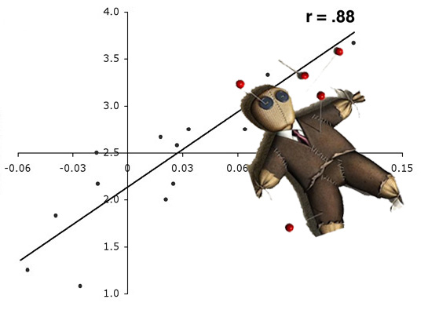
Voodoo Correlations

