Slide 1
Random Field Theory
Giles Story
Philipp Schwartenbeck
Methods for dummies 2012/13
With thanks to Guillaume Flandin

Slide 2
Outline
Where are we up to?
Part 1
Hypothesis Testing
Multiple Comparisons vs Topological Inference
Smoothing
Part 2
Random Field Theory
Alternatives
Conclusion
Part 3
SPM Example

Slide 3
Part 1: Testing Hypotheses

Slide 4



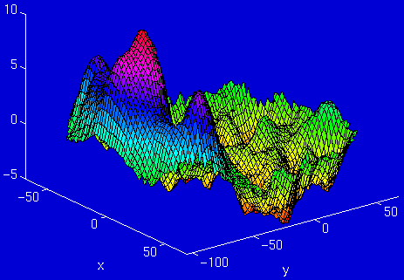
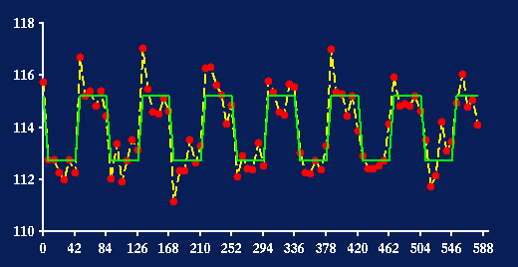
Where are we up to?
fMRI time-series
Kernel
Design matrix
Statistical Parametric Map
Motion
Correction
(Realign & Unwarp)
Smoothing
General Linear Model
Co-registration
Spatial normalisation
Parameter Estimates
Standard
template

Slide 5
Hypothesis Testing
To test an hypothesis, we construct “test statistics” and ask how likely that our
statistic could have come about by chance
The Null Hypothesis H₀
Typically what we want to disprove (no effect).
⇨ The Alternative Hypothesis H_{A} expresses outcome of interest.
The Test Statistic T
The test statistic summarises evidence about H₀.
Typically, test statistic is small in magnitude when the hypothesis H₀ is true and large when false.
⇨ We need to know the distribution of T under the null hypothesis
Null Distribution of T

Slide 6
Test Statistics
μ
An example (One-sample t-test):
SE = σ/√N
Can estimate SE using sample st dev, s:
SE estimated = s/ √N
t = sample mean – population mean/SE
t gives information about differences expected under H₀ (due to sampling error).
σ
Population
μ
σ/√N
Sampling distribution of mean x
for large N

Slide 7
How likely is it that our statistic could
have come from the null distribution?

Slide 8
Hypothesis Testing
Significance level α:
Acceptable false positive rate α.
⇨ threshold u_{α}
Threshold u_{α} controls the false positive rate
u_{α}
α
Observation of test statistic t, a realisation of T
Null Distribution of T
The conclusion about the hypothesis:
We reject the null hypothesis in favour of the alternative hypothesis if t > u_{α}
t
P-value:
A p-value summarises evidence against H₀.
This is the chance of observing value more extreme than t under the null hypothesis.
P-val
Null Distribution of T

Slide 9
In GLM we test hypotheses about β
β
is a point estimator of the population value
has a sampling distribution
has a standard error
-> We can calculate a t-statistic based on a null hypothesis about population β
e.g. H₀: β = 0
Y = Xβ + e

Slide 10
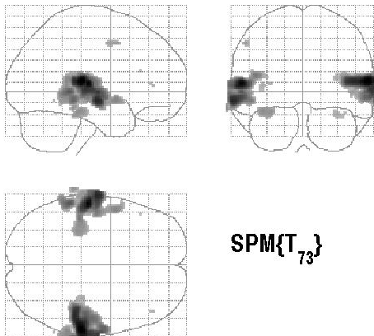

T-test on β: a simple example
Passive word listening versus rest
c^{T} = [ 1 0 ]
Q: activation during listening ?
1
Null hypothesis:
SPMresults:
10
Height threshold T = 3.2057 {p<0.001}
20
30
contrast of
estimated
parameters
40
50
60
T =
variance
estimate
70
80
0.5
1
1.5
2
2.5
Design matrix

Slide 11
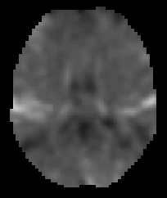
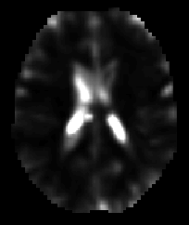
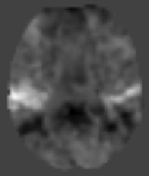
T-contrast in SPM
For a given contrast c:
ResMS image
beta_???? images
con_???? image
spmT_???? image
SPM{t}

Slide 12
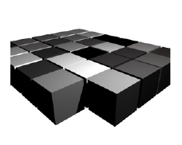
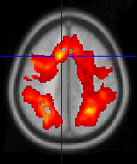
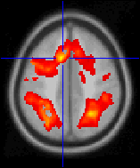
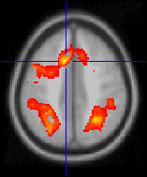
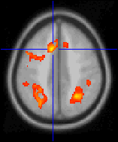
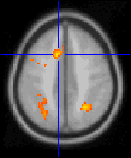
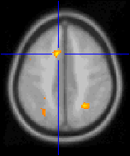
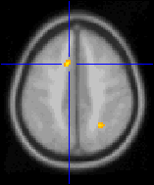
How to do inference on t-maps?
T-map for whole brain may contain say
60000 voxels
Each analysed separately would mean
60000 t-tests
At α = 0.05 this would be 3000 false positives (Type 1 Errors)
Adjust threshold so that any values above threshold are unlikely to under the null hypothesis (height thresholding)
t > 0.5
t > 2.5
t > 4.5
t > 0.5
t > 1.5
t > 3.5
t > 5.5
t > 6.5

Slide 13
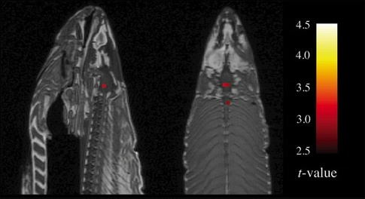
A t-image!

Slide 14


Uncorrected p <0.001 with regional hypothesis -> unquantified error control

Slide 15
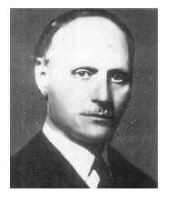
Classical Approach to Multiple Comparison
Bonferrroni Correction:
A method of setting the significance threshold to control the Family-wise Error Rate (FWER)
FWER is probability that one or more values among a family of statistics will be greater than α
For each test:
Probability greater than threshold: α
Probability less than threshold: 1- α

Slide 16
Classical Approach to Multiple Comparison
Probability that all n tests are less than α: (1- α)^{n}
Probability that one or more tests are greater than α:
P_{FWE} = 1 – (1- α)^{n}
Since α is small, approximates to:
P_{FWE} ≤ n . α
α = P_{FWE} / n

Slide 17
Classical Approach to Multiple Comparison
α = P_{FWE} / n
Could in principle find a single-voxel probability threshold, α, that would give the required FWER such that there would be P_{FWE} probability of seeing any voxel above threshold in all of the n values...

Slide 18
Classical Approach to Multiple Comparison
α = P_{FWE} / n
e.g. 100,000 t stats, all with 40 d.f.
For P_{FWE} of 0.05:
0.05/100000 = 0.0000005, corresponding t 5.77
=> a voxel statistic of >5.77 has only a 5% chance of arising anywhere in a volume of 100,000 t stats drawn from the null distribution

Slide 19
Why not Bonferroni?
Functional imaging data has a degree of spatial correlation
Number of independent values < number of voxels
Why?
The way that the scanner collects and reconstructs the image
Physiology
Spatial preprocessing (resampling, smoothing)
Also could be seen as a categorical error: unique situation in which have a continuous statistic image, not a series of independent tests
Carlo Emilio Bonferroni was born in Bergamo on 28 January 1892
and died on 18 August 1960 in Firenze (Florence). He studied in Torino
(Turin), held a post as assistant professor at the Turin Polytechnic, and
in 1923 took up the chair of financial mathematics at the Economics
Institute in Bari. In 1933 he transferred to Firenze where he
held his chair until his death.

Slide 20
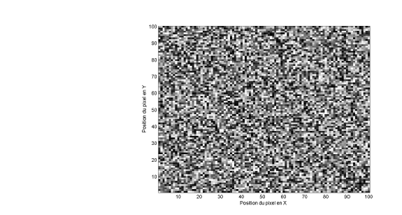
Illustration of Spatial Correlation
Take an image slice, say 100 by 100 voxels
Fill each voxel with an independent random sample from a normal distribution
Creates a Z-map (equivalent to t with v high d.f.)
How many numbers in the image are more positive than is likely by chance?

Slide 21
Illustration of Spatial Correlation
Bonferroni would give accurate threshold, since all values independent
10,000 Z scores
=> Bonferroni α for FWE rate of 0.05
0.05/10,000 = 0.000005
i.e. Z score of 4.42
Only 5 out of 100 such images expected to
have Z > 4.42

Slide 22
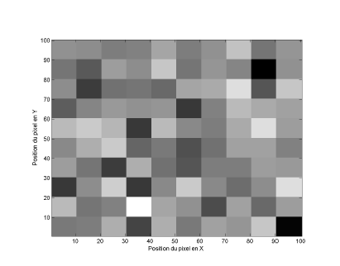
Illustration of Spatial Correlation
Break up image into squares of 10 x 10 pixels
For each square calculate the mean of the 100 values contained
Replace the 100 random numbers by the mean

Slide 23
Illustration of Spatial Correlation
Still have 10,000 numbers (Z scores) but only 100 independent
Appropriate Bonferroni correction: 0.05/100 = 0.0005
Corresponds to Z 3.29
Z 4.42 would have lead to FWER 100 times lower than the rate we wanted

Slide 24
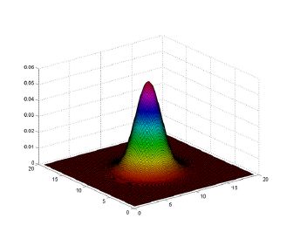
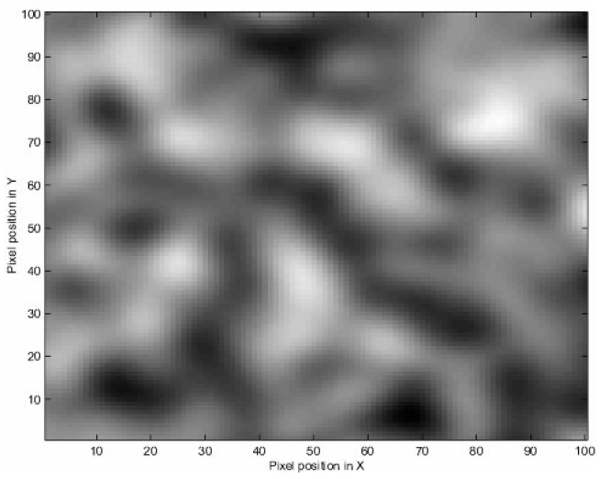
Smoothing
This time have applied a Gaussian kernel with FWHM = 10
(At 5 pixels from centre, value is half peak value)
Smoothing replaces each value in the image with weighted av of itself and neighbours
Blurs the image -> contributes to spatial correlation

Slide 25
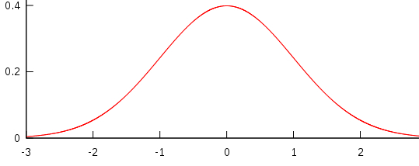
Smoothing kernel
FWHM
(Full Width at Half Maximum)
Notes:
Smoothing: Each voxel`s new value is set to an average of itself and that voxels it`s neighborhood
The original pixel's value receives the heaviest weight and neighbouring pixels receive smaller weights as their distance to the original pixel increases.
Kernel defines the shape of the function that is used to take the average of the neighbouring points.
FWHM: measure to describe the width of the kernel, also used as a measure for the smoothness of a picture

Slide 26
Why Smooth?
Increases signal : noise ratio (matched filter theorem)
Allow averaging across subjects (smooths over residual anatomical diffs)
Lattice approximation to continuous underlying random field -> topological inference
FWHM must be substantially greater than voxel size

Slide 27
Part 2: Random Field Theory

Slide 28
Outline
Where are we up to?
Hypothesis testing
Multiple Comparisons vs Topological Inference
Smoothing
Random Field Theory
Alternatives
Conclusion
Practical example

Slide 29
Random Field Theory
The key difference between statistical parametric mapping (SPM) and conventional statistics lies in the thing one is making an inference about.
In conventional statistics, this is usual a scalar quantity (i.e. a model parameter) that generates measurements, such as reaction times.
[…]
In contrast, in SPM one makes inferences about the topological features of a statistical process that is a function of space or time. (Friston, 2007)
Random field theory regards data as realizations of a continuous process in one or more dimensions.
This contrasts with classical approaches like the Bonferroni correction, which consider images as collections of discrete samples with no continuity properties. (Kilner & Friston, 2010)

Slide 30
Why Random Field Theory?
Therefore: Bonferroni-correction not only unsuitable because of spatial correlation
  But also because of controlling something completely different from what we need
  Suitable for different, independent tests, not continuous image
  Couldn’t we think of each voxel as independent sample?

Slide 31
Why Random Field Theory?
No
Imagine 100,000 voxels, α = 5%
  expect 5,000 voxels to be false positives
Now: halving the size of each voxel
  200,000 voxels, α = 5%
  Expect 40,000 voxels to be false positives
Double the number of voxels (e.g. by increasing resolution) leads to an increase in false positives by factor of eight!
  Without changing the actual data

Slide 32
Why Random Field Theory?
In RFT we are NOT controlling for the expected number of false positive voxels
  false positive rate expressed as connected sets of voxels above some threshold
RFT controls the expected number of false positive regions, not voxels (like in Bonferroni)
  Number of voxels irrelevant because being more or less arbitrary
  Region is topological feature, voxel is not

Slide 33
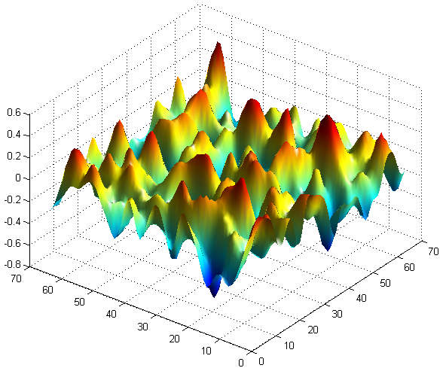
Why Random Field Theory?
So standard correction for multiple comparisons doesn’t work..
  Solution: treating SPMs as discretisation of underlying continuous fields
    With topological features such as amplitude, cluster size, number of clusters, etc.
    Apply topological inference to detect activations in SPMs

Slide 34
Topological Inference
Topological inference can be about
  Peak height
  Cluster extent
  Number of clusters
intensity
t_{α}
t_{clus}
space

Slide 35
Random Field Theory: Resels
Solution: discounting voxel size by expressing search volume in resels
  “resolution elements”
  Depending on smoothness of data
  “restoring” independence of data
Resel defined as volume with same size as FWHM
  R_{i} = FWHM_{x} x FWHM_{y} x FWHM_{z}

Slide 36
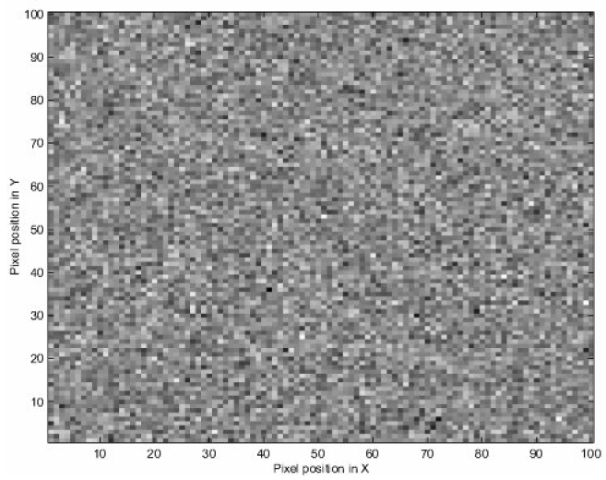
Random Field Theory: Resels
Example before:
Reducing 100 x 100 = 10,000 pixels by FWHM of 10 pixels
Therefore: FWHM_{x} x FWHM_{y} = 10 x 10 = 100
  Resel as a block of 100 pixels
  100 resels for image with 10,000 pixels

Slide 37
Random Field Theory:
Euler Characteristic
Euler Characteristic (EC) to determine height threshold for smooth statistical map given a certain FWE-rate
  Property of an image after being thresholded
  In our case: expected number of blobs in image after thresholding

Slide 38
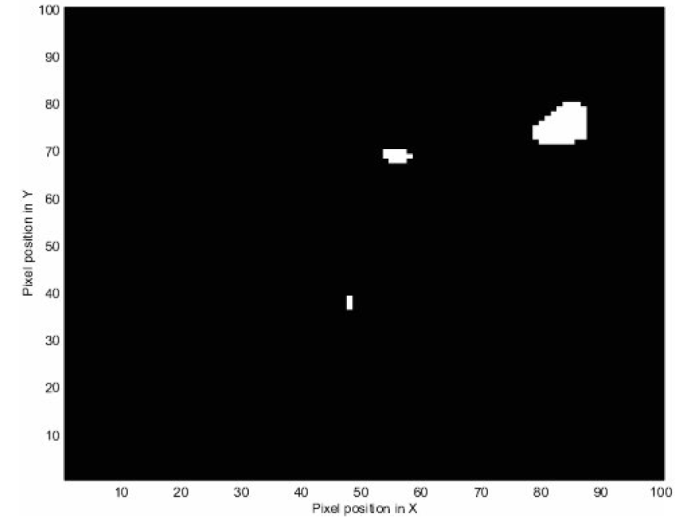
Random Field Theory:
Euler Characteristic
Example before: thresholding with Z = 2.5
  All pixels with Z < 2.5 set to zero, other to 1
  Finding 3 areas with Z > 2.5
  Therefore: EC = 3

Slide 39

Random Field Theory:
Euler Characteristic
Increasing to Z = 2.75
  All pixels with Z < 2.75 set to zero, other to 1
  Finding 1 area with Z > 2.75
  Therefore: EC = 1

Slide 40
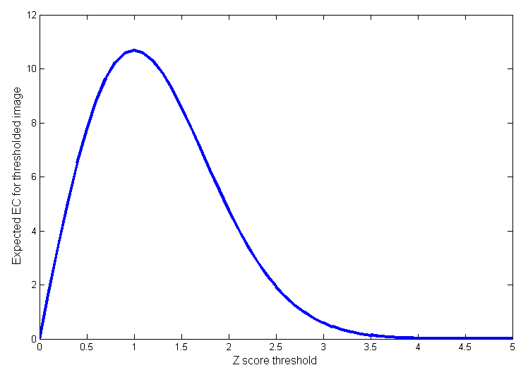
Random Field Theory:
Euler Characteristic
Expected EC (E[EC]) corresponds to finding an above threshold blob in statistic image
  Therefore: P_{FWE} ≈ E[EC]
At high thresholds EC is either 0 or 1
EC a bit more complex than simply number of blobs (Worsleyet al., 1994)…
Good approximation FWE

Slide 41
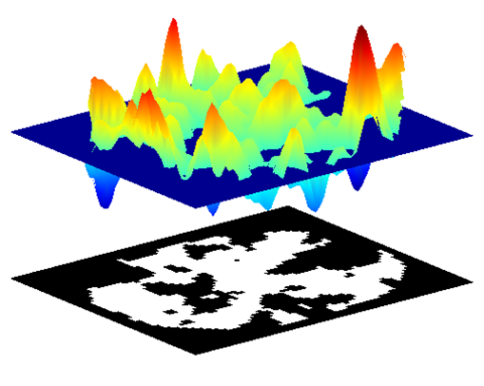
Random Field Theory:
Euler Characteristic
Why is E[EC] only a good approximation to P_{FWE} if threshold sufficiently high?
  Because EC basically is N(blobs) – N(holes)

Slide 42
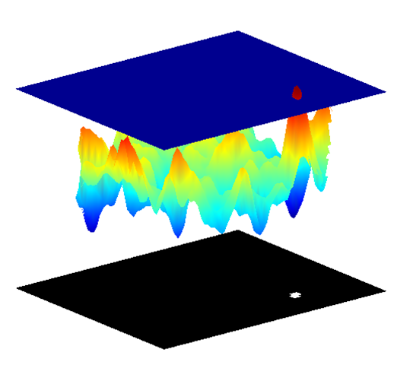
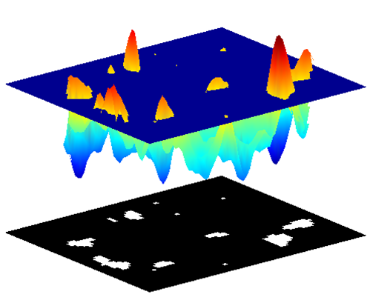
Random Field Theory:
Euler Characteristic
But if threshold is sufficiently high, then..
  E[EC] = N(blobs)

Slide 43
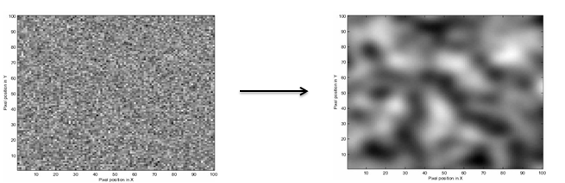
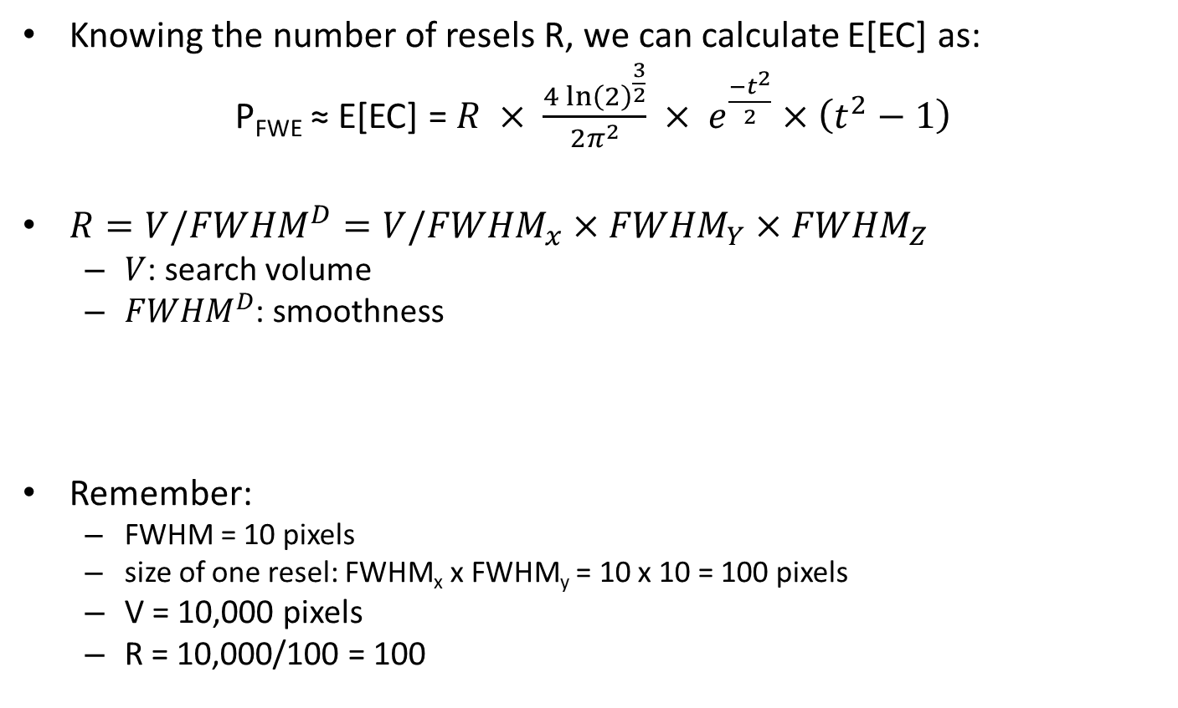
Random Field Theory:
Euler Characteristic
Knowing the number of resels R, we can calculate E[EC] as:
P_{FWE} ≈ E[EC] = $R × \frac{{4\ln\left(2\right)}^{\frac{3}{2}}}{{2π}^{2}} × e^{\frac{{−t}^{2}}{2}}×\left(t^{2}−1\right)$
${R=V/FWHM}^{D}=V/{FWHM}_{x}×{FWHM}_{Y}×{FWHM}_{Z}$
  $V$: search volume
  ${FWHM}^{D}$: smoothness
Remember:
  FWHM = 10 pixels
  size of one resel: FWHM_{x} x FWHM_{y} = 10 x 10 = 100 pixels
  V = 10,000 pixels
  R = 10,000/100 = 100
(for 3D)

Slide 44
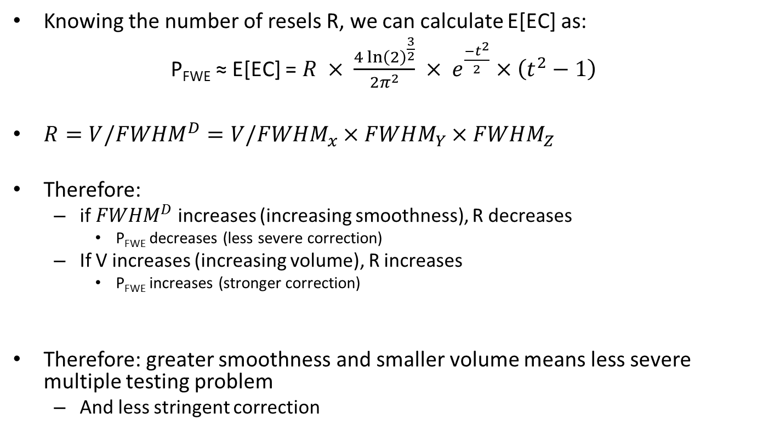
Random Field Theory:
Euler Characteristic
Knowing the number of resels R, we can calculate E[EC] as:
P_{FWE} ≈ E[EC] = $R × \frac{{4\ln\left(2\right)}^{\frac{3}{2}}}{{2π}^{2}} × e^{\frac{{−t}^{2}}{2}}×\left(t^{2}−1\right)$
${R=V/FWHM}^{D}=V/{FWHM}_{x}×{FWHM}_{Y}×{FWHM}_{Z}$
Therefore:
  if ${FWHM}^{D}$ increases (increasing smoothness), R decreases
    P_{FWE} decreases (less severe correction)
  If V increases (increasing volume), R increases
    P_{FWE} increases (stronger correction)
Therefore: greater smoothness and smaller volume means less severe multiple testing problem
  And less stringent correction
(for 3D)

Slide 45
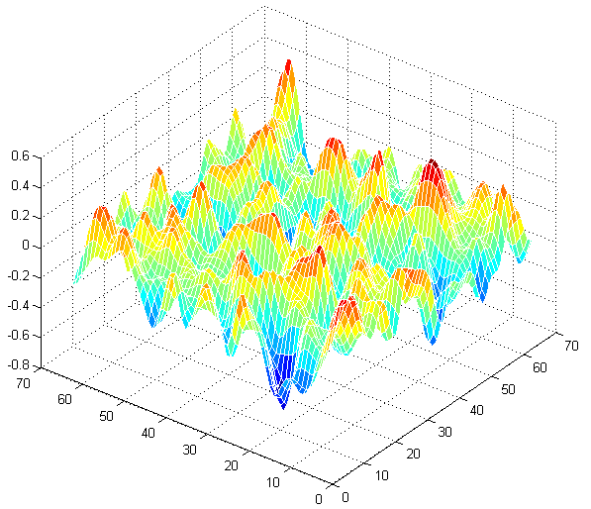
Random Field Theory: Assumptions
Assumptions:
  Error fields must be approximation (lattice representation) to underlying random field with multivariate Gaussian distribution
lattice representation

Slide 46
Random Field Theory: Assumptions
Assumptions:
  Error fields must be approximation (lattice representation) to underlying random field with multivariate Gaussian distribution
  Fields are continuous
Problems only arise if
  Data is not sufficiently smoothed
    important: estimating smoothness depends on brain region
      E.g. considerably smoother in cortex than white matter
  Errors of statistical model are not normally distributed

Slide 47
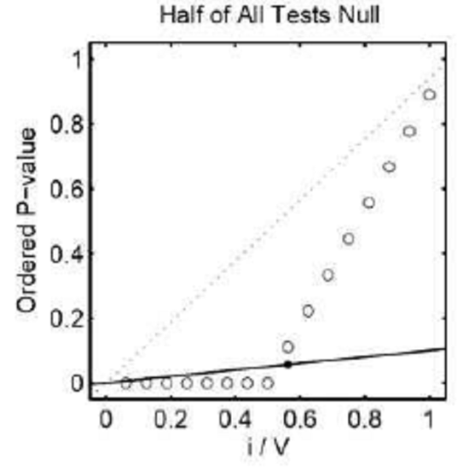
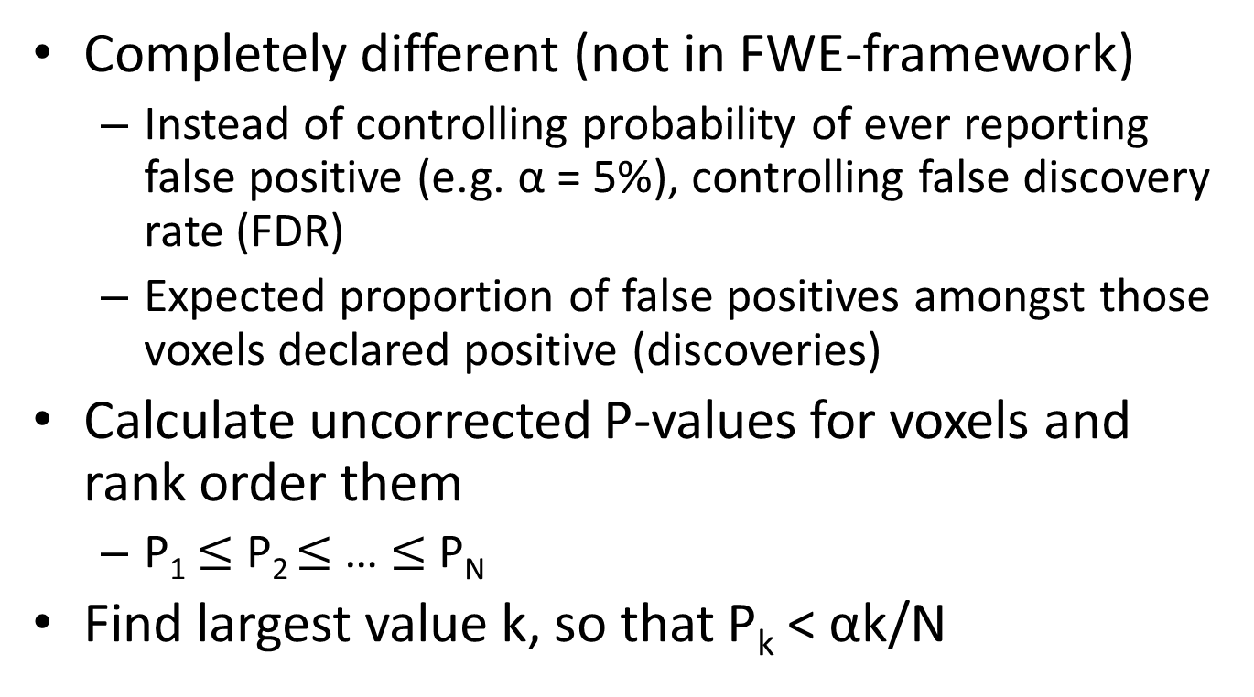
Alternatives to FWE:
False Discovery Rate
Completely different (not in FWE-framework)
  Instead of controlling probability of ever reporting false positive (e.g. α = 5%), controlling false discovery rate (FDR)
  Expected proportion of false positives amongst those voxels declared positive (discoveries)
Calculate uncorrected P-values for voxels and rank order them
  P₁ $≤$ P₂ $≤$ … $≤$ P_{N}
Find largest value k, so that P_{k} < αk/N

Slide 48
Alternatives to FWE:
False Discovery Rate
But: different interpretation:
  False positives will be detected
  Simply controlling that they make up no more than α of our discoveries
  FWE controls probability of ever reporting false positives
Therefore: better greater sensitivity, but lower specificity (greater false positive risk)
  No spatial specificity

Slide 49
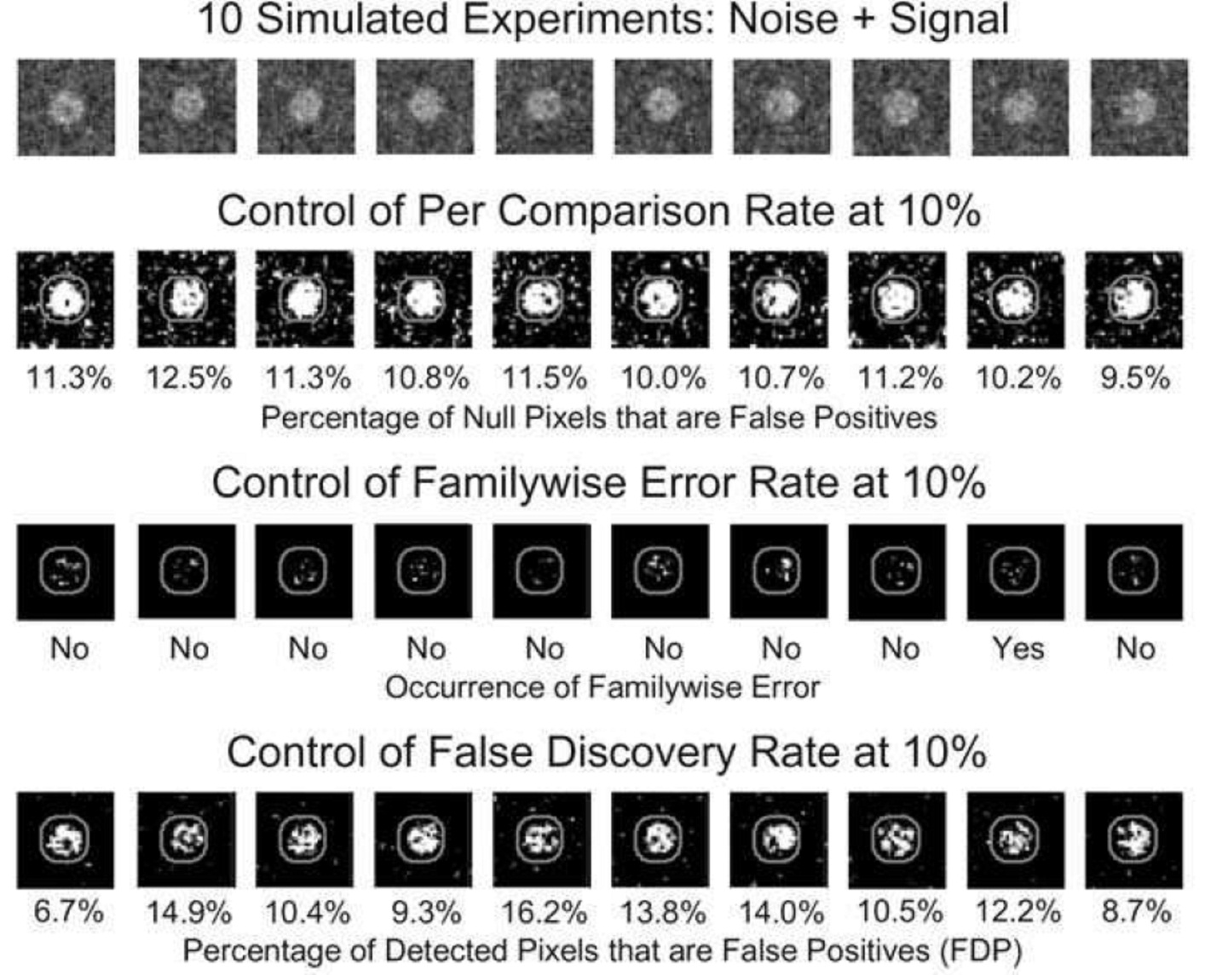
Alternatives to FWE:
False Discovery Rate

Slide 50
Alternatives to FWE
Permutation
  Gaussian data simulated and smoothed based on real data (cf. Monte Carlo methods)
  Create surrogate statistic images under null hypothesis
  Compare to real data set
Nonparametric tests
  Similar to permutation, but use empirical data set and permute subjects (e.g. in group analysis)
  E.g. construct distribution of maximum statistic with repeated permutation within data

Slide 51
Conclusion
Neuroimaging data needs to be controlled for multiple comparisons
  Standard approaches don’t apply
Inferences can be made voxel-wise, cluster-wise and set-wise
Inference is made about topological features
  Peak height, spatial extent, number of clusters
Random Field Theory provides valuable solution to multiple comparison problem
  Treating SPMs as discretization of continuous (random) field
Alternatives to FWE (RFT) are False Discovery Rate (FDR) and permutation tests

Slide 52
Part 3: SPM Example

Slide 53
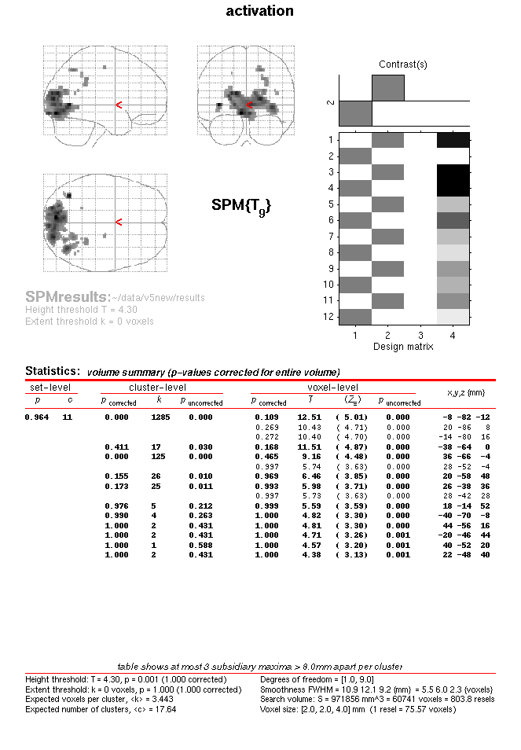
Results in SPM
Maximum Intensity Projection on Glass Brain
18/11/2009
RFT for dummies - Part II
53
53

Slide 54
This screen shows all clusters above a chosen significance, as well as separate maxima within a cluster
60,741 Voxels
803.8 Resels
18/11/2009
RFT for dummies - Part II
54
54

Slide 55
Peak-level inference
This example uses uncorrected p (!)
Height threshold T= 4.30
18/11/2009
RFT for dummies - Part II
55
55

Slide 56
MNI Coords of each Max
Peak-level inference
18/11/2009
RFT for dummies - Part II
56
56

Slide 57
Chance of finding peak above this threshold, corrected for search volume
Peak-level inference
18/11/2009
RFT for dummies - Part II
57
57

Slide 58
Cluster-level inference
Extent threshold k = 0 (this is for peak-level)
18/11/2009
RFT for dummies - Part II
58
58

Slide 59
Cluster-level inference
Chance of finding a cluster with at least this many voxels corrected for search volume
18/11/2009
RFT for dummies - Part II
59
59

Slide 60
Set-level inference
Chance of finding this or greater number of clusters in the search volume
18/11/2009
RFT for dummies - Part II
60
60

Slide 61
Thank you for listening
… and special thanks to Guillaume Flandin!

Slide 62
References
Kilner, J., & Friston, K. J. (2010). Topological inference for EEG and MEG data. Annals of Applied Statistics, 4, 1272-1290.
Nichols, T., & Hayasaka, S. (2003). Controlling the familywise error rate in functional neuroimaging: a comparative review. Statistical Methods in Medical Research, 12, 419-446.
Nichols, T. (2012). Multiple testing corrections, nonparametric methods and random field theory. Neuroimage, 62, 811-815.
Chapters 17-21 in Statistical Parametric Mapping by Karl Friston et al.
Poldrack, R. A., Mumford, J. A., & Nichols, T. (2011). Handbook of Functional MRI Data Analysis. New York, NY: Cambridge University Press.
Huettel, S. A., Song, A. W., & McCarthy, G. (2009). Functional Magnetic Resonance Imaging, 2nd edition. Sunderland, MA: Sinauer.
http://www.fil.ion.ucl.ac.uk/spm/doc/biblio/Keyword/RFT.html

