Slide 1
STATISTICAL ANALYSIS AND SOURCE LOCALISATION
METHODS FOR DUMMIES
2012-2013
ANADUAKA, CHISOM
KRISHNA, LILA
UNIVERSITY COLLEGE LONDON

Slide 2

M/EEG SO FAR
Source of Signal
Dipoles
Preprocessing and Experimental design

Slide 3
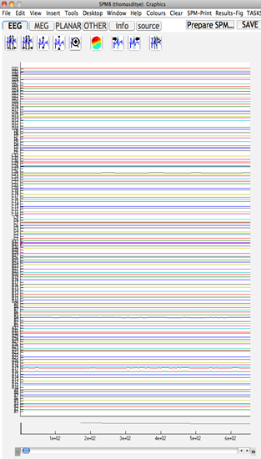
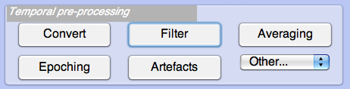
E/MEG SIGNAL

Slide 4
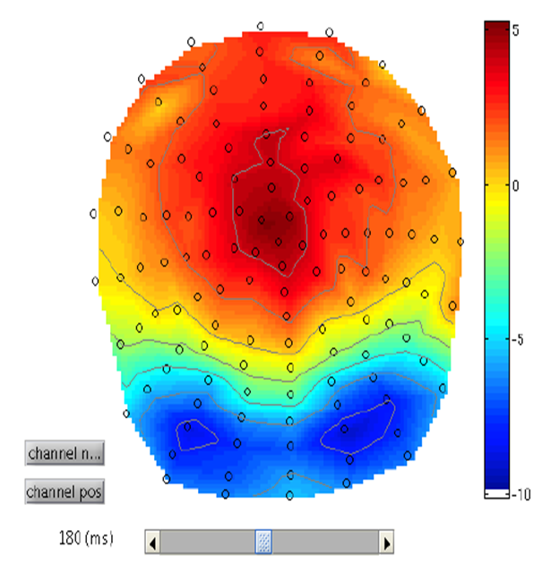
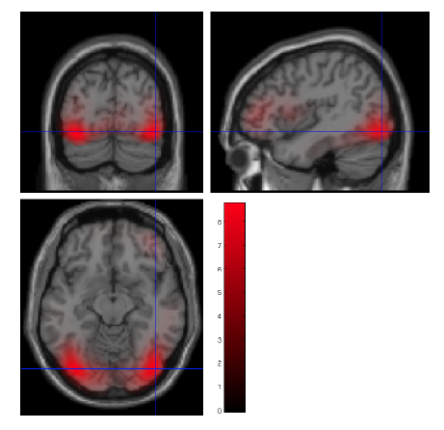
E/MEG SIGNAL
Statistical Analysis
Source Reconstruction

Slide 5
How does it work?
Statistical analysis
1. Sensor level analysis in SPM
2. Scalp vs. Time Images
3. Time-frequency analysis

Slide 6
Neuroimaging produces continuous data e.g. EEG/MEG data.
Time varying modulation of EEG/MEG signal at each electrode or sensor.
Statistical significance of condition specific effects.
Effective correction of number of tests required- FWER.
Notes:
FWER- family-wise error rate: probability of making false-+ve assumption over search space

Slide 7
Steps in SPM
Data transformed to image files (NifTI)
Between subject analysis as in “2nd level for fMRI”
Within subject possible
Generate scalp map/time frame using 2D sensor layout and linear interpolation btw sensors (64 pixels each spatial direction suggested)

Slide 8
Sensor level analysis
a
EVOKED SCALP RESPONSE
SLOW EVOLUTION IN TIME
In
Space-space-time maps
SPM
Notes:
Construction of a 3D (space × space × time(ms) data volume from sensor-space maps,
such as shown in Results of F test for difference between responses to faces and scrambled faces. Overall, single trials (168 for each
condition) were converted to images as shown in a. A two-sample t-test was performed and the results were assessed with an F-contrast to
test for differences of either polarity. The results were thresholded at P = .05 with FWER correction based on random field theory
Slow evolution in time explains blobs observed.

Slide 9
Sensor Level Analysis
This is used to identify pre-stimulus time or frequency windows.
Using standard SPM procedures(topological inference) applied to electromagnetic data; features are organised into images.
Raw contrast time frequency maps
Smoothing Kernel
SPM

Slide 10
Topological inference
Done when location of evoked/induced responses is unknown
Increased sensitivity provided smoothed data
Vs Bonferroni: acknowledges non-independent neighbours
ASSUMPTION
Irrespective of underlying geometry or data
support, topological behaviour is invariant.

Slide 11
Time vs. Frequency data
Time-frequency data: Decrease from 4D to 3D or 2D time-frequency (better for SPM).
Data features: Frequency-Power or Energy(Amplitudes) of signal.
Reduces multiple comparison problems by averaging the data over pre-specified sensors and time bins of interest.

Slide 12
Averaging
Averaging over time/frequency
Important: requires prior knowledge of time window of interest
Well characterised ERP→2D image + spatial dimensions
E.g. Scalp vs. time or Scalp vs. Frequency

Slide 13
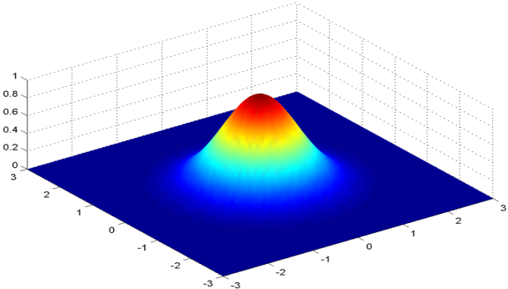
Smoothing step
Smoothing: prior to 2nd level/group analysis -multi dimensional convolution with Gaussian kernel.
Multi-dimensional convolution with Gaussian kernel
Important to accommodate spatial/temporal variability over subjects and ensure images conform to assumptions.

Slide 14
Source localisation
Source of signal difficult to obtain
Ill-posed inverse problem (infers brain activity from scalp data): Any field potential vector can be explained with an infinite number of possible dipole combinations.
Absence of constraints No UNIQUE solution
Need for Source Localisation/Reconstruction/Analysis

Slide 15
NO CORRECT ANSWER; AIM IS TO GET A CLOSE ENOUGH APPROXIMATION….

Slide 16
Forward/Inverse problems
Forward model:
Gives information about Physical and Geometric head properties.
Important for modeling propagation of electromagnetic field sources.
Approximation of data from Brain to Scalp.
Backward model/Inverse Problem:
Scalp data to Brain
Source localization in SPM solves the Inverse problem.

Slide 17
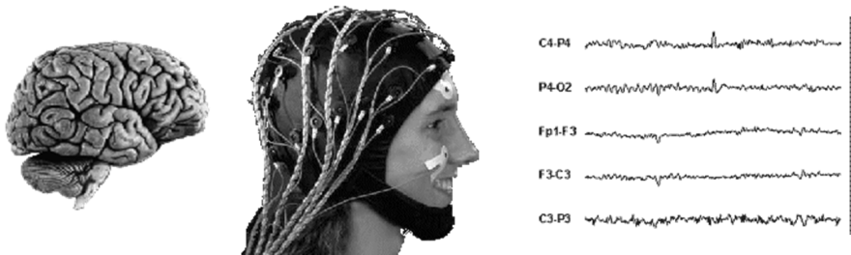
Forward/Inverse problems
FORWARD PROBLEM
INVERSE PROBLEM

Slide 18
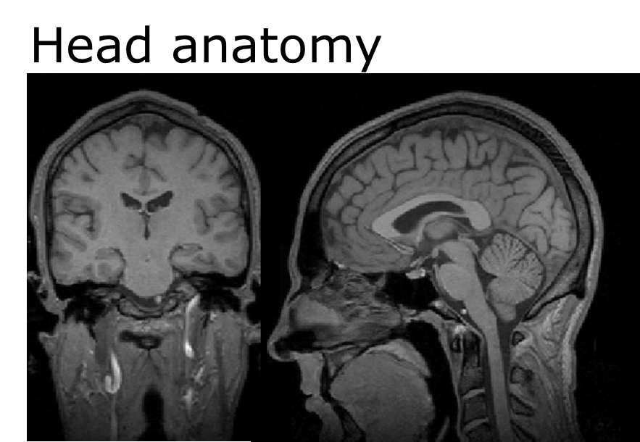
Forward/Inverse problems
Head model: conductivity layout
Source model: current dipoles
Solutions are mathematically derived.

Slide 19
Source reconstruction
Source space modeling
Data co-registration
Forward computation
Inverse reconstruction
Summarise reconstructed response as image
FORWARD MODEL

Slide 20
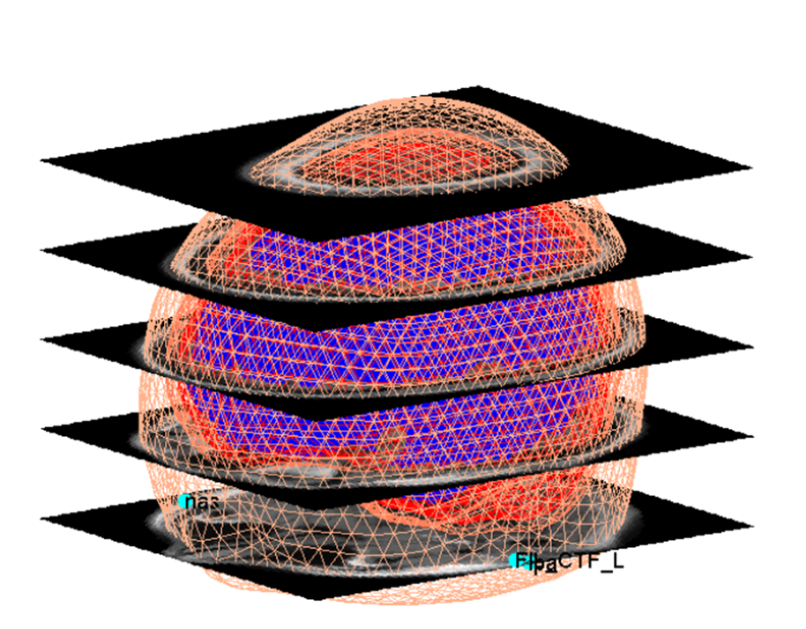
Source space modelling
Notes:
Template meshes used for distributed source imaging.. The
triangular grid shows the representation of the cortical surface used by SPM. All template meshes (cortex, inner skull, outer skull,
and scalp) superimposed on the template MRI. Default fiducial locations associated with the template anatomy are displayed in light blue.

Slide 21
Data co-registration
Rotation
Rigid-body transformation matrices
Fiducial matched to MRI applied to sensor positions
Surface matching: between head shape in MEEG and MRI-derived scalp tessellations. It is important to specify MRI points corresponding to fiducials whilst ensuring no shift
Transformation
Notes:
Fiducial- object used in field of view which appears in the image; used as a point of reference
Tessellation-is the process of creating a two-dimensional plane using the repetition of a geometric shape with no overlaps and no gaps.

Slide 22
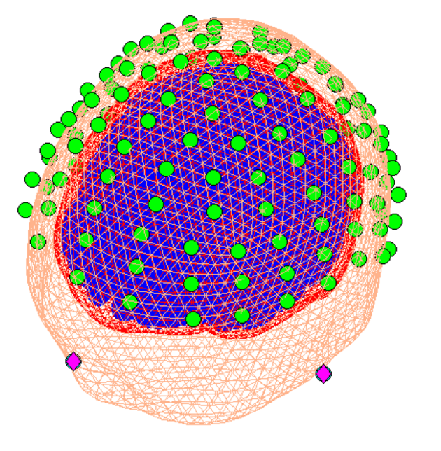
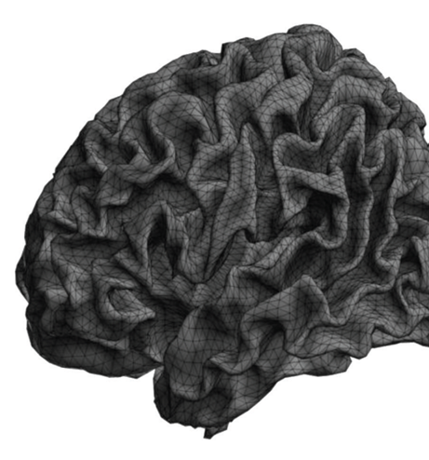
Data Co-registration
“Normal” cortical template mesh (8196 vertices), left view
Example of co-registration display (appears after the co-registration step has been completed)

Slide 23
Forward computation
Compute effects on sensors for each dipole
N x M matrix
Single shell model recommended for MEG, BEM(Boundary Element Model) for EEG.
No of sensors
No of mesh vertices

Slide 24
Distributed source reconstruction
3D
Using Cortical mesh Forward model parameterisation
Allows consideration of multiple sources simultaneously.
Individual meshes created based on subject’s structural MR scan–apply inverse of spatial deformation

Slide 25
Y = kJ + E
Data gain matrix noise/error
Estimate J (dipole amplitudes/strength)
Solve linear optimisation problem to determine Y
Reconstructs later ERP components
Problem
Fewer sensors than sources
needs constraints

Slide 26
Constraints
Every constraint can provide different solutions
Bayesian model tries to provide optimal solution given all available constraints
POSSIBILITIES
IID- Summation of power across all sources
COH- adjacent sources should be added
MSP- data is a combination of different patches
Sometimes MSP may not work.

Slide 27
Bayesian principle
Use probabilities to formalize complex models to incorporate prior knowledge and deal with randomness, uncertainty or incomplete observations.
Global strategy for multiple prior-based regularization of M/EEG source reconstruction.
Can reproduce a variety of standard constraints of the sort associated with minimum norm or LORETA algorithms.
Test hypothesis on both parameters and models

Slide 28
Summarise Reconstructed Data
Summarise reconstructed data as an image
Summary statistics image created in terms of measures of parameter/activity estimated over time and frequency(CONTRASTS)
Images normalised to reduce subject variance
The resulting images can enter standard SPM statistical pipeline (via ‘Specify 2nd level’ button).

Slide 29
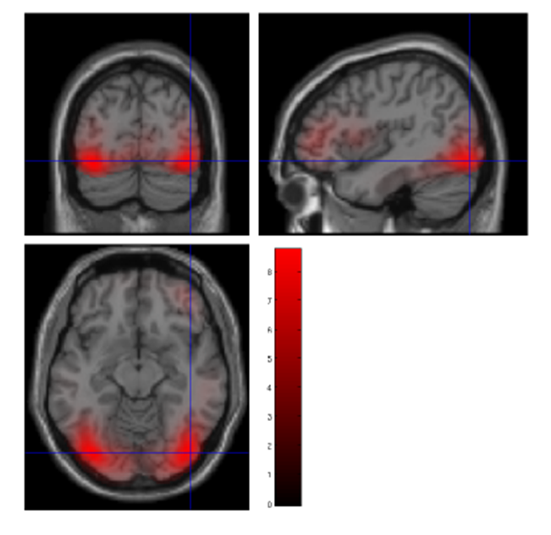
Summarise inverse reconstruction as an image

Slide 30
Equivalent Current Dipole (ECD)
Small number of parameters compared to amount of data
Prior information required
MEG data
Y=f(a)+e
Reconstructs Subcortical data
Reconstructs early components ERPs (Event related potentials)
Requires estimate of dipole direction
Problem
Non-linear optimisation

Slide 31
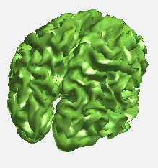
Dipole Fitting
Estimated data
Estimated Positions
Measured data

Slide 32
Variational bayesian- ECD
Priors for source locations can be specified.
Estimates expected source location and its conditional variance.
Model comparison can be used to compare models with different number of sources and different source locations.

Slide 33
VB-ECD
ASSUMPTIONS
Only few sources are simultaneously active
Sources are focal
Independent and identical normal distribution for errors
Iterative scheme which estimates posterior distribution of parameters
  Number of ECDs must not exceed no of channels÷6
  Non-linear form- optimise dipole parameters given observed potentials
  takes into account model complexity
  Prepare head model as for 3D
Notes:
Specific question is usually required for application.

Slide 34
Extras
Rendering interface: extra features e.g. videos
Group inversion: for multiple datasets
Batching source reconstruction: different contrasts for the same inversion

Slide 35
IN SPM
Activate SPM for M/EEG: type spm eeg on MATLAB command line enter
GUI INTERFACE BETTER FOR NEW USERS LIKE ME!!!!! Instructions are clearly outlined.

Slide 36
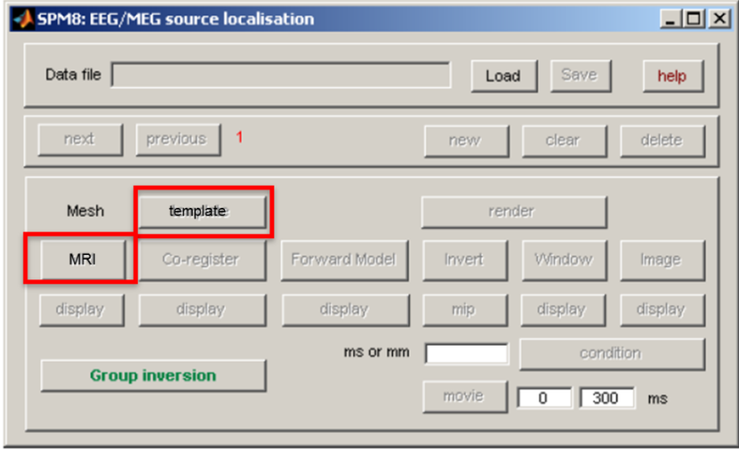
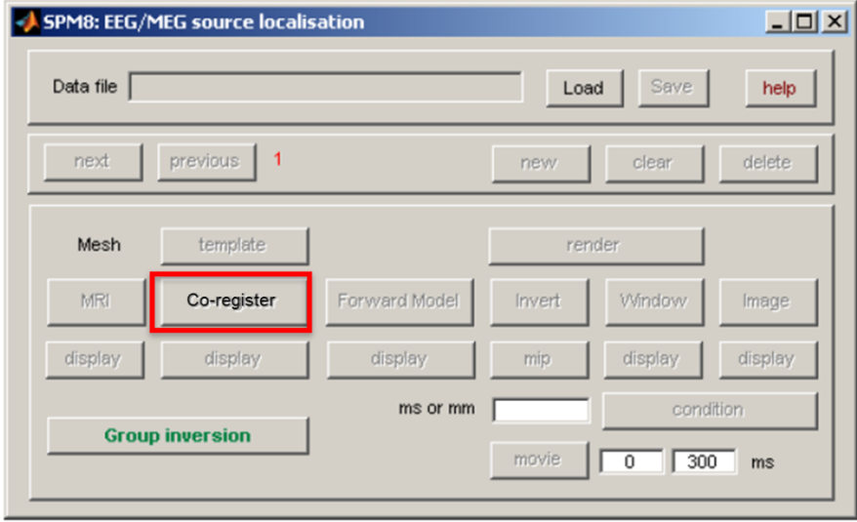
SPM Buttons 1

Slide 37
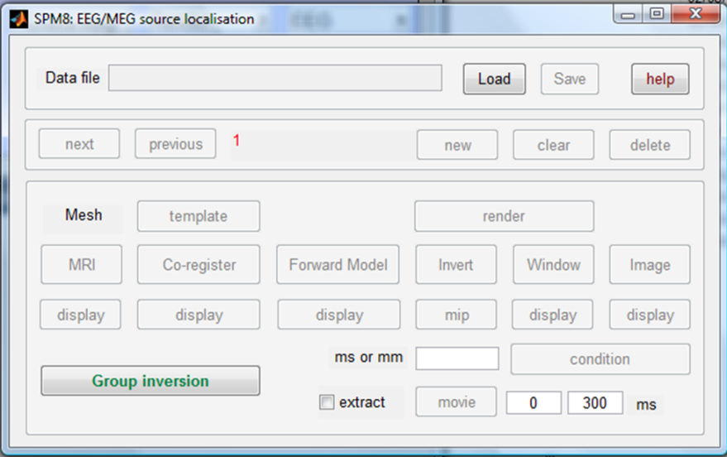
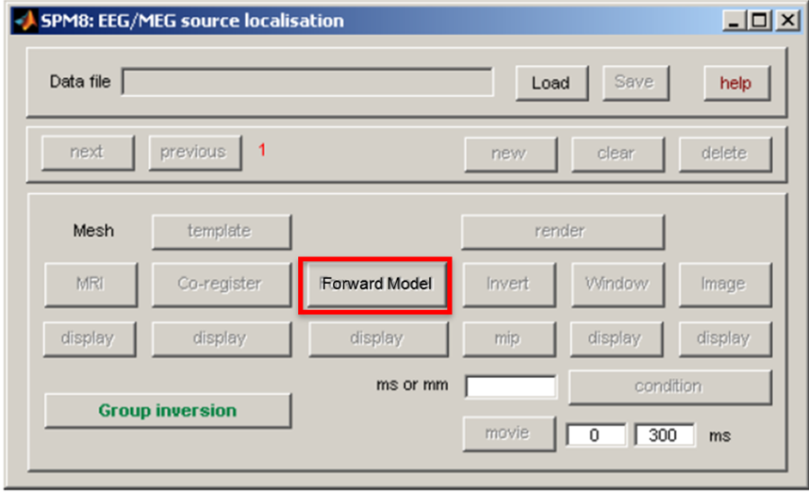
2
Forward computation
inversion

Slide 38
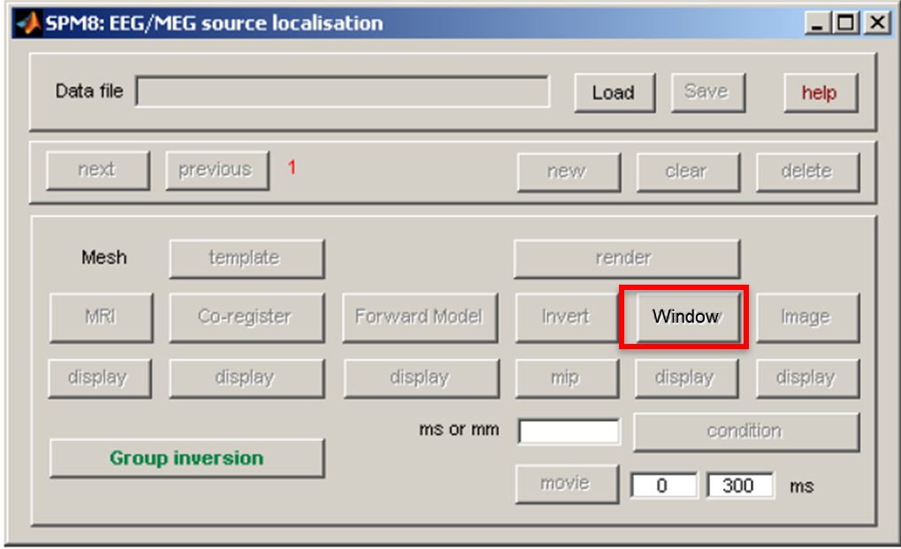
3

Slide 39
REFERENCES
SPM Course – May 2012 – London
SPM-M/EEG Course Lyon, April 2012
Tolga Esat Ozkurt-High Temporal Resolution brain Imaging with EEG/MEG Lecture 10: Statistics for M/EEG data
James Kilner and Karl Friston. 2010.Topological Inference for EEG and MEG. Annals of Applied Statistics Vol 4:3 pp 1272-1290
Vladimir Litvak et al. 2011. EEG and MEG data analysis in SPM 8. Computational Intelligence and Neuroscience Vol 2011
MFD 2011/12

