Slide 1

STUDY DESIGN AND EFFICIENCY
Ioannis Sarigiannidis & Diego Lorca
MfD – Wednesday 23rd January 2013

Slide 2
(fMRI) STUDY DESIGN AND EFFICIENCY
Ioannis Sarigiannidis & Diego Lorca

Slide 3
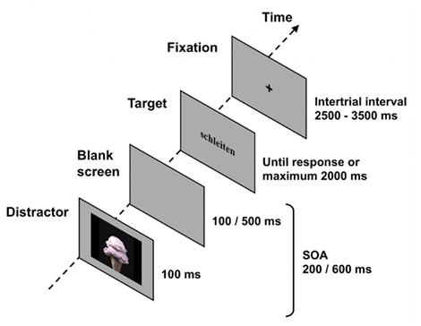
Some basic terminology…
Trials may consist of
  ‘events’ (burst of neural activity)
  blocks’ (sustained neural activity)
ITI (intertrial interval): time between the end of a trial and the beginning of the next one
SOA (stimulus onset asynchrony): time between the onset of components

Slide 4
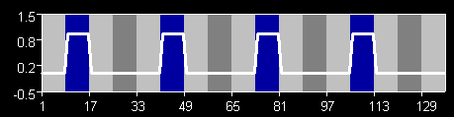
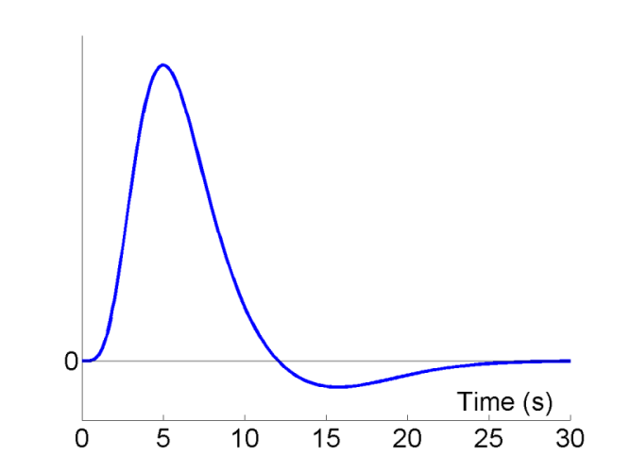
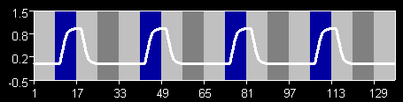
Some basic concepts…
PREDICTED ACTIVATION IN VISUAL AREA
BOXCAR
x
(convolve)
CONVOLVED
WITH HRF

Slide 5
Calculate Efficiency
General Linear Model:
Y = X . β + ε
Data Design Matrix Parameters error
Efficiency(e) is the ability to estimate β, given the design matrix (X) for a particular contrast (c)
  e (c, X) = inverse (σ² c^{T} Inverse(X^{T}X) c)
  All we can alter in this equation is in fact X

Slide 6
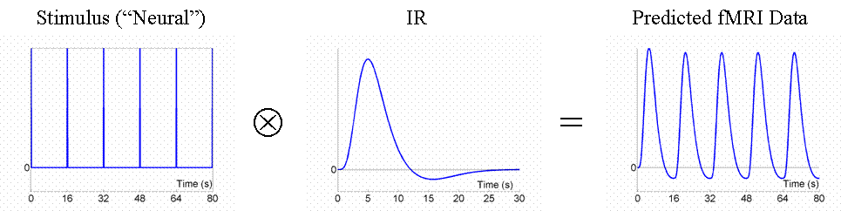
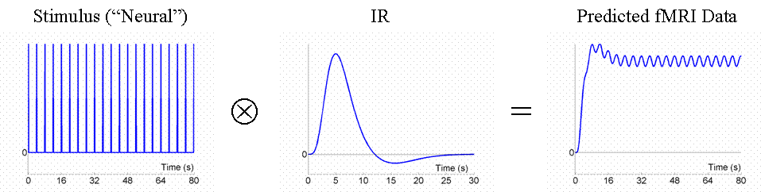
Design examples
-A signal that varies little will be difficult to detect.
Fixed SOA 16s
HRF
Fixed SOA 4s: low variance
HRF

Slide 7
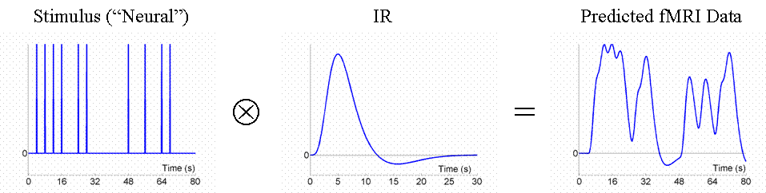
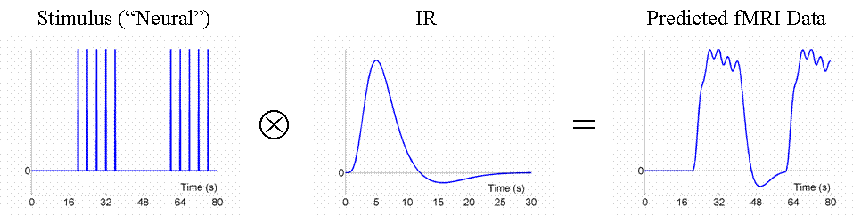
Design examples (2)
Random SOA minimum 4s e.g. event-related: larger variability in signal
HRF
Blocked, SOA 4s: larger variability in signal
HRF

Slide 8
Fourier transform 101
All waveforms in the universe, are actually just the sum of simple sinusoids of different frequencies.

Slide 9
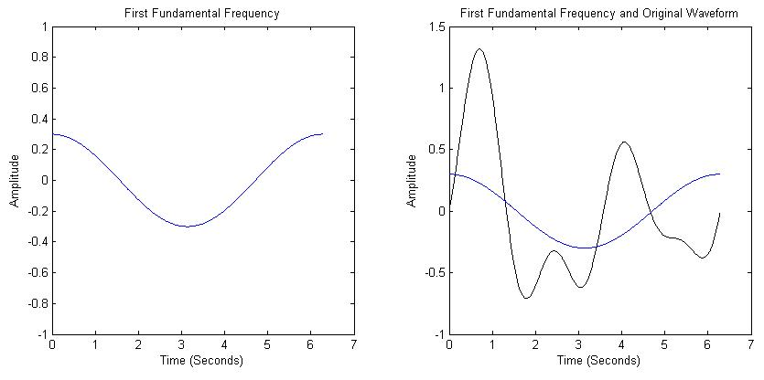
A (no-maths-involved) demonstration
the one we want to decompose into its “building blocks”
first component
prediction

Slide 10
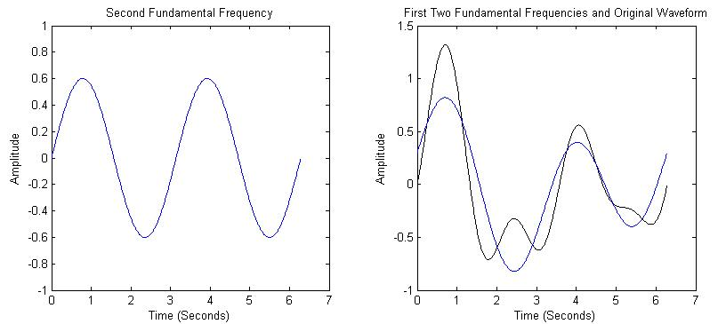
A (no-maths-involved) demonstration
the one we want to decompose into its “building blocks”
second component
prediction

Slide 11
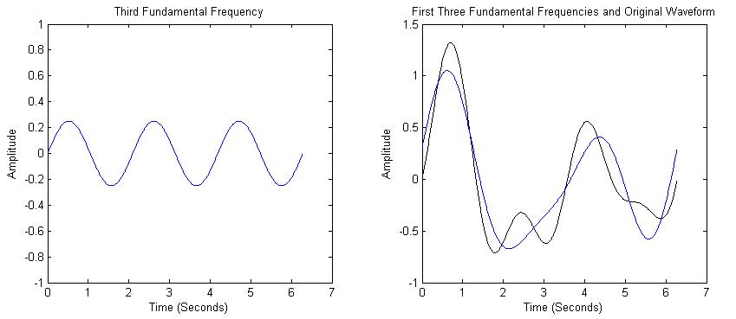
A (no-maths-involved) demonstration
the one we want to decompose into its “building blocks”
third component
prediction

Slide 12
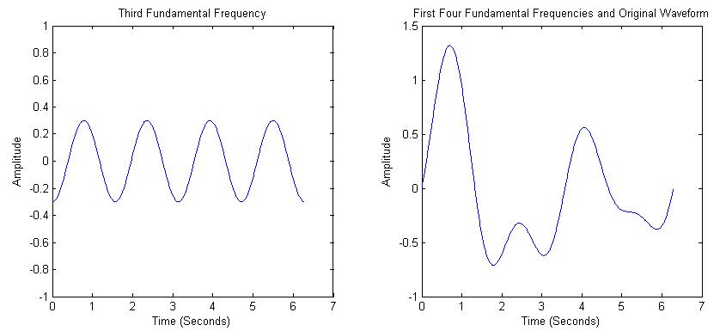
A (no-maths-involved) demonstration
fourth component
prediction==initial waveform

Slide 13
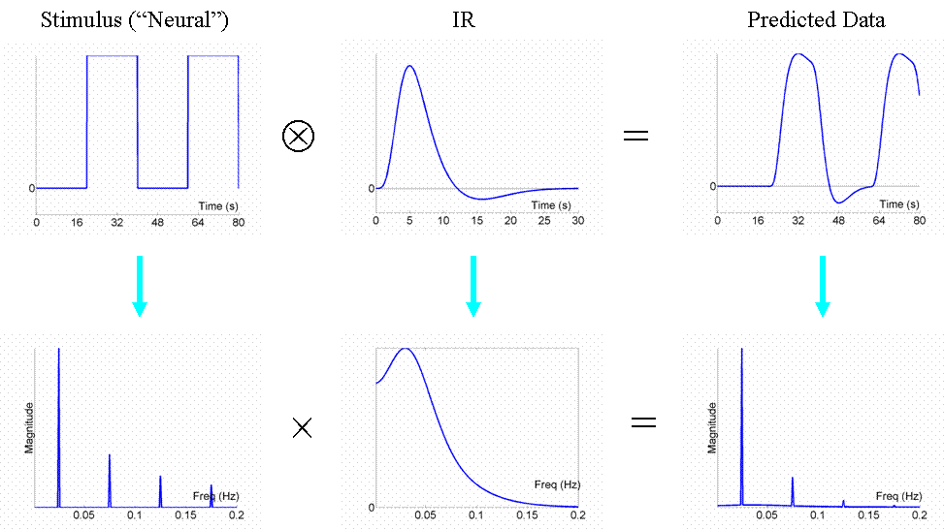
Fourier transform
HRF
Low pass filter!

Slide 14
So what is the most efficient design?

Slide 15
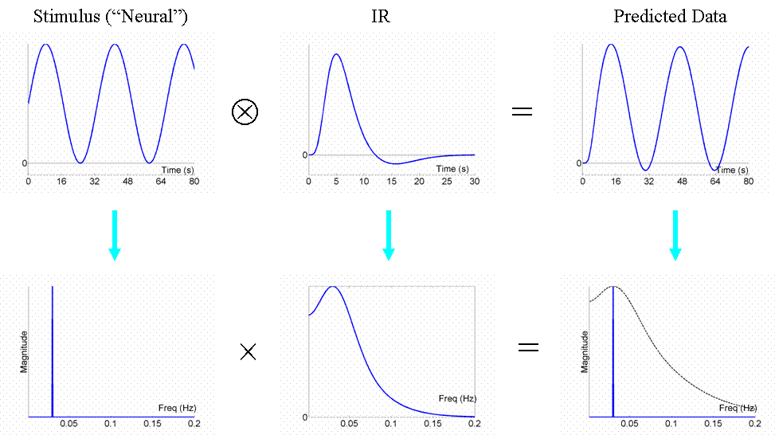
Most efficient design
HRF

Slide 16
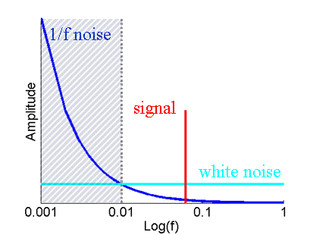
High-pass filter
fMRI noise tends to have two components:
  Low frequency ‘1/f’ noise
  -physical (scanner drifts);
  -physiological [cardiac (~1 Hz);
  respiratory (~0.25 Hz)]
  Background white noise
SPM uses a high-pass filter
  Goal: maximise noise reduction & minimise loss of signal.
High-pass filter + low-pass filter (inherent) = ‘band-pass’ filter

Slide 17
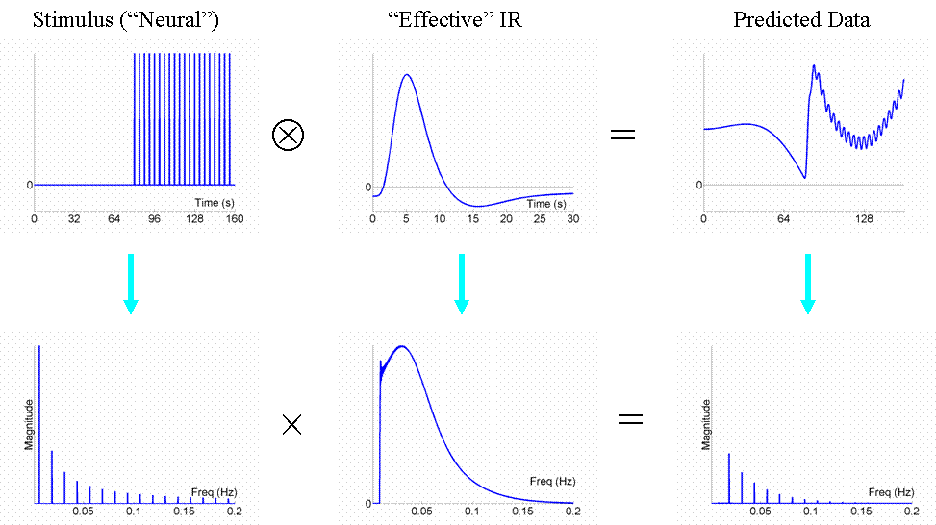
Long blocks (over 50s) → Less efficiency
HRF
x
frequency is lower than high-pass cutoff so, much energy is lost

Slide 18
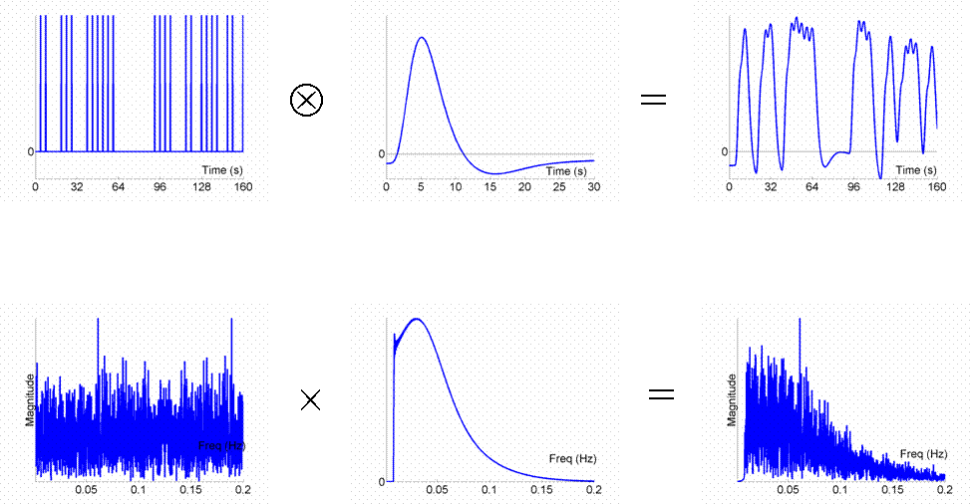
Randomised SOA → More efficiency

Slide 19
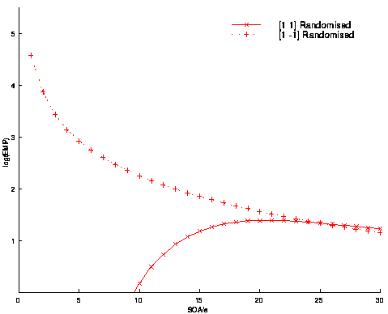
Timing: Randomised design
With randomised designs,
  optimal SOA for differential effect (A-B) is minimal SOA (>2 seconds),
  optimal SOA for main effect (A+B) is 16-20s
Differential Effect (A-B)
Common Effect (A+B)
4s smoothing; 1/60s highpass filtering

Slide 20
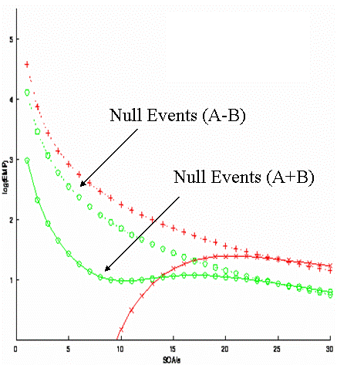
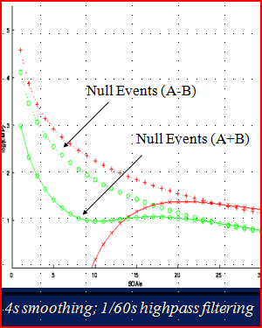
Timing: sampling
Introducing null events
→ Efficiency for differential and main effects at short SOA

Slide 21
Efficiency for fMRI experiments
Blocked designs generally more efficient
  keep SOAs short
  do not exceed optimal block length
Randomize the order, or randomize the SOA, of conditions that are close in time.

Slide 22
STUDY DESIGN AND EFFICIENCY
Ioannis Sarigiannidis & Diego Lorca

Slide 23
Cautions
Functional MRI is difficult.
Experiments on cognition are that much more difficult because cognitive function is a moving target.
Experimental design is not as self-consistent nor as theory-based as most of the other aspects of fMRI-based research.
(Savoy, 2005)

Slide 24
Paradigm Design
Paradigm
Scientific question
Hypothesis
Construction
Temporal organization
Behavioural predictions
Neuroanatomical basis
Suitable for Neuroimaging?
(Amaro & Barker, 2006)
Notes:
The main design goal is to test specific hypotheses. In order to accomplish this we manipulate the participants experience and behaviour in some way that is likely to produce a functionally specific neurovascular response. And, what can we manipulate? Basically:
Stimulus type and properties
Stimulus timing
Participant instructions

Slide 25
Experimental Design
Categorical
comparing the activity between stimulus types.
Parametric
continuous values, and may have as many ‘levels’ as there are values (Henson, 2006).
Factorial
combining two or more factors within a task and looking at the effect of one factor on the response to other factor.

Slide 26
FACTORIAL DESIGN
Simple Main Effects
e.g. A-B = Simple main effect of Treatment (vs. Control) in the context of Drug 1
Main Effects
e.g. (A + B) – (C + D) = the main effect of Drug 1 (vs. Drug 2) irrelevant of Psychotherapy
Interaction Terms
e.g. (A - B) – (C – D) = the interaction effect of Treatment (vs. Control) greater under Drug 1 (vs. 2)
PSYCHOTHERAPY
TREATMENT CONTROL
A B
C D
1
DRUG
2

Slide 27
FACTORIAL DESIGN IN SPM
Main effect of Drug 1:
(A + B) – (C + D)
Simple main effect of Treatment in the context of Drug 1:
(A – B)
Interaction term of Treatment greater under Drug 1:
(A – B) – (C – D)
A B C D
[1 1 -1 -1]
A B C D
[1 -1 0 0]
A B C D
[1 -1 -1 1]

Slide 28
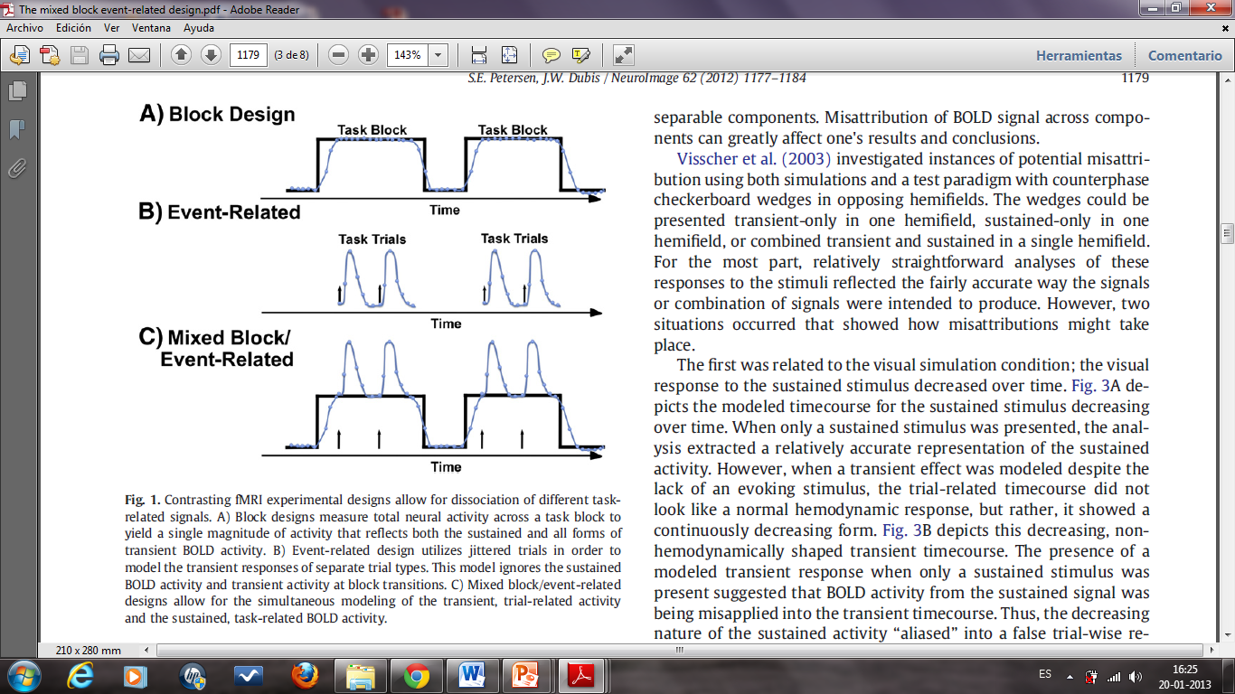
Stimulus Presentation Strategies
Blocked
based on maintaining cognitive engagement in a task by presenting stimuli sequentially within a condition, alternating this with other moments (epochs) when a different condition is presented (Amaro & Barker, 2006).
“on” Block
“off” Block
(Petersen & Dubis, 2012)

Slide 29
Advantages:
Robustness of results.
Disadvantages:
Induce differences in the cognitive ‘set’ or strategies adopted by subjects.
Increased statistical power.
Relatively large BOLD signal change related to baseline.
Cannot distinguish between trial types within a block.
(Amaro & Barker, 2006; Henson, 2006; Petersen & Dubis, 2012)

Slide 30
Event-related
discrete and short-duration events are presented with timing and order that may be randomized (Tie et al., 2009).
Slow event-related design
longer
inter-stimulus-interval (ISI)
HRF
Rapid event-related design
shorter
(Petersen & Dubis, 2012)

Slide 31
Advantages:
Analyses related to individual responses to trials.
Less sensitivity to head motion artifacts
Can be used to assess practice effects.
Randomization of the order of conditions presented.
Can also vary the time between stimulus presentation.
Post hoc methods.
Maintenance of a particular cognitive or attentional set.
Decrease the latitude the subject has for engaging alternative strategies.
Disadvantages:
Reduced ability to estimate the HRF properties of a single stimulus (Rapid event-related fMRI)
Linearity versus non-linearity of the BOLD interaction in overlapping HRFs (Rapid event-related fMRI).
Decrease of signal-to-noise.
(Amaro & Barker, 2006; Friston, 2003; Petersen & Dubis, 2012)

Slide 32
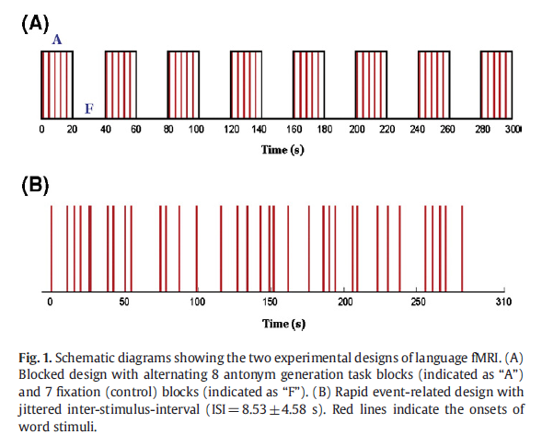
(Tie, 2009)
Pre-surgical mapping
Antonym generation task
Blocked design VS Event-related design
Up….Down
Remember jittering!!!

Slide 33
Mixed designs
A combination of block and event-related designs can provide information relating to ‘maintained’ versus ‘transient’ neural activity during paradigm performance.
baseline
Task block
events
Advantages:
Item-related pattern of information processing (transient activity).
Task-related information processing (sustained activity).
Disadvantages:
Involves more assumptions than other designs.
Issues associated with poorer HRF shape estimation.
Post hoc analysis of behaviour correlated activation.
Power considerations.
(Amaro & Barker, 2006; Petersen & Dubis, 2012)

Slide 34
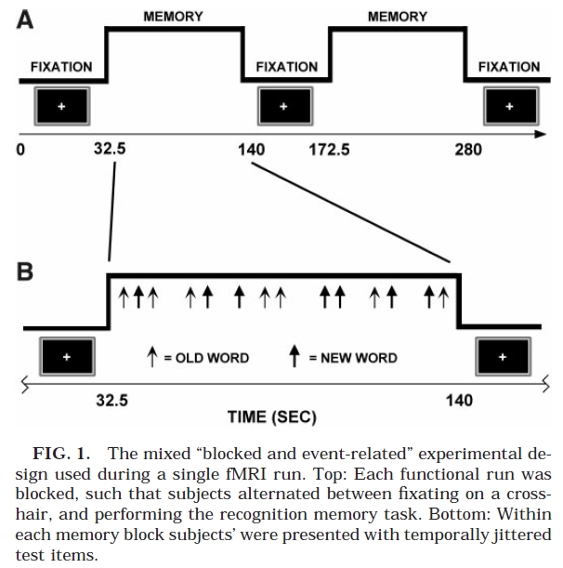
(Donaldson et al., 2001)

Slide 35
NOVEL EXPERIMENTAL PARADIGMS
fMRI Adaptation (Repetition Suppression)
fMRI responses
Pairs of stimuli
Identical feature
VS
Stimulus pairs
Differ in the feature
Reduced responses
Identical pairs VS nonidentical pairs
Neuronal selectivity
Similar responses
Repetitions and non repetitions
Lack of selectivity
(Larsson & Smith, 2012)

Slide 36
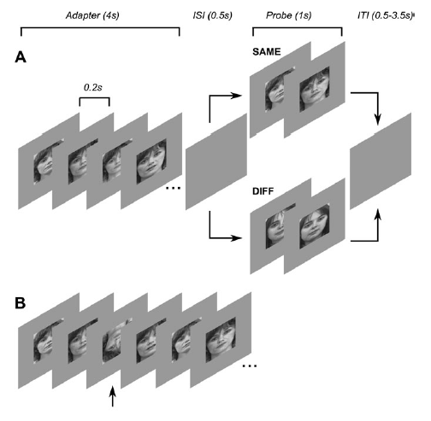
(Larsson & Smith, 2012)
Main Advantage:
Potential superiority over standard fMRI paradigms with regard to tapping into functional specificity of neuronal populations (Segaert et al., 2013).

Slide 37
Resting state fMRI
An alternative to the paradigms used in conventional designs is to let the subject lay inside the MR scanner doing nothing, and observe variations of the BOLD response related to spontaneous activity, or ‘resting state’.
Advantages:
Method of functional connectivity.
Disadvantages:
May have limitations related to linearity properties of overlapping HRFs.
Statistical power of the study is largely unknown beforehand.
(Amaro & Barker, 2006; Lowe, 2012)

Slide 38
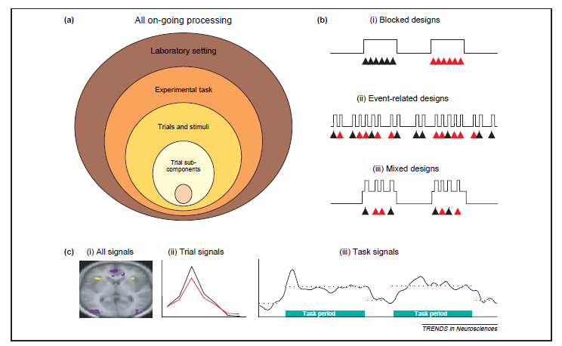
CONCLUSION
(Donaldson, 2004)
Think about your study EFFICIENCY, DESIGN and CONTRASTS before you start!

Slide 39
References
http://imaging.mrc-cbu.cam.ac.uk/imaging/DesignEfficiency
http://www.thefouriertransform.com/
Previous MfD slides
Amaro, E., & Barker, G. J. (2006). Study design in fMRI: Basic principles. Brain and Cognition, 60, 220-232. doi: 10.1016/j.bandc.2005.11.009
Donaldson, D. I. (2004). Parsing brain activity with fMRI and mixed designs: what kind of a state is neuroimaging in? Trends in Neurosciences, 27, 442-444. doi: 10.1016/j.tins.2004.06.001
Donaldson, D. I., Petersen, S. E., Ollinger, J. M., & Buckner, R. L. (2001). Dissociating state and item components of recognition memory using fMRI. Neuroimage, 13, 129-142. doi: 10.1006/nimg.2000.0664
Friston, K. J. (2004). Introduction: experimental design and statistical parametric mapping. In R. S. J. Frackowiak et al. (Eds.), Human brain function (pp. 599-634). London: Academic Press.
Henson, R. (2006). Efficient experimental design for fMRI. In K. J. Friston, J. T. Ashburner, S. T. Kiebel, T. E. Nichols, & W. D. Penny (Eds.), Statistical parametric mapping: The analysis of functional brain images (pp. 193-210). London: Academic Press.

Slide 40
Larsson, J., & Smith, A. T. (2012). fMRI repetition suppression: Neuronal adaptation or stimulus expectation? Cerebral Cortex, 22, 567-576. doi: 10.1093/cercor/bhr119
Lowe, M. J. (2012). The emergence of doing ''nothing'' as a viable paradigm design. Neuroimage, 62, 1146-1151. doi: 10.1016/j.neuroimage.2012.01.014
Petersen, S. E., & Dubis, J. W. (2012). The mixed block/event-related design. Neuroimage, 62, 1177-84. doi: 10.1016/j.neuroimage.2011.09.084
Savoy, R. L. (2005). Experimental design in brain activation MRI: Cautionary tales. Brain Research Bulletin, 67, 361-367. doi: 10.1016/j.brainresbull.2005.06.008
Segaert, K., Weber, K., de Lange, F. P., Petersson, K. M., & Hagoort, P. (2013). The suppression of repetition enhancement: A review of fMRI studies. Neuropsychologia, 51, 59–66. doi: 10.1016/j.neuropsychologia.2012.11.006
Tie, Y., Suarez, R. O., Whalen, S., Radmanesh, A., Norton, I. H., & Golby, A. J. (January 01, 2009). Comparison of blocked and event-related fMRI designs for pre-surgical language mapping. Neuroimage, 47, T107–T115. doi: 10.1016/j.neuroimage.2008.11.020

Slide 41
Special thanks to our expert
Thomas Fitzgerald!

