Slide 1
Methods for Dummies
Coregistration and
Spatial Normalization
Nov 14th
Marion Oberhuber and Giles Story

Slide 2
fMRI
fMRI data as 3D matrix of voxels repeatedly sampled over time.
fMRI data analysis assumptions
  Each voxel represents a unique and unchanging location in the brain
  All voxels at a given time-point are acquired simultaneously.
    These assumptions are always incorrect, moving by 5mm can mean each voxel is derived from more than one brain location. Also each slice takes a certain fraction of the repetition time or interscan interval (TR) to complete.
Issues:
- Spatial and temporal inaccuracy
- Physiological oscillations (heart beat and respiration)
- Subject head motion

Slide 3
Preprocessing
Computational procedures applied to fMRI data before statistical analysis to reduce variability in the data not associated with the experimental task.
Regardless of experimental design (block or event) you must do preprocessing
Remove uninteresting variability from the data
  Improve the functional signal to-noise ratio by reducing the total variance in the data
2. Prepare the data for statistical analysis

Slide 4

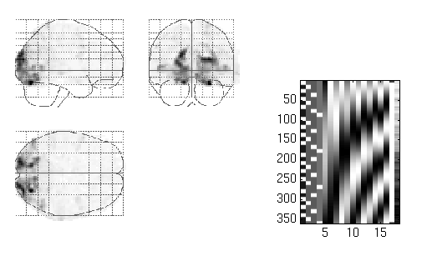
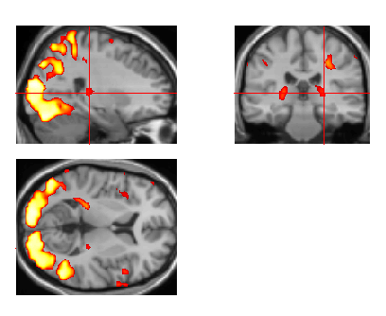
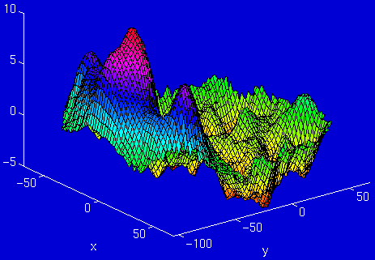
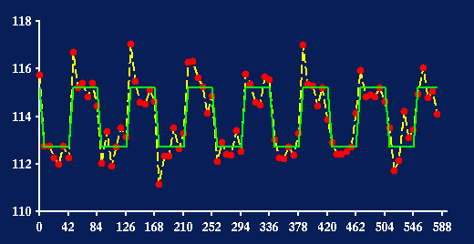
Overview
fMRI time-series
kernel
Design matrix
Statistical Parametric Map
Motion
Correction
(Realign & Unwarp)
Smoothing
General Linear Model
Co-registration
Spatial normalisation
Parameter Estimates
Standard
template

Slide 5
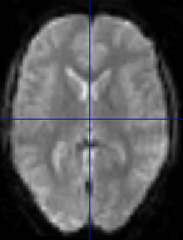
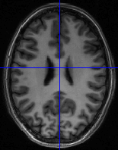
Coregistration
Coregistration
Aligns two images from different modalities (i.e. Functional to structural image) from the same individual (within subjects).
Similar to realignment but different modalities.
How does activity map onto anatomy? How consistent is this across subjects?
Functional Images have low resolution
Structural Images have high resolution (can distinguish tissue types)
Allows anatomical localisation of single subject activations; can relate changes in BOLD signal due to experimental manipulation to anatomical structures.
Achieve a more precise spatial normalisation of the functional image using the anatomical image.

Slide 6
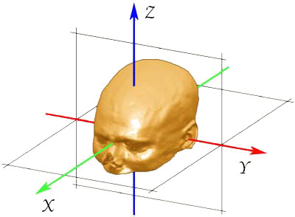
Coregistration
Steps
Registration – determine the 6 parameters of the rigid body transformation between each source image (i.e. fmri) and a reference image (i.e. Structural) (How much each image needs to move to fit the source image)
Rigid body transformation assumes the size and shape of the 2 objects are identical and one can be superimposed onto the other via 3 translations and 3 rotations
Z
X
Y

Slide 7
Realigning
Transformation – the actual movement as determined by registration (i.e. Rigid body transformation)
Reslicing - the process of writing the “altered image” according to the transformation (“re-sampling”).
Interpolation – way of constructing new data points from a set of known data points (i.e. Voxels). Reslicing uses interpolation to find the intensity of the equivalent voxels in the current “transformed” data.
Changes the position without changing the value of the voxels and give correspondence between voxels.

Slide 8
Coregistration
Different methods of Interpolation
1. Nearest neighbour (NN) (taking the value of the NN)
2. Linear interpolation – all immediate neighbours (2 in 1D, 4 in 2D, 8 in 3D) higher degrees provide better interpolation but are slower.
3. B-spline interpolation – improves accuracy, has higher spatial frequency
(NB: NN and Linear are the same as B-spline with degrees 0 and 1)
NB: the method you use depends on the type of data and your research question, however the default in SPM is 4th order B-spline

Slide 9
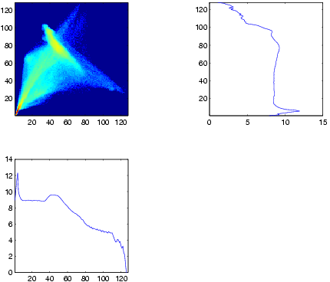
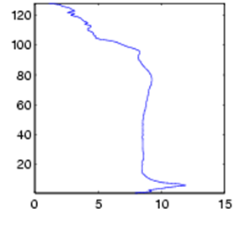
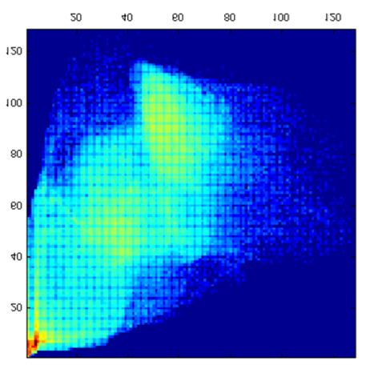
Coregistration
As the 2 images are of different modalities, a least squared approach cannot be performed.
To check the fit of the coregistration we look at how one signal intensity predicts another.
The sharpness of the Joint Histogram correlates with image alignment.

Slide 10
Overview
fMRI time-series
kernel
Design matrix
Statistical Parametric Map
Motion
Correction
(Realign & Unwarp)
Smoothing
General Linear Model
Co-registration
Spatial normalisation
Parameter Estimates
Standard
template

Slide 11
Preprocessing Steps
Realignment (& unwarping)
  Motion correction: Adjust for movement between slices
Coregistration
  Overlay structural and functional images: Link functional scans to anatomical scan
Normalisation
  Warp images to fit to a standard template brain
Smoothing
  To increase signal-to-noise ratio
Extras (optional)
  Slice timing correction; unwarping

Slide 12
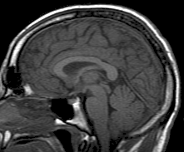
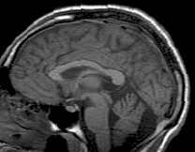
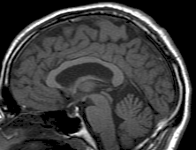
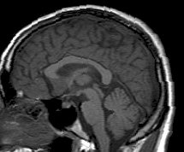
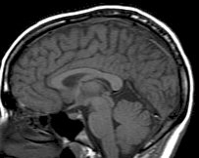
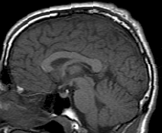
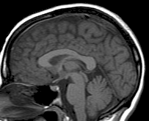
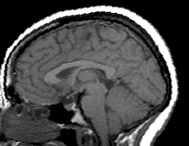
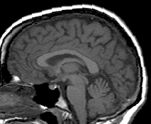
Within Person vs. Between People
Co-registration: Within Subjects
Between Subjects Problem:
Brain morphology varies significantly and fundamentally, from person to person
(major landmarks, cortical folding patterns)
Prevents pooling data across subjects (to maximise sensitivity)
Cannot compare findings between studies or subjects in standard coordinates
Notes:
Coregistration – allows to specify anatomical locations of functional activation within subjects
What if we want to compare results between subjects? Need to specify function in a standard anatomical space. You may want to ensure that your findings are representative, rather than an isolated neurological quirk.
Also to maximise sensitivity to detect neurophys changes in response to experimental manipulations – sometimes need to pool data between subjects. E.g. if want to detect which areas are active in response to faces – if same voxel in each image does not refer to same area – less likely to find sig effects at the relevant voxels.
However, not every functional imaging unit has
ready access to a high-quality magnetic resonance
(MR) scanner, so for many functional imaging studies
there are no structural images of the subject available
to the researcher. In this case, it is necessary to
determine the required warps based solely on the
functional images. These images may have a limited
field of view, contain very little useful signal, or be
particularly noisy. An ideal spatial normalization routine
would need to be robust enough to cope with this
type of data. Ashburner & Friston 1999

Slide 13
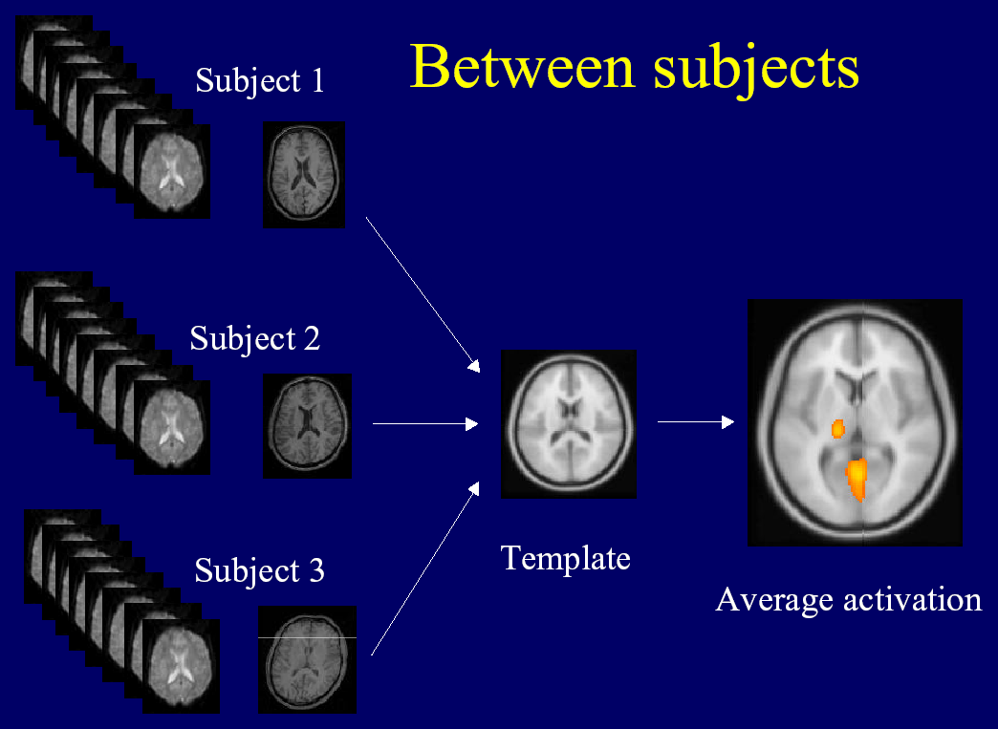
Spatial Normalisation
Solution:
Match all images to a template brain.
A kind of co-registration, but one where images fundamentally differ in shape
Template fitting: stretching/squeezing/warping images, so that they match a standardized anatomical template
➔ The goal is to establish functional voxel-to-voxel correspondence, between brains of different individuals
Notes:
Equivalent problem to realignment and coregistration – but more difficult because images differ fundamentally – cannot be described as rigid body transformations alone
Anatomical variability and structural changes due to pathology can be framed in terms of the transformations required to map the abnormal onto the normal. Friston et al 1996
Aim is to establish functional voxel-to-voxel correspondence, between brains of different individuals – so that each voxel of every image refers to the same anatomical structure across individuals
And even more than this (see later) refers to a functionally homologous area.

Slide 14
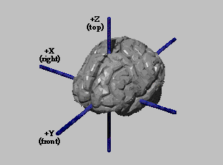
Why Normalise?
Matching patterns of functional activation to a standardized anatomical template allows us to:
Average the signal across participants
Derive group statistics
Improve the sensitivity/statistical power of the analysis
Generalise findings to the population level
Group analysis: Identify commonalities/differences between groups (e.g. patient vs. healthy)
Report results in standard co-ordinate system (e.g. MNI) → facilitates cross-study comparison
Notes:
Advantage of using spatially normalized
images is that activations can be reported according
to a set of meaningful Euclidian coordinates within
a standard space [Fox, 1995].
Tries to provide a solution to the problems outlined
If you only have a few images per subject, you may HAVE to combine data from different subjects in order to find your effect statistically
With many functional images from one subject, you may have enough statistical power to produce findings. BUT you want to ensure that your findings are representative, rather than an isolated neurological quirk
Even if you’re only looking at one subject (e.g. with a particular lesion), aligning to standardized space/normalizing enables you to communicate your findings in a way that is easily interpreted by other researchers

Slide 15
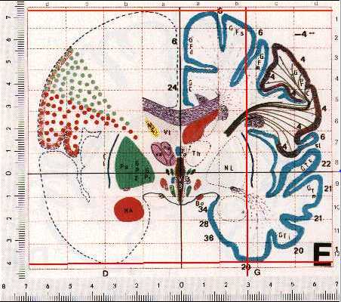
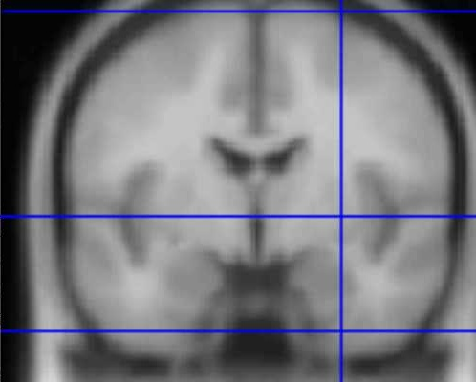
How? Need a Template
(Standard Space)
The Talairach Atlas
The MNI/ICBM AVG152 Template
Talairach:
  Not representative of population (single-subject atlas)
  Slices, rather than a 3D volume (from post-mortem slices)
MNI:
  Based on data from many individuals (probabilistic space)
  Fully 3D, data at every voxel
  SPM reports MNI coordinates (can be converted to Talairach)
  Shared conventions: AC is roughly [0 0 0], xyz axes = right-left, anterior-post superior-inferior
Notes:
In the absence of any constraints it is of course possible to transform any image such that it matches another exactly. The issue is therefore less about the nature of the transformation and more about defining
the constraints under which the transformation is effected.

Slide 16
Types of Spatial Normalisation
We want to match functionally homologous regions between different subjects:
an optimisation problem
Determine parameters describing a transformation/warp
Label based (anatomy based)
  Identify homologous features (points, lines, surfaces ) in the image and template
  Find the transformations that best superimpose them
  Limitation: Few identifiable features, manual feature-identification (time consuming and subjective)
Non-label based (intensity based)
  Identifies a spatial transformation that maximises voxel similarity, between template and image measure
    Optimization = Minimize the sum of squares, which measures the difference between template and source image
  Limitation: susceptible to poor starting estimates (parameters chosen)
    Typically not a problem – priors used in SPM are based on parameters that have emerged in the literature
    Special populations
Notes:
Priors/parameters – refer to the affine transformations (step 1) and the weights of the basis functions (step 2)
Spatial transformations can be broadly classified as label based and non-label based.
Label-based techniques identify homologous spatial structures, features, or landmarks in two images and find the transformation that best superposes the labelled points. These transformations can be linear [e.g., Pelizzari et al., 19881 or nonlinear (eg, thin plate splines [Bookstein, 19891).Label-based approaches are less reliable because they are non-automatic - Homologous features are often identified manually, but this process is time-consuming and subjective.
Non-label-based approaches identify a spatial transformation that minimizes some index of the difference between an object and a reference image, where both are treated as unlabelled continuous processes. The
matching criterion is usually based upon minimizing the sum of squared differences or maximizing the correlation coefficient between the images. For this criterion to be successful, there must be correspondence in the gray levels of the different tissue types between the image and template.

Slide 17
Optimisation
  Computationally complex
    Flexible warp = thousands of parameters to play around with
    More distortion vectors than voxels
    Even if it were possible to match all our images perfectly to the template, we might not be able to find this solution
  2) Structurally homologous?
    No one-to-one structural relationship between different brains
    Matching brains exactly means folding the brain to create sulci and gyri that do not really exist
  3) Functionally homologous?
    Structure-function relationships differ between subjects
    Co-registration algorithms differ (due to fundamental structural differences)
    → standardization/full alignment of functional data is not perfect
    Coregistering structure may not be the same as coregistering function
    Even matching gyral patterns may not preserve homologous functions
Notes:
Optimization= aim to match images to template as much as possible
BUT: constrained by anatomical plausibility of results (see over-fitting)
There is the registration itself,
whereby the parameters describing a transformation
are determined. Then there is the transformation, where
one of the images is transformed according to the set of
parameters.
Flexible warp
A potentially enormous number of parameters are required to describe the nonlinear transformations that warp two images together
Accepting our limitations! There may not be a perfect solution.
The rational for adopting a low dimensional approach is that there is not necessarily a one-to-one mapping between any pair of brains. Different subjects have different patterns of gyral convolutions, and even if gyral anatomy can be matched exactly, this is no guarantee that areas of functional specialization will be matched in a homologous way.
For the purpose of averaging signals from functional images of different subjects, very high-resolution spatial normalization may be unnecessary or unrealistic.
Another approach is to reduce the number of parameters that model the deformations. Some groups simply use only a 9- or 12-parameter affine transformation to spatially normalize their images, accounting for differences in position, orientation, and overall brain size. Low spatial frequency global variability in head shape can be accommodated by describing deformations by a linear combination of low-frequency basis functions. The small number of parameters will not allow every feature to be matched exactly, but it will permit the global head shape to be modeled.
Thousands of parameters, but they are not arbitrarily chosen.
The parameters chosen as starting estimates are deemed reasonable on the basis of past literature (i.e. have emerged historically, empirically, through other methods of spatial normalization that have used more anatomical approaches). SPM starts with these starting estimates, and then attempts to improve the model by changing the parameters, and observing the results (i.e. observing how well the images match the template, index by looking at the sum of squares)

Slide 18
The SPM Solution
Correct for large scale variability (e.g. size of structures)
Smooth over small-scale differences (compensate for residual misalignments)
Use Bayesian statistics (priors) to create anatomically plausible result
SPM uses the intensity-based approach
  Adopts a two-stage procedure:
    12-parameter affine
    Linear transformation: size and position
    Warping
    Non-linear transformation: deform to correct for e.g. head shape
    Described by a linear combination of low spatial frequency basis functions
    Reduces number of parameters
Notes:
Priors/parameters – refer to the affine transformations (step 1) and the weights of the basis functions (step 2)
Spatial transformations can be broadly classified as label based and non-label based.
Label-based techniques identify homologous spatial structures, features, or landmarks in two images and find the transformation that best superposes the labelled points. These transformations can be linear [e.g., Pelizzari et al., 19881 or nonlinear (eg, thin plate splines [Bookstein, 19891).Label-based approaches are less reliable because they are non-automatic - Homologous features are often identified manually, but this process is time-consuming and subjective.
Non-label-based approaches identify a spatial transformation that minimizes some index of the difference between an object and a reference image, where both are treated as unlabelled continuous processes. The
matching criterion is usually based upon minimizing the sum of squared differences or maximizing the correlation coefficient between the images. For this criterion to be successful, there must be correspondence in the gray levels of the different tissue types between the image and template.

Slide 19
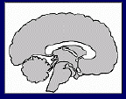
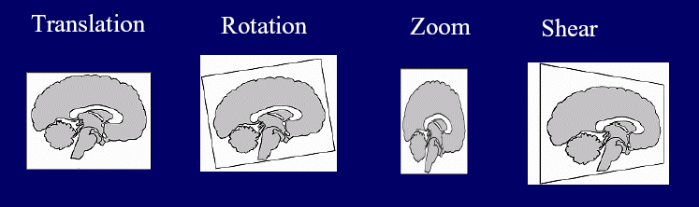
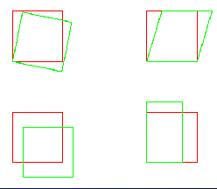
Step 1: Affine Transformation
Determines the optimum 12-parameter affine transformation to match the size and position of the images
12 parameters =
  3df translation
  3 df rotation
  3 df scaling/zooming
  3 df for shearing or skewing
Fits the overall position, size and shape
Rotation
Shear
Translation
Scale/Zoom
Notes:
Linear transformation is not enough to make the brains look even remotely similar

Slide 20
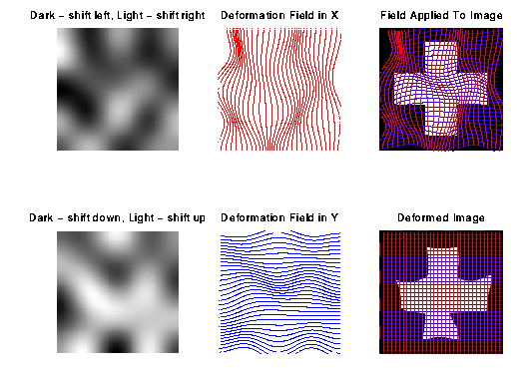
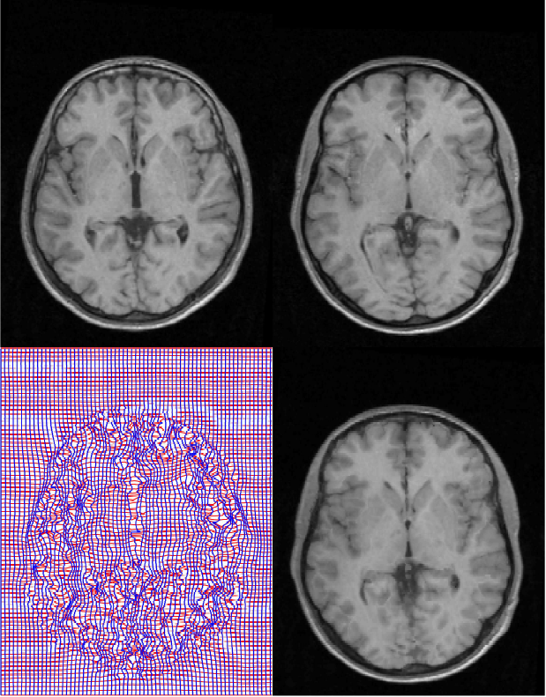
Step 2: Non-linear Registration (warping)
Warp images, by constructing a deformation map (a linear combination of low-frequency periodic basis functions)
  For every voxel, we model what the components of displacement are
Gets rid of small-scale anatomical differences
Notes:
Image
Image on top = original
To get it to fit the template, we warp it ➔ deformed cross, deformed relative to original, but now fits template
How to do this:
For every point in the image (every voxel in 3D), we model what the components of displacement are.
Dark/light image: deformation map? Displacement field, we need to parsimonously model this (otherwise there would be as many vectors as voxels)
To parsimonously model the deformation field, we use a combination of smooth basis functions
The approach adopted minimizes the residual squared difference
between an image and a template of the same modality. In order to reduce the number of parameters to be
fitted, the nonlinear warps are described by a linear combination of low spatial frequency basis functions.
The objective is to determine the optimum coefficients for each of the bases by minimizing the sum of
squared differences between the image and template, while simultaneously maximizing the smoothness of
the transformation using a maximum a posteriori (MAP) approach

Slide 21
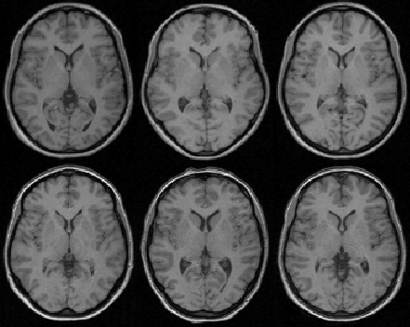
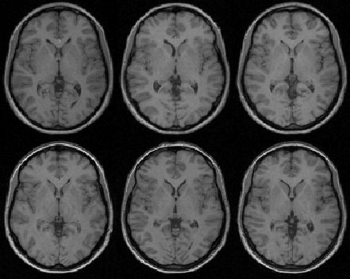
Results from Spatial Normalisation
Affine registration
Non-linear registration
Notes:
After Affine registration, size of ventricles is still markedly difference across subjects
After warping, things look a lot more similar – not identical though
Smoothing to get rid of other small scale differences- or use more complicated things like DARTEL

Slide 22
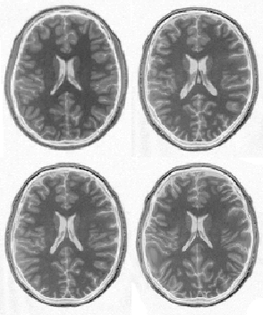
Risk: Over-fitting
Affine registration.
( χ² = 472.1)
Template
image
Non-linear
registration
without
regularisation.
( χ² = 287.3)
Over-fitting: Introduce unrealistic deformations, in the service of normalization
Notes:
More preferable to have a slightly less-good match, that is still anatomically realistic
The deformations required to transform images to the same space are not clearly defined. Unlike rigid body transformations, where the constraints are explicit, those for nonlinear warping are more arbitrary.
Without any constraints it is of course possible to transform any image such that it matches another exactly. The issue is therefore less about the nature of the transformation and more about defining constraints
or priors under which a transformation is effected. The validity of a transformation can usually be reduced to the validity of these priors.
The optimization method is extended to utilize Bayesian statistics in order to obtain a more robust fit. This requires knowledge of the errors associated with the parameter estimates, and also knowledge of the a
priori distribution from which the parameters are drawn.

Slide 23
Apply Regularisation
(protect against the risk of over-fitting)
Regularisation terms/constraints are included in normalization
Ensures voxels stay close to their neighbours
Involves
  Setting limits to the parameters used in the flexible warp (affine transformation + weights for basis functions)
Manually check your data for deformations
  e.g. Look through mean functional images for each subject - if data from 2 subjects look markedly different from all the others, you may have a problem

Slide 24
Risk: Over-fitting
Affine registration.
( χ² = 472.1)
Template
image
Non-linear
registration
using
regularisation.
( χ² = 302.7)
Non-linear
registration
without
regularisation.
( χ² = 287.3)
Notes:
More preferable to have a slightly less-good match, that is still anatomically realistic

Slide 25
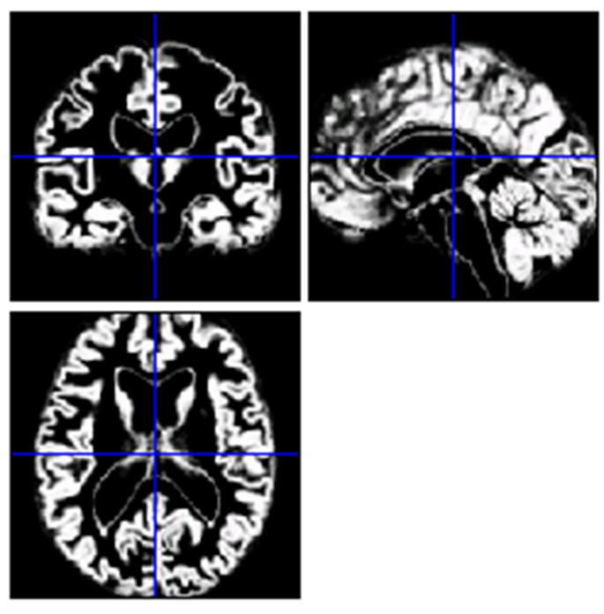
Segmentation
Separating images into tissue types
Why?
If one is interested in structural differences e.g. VBM
MR intensity is not quantitatively meaningful
If one could use segmented images for normalisation…

Slide 26
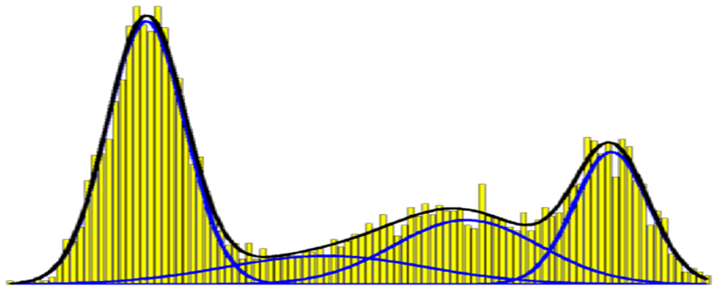
Mixture of Gaussians
  Probability function of intensity
  Most simply, each tissue type has Gaussian probability density function for intensity
  Grey, white, CSF
  Fit model likelihood of parameters (mean and variance) of each Gaussian
Probability
Intensity

Slide 27
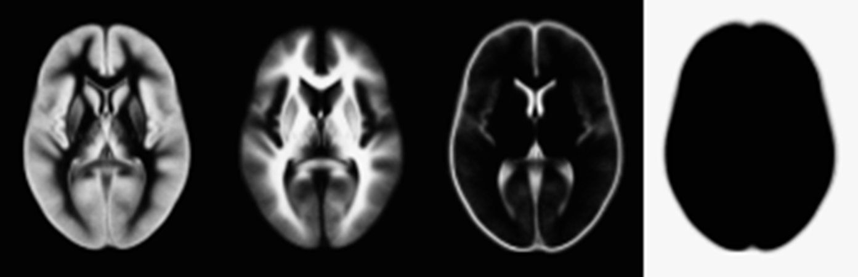
Tissue Probability Maps
P(y_{i} ,c_{i} = k|μ_{k} σ_{k} γ_{k}) = P(y_{i} |c_{i} = k, μ_{k} σ_{k} γ_{k}) x P(c_{i} = k| γ_{k})
Based on many subjects
Prior probability of any (registered) voxel being of any of the tissue types, irrespective of intensity
Fit MoG model based on both priors (plausibility) and likelihood
Find best fit parameters (μ_{k} σ_{k}) that maximise prob of tissue types at each location in the image, given intensity

Slide 28
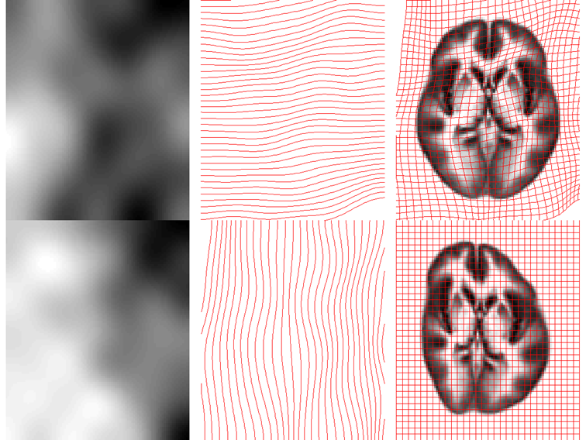
Unified Segmentation
Segmentation requires spatial normalisation (to tissue probability map)
Though could just introduce this as another parameter…
Iteratively warp TPM to
improve the fit of the
segmentation.
Solves normalisation and
segmentation in one!
The recommended
approach in SPM

Slide 29
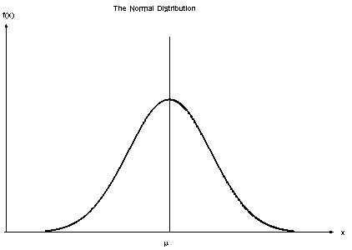
SmSmoothingthing
Why?
Improves the Signal-to-noise ratio therefore increases sensitivity
Allows for better spatial overlap by blurring minor anatomical differences between subjects
Allow for statistical analysis on your data.
    Fmri data is not “parametric” (i.e. normal distribution)
How much you smooth depends on the voxel size and what you are interested in finding. i.e. 4mm smoothing for specific anatomical region.

Slide 30
How to use SPM
for these steps…

Slide 31
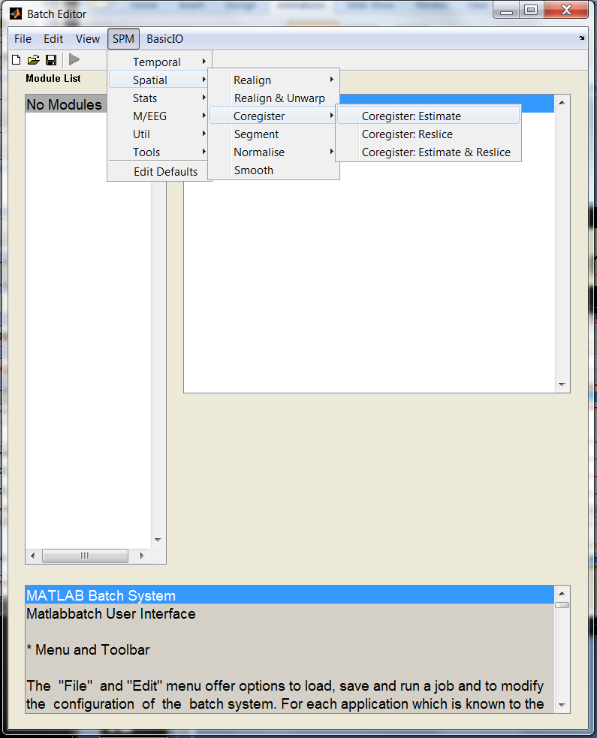
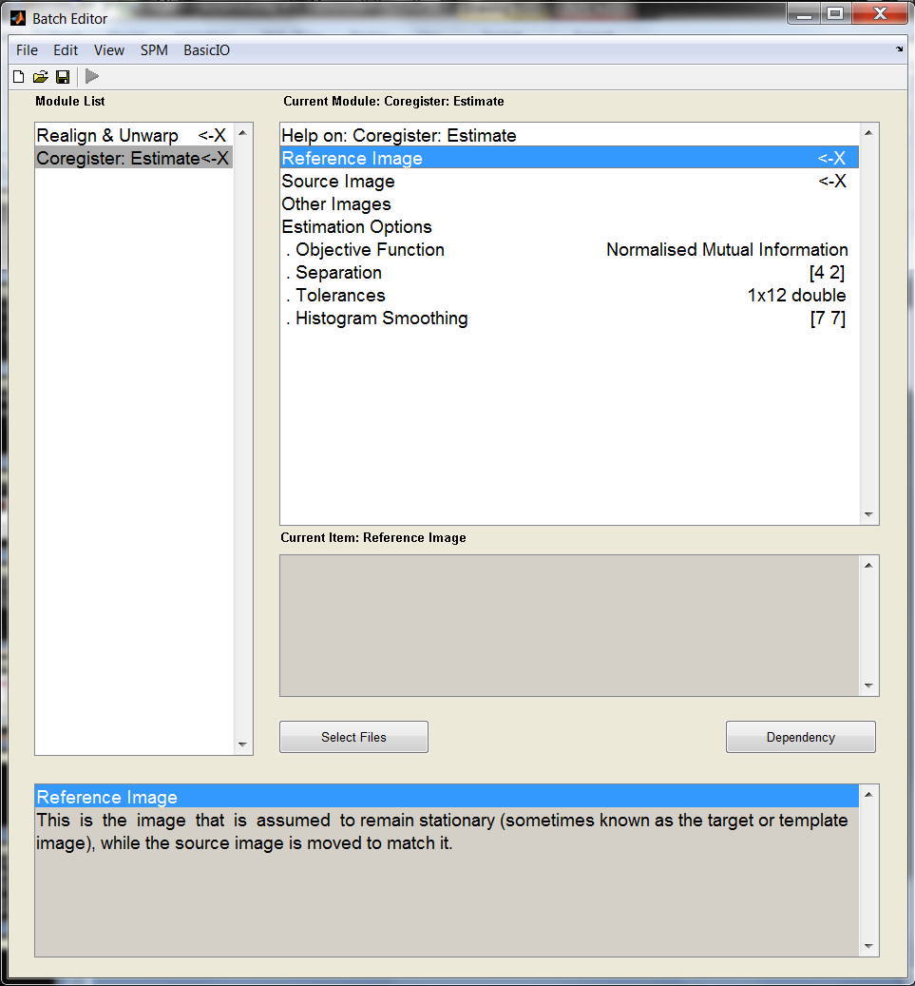
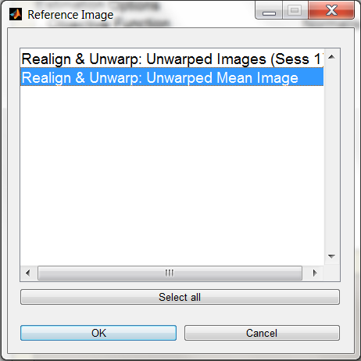
Coregistration
Coregister: Estimate; Ref image use dependency to select
Realign & unwarp: unwarped mean image
Source image use the subjects structural
Coregistration can be done as Coregistration:Estimate; Coregistration: Reslice; Coregistration Estimate & Reslice.
NB: If you are normalising the data you don’t need to reslice as this “writing” will be done later

Slide 32
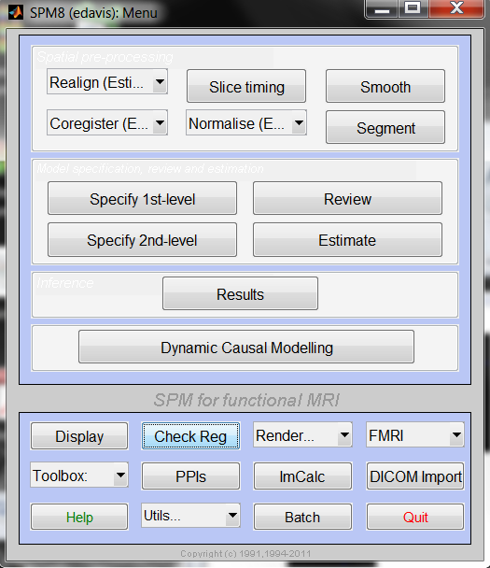
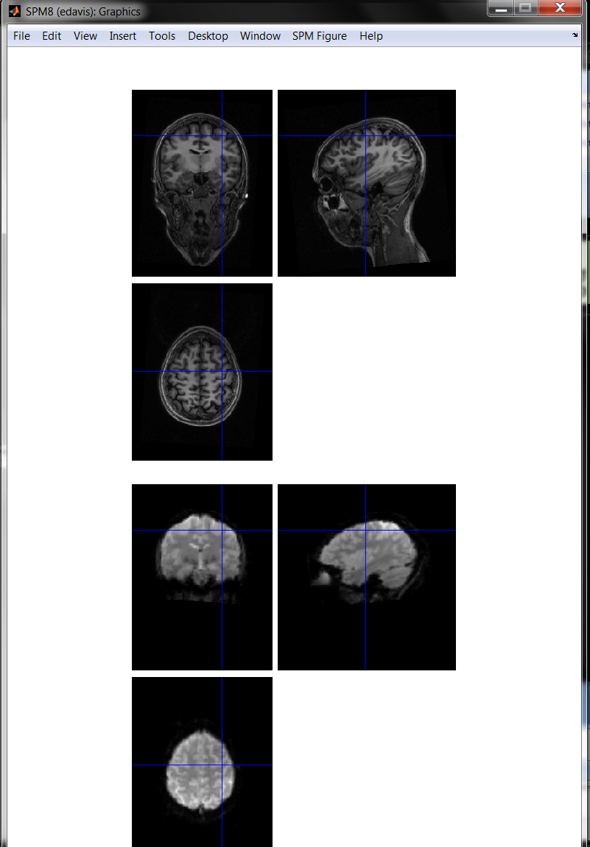
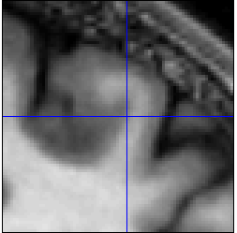
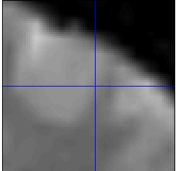
Check coregistration
Check Reg – Select the images you coregistered (fmri and structural)
NB: Select mean unwarped functional (meanufMA...) and the structural (sMA...)
Can also check spatial normalization (normalised files – wsMT structural, wuf functional)

Slide 33
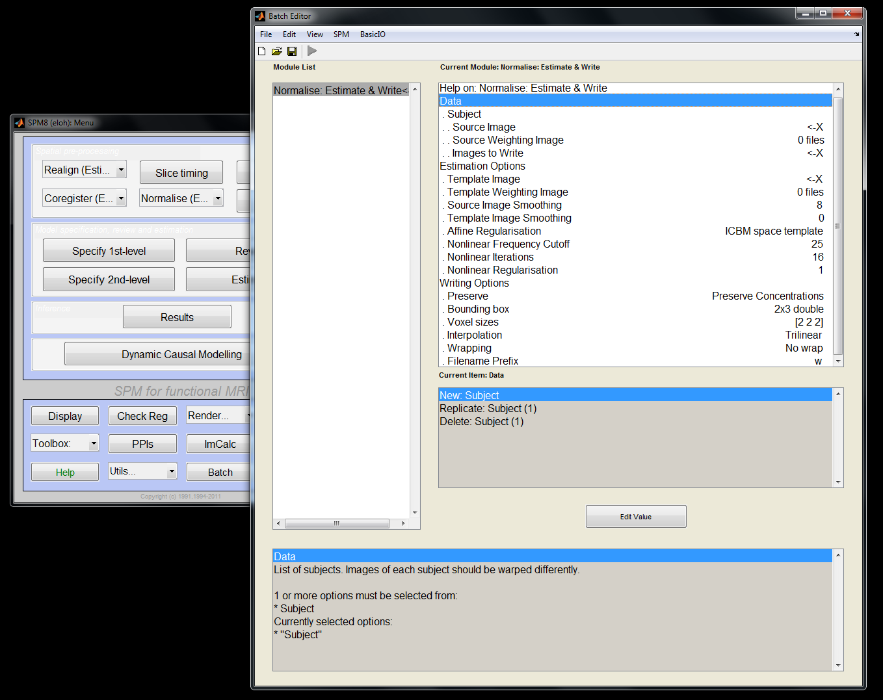
Normalisation

Slide 34
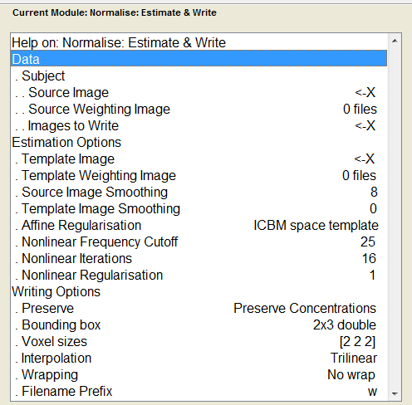
SPM: (1) Spatial normalization
Data for a single subject
Double-click ‘Data’ to add more subjects (batch)
Source image = Structural image
Images to Write = co-registered functionals
Source weighting image = (a priori) create a mask to exclude parts of your image from the estimation+writing computations (e.g. if you have a lesion)
See presentation comments, for more info about other options
Notes:
Other options (just if anyone was curious)
Source Image Smoothing & Template Image Smoothing – Template is smoothed (8mm), while source image (i.e. your structural) at this stage is not. Setting Source smoothing to 8 matches its smoothness to the Template.
Affine Regularisation – ICBM space template is used, because MNI tends to be bigger than raw data – this just accounts for this.
Nonlinear Frequency Cutoff – How many basis function cycles are included (sets a maximum). This determines how detailed you want your spatial normalization to be, and there is a tradeoff with overfitting and the time taken to run the analysis
Nonlinear Iterations – Model starts with prior estimates, and then tries to improve the fit 16 times

Slide 35
SPM: (1) Spatial normalization
Template Image = Standardized templates are available (T1 for structurals, T2 for functional)
Bounding box = NaN(2,3) → Instead of pre-specifying a bounding box, SPM will get it from the data itself
Voxel sizes = If you want to normalize only structurals, set this to [1 1 1] – smaller voxels
Wrapping = Use this if your brain image shows wrap-around (e.g. if the top of brain is displayed on the bottom of your image)
w for warped

Slide 36
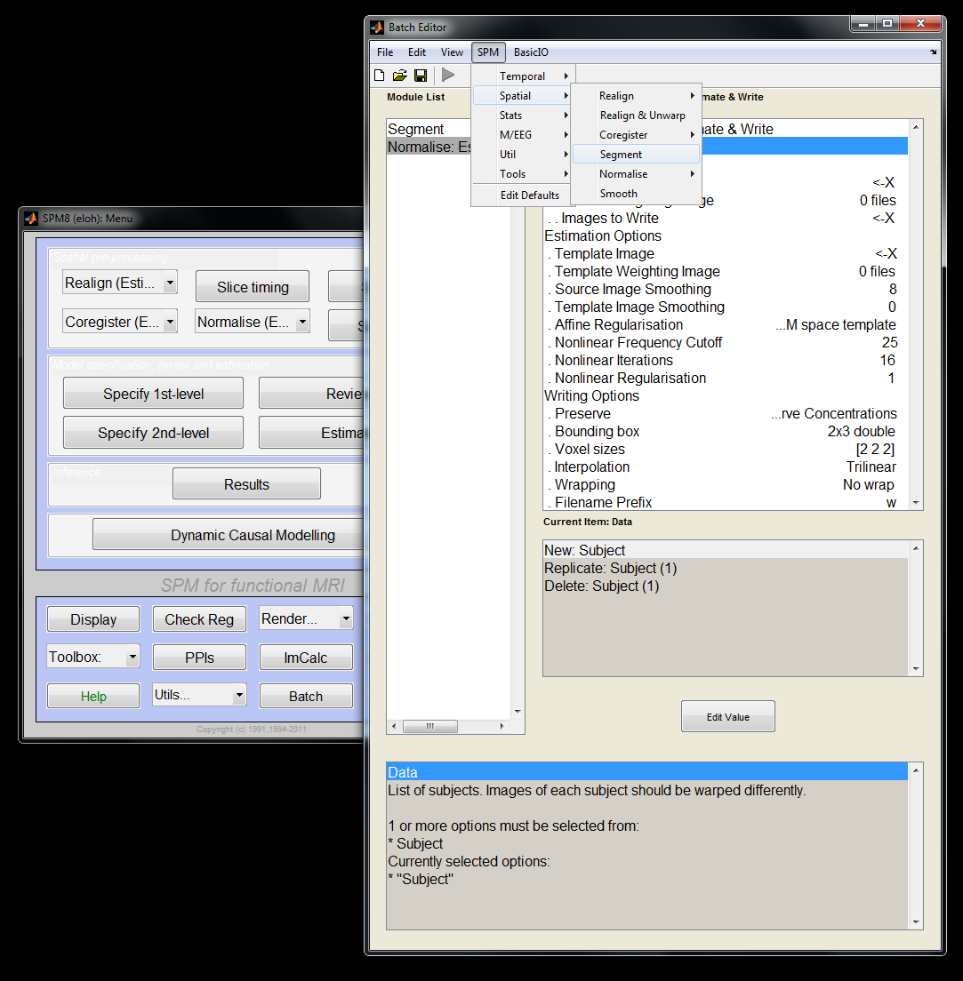
SPM: (2) Unified Segmentation
Batch
SPM → Spatial → Segment
SPM → Spatial → Normalize → Write

Slide 37
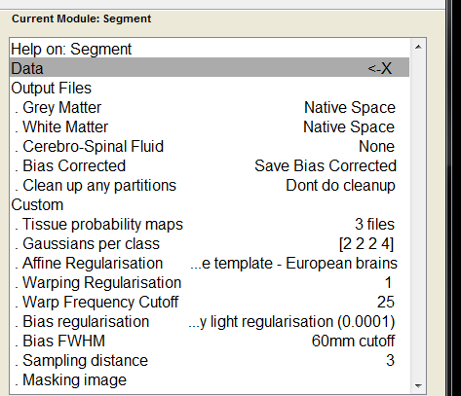
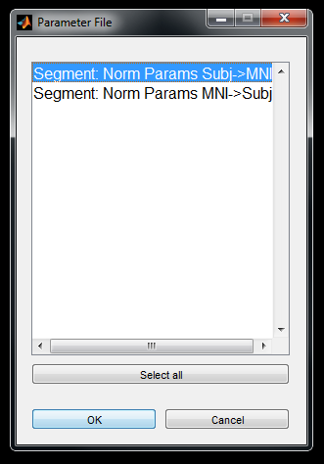
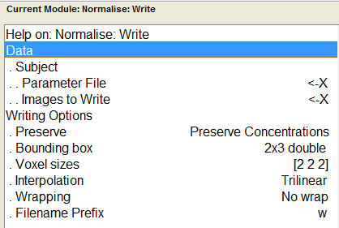
SPM: (2) Unified Segmentation
Data = Structural file (batched, for all subjects)
Tissue probability maps = 3 files: white matter, grey matter, CSF (Default)
Masking image = exclude regions from spatial normalization (e.g. lesion)
Parameter File = Click ‘Dependency’ (bottom right of same window)
Images to Write = Co-registered functionals
(same as in previous slide)
Notes:
Warp Regularisation and Warp Frequency Cutoff – same as Nonlinear Frequency Cutoff and Nonlinear Regularisation, in previous slides.

Slide 38
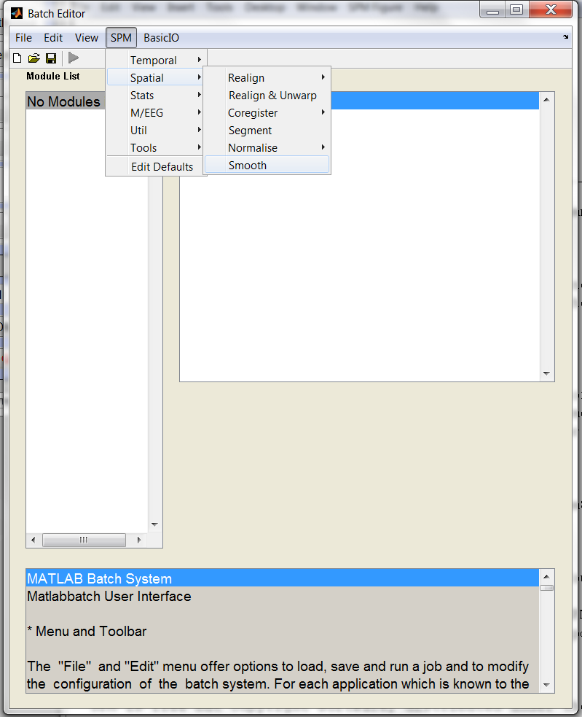


Smoothing
Smoothing
Smooth; Images to smooth – dependency – Normalise:Write:Normalised Images
4 4 4 or 8 8 8 (2 spaces) also change the prefix to s4/s8

Slide 39


Preprocessing - Batches
To make life easier once you have decided on the preprocessing steps make a generic batch
Leave ‘X’ blank, fill in the dependencies.
Fill in the subject specific details (X) and SAVE before running.
Load multiple batches and leave to run.
When the arrow is green you can run the batch.

Slide 40
Overview
fMRI time-series
kernel
Design matrix
Statistical Parametric Map
Motion
Correction
(Realign & Unwarp)
Smoothing
General Linear Model
Co-registration
Spatial normalisation
Parameter Estimates
Standard
template

Slide 41
References for coregistration & spatial normalization
SPM course videos & slides: http://www.ucl.ac.uk/stream/media/swatch?v=1d42446d1c34
Previous MfD Slides
Rik Henson’s Preprocessing Slides: http://imaging.mrc-cbu.cam.ac.uk/imaging/ProcessingStream

Slide 42
Thank you for your attention
And thanks to Ged Ridgeway for his help!

