Slide 1
EEG / MEG:
Experimental Design & Preprocessing
Ioannis Sarigiannidis
Wen-Jing Lin

Slide 2
Outline
Experimental Design
fMRI M/EEG
Analysis
  Oscillatory activity
  EP
Design
Inferences
Limitations
Combined Measures
Preprocessing in SPM8
Data Conversion
Montage Mapping
Epoching
Downsampling
Filtering
Artefact Removal
Referencing
Notes:
Experimental setups that work well for fMRI are often suboptimal for M/EEG, and vice versa

Slide 3
fMRI vs. MEG (EEG)
Notes:
schematic responses to stimuli of 200 ms, 2 s and 15 s in duration.
-BOLD signal is obtained only with stimulation persisting for several seconds,
-whereas MEG/EEG evoked responses are primarily elicited by stimulus onsets and offsets, with possibly a relatively weak sustained response.
-Cortical rhythms seen by MEG/EEG (mainly alpha around 10 Hz and mu with 10- and 20-Hz components) may undergo suppression and rebound modulation, (whose time course is more comparable to that of BOLD).
[Due to the sluggishness of the BOLD signal, it is sufficient to sample it 0.5–2 times per second; here, the dots denote sampling at a rate of 1/second (repetition time TR = 1 s). The MEG/EEG onset responses typically last for less than a second and change orders of magnitude more rapidly than BOLD, thus necessitating sampling rates above 300 Hz

Slide 4
MEG vs. EEG
Signal from pyramidal neurons of the cortex
Notes:
This is the direction of the electric field
-MEG fields reflect the primary neuronal currents directly, with minimum distortion from different layers – brain tissue, skull, scalp – with different electric conductivities
-MEG signals are highly sensitive to currents tangential to the skull, originating in the cortical sulci

Slide 5
MEG is mostly sensitive to tangential fields
gyrus
sulcus
Notes:
-Sources at the top of a gyrus cause radial fields that are not detectable by MEG. Sources in the fissures cause tangential fields that can be detected at the MEG.

Slide 6
Two types of MEG/EEG analysis
Event related changes
(EP / ERP – ERF)
Oscillatory activity – cortical rhythms
(Time-frequency analysis)
Otten, L. (2012, November 21). EEG/MEG Acquisition, Analysis and Interpretation,
MSc Cognitive Neuroscience, UCL
Notes:
-average a time locked response
Sampling rate - Must be high enough to capture
frequencies in signal

Slide 7
Oscillations
Otten, L. (2012, November 21). EEG/MEG Acquisition, Analysis and Interpretation,
MSc Cognitive Neuroscience, UCL

Slide 8
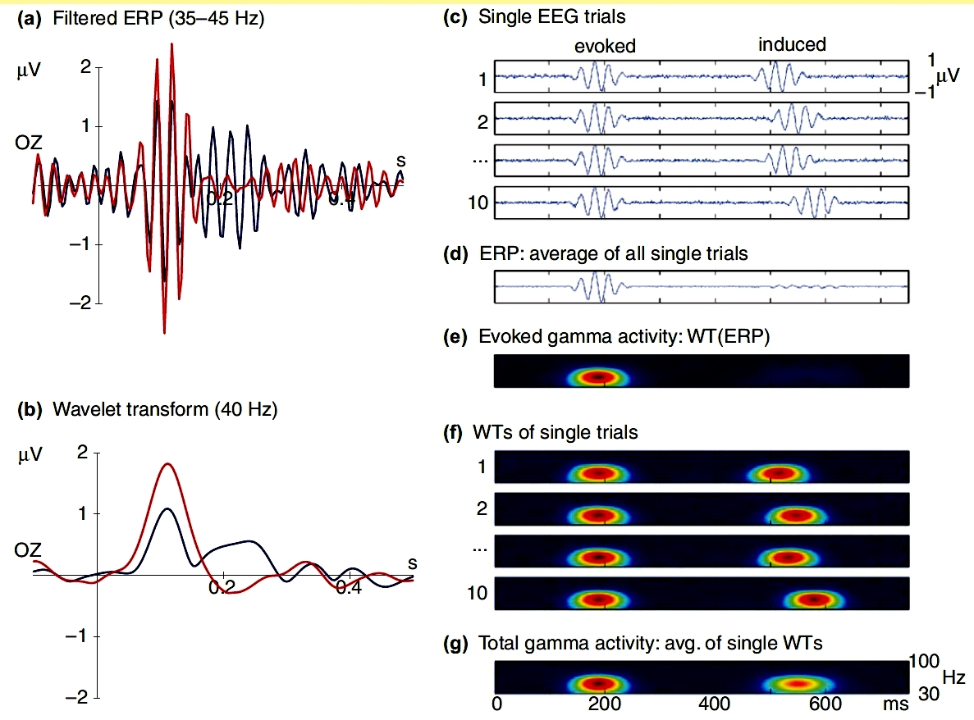
Evoked vs. Induced
(Hermann et al. 2004)
Notes:
assumption: response locked to stimulus presentation → signal averages in
problem, e.g. in self-paced task: jitter → signal averages out!
extract amplitude or power of oscillations in particular frequency bands, the so-called wavelet transform

Slide 9
Oscillations
Delta (0 – 4 Hz)
  Large-scale cortical integration
  Attentional and syntactic language processes
  Deep sleep
Theta (4 – 8 Hz)
  Codes locations in space, navigation
  Declarative memory processes
  Successful memory encoding
  Episodic memory processing

Slide 10
Oscillations
Alpha (8 – 12or 13 Hz)
  Closed eyes
  Level of cortical activation
  Cortical and behavioral deactivation or inhibition
  Perceptual, memory and attentional processes
Beta (12 – 30 Hz)
  Alert, REM sleep
  Attention, and higher cognitive function
  Stop movement

Slide 11
Oscillations
Gamma (30 – 80 Hz)
  Visual awareness
  Binding of information
  Encoding, retention and retrieval of information independent of sensory modality
  Recording gamma activity in the human EEG is difficult
    very small amplitude
    similarity in terms of its frequency characteristics with electrical muscle activity
    microsaccades – confused with gamma
Notes:
examples from literature:
Reduced neural synchronization of gamma-band MEG oscillations in first-degree relatives of children with autism

Slide 12
Oscillations
Non-averaged data collected during continuous stimulation or task performance (or during rest) lends itself to analysis of spectral power.
  i.e. We can do Fourier analysis and look at spectra (not-event related – break data in arbitrary segments and do some averaging)
  e.g. sleep studies, mental states (e.g. meditation)
Notes:
Check: Comparative power spectral analysis of simultaneous elecroencephalographic and magnetoencephalographic recordings in humans suggests non-resistive extracellular media, 2010

Slide 13
EP vs. ERP / ERF
Evoked potential (EP)
  short latencies (< 100ms)
  small amplitudes (< 1μV)
  sensory processes
Event related potential / field
  longer latencies (100 – 600ms),
  higher amplitudes (10 – 100μV)
  higher cognitive processes
but used interchangeably in general
Notes:
ERP = change in electrical activity due to some internal or external event
- subcortical (e.g. brainstem)
- somatosensory audiovisual primary areas - focal areas
more complex generators – many different areas

Slide 14
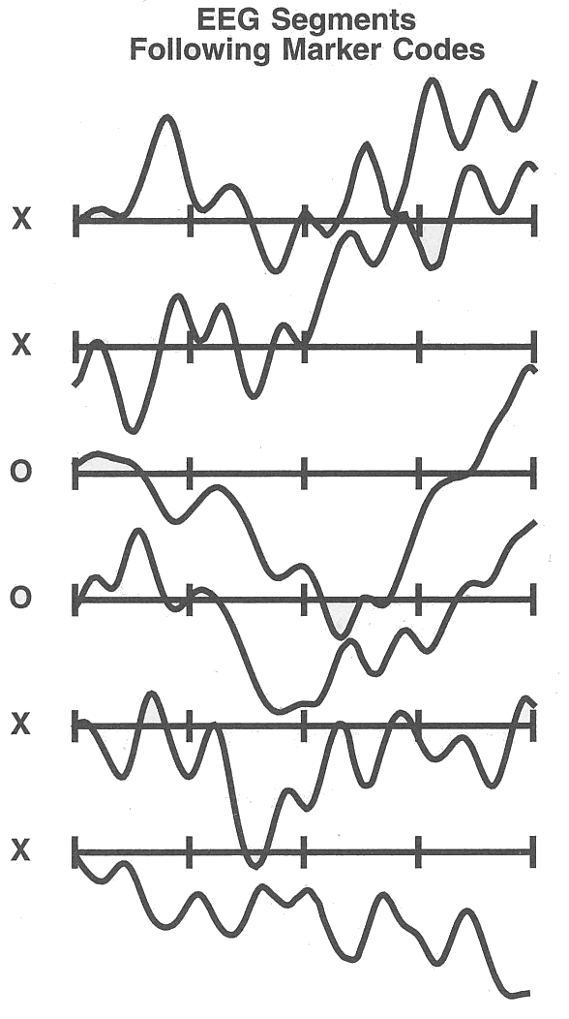
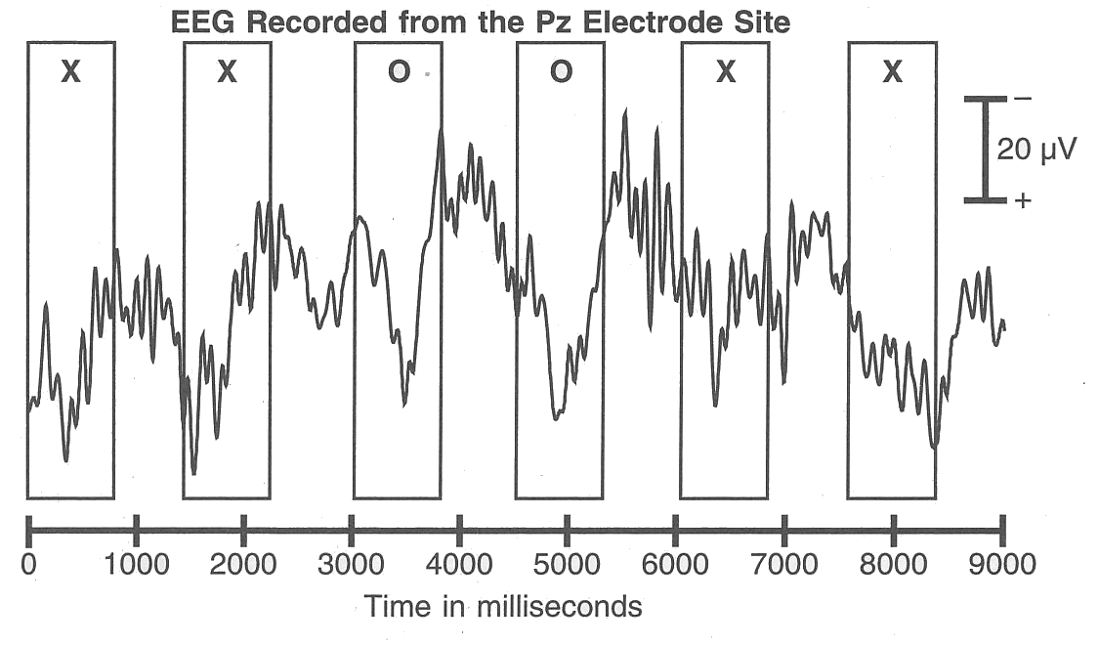
ERP/ ERF
Stimulus/ Event Onset
Average potential/ field at the scalp relative to some specific event
Baseline: typically 100ms before the onset of the stimulus

Slide 15
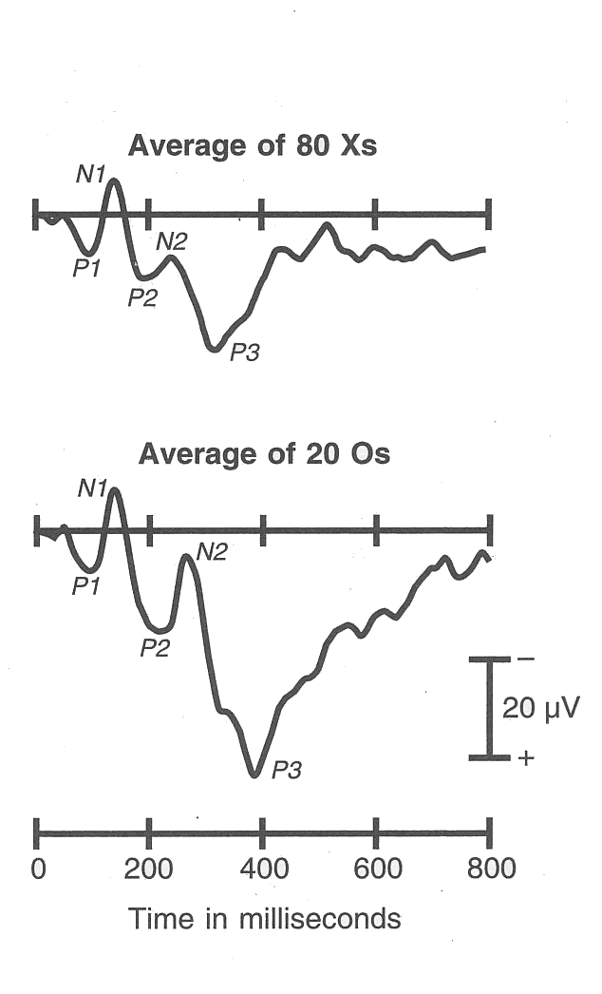
ERP/ ERF
Averaging
Non-time locked activity(noise) lost via averaging
Notes:
Definition: the average (across trials/ subjects) potential/field at the scalp relative to some specific event in time

Slide 16
Experimental design
Number of trials
  EP: 120 trials, 15-20% will be excluded
  Oscillatory activity: 40-50 trials
Duration of stimuli / task
  Short: Averaged EP is fine
  (Very) long: spectrotemporal analysis on averaged EP or non-averaged data
Collecting Behavioral Responses
  Only if necessary!

Slide 17
Inferences Not Based On Prior Knowledge
Observe
Time course
Amplitude
Distribution across scalp
Differences in ERP
Infer
Timing
Degree of engagement
Functional equivalence of underlying cognitive process
Notes:
(1) assume: specific cognitive processes manifest themselves in specific, invariant patterns of neural activity
→ same ERP pattern implies same cognitive process
(2) different signal across conditions in same electrode after, say, 200ms
→ cognitive process differentiating the two began 200ms after stimulus onset
(3) different scalp distributions of ERPs (across conditions, times, or both)
→ different patterns of neural activity → distinct functional processes
(4) different amplitude
→ quantitative difference in cognitive process

Slide 18
Inferences Based On Prior Knowledge
An “ERP component is scalp-recorded electrical activity that is generated in a given neuroanatomical module when a specific computational operation is performed.”
(Luck 2004, p. 22)

Slide 19
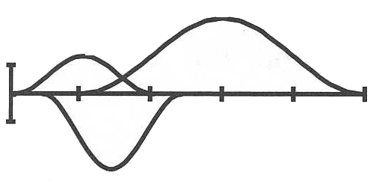
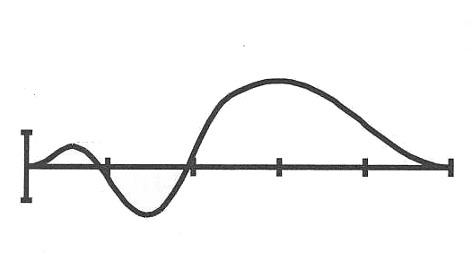
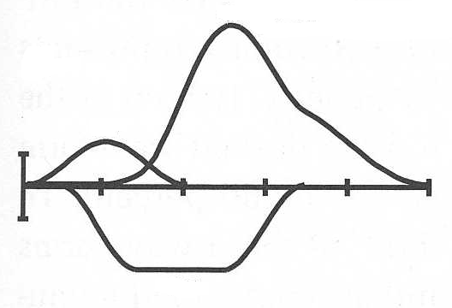
Observed vs. Latent Components
Observed waveform
Latent components
OR
Notes:
any given electrode / sensor records a series of temporally overlapping latent components
a given waveform could have arisen from many combinations of latent components
Rule #1 Peaks and components are not the same thing. There is nothing special about the point at which the voltage reaches a local maximum or minimum.
Rule #2 It is impossible to estimate the time course or peak latency of a latent ERP component by looking at a single ERP waveform-there may be no obvious relationship between the shape of a local part of the waveform and the underlying latent components.

Slide 20
Design Strategies
Focus on specific, large and easily isolated component
  E.g., P3, N400, LRP, N2pc…
Use well-studied experimental manipulations
Isolate components with different waves
Component-independent experimental designs
Notes:
Failure to isolate a specific ERP component
Measurement of one component is distorted by a different component
You think you’re measuring Component X, but you’re really measuring Component Y
Your latency difference is really caused by an amplitude difference (or vice versa)
Amplitude differences are due to differences in latency jitter, not differences in single-trial amplitudes
Offset of ERP from trial N-1 distorts baseline of trial N

Slide 21
Design Strategies
Avoid confounds and misinterpretations
  Physical stimulus confounds
Side effect
  What you manipulated indirectly influences other things
Vary conditions within rather than between blocks
Be cautious of behavioral confounds

Slide 22
Sources of Noise in EEG
EEG activity not elicited by stimuli
  e.g. alpha waves
Trial-by-trial variations
Articfactual bioelectric activity
  eye blinks, eye movement, muscle activity, skin potentials
Environmental electrical activity
  e.g. from monitors

Slide 23
Signal-to-Noise Ratio
Size of the noise in average = (1/√N) ×R
Number of trials:
  Large component: 30– 60 per condition
  Medium component: 150– 200 per condition
  Small component: 400– 800 per condition
  Double with children or psychiatric patients
Notes:
N: trial number
R: size of the noise in a single trial

Slide 24
Limitations
Ambiguous relation between observed ERP and latent components
Signal distorted en route to scalp
  arguably worse in EEG than MEG (head as “spherical conductor”)
MEG: application restrictions
  patients with implants
Poor localization (cf. “inverse problem”)
Notes:
MEG: reduced sensitivity to radial sources (head as spherical conductor)
EEG: inverse solution need to model conductivity profile of head, MEG doesn’t as secondary currents tend to cancel each other out in spherical conductor

Slide 25
Combining Techniques-How?
Converging evidence
  Combination of different information from different experiments
Generative models
  Establish generative models for which parameters are estimated from data of different nature.
Notes:
Converging evidence
This is simply the combination of different information originating from different experiments, and possibly different fields, to permit better interpretation. A vast majority of studies use converging evidence within modalities, but also across modalities
Generative models
The most ambitious and possibly most fruitful direction is to establish generative models for which parameters are estimated from data of different nature or provenance
correlate something happening in eeg something happening in fmri
eg. gamma oscilations
-use fmri data as a prior for eeg study
prior for source localisation

Slide 26
Combining Techniques - Why?
fMRI & M/EEG
BOLD activity can occur without M/EEG.
  Specific spatial configurations of the cells or of the sources may annihilate signals at the surface of the scalp.
M/EEG activity can occur in the absence of BOLD
  synchronization may not necessarily consume enough energy to be seen in BOLD.
The two activities are not necessarily spatially congruent. Many studies have found discrepancies between EEG dipolar localization and fMRI
M/EEG → increased resolution → improved localization
Notes:
Different kind of information
-BOLD activity can occur without EEG or MEG activity (MEG/EEG silent sources). Specific spatial configurations of the cells or of the sources may annihilate signals at the surface of the scalp. Electric signal synchronization is needed for MEG/EEG detection, but not necessarily for BOLD detection.
-MEG/EEG activity can occur in the absence of BOLD activity (fMRI silent sources) because synchronization may not necessarily consume enough energy to be seen in BOLD.
-The two activities are not necessarily spatially congruent. Many studies have found discrepancies between EEG dipolar localization and fMRI (in Bagshaw et al., 2005, up to 60 mm, but see also the differences reported for the early SI response in Kober et al., 2001; Stippich et al., 1998). These values can be regarded as alarmingly large in the first instance. However, the discrepancy can potentially be caused not only by the variability in the cell types and neuronal activities producing each particular signal of interest, but also by the approximate modeling of dipolar activities.
M/EEG – increased resolution - improved localization is due to the different properties of the two imaging modalities (rather than number of channels)
meg eeg the same or not?
Simultaneous acquisition or not
Cost.

Slide 27
Technical M/EEG Considerations
Amplifier and filter settings
Sampling frequency
EEG
  Number, type, location of electrodes
  Reference electrodes
MEG
  equipment and participant compatible with MEG?
  [digitize 3D head] matched to [structural MRI]
Notes:
impedance of the skull
MEG
-Faraday cage
-Shield from any external electric charges that could interfere with the magnetic signal
-Practically like fMRI, anything magnetic should be removed, otherwise it

Slide 28
Outline
Experimental Design
fMRI M/EEG
Analysis
  Oscillatory activity
  EP
Design
Inferences
Limitations
Combined Measures
Preprocessing in SPM8
Data Conversion
Montage Mapping
Epoching
Downsampling
Filtering
Artefact Removal
Referencing

Slide 29
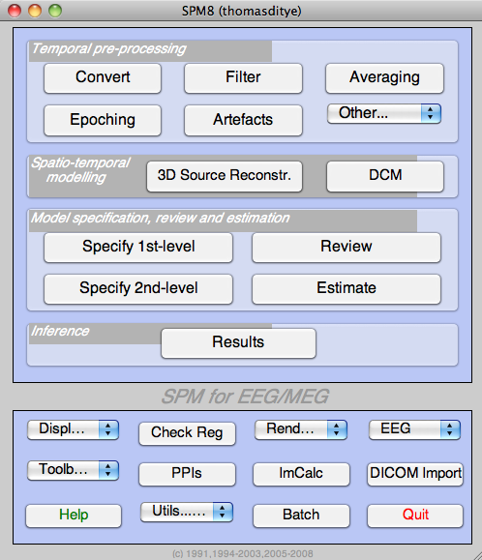
PREPROCESSING
Raw data to averaged ERP (EEG) or ERF (MEG) using SPM 8

Slide 30
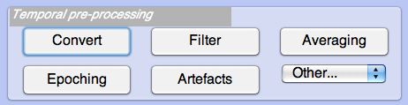
Conversion of data
Convert data from its native machine-dependent format to MATLAB based SPM format
Do not define setting:
“Just read”
Define settings:
  Read data as continuous or as trials
  Select channels
  Define file name
*.mat
(data)
*.bdf
*.bin
*.eeg
*.dat
(other info)
Notes:
‘Just read’: without questions-spm converts whole dataset preserving as much data as possible
‘yes’: controlling features of conversion
Is machine-dependent data already divided into trials/conditions?
Refining number and type of channels needed for further processing

Slide 31
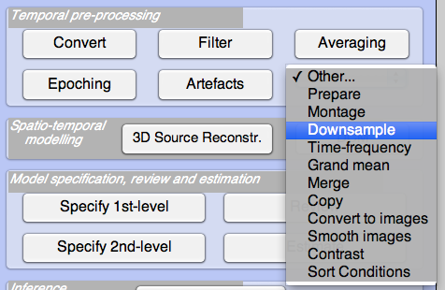
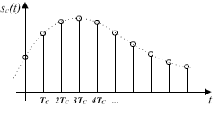
Downsampling
Sampling frequency: number of samples per second taken from a continuous signal
Data are usually acquired with a very high sampling rate
SF should be greater than twice the maximum frequency of the signal of interest?
Downsampling reduces the file size and speeds up the subsequent processing steps (e.g. 200 Hz)
Notes:
Useful if data acquired at higher sampling rate than one needs for making inferences about low-frequency components, for example, resampling from 1000Hz to 200 Hz = reduction of 20%
Sampling at high frequencies necessary to get good quality digital conversions of analogue signals
Nyquist frequency: minimum sampling frequency needs to be greater than twice the maximum frequency of any analogue signal likely to be present in the EEG.
New sampling rate must be smaller than original value!
Graph right bottom: example for good sampling frequency, each dot is recording of value of the wave (at different time points)

Slide 32
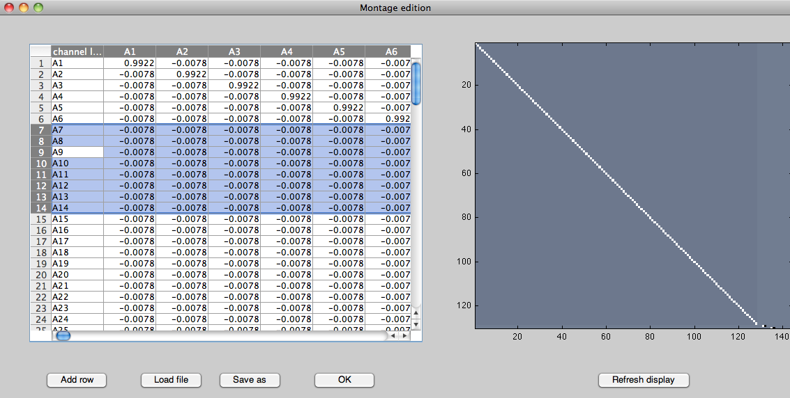
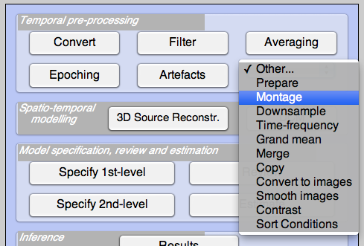
Montage and Referencing
Identify vEOG and hEOG channels, remove several channels that don’t carry EEG data
Specify reference for remaining channels
  Single electrode reference: free from neural activity of interest
  Average reference: Output of all amplifiers are summed and averaged and the averaged signal is used as a common reference for each channel
Notes:
Vertical and horizontal electrooculogram
average reference: “virtual electrode”; less susceptible to bias; used for source analysis and DCM is it better?
Single electrode reference: e.g. behind the ear, nose
Graph right bottom: review channel mapping

Slide 33
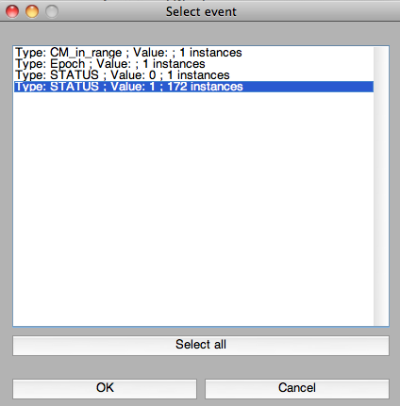
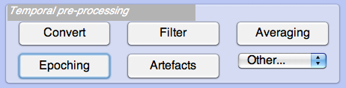
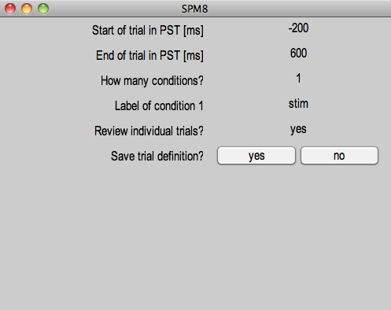
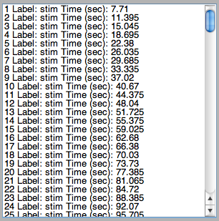
Epoching
Cut out chunks of continuous data (= single trials)
Specify time window associated with triggers [prestimulus time, poststimulus time]
Baseline-correction: automatic; the mean of the prestimulus time is subtracted from the whole trial
Segment length: at least 100 ms for baseline-correction; the longer the more artefacts
Padding: adds time points before and after each trial to avoid ‘edge effects’ when filtering
For multisubject/batch epoching in future
Notes:
Epoching splits the data into single trials, each referenced to stimulus presentation
For each stimulus onset, the epoched trial starts at some user-specified pre-stimulus time and ends at some post-stimulus time, e.g. from 100 ms before to 600ms after stimulus presentation.
The longer interval, the greater chance to include artefacts!
Padding: will add time points before and after each trial to allow the user to later cut out this padding again
filter all data and then epoch it to avoid edge effect
(longer trials .e.g. -300 to 1s is the interst? do -500 to 2s)
high pass and then low pass

Slide 34
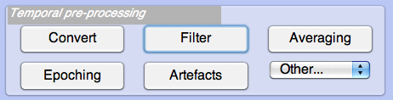
Filtering
EEG data consist of signal and noise
Some noise is sufficiently different in frequency content from the signal. It can be suppressed by attenuating different frequencies.
Non-neural physiological activity (skin/sweat potentials); (drifts – high pass filter takes care of that) noise from electrical outlets (bandstop)
SPM8: Butterworth filter
  High-, low-, band- pass or bandstop filter
Any filter distorts at least some part of the signal
Notes:
Choose between low-(attenuating high frequencies), high- (low frequencies), band- (attenuate both) or stop- (takes everything except data within a specified range) filter
band pass stop/ specific frequency

Slide 35
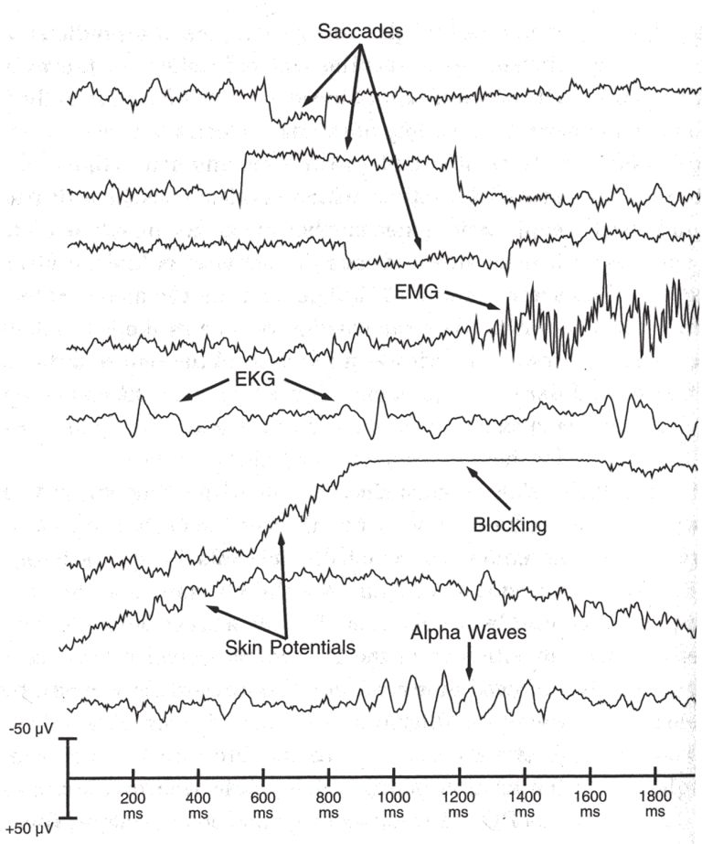
Artefact Removal
Eye movements
Eye blinks
Muscle activity
Skin potentials
‘Boredom’ (alpha waves)
Head movements
Notes:
Eye movements/eye blinks: Moving the eye itself actually changes the electrical gradients observable at the scalp, making them more positive in the direction the eye has moved towards. Also moves stimulus across retina, this generates unwanted visual ERPs. Less important over areas further away from the eye. If auditory task, justified to ignore eye artefacts
Muscle activity is characterised by bursts of high frequency activity in the EEG (eg swelling)
ECG reflects activity of the heart. This can intermittently appear in your data
Skin potentials are only really a problem for EEG. They reflect changes in skin impedence, this could happen if the subject starts to sweat more as the experiment progresses. They look like slow drifts.. Sometimes if they drift far enough, they cause saturation of the amplifier - a flat ‘blocking’ line.
Alpha waves are actually generated by the brain. They’re slow repetitive waves of about 10 hz which are unlikely to be of any interest to you if you’re looking at cognitive processes.

Slide 36
Artefact Removal
Removal
  Hand-picked
  Automatic SPM functions:
      Thresholding (e.g. 200 μV)
        1st – bad channels, 2nd – bad trials
        No change to data, just tagged
      Robust averaging: estimates weights (0-1) indicating how artefactual a trial is
Notes:
The function only indicates which trials are artefactual of clean and subsequent processing steps (e.g. averaging) will take this information into account, no data is actually removed from the file
Robust averaging: approach that estimates weights between 0 and 1 that indicate how artefactual a particular sample in a trial is. Later on, when averaging to produce evoked responses, each sample is weighted by this number e.g. if sample weight close to 0, it doesn’t have much influence in the average and is effectively treated like an artefact.

Slide 37
References
Ashburner, J. et al. (2010). SPM8 Manual. http://www.fil.ion.ucl.ac.uk/spm/
Hansen, C.P., Kringelbach M.L., Salmelin, R. (2010) MEG: An Introduction to Methods. Oxford University Press,
Hermann, C. et al. (2004). Cognitive functions of gammaband activity: memory match and utilization. Trends in Cognitive Science, 8(8), 347-355.
Herrmann, C. S., Grigutsch, M., & Busch, N. A. (2005). EEG oscillations and wavelet analysis. In T. C. Handy (Ed.), Event-related potentials: A methods handbook (pp. 229-259). Cambridge, MA: MIT Press.
Luck, S. J. (2005). Ten simple rules for designing ERP experiments. In T. C. Handy (Ed.), Event-related potentials: a methods handbook. Cambridge, MA: MIT Press.
Luck, S. J. (2010). Powerpoint Slides from ERP Boot Camp Lectures. http://erpinfo.org/Members/ldtien/bootcamp-lecture-pptx
Otten, L. (2012, November 21). EEG/MEG Acquisition, Analysis and Interpretation, MSc Cognitive Neuroscience, UCL
Otten, L. J. & Rugg, M. D. (2005). Interpreting event-related brain potentials. In T. C. Handy (Ed.), Event-related potentials: a methods handbook. Cambridge, MA: MIT Press..
Sauseng, P., & Klimesch, W. (2008). What does phase information of oscillatory brain activity tell us about cognitive processes? [Review]. Neuroscience and Biobehavioral Reviews, 32(5), 1001-1013. doi: 10.1016/j.neubiorev.2008.03.014
MfD slides from previous years

Slide 38
Special thanks to our expert
Vladimir Litvak

Slide 39
Kilner, unpublished
Wager et al. Neuroimage, 2005

