Slide 1
Basis of the BOLD signal
Methods for Dummies 2012-2013
Lila Krishna
Lucía Magis-Weinberg

Slide 2
PHYSICS

Slide 3
Overview
Hydrogen atoms have a magnetic moment and spin
Hydrogen spins align with B0 (the scanner magnet) with two consequences:
  They start precessing with a resonance frequency
  A net magnetization vector occurs
RF energy is applied matching the resonance frequency
Spins are flipped over to the transverse plane B1
RF is turned off
Spins relax back to B0.
This relaxation time is measured (T1 and T2) and used for image contrast

Slide 4
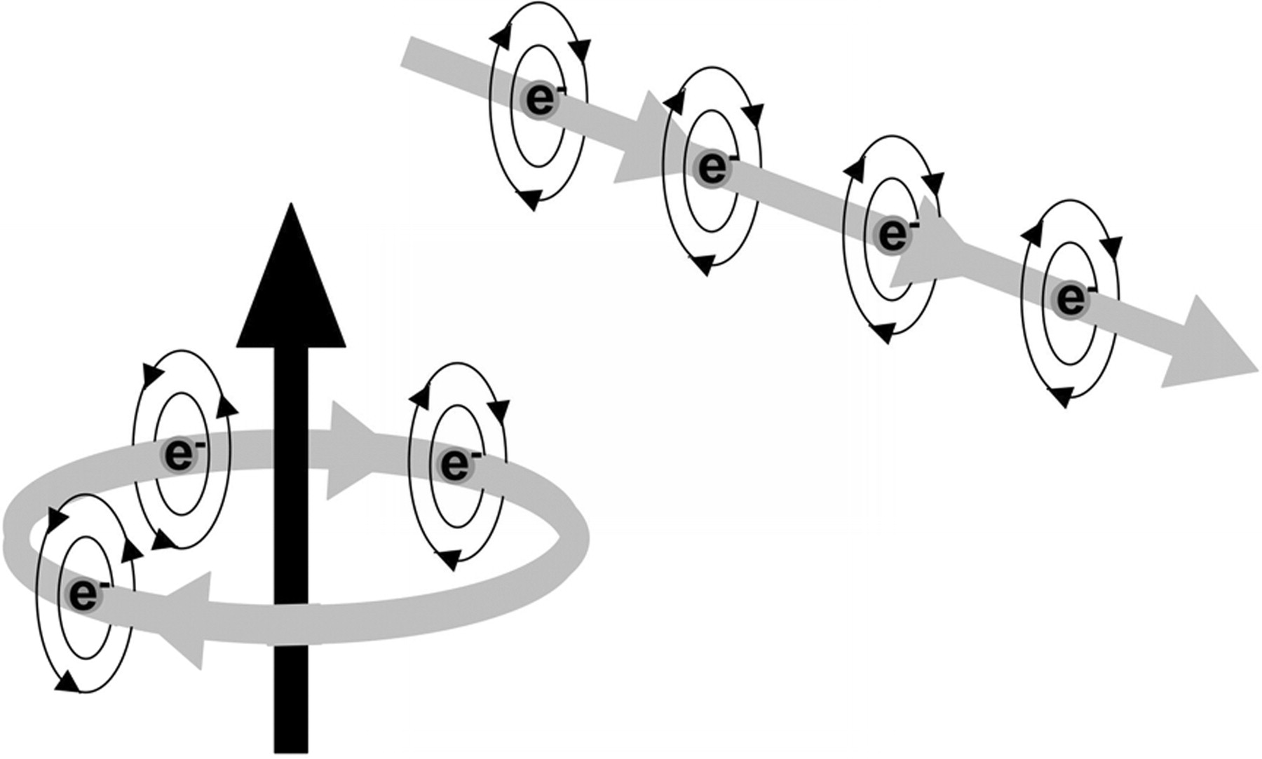
Production of a magnetic field
When an electric current flows in a wire that is formed into a loop, a large magnetic field will be formed perpendicular to the loop.
When an electron travels along a wire, a
magnetic field is produced around the electron.
Pooley R A Radiographics 2005;25:1087-1099
Notes:
Figure 1. Electrons flowing along a wire. An electric current in a loop of wire will produce a magnetic field (black arrow) perpendicular to the loop of wire. e− = electron.

Slide 5
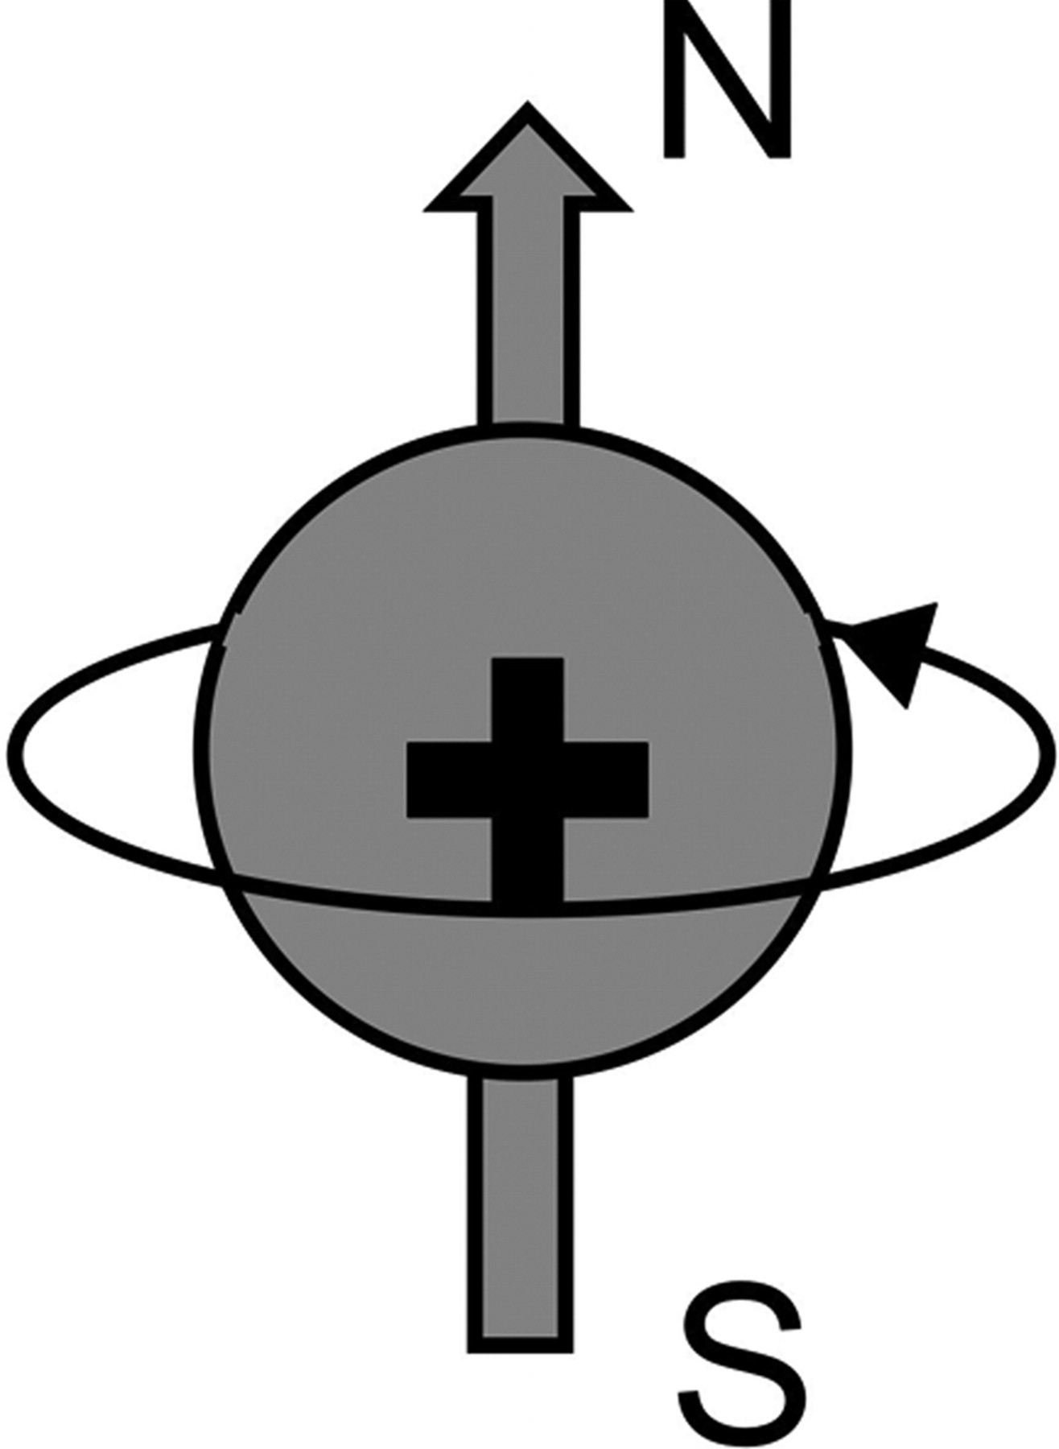
Hydrogen proton
Magnetic moment
SPIN
Notes:
Figure 2. Hydrogen proton. The positively charged hydrogen proton (+) spins about its axis and acts like a tiny magnet. N = north, S = south.

Slide 6
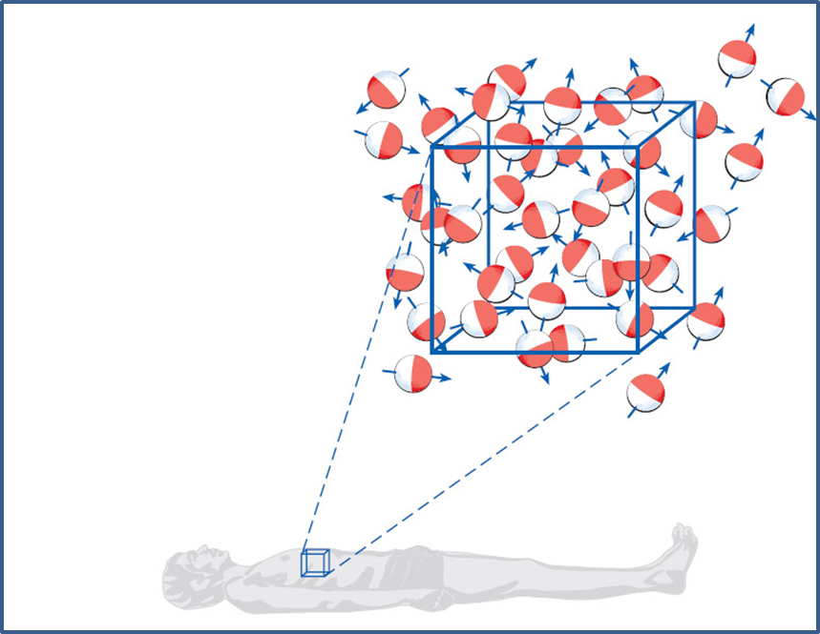
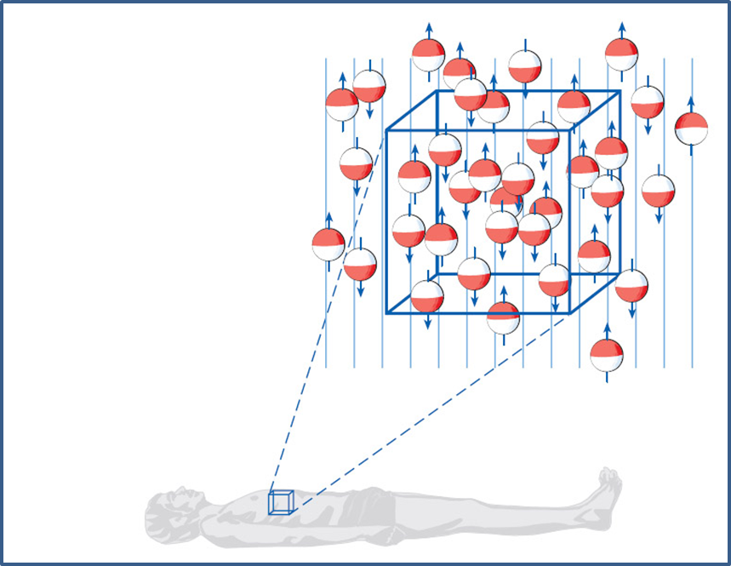
Alignment of protons with the B0 field.
No external magnetic field
Applied external magnetic field
Spins are randomly oriented
Magnetic fields cancel out
Spins are align parallel or antiparallel to B0
Net longitudinal magnetization
Spins start to precess at their resonance frequency.
Notes:
The magnetic fields from many protons will cancel out, but a slight excess of the protons will be aligned with the main magnetic field, producing a “net magnetization” that is aligned parallel to the main magnetic field. This net magnetization becomes the source of our MR signal and is used to produce MR images.

Slide 7
Results from interaction between magnetic fields and spinning
How many revolutions in a second does the proton precess?
Larmor (precessional) frequency
The resonance phenomenon can be used to efficiently transfer electromagnetic energy to the protons to successfully flip them into the transverse plane.
Notes:
The constant is called the gyromagnetic ratio and
is a characteristic of each type of nuclei. For hydrogen
protons, the gyromagnetic ratio is equal to
42.6 MHz/T (megahertz per tesla). The main
magnetic field strength, B0, depends on the magnet
design. For a typical superconducting MR
system, the magnetic field strength may be 1.5 T.
The child will swing back and forth at a
particular frequency. If we push the swing at the
right time, we will efficiently transfer energy to
the swing and child. If we consistently push at the
right time, we will be in resonance with the swing,
and the efficient transfer of energy will allow the child to swing higher.
The frequency of precession then will equal 42.6
MHz/T 1.5 T or about 64 MHz (64 million
times per second).

Slide 8
Radiofrequency energy
Radiofrequency energy = rapidly changing magnetic and electric fields
For the MR system, this RF energy is transmitted by an RF transmit coil. Typically, the RF is transmitted in a pulse.
This transmitted RF pulse must be at the precessional frequency of the protons (calculated via the Larmor equation) in order for resonance to occur and for efficient transfer of energy from the RF coil to the protons.

Slide 9

Absorption of RF Energy
If a spin is absorbs energy from the RF pulse, the net magnetization rotates away from the longitudinal direction to the transverse plane.
The amount of rotation (termed the flip angle) depends on the strength and duration of the RF pulse.

Slide 10
When the RF is switched off
Spins return from the transverse plane to the longitudinal axis
Spins start to dephase
These processes happen at the same time but are measured differently.

Slide 11

T1 relaxation
A 90° RF pulse rotates the longitudinal magnetization into transverse magnetization.
When the RF is off the magnetization then begins to grow back in the longitudinal direction
The rate at which this longitudinal magnetization grows back is different for protons associated with different tissues and is the source of contrast in T1-weighted images.
Notes:
White matter has a very short T1 time and relaxes rapidly. Cerebrospinal fluid (CSF) has a long T1 and relaxes slowly. Gray matter has an
intermediate T1 and relaxes at an intermediate rate (Fig 11). If we were to create an image at a time when these curves were widely separated, we would produce an image that has high contrast between these tissues. Thus, white matter contributes to the lighter pixels, CSF contributes to the darker pixels, and gray matter contributes to pixels with intermediate shades of gray. This type of contrast mechanism is termed T1-weighted contrast. If we were to create an image at a time when the curves were not widely separated, the image would not have much T1-weighted contrast

Slide 12
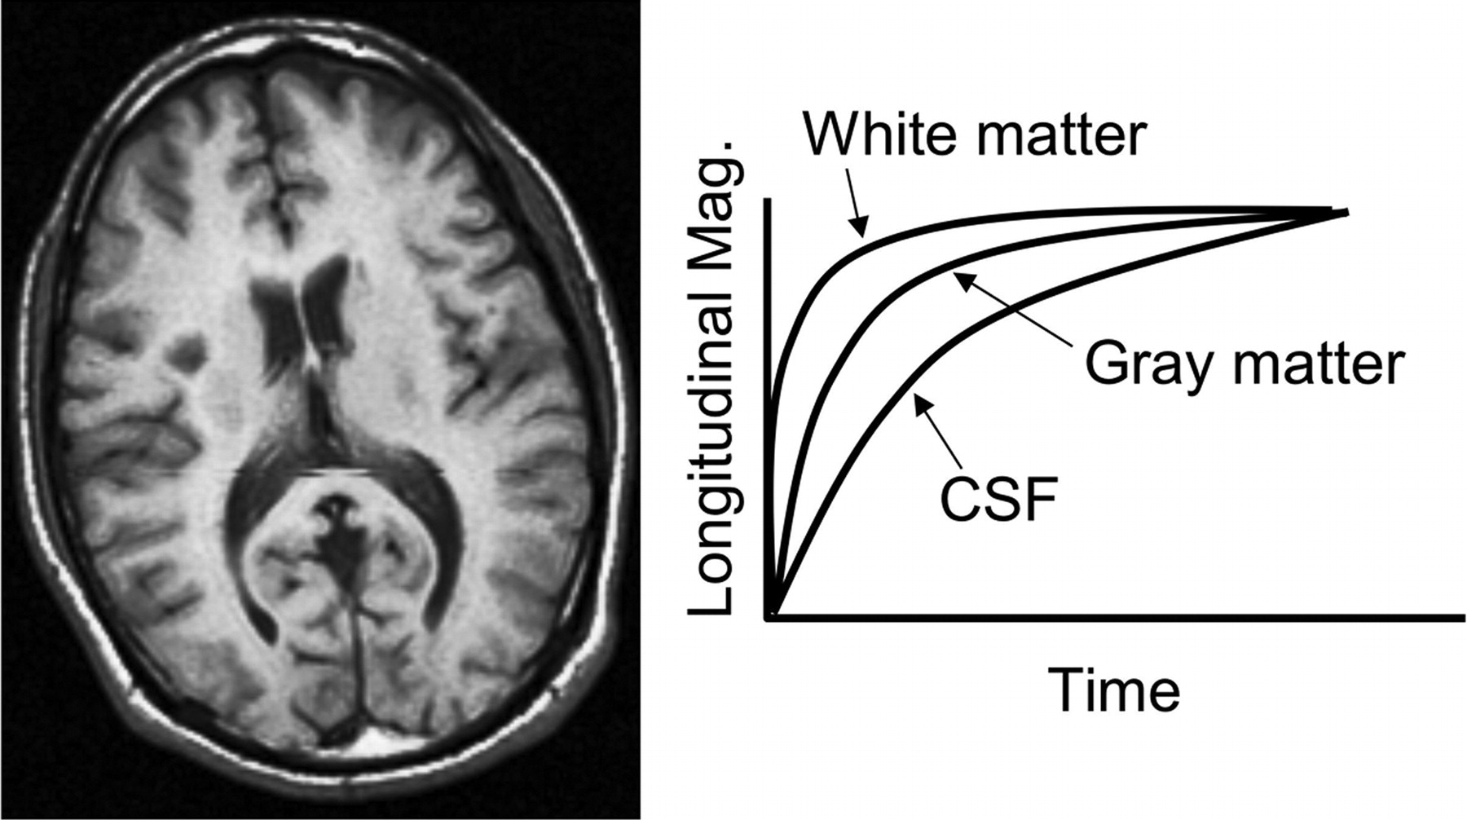
T1-weighted contrast
Pooley R A Radiographics 2005;25:1087-1099
Notes:
Figure 11. T1-weighted contrast. Different tissues have different rates of T1 relaxation. If an image is obtained at a time when the relaxation curves are widely separated, T1-weighted contrast will be maximized. Mag = magnetization.

Slide 13
T2 relaxation
During the RF pulse, the protons begin to precess together (they become “in phase”).
Immediately after the 90° RF pulse, the protons are still in phase but begin to dephase due spin-spin interactions (remember each spin acts as a little magnet)
Transverse magnetization
  completely in phase = maximum signal
  completely dephased = zero signal
  DECAY

Slide 14
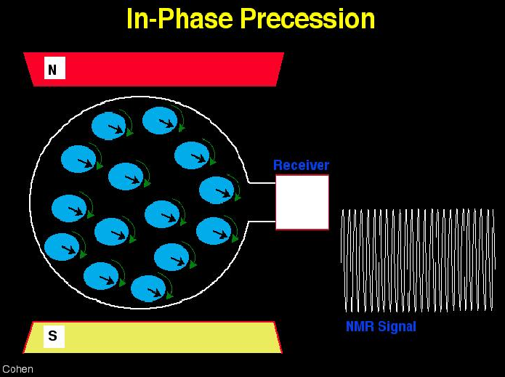
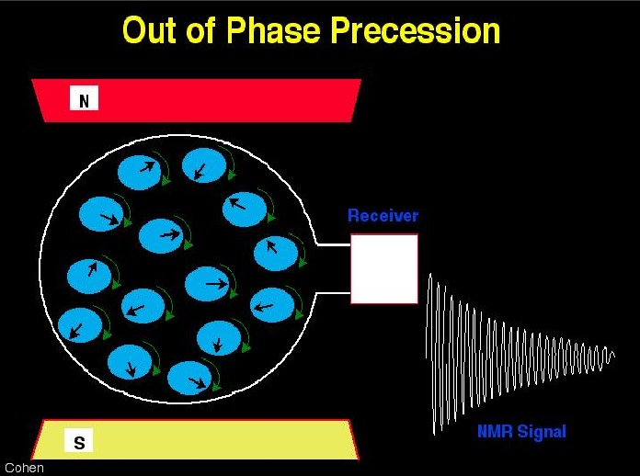
T2 relaxation
all nuclei aligned and precessing
in the same direction.
nuclei not aligned but still precessing
in the same direction.
So MR signal will start off strong but as protons begin to precess out of phase the signal will decay.
Source: Mark Cohen’s web slides

Slide 15
T2 relaxation
T2 is the time that it takes for the transverse magnetization to decay to 37% of its original value
Different tissues have different values of T2 and dephase at different rates.
Notes:
The T1 and T2 relaxation processes occur simultaneously.
After a 90° RF pulse, dephasing of
the transverse magnetization (T2 decay) occurs
while the longitudinal magnetization grows back
parallel to the main magnetic field. After a few
seconds, most of the transverse magnetization is
dephased and most of the longitudinal magnetization
has grown bac

Slide 16
T2*
Protons that experience slightly different magnetic field strengths will precess at slightly different Larmor frequencies.
T2* = T2 that accounts for spin-spin interactions, magnetic field inhomogeneities, magnetic susceptibility and chemical shifts effects

Slide 17
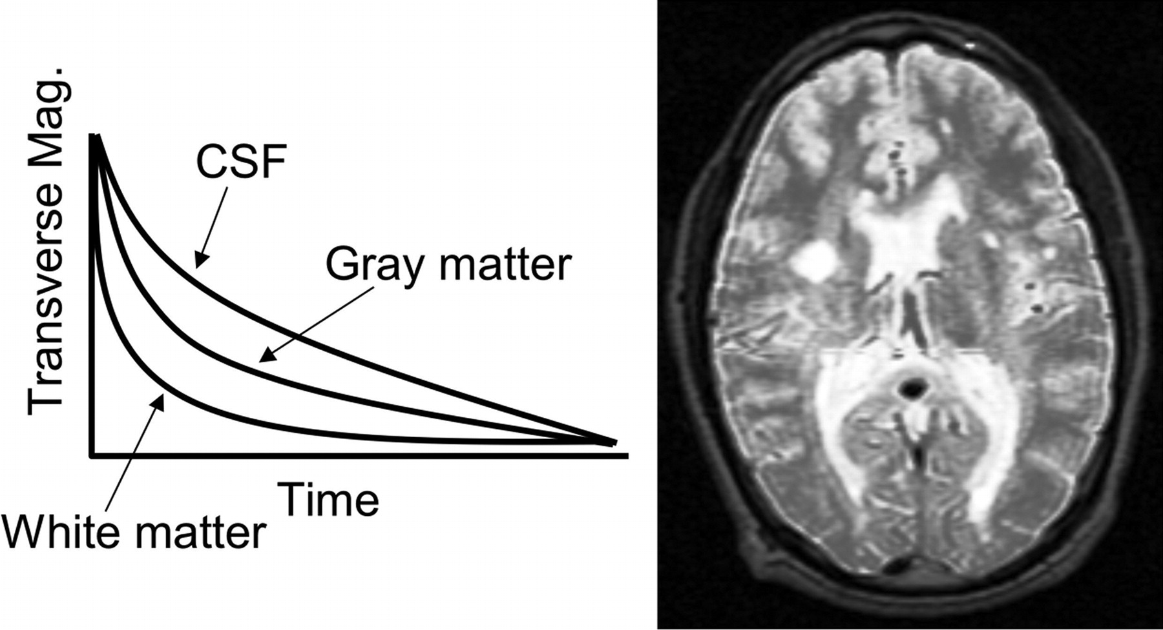
T2-weighted contrast
Pooley R A Radiographics 2005;25:1087-1099
Notes:
Figure 15. T2-weighted contrast. Different tissues have different rates of T2 relaxation. If an image is obtained at a time when the relaxation curves are widely separated, T2-weighted contrast will be maximized. Mag = magnetization.

Slide 18
Physiology

Slide 19
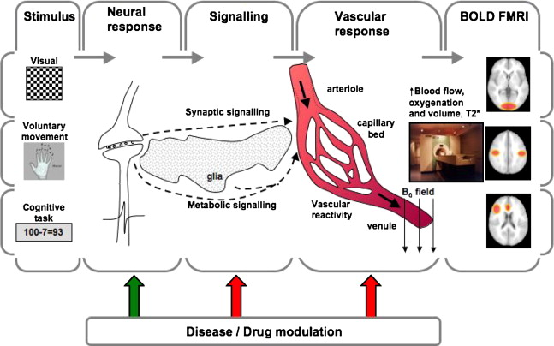
Notes:
AAPM/RSNA PHYSICS TUTORIAL 1087
AAPM/RSNA Physics
Tutorial for Residents
Fundamental Physics of MR Imaging1
Robert A. Pooley, PhD

Slide 20
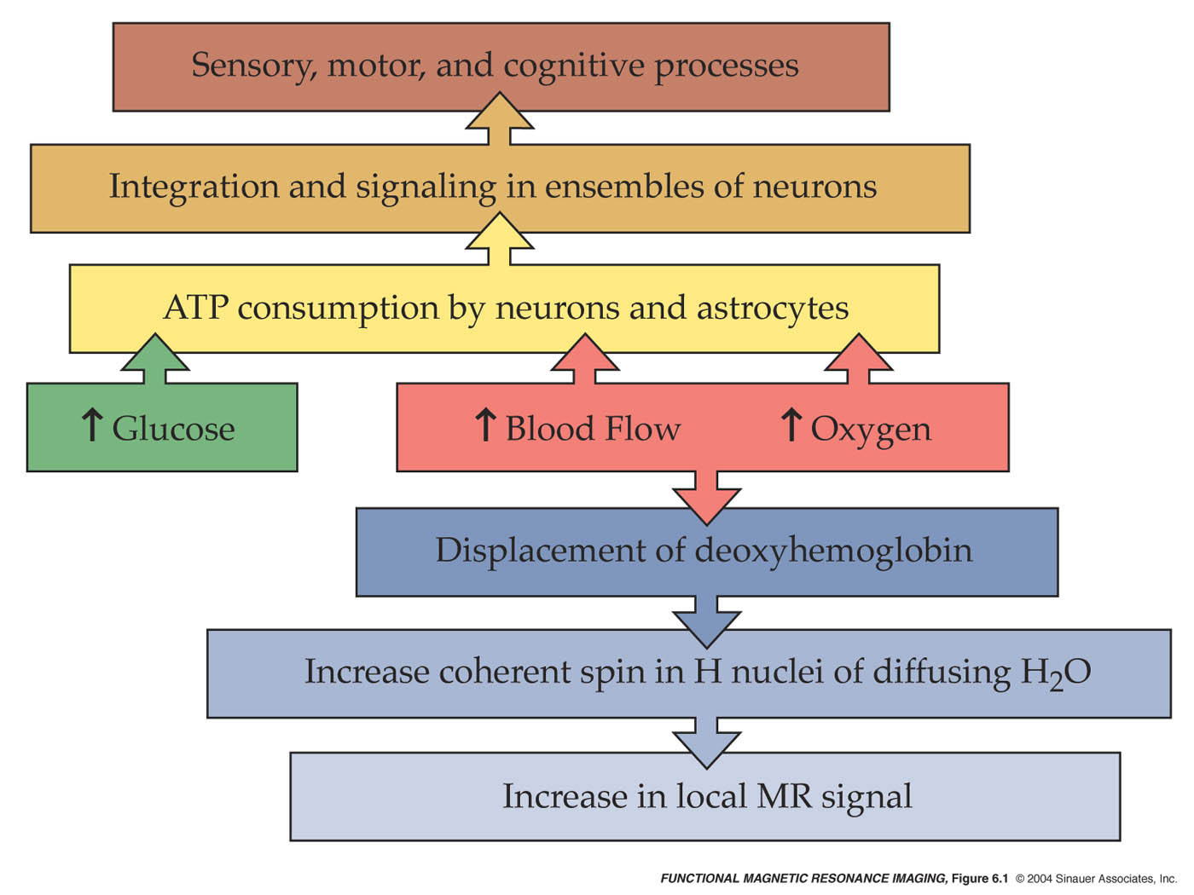

Slide 21
From A Physiology POV
Local
Consumption
of ATP
Local Energy
Metabolism
Neural Activity
CBF
CMRO₂
CMRGlc
CBV
BOLD signal results from a complicated mixture of these parameters

Slide 23
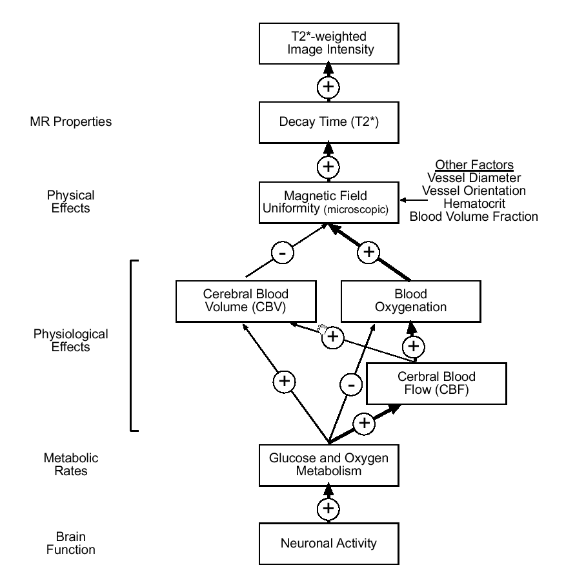
Source: Noll, 2001
Notes:
This diagram shows just how far the distance is between neuronal activity, which is what we are trying to measure, and the intensity of the T2* weighted image we record. (Discuss diagram)

Slide 24
(Very) General background
Neural activity has metabolic consequences
Energy is required for maintenance and restoration of neuronal membrane potentials
Energy is not stored, must be supplied continuosly by the vascular system (oxygen and glucose)

Slide 25
(Very) General background
Neurons participate in integration and signalling:
  Changes in cell membrane potential
  Release of neurotransmitters
Energy requiered for the restoration of ionic concentration gradients , supplied via the vascular system

Slide 26
(Very) General background
A major consequence of the vascular response to neuronal activity is the arterial supply of oxygentaed hemoglobin
These changes in the local concentration of deoxygenated hemoglobin provide the basis for fMRI

Slide 27
But keep in mind that…
Changes within the vascular system in response to neural activity may occur in brain areas far from the neuronal activity, initiated in part by flow controlling substances released by neurons into the extracellular space

Slide 28
Coupling of metabolism and blood flow
MR signal increases during neuronal activity
More oxygen is supplied to a brain region than is consumed
As the excess oxygenated blood flows through the active regions, it flushes the deoxygenated hemoglobin that had been suppressing the MR signal

Slide 29
The core of the matter
Oxygenated hemoglobin
  Diamagnetic
  has no unpaired electrons
  zero magnetic moment
Deoxygenated hemoglobin
  Paramagnetic
  unpaired electrons
  signifcant magnetic moment

Slide 30
Consequences of the magnetic properties of Hb
Paramagnetic substances distort the surrounding magnetic field → protons experience different field strengths → precess at diffent frequencies → more rapid decay of transverse magnetization (shorter T2*)
Notes:
Strong magnetic fields are necessary for MR imaging ot T2*

Slide 31
Relationship between neuronal activity and BOLD
The SPM analyses with the separate design matrices (one for each model) showed significant (p < 0.05 (FWE)) correlations between each model and the observed BOLD signal, as can be seen.
The locations of maximal correlation for each model were not far apart and were included in the voxels activated by the experimental task shown in
Although all functions correlated with BOLD, the Heuristic produced higher maximal F-scores and more voxels above the chosen threshold (p < 0.05 (FWE)) than the other two models

Slide 32
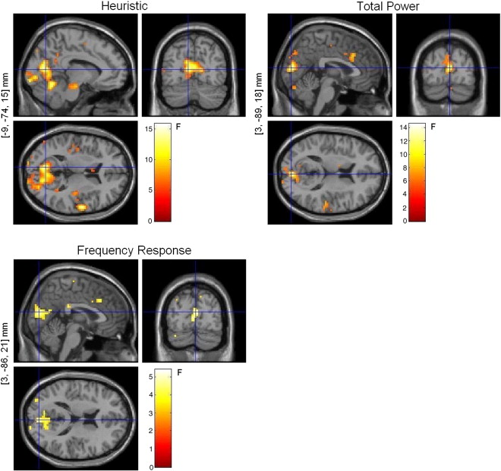
Estimating the transfer function from neuronal activity to BOLD using simultaneous EEG-fMRI

Slide 33
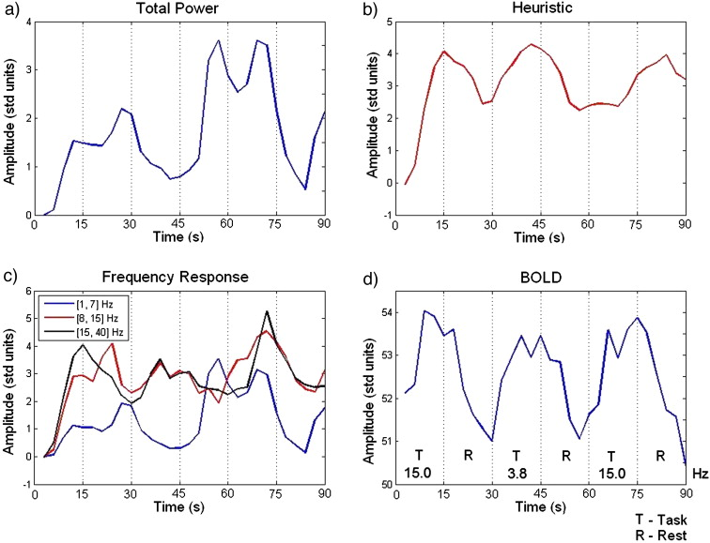
Fig. 5 Example regressors for (a) Total Power, (b) Heuristic, and (c) Frequency Response (3 bands) models after convolution with the HRF (subject 2). (d) Example BOLD time series for the same period of time and subject, at the most significant cl...
M.J. Rosa , J. Kilner , F. Blankenburg , O. Josephs , W. Penny
Estimating the transfer function from neuronal activity to BOLD using simultaneous EEG-fMRI
NeuroImage Volume 49, Issue 2 2010 1496 - 1509
http://dx.doi.org/10.1016/j.neuroimage.2009.09.011
Notes:
Bold signal
Dip: burning down oxygen
Peak: more oxygen to the area
Decay:

Slide 34
Conclusion
Understanding the nature of the link between neuronal activity and BOLD plays a crucial role in improving the interpretability of BOLD imaging and relating electrical and hemodynamic measures of human brain function. Finding the optimal transfer function should also aid the design of more robust and realistic models for the integration of EEG and fMRI, leading to estimates of neuronal activity with higher spatial and temporal resolution, than are currently available.

Slide 35
Our special thanks to Dr. Antoine Lutti

Slide 36
References
Pooley R A. Fundamental Physics of MR Imaging. Radiographics 2005;25:1087-1099
Noll, D. A primer on MRI and Functional MRI. 2001.
Huettel, S. Functional Magnetic Resonance Imaging. Second edition. Sinauer, USA, 2008

