Slide 1
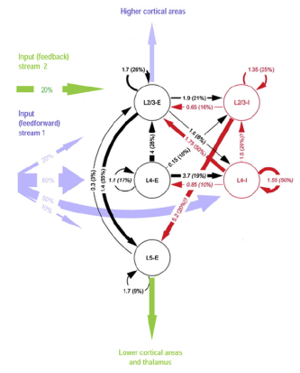
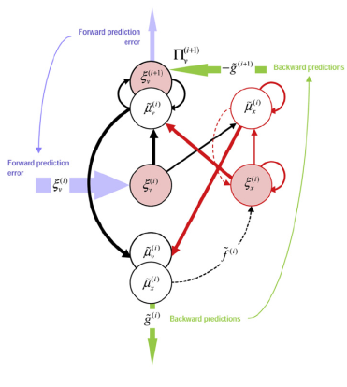
DYNAMIC CAUSAL MODELLING FOR fMRI
Theory and Practice
Diego Lorca Puls and Sotirios Polychronis

Slide 2
OUTLINE
DCM: Theory
  Background
  Basis of DCM
    Neuronal Model
    Hemodynamic Model
    Model Inversion: Parameter Estimation, Model Comparison and Selection
    DCM Implementation Alternatives
DCM: Practice
  Rules of Good Practice
  Experimental Design
  Step-by-step Guide

Slide 3

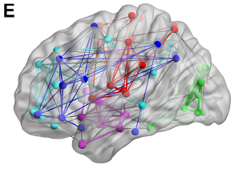
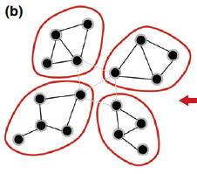
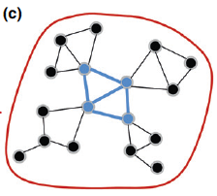
FUNDAMENTS OF CONNECTIVITY
Functional Segregation
A given cortical area is specialized for some aspects of perceptual, motor or cognitive processing.
Functional Integration
Refers to the interactions among specialised neuronal populations and how these interactions depend upon the sensorimotor or cognitive context.

Slide 4
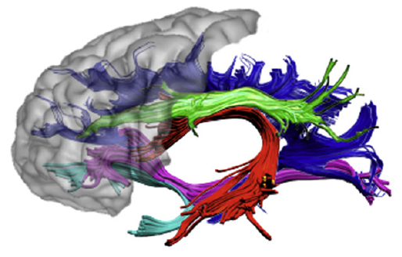
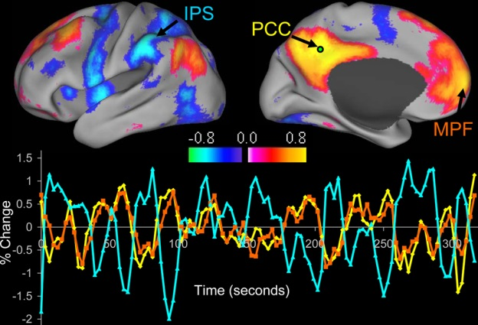
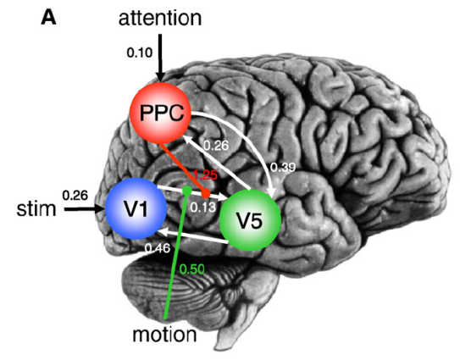
Structural, Functional and Effective Connectivity
large-scale anatomical infrastructures that support effective connections for coupling
Structural connectivity
statistical dependencies among remote neurophysiological events
Functional connectivity
Effective connectivity
influence that one system exerts over another

Slide 5
Models of Effective Connectivity for fMRI Data
Structural Equation Modelling (SEM)
Regression models
(e.g. psycho-physiological interactions, PPIs)
Volterra kernels
Time series models (e.g. MAR/VAR, Granger causality)
Dynamic Causal Modelling (DCM)

Slide 6
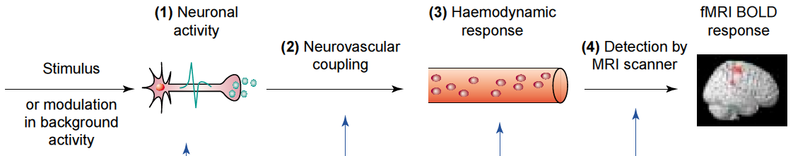
DCM OVERVIEW
is a generic approach for inferring hidden (unobserved) neural states from measured brain activity by means of fitting a generative model to the data which provides mechanistic insights into brain function.
Key features:
Dynamic
Causal
Neurophysiologically plausible/interpretable
Make use of a generative/forward model (mapping from consequences to causes)
Bayesian in all aspects

Slide 7
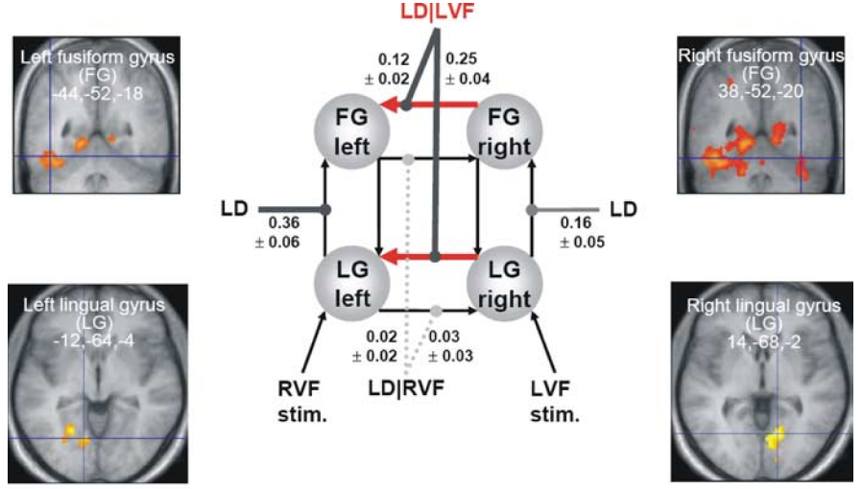
A Bilinear Model of Interacting Visual Regions
u₃
z₃
z₄
*Z = X
z₁
z₂
u₂
u₁

Slide 8
A Bilinear Model of Interacting Visual Regions
u₃
z₃
z₄
*Z = X
z₁
z₂
u₂
u₁

Slide 9
A Bilinear Model of Interacting Visual Regions
u₃
z₃
z₄
*Z = X
z₁
z₂
u₂
u₁

Slide 10

Neuronal Model
Bilinear State Equation
state
changes
endogenous connectivity
modulation of
connectivity
system state
input parameters
external
inputs
n regions
m inputs (mod.)
m inputs (driv.)

Slide 11

“C” (direct or driving effects)
extrinsic influences of inputs on neuronal activity.
“A” (endogenous coupling or latent connectivity)
fixed or intrinsic effective connectivity;
first order connectivity among the regions in the absence of input;
average/baseline connectivity in the system.
“B” (bilinear term, modulatory effects or induced connectivity)
context-dependent change in connectivity;
second-order interaction between the input and activity in a source region when causing a response in a target region.
rate constants (Hz)
a strong connection means an influence that is expressed quickly or with a small time constant.
Units of
parameters

Slide 12
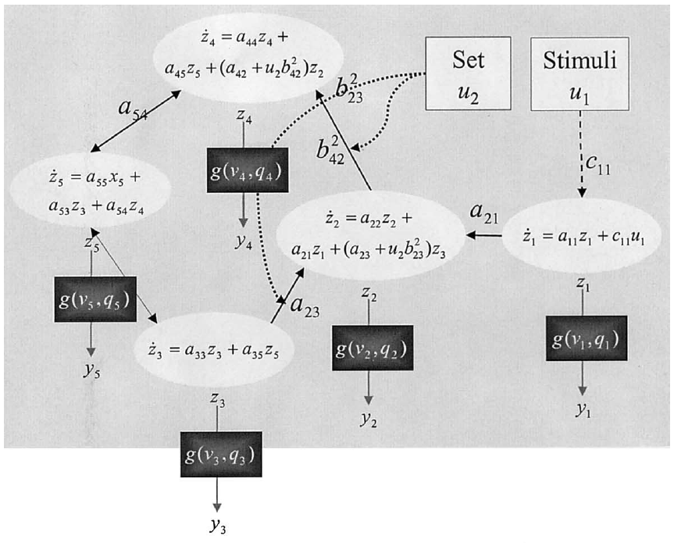




Neuronal Model
Hemodynamic Model
BOLD signal
Endogenous Connectivity
Modulation of connectivity
Input parameters

Slide 13
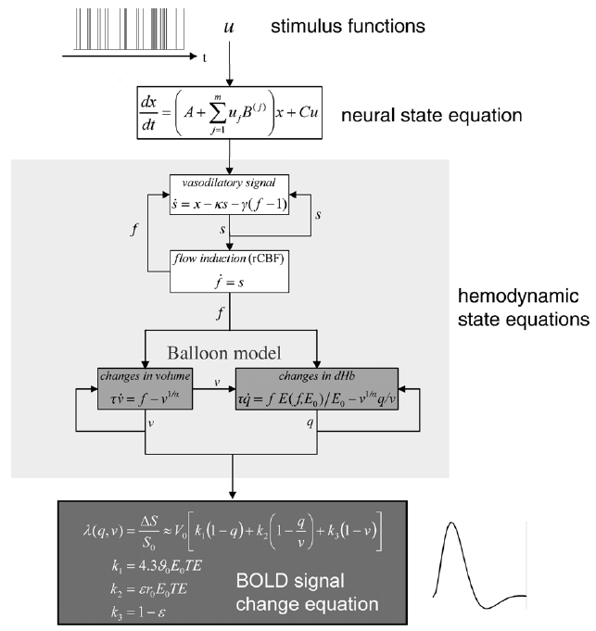
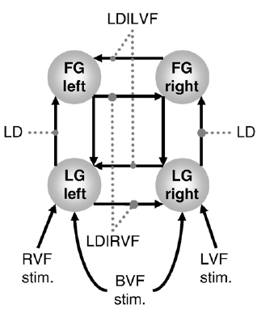
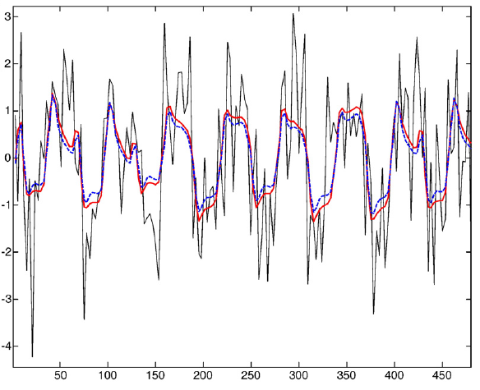
Hemodynamic Model

Slide 14
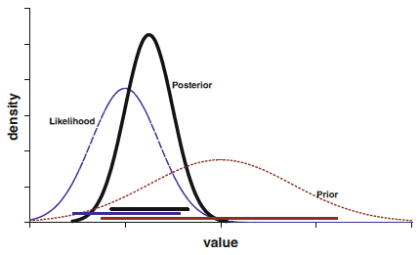

Model Inversion
DCM is a fully Bayesian approach aiming to explain how observed data (BOLD signal) was generated.
DCM accommodates
Prior knowledge
New data
posterior ∝ likelihood x prior
updates (optimise) parameter estimates
Empirical
DCM priors on parameters
assumed Gaussian distribution
parameter (re)estimation by means of VB under Laplace approximation
iterative process
Principled
Shrinkage

Slide 15
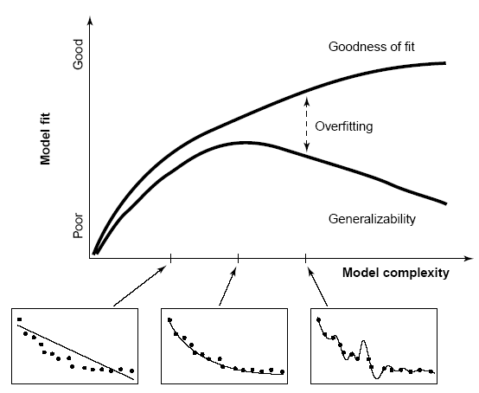




Model Evidence
Akaike's Information Criterion (AIC)
Different approximations
Bayesian Information Criterion (BIC)
Negative variational free energy

Slide 16

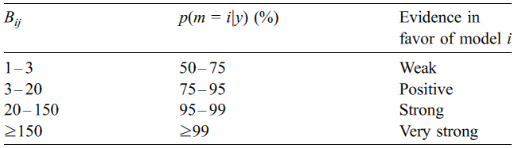
A more intuitive interpretation of model comparisons is granted by Bayes factor:
Winning model?
Best balance between accuracy and complexity
Occam's razor (principle of parsimony)

Slide 17
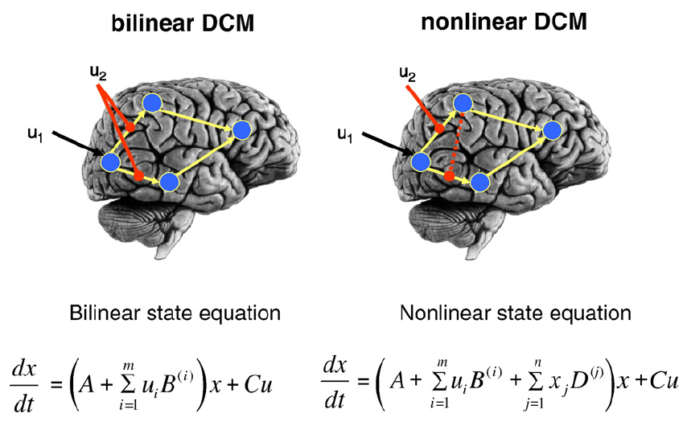
DCM Implementation Alternatives

Slide 18
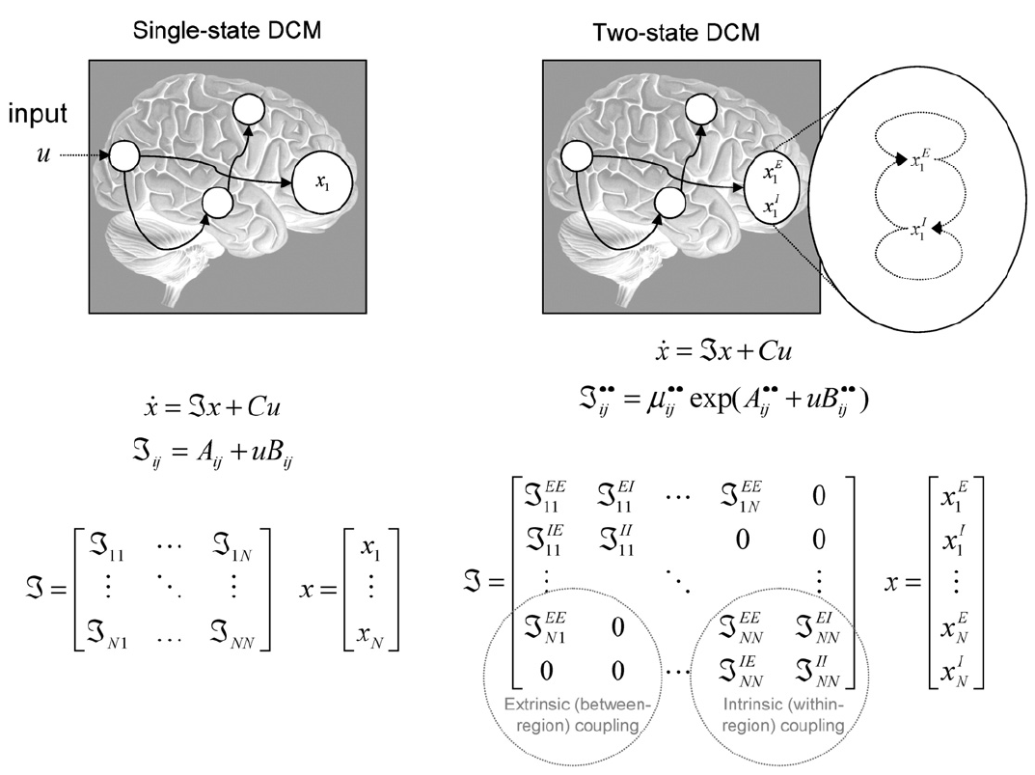

DCM
Deterministic
Stochastic

Slide 19
DCM: Practice
Rules of good practice
  10 Simple Rules for DCM (2010). Stephan et al. NeuroImage, 52
DCM in SPM.
  Steps within SPM.
  Example: attention to motion in the visual system (Büchel & Friston 1997, Cereb. Cortex, Büchel et al. 1998, Brain)

Slide 20
Rules of good practice
DCM is dependent on experimental disruptions.
  Experimental conditions enter the model as inputs that either drive the local responses or change connections strengths.
  It is better to include a potential activation found in the GLM analysis.
Use the same optimization strategies for design and data acquisition that apply to conventional GLM of brain activity:
  preferably multi-factorial (e.g. 2 x 2).
  one factor that varies the driving (sensory) input.
  one factor that varies the contextual input.

Slide 21
Define the relevant model space
  Define sets of models that are plausible, given prior knowledge about the system, this could be
    derived from principled considerations.
    informed by previous empirical studies using neuroimaging, electrophysiology, TMS, etc. in humans or animals.
Use anatomical information and computational models to refine the DCMs.
The relevant model space should be as transparent and systematic as possible, and it should be described clearly in any article.

Slide 22
Motivate model space carefully
Models are never true. They are meant to be helpful caricatures of complex phenomena.
The purpose of model selection is to determine which model, from a set of plausible alternatives, is most useful i.e., represents the best balance between accuracy and complexity.
The critical question in practice is how many plausible model alternatives exist?
  For small systems (i.e., networks with a small number of nodes), it is possible to investigate all possible connectivity architectures.
  With increasing number of regions and inputs, evaluating all possible models, a fact that becomes practically impossible.

Slide 23
What you can not do with BMS
Model evidence is defined with respect to one particular data set. This means that BMS cannot be applied to models that are fitted to different data.
Specifically, in DCM for fMRI, we cannot compare models with different numbers of regions, because changing the regions changes the data (We are fitting different data).

Slide 24
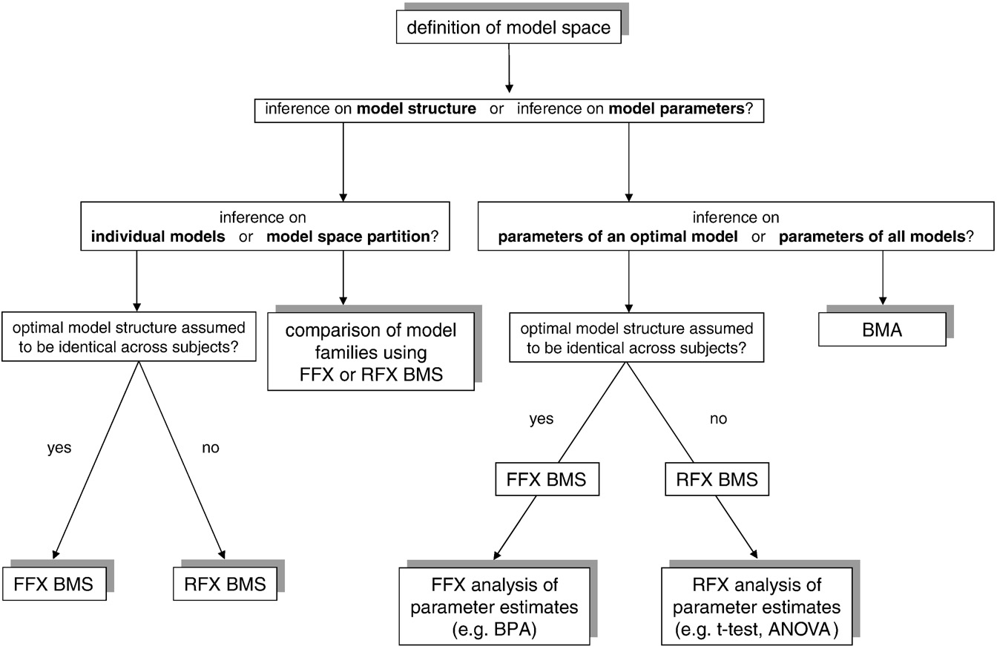
Fig. 1. This schematic summarizes the typical sequence of analysis in DCM, depending on the question of interest. Abbreviations: FFX=fixed effects, RFX=random effects, BMS=Bayesian model selection, BPA=Bayesian parameter averaging, BMA=Bayesian model averaging, ANOVA=analysis of variance.

Slide 25
Steps for conducting a DCM study on fMRI data…
Planning a DCM study
The example dataset
Identify your ROIs & extract the time series
Defining the model space
Model Estimation
Bayesian Model Selection/Model inference
Family level inference
Parameter inference
Group studies

Slide 26
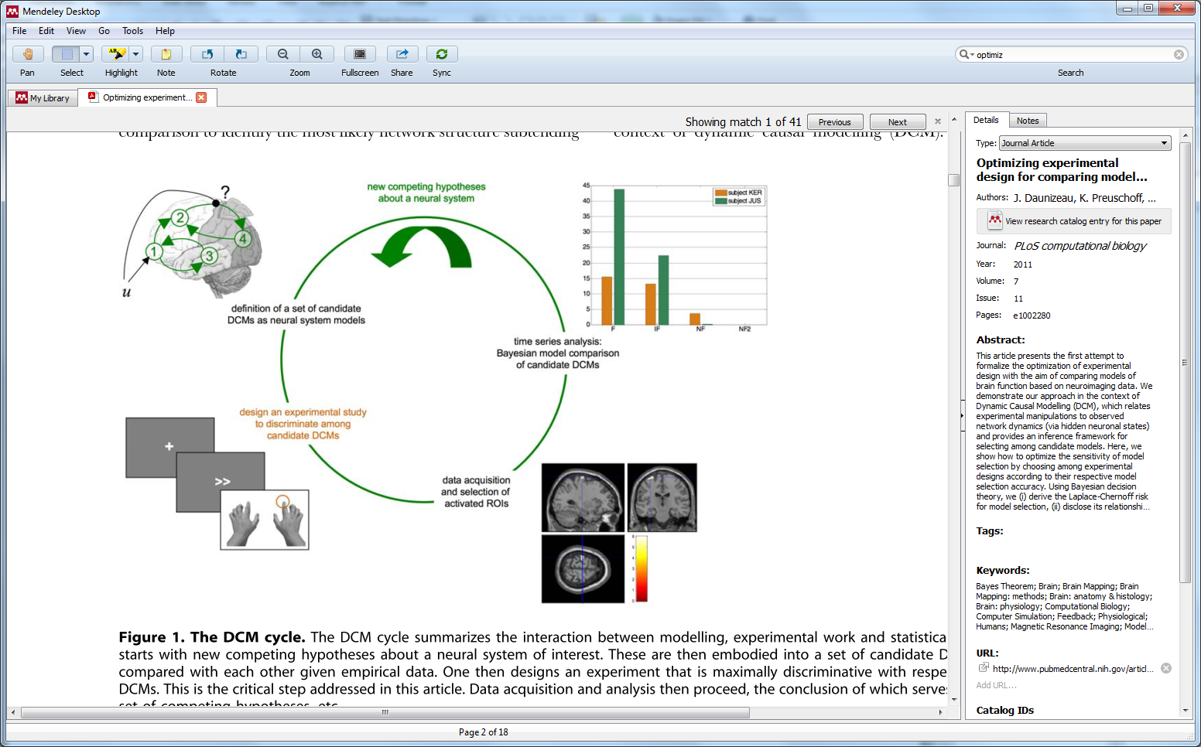
Planning a DCM Study
DCM can be applied to most datasets analysed using a GLM.
BUT! there are certain parameters that can be optimised for a DCM study.

Slide 27
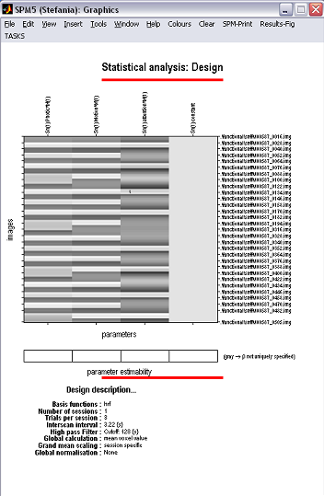
Attention to Motion Dataset
Question: Why does attention cause a boost of activity on V5?
  Sensory input factor
static
moving
Contextual factor
No attent
No motion/ no attention
Motion / no attention
Attent.
No motion/ attention
Motion / attention
DCM analysis regressors:
    Vision (photic)
    motion
    attention

Slide 28
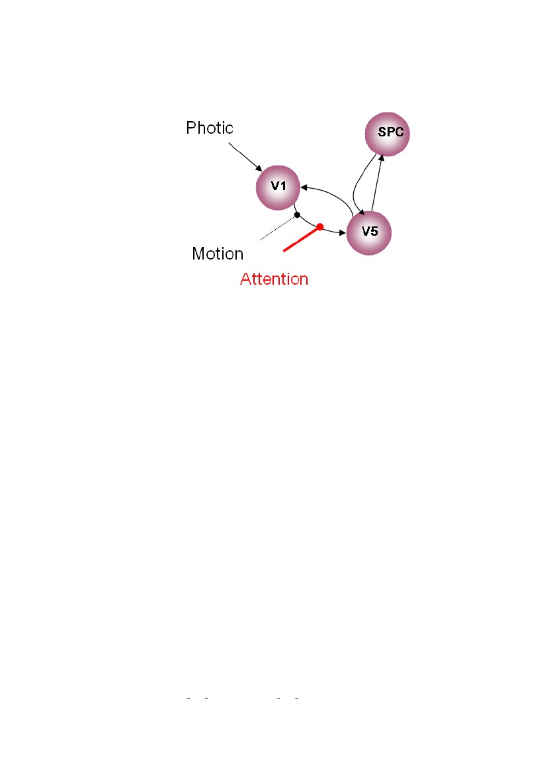
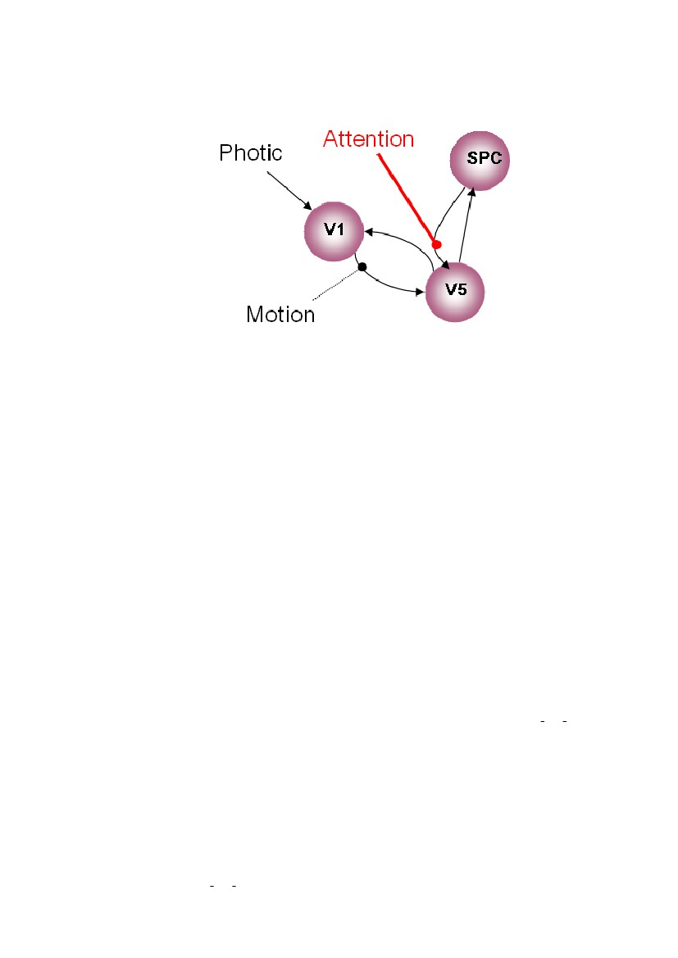
MODEL 1
Attentional modulation of V1→V5
forward/bottom-up
(modulation)
MODEL 2
Attentional modulation of SPC→V5
backward/top-down
(modulation)

Slide 29
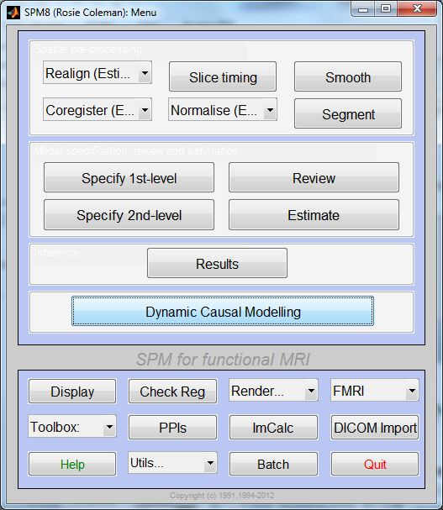
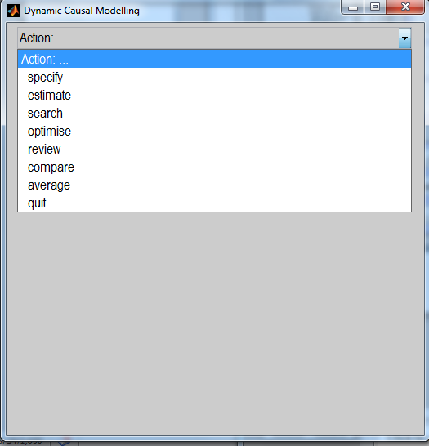
SPM8 Menu – Dynamic Causal Modelling

Slide 30
1. Extracting the time-series
We define our contrast (e.g. task vs. rest) and extract the time-series for the areas of interest.
  The areas need to be the same for all subjects.
  There needs to be significant activation in the areas that you extract.
  For this reason, DCM is not appropriate for resting state studies.

Slide 31
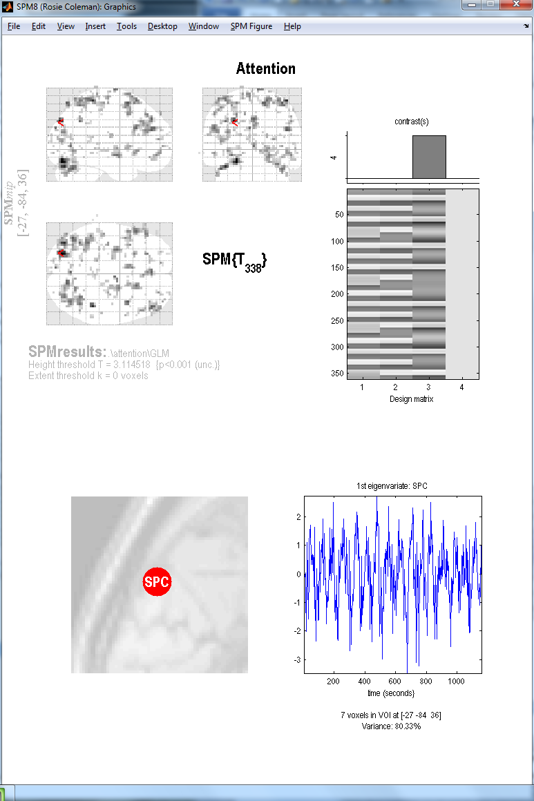
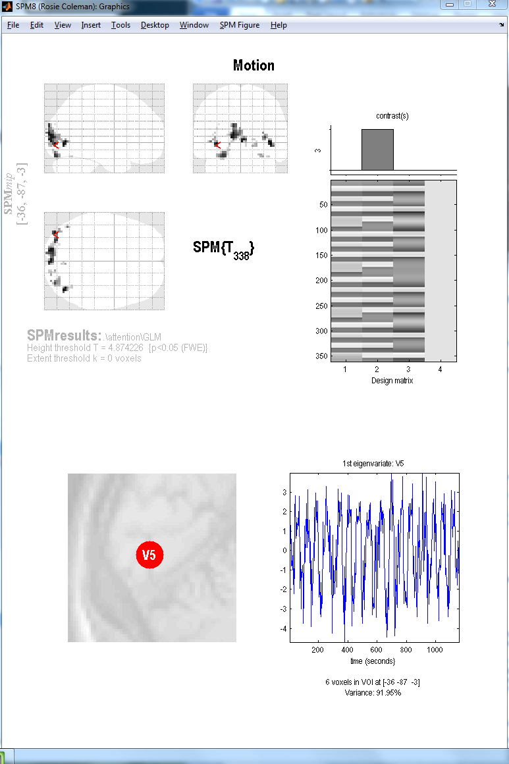
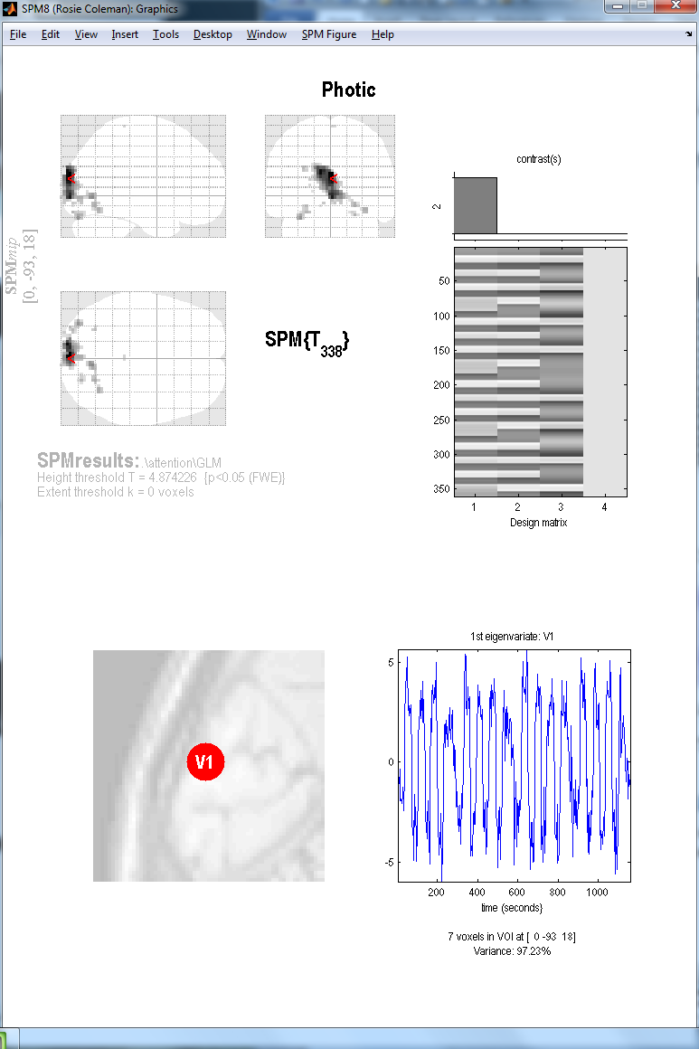
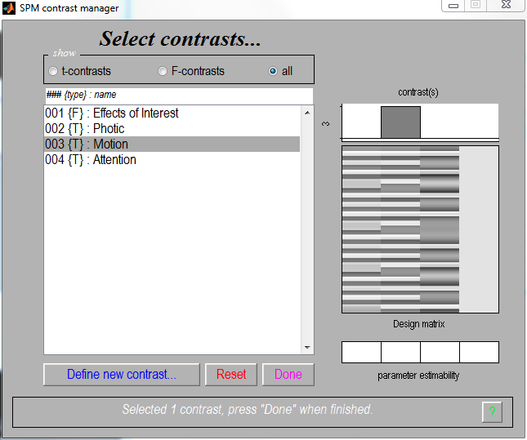

Slide 32
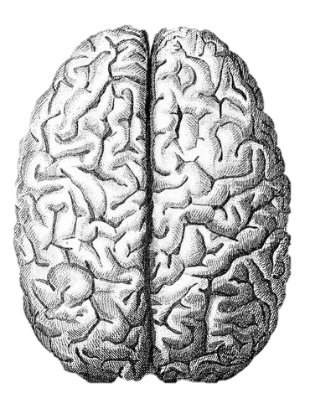
2. Defining the model space
The models that you choose to define for your DCM depend largely on your hypotheses.
  well-supported predictions
  inferences on model structure
  → can define a small number of possible models.
  no strong indication of network structure
  inferences on connection strengths
  → may be useful to define all possible models.
We use anatomical and computational knowledge.
More models do NOT mean we are eligible for multiple comparisons!

Slide 33
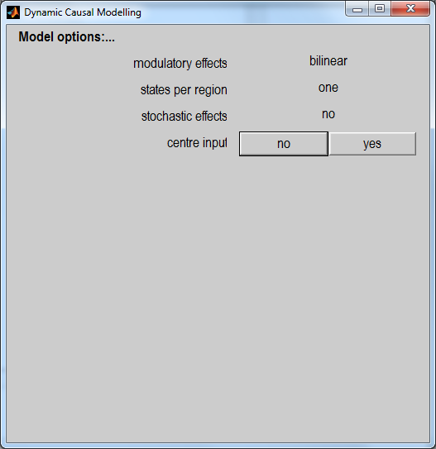
At this stage, you can specify various options.
MODULATORY EFFECTS: bilinear vs non-linear
STATES PER REGION: one vs. two
STOCHASTIC EFFECTS: yes vs. no
CENTRE INPUT: yes vs. no

Slide 34
3. Model Estimation
We fit the predicted model to the data.
The dotted lines represent the real data whereas full lines represent the predicted data from SPM: blue being V1, green V5 and red SPC.
Bottom graph shows your parameter estimations.

Slide 35
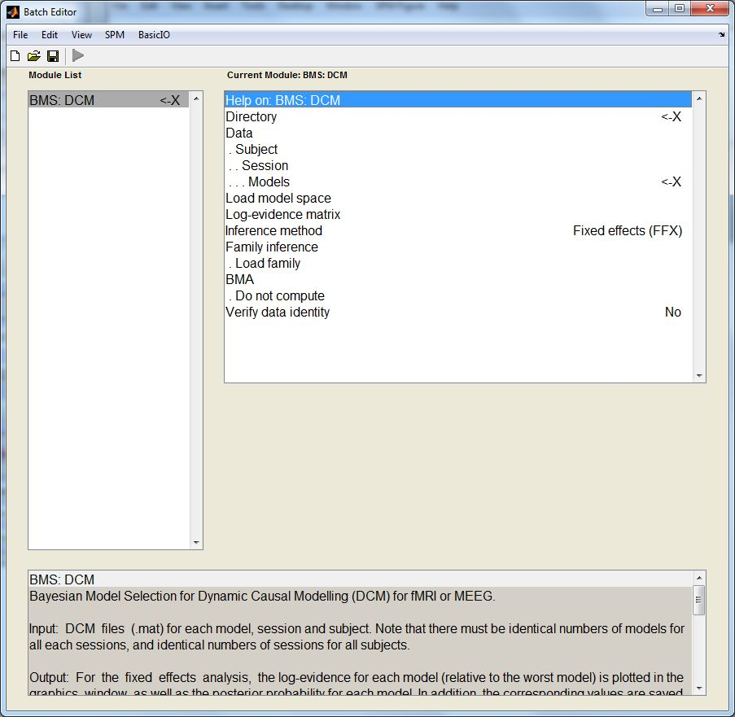
4. BMS & Model-Level Inference
We choose directory
Load all models for all subjects (must be estimated!)
Then, choose FFX or RFX – Multiple subjects with possibility for different models = RFX
    Optional:
    Define families
    Compute BMA
    Use ‘load model space’ to save time (this file is included in Attention to Motion dataset)

Slide 36
Winning Model!
MODEL 1
Attentional modulation of V1→V5
forward/bottom-up

Slide 37
Modulatory Connections
Intrinsic Connections

Slide 38
5. Family-Level Inference
Often, there doesn’t appear to be one model that is an overwhelming ‘winner’.
In these circumstances, we can group similar models together to create families.
By sorting models into families with common characteristics, you can aggregate evidence.
We can then use these to pool model evidence and make inferences at the level of the family.

Slide 39
6. Parameter-Level Inference
Bayesian Model Averaging
Calculates the mean parameter values, weighted by the evidence for each model.
Parameter Level
Within Groups
parameter > 0 ?
parameter 1 > parameter 2 ?
Does connection strength vary by performance/symptoms/other variable?
BMA can be calculated based on an individual subject, or on a group-level.
T-tests can be used to compare connection strengths.

Slide 40
7. Group Studies
DCM can be fruitful for investigating group differences.
E.g. patients vs. controls
Groups that may differ in;
  Winning model
  Winning family
  Connection values as defined using BMA

Slide 41
So, DCM…
enables us to infer hidden neuronal processes from fMRI data.
allows us to test mechanistic hypotheses about observed effects
  using a deterministic differential equation to model neuro-dynamics (represented by matrices A,B and C).
is governed by anatomical and physiological principles.
uses a Bayesian framework to estimate model parameters.
is a generic approach to modelling experimentally disrupted dynamic systems.

Slide 42
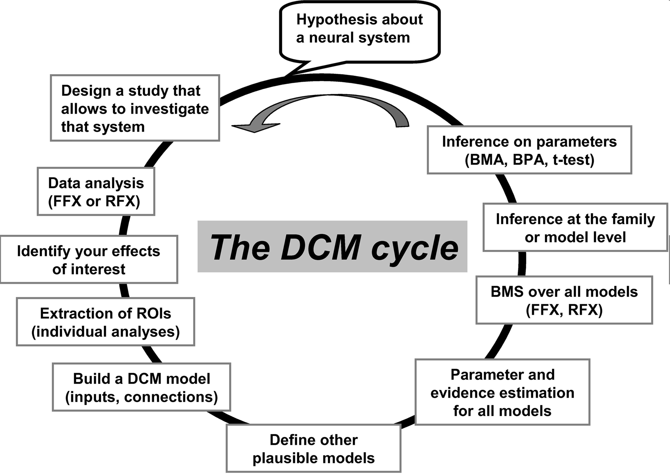

Slide 43
Thank you for listening…
… and special thanks to our expert Mohamed Seghier!

Slide 44
REFERENCES
http://www.fil.ion.ucl.ac.uk/spm/course/video/
Previous MfD slides
Arthurs, O. J., & Boniface, S. (2002). How well do we understand the neural origins of the fMRI BOLD signal?. Trends in Neurosciences, 25, 27-31.
Bastos, A. M., Usrey, W. M., Adams, R. A., Mangun, G. R., Fries, P., & Friston, K. J. (2012). Canonical microcircuits for predictive coding. Neuron, 76, 695-711.
Daunizeau, J., David, O., & Stephan, K. E. (2011). Dynamic causal modelling: a critical review of the biophysical and statistical foundations. Neuroimage, 58, 312-22.
Daunizeau, J., Preuschoff, K., Friston, K., & Stephan, K. (2011). Optimizing Experimental Design for Comparing Models of Brain Function. PLoS Computational Biology, 7, 1-18.
Daunizeau, J., Stephan, K. E., & Friston, K. J. (2012). Stochastic dynamic causal modelling of fMRI data: Should we care about neural noise?. Neuroimage, 62, 464-481.
Friston, K. J. (2011). Functional and Effective Connectivity: A Review. Brain Connectivity, 1, 13-36.
Friston, K. J., Harrison, L., & Penny, W. (2003). Dynamic causal modelling. Neuroimage, 19, 1273-1302.
Friston, K. J., Kahan, J., Biswal, B., & Razi, A. (in press). DCM for resting state fMRI. NeuroImage.
Friston, K. J., Mechelli, A., Turner, R., & Price, C. J. (2000). Nonlinear Responses in fMRI: The Balloon Model, Volterra Kernels, and Other Hemodynamics. Neuroimage, 12, 466-477.

Slide 45
Friston, K., Moran, R., & Seth, A. K. (2013). Analysing connectivity with Granger causality and dynamic causal modelling. Current Opinion in Neurobiology, 23, 172-178.
Goulden, N., Elliott, R., Suckling, J., Williams, S. R., Deakin, J. F., & McKie, S. (2012). Sample size estimation for comparing parameters using dynamic causal modeling. Brain Connectivity, 2, 80-90.
Kahan, J., & Foltynie, T. (2013). Understanding DCM: Ten simple rules for the clinician. Neuroimage, 83, 542-549.
Marreiros, A., Kiebel, S., & Friston, K. (2008). Dynamic causal modelling for fMRI: A two-state model. Neuroimage, 39, 269-278.
Penny, W. D. (2012). Comparing Dynamic Causal Models using AIC, BIC and Free Energy. Neuroimage, 59, 319-330.
Penny, W. D., Stephan, K. E., Daunizeau, J., Rosa, M. J., Friston, K. J., Schofield, T. M., & Leff, A. P. (2010). Comparing families of dynamic causal models. PLoS Computational Biology, 6, 1-14.
Penny, W., Stephan, K., Mechelli, A., & Friston, K. (2004). Comparing dynamic causal models. Neuroimage, 22, 1157-1172.
Pitt, M. A., & Myung, I. J. (2002). When a good fit can be bad. Trends in Cognitive Sciences, 6, 421-425.
Rigoux, L., Stephan, K. E., Friston, K. J., & Daunizeau, J. (2014). Bayesian model selection for group studies - revisited. Neuroimage, 84, 971-985.

Slide 46
Seghier, M. L., & Friston, K. J. (2013). Network discovery with large DCMs. Neuroimage, 68, 181-191.
Seghier, M. L., Zeidman, P., Neufeld, N. H., Price, C. J., & Leff, A. P. (2010). Identifying abnormal connectivity in patients using dynamic causal modeling of fMRI responses. Frontiers in Systems Neuroscience, 4, 1-14.
Stephan, K. E. (2004). On the role of general system theory for functional neuroimaging. Journal of Anatomy, 205, 443-470.
Stephan, K. E., Harrison, L. M., Penny, W. D., & Friston, K. J. (2004). Biophysical models of fMRI responses. Current Opinion in Neurobiology, 14, 629-635.
Stephan, K. E., Kasper, L., Harrison, L. M., Daunizeau, J., den, O. H. E., Breakspear, M., & Friston, K. J. (2008). Nonlinear dynamic causal models for fMRI. Neuroimage, 42, 649-662.
Stephan, K. E., Marshall, J. C., Penny, W. D., Friston, K. J., & Fink, G. R. (2007). Interhemispheric Integration of Visual Processing during Task-Driven Lateralization. Journal of Neuroscience, 27, 3512-3522.
Stephan, K. E., Penny, W. D., Daunizeau, J., Moran, R. J., & Friston, K. J. (2009). Bayesian Model Selection for Group Studies. Neuroimage, 46, 1004–1017.
Stephan, K. E., Weiskopf, N., Drysdale, P. M., Robinson, P. A., & Friston, K. J. (2007). Comparing hemodynamic models with DCM. Neuroimage, 38, 387-401.
Stephan, K.E., Penny, W.D., Moran, R.J., den Ouden, H.E.M., Daunizeau, J., & Friston, K.J. (2010). Ten simple rules for dynamic causal modeling. NeuroImage, 49, 3099–3109.

