Slide 1
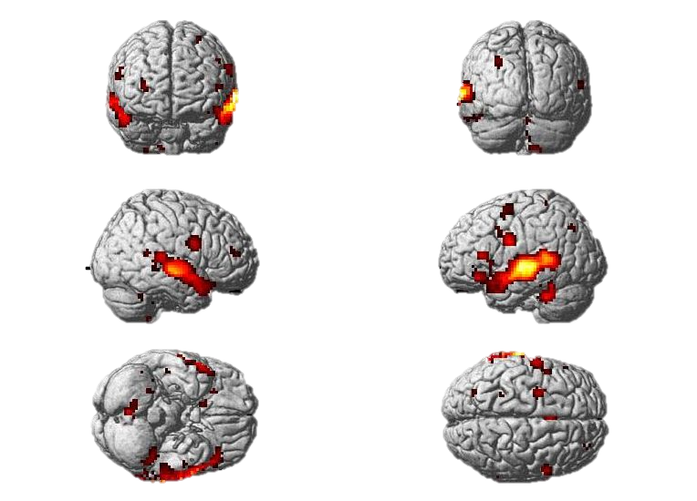
Dynamic Causal Modelling for fMRI
Rosie Coleman
Philipp Schwartenbeck
Methods for dummies 2012/13
With thanks to Peter Zeidman & 'Ōiwi Parker-Jones

Slide 2
Outline
DCM: Theory
  Background
  Basis of DCM
    Hemodynamic model
    Neuronal Model
  Developments in DCM
DCM: Practice
  Experimental Design
  Step-by-step guide

Slide 3
Background of DCM

Slide 4
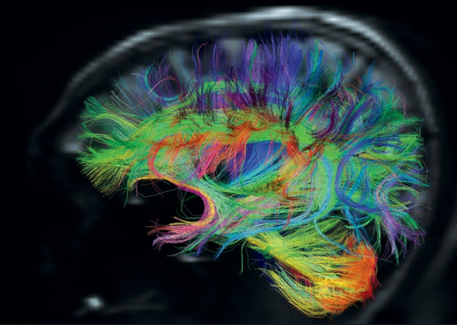
The connected brain
“We can isolate processes occurring in the living organism and describe then in terms and laws of physico-chemistry. […] But when it comes to the properly ‘vital’ features, it is found that they are essentially problems of organisation, […] resulting from the interaction of an enormous number of highly complicated physico-chemical events.” (von Bertalanffy, 1950)
“The functional role, played by any component (e.g., cortical area, sub-area, neuronal population or neuron) of the brain, is defined largely by its connections.
Functional Specialisation is only meaningful in the context of functional integration and vice versa.” (Friston, 2003)
“Yet, there does not seem to be a single area for which we are able to deduce its functional properties in a direct and causal fashion from its microstructural properties.” (Stephan, 2004)

Slide 5
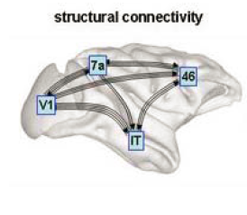
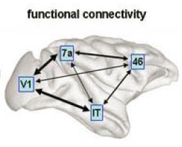
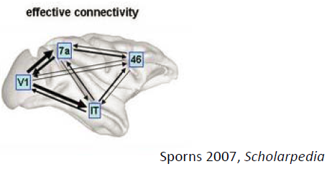
Types of Connectivity
Anatomical connectivity
  Anatomical layout of axons and synaptic connections
  Which neural units interact directly with each other
  E.g. DTI
Functional connectivity
  Correlation among activity in different brain areas
  Statistical dependencies between measured time series
Effective connectivity
  Causal influence that one neuronal system exerts over another
  At synaptic or neuronal population level

Slide 6
Effective Connectivity
Two basic implications
  Effective connectivity is dynamic
    i.e. activity- and time-dependent
    That means influence of neuronal system on another changes with time and context
  Effective connectivity includes interactions (nonlinearities) between neuronal systems
Models of connectivity need to rely on effective connectivity to be biologically plausible
  Brain is dynamic
    Current state of brain effects its state in the future
    As sampling rate of measurement increases, data becomes more dynamic (PET -> fMRI –> MEEG)
  Brain is nonlinear
    Non-additive (interactions) effects like saturation, habituation,…

Slide 7
Methods based on effective connectivity
Structural Equation modelling
  Multivariate analysis testing for influences among interacting variables
Time-series analysis
  E.g. Granger Causality
    Can dynamics of region A be predicted better using past values of region A and region B as opposed to using past values of region A alone
Methods based on linear regression analysis, e.g.
  Psychophysical-Interaction analysis
Methods based on nonlinear dynamic models
  Dynamic Causal Modelling (DCM)

Slide 8
Problems of other methods than DCM
Most methods do not allow to test for directionality/causality
  Impossible to characterise by methods based on regression
Regarding inputs as stochastic (noise)
  Idea of experiment is to change connectivity in a controlled way
  Input therefore is not stochastic but experimentally controlled
Relying on hemodynamic response (BOLD-signal)
  Definition of effective connectivity: influences of neuronal system
  Transformation from neuronal activity to hemodynamic response has non-linear components
  Not trivial to estimate to what degree the estimated coupling in the hemodynamic response was affected by transformation
  Cf. David et al., 2008

Slide 9
Basis of DCM
“The central idea behind dynamic causal modelling (DCM) is to treat the brain as a deterministic nonlinear dynamic system that is subject to inputs and produces outputs.” (Friston, 2003)

Slide 10
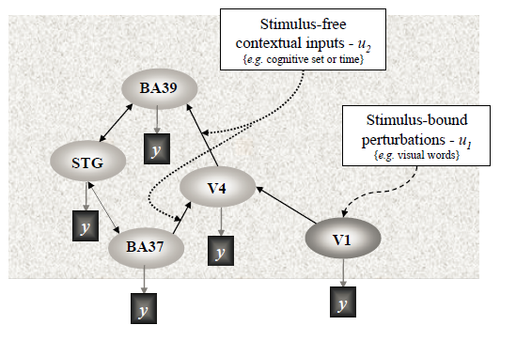
Brain as input-state-output system
Two types of inputs:
  Influence on specific anatomical regions (nodes)
  Modulation of coupling among regions (nodes)
E.g. visual input:

Slide 11
Brain as input-state-output system
Inputs: experimental manipulations
  External input on brain, e.g. visual stimuli
  Context, e.g. attention
State variables: neuronal activities in the brain
Outputs: electromagnetic or hemodynamic responses over brain regions
  Measured in scanner

Slide 12
Hemodynamic model

Slide 13
Hemodynamic “Forward” model
  Effective connectivity: influence that one neuronal system exerts over another
Problem: neuronal activity not directly accessible in fMRI…
Hemodynamic “forward” model of how neuronal synaptic activity transformed into measured response
Key difference to other measurements of connectivity

Slide 14
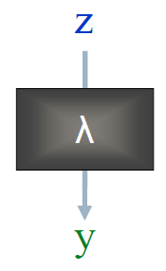
Forward model
Neuronal dynamics (z) transformed into BOLD-signal (y) via hemodynamic response function (λ)
DCM: Use this specific model to estimate parameters at neuronal level
  Such that modelled and measured BOLD signal maximally similar
For details see Stephan et al., 2007…

Slide 15
Neuronal model

Slide 16
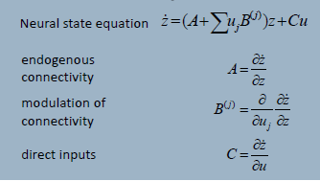
What is DCM modelling?
Forward model:

Slide 17


Neuronal model
Aim: model temporal evolution of set of neuronal states z_{t}
Important: not interested in neuronal state itself, but its rate of change in time
  Due to experimental perturbation in system
Expressed in differential equation:
current state
external input
Intrinsic connectivity

Slide 18
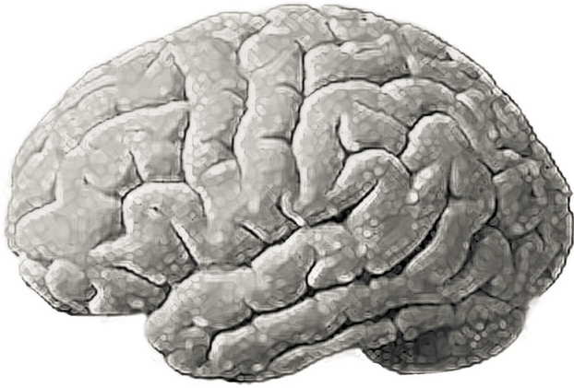


General State Equation
$$\frac{dz}{dt}=F(z,u,θ)$$
z₂
z: current state of system
z₃
u: external input to system
Z₁
θ: intrinsic connectivity

Slide 19
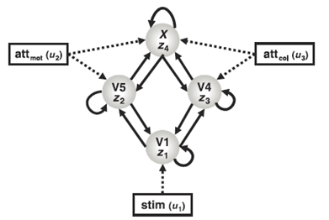
Neural State Equation in DCM
Example: attention to motion or colour of visual stimulus (Chawla, 1999)
Neural system consisting of:
  4 nodes (regions)
  Connections
    Within regions
    Between regions
  External input
    Stimulus
    Context
Taken from: Stephan, 2004

Slide 20
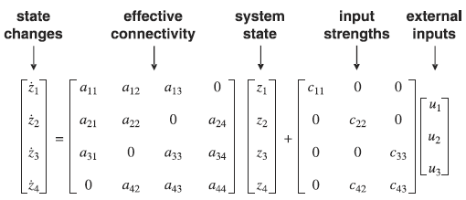

Neural State Equation in DCM

Slide 21
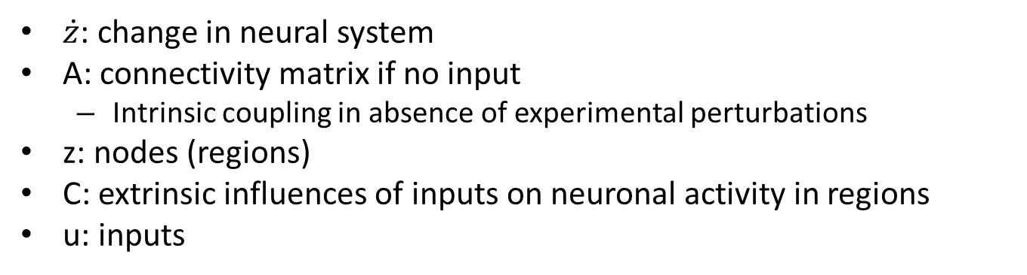
Neural State Equation in DCM
Problem: want to account for changes in connectivity due to input…
$\dot{z}$: change in neural system
A: connectivity matrix if no input
  Intrinsic coupling in absence of experimental perturbations
z: nodes (regions)
C: extrinsic influences of inputs on neuronal activity in regions
u: inputs

Slide 22
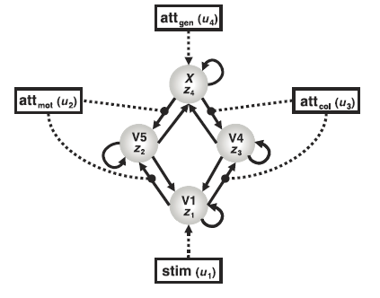
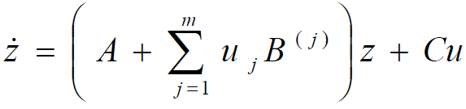
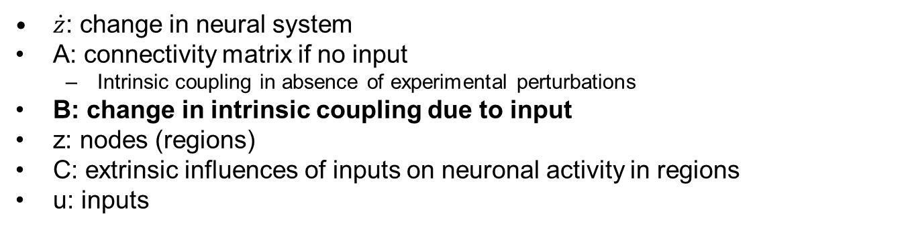
Neural State Equation in DCM
$\dot{z}$: change in neural system
A: connectivity matrix if no input
  Intrinsic coupling in absence of experimental perturbations
B: change in intrinsic coupling due to input
z: nodes (regions)
C: extrinsic influences of inputs on neuronal activity in regions
u: inputs
Allowing for interactions between input and activity in region (i.e. nonlinearities)

Slide 23

Neural State Equation in DCM
Having established this neural state equation, we can now specify DCMs to look at:
  Intrinsic coupling between regions (A matrix)
  Changes in coupling due to external input (B matrix)
    Usually most interesting
  Direct influences of inputs on regions (C matrix)

Slide 24
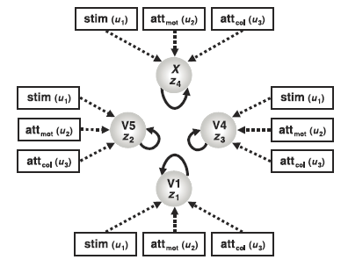
Standard fMRI as special case of DCM
Btw: Assuming that B=[] and only allowing for connectivity within regions gives us…
… a model for standard analysis of fMRI time-series (GLM for region-specific activation)…

Slide 25
Inference in DCM
Bayesian Inference
Relying on prior knowledge about connectivity parameters
Bayesian model selection to find model with highest model-evidence
  Most likely connections & influences of inputs
Important: trade off between model fit and complexity (e.g., parameters in model)
  Overfitting (i.e., explaining noise as well) if only aiming at best fit

Slide 26
Developments in DCM

Slide 27
Upgrades & more sophisticated DCMs
DCM10
  Intrinsic connectivity (A matrix) can be:
    Coupling without any perturbation (at rest)
    Coupling during average perturbation (during experiment)
  Bilinear (as explained) or Nonlinear DCM (Stephan et al., 2008)
    Including interactions with other units
    Account more accurately for processes like attention, learning, …
  Deterministic (as explained) or Stochastic DCM (Daunizeau et al., 2009)
    Including noise, short-term variations in effective connectivity
  One-state (as explained) or two-state DCM (Marreiros et al., 2008)
    Splitting every z in inhibitory and excitatory neuronal population
    Higher biological plausibility
  All changes: http://tinyurl.com/bueuqae

Slide 28

Interim Summary
Dynamic Causal Modelling measures effective connectivity in the brain
  Dynamic: capturing dependencies of brain regions over time
  Causal: measuring effective connectivity (i.e., causal influence of one neuronal system over another)
  Nonlinear: interactions between inputs and activity in regions
Hemodynamic “forward” model
  Accounting for neuronal coupling (not coupling in BOLD-signal)
  Allows to account for effective connectivity
Neuronal model
  Express changes in neural states via parameters for
    Intrinsic connectivity
    Influence of inputs on connectivity
    Influence of inputs on brain regions

Slide 29
DCM in practice

Slide 30
Steps for conducting a DCM study on fMRI data…
Planning a DCM study
The example dataset
Identify your ROIs & extract the time series
Defining the model space
Model Estimation
Bayesian Model Selection/Model inference
Family level inference
Parameter inference
Group studies

Slide 31
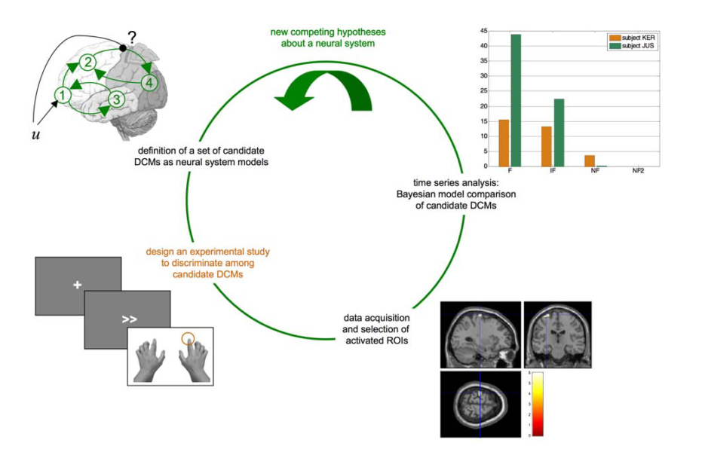
Planning a DCM Study
DCM can be applied to most datasets analysed using a GLM.
BUT! there are certain parameters that can be optimised for a DCM study.
If you’re interested…
Daunizeau, J., Preuschoff, K., Friston, K., & Stephan, K. (2011). Optimizing experimental design for comparing models of brain function. PLoS Computational Biology, 7(11)
Notes:
Define a set of DCMs, design an experimental procedure to discriminate between competing models, acquire the data and analyses the time-series, start again with more specific models in light of new data.

Slide 32
Attention to Motion Dataset
Can be downloaded from the SPM website
Question: Why does attention cause a boost of activity on V5?
4 Conditions:
Fixation | F
Static Dots | S | + Photic | V1
Moving Dots | N | + Motion | V5
Attention to Moving Dots | A | + Attention | V5 + Parietal cortex
Inputs to our models:
1. Photic input to V1
2. Motion modulatory input acting on the coupling from V1→V5
We know about these inputs, so they are the same in each model, and we do not need to model variations on where the inputs may enter the system because that is known.
The only unknown is the point at which attention modulates V5 activation.
As such, we are only going to look at two possible models.
Notes:
Block Design – 10 scans/block, 360 scans in total, TR = 3.22s

Slide 33
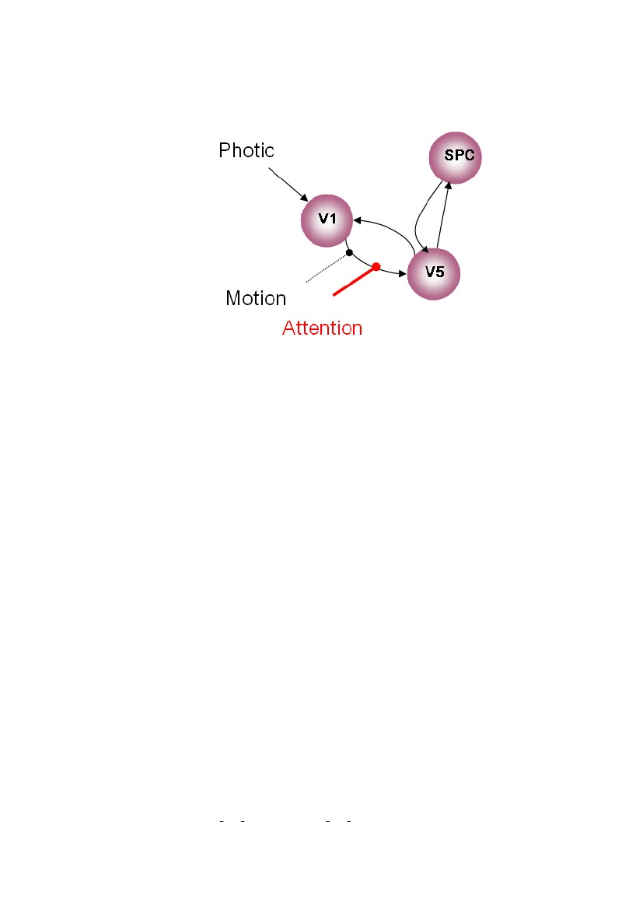
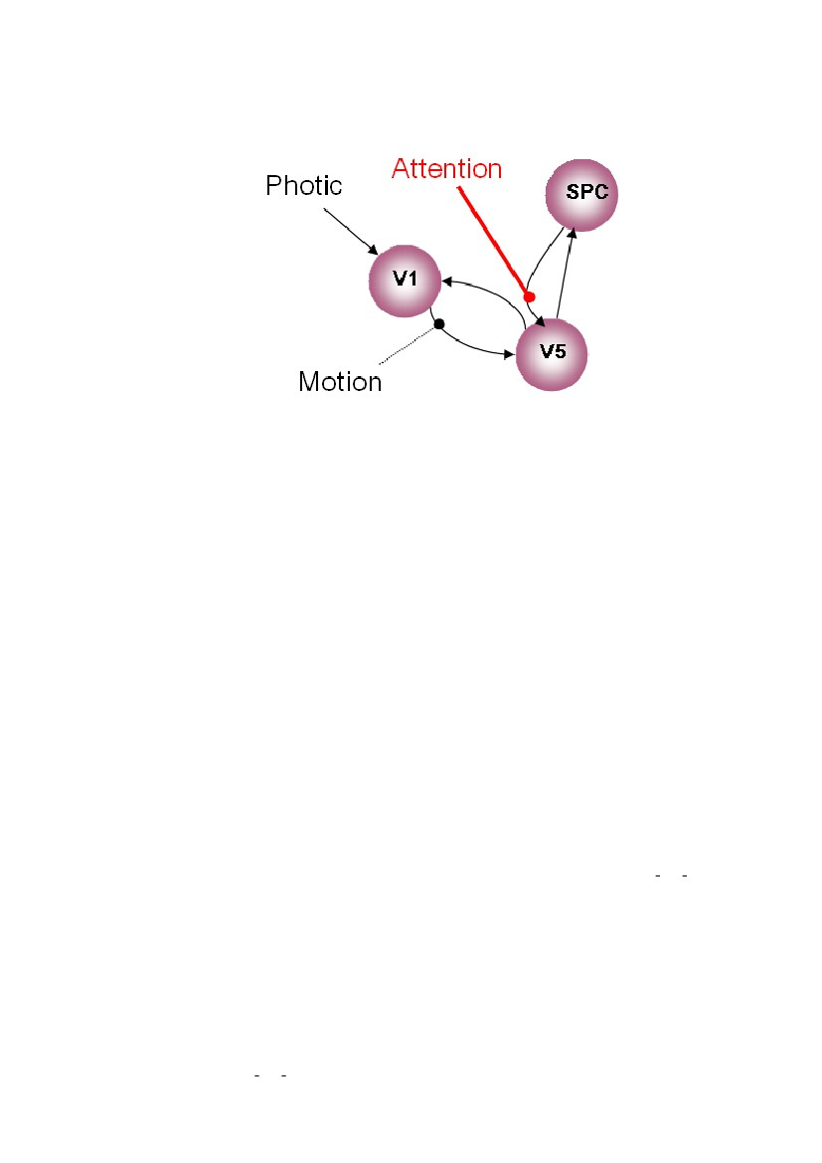
MODEL 1
Attentional modulation of V1→V5
forward/bottom-up
MODEL 2
Attentional modulation of SPM→V5
backward/ top-down

Slide 34
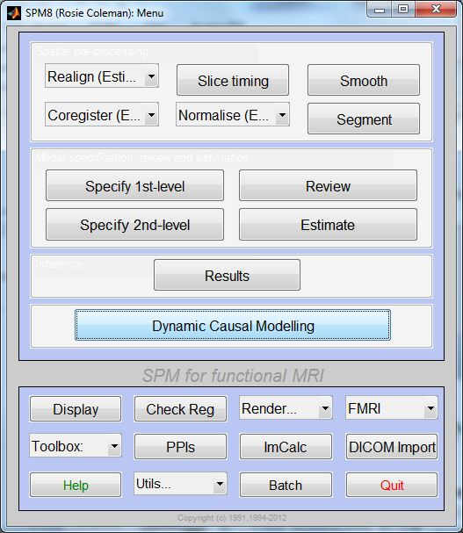
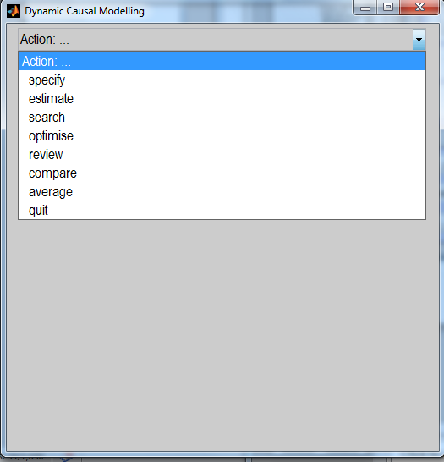
SPM8 Menu – Dynamic Causal Modelling
Notes:
Easy to find, you can’t miss it. Most of the things you’ll need to do in DCM can be done from this button.

Slide 35
1. Extracting the time-series
Define your contrast (e.g. task vs. rest) and extract the time-series for the areas of interest.
  The areas need to be the same for all subjects.
  There needs to be significant activation in the areas that you extract.
  For this reason, DCM is not appropriate for resting state studies
  (NB: you can use stochastic DCM to model resting state – but this is computationally demanding. To read more about this see references at the end. Don’t ask me because I really can’t explain it to you.)
Notes:
If there’s no significant activation/too few significantly activated voxels then you’re not predicting anything with DCM – DCM predicts responses to experimental manipulations.

Slide 36
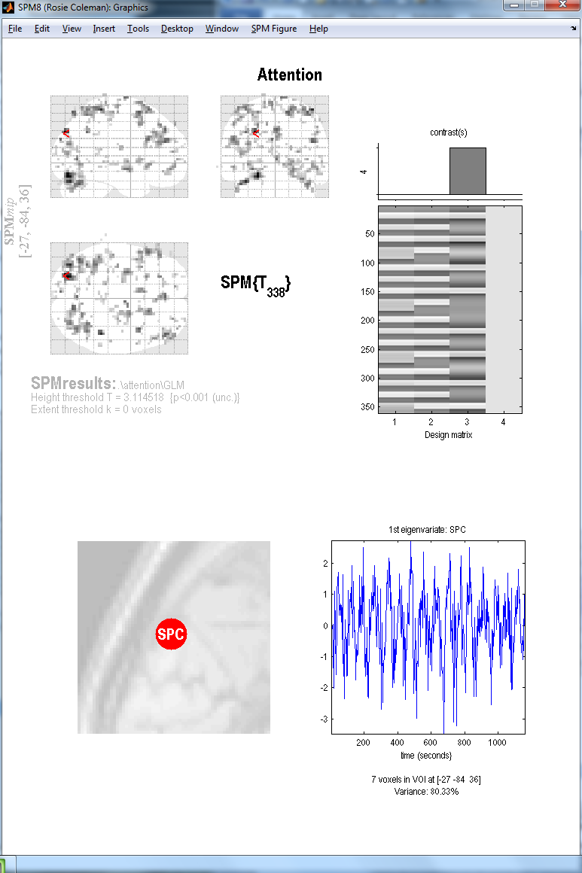
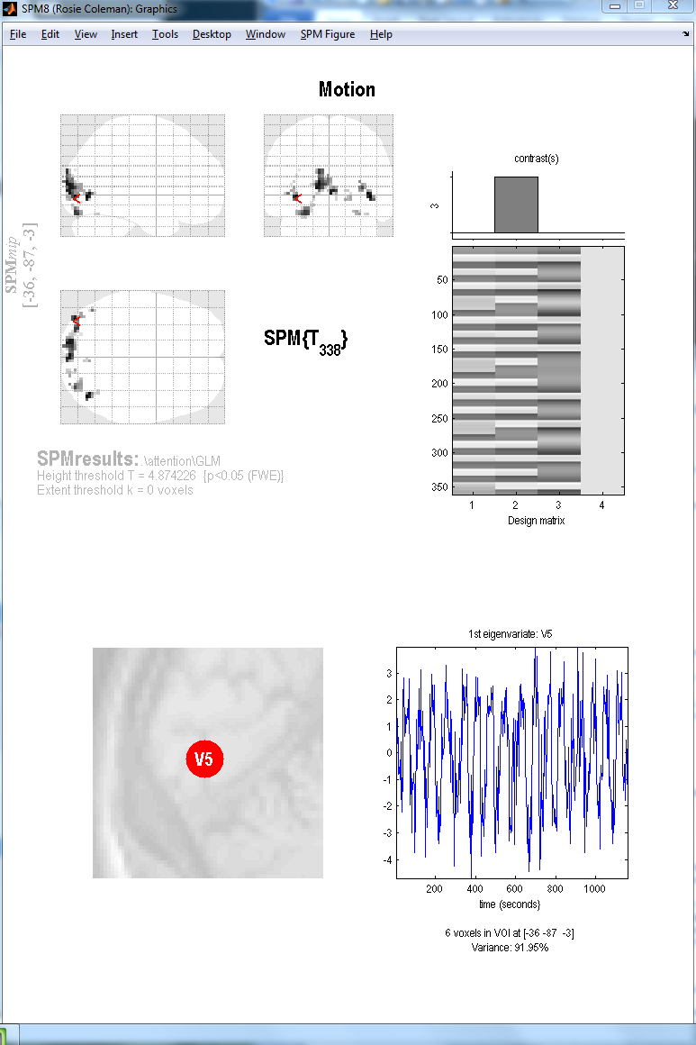
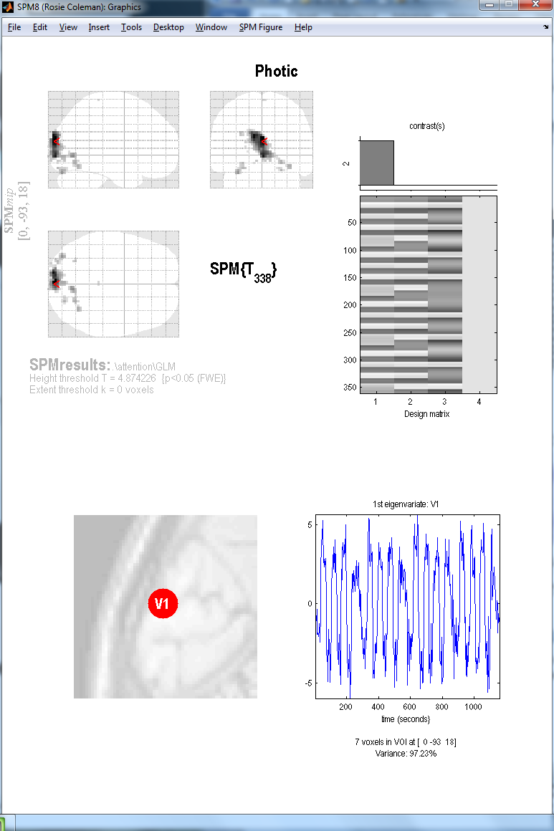
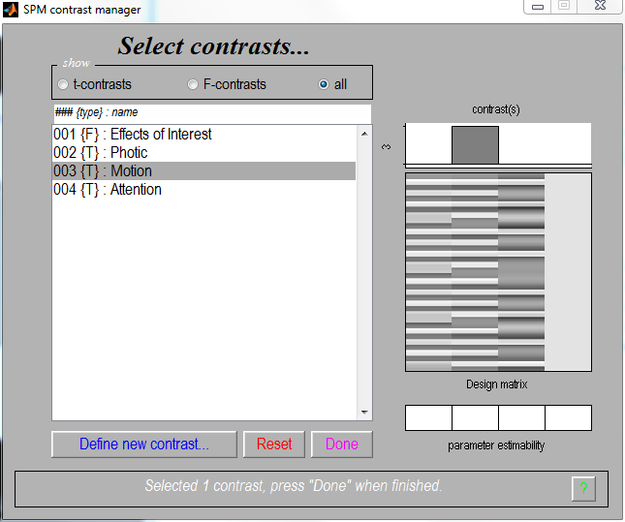

Slide 37
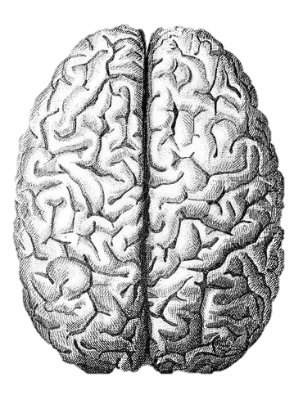
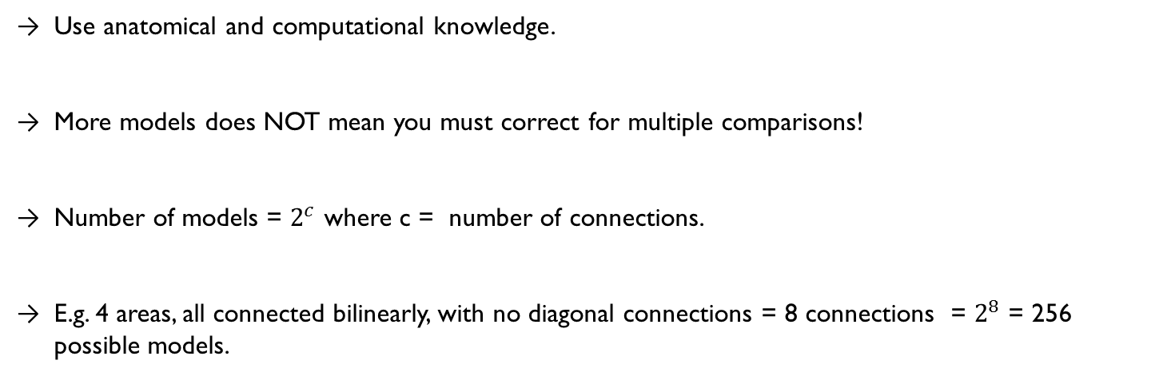
2. Defining the model space
The models that you choose to define for your DCM depend largely on your hypotheses.
  well-supported predictions
  inferences on model structure
  → can define a small number of possible models.
  no strong indication of network structure
  inferences on connection strengths
  → may be useful to define all possible models.
Use anatomical and computational knowledge.
More models does NOT mean you must correct for multiple comparisons!
Number of models = $2^{c}$ where c = number of connections.
E.g. 4 areas, all connected bilinearly, with no diagonal connections = 8 connections = $2^{8}$ = 256 possible models.
Notes:
Each model is defined and estimated independent of the others, and as such the umber of models does not detrimentally affect the statistical power your DCM analysis.

Slide 38
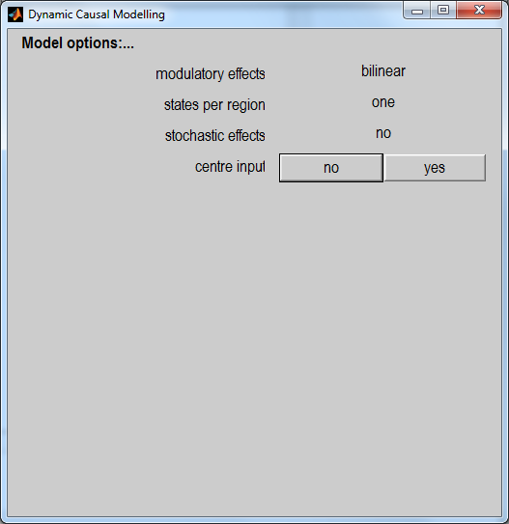
At this stage, you can specify various options.
MODULATORY EFFECTS: bilinear vs non-linear
STATES PER REGION: one vs. two
STOCHASTIC EFFECTS: yes vs. no
CENTRE INPUT: yes vs. no

Slide 39
3. Model Estimation
Fit your predicted model to the data.
The dotted lines represent the data, full lines represent the regions, blue being V1, green V5 and red SPC.
Bottom graph shows your parameter estimates.

Slide 40
Separate fitting of identical models for each subject
Family Level
Model Level
Does the winning family differ by group/condition/performance?
Does the winning model differ by group/condition/performance?
Parameter Level
Within Groups
Between Groups
parameter > 0 ?
parameter 1 > parameter 2 ?
Does connection strength vary by performance/symptoms/other variable?
Connection from region A ->region B
group 1 > group 2 ?

Slide 41
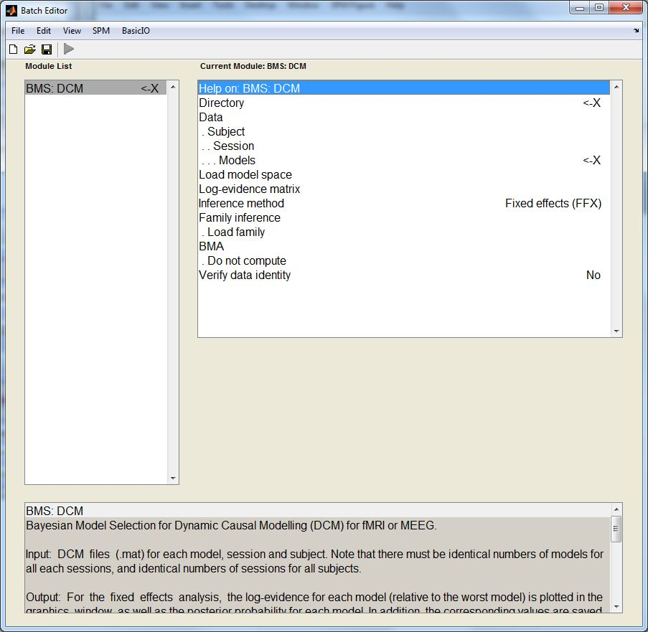
4. BMS & Model-Level Inference
Choose directory
Load all models for all subjects (must be estimated!)
Choose FFX or RFX – Multiple subjects with possibility for different models = RFX
Optional:
    Define families
    Compute BMA
    Use ‘load model space’ to save time (this file is included in Attention to Motion dataset)

Slide 42
Winning Model!
MODEL 1
Attentional modulation of V1→V5
forward/bottom-up

Slide 43
Modulatory Connections
Intrinsic Connections
Notes:
Gives you parameter values (in Hz for fMRI) and associated posterior probabilities.
These values are weighted by your winning model.

Slide 44
Separate fitting of identical models for each subject
Family Level
Model Level
Does the winning family differ by group/condition/performance?
Does the winning model differ by group/condition/performance?
Parameter Level
Within Groups
Between Groups
parameter > 0 ?
parameter 1 > parameter 2 ?
Does connection strength vary by performance/symptoms/other variable?
Connection from region A ->region B
group 1 > group 2 ?

Slide 45
5. Family-Level Inference
Often, there doesn’t appear to be one model that is an overwhelming ‘winner’
In these circumstances, we can group similar models together to create families.
By sorting models into families with common characteristics, you can aggregate evidence.
We can then use these to pool model evidence and make inferences at the level of the family.
Penny, W. D., Stephan, K. E., Daunizeau, J., Rosa, M. J., Friston, K. J., Schofield, T. M., & Leff, A. P. (2010). Comparing families of dynamic causal models. PLoS Computational Biology, 6(3)

Slide 46
Separate fitting of identical models for each subject
Family Level
Model Level
Does the winning family differ by group/condition/performance?
Does the winning model differ by group/condition/performance?
Parameter Level
Within Groups
Between Groups
parameter > 0 ?
parameter 1 > parameter 2 ?
Does connection strength vary by performance/symptoms/other variable?
Connection from region A ->region B
group 1 > group 2 ?

Slide 47
6. Parameter-Level Inference
Bayesian Model Averaging
Calculates the mean parameter values, weighted by the evidence for each model.
BMA uses a default of 10000 samples to create this average value.
BMA values therefore account for uncertainty in your data.
Parameter Level
Within Groups
parameter > 0 ?
parameter 1 > parameter 2 ?
Does connection strength vary by performance/symptoms/other variable?
BMA can be calculated on an individual subject, or at a group level.
Within a group (or on a single subject) you can use T-tests to compare connection strengths.
Can assess the relationship between connection strength and some linear variable e.g. performance, symptoms, age using regression analysis/correlation.
Notes:
Making inferences about connection strengths, rather than model structure.

Slide 48
7. Group Studies
Parameter Level
DCM can be fruitful for investigating group differences.
E.g. patients vs. controls
Groups may differ in;
  Winning model
  Winning family
  Connection values as defined using BMA
Between Groups
Connection from region A ->region B
group 1 > group 2 ?
Seghier, M. L., Zeidman, P., Neufeld, N. H., Leff, A. P., & Price, C. J. (2010). Identifying abnormal connectivity in patients using dynamic causal modeling of FMRI responses. Frontiers in systems neuroscience, 4(August), 1–14.
Notes:
The level of involvement of a connection/region

Slide 49
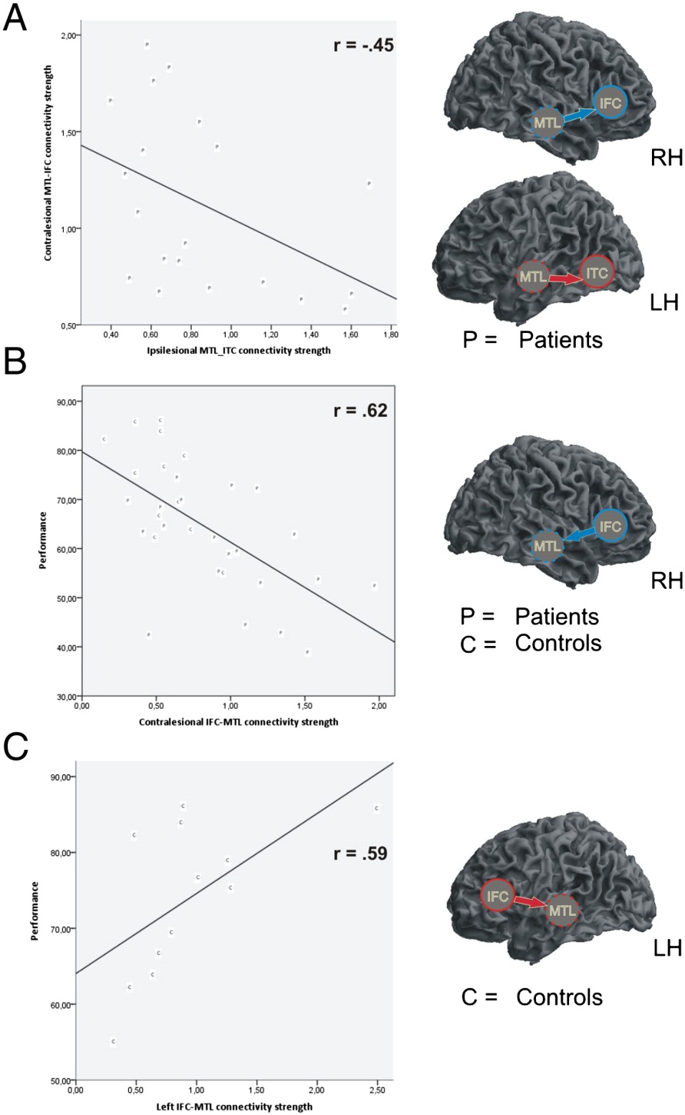
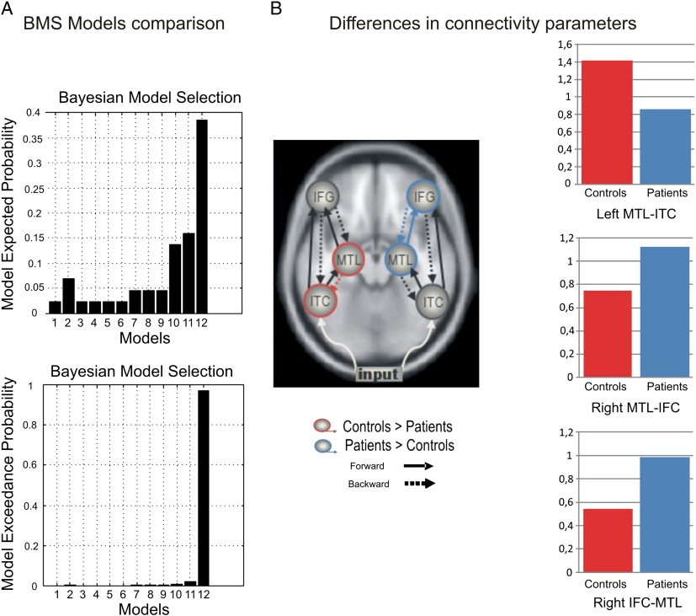
Network reconfiguration and working memory impairment in mesial temporal lobe epilepsy. Campo et al (2013) NeuroImage
connection strength vs. connection strength
←
connection strength vs. performance
←
↙
↑
connection strength – patients vs. controls
Recent example of how you can use DCM to make inferences at the model, family, and parameter level.

Slide 50
Thank you for listening
… and special thanks to Peter Zeidman & 'Ōiwi Parker-Jones!

Slide 51
References
Ouden, d. H. (2013, February). Effective Connectivity & the basics of Dynamic Causal Modelling. Talk given at SPM course Zurich.
Marreiros, A. (2012, May). Dynamic causal modelling for fMRI. Talk given at SPM course London.
Stephan, K. E. (2012, May). DCM: Advanced Topics. Talk given at SPM course London.
Friston, K. (2003). Dynamic Causal Modelling. In J. Ashburner, K. Friston & W. Penny (Eds.) Human Brain Function (2nd ed.). London: Elsevier.
Harrison, L., & Friston, K. (2003). Effective Connectivity. In J. Ashburner, K. Friston & W. Penny (Eds.) Human Brain Function (2nd ed.). London: Elsevier.
Friston, K. (2003). Functional Integration in the brain. In J. Ashburner, K. Friston & W. Penny (Eds.) Human Brain Function (2nd ed.). London: Elsevier.
Friston, K. Experimental design and Statistical Parametric Mapping (www.fil.ion.ucl.ac.uk/spm/doc/intro/)
Previous MfD talks

Slide 52
References Theory
Daunizeau, J., David, O., & Stephan, K. E. (2011). Dynamic causal modelling: A critical review of the biophysical and statistical foundations. NeuroImage, 58, 312-322.
David, O., Guillemain, I., Saillet, S., Reyt, S., Deransart, C., Segebarth, C., & Depaulis, A. (2008). Identifying Neural Drivers with Functional MRI: An Electrophysiological Validation. PLoS Biology, 6, 2683-2697.
Friston, K.J., Harrison, L., & Penny, W. (2003). Dynamic Causal Modelling. Neuroimage, 19, 1273-1302.
Friston, K. J., Li, B., Daunizeau, J., & Stephan, K. E. (2011). Network discovery with DCM. NeuroImage, 56, 1202-1221.
Marreiros, A. C., Kiebel, S. J., & Friston, K. J. (2008). Dynamic causal modelling for fMRI: A two-state model. NeurImage, 39, 269-278.
Stephan, K. E. (2004). On the role of general system theory for functional neuroimaging. Journal of Anatomy, 205, 443-470.
Stephan, K. E., Weiskopf, N., Drysdale, P. M., Robinson, P. A., & Friston, K. J. (2007). Comparing hemodynamic models with DCM. NeuroImage, 38, 387-401.
Stephan, K. E., Kasper, L., Harrison, L. M., Daunizeau, J., den Ouden, H. E. M., Breakspear, M., & Friston, K. J. (2008). Nonlinear dynamic causal models for fMRI. NeuroImage, 42, 649-662.
Stephan, K. E., Penny, W. D., Daunizeau, J., Moran, R. J., & Friston, K. J. (2009). Bayeisan model selection for group studies. NeuroImage, 46, 1004-1017.
Stephan, K. E., Penny, W. D., Moran, R. J., den Ouden, H. E. M., Daunizeau, J., & Friston, K. J. (2010). Ten simple rules for dynamic causal modelling. Neuroimage, 49, 3099-3109.
v. Bertalanffy, L. (1950). An Outline of General System Theory. The British Journal for the Philosophy of Science, 1, 134-147.

Slide 53
References Practice
Stephan, K. E., Penny, W. D., Moran, R. J., Den Ouden, H. E. M., Daunizeau, J., & Friston, K. J. (2010). Ten simple rules for dynamic causal modeling. NeuroImage, 49(4), Stephan, K. E., & Friston, K. J. (2010). Analyzing effective connectivity with fMRI. Wiley interdisciplinary reviews. Cognitive science, 1(3), 446–459. doi:10.1002/wcs.58
Daunizeau, J., Preuschoff, K., Friston, K., & Stephan, K. (2011). Optimizing experimental design for comparing models of brain function. PLoS Computational Biology, 7(11)
Penny, W. D., Stephan, K. E., Daunizeau, J., Rosa, M. J., Friston, K. J., Schofield, T. M., & Leff, A. P. (2010). Comparing families of dynamic causal models. PLoS Computational Biology, 6(3)
Seghier, M. L., Zeidman, P., Neufeld, N. H., Leff, A. P., & Price, C. J. (2010). Identifying abnormal connectivity in patients using dynamic causal modeling of FMRI responses. Frontiers in systems neuroscience, 4(August), 1–14
Campo et al. (2013). Network reconfiguration and working memory impairment in mesial temporal lobe epilepsy. NeuroImage, 72, 48-54.

