Slide 1


Methods for Dummies
2013
Introduction / Overview
23th October 2013
Archy de Berker & Marion Oberhuber
Wellcome Trust Centre for Neuroimaging, UCL

Slide 2
Overview
Introduction
    What’s MfD
Introduction to MfD 2013

Slide 3
Overview
Introduction
    What’s MfD
    Programme for 2013
Introduction to MfD 2013

Slide 4
Overview
Introduction
    What’s MfD
    Programme for 2013
    How to prepare your presentation
Introduction to MfD 2013

Slide 5
Overview
Introduction
    What’s MfD
    Programme for 2013
    How to prepare your presentation
    Where to find information and help
Introduction to MfD 2013

Slide 6
Overview
Introduction
    What’s MfD
    Programme for 2013
    How to prepare your presentation
    Where to find information and help
    Experts
Introduction to MfD 2013

Slide 7
Overview
Introduction
    What’s MfD
    Programme for 2013
    How to prepare your presentation
    Where to find information and help
    Experts
Overview for dummies
Introduction to MfD 2013

Slide 8
Overview
Introduction
    What’s MfD
    Programme for 2013
    How to prepare your presentation
    Where to find information and help
    Experts
Overview for dummies
Setting up your first experiment
Introduction to MfD 2013

Slide 9
Methods for Dummies 2013
Aim: to give a basic introduction to human brain imaging analysis methods, focusing on fMRI and M/EEG
Wednesdays / 13h00 – 14h00 / FIL Seminar Room
NEW we are now using SPM12 for MfD – please update slides accordingly
Introduction to MfD 2013

Slide 10
Methods for Dummies 2013
Aim: to give a basic introduction to human brain imaging analysis methods, focusing on fMRI and M/EEG
Wednesdays / 13h00 – 14h00 / FIL Seminar Room
Areas covered in MfD
Basic Statistics
fMRI (BOLD)
EEG / MEG
Connectivity
VBM & DTI
NEW we are now using SPM12 for MfD – please update slides accordingly
Introduction to MfD 2013

Slide 11
PROGRAMME 2013
Introduction to MfD 2013

Slide 12
I. fMRI - What are we measuring?
Part I: 30th Oct
Basis of the BOLD signal (Paul Forbes & Camilla Nord)
Introduction to MfD 2013

Slide 13
II. fMRI Analysis - Preprocessing
6th Nov – 13th Nov
Preprocessing:
  Realigning and un-warping (Sebastian Bobadilla & Charlie Harrison)
Introduction to MfD 2013

Slide 14
II. fMRI Analysis - Preprocessing
6th Nov – 13th Nov
Preprocessing:
  Realigning and un-warping (Sebastian Bobadilla & Charlie Harrison)
  Co-registration & spatial normalisation (Lieke De Boer & Julie Guerin)
Introduction to MfD 2013

Slide 15
III. Basic Statistics and application to fMRI analysis
20th Nov – 11th Dec
T-tests, ANOVA’s & Regression (Natasha Bobrowski-Khoury & Sana Chhipa)
Introduction to MfD 2013

Slide 16
III. Basic Statistics and application to fMRI analysis
20th Nov – 11th Dec
T-tests, ANOVA’s & Regression (Natasha Bobrowski-Khoury & Sana Chhipa)
1st level analysis – Design matrix, contrasts and inference, GLM (Samira Kazan & ?)
Introduction to MfD 2013

Slide 17
III. Basic Statistics and application to fMRI analysis
20th Nov – 11th Dec
T-tests, ANOVA’s & Regression (Natasha Bobrowski-Khoury & Sana Chhipa)
1st level analysis – Design matrix, contrasts and inference, GLM (Samira Kazan & ?)
1st level analysis – Basis functions, parametric modulation and correlated regressors (Shuman Ji & Konstantina Kyriakopoulou)
Introduction to MfD 2013

Slide 18

III. Basic Statistics and application to fMRI analysis
20th Nov – 11th Dec
T-tests, ANOVA’s & Regression (Natasha Bobrowski-Khoury & Sana Chhipa)
1st level analysis – Design matrix, contrasts and inference, GLM (Samira Kazan & ?)
1st level analysis – Basis functions, parametric modulation and correlated regressors (Shuman Ji & Konstantina Kyriakopoulou)
2nd level analysis – between-subject analysis (Bex Bond & Tom Ainscough)
Christmas break…!
Introduction to MfD 2013

Slide 19
III. (Not so) basic Statistics and application to fMRI analysis (cont.)
15th Jan – 22nd Jan
Bayes for Beginners (Nick Todd & ?)
Introduction to MfD 2013

Slide 20
III. (Not so) basic Statistics and application to fMRI analysis (cont.)
15th Jan – 22nd Jan
Bayes for Beginners (Nick Todd & ?)
Random Field Theory (Assel Kashkenbayeva & Annika Lubbert)
Introduction to MfD 2013

Slide 21
IV. fMRI Analysis – Design principles
29th Jan – 5th Feb
Study design and efficiency (Wanyi Liu & Natalie Berger)
Introduction to MfD 2013

Slide 22
IV. fMRI Analysis – Design principles
29th Jan – 5th Feb
Study design and efficiency (Wanyi Liu & Natalie Berger)
Issues with analysis and interpretation (e.g. double dipping, Type I/Type II errors) (Alexandra Surdina & Liora de Pellerin)
Introduction to MfD 2013

Slide 23
I. EEG - What are we measuring?
Part II: 12th Feb
Basis of the M/EEG signal (David Sutton & Lucy Ferguson)
Introduction to MfD 2013
Notes:
23

Slide 24
II. EEG & MEG
19th Feb – 26th Feb
Pre-processing and experimental design (Denisa Jamecna & Sofie Meyer)
Introduction to MfD 2013

Slide 25
II. EEG & MEG
19th Feb – 26th Feb
Pre-processing and experimental design (Denisa Jamecna & Sofie Meyer)
Contrasts, inference and source localisation (Matthew Constatinou & Wenjun Bai)
Introduction to MfD 2013

Slide 26
V. Connectivity
5th March – 19th March
Intro to connectivity - PPI & Resting state (Rosie Coleman & Josh Kahan)
Introduction to MfD 2013

Slide 27
V. Connectivity
5th March – 19th March
Intro to connectivity - PPI & Resting state (Rosie Coleman & Josh Kahan)
DCM for fMRI – theory & practice (Diego Lorca Puls & Sotirios Polychronis)
Introduction to MfD 2013

Slide 28
V. Connectivity
5th March – 19th March
Intro to connectivity - PPI & Resting state (Rosie Coleman & Josh Kahan)
DCM for fMRI – theory & practice (Diego Lorca Puls & Sotirios Polychronis)
DCM for ERP / ERF – theory & practice (Elina Jacobs & Clare Palmer)
Introduction to MfD 2013

Slide 29
VI. Structural MRI Analysis
26th March- 2nd April
Voxel Based Morphometry (Clarisse Aichelburg & Andrea Gajardo)
Introduction to MfD 2013

Slide 30
VI. Structural MRI Analysis
26th March- 2nd April
Voxel Based Morphometry (Clarisse Aichelburg & Andrea Gajardo)
Diffusion Tensor Imaging (Nora Butkute & Richard Daws)
Introduction to MfD 2013

Slide 31
How to prepare your presentation
Very important!!!: Read the Presenters’ guide
(http://www.fil.ion.ucl.ac.uk/mfd/guide.pdf)
Introduction to MfD 2013

Slide 32
How to prepare your presentation
Very important!!!: Read the Presenters’ guide
(http://www.fil.ion.ucl.ac.uk/mfd/guide.pdf)
Remember your audience are not experts…
The aim of the sessions is to
  introduce the concepts and explain why they are important to imaging analysis
  familiarise people with the basic theory and standard methods
Introduction to MfD 2013

Slide 33
How to prepare your presentation
Very important!!!: Read the Presenters’ guide
(http://www.fil.ion.ucl.ac.uk/mfd/guide.pdf)
Remember your audience are not experts…
The aim of the sessions is to
  introduce the concepts and explain why they are important to imaging analysis
  familiarise people with the basic theory and standard methods
Time: 45min. + 15min. questions – 2 presenters per session
Introduction to MfD 2013

Slide 34
How to prepare your presentation
Very important!!!: Read the Presenters’ guide
(http://www.fil.ion.ucl.ac.uk/mfd/guide.pdf)
Remember your audience are not experts…
The aim of the sessions is to
  introduce the concepts and explain why they are important to imaging analysis
  familiarise people with the basic theory and standard methods
Time: 45min. + 15min. questions – 2 presenters per session
Don’t just copy last year’s slides!!!...
Introduction to MfD 2013

Slide 35
How to prepare your presentation
Very important!!!: Read the Presenters’ guide
(http://www.fil.ion.ucl.ac.uk/mfd/guide.pdf)
Remember your audience are not experts…
The aim of the sessions is to
  introduce the concepts and explain why they are important to imaging analysis
  familiarise people with the basic theory and standard methods
Time: 45min. + 15min. questions – 2 presenters per session
Don’t just copy last year’s slides!!!...
Start preparing your talk with your co-presenter at least 2 weeks in advance
Introduction to MfD 2013

Slide 36
How to prepare your presentation
Very important!!!: Read the Presenters’ guide
(http://www.fil.ion.ucl.ac.uk/mfd/guide.pdf)
Remember your audience are not experts…
The aim of the sessions is to
  introduce the concepts and explain why they are important to imaging analysis
  familiarise people with the basic theory and standard methods
Time: 45min. + 15min. questions – 2 presenters per session
Don’t just copy last year’s slides!!!...
Start preparing your talk with your co-presenter at least 2 weeks in advance
Talk to the allocated expert 1 week in advance
Introduction to MfD 2013

Slide 37
What if I can’t make my presentation?
If you want to change / swap your topic, try and find someone else to swap with….
…if you still can’t find a solution, then get in touch with Archy or Marion as soon as possible (at least 3 weeks before the talk).
Introduction to MfD 2013

Slide 38
Where to find help
MfD Home
Resources
http://www.fil.ion.ucl.ac.uk/mfd/page2/page2.html
Online
Key papers
Previous years’ slides
Human Brain Function Textbook (online)
SPM course slides
Cambridge CBU homepage (Rik Henson’s slides)
Introduction to MfD 2013

Slide 39
Where to find help
MfD Home
Resources
http://www.fil.ion.ucl.ac.uk/mfd/page2/page2.html
Online
Key papers
Previous years’ slides
Human Brain Function Textbook (online)
SPM course slides
Cambridge CBU homepage (Rik Henson’s slides)
Locally
Methods Group Experts
Monday Methods Meetings (4th floor FIL, 12.30)
SPM email List
Introduction to MfD 2013

Slide 40
Experts
Nikolaus Weiskopf – Head of Physics
Will Penny – Head of Methods
John Ashburner
Gareth Barnes
Mohamed Seghier
Tom FitzGerald
Guillaume Flandin
Sarah Gregory
Vladimir Litvak
Dimitris Pinotsis
Ged Ridgway
Contact the expert: discuss presentation and other issues (1 week before talk)
Expert will be present in the session
Introduction to MfD 2013

Slide 41
Website
http://www.fil.ion.ucl.ac.uk/mfd/
Where you can find
all the information about MfD 2013:
Programme
Contacts
Presenter’s guide
Resources (Help)
Etc…
Introduction to MfD 2013

Slide 42
Other helpful courses
Matlab for Cognitive Neuroscience (ICN)
  Organiser: Daniel Bush (d.bush@ucl.ac.uk)
  17 Queen Square, basement seminar room
  http://www.icn.ucl.ac.uk/courses/MATLAB-Tutorials/index.htm
    First term: Thursdays at 2pm
    Second term: Wednesdays at 10am
    Third term: Thursdays at 2pm
Introduction to MfD 2013

Slide 43
Overview for Dummies
Introduction to MD 2013
Notes:
I will very briefly discuss the course of doing a whole fMRI experiment, as this is what most people in this course are interested in, and it serves as a good example. Please note that for doing an EEG/MEG experiment the steps are broadly the same, though the implementation can be different

Slide 44
Outline
SPM & your (fMRI) data
  Preprocessing
  Analysis
  Connectivity
Introduction to MfD 2013

Slide 45
Outline
SPM & your (fMRI) data
  Preprocessing
  Analysis
  Connectivity
Acronyms
Introduction to MfD 2013

Slide 46
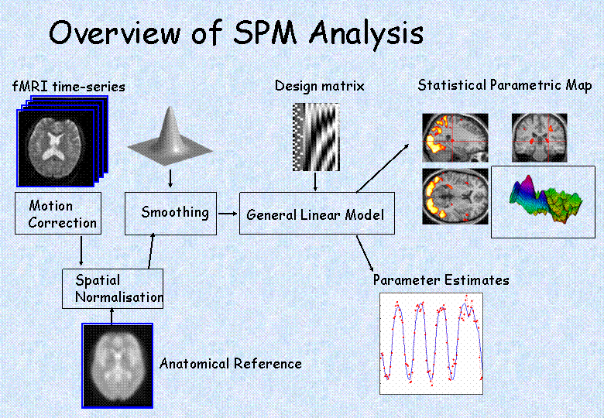
Pre-processing
Introduction to MfD 2013
Notes:
Preprocessing: do motion correction (realignment of the data), normalise so that it’s all in the same space, smooth the data so that you can compare between subjects. Then create a design matrix which describes the design of your study. Then you estimate how much your parameters of interest explain the BOLD response for each voxel, and threshold the resulting estimates to find out where your parameters explain significant amounts of variance.

Slide 47
Preprocessing Possibilities…
These steps basically get your imaging data to a state where you can start your analysis
  Realignment to correct for motion
  Normalisation to standard space
  Smoothing
Introduction to MfD 2013
Notes:
Realignment = motion correction

Slide 48
Model specification and estimation
Introduction to MfD 2013
Notes:
Preprocessing: do motion correction (realignment of the data), normalise so that it’s all in the same space, smooth the data so that you can compare between subjects. Then create a design matrix which describes the design of your study. Then you estimate how much your parameters of interest explain the BOLD response for each voxel, and threshold the resulting estimates to find out where your parameters explain significant amounts of variance.

Slide 49

General Linear Model
Design matrix
GLM describes data at each voxel
General Linear Model
Parameter estimates
Introduction to MfD 2013

Slide 50
General Linear Model
Design matrix
GLM describes data at each voxel
Experimental and confounding effects…
and residual variability
General Linear Model
Parameter estimates
Introduction to MfD 2013

Slide 51
General Linear Model
Design matrix
GLM describes data at each voxel
Experimental and confounding effects…
and residual variability
GLM used in combination with a temporal convolution model
General Linear Model
Parameter estimates
Introduction to MfD 2013

Slide 52


General Linear Model
Design matrix
GLM describes data at each voxel
Experimental and confounding effects…
and residual variability
GLM used in combination with a temporal convolution model
General Linear Model
Parameter estimates
Introduction to MfD 2013

Slide 53
Analysis
Once you have carried out your pre-processing you can specify your design and data
  The design matrix is simply a mathematical description of your experiment
  E.g. ‘visual stimulus on = 1’ ‘visual stimulus off = 0’
Introduction to MfD 2013

Slide 54
Inference
Introduction to MfD 2013
Notes:
Preprocessing: do motion correction (realignment of the data), normalise so that it’s all in the same space, smooth the data so that you can compare between subjects. Then create a design matrix which describes the design of your study. Then you estimate how much your parameters of interest explain the BOLD response for each voxel, and threshold the resulting estimates to find out where your parameters explain significant amounts of variance.

Slide 55
Contrasts & inference
Contrasts allow us to test hypotheses about our data
SPM:
An image whose voxel values are statistics
Introduction to MfD 2013

Slide 56
Contrasts & inference
Contrasts allow us to test hypotheses about our data
Using t & f tests on the GLM parameters
SPM:
An image whose voxel values are statistics
Introduction to MfD 2013

Slide 57
Contrasts & inference
Contrasts allow us to test hypotheses about our data
Using t & f tests on the GLM parameters
1st level analysis: activation over scans (within subject)
SPM:
An image whose voxel values are statistics
Introduction to MfD 2013

Slide 58
Contrasts & inference
Contrasts allow us to test hypotheses about our data
Using t & f tests on the GLM parameters
1st level analysis: activation over scans (within subject)
2nd level analysis: activation over subjects
SPM:
An image whose voxel values are statistics
Introduction to MfD 2013

Slide 59
Contrasts & inference
Contrasts allow us to test hypotheses about our data
Using t & f tests on the GLM parameters
1st level analysis: activation over scans (within subject)
2nd level analysis: activation over subjects
Multiple Comparison Problem – Random Field Theory
SPM:
An image whose voxel values are statistics
Introduction to MfD 2013

Slide 60
Write up and publish…
Introduction to MfD 2013
Notes:
Preprocessing: do motion correction (realignment of the data), normalise so that it’s all in the same space, smooth the data so that you can compare between subjects. Then create a design matrix which describes the design of your study. Then you estimate how much your parameters of interest explain the BOLD response for each voxel, and threshold the resulting estimates to find out where your parameters explain significant amounts of variance.

Slide 61
Brain connectivity
Causal interactions between brain areas, statistical dependencies
Structural connectivity (DTI)
Introduction to MfD 2013
Notes:
All the analysis so far was on functional segregation…

Slide 62
Brain connectivity
Causal interactions between brain areas, statistical dependencies
Structural connectivity (DTI)
Functional integration – how one region influences another…subdivided into:
  Functional connectivity: correlations among brain systems (e.g. principal component analysis)
  Effective connectivity: the influence of one region over another (e.g. psycho-physiological interactions, or Dynamic Causal Modelling)
Introduction to MfD 2013
Notes:
All the analysis so far was on functional segregation…

Slide 63
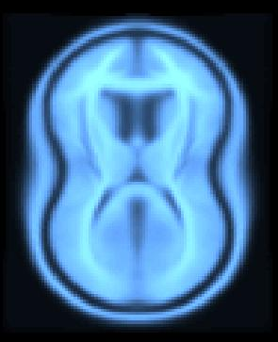
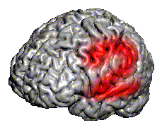
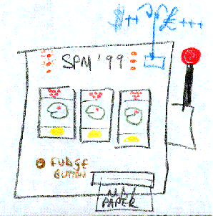
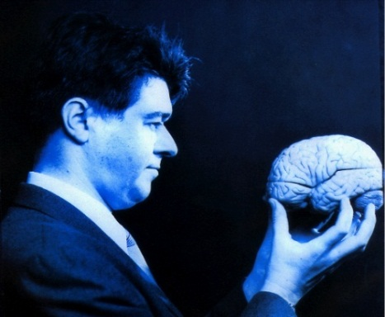
Statistical Parametric Mapping
MfD 2013 will focus on the use of SPM12
Introduction to MfD 2013

Slide 64
Statistical Parametric Mapping
MfD 2013 will focus on the use of SPM12
SPM software has been designed for the analysis of brain imaging data in fMRI, PET, SPECT, EEG & MEG
Introduction to MfD 2013

Slide 65
Statistical Parametric Mapping
MfD 2013 will focus on the use of SPM12
SPM software has been designed for the analysis of brain imaging data in fMRI, PET, SPECT, EEG & MEG
It runs in Matlab… just type SPM at the prompt and all will be revealed.
Introduction to MfD 2013

Slide 66
Statistical Parametric Mapping
MfD 2013 will focus on the use of SPM12
SPM software has been designed for the analysis of brain imaging data in fMRI, PET, SPECT, EEG & MEG
It runs in Matlab… just type SPM at the prompt and all will be revealed.
There are sample data sets available on the SPM website to play with
Introduction to MfD 2013

Slide 67
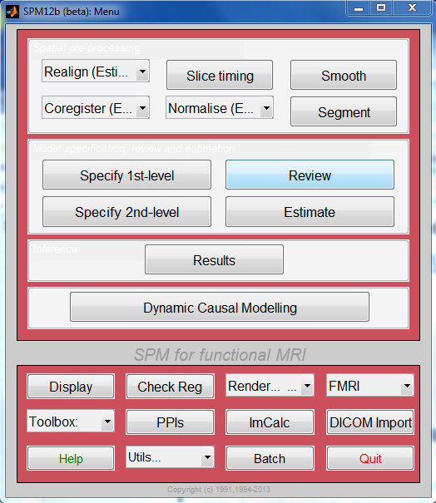
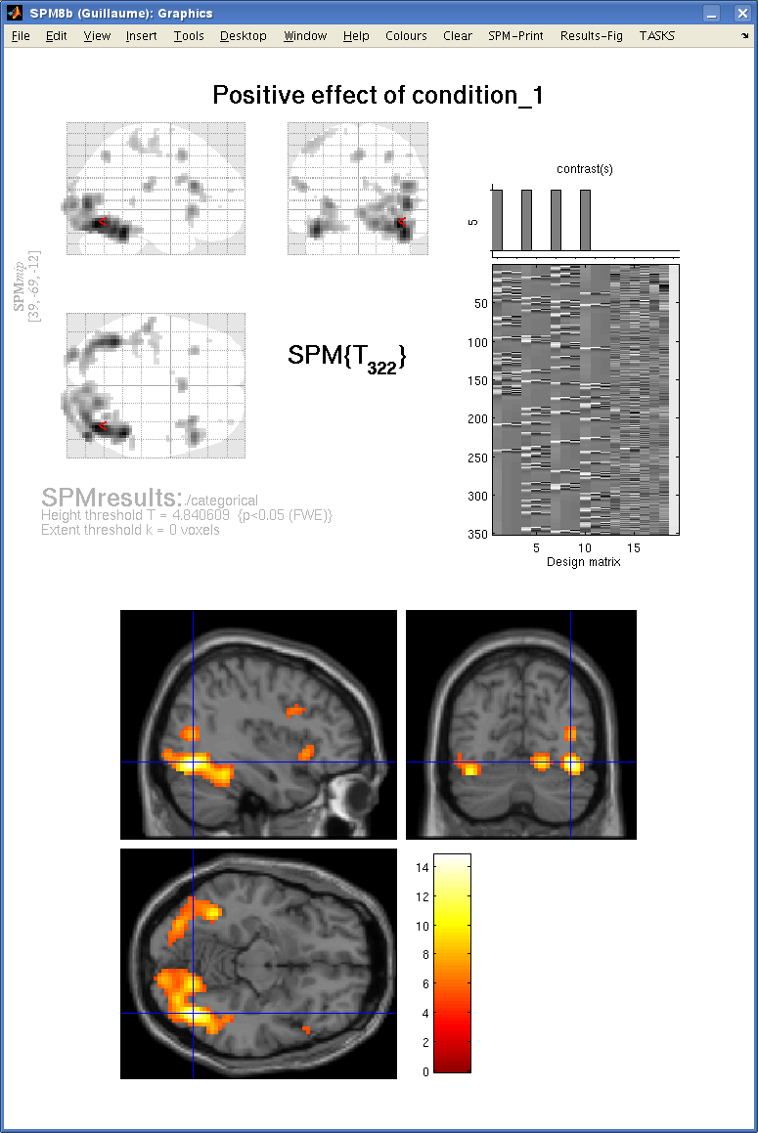
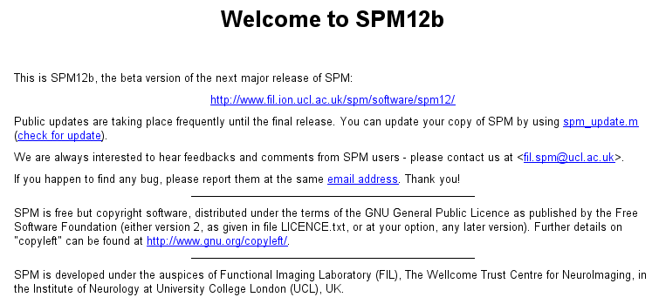
Introduction to MfD 2013

Slide 68
Getting started – Cogent
http://www.vislab.ucl.ac.uk/cogent.php
present scanner-synchronized visual stimuli, auditory stimuli, mechanical stimuli, taste and smell stimuli
  monitor key presses
  physiological recordings
  logging stimulus & scan onset times
Try and get hold of one to modify rather than starting from scratch! People are more than happy to share scripts around
Introduction to MfD 2013

Slide 69
Pragmatics of experiments
Setting up the experiment

Slide 70
Pragmatics of experiments
Setting up the experiment
Setting scanning parameters

Slide 71
Pragmatics of experiments
Setting up the experiment
Setting scanning parameters
Scanning

Slide 72
1. Setting up your experiment
If you need…
special equipment
  Peter Aston
  Physics team
special scanning sequences
  Physics team
They are very happy to help, but contact them in time!
Introduction to MfD 2013

Slide 73
2. Scanning decisions to be made
What are your scanning parameters:
  How many conditions/sessions/blocks
  Interstimulus interval
  Scanning sequence
  Scanning angle
  How much brain coverage do you need
    how many slices
    what slice thickness
  what TR
Introduction to MfD 2013

Slide 74
3. Scanning protocol
Get you script ready & working with the scanner
Make sure it logs all the data you need for your analysis
Back up your data from the stimulus PC! You can transfer it via the network after each scanning session…
Get a scanning buddy if it’s your first scanning study
Provide the radiographers with tea, biscuits, chocolate etc.
Introduction to MfD 2013

Slide 75
Use the project presentations!
They are there to help you design a project that will get you data that can actually be analyzed in a meaningful way
Introduction to MfD 2013

Slide 76
Acronyms
DCM – dynamic causal model
DTI – diffusion tensor imaging
FDR – false discovery rate
FFX – fixed effects analysis
FIR – finite impulse response
FWE – family wise error
FWHM – full width half maximum
GLM – general linear model
GRF – gaussian random field theory
HRF – haemodynamic response function
ICA – independent component analysis
ISI – interstimulus interval
PCA – principal component analysis
PEB – parametric empirical bayes
PPI – psychophysiological interaction
PPM – posterior probability map
ReML – restricted maximum likelihood
RFT– random field theory
RFX – random effects analysis
ROI – region of interest
SOA – stimulus onset asynchrony
SPM – statistical parametric mapping
VBM – voxel-based morphometry
Introduction to MfD 2013

