Slide 1
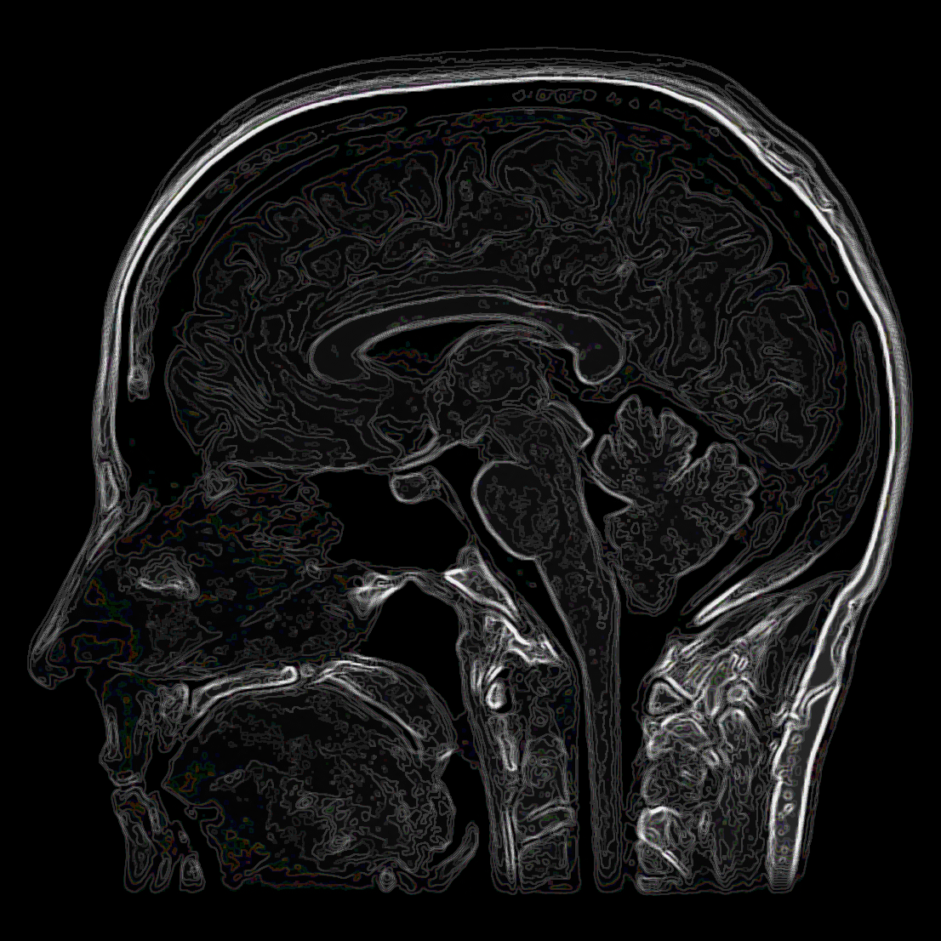
Pre-processing in fMRI:
Realigning and unwarping
Methods for Dummies
Sebastian Bobadilla
Charlie Harrison

Slide 2
Contents
Pre-processing in fMRI
Motion in fMRI
  Motion prevention
  Motion correction
Realignment
  Registration
  Transformation
Unwarping
SPM
  Charlie
  Sebastian

Slide 3



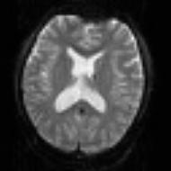
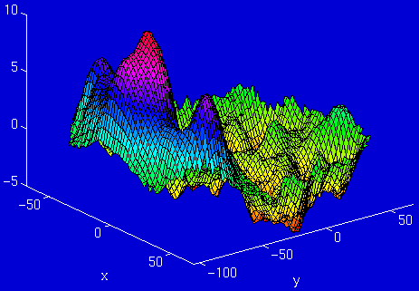
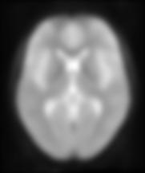
Overview
|
|
|
|
|
|
|
|
|
|
|
|
|
|
Design matrix
Statistical Parametric Map
fMRI time-series
Motion
Correction
(and unwarping)
Smoothing
General Linear Model
Spatial
Normalisation
(including co-registration)
Parameter Estimates
← Pre-processing
Anatomical reference

Slide 4
Pre-processing in fMRI
What?
Computational procedures applied to fMRI data before statistical analysis
  Regardless of experimental design you must pre-process data
Why?
Remove uninteresting variability from the data
  E.g. variability not associated with the experimental task
Improve the functional signal to-noise ratio
Prepare the data for statistical analysis
  The first stage in pre-processing is often motion correction

Slide 5

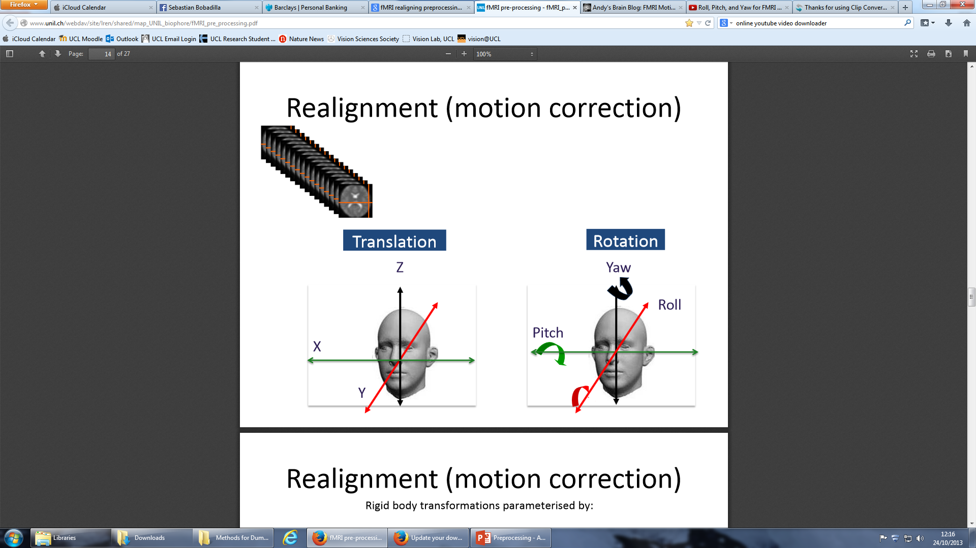
Motion in fMRI: Types of movement
Two types of movement – random and periodic
Head can move along 6 possible axes
  Translation: x, y and z directions
  Rotation: pitch, yaw and roll
Translation
Rotation
http://www.youtube.com/watch?v=YI967Jbw_Ow

Slide 6
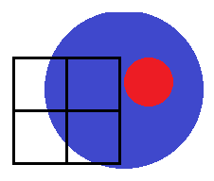
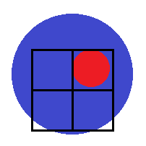
Motion in fMRI: Why is it bad?
If a participants moves, the fMRI image corresponding to Voxel A may not be in the same location throughout the entire time series.
The aim of pre-processing for motion is to insure that when we compare voxel activation corresponding to different times (and presumably different cognitive processes), we are comparing activations from the same area of the brain.
Very important because the movement-induced variance is often much larger than the experimental-induced variance.
Voxel A: Inactive
Subject
moves
Voxel A: Active

Slide 7
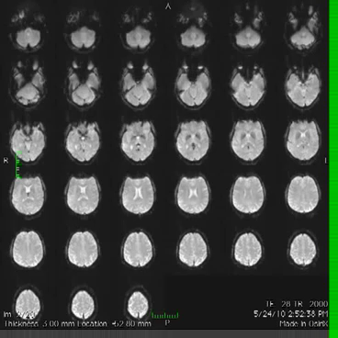
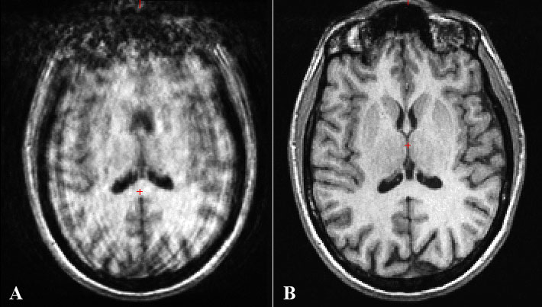
Motion in fMRI: Why is it bad?
Movement during an MRI scan can cause motion artefacts
What can we do about it?
  We can either try to prevent motion from occurring
  Or correct motion after it’s occurred
http://practicalfmri.blogspot.co.uk/2012/05/common-intermittent-epi-artifacts.html

Slide 8
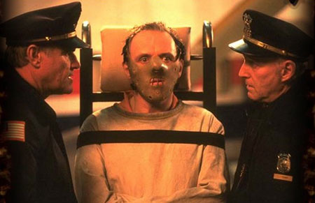
Motion in fMRI: Prevention
    Constrain the volunteer’s head
    Give explicit instructions:
      Lie as still as possible
      Try not to talk between sessions
      Swallow as little as possible
    Make sure your subject is as comfortable as possible before you start
    Try not to scan for too long
    Mock scanner training for participants who are likely to move (e.g. children or clinical groups)
  Ways to constrain:
  Padding:
  Soft padding
  Expandable foam
  Vacuum bags
  Other:
  Hammock
  Bite bar
  Contour masks
  The more you can prevent movement, the better!

Slide 9
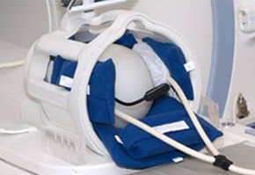
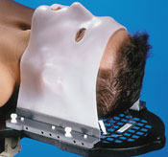
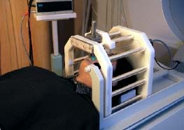
Motion in fMRI: Prevention
Soft padding
Contour mask
Bite bar

Slide 10
Motion in fMRI: Correction
You cannot prevent all motion in the scanner – subjects will always move!
Therefore motion correction of the data is needed
  Adjusts for an individual’s head movements and creates a spatially stabilized image
Realignment assumes that all movements are those of a rigid body (i.e. the shape of the brain does not change)
Two steps:
  Registration: Optimising six parameters that describe a rigid body transformation between the source and a reference image
  Transformation: Re-sampling according to the determined transformation

Slide 11
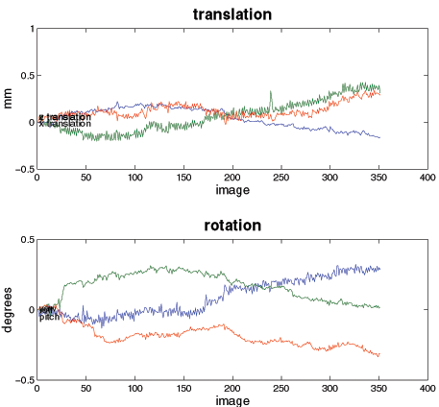
Realigning: Registration
  A reference image is chosen, to which all subsequent scans are realigned – normally the first image.
  These operations (translation and rotation) are performed by matrices and these matrices can then be multiplied together
Rigid body transformations parameterised by:
Translations
Pitch
about X axis
Roll
about Y axis
Yaw
about Z axis

Slide 12
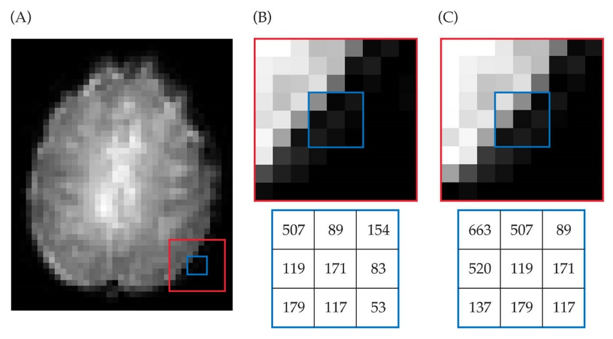
Realigning: Transformation
The intensity of each voxel in the transformed image must be determined from the intensities in the original image.
In order to realign images with subvoxel accuracy, the spatial transformations will involve fractions of a voxel.
Requires an interpolation scheme to estimate the intensity of a voxel, based on the intensity of its neighbours.

Slide 13
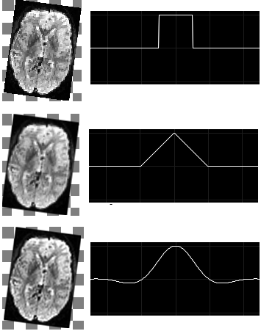
Realigning: Interpolation
Interpolation is a way of constructing new data points from a set of known data points (i.e. voxels).
Simple interpolation
  Nearest neighbour: Takes the value of the closest voxel
  Tri-linear: Weighted average of the neighbouring voxels
B-spline interpolation
  Improves accuracy, has higher spatial frequency
  SPM uses this as standard

Slide 14
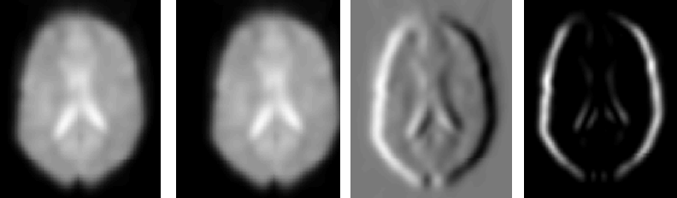
Motion in fMRI: Correction cost function
Motion correction uses variance to check if images are a good match.
Smaller variance = better match (‘least squares’)
The realigning process is iterative: Image is moved a bit at a time until match is worse.
Image 1
Image 2
Difference
Variance (Diff²)

Slide 15
Residual Errors
Even after realignment, there may be residual errors in the data → need unwarping
Realignment removes rigid transformations
  (i.e. purely linear transformations)
Unwarping corrects for deformations in the image that are non-rigid in nature

Slide 16

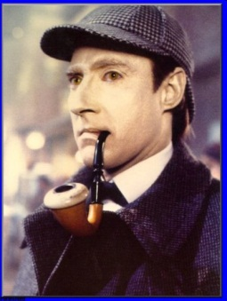
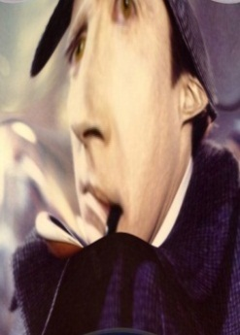
Undoing image deformations: unwarping
Undoing image deformations:
unwarping

Slide 17
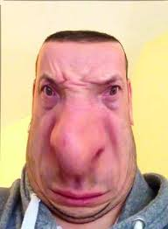
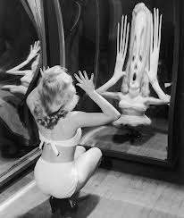

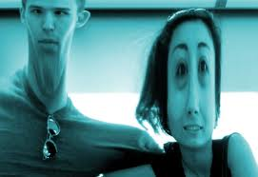

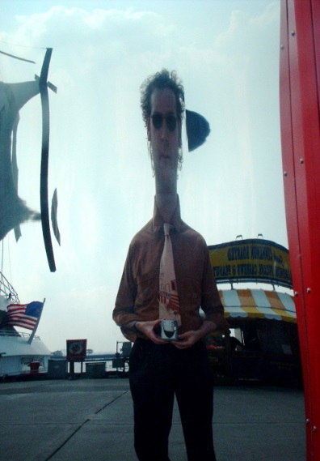
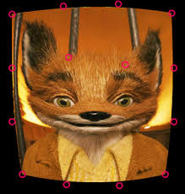
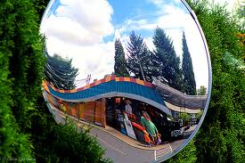
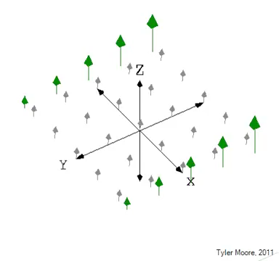
Notes:
Even after realignment there is considerable variance in fMRI time series that covary with, and is most probably caused by, subject movements. It is also the case that this variance is typically large compared to experimentally induced variance. Anyone interested can include the estimated movement parameters as covariates in the design matrix, and take a look at an F-contrast encompassing those columns. It can be quite dramatic. The result is loss of sensitivity, and if movements are correlated to task specificity. I.e. we may mistake movement induced variance for true activations. Because the movement induced variance is often very large compared to "true" activations false positives may ensue even from a relatively modest correlation between task and movement.

Slide 18
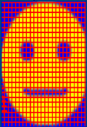
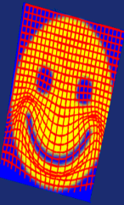
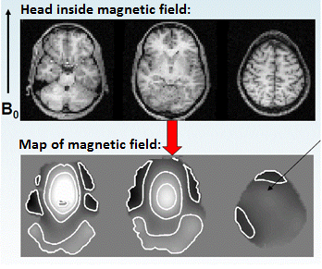
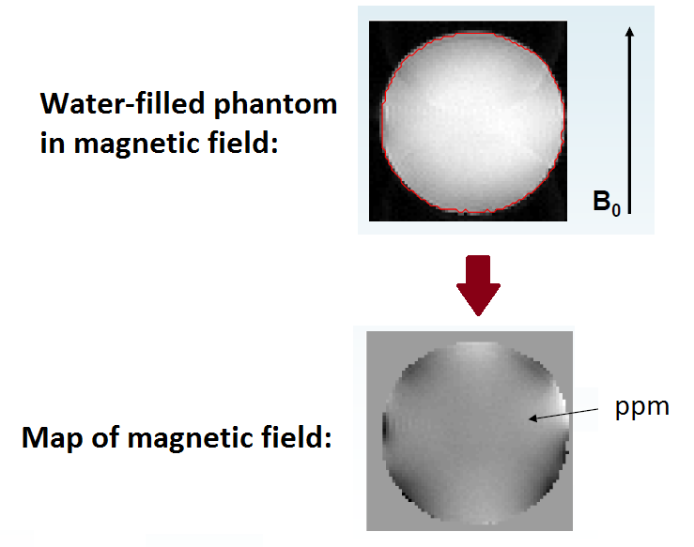
Inhomogeneities in magnetic fields
Field homogeneity indicated by the more-or-less uniform colouring inside the map of the magnetic field (aside from the dark patches at the borders)
Phantom (right) has a homogenous magnetic field; Brain (right) does not due to differences between air & tissue
Notes:
The "Unwarp" toolbox is based on a different hypothesis regarding the residual variance. EPI images are not particularly faithful reproductions of the object, and in particular there are severe geometric distortions in regions where there is an air-tissue interface (e.g. orbitofronal cortex and the anterior medial temporal lobes). In these areas in particular the observed image is a severely warped version of reality, much like a funny mirror at a fair ground. When one moves in front of such a mirror ones image will distort in different ways and ones head may change from very elongated to seriously flattened. If we were to take digital snapshots of the reflection at these different positions it is rather obvious that realignment will not suffice to bring them into a common space.
The situation is similar with EPI images, and an image collected for a given subject position will not be identical to that collected at another. Hence, even after a "successful" realignment there will be residual variance caused by the object having different shape at different time points. We call this effect susceptibility-by-movement interaction. "Unwarp" is predicated on the assumption that the susceptibility-by-movement interaction is responsible for a sizeable part of residual movement related variance.

Slide 19
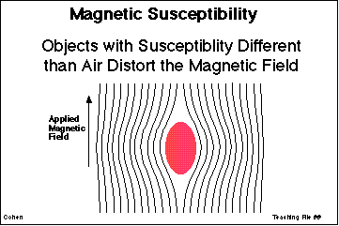
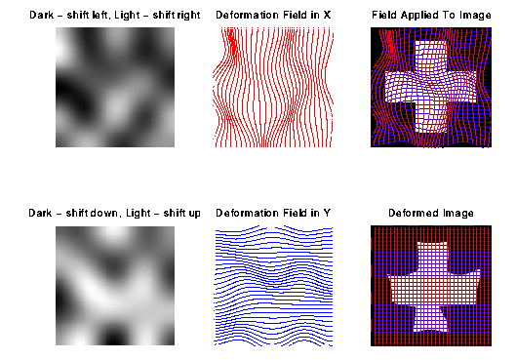
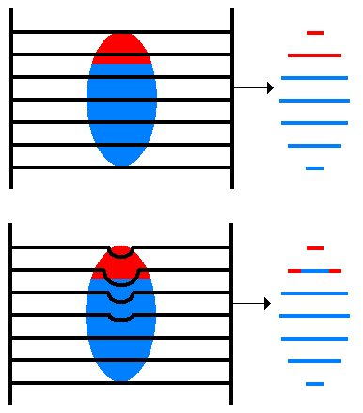
Different visualizations of deformations of magnetic fields
Notes:
Assume that we know how the deformations change when the subject changes position (i.e. we know the derivatives of the deformations with respect to subject position). That means that for a given time series and a given set of subject movements we should be able to predict the "shape changes" in the object and the ensuing variance in the time series. It also means that, in principle, we should be able to formulate the inverse problem, i.e. given the observed variance (after realignment) and known (esti ated) movements we should be able to estimate how deformations change with subject movement.
We have made an attempt at formulating such an inverse model, and at solving for the "derivative fields". A deformation field can be thought of as little vectors at each position in space showing how that particular location has been deflected. A "derivative field" is then the rate of change of those vectors with respect to subject movement. Given these "derivative fields" we should be able to remove the variance caused by the susceptibility-by-movement interaction. Since the underlying model is so re tricted we would also expect experimentally induced variance to be preserved. Our experiments have also shown this to be true. Indeed one particular experiment even indicated that in some cases the method will reintroduce experimental variance that had been obliterated by movement related variance.
In theory it should be possible to estimate also the "static" deformation field, yielding an unwarped (to some true geometry) version of the time series. In practice that doesn't really seem to work, hence the method deals only with residual movement related variance induced by the susceptibility-by-movement interaction.

Slide 20
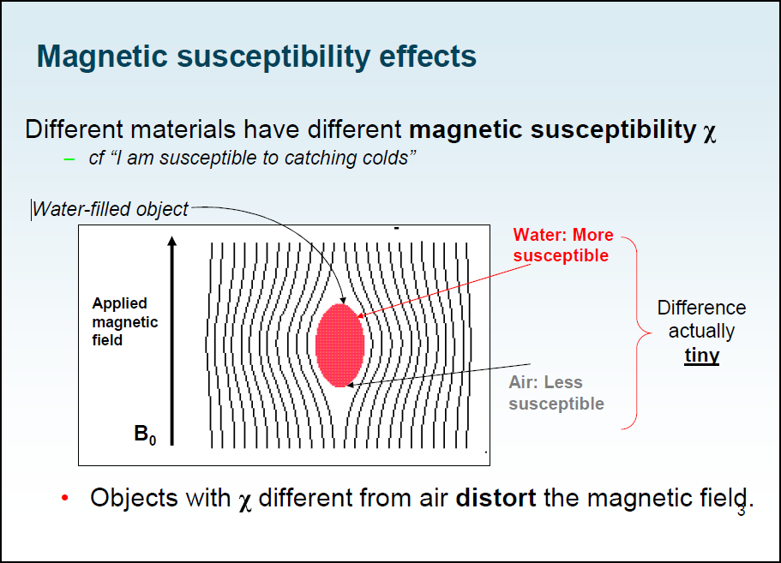
Notes:
This means that the time-series will be undistorted to some "average distortion" state rather than to the true geometry. If one wants additionally to address the issue of anatomical fidelity one should combine Unwarp with a measured field-map. A field-map in the format that Unwarp expects can be created using the FieldMap toolbox.
The description above can be thought of in terms of a Taylor expansion of the field as a function of subject movement. Unwarp alone will estimate the first (and optionally second, see below) order terms of this expansion. It cannot estimate the zeroth order term (the distortions common to all scans in the time series) since that doesn't introduce (almost) any variance in the time series. The measured fieldmap takes the role of the zeroth order term. Refer to the FieldMap toolbox and the documents FieldMap.man and FieldMap_principles.man for a description of how to obtain fieldmaps in the format expected by Unwarp.

Slide 21
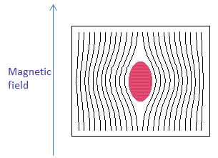
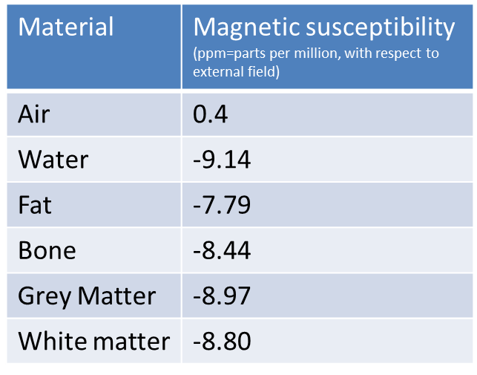
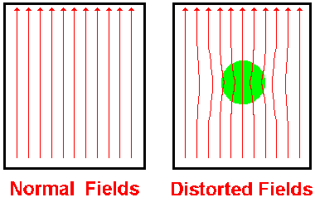
Air is “responsible” for the main deformations when its susceptibility is contrasted with the rest of the elements present in the brain.

Slide 22
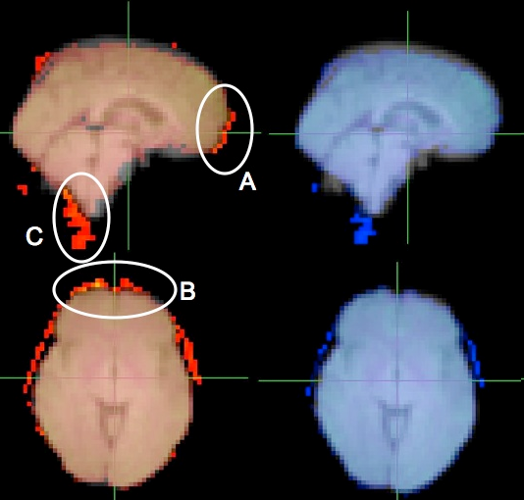
Can result in False activations
Original EPI
Unwarped EPI
Orbitofrontal cortex, especially near the sinuses, is a problematic area due to differences in air to tissue ratio.

Slide 23
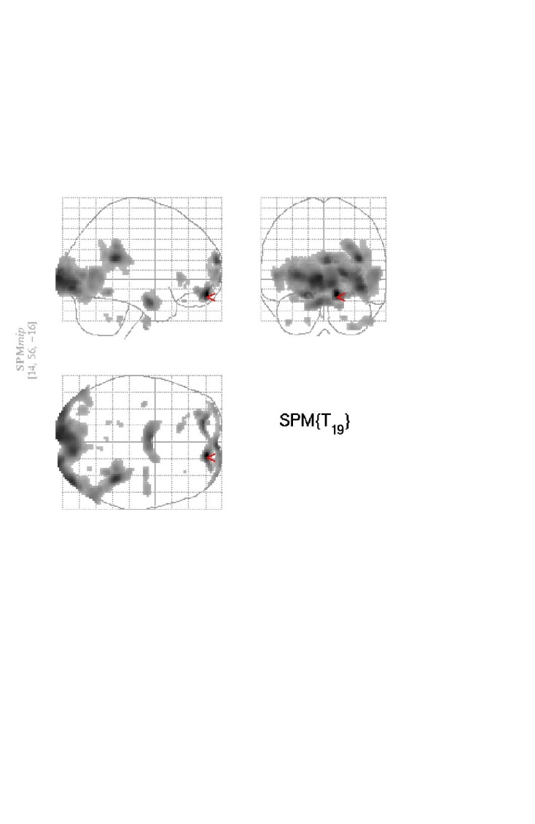
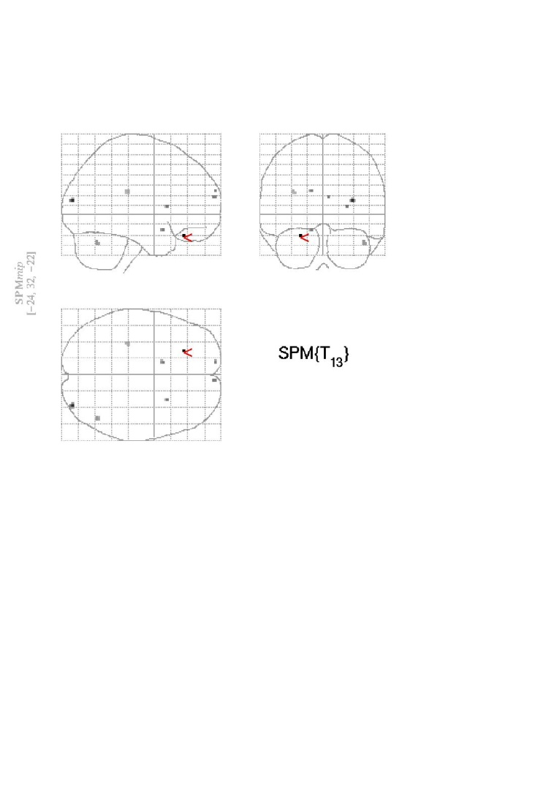
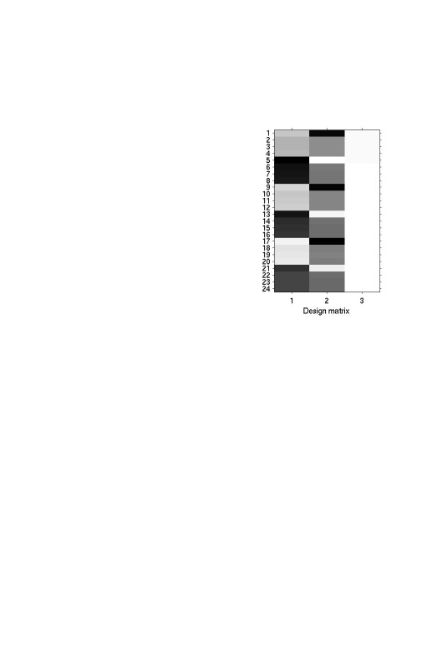
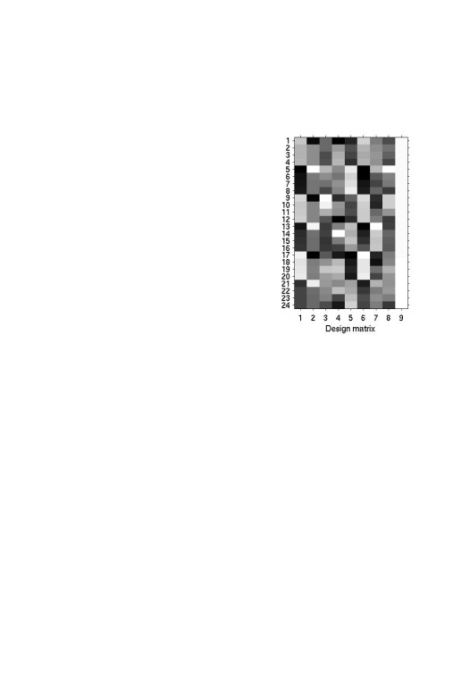
Using movement parameters as covariates can reduce statistical power (sensitivity)
This can happen when movements are correlated with the task, thus reducing variance caused by warping and the task.
Notes:
The problem is well known, and several solutions have been suggested. A quite pragmatic (and conservative) solution is to include the estimated movement parameters (and possibly squared) as covariates in the design matrix. Since we typically have loads of degrees of freedom in fMRI we can usually afford this. The problem occurs when movements are correlated with the task, since the strategy above will discard "good" and "bad" variance alike.
The "covariate" strategy described above was predicated on a model where variance was assumed to be caused by "spin history" effects, but will work pretty much equally good/bad regardless of what the true underlying cause is.
Others have assumed that the residual variance is caused mainly by errors caused by the interpolation kernel in the resampling step of the realignment. One has tried to solve this through higher order resampling (huge Sinc kernels, or k-space resampling)

Slide 24
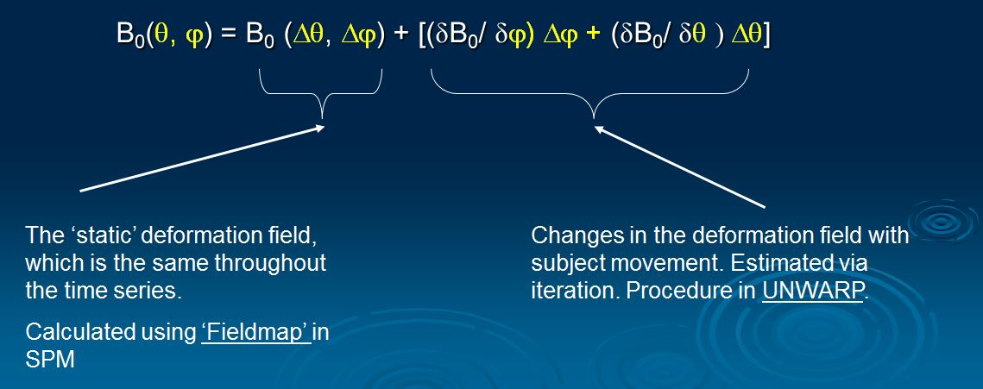
Estimating derivative fields from distortion fields
Notes:
If we think of the field as a function of subject movement it should in principle be a function of six variables since rigid body movement has six degrees of freedom. However, the physics of the problem tells us that the field should not depend on translations nor on rotation in a plane perpendicular to the magnetic flux. Hence it should in principle be sufficient to model the field as a function of out-of-plane rotations (i.e. pitch and roll). One can object to this in terms of the effects of shimming (object no longer immersed in a homogenous field) that introduces a dependence on all movement parameters. In addition SPM/Unwarp cannot really tell if the transversal slices it is being passed are really perpendicular to the flux or not. In practice it turns out thought that it is never (at least we haven't seen any case) necessarry to include more than Pitch and Roll. This is probably because the individual movement parameters are typically highly correlated anyway, which in turn is probably because most heads that we scan are attached to a neck around which rotations occurr.
On the subject of Taylor expansion we should mention that there is the option to use a second-order expansion (through the defaults) interface. This implies estimating also the rate-of-change w.r.t. to some movement parameter of the rate-of-change of the field w.r.t. some movement parameter (colloquially known as a second derivative). It can be quite intresting to watch (and it is amazing that it is possible) but rarely helpful/necessarry.

Slide 25
LIMITATIONS
In addition to Susceptibility-distortion-by-movement interaction , it should also be noted that there are several reasons for residual movement related variance:
Spin-history effects: The signal will depend on how much of longitudinal magnetisation has recovered (through T₁ relaxation) since it was last excited (short T_{R}→low signal). Assume we have 42 slices, a T_{R} of 4.2seconds and that there is a subject z-translation in the direction of increasing slice # between one excitation and the next. This means that for that one scan there will be an effective T_{R} of 4.3seconds, which means that intensity will increase.
Notes:
Spin-history effects: The signal will depend on how much of longitudinal magnetisation has recovered (through T₁ relaxation) since it was last excited (short T_{R}→low signal). Assume we have 42 slices, a T_{R} of 4.2seconds and that there is a subject z-translation in the direction of increasing slice # between one excitation and the next. This means that for that one scan there will be an effective T_{R} of 4.3seconds, which means that intensity will increase.

Slide 26
LIMITATIONS
Slice-to-volume effects: The rigid-body model that is used by most motion-correction (e.g. SPM) methods assume that the subject remains perfectly still for the duration of one scan (a few seconds) and that any movement will occurr in the few μs/ms while the scanner is preparing for next volume. Needless to say that is not true, and will lead to further apparent shape changes.

Slide 27
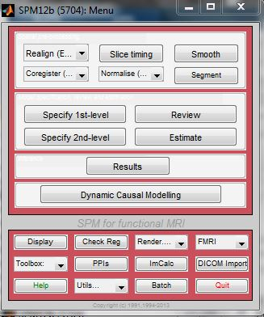
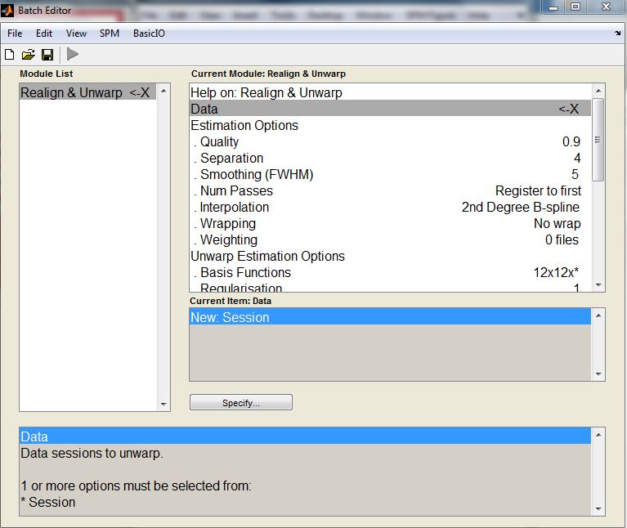
Notes:
In addition to inducing residual (after realignment) movement-related variance, movement-by-susceptibility distortion changes may bias the estimation of the movement. For each iteration Unwarp gets a better idea of the true shape of each scan, and can potentially get a better estimate of movement. In Unwarp there is an option (default) to re-estimate (do a new realign) the movements between each iteration of estimating the fields. Our testing indicates that this is a good idea.

Slide 28
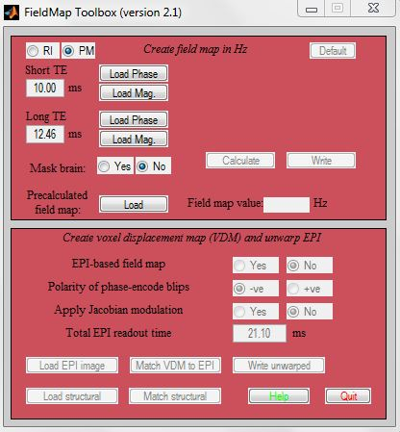
Notes:
It should be noted that this is a method intended to correct data afflicted by a particular problem. If there is little movement in your data to begin with this method will do you no good. If on the other hand there is appreciable movement in your data (>1mm or >1deg) it will remove some of that unwanted variance. If, in addition, movements are task related it will do so without removing all your "true" activations.
The method attempts to minimise total (across the image volume) variance in the data set. It should be realised that while (for small movements) a rather limited portion of the total variance is removed, the susceptibility-by-movement interaction effects are quite localised to "problem" areas. Hence, for a subset of voxels in e.g. frontal-medial and orbitofronal cortices and parts of the temporal lobes the reduction can be quite dramatic (>90%).

Slide 29
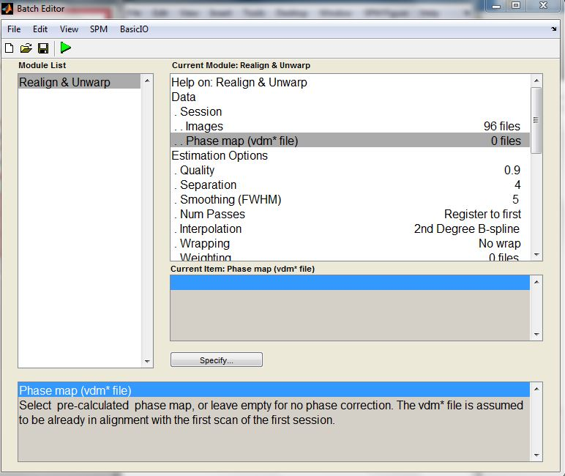
Notes:
In the defaults there is also an option to include Jacobian intensity modulation when estimating the fields. "Jacobian intensity modulation" refers to the dilution/concentration of intensity that ensue as a consequence of the distortions. Think of a semi-transparent coloured rubber sheet that you hold against a white background. If you stretch a part of the sheet (induce distortions) you will see the colour fading in that particular area (you can also think of future appearance of a tattoo obtained when young and slim). In theory it is a brilliant idea to include also these effects when estimating the field (see e.g. Andersson et al, NeuroImage 20:870-888). In practice for this specific problem it is NOT a good idea.

Slide 30
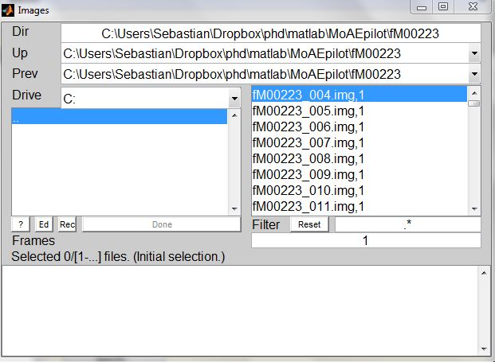

Slide 31
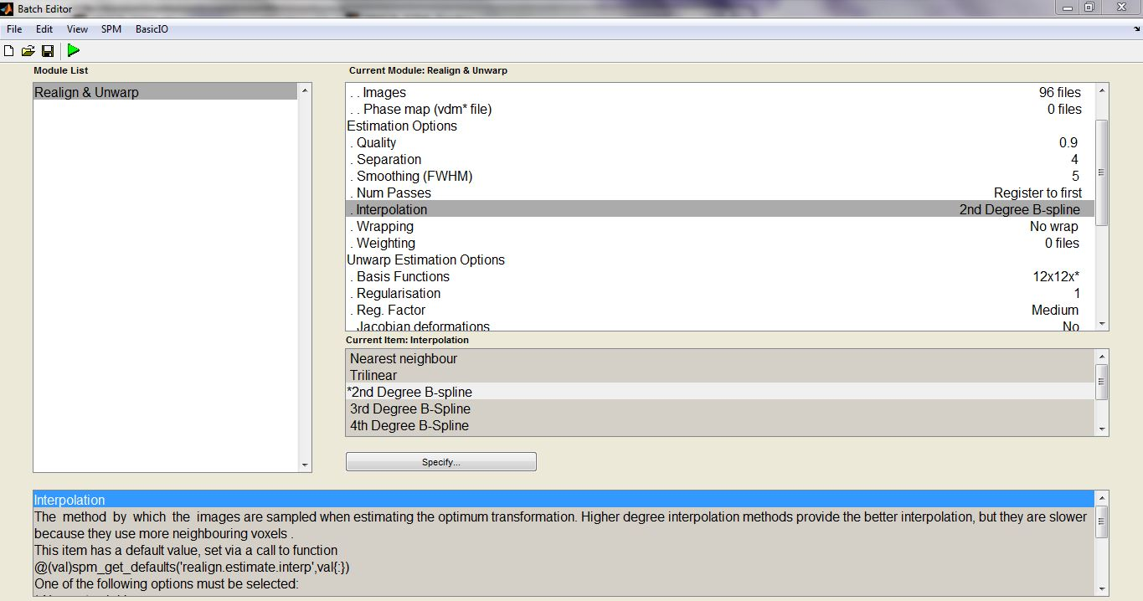

Slide 32
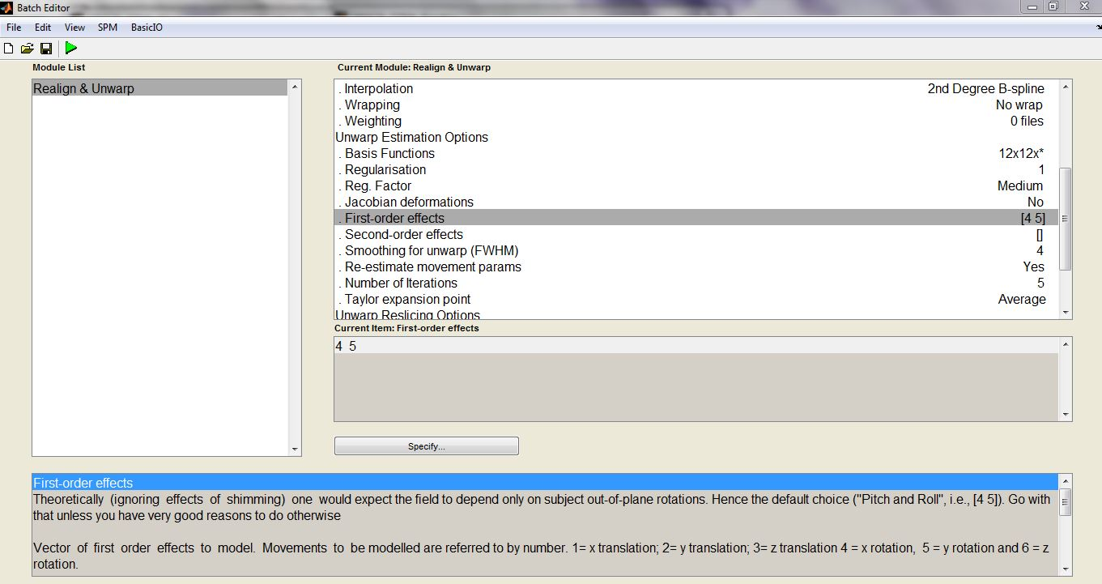

Slide 33




Slide 34


Slide 35
References and Useful Links
PractiCal fMRI: http://practicalfmri.blogspot.co.uk/2012/05/common-intermittent-epi-artifacts.html
Andy’s Brain Blog: http://andysbrainblog.blogspot.co.uk/
The past MfD slides on realignment and unwarping
Huettel, S. A., Song, A. W., & McCarthy, G. (2004). Functional magnetic resonance imaging. Sunderland: Sinauer Associates.
SPM Homepage: http://www.fil.ion.ucl.ac.uk/spm/toolbox/unwarp/

