Slide 1
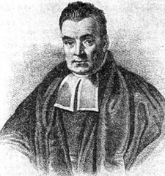
Bayes for Beginners
Presenters: Shuman ji & Nick Todd

Slide 2
Statistic Formulations.
P(A): probability of event A occurring
P(A|B): probability of A occurring given B occurred
P(B|A): probability of B occurring given A occurred
P(A,B): probability of A and B occurring simultaneously (joint probability of A and B)
  Joint probability of A and B
    P(A,B) = P(A|B)*P(B) = P(B|A)*P(A)

Slide 3

Bayes Rule
True Bayesians actually consider conditional probabilities as more basic than joint probabilities . It is easy to define P(A|B) without reference to the joint probability P(A,B). To see this note that we can rearrange the conditional probability formula to get:
P(A|B) P(B) = P(A,B)
by symmetry:
P(B|A) P(A) = P(A,B)
It follows that:
which is the so-called Bayes Rule.
Thus, Bayes Rule is a simple mathematical formula used for calculating conditional probabilities

Slide 4
Bayesian Reasoning
ASSUMPTIONS
P(A) =1% of women aged forty who participate in a routine screening have breast cancer
P(B|A)=80% of women with breast cancer will get positive tests
9.6% of women without breast cancer will also get positive tests
EVIDENCE
A woman in this age group had a positive test in a routine screening
PROBLEM
What’s the probability that she has breast cancer?
= proportion of cancer patients with positive results, within the group of All patients with positive results
---→ P(A|B)
P(B)= proportion of all patients with positive results

Slide 5
Bayesian Reasoning
ASSUMPTIONS
100 out of 10,000 women aged forty who participate in a routine screening have breast cancer
80 of every 100 women with breast cancer will get positive tests
950 out of 9,900 women without breast cancer will also get positive tests
PROBLEM
If 10,000 women in this age group undergo a routine screening, about what fraction of women with positive tests will actually have breast cancer?

Slide 6
Bayesian Reasoning
Before the screening:
100 out of 10000women with breast cancer
9,900 out of 10000women without breast cancer
After the screening:
A = 80 out of 10000women with breast cancer and positive test
B = 20 out of 10000 women with breast cancer and negative test
C = 950 out of 10000 women without breast cancer and positive test
D = 8,950 out of 10000women without breast cancer and negative test
All patients that has positive test result = A+C
Proportion of cancer patients with positive results, within the group of ALL patients with positive results:
A/(A+C) = 80/(80+950) = 80/1030 = 0.078 = 7.8%

Slide 7
Bayesian Reasoning
Prior Probabilities:
100/10,000 = 1/100 = 1% = p(A)
9,900/10,000 = 99/100 = 99% = p(~A)
Conditional Probabilities:
A = 80/10,000 = (80/100)*(1/100) = p(B|A)*p(A) = 0.008
B = 20/10,000 = (20/100)*(1/100) = p(~B|A)*p(A) = 0.002
C = 950/10,000 = (9.6/100)*(99/100) = p(B|~A)*p(~A) = 0.095
D = 8,950/10,000 = (90.4/100)*(99/100) = p(~B|~A) *p(~A) = 0.895
Rate of cancer patients with positive results, within the group of ALL patients with positive results:
P(A|B) = P(B|A) * P(A)/ P(B) = 0.008/(0.008+0.095) = 0.008/0.103 = 0.078 = 7.8%

Slide 8
Another example
Suppose that we are interested in diagnosing cancer in patients who visit a chest clinic:
Let A represent the event "Person has cancer"
Let B represent the event "Person is a smoker"
We know the probability of the prior event P(A)=0.1 on the basis of past data (10% of patients entering the clinic turn out to have cancer). We want to compute the probability of the posterior event P(A|B). It is difficult to find this out directly. However, we are likely to know P(B) by considering the percentage of patients who smoke – suppose P(B)=0.5. We are also likely to know P(B|A) by checking from our record the proportion of smokers among those diagnosed. Suppose P(B|A)=0.8.
We can now use Bayes' rule to compute:
P(A|B) = (0.8 * 0.1)/0.5 = 0.16
Thus we found the proportion of cancer patients who are smokers.

Slide 9
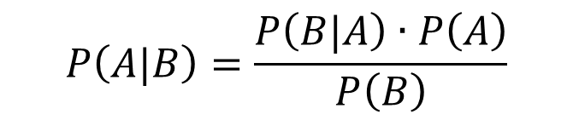
Bayes in Brain Imaging
Extension to distributions:
likelihood
prior
$$P\left(A|B\right)=\frac{P\left(B|A\right)∙P\left(A\right)}{P\left(B\right)}$$
posterior
marginal probability

Slide 10
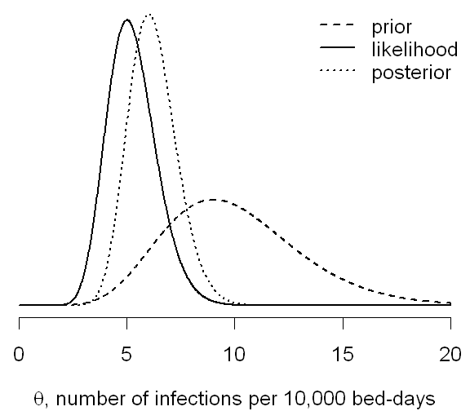

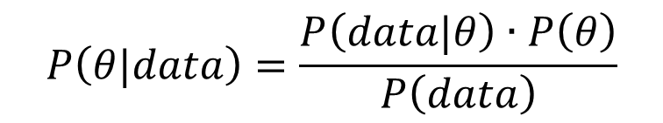
Bayes in Brain Imaging
Extension to distributions:
likelihood
prior distribution
$$P\left(A|B\right)=\frac{P\left(B|A\right)∙P\left(A\right)}{P\left(B\right)}$$
$$P\left(A|B\right)=\frac{P\left(B|A\right)∙P\left(A\right)}{P\left(B\right)}$$
$$P\left(θ|data\right)=\frac{P\left(data|θ\right)∙P\left(θ\right)}{P\left(data\right)}$$
posterior distribution
marginal probability
$$θ$$
is a set of parameters defining a model

Slide 11
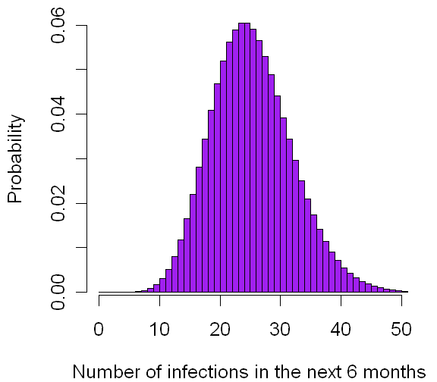

Bayes in Brain Imaging
likelihood
prior distribution
$$P\left(θ|data\right)=\frac{P\left(data|θ\right)∙P\left(θ\right)}{P\left(data\right)}$$
posterior distribution
Example: How many infections should a hospital expect over 40,000 bed-days?
Data from other hospitals show 5 to 17 infections per 10,000 bed-days:
Prior distribution
Over the first 6 months of the year, 4 infections per 10,000 bed-days:
Likelihood distribution
*
Product of the distributions:
Posterior distribution
Answer is calculated using the posterior distribution
*Spiegelhalter and Rice
Number of infections for 40,000 bed-days

Slide 12
Bayes in Brain Imaging
Classical Approach:
Null hypothesis is that no activation occurred
Statistics performed, e.g. a T-statistic
Reject null hypothesis if data is sufficiently unlikely
Bayesian Approach:
Use the likelihood and prior distributions to construct the posterior distribution
Compute probability that activation exceeds some threshold directly from the posterior distribution.
This approach gives the likelihood of getting the data, given no
activation.
Cannot accept the null hypothesis that no activation has occurred.
This approach gives the probability
distribution of the activation given the data.
Can determine activation / no activation.
Can compare models of the data.

Slide 13
Bayes Example 1
The GLM: Estimating Beta’s
β
y
=
X
+
ε
Observed Signal/Data = Experimental Matrix x Parameter Estimates(prior) + Error (Artifact, Random Noise)

Slide 14
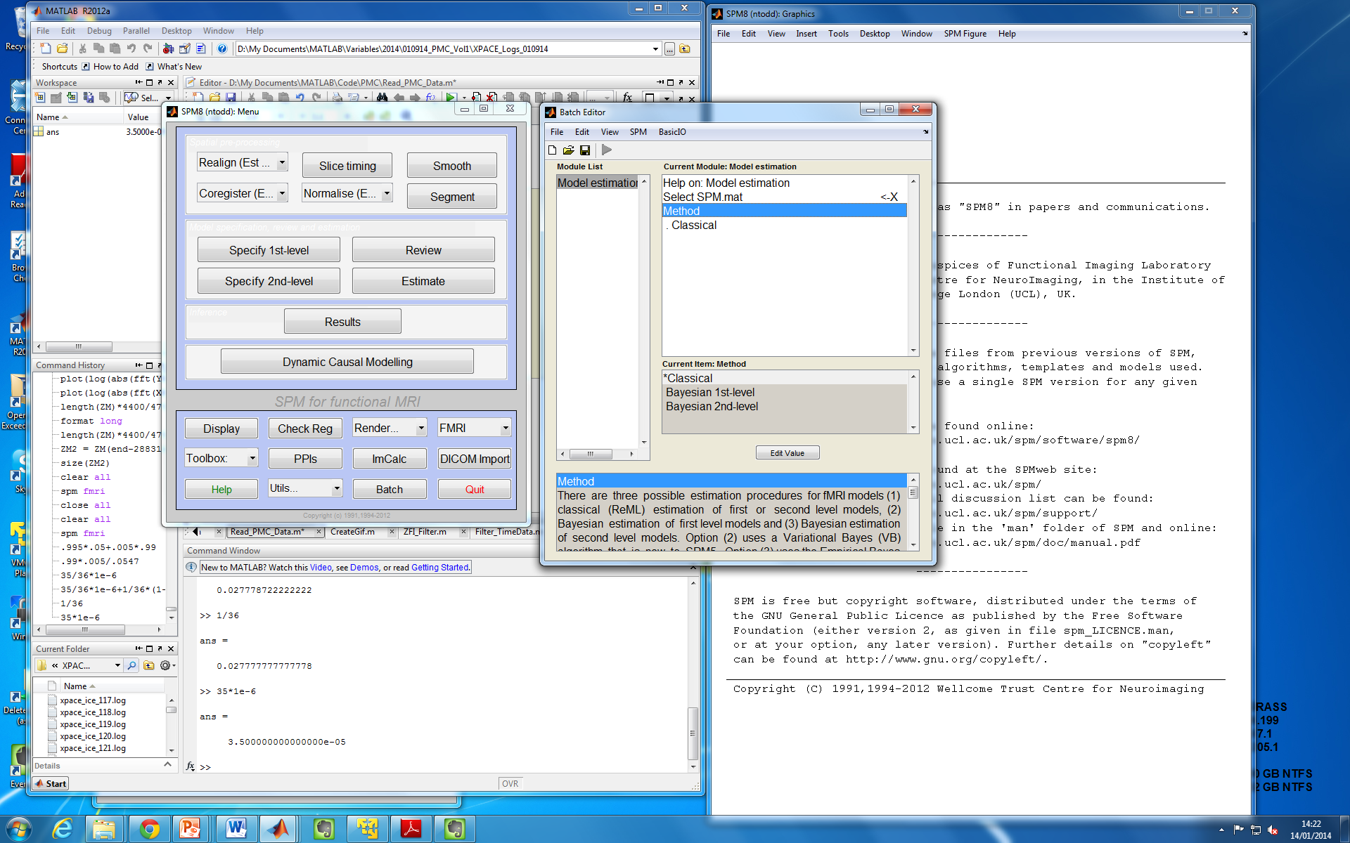
Bayes Example 1
The GLM: Estimating Beta’s

Slide 15
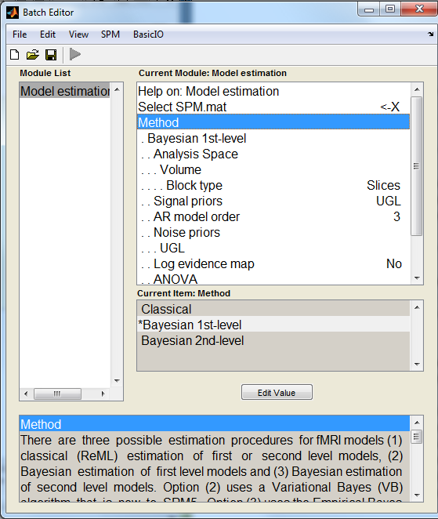
Bayes Example 1
The GLM: Estimating Beta’s

Slide 16
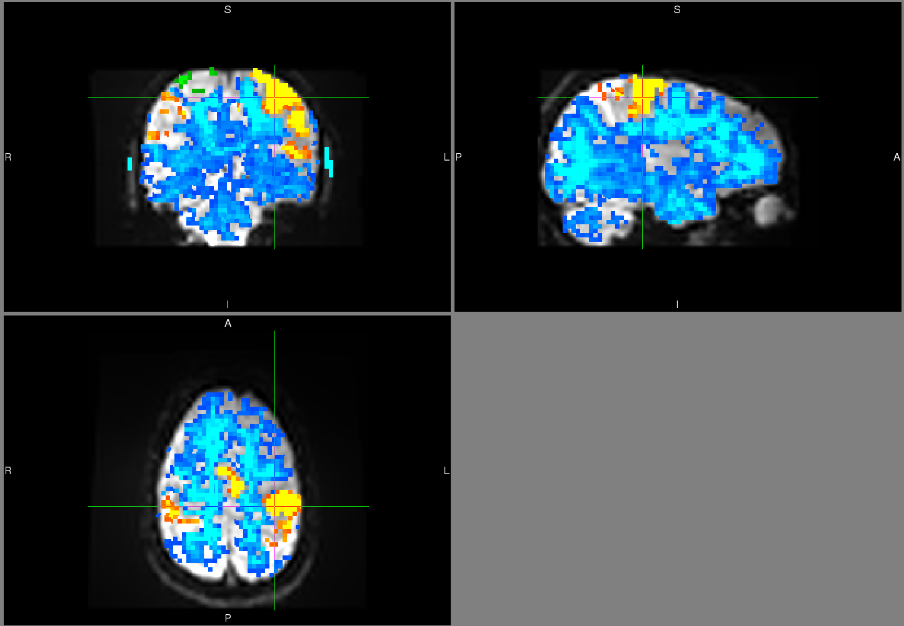
Bayes Example 2
Example 2: Accepting/Rejecting Null Hypothesis
Activated
Not Activated
*Dr. Joerg Magerkurth

Slide 17
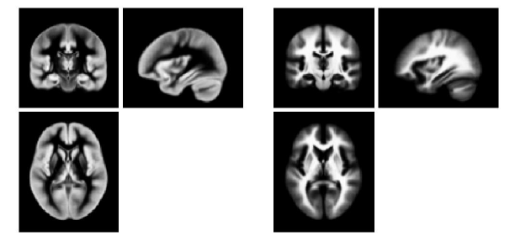
Bayes Example 3
Segmentation and Normalization
Tissue probability maps of gray and white matter used as priors in the segmentation algorithm.
Probability of expected zooms and shears used as prior in normalization algorithm.

Slide 18
Thanks to Will Penny and Previous MfD Presentations
Questions?

