Slide 1
Methods for Dummies
General Linear Model
Samira Kazan &Yuying Liang

Slide 2
Part 1
Samira Kazan

Slide 3



Overview of SPM
Statistical parametric map (SPM)
Image time-series
Kernel
Design matrix
Realignment
Smoothing
General linear model
Statistical
inference
Gaussian
field theory
Normalisation
p <0.05
Template
Parameter estimates

Slide 4
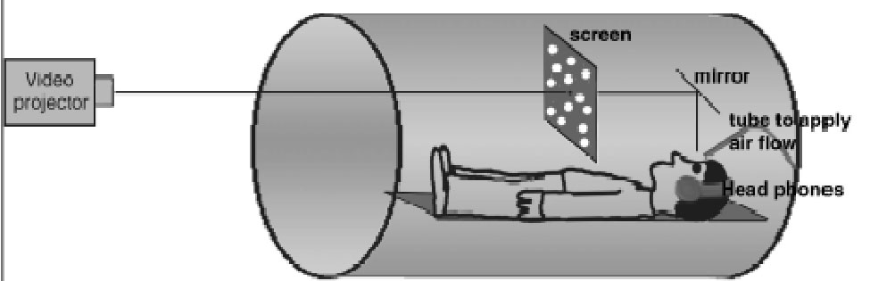


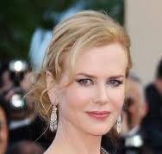
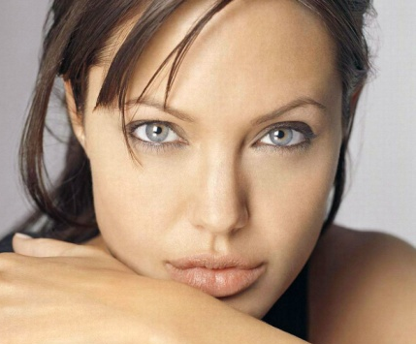
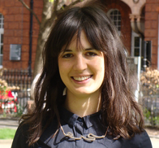




Question: Is there a change in the BOLD response between seeing famous and not so famous people?
Images courtesy of [1], [2]

Slide 5
Modeling the measured data
Why?
Make inferences about effects of interest
How?
  1) Decompose data into effects and error
  2) Form statistic using estimates of effects and error
Images courtesy of [1], [2]
Notes:
http://en.wikipedia.org/wiki/Magnetic_resonance_imaging
http://www.snl.salk.edu/~anja/links/projectsfMRI1.html

Slide 6
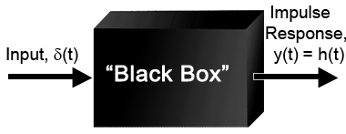
What is a system?
Input
Output

Slide 7
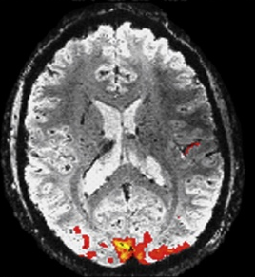

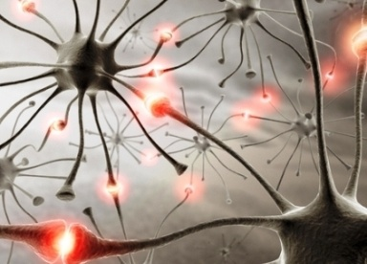
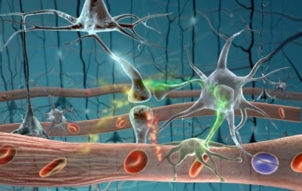
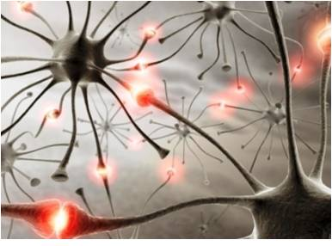
Images courtesy of [3], [4]

Slide 8
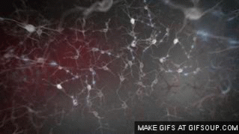
Neuronal activity
Neurovascular coupling
Cognition
Neuroscience
Physiology
Physics
Stimulus
System 1
System 2
BOLD
T2* fMRI
Images courtesy of [1], [2], [5]

Slide 9

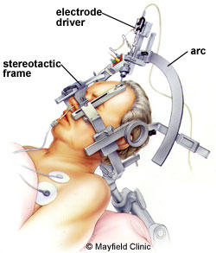
System 1 – Cognition / Neuroscience
System 1
Our system of interest
Highly non – linear
Images courtesy of [3], [6]

Slide 10
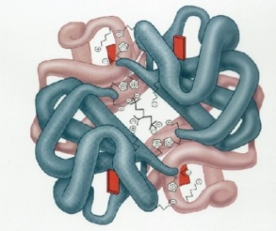
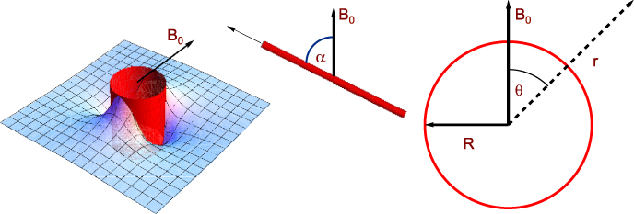
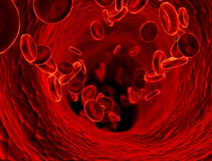
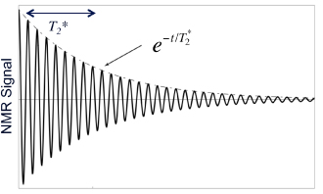

System 2 – Physics / Physiology
System 2
Images courtesy of [7-10]

Slide 11

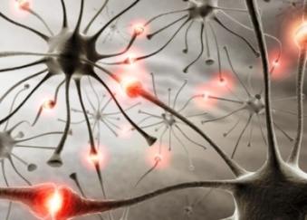


System 2 – Physics / Physiology
system 1 is highly non-linear
System 1
system 2 is close to being linear
System 2
System 2

Slide 12
Linear time invariant (LTI) systems
A system is linear if it has the superposition property:
x₁(t) y₁(t)
x₂(t) y₂(t)
ax₂(t) + bx₂(t) ay₂(t) +by₂(t)
A fact: If we know the response of a LTI system to some input (i.e. impulse), we can fully characterize the system (i.e. predict what the system will give for any type of input)
A system is time invariant if a shift in the input causes a corresponding shift of the output.
x₁(t - T) y₁(t - T)

Slide 13
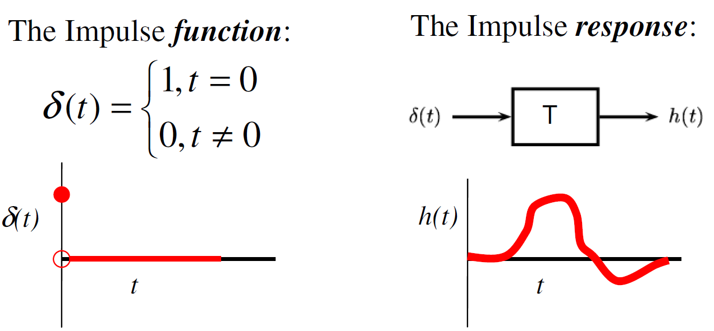
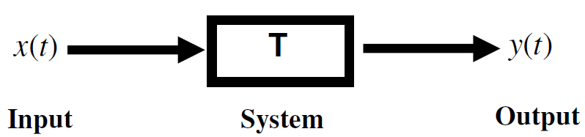
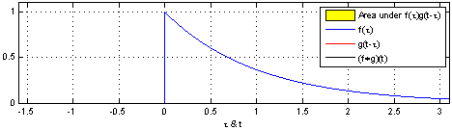
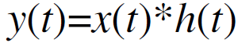
Linear time invariant (LTI) systems
Convolution animation: [11]

Slide 14

Measuring HRF

Slide 15
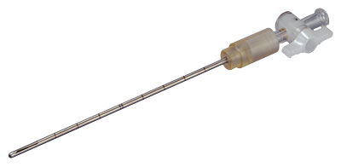

Measuring HRF

Slide 16
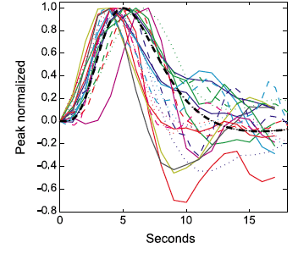
Variability of HRF
HRF varies substantially across voxels and subjects
Inter-subject variability of HRF
Handwerker et al., 2004, NeuroImage
Solution: use multiple basis functions (to be discussed in event-related fMRI)
Image courtesy of [12]

Slide 17
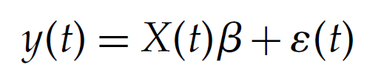
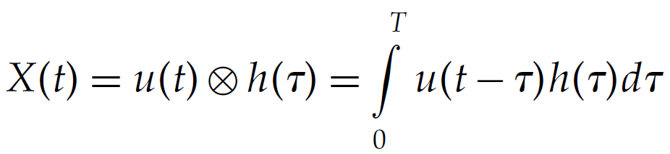
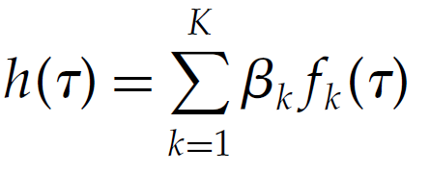
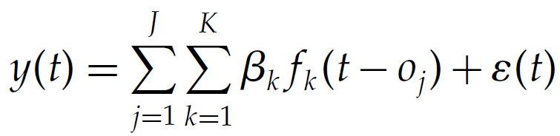
Variability of HRF

Slide 18
Measuring HRF

Slide 19
Neuronal activity
HRF function
=
BOLD Signal

Slide 20
Neuronal activity
HRF function
=
BOLD Signal

Slide 21
=

Slide 22
Random Noise
+
=

Slide 23
Linear Drift
+
=

Slide 24
Recap from last week’s lecture
General Linear Model
Linear regression models the linear relationship between a single dependent variable, Y, and a single independent variable, X, using the equation:
Y = β X + c + ε
Reflects how much of an effect X has on Y?
ε is the error term assumed ~ N(0,σ²)

Slide 25
Recap from last week’s lecture
General Linear Model
Multiple regression is used to determine the effect of a number of independent variables, X1, X2, X3, etc, on a single dependent variable, Y
Y = β₁X₁ + β₂X₂ +…..+ β_{L}X_{L} + ε
reflect the independent contribution of each independent variable, X, to the value of the dependent variable, Y.

Slide 26
General Linear Model
General Linear Model is an extension of multiple regression, where we can analyse several dependent, Y, variables in a linear combination:
Y₁= X₁₁β₁ +…+X_{1l}β_{l} +…+ X_{1L}β_{L} + ε₁
Y_{j}= X_{j1} β₁ +…+X_{jl}β_{l} +…+ X_{jL}β_{L} + ε_{j}
. . . . .
. . . . .
. . . . .
Y_{J}= X_{J1}β₁ +…+X_{Jl}β_{l} +…+ X_{JL}β_{L} + ε_{J}

Slide 27
General Linear Model
regressors
Y₁
Y₂
.
.
.
Y_{J}
X₁₁ … X_{1l} … X_{1L}
X₂₁ … X_{2l} … X_{2L}
.
.
.
X_{J1} … X_{Jl} … X_{JL}
β₁
β₂
.
.
.
β_{L}
ε₁
ε₂
.
.
.
ε_{J}
=
+
time
points
time
points
regressors
time
points
Y = X * β + ε
Observed data
Design Matrix
Parameters
Residuals/Error

Slide 28
General Linear Model
GLM definition from Huettel et al.:
“a class of statistical tests that assume that the experimental data are composed of the linear combination of different model factors, along with uncorrelated noise”
General
  many simpler statistical procedures such as correlations, t-tests and ANOVAs are subsumed by the GLM
Linear
  things add up sensibly
    linearity refers to the predictors in the model and not necessarily the BOLD signal
Model
  statistical model

Slide 29

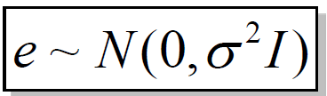
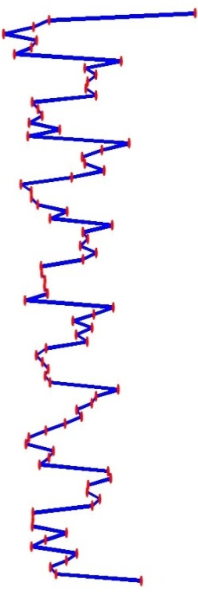
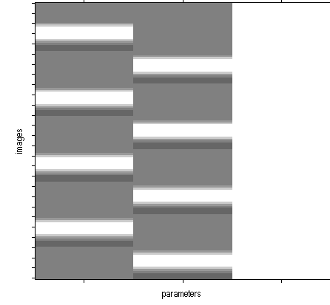

General Linear Model and fMRI
Y = X . β + ε
β1
β2
.
.
.
βp
Famous
Not Famous
Observed data
Y is the BOLD signal at various time points at a single voxel
Design matrix
Several components which explain the observed BOLD time series for the voxel. Timing info: onset vectors, and duration vectors, HRF. Other regressors, e.g. realignment parameters
Parameters
Define the contribution of each component of the design matrix to the value of Y
Error/residual
Difference between the observed data, Y, and that predicted by the model, Xβ.
Notes:
head movements
•arterial pulsations (particularly bad in brain stem)
•breathing
•eye blinks (visual cortex)
•adaptation effects, fatigue, fluctuations in concentration, etc.
Physiological confounds
SPM represents time as going down
SPM represents predictors within the design matrix as grayscale plots (where black = low, white = high) over time
GLM includes a constant to take care of the average activation level throughout each run
SPM shows this explicity (BV may not)

Slide 30
General Linear Model and fMRI
Y = X . β + ε
In GLM we need to minimize the sums of squares of difference between predicted values (X β ) and observed data (Y), (i.e. the residuals, ε=Y- X β )
S = Σ(Y- X β )²
S is minimum
∂S/∂β = 0
S
β = (X^{T}X)⁻¹ X^{T}Y
β

Slide 31
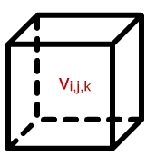
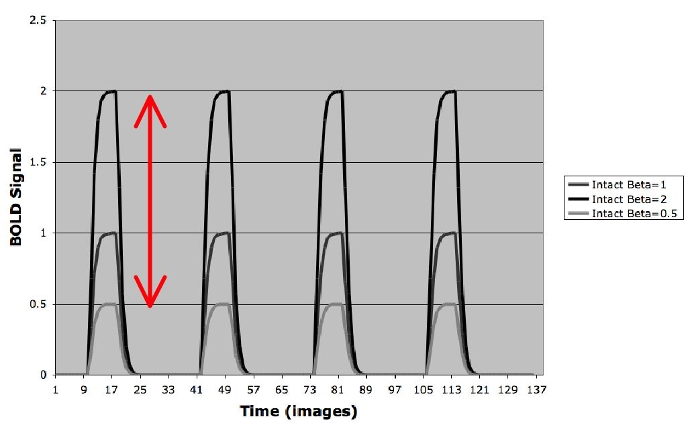
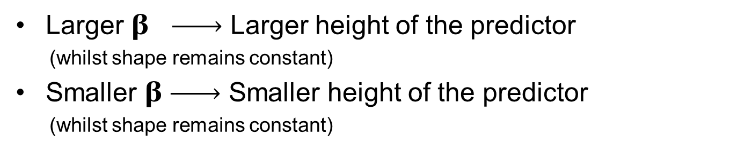
Beta Weights
β is a scaling factor
β1
β2
β3
Larger β Larger height of the predictor
(whilst shape remains constant)
Smaller β Smaller height of the predictor
(whilst shape remains constant)
courtesy of [13]

Slide 32
The beta weight is NOT a statistic measure (i.e. NOT correlation)
Beta Weights
correlations measure goodness of fit regardless of scale
beta weights are a measure of scale
small ß
large r
small ß
small r
large ß
large r
large ß
small r
courtesy of [13]

Slide 33
References (Part 1)
http://en.wikipedia.org/wiki/Magnetic_resonance_imaging
http://www.snl.salk.edu/~anja/links/projectsfMRI1.html
http://www.adhd-brain.com/adhd-cure.html
Dr. Arthur W. Toga, Laboratory of Neuro Imaging at UCLA
https://gifsoup.com/view/4678710/nerve-impulses.html
http://www.mayfieldclinic.com/PE-DBS.htm
http://ak4.picdn.net/shutterstock/videos/344095/preview/stock-footage--d-blood-cells-in-vein.jpg
http://web.campbell.edu/faculty/nemecz/323_lect/proteins/globins.html
http://ej.iop.org/images/0034-4885/76/9/096601/Full/rpp339755f09_online.jpg
http://ej.iop.org/images/0034-4885/76/9/096601/Full/rpp339755f02_online.jpg
http://en.wikipedia.org/wiki/Convolution
Handwerker et al., 2004, NeuroImage
http://www.fmri4newbies.com/
http://www.youtube.com/watch?v=vGLd-bUwVXg
Acknowledgments:
Dr Guillaume Flandin
Prof. Geoffrey Aguirre

Slide 34
Part 2
Yuying Liang

Slide 35
Contrasts and Inference
Contrasts: what and why?
T-contrasts
F-contrasts
Example on SPM
Levels of inference

Slide 36
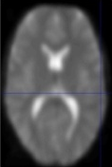
First level Analysis = Within Subjects Analysis
Time
Time
Time
Time
Run 1
Run 2
Run 1
Run 2
Subject 1
Subject n
First level
Second level
group(s)

Slide 37
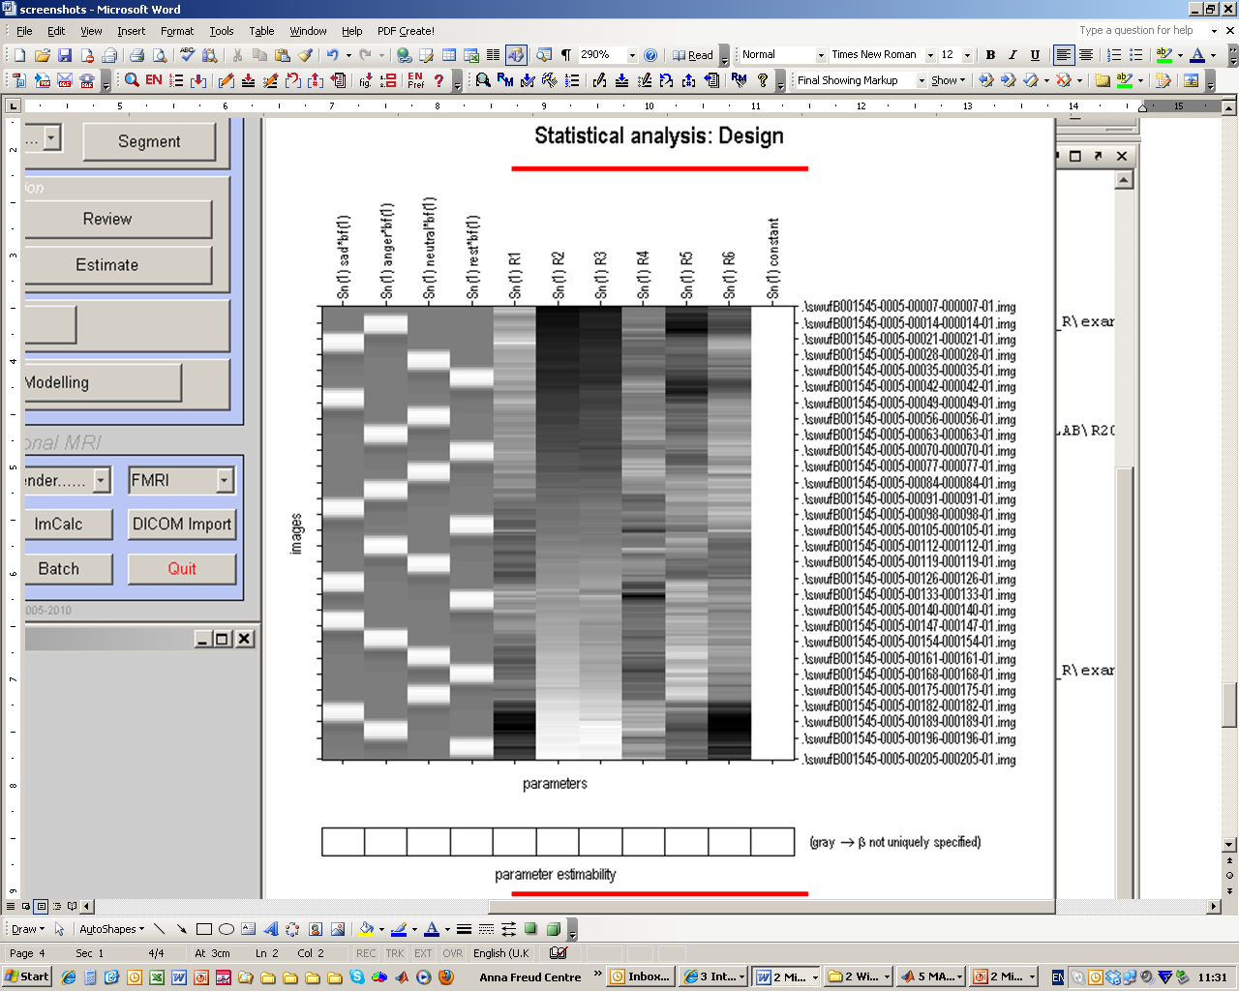
Outline
The Design matrix
  What do all the black lines mean?
  What do we need to include?
Contrasts
  What are they for?
  t and F contrasts
  How do we do that in SPM12?
  Levels of inference
A B C D
[1 -1 -1 1]

Slide 38
‘X’ in the GLM
X = Design Matrix
Time
(n)
Regressors (m)
Notes:
Regressors – represent the hypothesised contribution of your experiment to the fMRI time series. They are represented by the columns in the design matrix (1column = 1 regressor)
Regressors of interest i.e. Experimental Regressors – represent those variables which you intentionally manipulated. The type of variable used affects how it will be represented in the design matrix
E.g. - The 6 movement regressors (rotations x3 & translations x3 ) or physiological factors e.g. heart rate, breathing or others (e.g., scanner known linear drift)
Regressors of no interest or nuisance regressors – represent those variables which you did not manipulate but you suspect may have an effect. By including nuisance regressors in your design matrix you decrease the amount of error.

Slide 39
Regressors
A dark-light colour map is used to show the value of each regressor within a specific time point
Black = 0 and illustrates when the regressor is at its smallest value
White = 1 and illustrates when the regressor is at its largest value
Grey represents intermediate values
The representation of each regressor column depends upon the type of variable specified
)

Slide 40



Parameter estimation
Objective:
estimate parameters to minimize
=
+
y
X
Ordinary least squares estimation (OLS) (assuming i.i.d. error):
Notes:
We find the estimation of the B by minimizing the variance of the error/residual. Parameters of interest have been estimated.

Slide 41
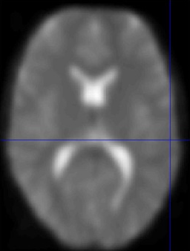

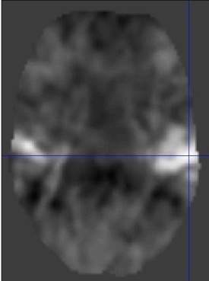
Voxel-wise time series analysis
Model
specification
Parameter
estimation
Time
Hypothesis
Statistic
Time
BOLD signal
single voxel
time series
SPM
Notes:
After model specification and estimation, we now need to perform statistical tests of our effects of interest.

Slide 42
Contrasts: definition and use
To do that → contrasts, because:
  Research hypotheses are most often based on comparisons between conditions, or between a condition and a baseline
Notes:
Because fMRI provides no information about absolute levels of activation, only about changes in activation over time
Research hypotheses involve comparison of activation between conditions

Slide 43
Contrasts: definition and use
Contrast vector, named c, allows:
  Selection of a specific effect of interest
  Statistical test of this effect
Form of a contrast vector:
c^{T} = [ 1 0 0 0 ... ]
Meaning: linear combination of the regression coefficients β
c^{T}β = 1 * β₁ + 0 * β₂ + 0 * β₃ + 0 * β₄ ...
Notes:
Contrast is a weighted sum of parameters. In this example, we ask if B1 is significantly different from noise

Slide 44
Contrasts and Inference
Contrasts: what and why?
T-contrasts
F-contrasts
Example on SPM
Levels of inference

Slide 45
T-contrasts
One-dimensional and directional
  eg c^{T} = [ 1 0 0 0 ... ] tests β₁ > 0, against the null hypothesis H₀: β₁=0
  Equivalent to a one-tailed / unilateral t-test
Function:
  Assess the effect of one parameter (c^{T} = [1 0 0 0])
  OR
  Compare specific combinations of parameters
  (c^{T} = [-1 1 0 0])

Slide 46
T-contrasts
Test statistic:
Signal-to-noise measure: ratio of estimate to standard deviation of estimate
contrast of
estimated
parameters
T =
variance
estimate
Notes:
Effect size of C transposed B divided by how variable is B1

Slide 47
T-contrasts: example
Effect of emotional relative to neutral faces
Contrasts between conditions generally use weights that sum up to zero
This reflects the null hypothesis: no differences between conditions
[ ½ ½ -1 ]
Notes:
If you define the contrast [1 1 -1] this is possible and SPM will not return an error but this will test for the hypotheses that the effect of emotional faces is twice as great as the effect of neutral faces, explaining why you need to average across the two emotion conditions.

Slide 48
Contrasts and Inference
Contrasts: what and why?
T-contrasts
F-contrasts
Example on SPM
Levels of inference
Notes:
T-contrasts = particular case of F-contrast, when matrix is a vector, and F=T²

Slide 49
F-contrasts
Multi-dimensional and non-directional
  Tests whether at least one β is different from 0, against the null hypothesis H₀: β₁=β₂=β₃=0
  Equivalent to an ANOVA
Function:
  Test multiple linear hypotheses, main effects, and interaction
  But does NOT tell you which parameter is driving the effect nor the direction of the difference (F-contrast of β₁-β₂ is the same thing as F-contrast of β₂-β₁)

Slide 50
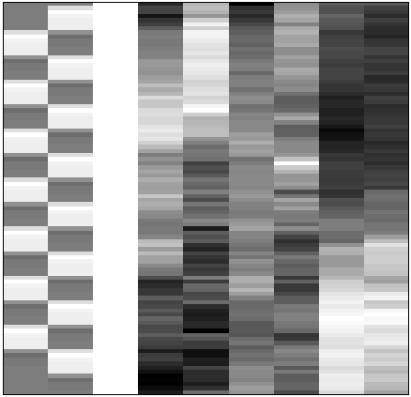
F-contrasts
Based on the model comparison approach: Full model explains significantly more variance in the data than the reduced model X₀ (H₀: True model is X₀).
F-statistic: extra-sum-of-squares principle:
X₀
X₁
X₀
SSE
SSE₀
SSE₀ - SSE
F =
SSE
Full model ?
or Reduced model?
Notes:
e.G drift parameters, sum of sq errors

Slide 51
Contrasts and Inference
Contrasts: what and why?
T-contrasts
F-contrasts
Example on SPM
Levels of inference

Slide 52
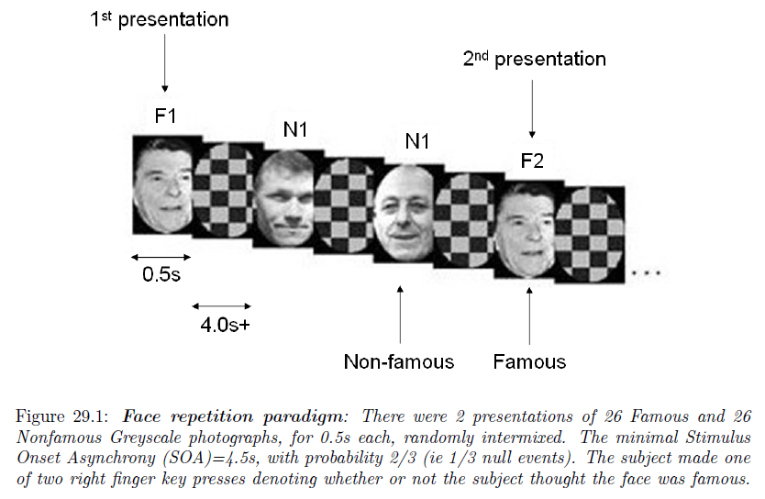
1st level model specification
N2
Henson, R.N.A., Shallice, T., Gorno-Tempini, M.-L. and Dolan, R.J. (2002) Face repetition effects in implicit and explicit memory tests as measured by fMRI. Cerebral Cortex, 12, 178-186.

Slide 53
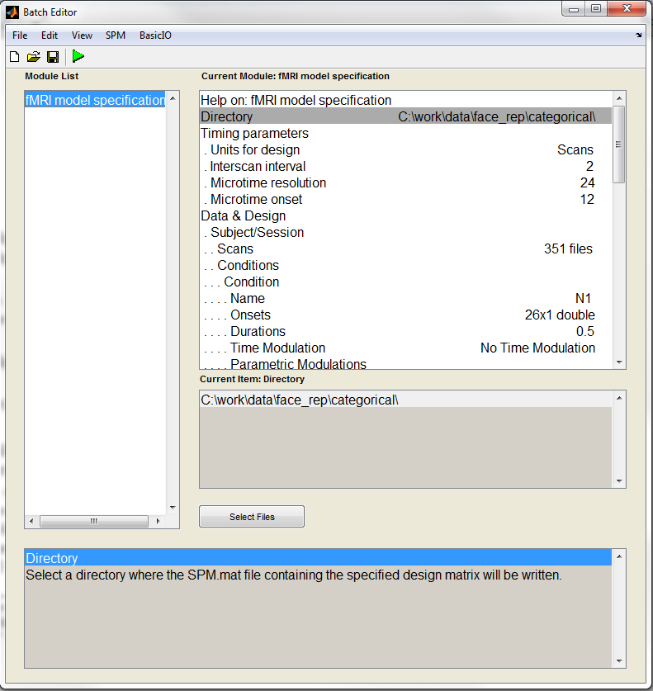
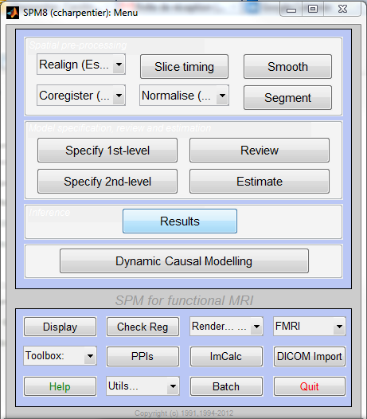
An Example on SPM

Slide 54
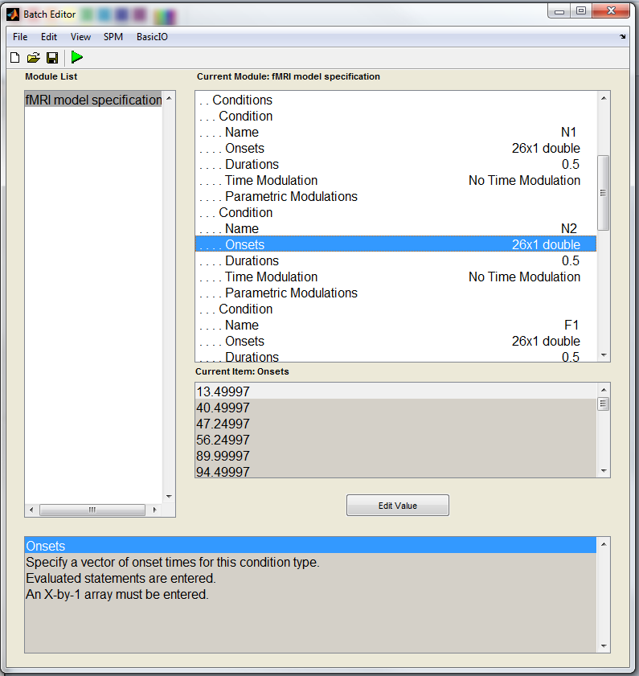
Specification of each condition to be modelled: N1, N2, F1, and F2
Name
Onsets
Duration

Slide 55
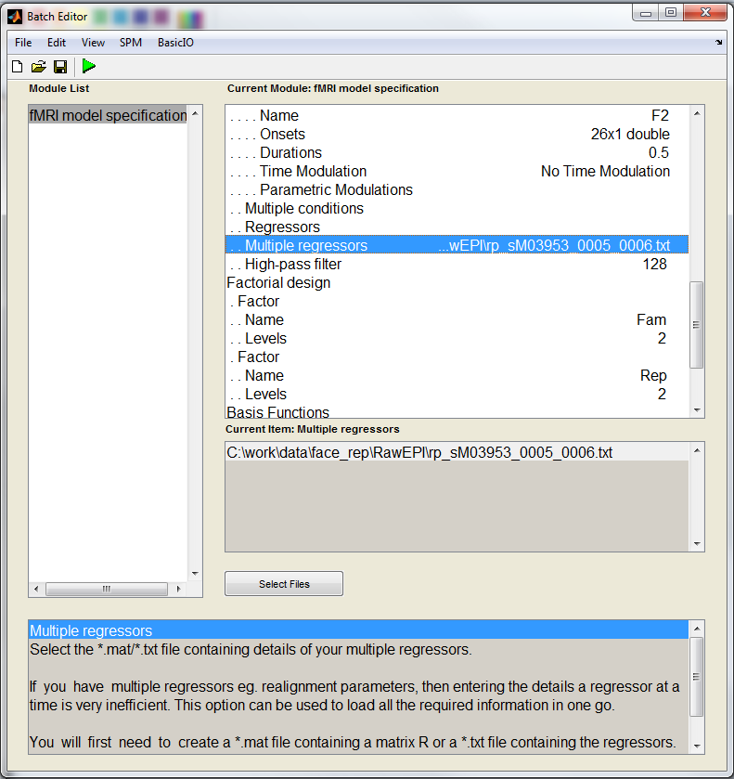
Add movement regressors in the model
Filter out low-frequency noise
Define 2*2 factorial design (for automatic contrasts definition)

Slide 56
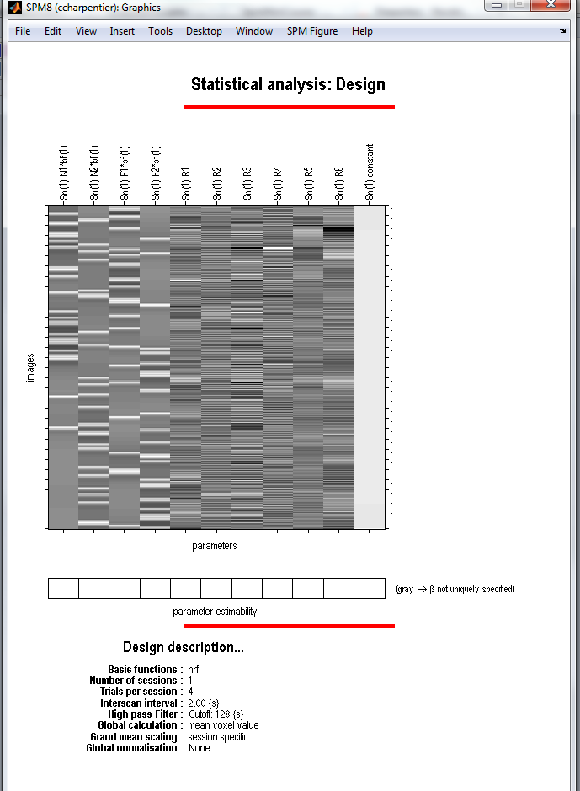
The Design Matrix
Regressors of interest:
β1 = N1 (non-famous faces, 1st presentation)
β2 = N2 (non-famous faces, 2nd presentation)
β3 = F1 (famous faces, 1st presentation)
β4 = F2 (famous faces, 2nd presentation)
Regressors of no interest:
Movement parameters (3 translations + 3 rotations)

Slide 57
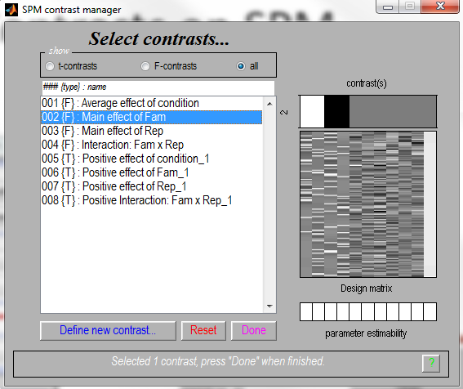
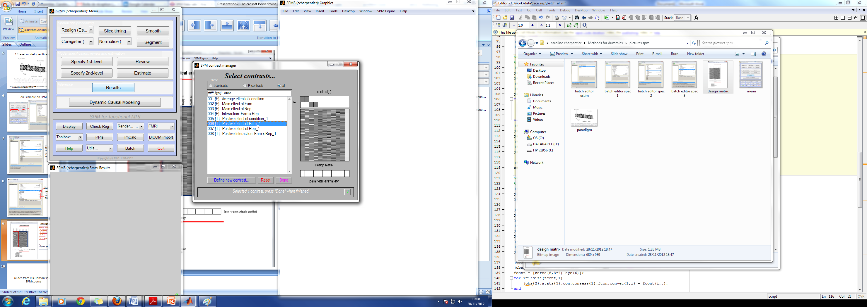
Contrasts on SPM
F-Test for main effect of fame: difference between famous and non –famous faces?
T-Test specifically for Non-famous > Famous faces (unidirectional)

Slide 58
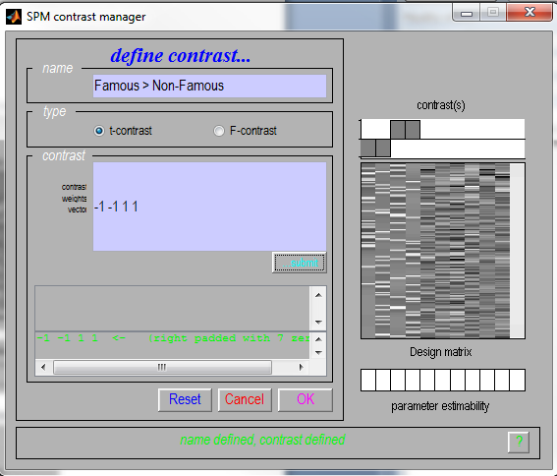
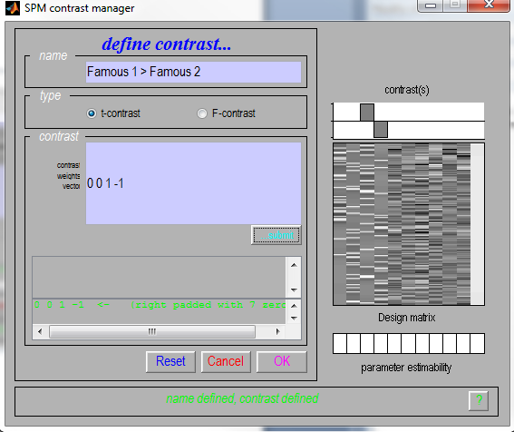
Contrasts on SPM
Possible to define additional contrasts manually:

Slide 59
Contrasts and Inference
Contrasts: what and why?
T-contrasts
F-contrasts
Example on SPM
Levels of inference
Notes:
Contrast: what questions you can put to the model

Slide 60
Summary
We use contrasts to compare conditions
Important to think your design ahead because it will influence model specification and contrasts interpretation
T-contrasts are particular cases of F-contrasts
  One-dimensional F-Contrast → F=T²
F-Contrasts are more flexible (larger space of hypotheses), but are also less sensitive than T-Contrasts
T-Contrasts | F-Contrasts
One-dimensional (c = vector) | Multi-dimensional (c = matrix)
Directional (A > B) | Non-directional (A ≠ B)

Slide 61
Thank you!
Resources:
Slides from Methods for Dummies 2011, 2012
Guillaume Flandin SPM Course slides
Human Brain Function; J Ashburner, K Friston, W Penny.
Rik Henson Short SPM Course slides
SPM Manual and Data Set

