Slide 1
Introduction to Connectivity: resting-state and PPI
Josh Kahan
Slides adapted from MfD 2013 by Dana Boebinger & Lisa Quattrocki Knight
(Thanks guys)
Wednesday 5th March 2014

Slide 2
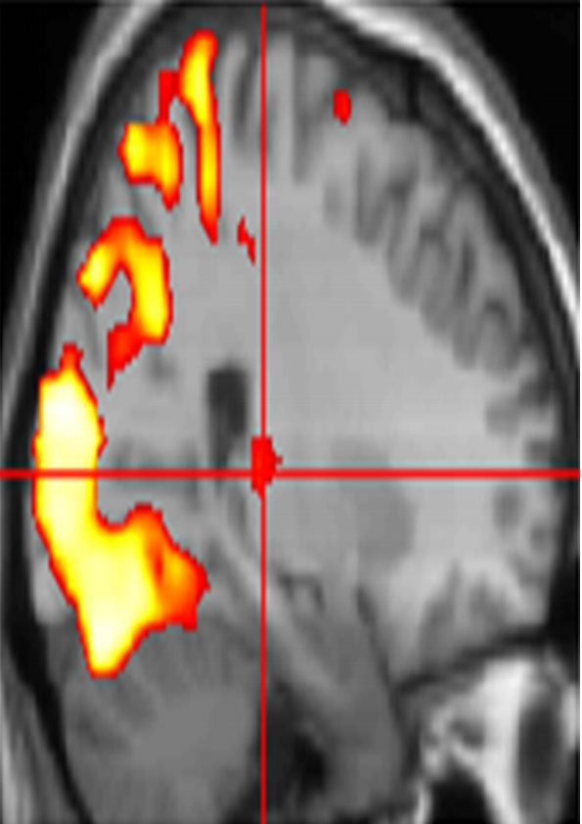
Two fundamental properties of brain architecture
Functional Segregation
Specialised areas exist in the cortex
Functional Integration
Networks of interactions among specialised areas
What is the neuroanatomical correlate of… ?
How do neural components interact … ?
‘Connectivity’ analysis
Standard SPM

Slide 3
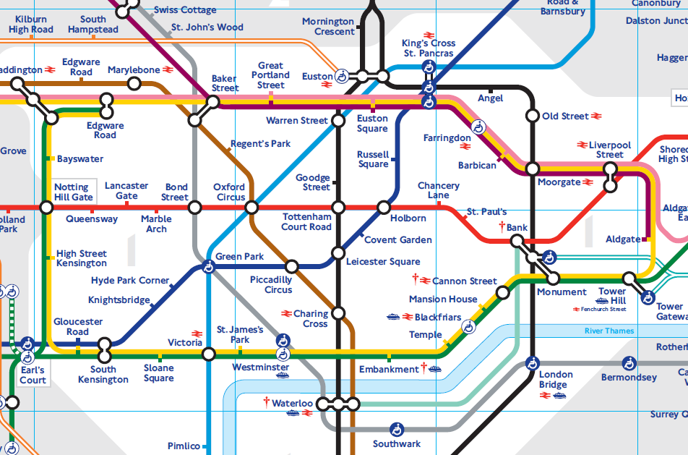
Types of connectivity
Anatomical/structural connectivity presence of axonal connections
example: tracing techniques, DTI
Is there a detectable physical connection between…?
Sporns, 2007

Slide 4
Types of connectivity
Data from: http://www.tfl.gov.uk/assets/downloads/businessandpartners/Counts_Entries_10_Weekday_sample.csv
Functional connectivity statistical dependencies between regional time series
Simple temporal correlation between activation of remote neural areas
Descriptive in nature; establishing whether correlation between areas is significant
example: seed voxel, eigen-decomposition (PCA, SVD), independent component analysis (ICA)
Is activity here correlated with activity there?
Sporns, 2007

Slide 5
Types of connectivity
Effective connectivity causal/directed influences between neurons or populations
The influence that one neuronal system exerts over another (Friston et al., 1997)
Model-based; analysed through model comparison or optimisation
examples: PPIs - Psycho-Physiological Interactions
SEM - Structural Equation Modelling
GCM - Granger Causality Modelling
DCM - Dynamic Causal Modelling
Does activity here cause activity there?
Sporns, 2007

Slide 6
“Resting-state” fMRI

Slide 7
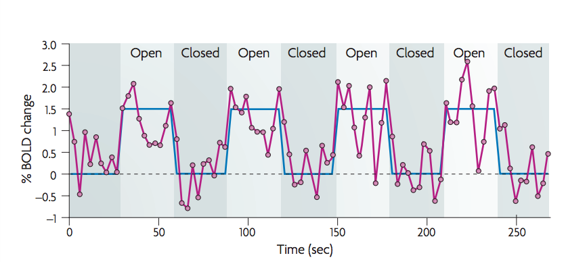
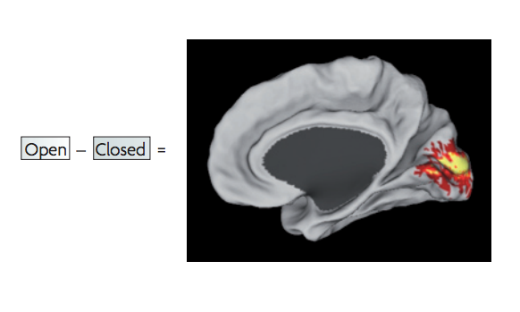
Task-evoked fMRI paradigm
task-related activation paradigm
changes in BOLD signal attributed to experimental paradigm
brain function mapped onto brain regions
Fox et al., 2007

Slide 8
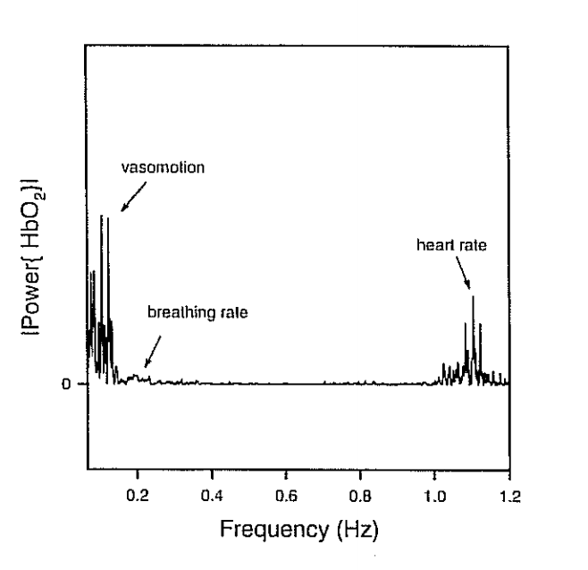
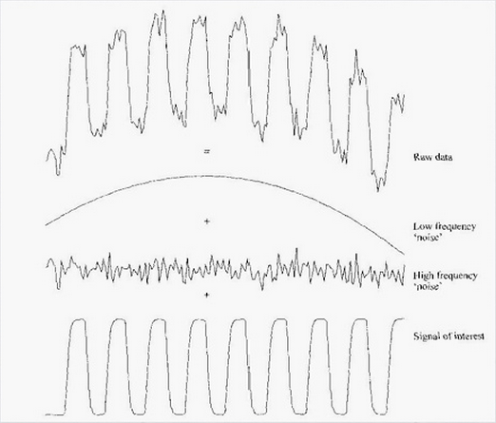
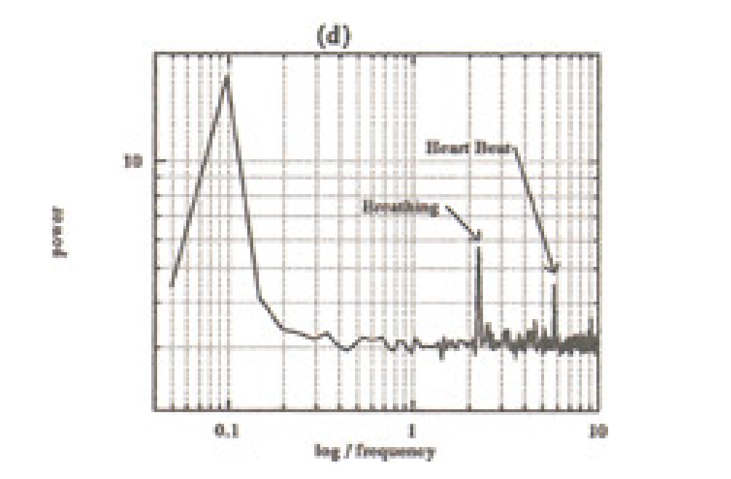
Spontaneous BOLD activity
the brain is always active, even in the absence of explicit input or output
task-related changes in neuronal metabolism are only about 5% of brain’s total energy consumption
what is the “noise” in standard activation studies?
physiological fluctuations or neuronal activity?
peak in frequency oscillations from 0.01 – 0.10 Hz
distinct from faster frequencies of respiratory and cardiac responses
< 0.10 Hz
Elwell et al., 1999
Mayhew et al., 1996

Slide 9
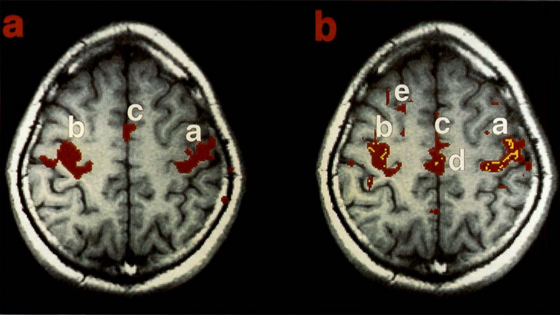
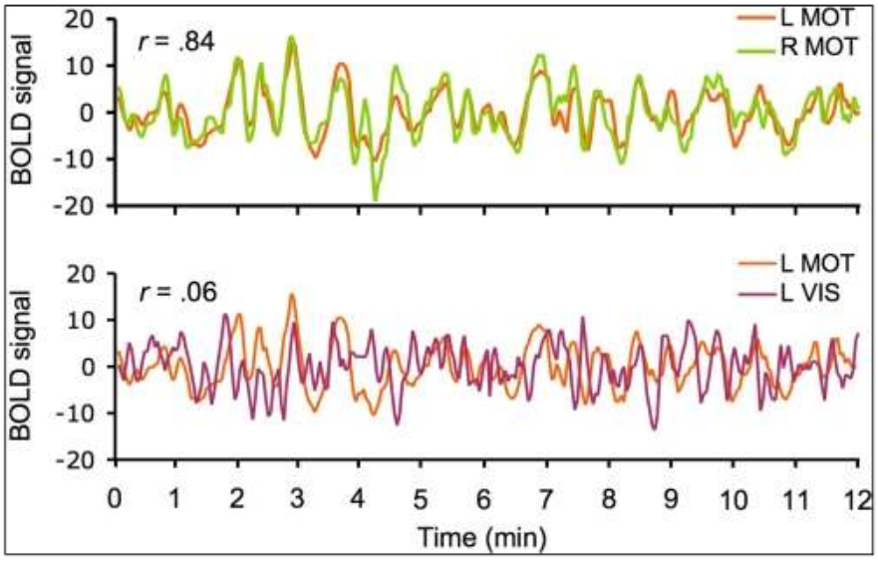
Spontaneous BOLD activity
occurs during task and at rest
intrinsic brain activity
“resting-state networks”
correlation between spontaneous BOLD signals of brain regions thought to be functionally and/or structurally related
More accurately: Endogenous brain networks
Biswal et al., 1995
Van Dijk et al., 2010

Slide 10
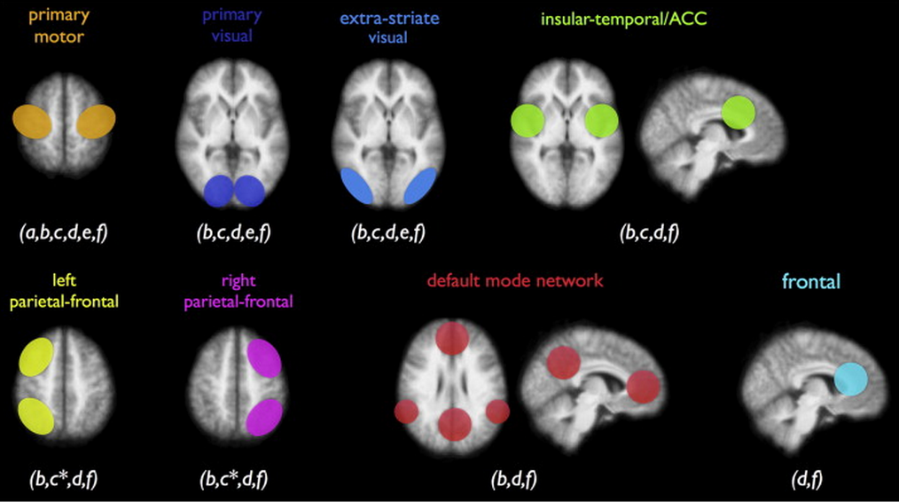
Resting-state networks (RSNs)
multiple resting-state networks (RSNs) have been found
all show activity during rest and during tasks
one of the RSNs, the default mode network (DMN), shows a decrease in activity during cognitive tasks

Slide 11
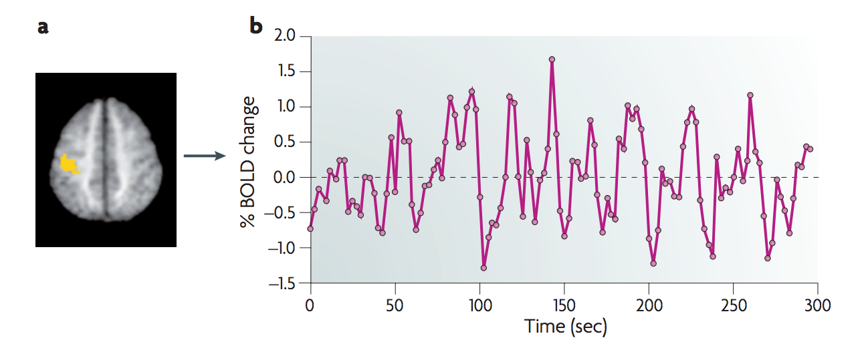
Resting-state fMRI: acquisition
resting-state paradigm
no task; participant asked to lie still
time course of spontaneous BOLD response measured
Fox & Raichle, 2007

Slide 12
Resting-state fMRI: pre-processing
…exactly the same as other fMRI data!

Slide 13
Resting-state fMRI: Analysis
model-dependent methods: seed method
a priori or hypothesis-driven from previous literature
Data from: Single subject, taken from the FC1000 open access database. Subject code: sub07210

Slide 14
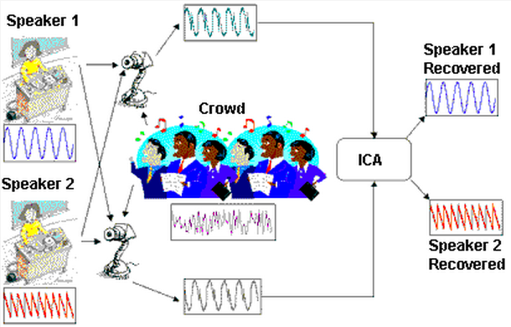
Resting-state fMRI: Analysis
model-free methods: independent component analysis (ICA)
http://www.statsoft.com/textbook/independent-components-analysis/

Slide 15
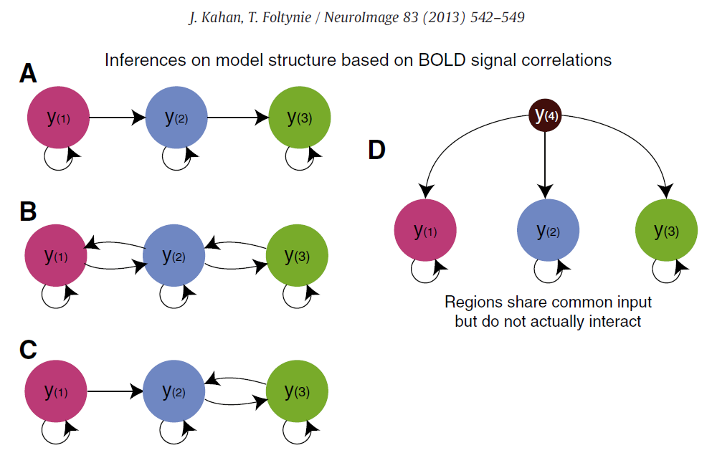
Pros & cons of functional connectivity analysis
Pros:
free from experimental confounds
makes it possible to scan subjects who would be unable to complete a task (i.e. Alzheimer’s patients, disorders of consciousness patients)
useful when we have no experimental control over the system of interest and no model of what caused the data (i.e. sleep, hallucinations, etc.)
Cons:
merely descriptive
no mechanistic insight
usually suboptimal for situations where we have a priori knowledge / experimental control
→ Effective connectivity
Marreiros, 2012; Kahan & Foltynie 2013

Slide 16
Psychophysiological Interactions

Slide 17
Correlation vs. Regression
Continuous data
Assumes relationship between two variables is constant
Pearson’s r
No directionality
Are two datasets related?
Continuous data
Tests for influence of an explanatory variable on a dependent variable
Least squares method
Is dataset 1 a function of dataset 2?
i.e. can we predict 1 from 2?
Adapted from D. Gitelman, 2011

Slide 18
Psychophysiological Interaction
Measures ‘effective’ connectivity: how psychological variables or external manipulations change the coupling between regions.
A change in the regression coefficient between two regions during two different conditions determines significance.

Slide 19
PPI: Experimental Design
Key question: How can brain activity be explained by the interaction between psychological and physiological variables?
Factorial Design
Plausible conceptual anatomical model or hypothesis:
e.g. How can brain activity in V5 (motion detection area) be explained by the interaction between attention and V2 (primary visual cortex) activity?
Neuronal model

Slide 20
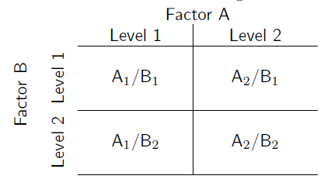
PPI: Factorial Design
G = confounds
E = error
Main effect A
Main effect B
Interaction between factors A & B
Main effect V1
Main effect B
Interaction between factors V1 & B

Slide 21
PPI: Factorial Design
Y = (V₁) β₁ + (Att-NoAtt) β₂ + [(Att-NoAtt) * V1] β₃ + e
Physiological Variable:
V2 Activity
Psychological Variable:
Attention – No attention
Interaction term: the effect of attention vs no attention on V2 activity
Which parts of the brain show a significant attention-dependent coupling with V1?
Attention
y
No Attention
V1 activity

Slide 22
PPI: Interpretations
Two possible interpretations:
The contribution of the source area to the target area response depends on experimental context
e.g. V2 input to V5 is modulated by attention
Target area response (e.g. V5) to experimental variable (attention) depends on activity of source area (e.g. V2)
e.g. The effect of attention on V5 is modulated by V2 input
attention
1.
V2
V5
V1
attention
2.
Mathematically, both are equivalent, but one may be more neurobiologically plausible
V1
V5
V2

Slide 23
PPI: Deconvolve & create & reconvolve
Don’t worry – SPM does this for you...

Slide 24
PPIs in SPM
Perform Standard GLM Analysis with 2 experimental factors (one factor preferably a psychological manipulation) to determine regions of interest and interactions
Define source region and extract BOLD SIGNAL time series (e.g. V2)
Use Eigenvariates (there is a button in SPM) to create a summary value of the activation across the region over time.
Adjust the time course for the main effects

Slide 25
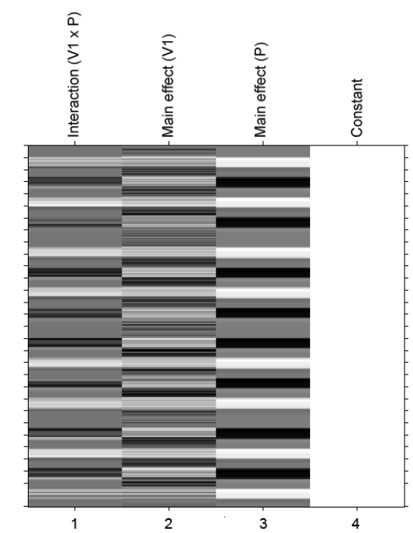
PPIs in SPM
4. Create PPI-GLM using the Interaction term
Y = (Att-NoAtt) β₁ + V1 β₂ + (Att-NoAtt) * V1 β₃ + β_{i}Xi + e
H₀: β₃ = 0

Slide 26
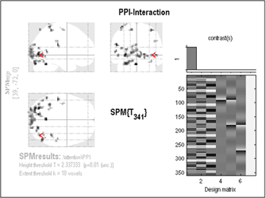
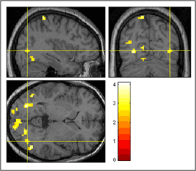
PPI results

Slide 27
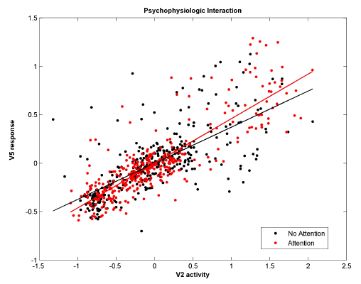
PPI plot

Slide 28
PPI vs. Functional connectivity
PPI’s are based on regressions and assume a dependent and independent variables (i.e., they assume causality in the statistical sense).
PPI’s explicitly discount main effects
Adapted from D. Gitelman, 2011

Slide 29
Pros & Cons of PPIs
Pros:
Given a single source region, PPIs can test for the regions context-dependent connectivity across the entire brain
Simple to perform
Cons:
Very simplistic model: only allows modelling contributions from a single area
Ignores time-series properties of data (can do PPI’s on PET and fMRI data)
Inputs are not modelled explicitly
Interactions are instantaneous for a given context
Need DCM to elaborate a mechanistic model
Adapted from D. Gitelman, 2011

Slide 30
The End
Many thanks to Sarah Gregory!
& to Dana Boebinger & Lisa Quattrocki Knight for the slides!

Slide 31
References
previous years’ slides, and…
Biswal, B., Yetkin, F.Z., Haughton, V.M., & Hyde, J.S. (1995). Functional connectivity in the motor cortex of resting human brain using echo-planar MRI. Magnetic Resonance Medicine, 34(4), 537-41.
Buckner, R. L., Andrews-Hanna, J. R., & Schacter, D. L. (2008). The brain’s default network: anatomy, function, and relevance to disease. Annals of the New York Academy of Sciences, 1124, 1–38. doi:10.1196/annals.1440.011
Damoiseaux, J. S., Rombouts, S. A. R. B., Barkhof, F., Scheltens, P., Stam, C. J., Smith, S. M., & Beckmann, C. F. (2006). Consistent resting-state networks, (2).
De Luca, M., Beckmann, C. F., De Stefano, N., Matthews, P. M., & Smith, S. M. (2006). fMRI resting state networks define distinct modes of long-distance interactions in the human brain. NeuroImage, 29(4), 1359–67. doi:10.1016/j.neuroimage.2005.08.035
Elwell, C. E., Springett, R., Hillman, E., & Delpy, D. T. (1999). Oscillations in Cerebral Haemodynamics. Advances in Experimental Medicine and Biology, 471, 57–65.
Fox, M. D., & Raichle, M. E. (2007). Spontaneous fluctuations in brain activity observed with functional magnetic resonance imaging. Nature reviews. Neuroscience, 8(9), 700–11. doi:10.1038/nrn2201
Fox, M. D., Snyder, A. Z., Vincent, J. L., Corbetta, M., Van Essen, D. C., & Raichle, M. E. (2005). The human brain is intrinsically organized into dynamic, anticorrelated functional networks. Proceedings of the National Academy of Sciences of the United States of America, 102(27), 9673–8. doi:10.1073/pnas.0504136102
Friston, K. J. (2011). Functional and effective connectivity: a review. Brain connectivity, 1(1), 13–36. doi:10.1089/brain.2011.0008
Greicius, M. D., Krasnow, B., Reiss, A. L., & Menon, V. (2003). Functional connectivity in the resting brain: a network analysis of the default mode hypothesis. Proceedings of the National Academy of Sciences of the United States of America, 100(1), 253–8. doi:10.1073/pnas.0135058100
Greicius, M. D., Supekar, K., Menon, V., & Dougherty, R. F. (2009). Resting-state functional connectivity reflects structural connectivity in the default mode network. Cerebral cortex (New York, N.Y. : 1991), 19(1), 72–8. doi:10.1093/cercor/bhn059
Kalthoff, D., & Hoehn, M. (n.d.). Functional Connectivity MRI of the Rat Brain The Resonance – the first word in magnetic resonance.
Kahan & Foltynie (2013). Understanding DCM: Ten simple rules for the clinician NeuroImage 83 (2013) 542–549
Marreiros, A. (2012). SPM for fMRI slides.
Smith, S. M., Miller, K. L., Moeller, S., Xu, J., Auerbach, E. J., Woolrich, M. W., Beckmann, C. F., et al. (2012). Temporally-independent functional modes of spontaneous brain activity. Proceedings of the National Academy of Sciences of the United States of America, 109(8), 3131–6. doi:10.1073/pnas.1121329109
Friston KJ, Buechel C, Fink GR et al. Psychophysiological and Modulatory Interactions in Neuroimaging. Neuroimage (1997) 6, 218-229
Buchel C & Friston KJ. Assessing interactions among neuronal systems using functional neuroimaging. Neural Networks (2000) 13; 871-882.
Gitelman DR, Penny WD, Ashburner J et al. Modeling regional and neuropsychologic interactions in fMRI: The importance of hemodynamic deconvolution. Neuroimage (2003) 19; 200-207.
http://www.fil.ion.ucl.ac.uk/spm/data/attention/
http://www.fil.ion.ucl.ac.uk/spm/doc/mfd/2012/
http://www.fil.ion.ucl.ac.uk/spm/doc/manual.pdf
http://www.neurometrika.org/resources
Graphic of the brain is taken from Quattrocki Knight et al., submitted.
Several slides were adapted from D. Gitelman’s presentation for the October 2011 SPM course at MGH

Slide 32
PPI Questions
How is a group PPI analysis done?
The con images from the interaction term can be brought to a standard second level analysis (one-sample t-test within a group, two-sample t-test between groups, ANOVA’s, etc.)
Adapted from D. Gitelman, 2011

