Slide 1
Methods for Dummies
Random Field Theory
Annika Lübbert & Marian Schneider

Slide 2
Neural Correlates of Interspecies Perspective Taking in the Post-Mortem Atlantic Salmon
task > rest contrast
Bennett et al., (2010) in
Journal of Serendipitous and Unexpected Results
Notes:
The salmon was shown the same social perspectivetaking
task that was later administered to a group of human
subjects.
Sagittal and axial images of significant brain voxels in the task > rest contrast. The parameters for this comparison
were t(131) > 3.15, p(uncorrected) < 0.001, 3 voxel extent threshold. Two clusters were observed in the salmon central
nervous system. One cluster was observed in the medial brain cavity and another was observed in the upper spinal column.
Statistics that were uncorrected for multiple comparisons
showed active voxel clusters in the salmon’s brain
cavity and spinal column. Statistics controlling for the familywise
error rate (FWER) and false discovery rate (FDR) both
indicated that no active voxels were present, even at relaxed
statistical thresholds.

Slide 3
1. Multiple Comparisons Problem
2. Classical Approach to MCP
3. Random Field Theory
4. Implementation in SPM
Overview of Presentation

Slide 4
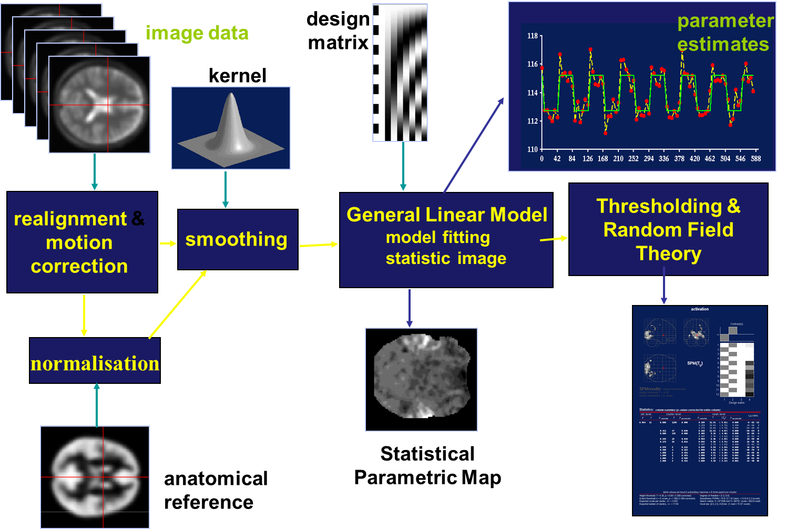
Overview of Data Analysis so far

Slide 5
1. Multiple Comparisons Problem

Slide 6
Hypothesis Testing
To test an hypothesis, we construct “test statistics” and ask how likely that our statistic could have come about by chance
The Null Hypothesis H0
  Typically what we want to disprove (no effect).
  The Alternative Hypothesis HA expresses outcome of interest.
The Test Statistic T
  The test statistic summarises evidence about H0.
  Typically, test statistic is small in magnitude when the hypothesis H0 is true and large when false.
  We need to know the distribution of T under the null hypothesis
Null Distribution of T

Slide 7
1. Multiple Comparisons Problem
u_{α}
Mass univariate analysis : perform t-tests for each voxel
test t-statistic against the null hypothesis -> estimate how likely it is that our statistic could
have come about by chance
Decision rule (threshold) u,
determines false positive rate α
Choose u to give acceptable α
α = P(type I error)
i.e. chance we are wrong when rejecting the null hypothesis
t
α = p(t>u|H)
Notes:
We have fitted a statistical model to
the data, to give us model parameters.
We then use the model parameters
to look for an effect we are interested in, such as the difference between a
task and baseline.
To do this, we usually calculate a statistic (t-values) for each brain
voxel that tests for the effect of interest in that voxel.
When we calculate a statistic, we often want to decide whether the statistic
represents convincing evidence of the effect we are interested in. Usually we
test the statistic against the null hypothesis, which is the hypothesis that
there is no effect. If the statistic is not compatible with the null hypothesis,
we may conclude that there is an effect.
To test against the null hypothesis,
we can compare our statistic value to a null distribution, which is the
distribution of statistic values we would expect if there is no effect. Using
the null distribution, we can estimate how likely it is that our statistic could
have come about by chance. We may find that the result we found has a 5%
chance of resulting from a null distribution. We therefore decide to reject the
null hypothesis, and accept the alternative hypothesis that there is an effect.
In rejecting the null hypothesis, we must accept a 5% chance that the result
has in fact arisen when there is in fact no effect, i.e. the null hypothesis is
true. 5% is our expected type I error rate, or the chance that we take that
we are wrong when we reject the null hypothesis.

Slide 8
1. Multiple Comparisons Problem
u_{α}
u_{α}
Problem: fMRI – lots of voxels, lots of t-tests
If use same threshold, inflated probability of obtaining false positives
u_{α}
u_{α}
u_{α}
α
α
t
α
t
t
α
t
α
t
Notes:
The situation is more complicated in functional imaging because we have
many voxels and therefore many statistic values. If we do not know where in
the brain our effect will occur, our hypothesis refers to the whole volume of
statistics in the brain.
Evidence against the null hypothesis would be that
the whole observed volume of values is unlikely to have arisen from a null
distribution. The question we are asking is now a question about the volume,
or family of voxel statistics, and the risk of error that we are prepared to
accept is the Family–Wise Error rate (FWE) — which is the likelihood that
this family of voxel values could have arisen by chance.

Slide 9
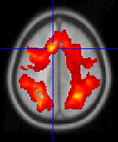
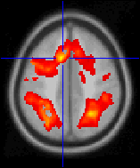
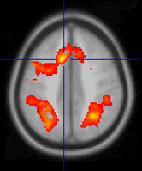
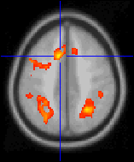
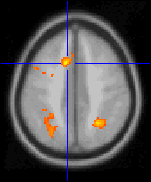
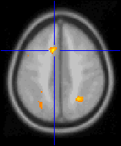
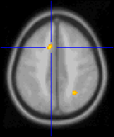
Example
T-map for whole brain may contain say
60000 voxels
Each analysed separately would mean
60000 t-tests
At α = 0.05 this would be 3000 false positives (Type 1 Errors)
Adjust threshold so that any values above threshold are unlikely to under the null hypothesis (height thresholding & take into account the number of tests.)
t > 0.5
t > 2.5
t > 4.5
t > 0.5
t > 1.5
t > 3.5
t > 5.5
t > 6.5

Slide 10
Neural Correlates of Interspecies Perspective Taking in the Post-Mortem Atlantic Salmon
task > rest contrast
t(131) > 3.15, p(uncorrected) < 0.001,
→ resulting in 3 false positives
Notes:
The salmon was shown the same social perspectivetaking
task that was later administered to a group of human
subjects.
Sagittal and axial images of significant brain voxels in the task > rest contrast. The parameters for this comparison
were t(131) > 3.15, p(uncorrected) < 0.001, 3 voxel extent threshold. Two clusters were observed in the salmon central
nervous system. One cluster was observed in the medial brain cavity and another was observed in the upper spinal column.
Statistics that were uncorrected for multiple comparisons
showed active voxel clusters in the salmon’s brain
cavity and spinal column. Statistics controlling for the familywise
error rate (FWER) and false discovery rate (FDR) both
indicated that no active voxels were present, even at relaxed
statistical thresholds.

Slide 11
2. Classical Approach to MCP

Slide 12
Bonferroni Correction
α = P_{FWE} / n
α = new single-voxel threshold
n = number of tests (i.e. Voxels)
FWE = family-wise error
Notes:
FWER is probability that one or more values among a family of statistics will be greater than 

Slide 13
Bonferroni Correction Example
single-voxel probability threshold α
Number of voxels
α = P_{FWE} / n
e.g. 100,000 t stats, all with 40 d.f.
For P_{FWE} of 0.05:
0.05/100000 = 0.0000005 ,
corresponding t=5.77
=> a voxel statistic of t>5.77 has only a 5% chance of arising anywhere in a volume of 100,000 t stats drawn from the null distribution
Family-wise error rate
Notes:
If we have a brain volume of 100,000 t statistics, all with 40 degrees
of freedom, and we want a FWE rate of 0.05, then the required probability
threshold for a single voxel, using the Bonferroni correction, would be
0.05/100, 000 = 0.0000005. The corresponding t statistic is 5.77. If any
voxel t statistic is above 5.77, then we can conclude that a voxel statistic
of this magnitude has only a 5% chance of arising anywhere in a volume of
100,000 t statistics drawn from the null distribution.
The Bonferroni procedure gives a corrected p value; in the case above,
the uncorrected p value for a voxel with a t statistic of 5.77 was 0.0000005;
the p value corrected for the number of comparisons is 0.05.

Slide 14
Why Bonferroni is too conservative
Functional imaging data has a degree of spatial correlation
Number of independent values < number of voxels
Why?
The way that the scanner collects and reconstructs the image
Physiology
Spatial preprocessing (resampling, smoothing)
Fundamental problem: image data represent situation in which we have a continuous statistic image, not a series of independent tests
Notes:
Spatial correlation means that there are fewer independent observations in the data than there are voxels.
This means that the Bonferroni correction
will be too conservative because the family–wise probability from equation
1 relies on the individual probability values being independent, so that we
can use multiplication to calculate the probability of combined events.
This is best illustrated by example.

Slide 15
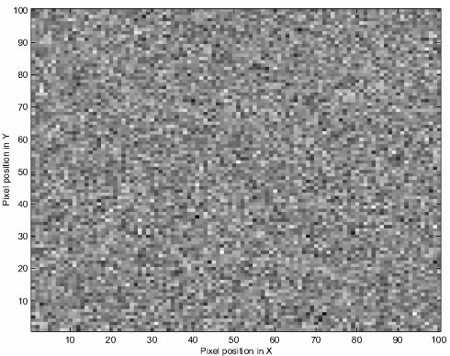
Illustration Spatial Correlation
Single slice image with 100 by 100 voxels
Filling the voxel values with
independent random numbers from the normal distribution
→ Bonferroni accurate
Notes:
Let us take a single image slice, of 100 by 100 voxels, with a t statistic
value for each voxel. For the sake of simplicity, let the t statistics have very
high degrees of freedom, so that we can consider the t statistic values as
being from the normal distribution - i.e. that they are Z scores. We can
simulate this slice from a null distribution by filling the voxel values with
independent random numbers from the normal distribution, which results in
an image such as that in figure 1.
If this image had come from the analysis of real data, we might want to
test if any of the numbers in the image are more positive than is likely by
chance. The values are independent, so the Bonferroni correction will give an
accurate threshold. There are 10,000 Z scores, so the Bonferroni threshold,
alpha, for a FWE rate of 0.05, is 0.05/10000 = 0.000005. This corresponds to
a Z score of 4.42. Given the null hypothesis (which is true in this case) we
would expect only 5 out of 100 such images to have one or more Z scores
more positive than 4.42.

Slide 16
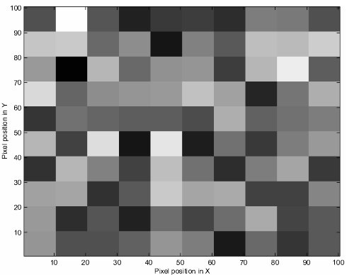
Illustration Spatial Correlation
add spatial correlation:
break up the image into squares of 10 by
10 pixels
calculate the mean of the 100 values contained
10000 numbers in image but only 100 independent
Bonferroni 100 times too conservative!
Notes:
The situation changes if we add spatial correlation. Let us perform the
following procedure on the image: break up the image into squares of 10 by
10 pixels; for each square, calculate the mean of the 100 values contained;
replace the 100 random numbers in the square by the mean value1. The
image that results is shown in figure 2.
We still have 10000 numbers in our image, but there are only 10 by 10 =
100 numbers that are independent. The appropriate Bonferroni correction
is now 0.05 / 100 = 0.0005, which corresponds to a Z score of 3.29. We
would expect only 5 of 100 of such images to have a square of values greater
than 3.29 by chance. If we had assumed all the values were independent,
then we would have used the correction for 10,000 values, of alpha = 0.000005.
Because we actually have only 100 independent observations, equation 2,
with n = 100 and alpha = 0.000005, tells us that we expect a FWE rate of
0.0005, which is one hundred times lower (i.e. more conservative) than the
rate that we wanted.

Slide 17
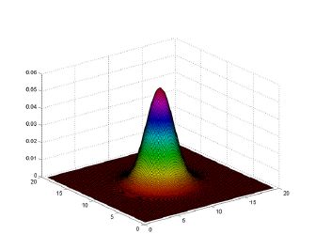
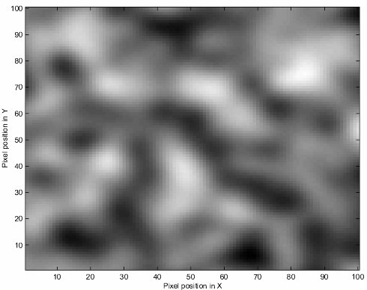
Smoothing contributes Spatial Correlation
Smooth image by applying a Gaussian kernel with FWHM = 10 (at 5 pixels from centre, value is half peak value)
Smoothing replaces each value in the image with weighted average of itself and neighbours
Blurs the image -> reduces number of independent observations
Notes:
The procedure just applied is a very simple form of smoothing. When we
smooth an image with a smoothing kernel such as a Gaussian, each value in
the image is replaced with a weighted average of itself and its neighbours.
Figure 3 shows the image from figure 1 after smoothing with a Gaussian
kernel of Full Width at Half Maximum (FWHM) of 10 pixels 2. An FWHM
of 10 pixels means that, at five pixels from the centre, the value of the kernel
is half its peak value. Smoothing has the effect of blurring the image, and
reduces the number of independent observations.

Slide 18
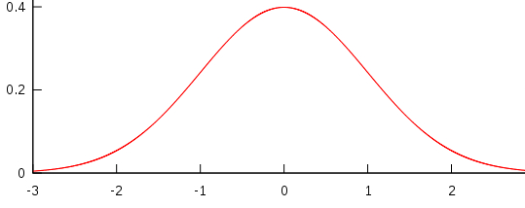
Smoothing Kernel
FWHM
(Full Width at Half Maximum)
Notes:
The smoothed image contains spatial correlation, which is typical of the
output from the analysis of functional imaging data.
We now have a problem, because there is no simple way of calculating the number of independent observations in the smoothed data, so we cannot use the Bonferroni correction.
→ This problem can be addressed using random field theory.

Slide 19
3. Random Field Theory

Slide 20
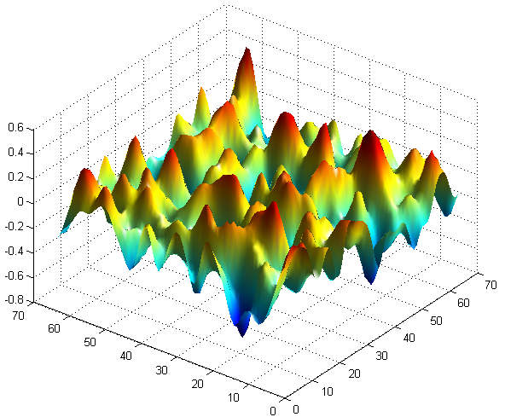
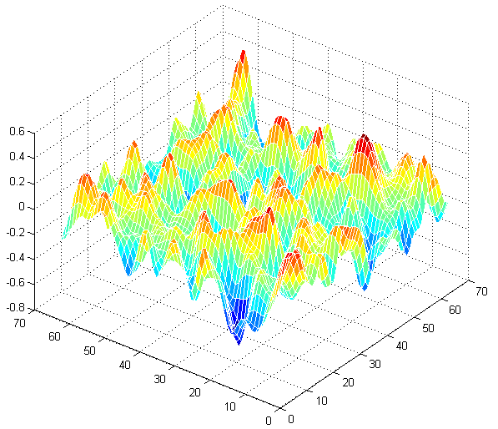
Using RFT to solve the Multiple Comparison Problem (get FWE)
RFT approach treats SPMs as a discretisation of underlying continuous fields
  Random fields have specified topological characteristics
  Apply topological inference to detect activations in SPMs

Slide 21
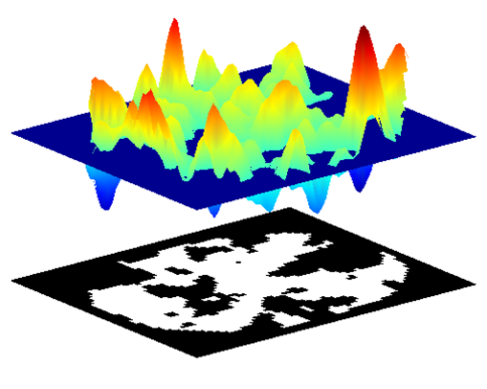
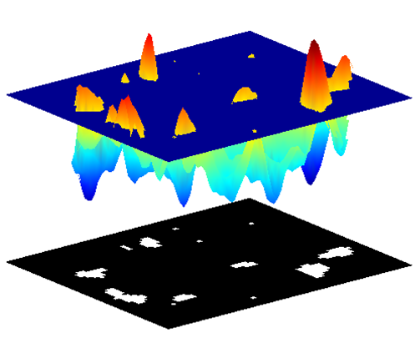
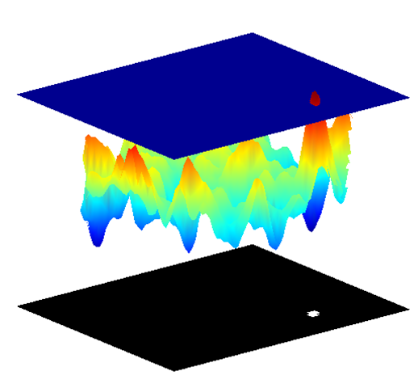
Three stages of applying RFT:
1. Estimate smoothness
2. Find number of ‘resels’ (resolution elements)
3. Get an estimate of the Euler Characteristic at different thresholds
Notes:
Resels = resolution elements; depend on smoothness and number of voxels (i.e. size of search region)!

Slide 22
1. Estimate Smoothness
estimate
Given: Image with applied and intrinsic smoothness
Estimated using the residuals (error) from GLM
→ Estimate the increase in spatial correlation from i.i.d. noise to imaging data (‘from right to left’)
Notes:
In practice, smoothness is calculated using the residual values from the statistical analysis → Y = bX + e → b = beta = scaling values, X = design matrix, e = residual error
I.i.d. noise = independently and identically distributed noise → all variables have the same probability distribution and are mutual INDEPENDENT

Slide 23
2. Calculate the number of resels
Look at your estimated smoothness (FWHM)
Express your search volume in resels
  Resolution element (R_{i} = FWHM_{x} x FWHM_{y} x FWHM_{z})
  # depends on smoothness of data (+volume of ROI)
  “Restores” independence of the data
Notes:
A resel is simply defined as a block of values (e.g. pixels) that is the same size as the FWHM

Slide 24
3. Get an estimate of the Euler Characteristic
Steps 1 and 2 yield a ‘fitted random field’ (appropriate smoothness)
Now: how likely is it to observe above threshold (‘significantly different’) local maxima (or clusters, sets) under H₀?
How to find out? EC!

Slide 25
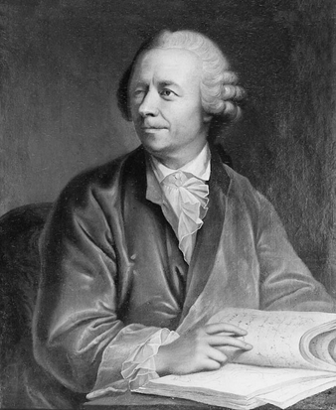
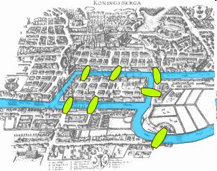
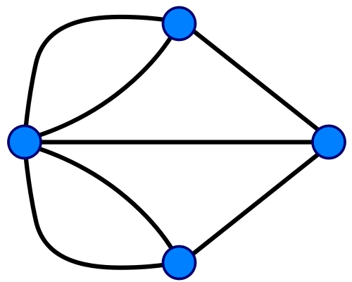
Euler Characteristic – a topological property
Leonhard Euler 18th century swiss mathematician
SPM → threshold → EC
EC = number of blobs (minus number of holes)*
“Seven bridges of Kӧnisberg”
*Not relevant: we are only interested in EC at high thresholds (when it approximates P of FEW)
Notes:
Leonhard Euler (1797-1783), Swiss mathematician → Seven bridges of Kӧnisberg

Slide 26
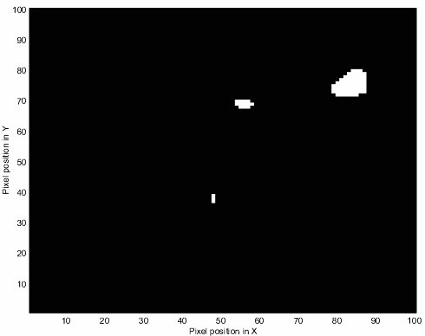
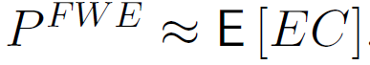
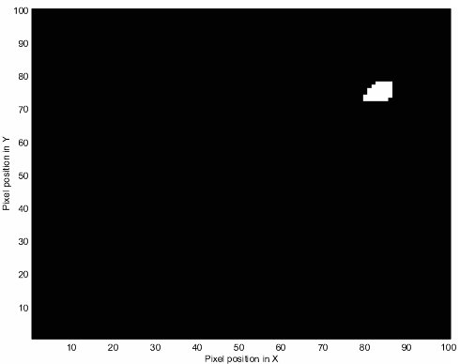
Euler Characteristic and FWE
Z_{t} = 2.5
EC = 3
Z_{t} = 2.75
The probability of a family wise error is approximately equivalent to the expected Euler Characteristic
Number of “above threshold blobs”
EC = 1
Notes:
If we increase the Z score threshold to 2.75, we find that the two central blobs disappear –
because the Z scores were less than 2.75.

Slide 27
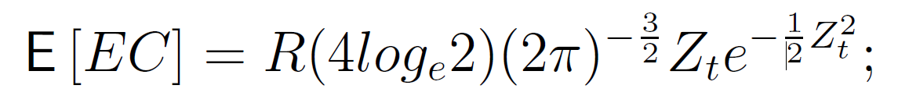
How to get E [EC] at different thresholds
# of resels
Expected Euler Characteristic
Z (or T) -score threshold
* Or Monte Carlo Simulation, but the formula is good! It gives exact estimates, as long as your smoothness is appropriate
Notes:
From this equation, it follows that the threshold depends only on the number of resels in our image.

Slide 28
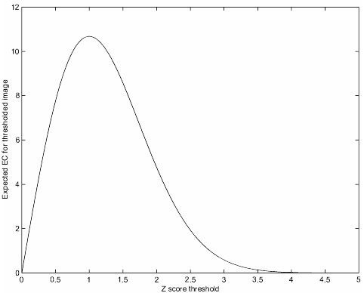
Given # of resels and E[EC], we can find the appropriate z/t-threshold
E [EC] for an image of 100 resels, for Z score thresholds 0 – 5
Notes:
The graph does a reasonable job of predicting the EC in our image; at a Z threshold of 2.5 it predicted an EC of 1.9, when we observed a value of 3; at Z=2.75 it predicted an EC of 1.1, for an observed EC of 1.

Slide 29
How to get E [EC] at different thresholds
# of resels
Expected Euler Characteristic
Z (or T) -score threshold
From this equation, it looks like the threshold depends only on the number of resels in our image
Notes:
From this equation, it follows that the threshold depends only on the number of resels in our image.

Slide 30
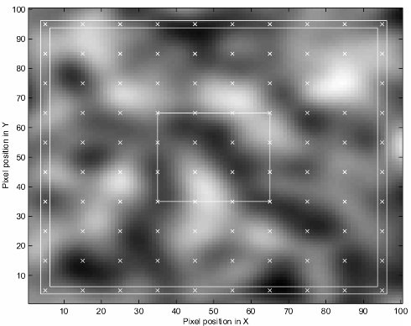
Shape of search region matters, too!
#resels → E [EC]
not strictly accurate!
close approximation if ROI is large compared to the size of a resel
# + shape + size resel →
E [EC]
Matters if small or oddly shaped ROI
Example:
central 30x30 pixel box = max. 16 ‘resels’ (resel-width = 10pixel)
edge 2.5 pixel frame = same volume but max. 32 ‘resels’
Multiple comparison correction for frame must be more stringent

Slide 31
Different types of topological Inference
Topological inference can be about
  Peak height (voxel level)
  Regional extent (cluster level)
  Number of clusters (set level)
    localizing power!
      …intermediate…
        → sensitivity!
intensity
Different height and spatial extent thresholds
t_{α}
t_{clus}
space
Notes:
Voxel-level inference based on height thresholds asks: is activation at a given voxel significantly non-zero?
Bigger framework: cluster-level and set-level inference. These require height and spatial extent thresholds to be specified by the user
Corrected p-values can then be derived that pertain to…

Slide 32

Assumptions made by RFT
  Underlying fields are continuous with twice-differentiable autocorrelation function
  Error fields are reasonable lattice approximation to underlying random field with multivariate Gaussian distribution
lattice representation
Check: FWHM must be min. 3 voxels in each dimension
In general: if smooth enough + GLM correct (error = Gaussian) → RFT
Notes:
- Autocorrelation function need not be Gaussian
- If the data have been sufficiently smoothed and the General Linear Models correctly specified (so that the errors are indeed Gaussian) then the RFT assumptions will be met

Slide 33
Assumptions are not met if...
  Data is not sufficiently smooth
  Small number of subjects
  High-resolution data
Non-parametric methods to get FWE (permutation)
Alternative ways of controlling for errors: FDR (false discovery rate)
Notes:
E.g. in random effects analysis (chp.12) with a small number of subjects → because the resulting error fields will not be very smooth and so may violate the ‘reasonable lattice approximation’ assumption.

Slide 34
4. Implementation in SPM

Slide 35
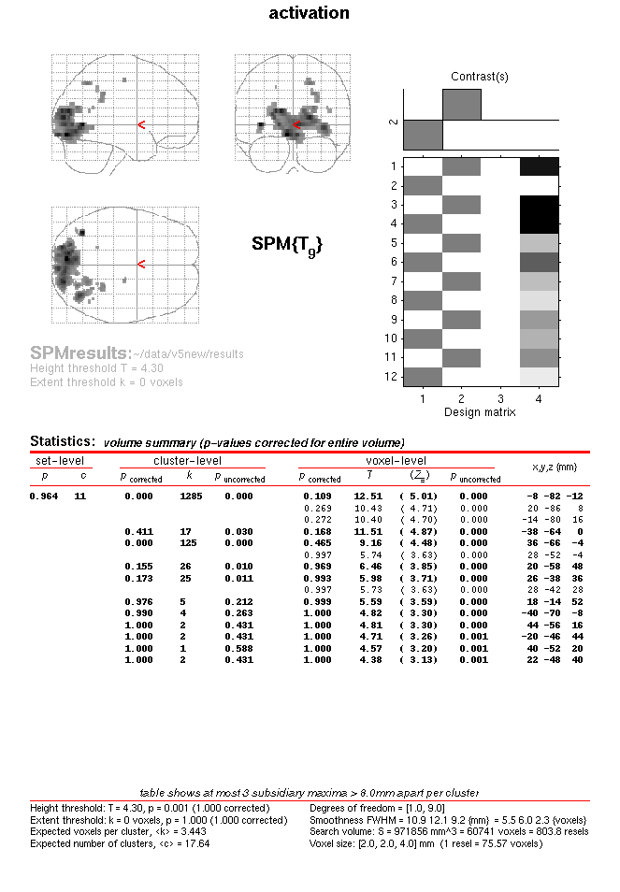
4. Implementation in SPM

Slide 36
Notes:
Activations Significant at Cluster level But not at Voxel Level

Slide 37
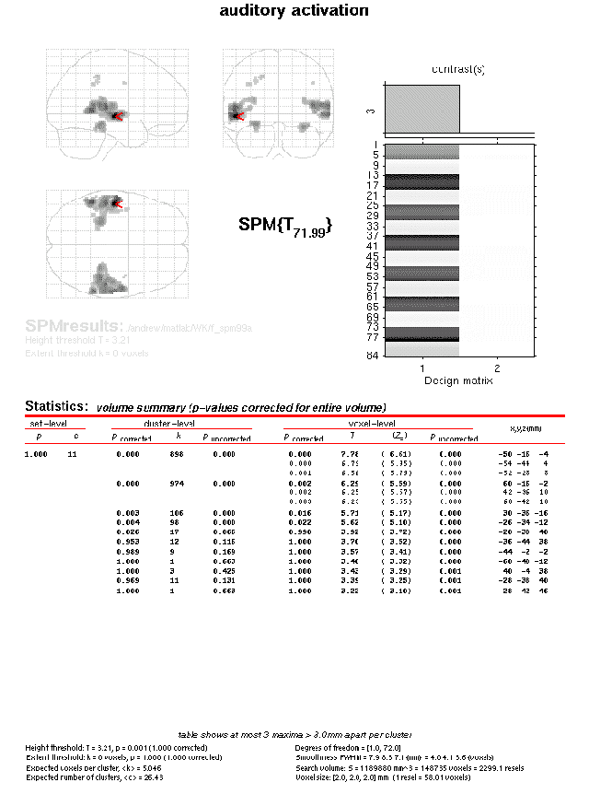
Another example:

Slide 38
Notes:
Activations Significant at Voxel and Cluster level

Slide 39
Take-home message, overview:
Large volume of imaging data
Multiple comparison problem
<smoothing with a
Gaussian kernel,
FWHM >
Mass univariate analysis
Uncorrected p value
Too many false positives
Bonferroni correction
α=P^{FWE}/n
Corrected p value
Random field theory (RFT)
α = P^{FWE} ≒ E[EC]
Corrected p value
Null hypothesis rarely rejected
Too many false negatives
Never use this.

Slide 40
Thank you for your attention!
…and special thanks to Guillaume!

Slide 41
Sources
Human Brain Function, Chapter 14, An Introduction to Random Field Theory (Brett, Penny, Kiebel)
http://www.fil.ion.ucl.ac.uk/spm/course/video/#RFT
http://www.fil.ion.ucl.ac.uk/spm/course/video/#MEEG_MCP
Former MfD Presentations
Expert Guillaume Flandin

