Slide 1
T-tests and ANOVA
Statistical analysis of group differences

Slide 2
Outline
Criteria for t-test
Criteria for ANOVA
Variables in t-tests
Variables in ANOVA
Examples of t-tests
Examples of ANOVA
Summary

Slide 3
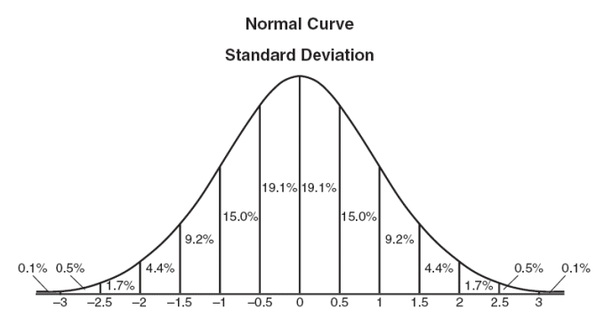
Criteria to use a t-test
Notes:
Sample data must fit a normal distribution (parametric)
Groups are independent
Sample data have similar standard deviation
Violation of assumptions require another test
Ex. Mann-Whitley, Chi-squared (non-parametric testing)

Slide 4
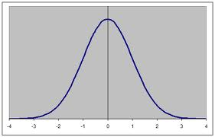
Criteria to use ANOVA
Main Difference: 3 or more groups
Notes:
Looking at the mean differences between groups
Reduces the chance of a Type 1 error

Slide 5
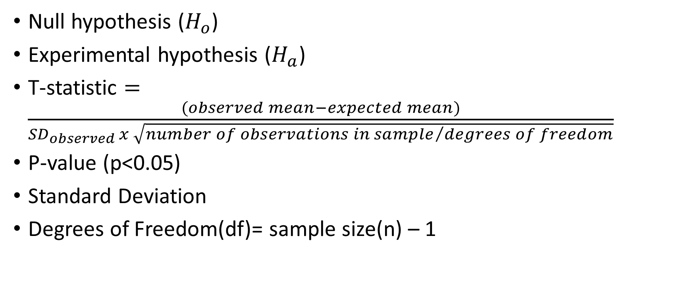
Variables in a t-test
Null hypothesis ($H_{o}$)
Experimental hypothesis ($H_{a}$)
T-statistic $=\frac{(observed mean−expected mean)}{{SD}_{observed }x \sqrt{{number of observations in sample}/{degrees of freedom}}}$
P-value (p<0.05)
Standard Deviation
Degrees of Freedom(df)= sample size(n) – 1
Notes:
Null hypothesis= the default hypothesis that always states there is no significant relationship in our samples
Experimental hypothesis= the hypothesis that is proven when the null is rejected
T-statistic= the value in which the data falls under
P-value=The number in which determines the acceptance or rejection of the null hypothesis; Compare this value with the t-statistic
Standard Deviation=
Degrees of Freedom=(the number of individual scores that can vary without changing the sample mean)

Slide 6
Standard Deviation vs Standard Error
Standard Deviation= relationship of individual values of the sample
Standard Error= relationship of standard deviation with the sample mean
  How it relates to the population
Notes:
Standard deviation = a measure of how much the values of individual members vary in relation to the mean
Standard error
Is the standard deviation of sample means
It is a measure of how representative a sample is likely to be of the population
Large SE (relative to the sample mean): lots of variability between means of different samples ⇨ used sample may not be representative of a population
Small SE: most sample means are similar to the population mean ⇨ sample is likely to be an accurate reflection of the population

Slide 7
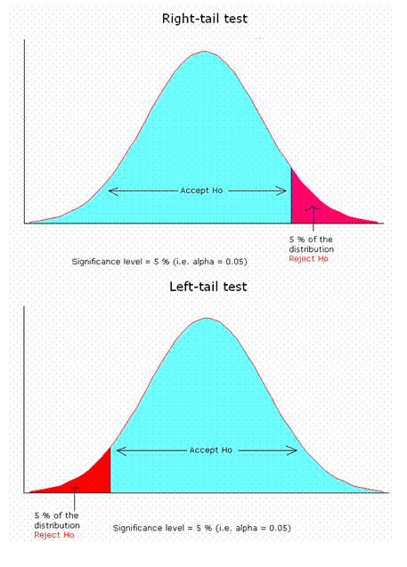
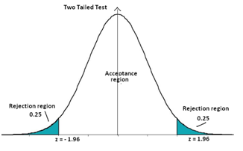
One-tailed and Two-tailed

Slide 8

Variables in ANOVA
F-ratio= $\frac{Variance Between}{Variance Within}$
Sum of Squares: Sum of the variance from the mean [ $\sum{{(x−μ)}^{2}}$]
Means of Squares: estimates the variance in groups using the sum of squares and degrees of freedom

Slide 9
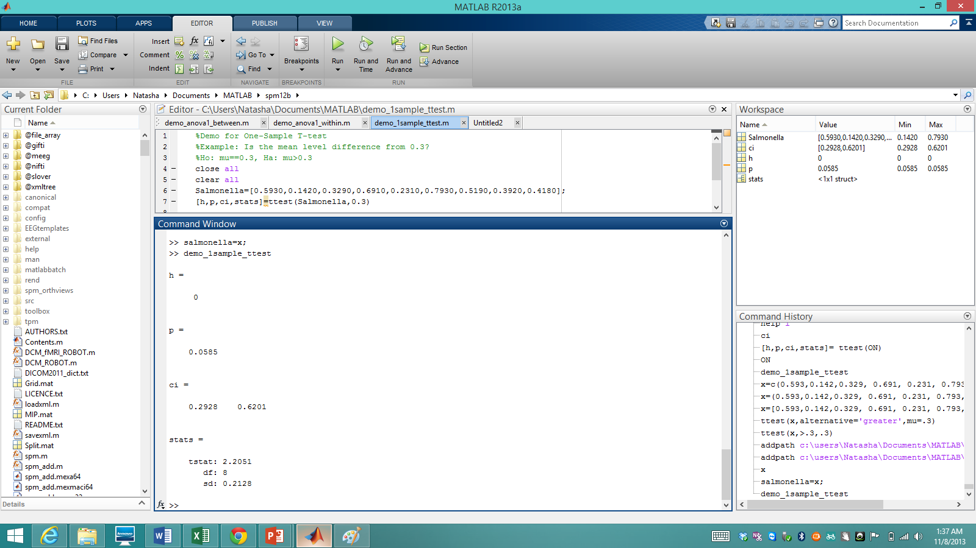

Example : One Sample t-test
An ice cream factory is made aware of a salmonella outbreak near them. They decide to test their product contains Salmonella. Safe levels are 0.3 MPN/g
$$H_{o}: μ=0$$
${ H}_{a}:μ$≠ 0
Notes:
Have to have a population mean

Slide 10
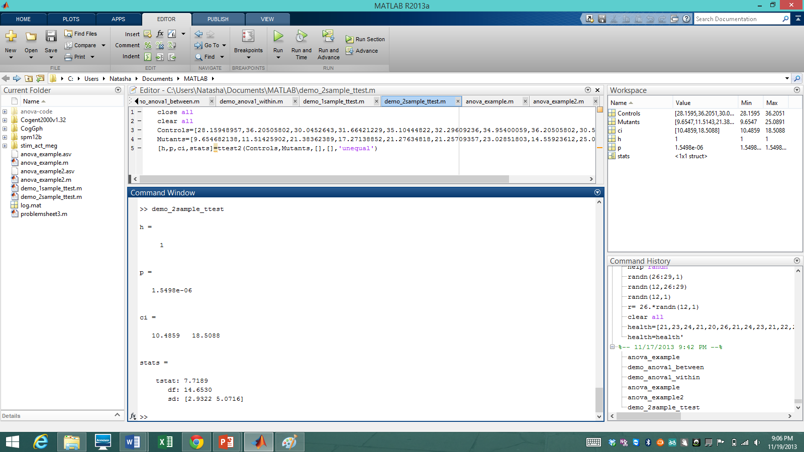
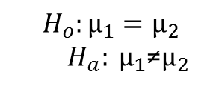
Example: Two Sample t-test
In vitro compound action potential study compared mouse models of demyelination to controls. Conduction velocities were calculated from the sciatic nerve (m/s).
$$H_{o}:μ_{1}=μ_{2}$$
${ H}_{a}: μ_{1}$≠$μ_{2}$

Slide 11
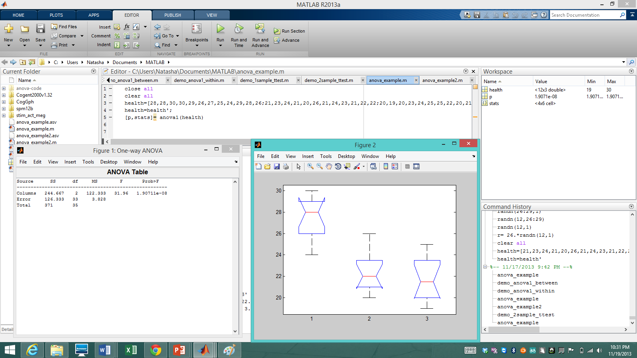
Example of Within Subjects ANOVA
A sample of 12 people volunteered to participate in a diet study. Their BMI indices were measured before beginning the study. For one month they were given a exercise and diet regiment. Every two weeks each subject had their BMI index remeasured

Slide 12
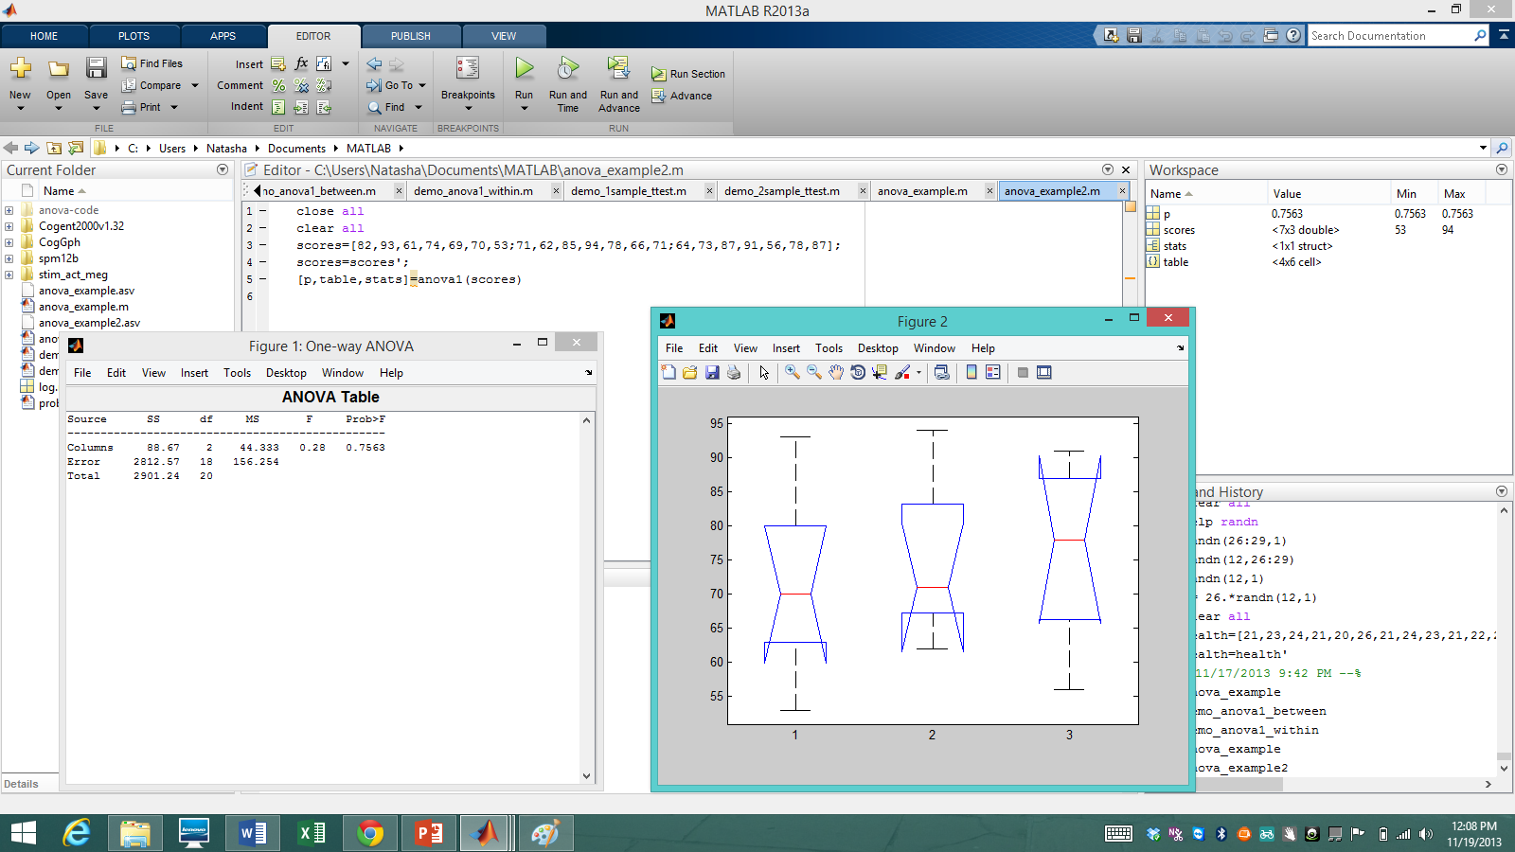
Example of Between Subjects ANOVA
AM University took part in a study that sampled students from the first three years of college to determine the study patterns of its students. This was assessed by a graded exam based on a 100 point scale.

Slide 13
Summary of MatLab syntax
T-test
  [h, p, ci, stats]=ttest1(X, mean of population)
  [h, p, ci, stats]=ttest2(X)
ANOVA
  [p,stats] = anova1(X,group,displayopt)
  p = anova2(X,reps,displayopt)
  http://www.mathworks.co.uk/help/stats/
Notes:
Example: p=anova1(“your data set”, “Can be inserted if you want to rename ”, displayopt used to mute the figure and graph)

Slide 14
Types of Error
Type 1- Significance when there is none
Type 2- No significance when there is

Slide 15
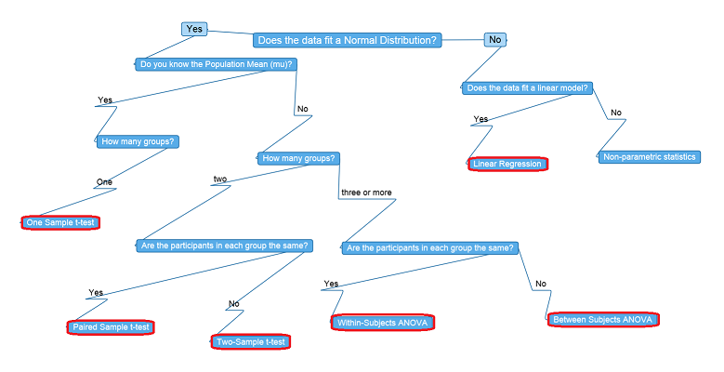
Summary

Slide 16
Correlation and Regression

Slide 17
Correlation
Correlation aims to find the degree of relationship between two variables, x and y.
Correlation ≠ causality
Scatter plot is the best method of visual representation of relationship between two independent variables.
Notes:
SO we cannot say for certain that there is a causal relationship between the two variables
Though there might be such a causality however we cannot infer this from the information. For example, a person who smile live longer. However there are other intermediate stages that affect living long rather than just smiling!

Slide 18
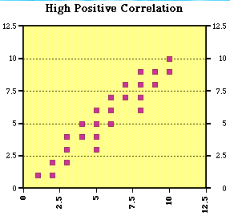
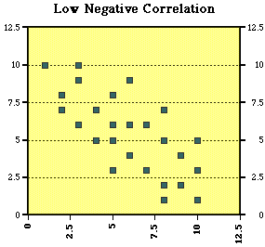
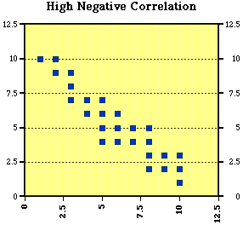
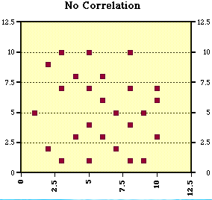
Scatter plots
Notes:
So, Scatter diagrams tell us what is relationship between x and y, in each case.

Slide 19
How to quantify correlation?
Covariance
Pearson Correlation Coefficient
Notes:
Both only measure linear relationships

Slide 20
Covariance
Is the measure of two random variables change together.
Notes:
So what is happening here? Each individual x value is subtracted from the mean of x and similarly for y. These are multiplied together and added together. The sum is divided by the total number of sample. This final value represents the covariance between two variables.

Slide 21
How to interpret covariance values?
Sign of covariance
  (+) → two variables are moving in same direction
  (-) → two variables are moving in opposite directions.
Size of covariance: if the number is large the strength of correlation is strong

Slide 22
Problem?
The covariance is dependent on the variability in the data. So large variance gives large numbers.
Therefore the magnitude cannot be measured.
Solution????

Slide 23
Pearson Coefficient correlation
Both give a value between
-1 ≤ r ≤ 1
-1 = negative correlation
0 = no correlation
1 = positive correlation
r² = the degree of variability of variable y which is explained by it’s relationship with x.
Notes:
Find the correlation between the variables by dividing the covariance by their standard deviations

Slide 24
Limitations
Sensitive to outliers
Cannot be used to predict one variable to other
Notes:
An outlier can affect the r value

Slide 25
Linear Regression
Correlation is the premises for regression.
Once an association is established → can a dependent variable be predicted when independent variable is changed?

Slide 26
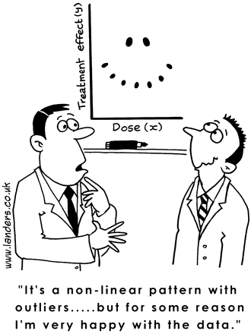
Assumptions
Linear relationship
Observations are independent
Residuals are normally distributed
Residuals have the same variance

Slide 27
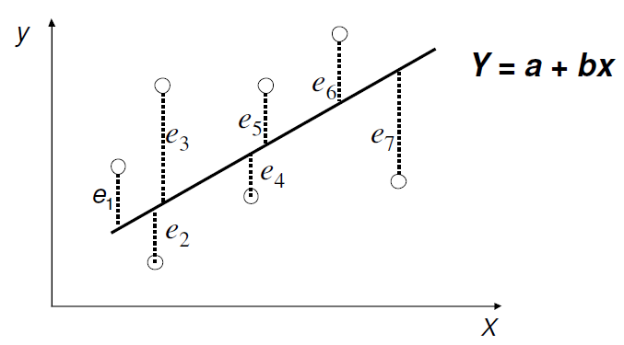
Residuals
Notes:
In an effort to find the best possible fit for a data, we minimise the distance between the original data and the fitted data.

Slide 28
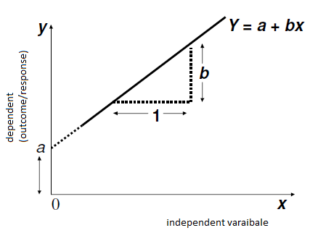
Linear Regression
a = estimated intercept
b = estimated regression coefficient, gradient/slope
Y = predicted value of y for any given x
Every increase in x by one unit leads to b unit of change in y.

Slide 29
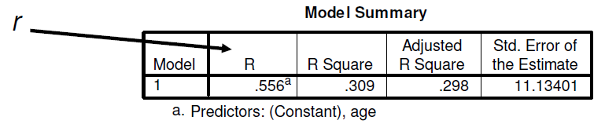
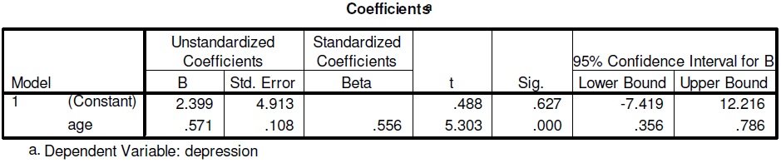
Data interpretation
Y 0.571(age) + 2.399
P value (<0.05)
Notes:
R value shows how much variability is accounted by age

Slide 30
Multiple Regression
Use to account for the effect of more than one independent variable on a give dependent variable.
y = a₁x₁+ a₂x₂ +…..+ a_{n}x_{n} + b + ε
Notes:
When generally have more than one factor affecting an issue. E.g. depression can be affected by age, gender, mood, health,………

Slide 31
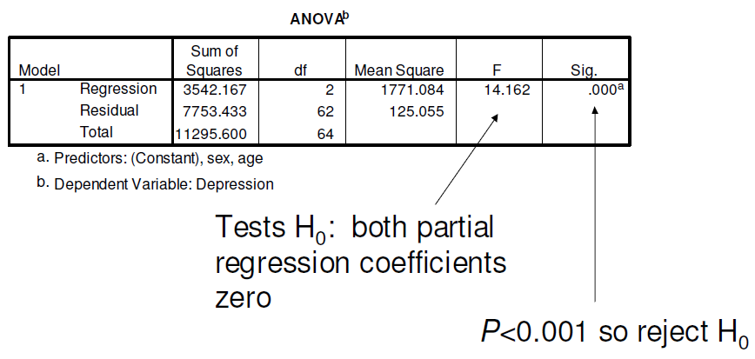
Data interpretation

Slide 32
General Linear Model
GLM can also allow you to analyse the effects of several independent x variables on several dependent variables, y₁, y₂, y₃ etc, in a linear combination

Slide 33
Summary
Correlation (positive, no correlation, negative)
No causality
Linear regression – predict one dependent variable y through x
Multiple regression – predict one dependent variable y through more than one indepdent variable.

Slide 34

?? Questions ??

