Slide 1

1st level analysis: Design matrix, contrasts, and inference
Roy Harris & Caroline Charpentier

Slide 2
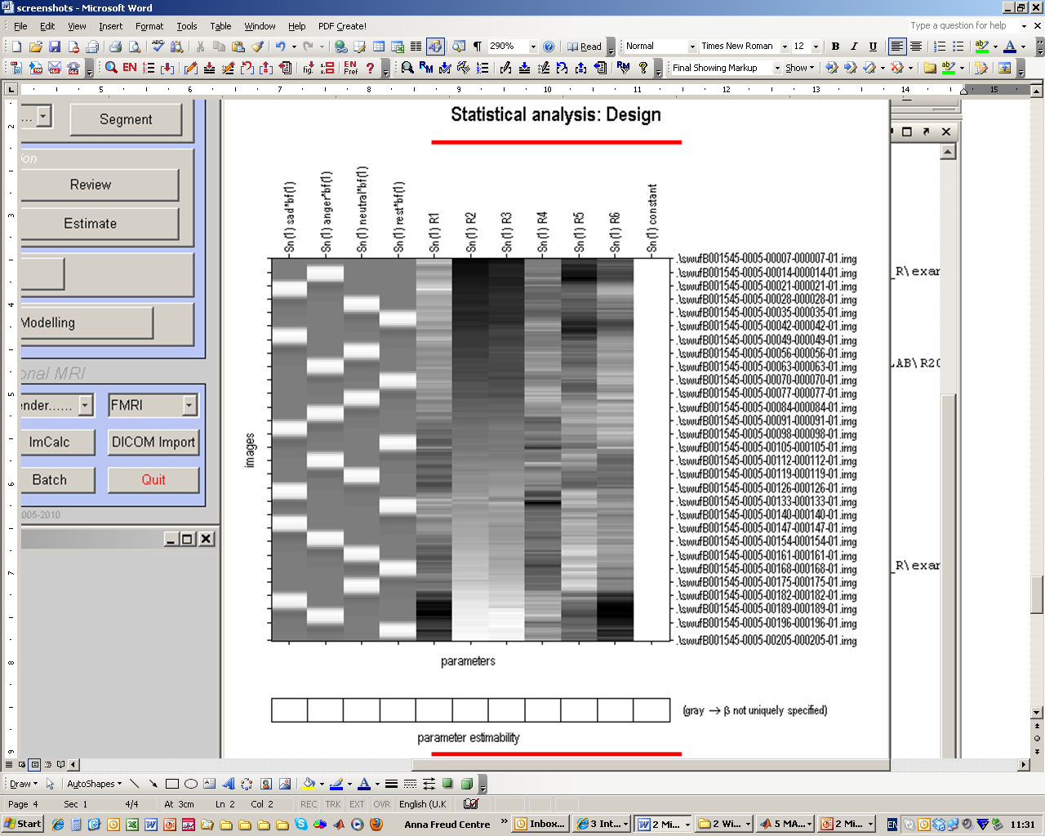
Outline
What is ‘1st level analysis’?
The Design matrix
  What are we testing for?
  What do all the black lines mean?
  What do we need to include?
Contrasts
  What are they for?
  t and F contrasts
  How do we do that in SPM8?
  Levels of inference
A B C D
[1 -1 -1 1]

Slide 3

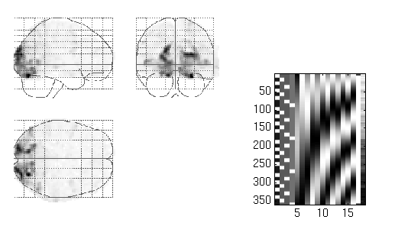
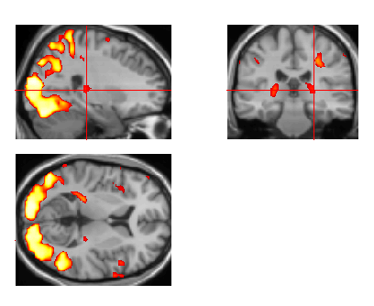
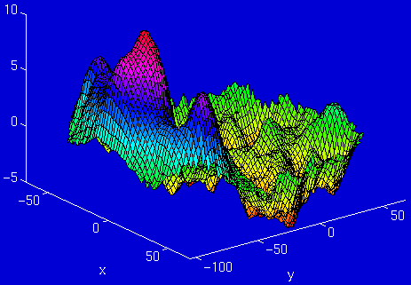
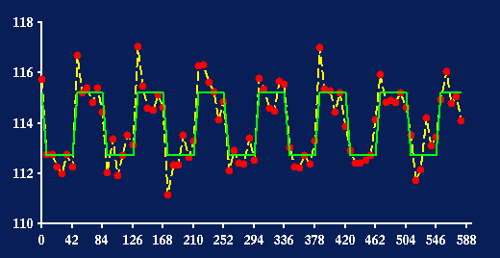
Overview
fMRI time-series
kernel
Design matrix
Statistical Parametric Map
Motion
correction
Smoothing
General Linear Model
Spatial
normalisation
Parameter Estimates
Standard
template
Once the image has been reconstructed, realigned, spatially normalised and
smoothed….
The next step is to statistically analyse the data
Rebecca Knight

Slide 4
Key concepts
1st level analysis – A within subjects analysis where activation is averaged across scans for an individual subject
The Between - subject analysis is referred to as a 2nd level analysis and will be described later on in this course
Design Matrix –The set of regressors that attempts to explain the experimental data using the GLM
  ➔A dark-light colour map is used to show the value of each variable at specific time points – 2D, m = regressors, n = time.
The Design Matrix forms part of the General linear model, the majority of statistics at the analysis stage use the GLM

Slide 5
General Linear Model
Generic Model
β
⁺
ε
Y
X
⁼
^{x}
Dependent Variable (What you are measuring)
Independent Variable (What you are manipulating)
Relative Contribution
of X to the overall
data (These need to
be estimated)
Error (The difference between the observed data and that which is predicted by the model)
Aim: To explain as much of the variance in Y by using X, and thus reducing ε
Y = X₁β₁ + X₂β₂ + ....X _{n} β_{n}.... + ε

Slide 6
GLM continued
How does this equation translate to the 1st level analysis ?
Each letter is replaced by a set of matrices (2D representations)
X
β
Y
⁺
ε
⁼
^{x}
Matrix of BOLD
at various time points
in a single voxel
(What you collect)
Design matrix
(This is your model specification in SPM)
Parameters matrix
(These need to be estimated)
Error matrix
(residual error for
each voxel)
Parameter weights (rows)
Time
(rows)
Time
(rows)
Time (rows)
1 x column (Voxel)
Regressors (columns)
1 x Column

Slide 7
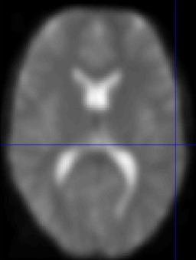
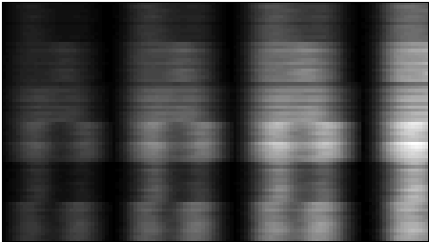
‘Y’ in the GLM
Y = Matrix of Bold signals
fMRI brain scans
Voxel time course
Y
Time
Time
(scan every 3 seconds)
1 voxel = ~ 3mm³
Amplitude/Intensity
Rebecca Knight

Slide 8
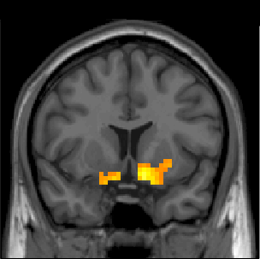
‘X’ in the GLM
X = Design Matrix
Time
(n)
Regressors (m)

Slide 9
Regressors
Regressors – represent the hypothesised contribution of your experiment to the fMRI time series. They are represented by the columns in the design matrix (1column = 1 regressor)
Regressors of interest i.e. Experimental Regressors – represent those variables which you intentionally manipulated. The type of variable used affects how it will be represented in the design matrix
Regressors of no interest or nuisance regressors – represent those variables which you did not manipulate but you suspect may have an effect. By including nuisance regressors in your design matrix you decrease the amount of error.
E.g. - The 6 movement regressors (rotations x3 & translations x3 ) or physiological factors e.g. heart rate, breathing or others (e.g., scanner known linear drift)

Slide 10
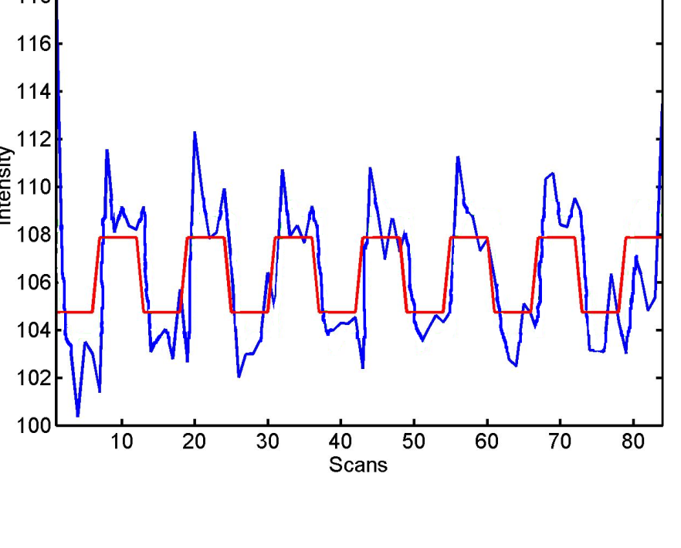

Conditions
Termed indicator variables as they indicate conditions
Type of dummy code is used to identify the levels of each variable
E.g. Two levels of one variable is on/off, represented as
ON = 1
OFF = 0
Changes in the bold activation associated with the presentation of a stimulus
When you IV is presented
When you IV is absent (implicit baseline)
Red box plot of [0 1] doesn’t model the rise and falls
Fitted Box-Car

Slide 11
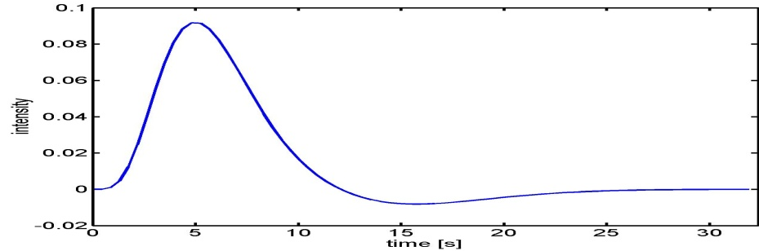
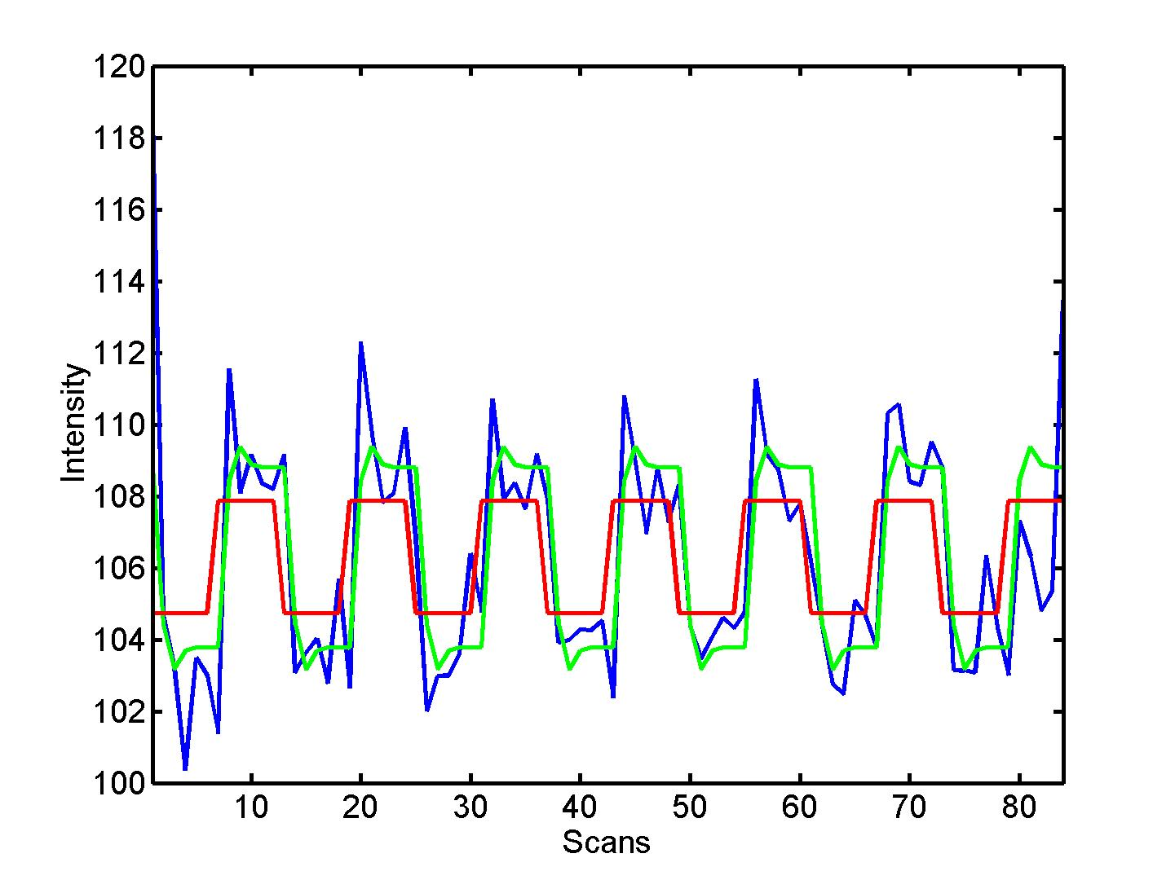


Ways to improve your model: modelling haemodynamics
Modelling haemodynamics
The brain does not just switch on and off.
Convolve regressors to resemble HRF
  HRF basic function
Original
HRF Convolved

Slide 12
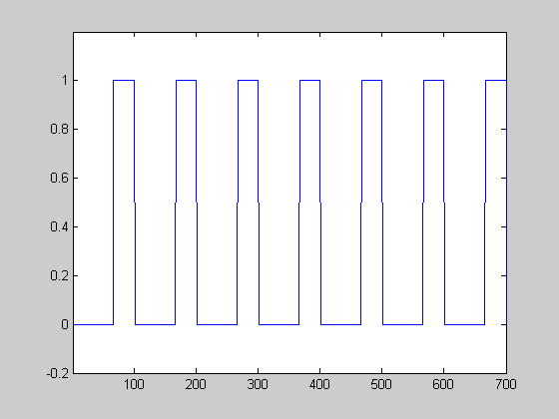
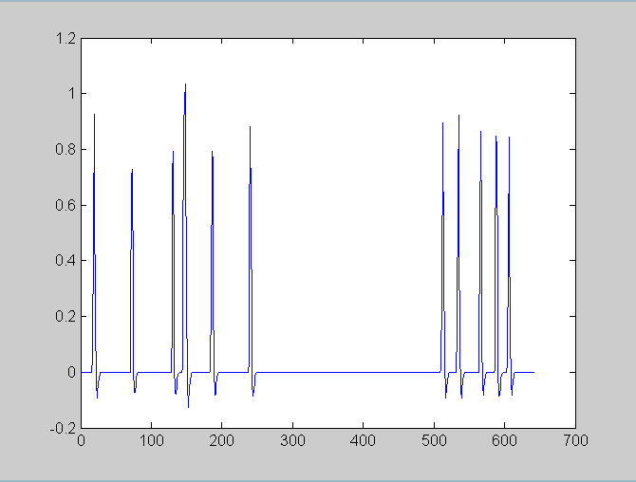
Designs
Block design Event- related design
Intentionally design events of interest into blocks
Retrospectively look at when the events of interest occurred. Need to code the onset time for each regressor

Slide 13
Regressors
A dark-light colour map is used to show the value of each regressor within a specific time point
Black = 0 and illustrates when the regressor is at its smallest value
White = 1 and illustrates when the regressor is at its largest value
Grey represents intermediate values
The representation of each regressor column depends upon the type of variable specified
)

Slide 14
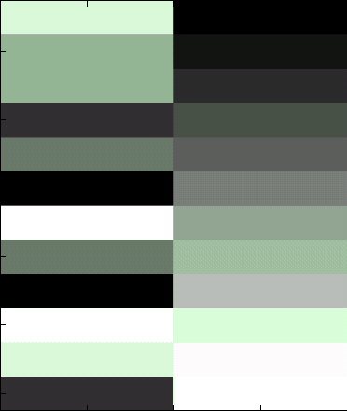
Regressors of no interest
Variable that can’t be described using conditions
E.g. Movement regressors – not simply just one state or another
  The value can take any place along the X,Y,Z continuum for both rotations and translations
Covariates
E.g. Habituation
Including them explains more of the variance and can improve statistics

Slide 15
Summary
The Design Matrix forms part of the General Linear Model
The experimental design and the variables used will affect the construction of the design matrix
The aim of the Design Matrix is to explain as much of the variance in the experimental data as possible

Slide 16
Contrasts and Inference
Contrasts: what and why?
T-contrasts
F-contrasts
Example on SPM
Levels of inference

Slide 17
Contrasts and Inference
Contrasts: what and why?
T-contrasts
F-contrasts
Example on SPM
Levels of inference

Slide 18
Contrasts: definition and use
After model specification and estimation, we now need to perform statistical tests of our effects of interest.
To do that → contrasts, because:
  Usually the whole β vector per se is not interesting
  Research hypotheses are most often based on comparisons between conditions, or between a condition and a baseline
Contrast vector, named c, allows:
  Selection of a specific effect of interest
  Statistical test of this effect

Slide 19
Contrasts: definition and use
Form of a contrast vector:
c^{T} = [ 1 0 0 0 ... ]
Meaning: linear combination of the regression coefficients β
c^{T}β = 1 * β₁ + 0 * β₂ + 0 * β₃ + 0 * β₄ ...
Contrasts and their interpretation depend on model specification and experimental design → important to think about model and comparisons beforehand

Slide 20
Contrasts and Inference
Contrasts: what and why?
T-contrasts
F-contrasts
Example on SPM
Levels of inference

Slide 21
T-contrasts
One-dimensional and directional
  eg c^{T} = [ 1 0 0 0 ... ] tests β₁ > 0, against the null hypothesis H₀: β₁=0
  Equivalent to a one-tailed / unilateral t-test
Function:
  Assess the effect of one parameter (c^{T} = [1 0 0 0])
  OR
  Compare specific combinations of parameters
  (c^{T} = [-1 1 0 0])

Slide 22
T-contrasts
Test statistic:
Signal-to-noise measure: ratio of estimate to standard deviation of estimate
contrast of
estimated
parameters
T =
variance
estimate

Slide 23
T-contrasts: example
Effect of emotional relative to neutral faces
Contrasts between conditions generally use weights that sum up to zero
This reflects the null hypothesis: no differences between conditions
No effect of scaling
[ ½ ½ -1 ]
[ 1 1 -2 ]
Notes:
If you define the contrast [1 1 -1] this is possible and SPM will not return an error but this will test for the hypotheses that the effect of emotional faces is twice as great as the effect of neutral faces, explaining why you need to average across the two emotion conditions.

Slide 24
Contrasts and Inference
Contrasts: what and why?
T-contrasts
F-contrasts
Example on SPM
Levels of inference
Notes:
T-contrasts = particular case of F-contrast, when matrix is a vector, and F=T²

Slide 25
F-contrasts
Multi-dimensional and non-directional
  [ 1 0 0 0 ... ]
  eg c = [ 0 1 0 0 ... ] (matrix of several T-contrasts)
  [ 0 0 1 0 ... ]
  Tests whether at least one β is different from 0, against the null hypothesis H₀: β₁=β₂=β₃=0
  Equivalent to an ANOVA
Function:
  Test multiple linear hypotheses, main effects, and interaction
  But does NOT tell you which parameter is driving the effect nor the direction of the difference (F-contrast of β₁-β₂ is the same thing as F-contrast of β₂-β₁)

Slide 26
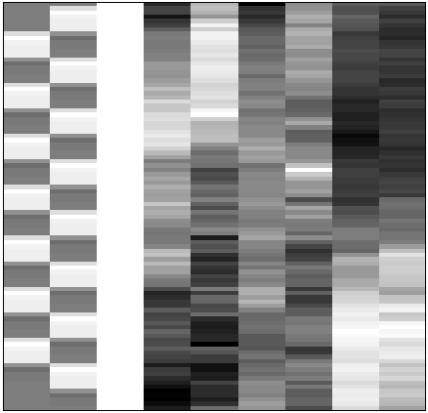
F-contrasts
Based on the model comparison approach: Full model explains significantly more variance in the data than the reduced model X₀ (H₀: True model is X₀).
F-statistic: extra-sum-of-squares principle:
X₀
X₁
X₀
SSE₀ - SSE
F =
SSE
SSE₀
SSE
Explained variability
F =
Error variance estimate or unexplained variability
Full model ?
or Reduced model?

Slide 27
Contrasts and Inference
Contrasts: what and why?
T-contrasts
F-contrasts
Example on SPM
Levels of inference

Slide 28
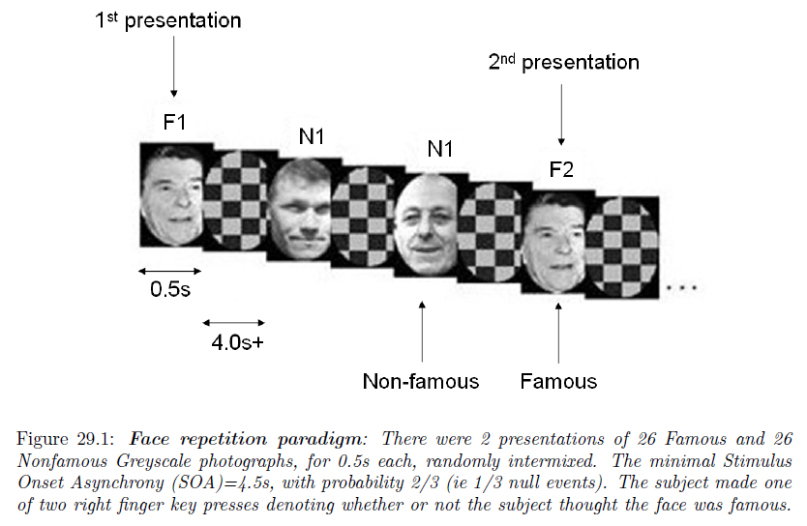
1st level model specification
Henson, R.N.A., Shallice, T., Gorno-Tempini, M.-L. and Dolan, R.J. (2002) Face repetition effects in implicit and explicit memory tests as measured by fMRI. Cerebral Cortex, 12, 178-186.

Slide 29
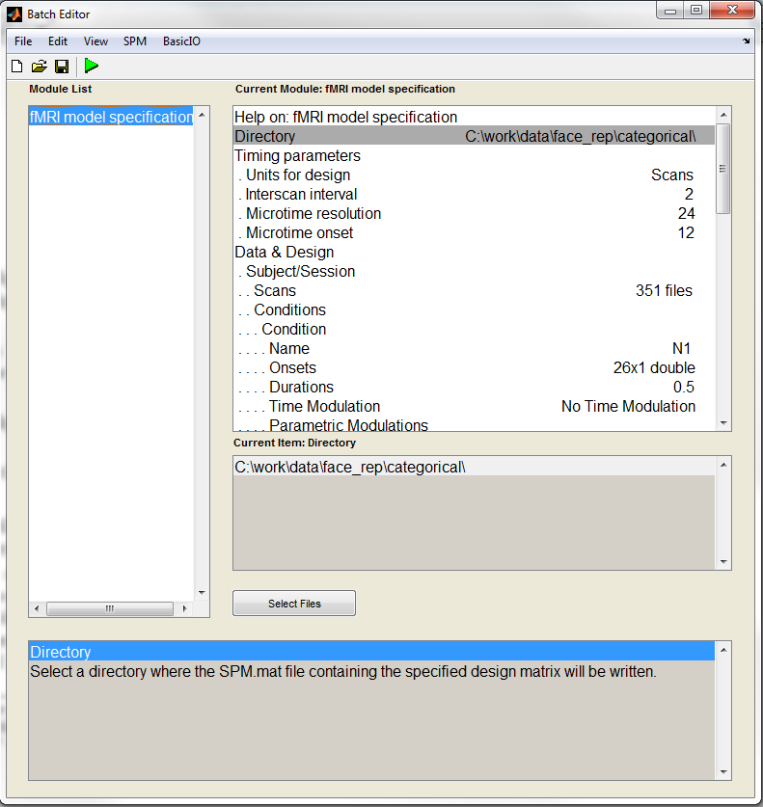
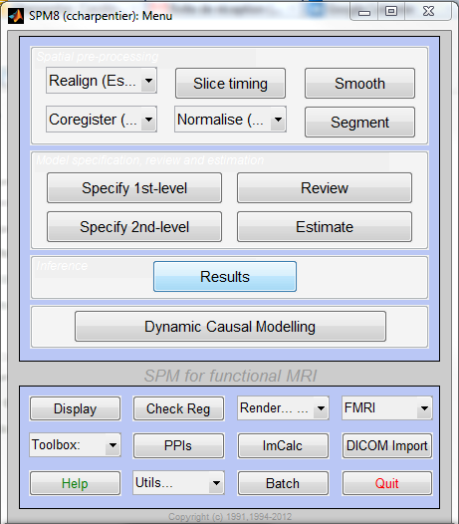
An Example on SPM

Slide 30
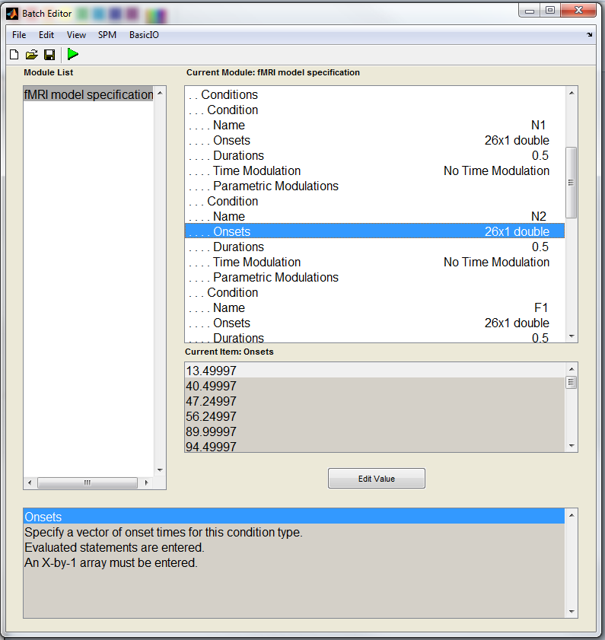
Specification of each condition to be modelled: N1, N2, F1, and F2
Name
Onsets
Duration

Slide 31
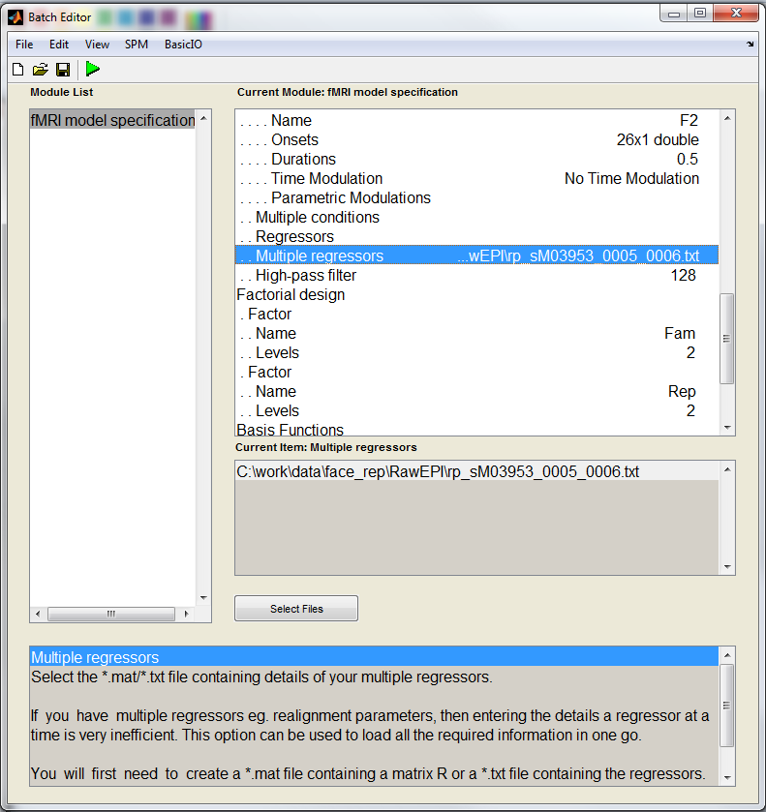
Add movement regressors in the model
Filter out low-frequency noise
Define 2*2 factorial design (for automatic contrasts definition)

Slide 32
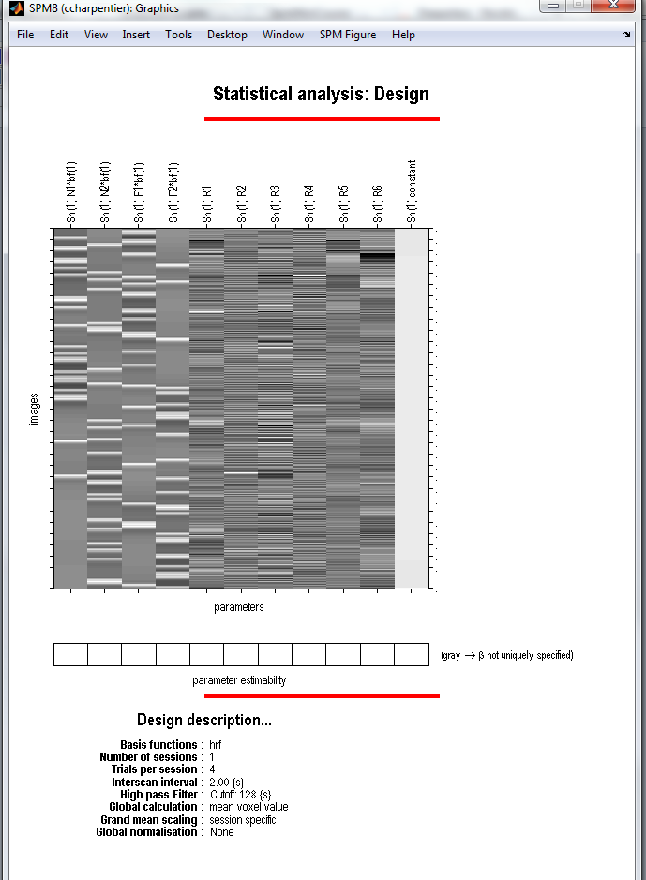
The Design Matrix
Regressors of interest:
β1 = N1 (non-famous faces, 1st presentation)
β2 = N2 (non-famous faces, 2nd presentation)
β3 = F1 (famous faces, 1st presentation)
β4 = F2 (famous faces, 2nd presentation)
Regressors of no interest:
Movement parameters (3 translations + 3 rotations)

Slide 33
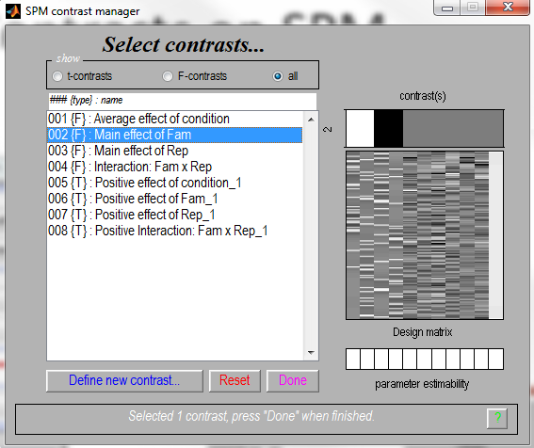
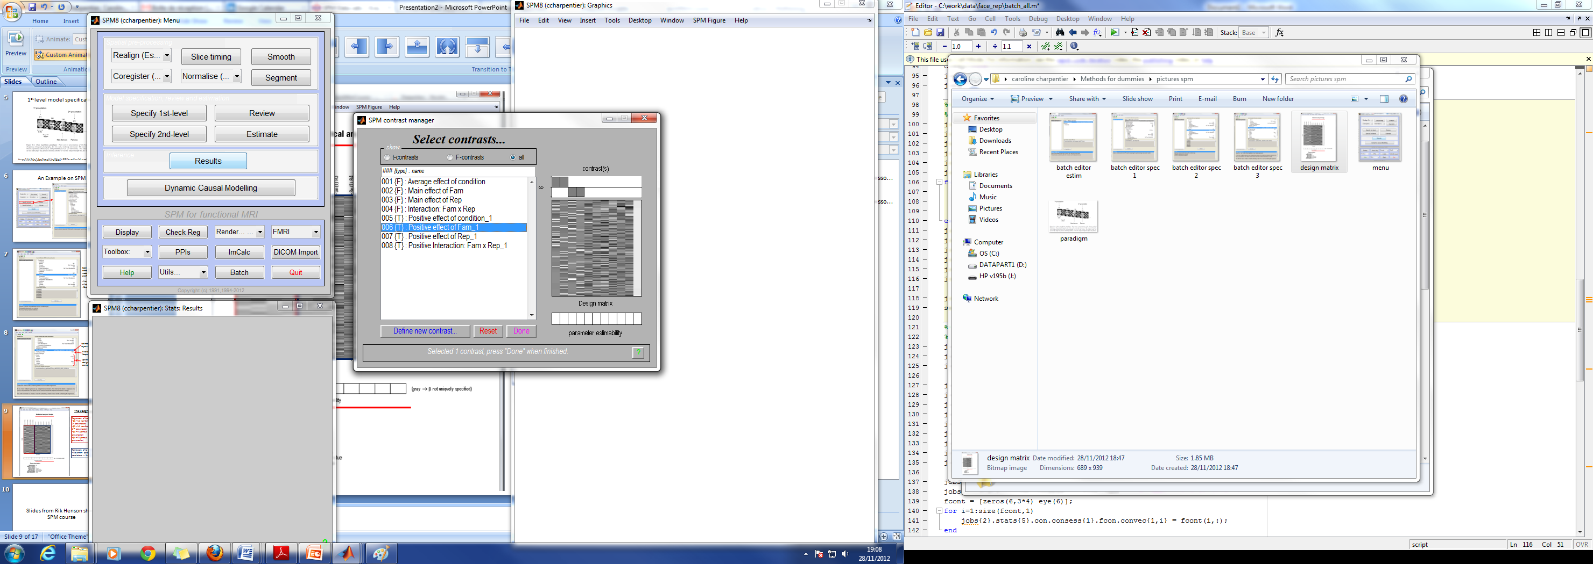
Contrasts on SPM
F-Test for main effect of fame: difference between famous and non –famous faces?
T-Test specifically for Non-famous > Famous faces (unidirectional)

Slide 34
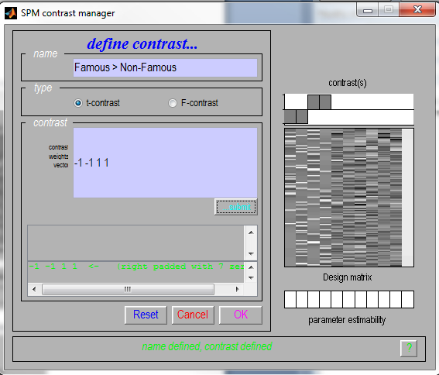
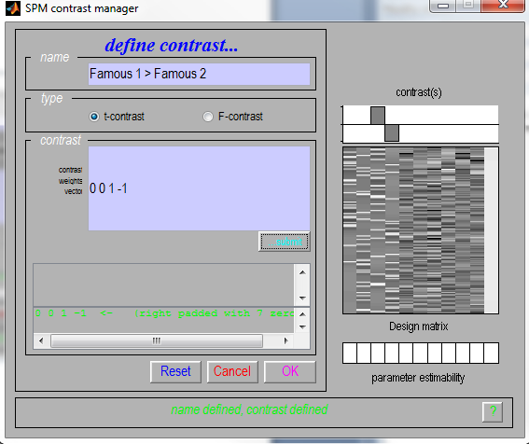
Contrasts on SPM
Possible to define additional contrasts manually:

Slide 35
Contrasts and Inference
Contrasts: what and why?
T-contrasts
F-contrasts
Example on SPM
Levels of inference

Slide 36
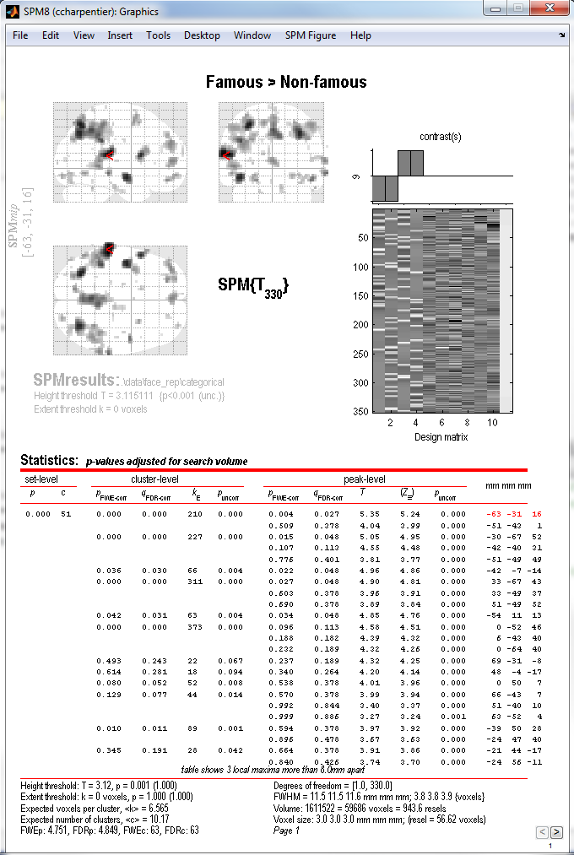
Inferences can be drawn at 3 levels:
Voxel-level inference = height, peak-voxel
Cluster-level inference = extent of the activation
Set-level inference = number of suprathreshold clusters
Notes:
For now we know how SPM computed the uncorrected p-value (directly from the F or T value), but how the correction for multiple comparison is performed will be the object of a later presentation.

Slide 37
Summary
We use contrasts to compare conditions
Important to think your design ahead because it will influence model specification and contrasts interpretation
T-contrasts are particular cases of F-contrasts
  One-dimensional F-Contrast → F=T²
F-Contrasts are more flexible (larger space of hypotheses), but are also less sensitive than T-Contrasts
T-Contrasts | F-Contrasts
One-dimensional (c = vector) | Multi-dimensional (c = matrix)
Directional (A > B) | Non-directional (A ≠ B)

Slide 38
Thank you!
Resources:
Slides from Methods for Dummies 2009, 2010, 2011
Human Brain Function; J Ashburner, K Friston, W Penny.
Rik Henson Short SPM Course slides
SPM 2012 Course slides on Inference
SPM Manual and Data Set
Special thanks to Guillaume Flandin

