Slide 1
Bayes for Beginners
Graziella Quattrocchi & Louise Marshall Methods for Dummies
2014

Slide 2
Question
A disease occurs in 0.5% of population.
A diagnostic test gives a positive result in:
99% of people with the disease
5% of people without the disease (false positive)
A random person off the street is found to have a positive test result.
What is the probability that this person has the disease?
A: 0-30%
B: 30-70%
C: 70-99%

Slide 3
How do we figure this out?
A disease occurs in 0.5% of population.
99% of people with the disease have a positive test result.
5% of people without the disease have a positive test result.
A = disease
B = positive test result
P(A) = 0.005 (probability of having disease)
P(~A) = 1 – 0.005 = 0.995 (probability of not having disease)
P(B) = P(B|A) * P(A) + P(B|~A) * P(~A)
= (0.99 * 0.005) + (0.05 * 0.995)
= 0.055
i.e. >5% of all tests are positive

Slide 4
Conditional Probabilities
P(B|A) = 0.99 probability of +ve result given disease
P(~B|A) = 1 – 0.99 = 0.01 probability of -ve result given disease
P(B|~A) = 0.05 probability of +ve result given no disease
P(~B|~A) = 1 – 0.05 = 0.95 probability of -ve result given no disease
We want:
P(A|B)
probability of disease given positive test result

Slide 5
Let’s take an example population
A = disease
B = positive test result
P(A) = 0.005
P(B) = 0.055
Population = 1000
positive test = 55
P(A,B)
disease = 5
P(A,B)
Joint Probability

Slide 6
We already know the test result was positive….
We have to take that into account!
Of all the people already in the purple circle, how many fall into the P(A,B) part?
P(A|B) = P(A,B)/P(B)
Population = 1000
positive test = 55
P(B)
P(A,B)
disease = 5
P(A)

Slide 7
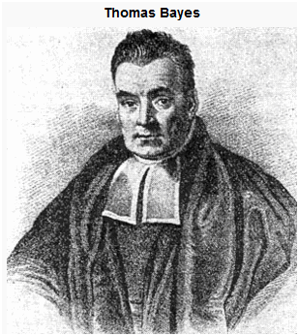
Bayes’ Theorem
P(A|B) = P(A,B)/P(B)
The same follows for the inverse:
P(B|A) = P(A,B)/P(A)
Therefore, the joint probability can be expressed as:
P(A,B) = P(A|B)*P(B)
P(A,B) = P(B|A)*P(A)
And with a bit of shuffling we get:
P(A|B) = P(B|A) * P(A)
P(B)

Slide 8
Using Bayes’ Theorem
P(A) = 0.005 A = disease
P(B|A) = 0.99 B = positive test
P(B) = 0.055
P(A|B) = P(B|A) * P(A)
P(B)
P(A|B) = 0.99 * 0.005
0.055
= 0.09
A positive test result only increases your probability of having the disease to 9%, simply because the disease is very rare (relative to the false positive rate).

Slide 9
Some terminology
posterior
likelihood
prior
P(A|B) = P(B|A) * P(A)
P(B)
marginal probability
P(A): before test result, we estimate a 0.5% chance of having the disease
P(B|A): probability of a positive test result given an underlying disease
P(B): probability of observing this outcome, taken over all possible values of A
(disease and no disease)
P(A|B): combines what you thought before obtaining the data, and the new
information the data provided

Slide 10
Applications: Finding missing planes

Slide 11
Applications: Finding missing planes

Slide 12
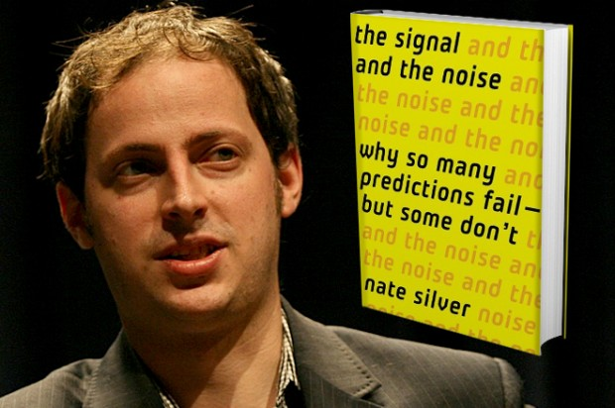
Applications: Predicting election results
Nate Silver
Forecast the performance & career development of Major League Baseball players
Correctly predicted the winner in 49/50 states during 2008 US presidential election

Slide 13
So, Bayes’ Rule allows us to…
Represent information probabilistically
Take uncertainty into account
Incorporate prior knowledge and update our beliefs
Invert the question (i.e. how good is our hypothesis given the data?)
Used in many aspects of science…

Slide 14
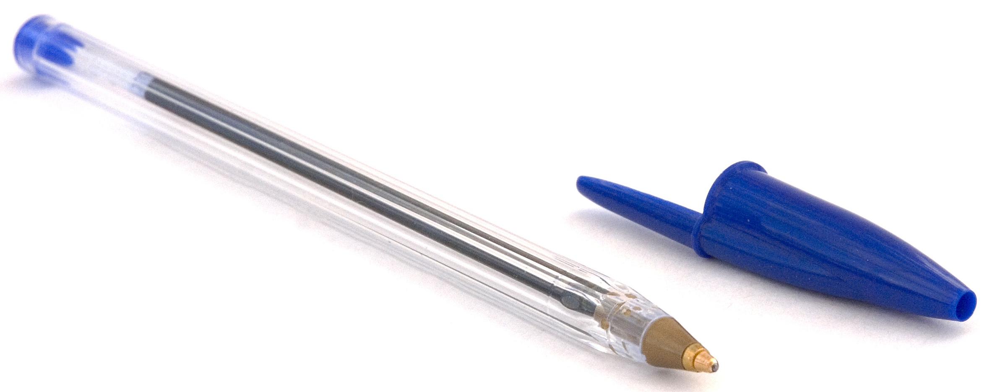
1. Bayesian systems represent information probabilistically
How wide is the pen?
The pen is 8 mm wide
There is a 95% chance that the pen is between 7.5 and 8.49 mm wide
Probability density function (PDF)
Represents both the average estimate of the quantity itself and the confidence in that estimate
Probability
precision
O’Reilly et al, EJN 2012(35), 1169-72

Slide 15
2. Bayesian systems integrate information using uncertainty
How wide is the pen?
Sensory dominance
Combined estimate between the monosensory estimates
Combined
Touch
Visual
The Bayesian systems integrate information using uncertainty
precision
P(width|touch, vision) P(touch, vision|width) * P(width)
O’Reilly et al, EJN 2012(35), 1169-72

Slide 16
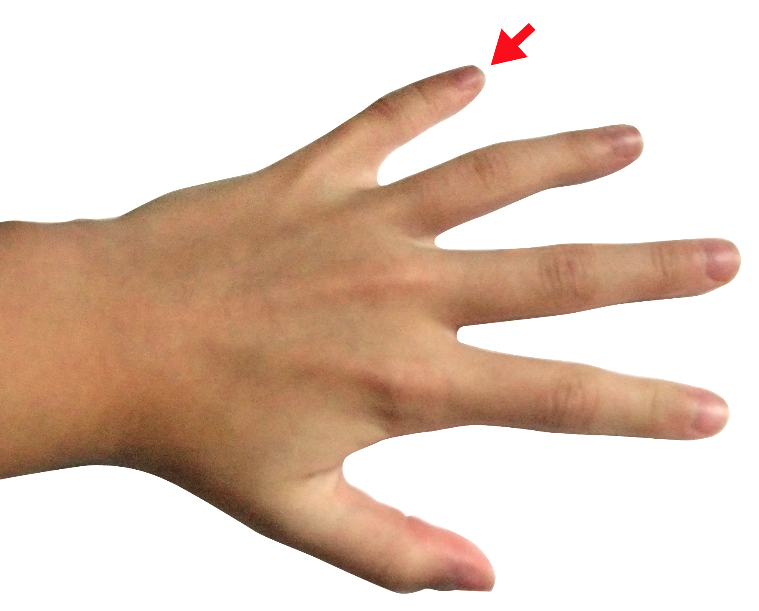
Multisensory integration in human performance
Humans do show near-Bayesian behaviour in multi-sensory integration tasks
Non-optimal bias to give more weight to one sensory modality than another
VISION
PROPRIOCEPTION
Van Beers et al, Exp Brain Res 1999;125:43-9

Slide 17
3. Bayesian system incorporates prior knowledge
P(width|touch, vision) P(touch, vision|width) * P(width)
The posterior estimate is biased towards the prior mean
Prior permits to increase accuracy, useful considering uncertainty of observations
Posterior
Observed
Prior
5 7
Width (mm)
O’Reilly et al, EJN 2012(35), 1169-72

Slide 18
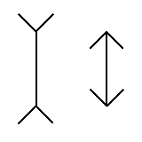
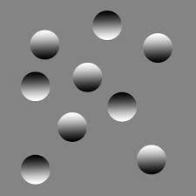
When stimuli are ambiguous, prior govern perception…
The Muller-Lyer Illusion
Priors could be acquired trough long experience with the environment
Some others priors seem to be innate
Notes:
The ideas behind Bayesian inference can be illustrated using the game of tennis. The best estimate of where the tennis ball will land can be gotten from combining about where they served before (the prior) with current information from the visual system (the likelihood). The prior is shown in blue, the likelihood distribution in red, and the posterior distribution with the white ellipse. The maximum posterior estimate is shown by the magenta ball. This estimate can be updated in light of new information from the balls trajectory

Slide 19
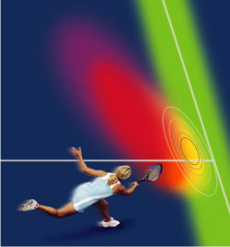
Bayesian system incorporates prior knowledge to update our beliefs
The posterior distribution as the new prior, which can be updated using new observation
Bayes’ rules allow to learn from observations one after the other and shows that the more data we have, the more precise our estimate on the parameters
Learning as a form of Bayesian reasoning
Körding & Wolpert (2004) Nature
Notes:
The ideas behind Bayesian inference can be illustrated using the game of tennis. The best estimate of where the tennis ball will land can be gotten from combining about where they served before (the prior) with current information from the visual system (the likelihood). The prior is shown in blue, the likelihood distribution in red, and the posterior distribution with the white ellipse. The maximum posterior estimate is shown by the magenta ball. This estimate can be updated in light of new information from the balls trajectory

Slide 20
Resources
Further Reading
Will Penny’s slides (on his website)
O’Reilly et al. (2012) How can a Bayesian approach inform neuroscience? EJN
LessWrong Blog Page on Bayes
History of Bayes Rule by Sharon McGrayne
Previous MfD slides

Slide 21
Thanks!
Thanks to Will Penny and previous MfD presentations, and…

