Slide 1
Methods for Dummies
Overview and Introduction
23rd October 2014
Svenja Espenhahn and Sofie Meyer

Slide 2
PROS CONS
Relaxed environment
Presentation skills
Networking/knowing who to ask
No assessment involved
Fun at the FIL
Know-how/practical guide
Presenting with partner
Learning
  Specific/deep understanding
  Overall view

Slide 3
Overview
    What is MfD?
    Programme
    How to prepare your presentation
    Where to find information and help
    Experts
    SPM

Slide 4
Welcome
Aim of MfD: to provide a basic introduction to human brain imaging analysis methods, focusing on fMRI and M/EEG
Wednesdays 13-14 in 4th floor seminar room
Each talk will be given by two presenters and last about 30 min + 15 minutes for questions. Generally it should introduce the relevant theory and be followed by a demo using SPM12 interface.

Slide 5
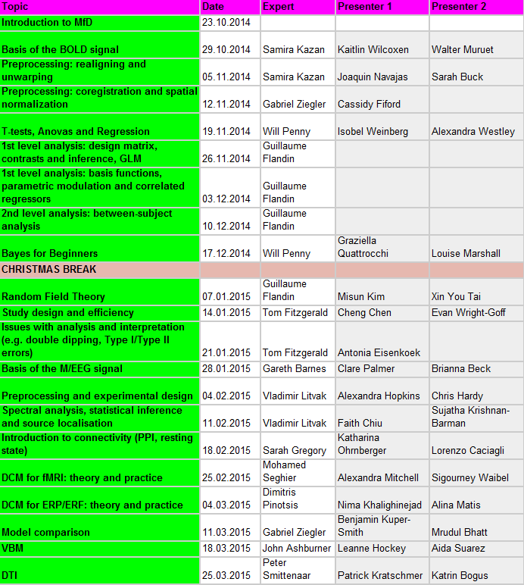

Slide 6
How to prepare
Read the Presenter’s Guide http://www.fil.ion.ucl.ac.uk/mfd/page1/guide2014.pdf
Remember your audience are not experts…
Don’t just copy last year’s slides
  Svenja.espenhahn.13@ucl.ac.uk
  Sofie.meyer.10@ucl.ac.uk

Slide 7
Where to find information
MfD homepage:
http://www.fil.ion.ucl.ac.uk/mfd/
Programme
Resources: Presenter’s guide, previous slides, links, SPM manual etc
Name of expert (email in UCL Outlook or from typing name + “FIL” or “UCL” into Google)

Slide 8
Where to find information
Go to the MfD homepage → Resources
Online
Key papers
Previous years’ slides
Human Brain Function Textbook (online)
SPM course slides
Cambridge CBU homepage (Rik Henson’s slides)
Local
Methods Group Experts
Monday Methods Meetings (4th floor FIL, 12.30)
SPM email list

Slide 9
Where to find help:
Experts
Samira Kazan
Gabriel Ziegler
Will Penny
John Ashburner
Gareth Barnes
Mohamed Seghier
Tom FitzGerald
Guillaume Flandin
Sarah Gregory
Vladimir Litvak
Bernadette van Wijk
Dimitris Pinotsis
Peter Smittenaar
Email the expert: discuss presentation and other issues (1 week before talk)
Expert will be present in the session

Slide 10
Overview
    What is MfD?
    Programme
    How to prepare your presentation
    Where to find information and help
    Experts
    SPM

Slide 11
Overview
    What is MfD?
    Programme
    How to prepare your presentation
    Where to find information and help
    Experts
    SPM

Slide 12
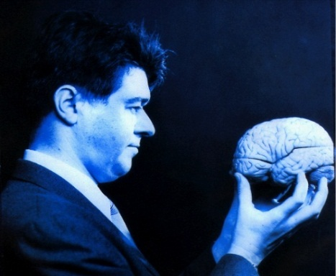
SPM
Statistical Parametric Mapping
Invented at the FIL
A software package designed for the analysis of brain imaging data in fMRI, PET, SPECT, EEG & MEG

Slide 13
SPM
Statistical Parametric Mapping
Invented at the FIL
A software package designed for the analysis of brain imaging data in fMRI, PET, SPECT, EEG & MEG
It runs in Matlab… just type SPM at the prompt and all will be revealed

Slide 14
SPM
Statistical Parametric Mapping
Invented at the FIL
A software package designed for the analysis of brain imaging data in fMRI, PET, SPECT, EEG & MEG
It runs in Matlab: just type SPM at the prompt and all will be revealed
The SPM website has a manual and datasets available for playing around with

Slide 15
What does SPM and MfD do?
Using neuroimaging, the idea behind SPM is to identify and make inferences about regionally specific brain activity. This gives way for analysing the integration and interactions among the engaged and identified regions.
MfD helps to provide the background to understand the principles of experimental design and data analysis implemented in SPM

Slide 16
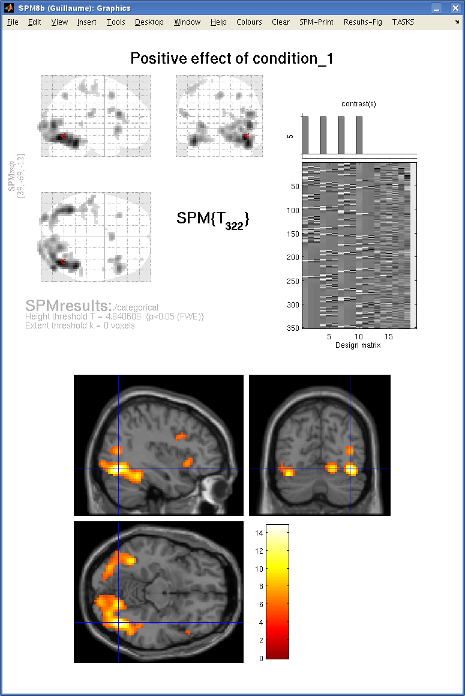
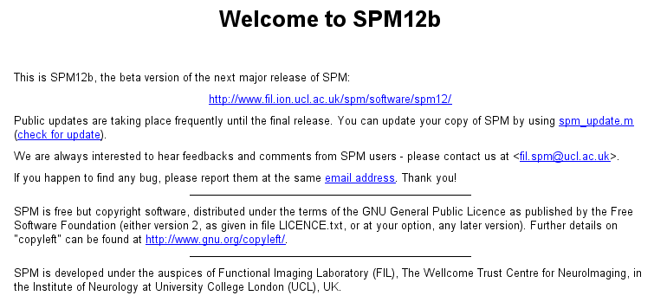

Slide 17
What does SPM do?
Allows you to do:
  preprocessing
  data analysis:
  connectivity
  general linear model
  parameter estimation
  dynamic causal modeling

Slide 18
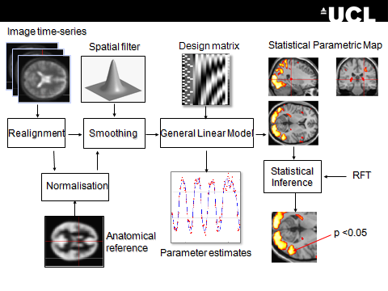
SPM overview
Notes:
GLM describes the data at each voxel: mass univariate approach
Takes into account Experimental and confounding effects…
and residual variability
GLM used in combination with a temporal convolution model
Once you have carried out your pre-processing you can specify your design and data
The design matrix is simply a mathematical description of your experiment
E.g. ‘visual stimulus on = 1’ ‘visual stimulus off = 0’

Slide 19
  Preprocessing is the preparation of your imaging data to start your analysis
  Do motion correction (realignment of the data), normalise so that it’s all in the same space, smooth the data so that you can compare between subjects.

Slide 20
Once you have carried out your pre-processing you can specify your design and data
The design matrix is simply a mathematical description of your experiment
E.g. ‘visual stimulus on = 1’ ‘visual stimulus off = 0’

Slide 21
  GLM describes the data at each voxel: mass univariate approach
  It takes into account experimental and confounding effects and residual variability

Slide 22
  Then you estimate how much your parameters of interest explain the BOLD response for each voxel, and threshold the resulting estimates to find out where your parameters explain significant amounts of variance.

Slide 23
Overview
    What is MfD?
    Programme
    How to prepare your presentation
    Where to find information and help
    Experts
    SPM

Slide 25
Mass-univariate analysis: voxel-wise GLM
X
y
+
=
Model is specified by
Design matrix X
Assumptions about e
N: number of scans
p: number of regressors
The design matrix embodies all available knowledge about experimentally controlled factors and potential confounds.

