Slide 1
T-tests, ANOVAs and Regression
Methods for Dummies
Isobel Weinberg & Alexandra Westley

Slide 2
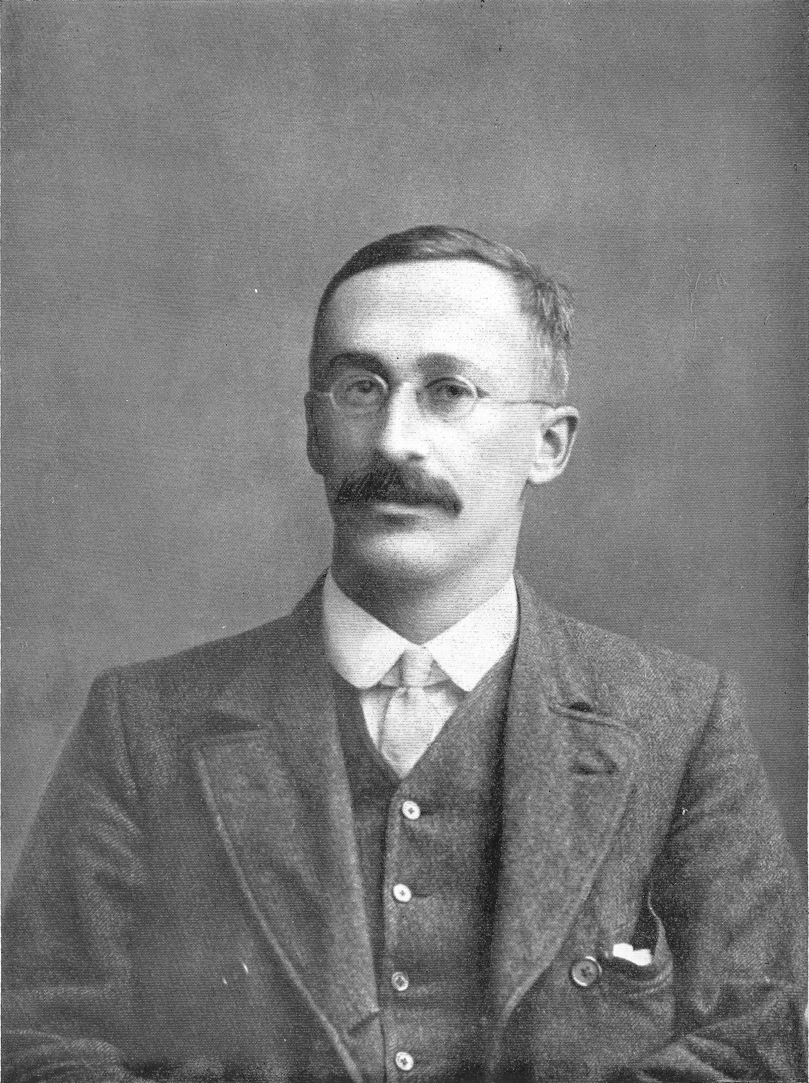
Student’s t-test
Are these two data sets significantly different from one another?
William Sealy Gossett
Notes:
Invented by William Sealy Gossett in 1908, working for Guinness – used to monitor the quality of Guinness
Chemists could not publish their findings, but they were allowed study leave – Gossett published under the pseudonym Student
Used to tell if two data sets are signigicantly different from one another

Slide 3
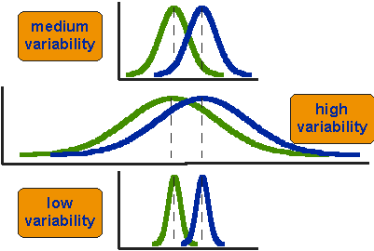
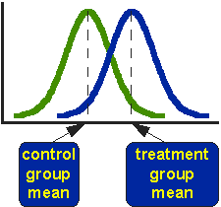
Are these two distributions different?
Diagrams from http://www.socialresearchmethods.net/kb/stat_t.php
Notes:
Two groups – are they different to one another – need to look at the means
But, the second diagram shows three situations where all have the same difference between their means – clearly, the distributions are very similar for the high variability curve and very different where variability is low. So variability also matters.

Slide 4
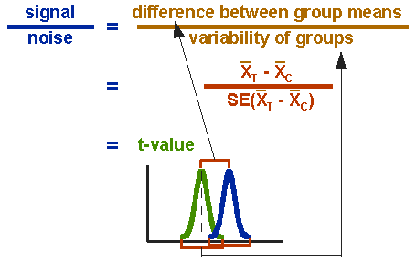
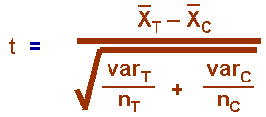
Diagrams from http://www.socialresearchmethods.net/kb/stat_t.php
Notes:
Numerator: difference between the means
Denominator: “standard error of the difference”
Computed by the variance of each group, divided by n. Add them together and take the square root.
Show final equation for the t statistic
Equivalent to “effect:error” or “signal:noise”

Slide 5
Using the t-test
Calculate the t-statistic
Compare to known distributions (with degrees of freedom) to get significance level
Compare to chosen significance level to accept/reject the null hypothesis

Slide 6
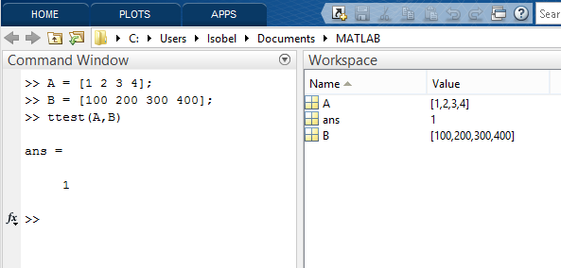
In MATLAB:
H = ttest(X,Y)
Returns H = 0 for null hypothesis or H = 1 for alternative hypothesis

Slide 7
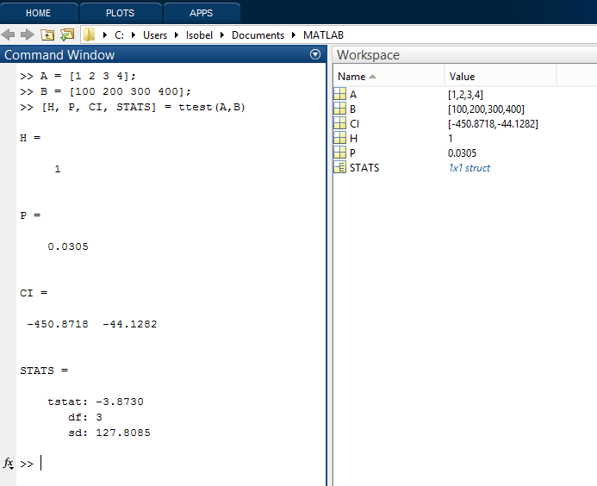
[H,P,CI,STATS] = ttest(X,Y)
Notes:
What is it the CI of?

Slide 8
One-tailed vs two-tailed
Diagram from http://en.wiki.backyardbrains.com/Analysis_with_Statistics
Notes:
One-tailed – you know which way you expect the effect to go
Two-tailed – you don’t know which way you expect the effect to go – looking for any difference
E.g. two-tailed – coffee alters formation of new memories
E.g. one-tailed – coffee improves memory
How does one-tailed change significance level?

Slide 9
Paired vs unpaired
a.k.a. Dependent vs Independent
If data in the two groups are paired (same participants; twins) etc -> paired/dependent t-test
Otherwise -> independent t-test

Slide 10
Quiz
An experiment measures people's lung capacity before and then after an exercise programme to see if their fitness has improved.
Paired or unpaired t-test?
One or two tails?
A different experiment measures the lung capacity of one group who took one exercise programme and another group who took a different exercise programme to see if there was a difference.
Dependent or independent t-test?
One or two tails?
Notes:
Paired; 1-tailed
Independent; 2-tailed

Slide 11
In MATLAB:
One-tailed vs two-tailed:
ttest(A, B, ‘tail’, ‘value’)
‘value’ = ‘left’, ‘right’, or ‘both’
Paired vs unpaired:
ttest(A,B) ~ paired
ttest2(A,B) ~ unpaired

Slide 12
Assumptions
Normally distributed
Test for normality using Shapiro-Wilk or Kolmogorov-Smirnov
Same variance (independent t-test)
If different: use Welch’s t-test
Sampling should be independent (independent t-test)
Notes:
Both of the two populations should be normally distributed
The two populations should have the same variance in the independent t-test

Slide 13
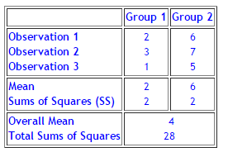
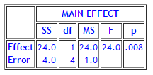
ANalysis of VAriance (ANOVA)
Example from http://www.statsoft.com/textbook/anova-manova
SS Error = Within-group variability = 2 + 2 = 4
SS Effect = Between-group variability = 28 – 4 = 24
Notes:
If you have three treatments you want to compare; then you would need 3 t-tests.
This is flawed because of p=0.05
ANOVA allows us to do one test to look for differences between the means
Example:
Two groups with 3 data points each in them
Can calculate the means
Can calculate the sum of the squared deviations from the mean
BUT can also calculate an overall mean
Then calculate a new sum of squares form overall mean
Calculating an ANOVA partitions the total sum of squares according to the within-group variability and the variability due to differences in means
Within group variability = 2+2 = 4
Between group variability = 28 – 4 = 24
With this example, we could just have used an unpaired t-test
It would give the same result
But if you have more than 2 samples; need an ANOVA [1st key advantage of an ANOVA]

Slide 14
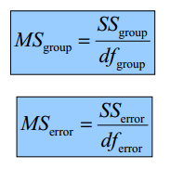
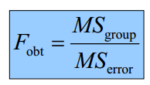
ANalysis of VAriance (ANOVA)
Example from http://www.statsoft.com/textbook/anova-manova
Notes:
Mean squares: average error ~ scale to number of observations
F statistic: effect:error; signal:noise

Slide 15
One-way ANOVA vs Two-way ANOVA
Weight loss effect of 5 different types of exercise
Recruit 20 men and assign each to an exercise i.e. 4 per group
This needs a one-way ANOVA – one independent variable with >2 conditions
Weight loss effect of 5 different types of exercise, with and without calorie-controlled diet
Recruit 40 men and assign each to an exercise
Half the men follow a calorie-controlled diet; half don’t – 4 per group
This needs a two-way ANOVA – two independent variables
Can also have three-way ANOVA, etc.
Notes:
A two-way ANOVA allows you to look at **interaction** (the second key advantage of an ANOVA)

Slide 16
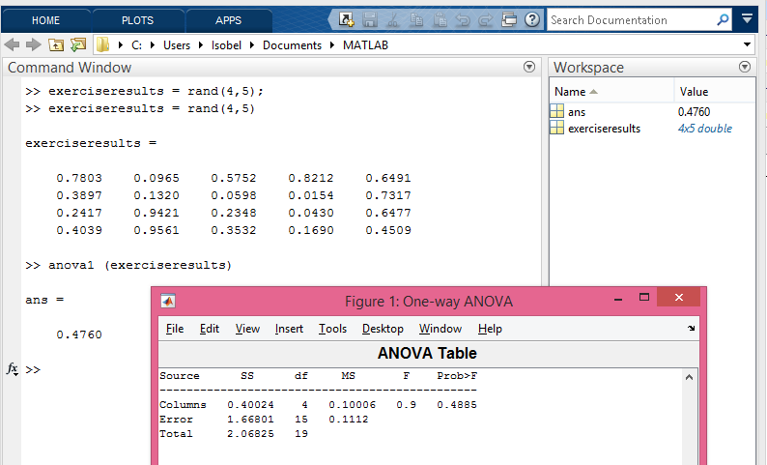
One-way ANOVA in MATLAB:
Notes:
Anova1 for a one-way anova
Columns represent different independent variable
Rows are observations

Slide 17
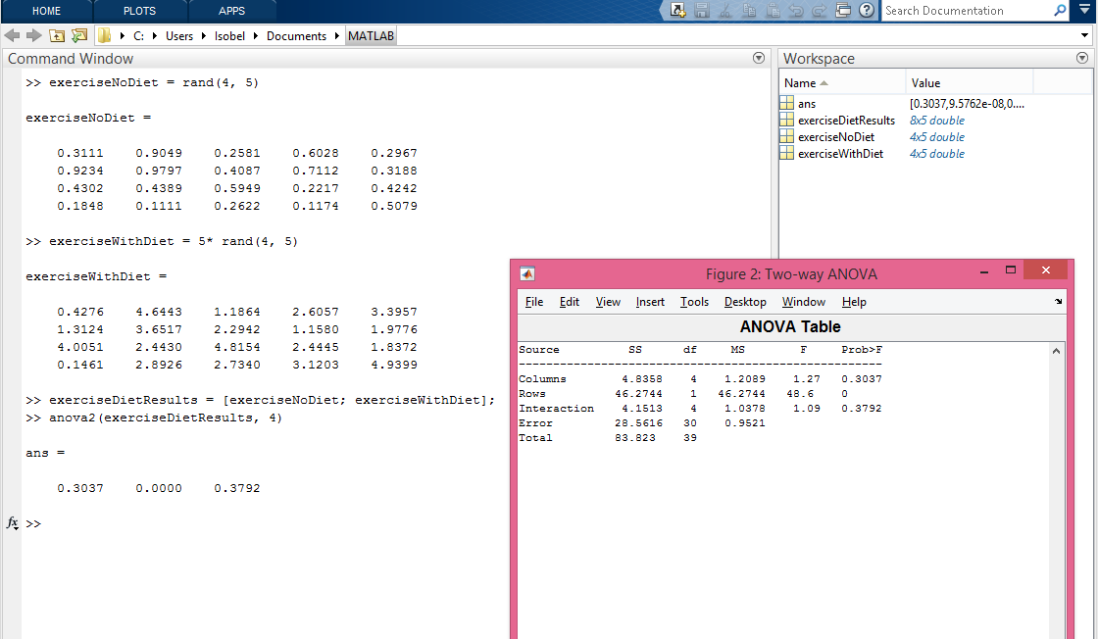
Two-way ANOVA in MATLAB:
Notes:
Anova2 for a two-way ANOVA
Need to stick the two-tables on to each other and tell MATLAB how many observations
Rows are significant, but no interaction

Slide 18
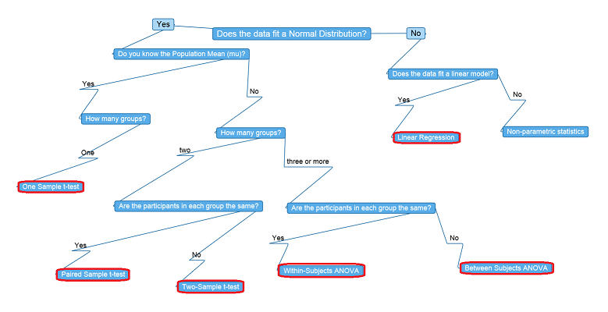
Notes:
Diagram from last year

Slide 19
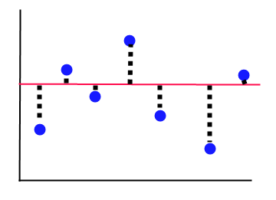
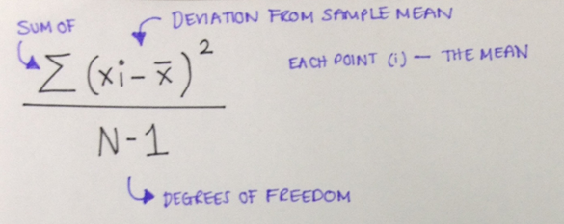
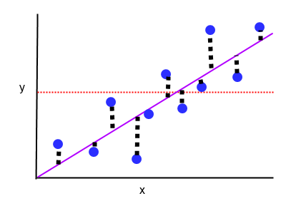
Correlations
Variance
The amount a single variable deviated from it’s mean.
Covariance
Are changes in one variable associated with changes in another?
When 1 variable deviates from it’s mean, does another variable deviate from it’s mean in a similar way?
For suspected linear relationships.
Notes:
Degrees of freedom are the number of values in the final calculation that are free to vary, without changing the overall outcome. Because we are using the mean, the calculation is defined by N number of random values, and the mean.

Slide 20
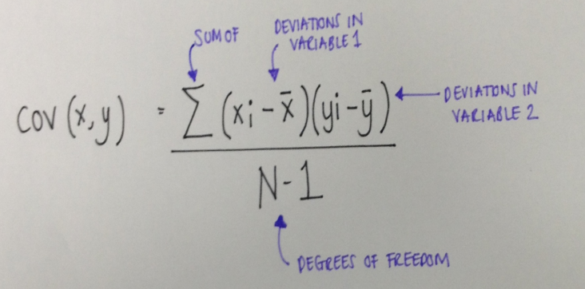
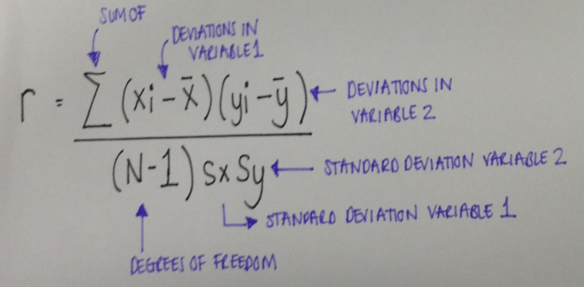
Covariance
Multiply the deviations in one variable by the deviations in the other
This is dependent on the unit/measurement scale
Therefore we need to standardise it.
Notes:
This is the pearson’s r correlation coefficient. When you do stats using this, you are testing the null hypothesis that this correlation coefficient is 0 → meaning, there is no relationship between the two variables, so when one deviates from it’s mean, the other does not deviate in a similar way.
When we compare variance, the variance between individual points and the model is sometimes positive, and sometimes negative. Therefore, we square the variances before we start to work with them.

Slide 21
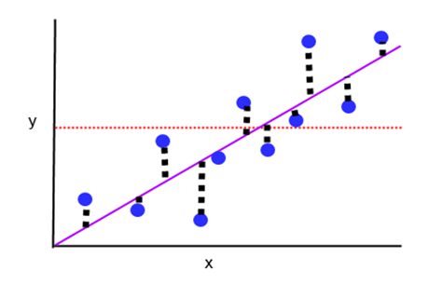
Regression
Prediction
Simple regression predicts an outcome variable using a single predictor variable (i.e. predict weight using height)
Multiple regression predicts an outcome variable using multiple predictor variables (i.e. predict weight using height, gender, and waist measurements)
Notes:
If I know a value from x, I can use this to predict what the value from Y will be, using the regression model

Slide 22
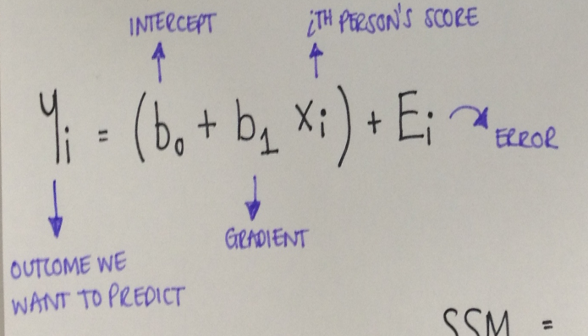
Regression Model
The regression model is linear
The line is defined by two factors:
The gradient
The intercept
These fit into this equation, from which values can be predicted:
Notes:
The gradient is the slope of the line
The intercept is the point at which the line crosses the vertical (y) axis

Slide 23
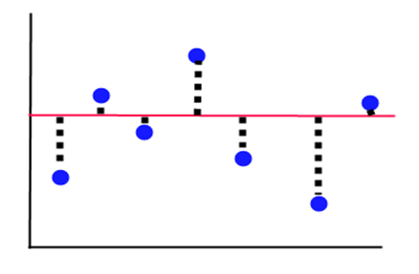
Assessing the fit of the model
Method of least squares
Compare the reductions in the variance between the simplest model, and our new regression model
SST SSR
Notes:
The mean is the simplest model, it is a flat line. Variance in one variable is not associated with variance in the other.
We fit a regression model, with a sloped line. We then calculate the variance between our points and the mean, and the variance between our points and the new line, and hope that the latter is smaller.
We already know that we need to square variances, so this is the method of least squares – which model gives us the smallest number for the squared deviances?
When we compare variance, the variance between individual points and the model is sometimes positive, and sometimes negative. Therefore, we square the variances before we start to work with them.

Slide 24
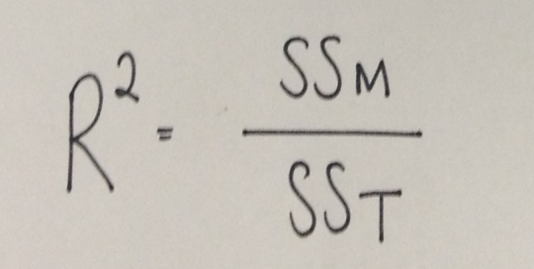
Method of Least Squares
SST SSR
Notes:
SST is TOTAL variance, variance from the mean
SSR is RESIDUAL variance, variance from the new fitted model
SSM is MODEL variance, the amount of variance the new model accounts for, more than the mean.
This is dependent on the units used, so we turn it into a percentage so that we can compare across different things (like age, weight, height).
This is Rsquared
Obviously the Square Root of Rsquared is Pearson’s R!

Slide 25
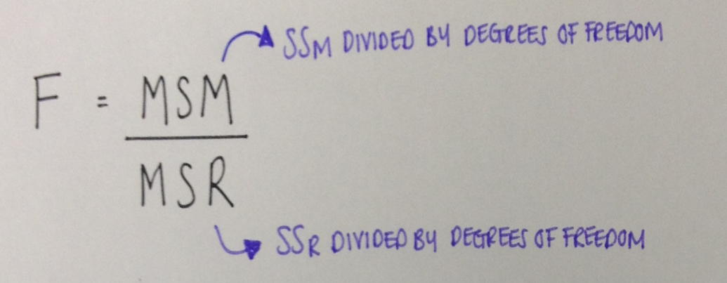
Assessing the fit of the model
F-Test
T-Statistic
Notes:
The F test tests: how much systematic variance there is in the model, compared to unsystematic variance. In other words, how much has the model improved the prediction of the outcome, compared to how much inaccuracy the model contains. Is it better to use the model, or does it actually not represent the true relationship at all?
The difference between the Mean Square of variance from the model, and the Mean Square of variance from what’s left over after the model is fitted.
A bad model would have a regression co-efficient of 0 → it doesn’t predict the outcome at all. A change in the predictor variable leads to no change in the outcome variable.
We know a t-test examines the null hypothesis, this is the hypothesis that there is NO relationship between the two variables in the model → in equation terms, this is the hypothesis that the regression coefficient is 0.

Slide 26
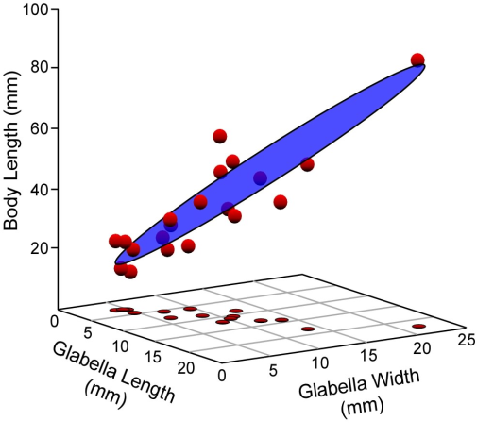
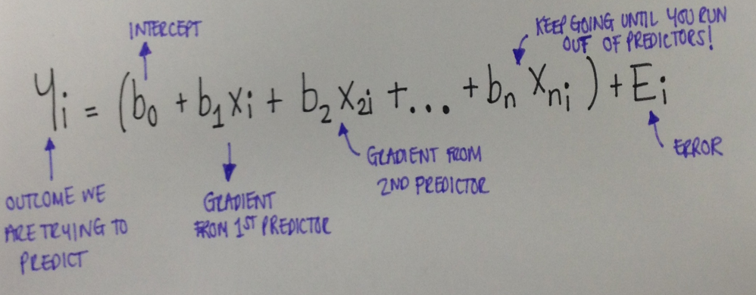
Multiple Regression
Multiple regression follows the same principle, and simply adds in more predictors
Notes:
Multiple regression doesn’t simply build a 2D line, it builds a plane with multiple dimensions.

Slide 27
Assumptions for Multiple Regression
Variable types
Predictors quantitative/categorical
Outcome quantitative/continuous
Non-zero Variance
Predictors cannot have a variance of 0
No perfect multicollinearity
Predictor variables should not correlate too highly
Predictors uncorrelated with external variables
If there are external variables correlating with our model and not included, our analysis becomes unreliable
Homoscedasticity
Residuals at each level of the predictors should be equal → similar variance across all levels of any one predictor
Independent errors
Normally distributed errors
Independence
Linearity

