Slide 1
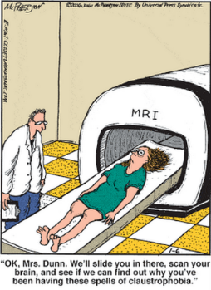
Basis of the BOLD signal
Victoria fleming
Mohammed Kamel

Slide 2
MRI
Underpinned by nuclear magnetic resonance (NMR)
fMRI looks at MRI signal changes associated with functional brain activity.
The most widely used method is BOLD:
blood oxygen level dependent
Notes:
Underpinned by magnetic resonance imaging (MRI).
Based on magnetic properties of hydrogen atoms
fMRI assesses brain function by looking at MRI signal changes associated with functional brain activity.
The most widely used method is BOLD (blood oxygen level dependent)
Based on hemodynamic and metabolic sequalae of neuronal responses.

Slide 3

The MRI Scanner
MRI → hydrogen nuclei respond to magnetic fields
Giant electromagnet
  Earth’s magnetic field: 0.00003 Tesla Clinical MRI: 1.5 - 3 Tesla
Notes:
To recap:
MRI based on how hydrogen nuclei respond to magnetic fields
fMRI is a specialised MRI technique which tracks oxygen to image blood flow
MRI produces a magnetic field much stronger than Earth’s magnetic field
An MRI scanner is a giant magnet which produces a magnetic field much stronger than Earth’s magnetic field.
The scanner is in a specially shielded room which blocks out RF energy, e.g. from radio stations, which would otherwise drown out the energy emitted by the protons you want to capture.

Slide 4
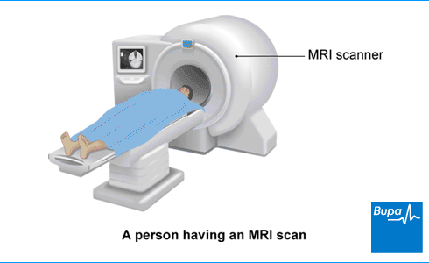
Z B₀ longitudinal axis
X
Y
Notes:
Planes.

Slide 5
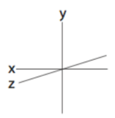
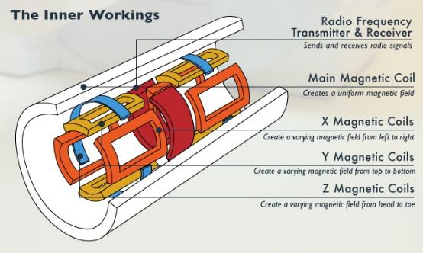
The MRI Scanner
Notes:
The scanner is made up of 4 key components.
The main magnetic coil is a superconducting electromagnet. It creates a uniform and constant magnetic field.
The field it creates is known as B0, and aligns longitudinally on the z axis of the scanner.
The RF transmitter transmits pulses of radio frequency energy, at the same frequency as spinning hydrogen ions. The resultant absorption and then release of this energy is picked up by the RF reciever and forms the basis of images.
It is in the x-y transverse plane.
RF coils have overlapping fields to give good coverage of the whole head.
There are three further magnetic coils, which create varying magnetic fields on different planes.
These are used to modify the strenght of the main magnetic field over the x, y and z dimensions.
Modifying these sets of coils rapidly over time means you can target slices of the brain sequentially, and find the source of the signal from the brain.
One more element are the shimming coils. They correct for inhomogeneities in the main magnetic fiels, e.g. patients head, and produce additional fields to compensate for this.

Slide 6
Physics of Magnetic Resonance Imaging (MRI)
Physics
  Hydrogen Ions
  Nuclear spin: precession
  Lamour Equation
  Radio frequency pulse
  T1 recovery, T2 decay
Notes:
In this part of the presentation I’ll be talking about:

Slide 7
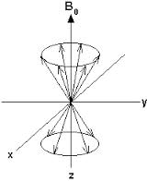
Hydrogen Ions
Human tissue contains many hydrogen ions.
  Fat
  Water:
  A trillion, trillion, trillion water molecules in the human body.
Hydrogen atoms are tiny magnets
Notes:
MRI is based on the properties of hydrogen ions. These are found in abundance in the body, for example in water and fat.
Atoms consist of protons, neutrons and electrons.
If there is an uneven number of protons or neutrons or both in an atom, the nuclei possesses nuclear spin. This is it’s natural state, and can be thought of as a tiny magnetic field.
Nuclei that possess a nuclear spin can be pictured as small rotation magnets, which spin around their own axis.
The spin is referenced against axis points, where B0 is the magnetic field (for example the giant magnetic field in the scanner), and Y and X are the transverse planes.
The important thing to remember is that in their natural state, the hydrogen protons spin either in parallel or antiparallel alignment with the Z axis.
So… MRI can essentially be thought of as hydrogen imaging.

Slide 8
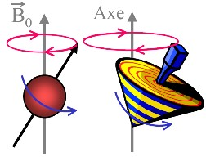
Nuclear spin: precession
In nuclear spin, the proton spins around the long axis of the primary magnetic field.
The proton gyrates as it spins into alignment.
= precession
Notes:
In addition to spin, the proton also takes another important motion. This is called gyration, and it descrbes how the proton wobbles as it spins around the axis.
Never truly aligned – like spinning top.
This examples shows one proton spinning around its axis.

Slide 9
Lamour Equation
Precession is calculated by the Lamour equation:
  ω₀ = γ Β₀
  ω₀ resonant frequency
  γ gyromagnetic ratio
  Β₀ magnetic field strength
Lamour Frequency is the specific precessional frequency of protons in the MRI scanner.
Notes:
The process of precession is defined by the Lamour Frequency equation, which is a very important concept in MR imaging.
This describes the rate at which spins wobble when placed in a magnetic field.
The Larmor requency is directly proportional to the strength (B0) of the magnetic field.
The precessional frequency ω0= B0 x λ
Where B0 is the magnetic field strength
And λ is the gyro magnetic ratio

Slide 10
Nuclear spin: precession
Notes:
Hydrogen ions in the body are constantly precessing, or spinning, in a haphazard way in different directions.
So as we are all sitting here, the hydrogen ions in our bodies and in our water bottles, are spinning all over the place.
Because of these different directions, there is no net magnetic field, as these all cancel themselves out.

Slide 11
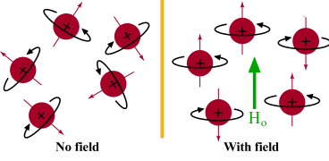
Nuclear spin: precession
Normally:
Magnetic fields are randomly aligned
In magnetic field of MRI:
Spinning nuclei align to B₀ field
Notes:
So, what happens to hydrogen ions in the MRI scanner?
As we saw before, the hydrogen ions are randomly aligned normally in earths magnetic field.
Net magnetisation is therefore 0.
Inside the scanner, the magnetic field is very strong.
The spinning atoms align to the strong magnetic field, either into parallel and antiparallel directions with the Z axis..
Remember, they are like little magnets, or like the points of a compass needle.
However, because the up spin direction is energetically more favourable, more protons align in the parallel direction with the B0 axis.
This leads to a net magnetization value, due to the difference in their spin up and spin down states.
The energy difference between the two spin states, Is proportional to the strength of B0.
With a stronger magnetic field, more spins will be in the parallel state, leading to a stronger net magnetisation. This means a stronger signal.
This is why the MRI scanner has a very strong magnetic.
To recap: the magnetic field is used to align the tiny hydrogen atoms so they are in the same direction, and they align to the longitudianal axis of the scanner. The net difference in magnetisation between the two up/down alignments is what creates the MR signal.

Slide 12
https://www.youtube.com/watch?v=0YBUSOrH0lw

Slide 13
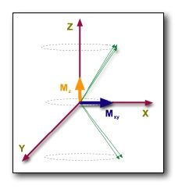
Nuclear spin: radio frequency pulse
Radio frequency pulse emitted
Protons absorb RF energy, and the spin system is excited.
Results in X2 effects:
  Reduction in X axis net magnetisation
  Increase in transverse (xy) magnetisation (due to phase coherence)
RF pulse ceases, protons return to their low energy state.
Phase coherence.
Notes:
Energy can be introduced into this stable spin system by applying an electromagnetic wave of the same frequency as the Larmor frequency (I.E. precession frequency).
This is called the resonant frequency. This is an important concept – in order for the hyrogen atoms to absorb the radiofrequency energy, it must match its own resonant frequency, so the RF energy needs to match the strength of the scanner’s magnetic field.
In the scanner, the electromagneitc wave is delivered from a radio transmitter in pulses.
The energy excites the spin system.
The effects are twofold:
1
Reduction of the NMV in Z axis, because some protons flip into the antiparallel state.
2
Phase coherence, where all of the spinning protons align with each other into the same phase.
We are most interested in this second process:
All of the longitudinal magnetization is rotated into the transverse plane (x, y). How far the NMV tips away from the Z axis is called the flip angle, and is proportional to the strength of the RF pulse transmitted.
The flip angle is usually 90 degrees, and is perpendicular to the z axis.
The outcome of phase coherence is the establishment of a magnetic sum vector in the X-Y plane, called the Transverse Magnetization.

Slide 14
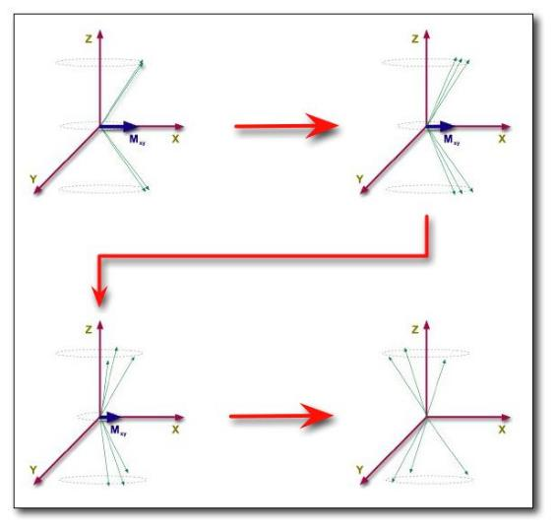
Nuclear spin: radio frequency pulse
  Precession back towards B0 longitudinal field (T1 recovery)
  De-phasing of spins
  (T2 decay)
Notes:
When the RF pulse ceases, we can look to what happens along both the Z and XY planes.
Along the Z axis, there is longitudinal relaxation, also known as spin recovery. The protons emit the RF energy they have absorbed, returning to their natural lower energy state.
This diagram represents what happens to phase coherenece:
Along the transverse plane, transverse relaxation occurs, also known as phase decay. Previously, the protons were precessing in phase with each other. Now, they gradually lose their coherence, and the XY magnetisation returns to 0.
Each individual spin is a little ‘magnet’ that creates its own magnetic field.
Each spin therefore experiences a specific field due to the influence of its neighbors: spin-spin interactions
Since spins precess at a frequency given by the local value of the magnetic field, they gradually get out of phase: the detected MR signal is reduced with time due to T2 relaxation

Slide 15
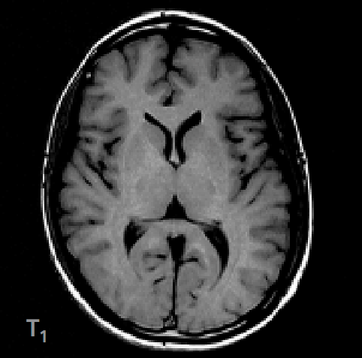
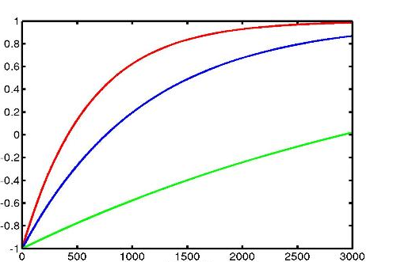
T1 recovery, T2 decay
Different tissue types have different T1 and T2 characteristics.
This creates contrast in imaging.
WM
GM
CSF
Notes:
These forms of relaxation are also known as T1 and T2 characteristics.
These are important in MRI, because they are crucial for producing contrast in imaging.
Different tissue types have different T1 and T2 characteristics, because the rate at which the protons release their absorbed energy depends on the tissues composition.
This means that you can create high contrast images of brain strucutres.
Here you can see the T1 recovery curve for different tissue types.
white matter indeed gives us the highest signal, which is shown bright in the image,
and CSF a low signal, shown dark in the image.

Slide 16
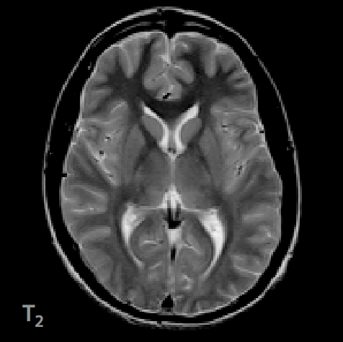
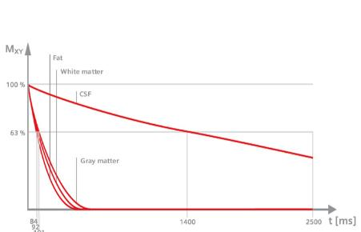
T1 recovery, T2 decay
Different tissue types have different T1 and T2 characteristics.
This creates contrast in imaging.
Notes:
For fMRI, we are most interested in T2 relaxation, of loss of phase coherence.
Here you can see the T2 recovery curve of different tissue types and the resulting T2 image
because spins dephase slower in CSF, CSF has a higher and brighter value
Gray and white matter have a much lower value.
De-phasing is affected by:
External magnetic effects (I.E. scanner)
Spin Echo imaging corrects for this
Internal magnetic effects
(I.E. interactions with neighbouring molecules)
T2 = the true ‘natural’ decay time of the tissues
T2* = predicted decay based on natural atomic and molecular mechanisms (an ‘observed’ T2).
Is faster than T2 decay due to natural inhomogeneities in the main magnet

Slide 17
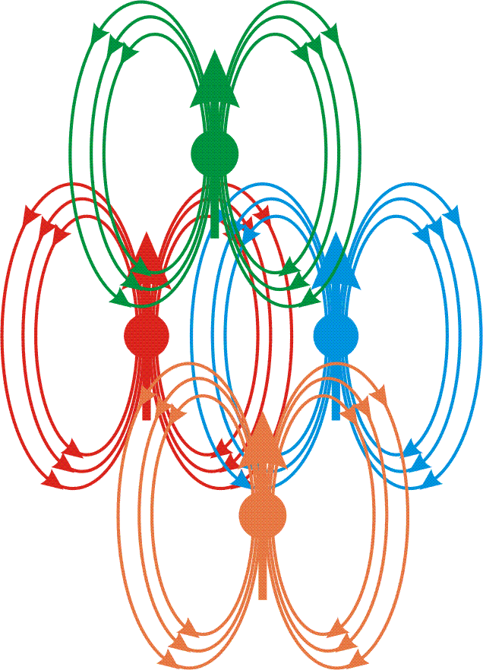
T2 and T2*
T2 = the true ‘natural’ decay time of the tissues
T2* = de phasing is faster than T2 due to inhomogeneities, which affect spin dephasing, and lead to signal loss.
In BOLD fMRI:
T2* affected by neural activity
Gradient echo techniques used to enhance signal
B
B
B
Spin-spin interactions
B
Notes:
T2 and T2* represent slightly different things in MRI
T2 is the natural decay time of tissues which would occur in a perfect homogenous environment.
T2* reflects the decay which is impacted by inhomogeneities in magnetisation.
This is particularly relevant for fMRI.
The reasons are twofold:
firstly, there are natural scanner wide variations in the giant magnet of the scanner.
Secondly, there are inhomogenties due to spin-spin interactions. Spin spin is where the phases begin to spin out pf phase with each other due to interactions with neighbouring protons.
This is particularly relevent for the BOLD response. This is because there are things like iron present in the blood, which can locally alter magnetic fields.

Slide 18
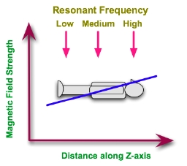
Gradient coils: x, y, z
Alter the strength of the primary magnetic field
Change the precession frequency between slices
Allow Spatial encoding for MRI images
Notes:
For spatial localisation.
A 90º pulse applied in conjunction with a magnetic field gradient will rotate spins which are located in a slice or plane through the object.
Frequency discrimination can be achieved by arranging for RF emissions from the patient to have slightly different frequencies depending on their origin.
Furthermore, phase discrimination can also be applied so that the phase of the RF emissions can be related to locations within the patient.
The magnetic field of the magnet in an MRI scanner is therefore supplemented by small fields introduced using gradient coils so that a linear gradient, for instance, in the field can be established.
With such a gradient applied along the patient's Z-axis, we can expect the resonant frequency of hydrogen protons to be different for planes along this axis,

Slide 19
Recap:
Person enters scanner
Big magnetic field (B0)
Protons align to B0
Magnetic field applied at 90 degrees (B1)
(RF pulse)
Protons align to B1
RF pulse stops
MR signal emitted by protons as they go back to normal state
Magnetic gradients manipulate emission
Signals processed
Images reconstructed using Fourier transformation.

Slide 20
BOLD in fMRI
BOLD is based on neural activity-dependent changes in the relative concentration of oxygenated and deoxygenated blood.
Deoxyhaemoglobin (dHb)
  Paramagnetic (has a high spin state)
  **Influences the MR signal**
Oxyhaemoglobin ((Hb)
  Diamagnetic (has a low spin state)
  **does not influence the MR signal**
These difference induce a different magnetic susceptibility in the blood and surrounding tissue.
Notes:
DELETE

Slide 21
The BOLD Signal

Slide 22
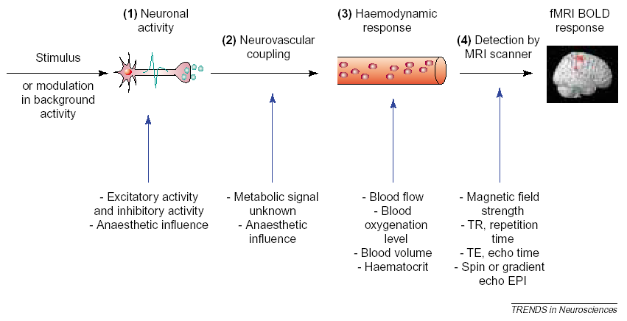
Stimulus to BOLD
Source: Arthurs & Boniface, 2002, Trends in Neurosciences

Slide 23
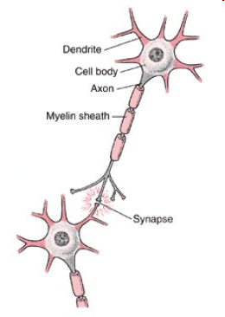
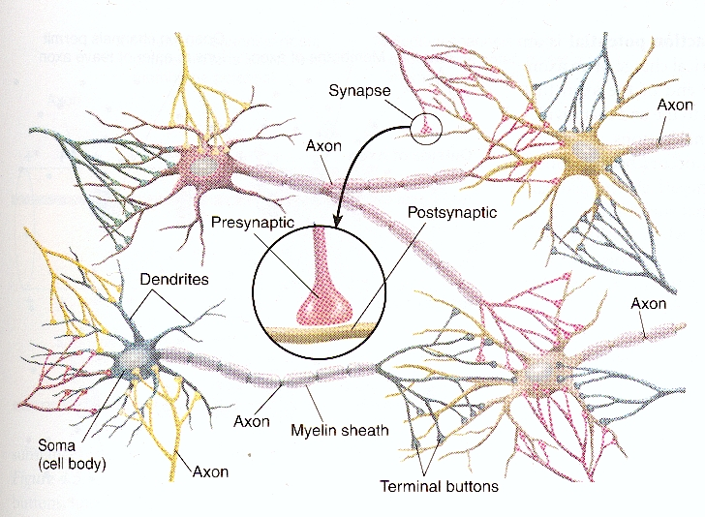
Neurons & Neural Networks

Slide 24
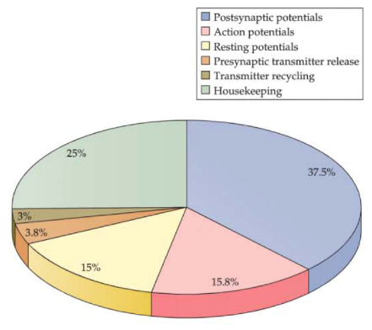
How does the brain use energy ?
ATP: adenosine triphosphate:
  Mainly produced through oxidative glucose metabolism
Energy Budget of the Brain
Atwell & Iadecola, 2002
Data Source: Howarth et al., 2012
Figure Source, Huettel, Song & McCarthy, Functional Magnetic Resonance Imaging, 3rd ed.

Slide 25
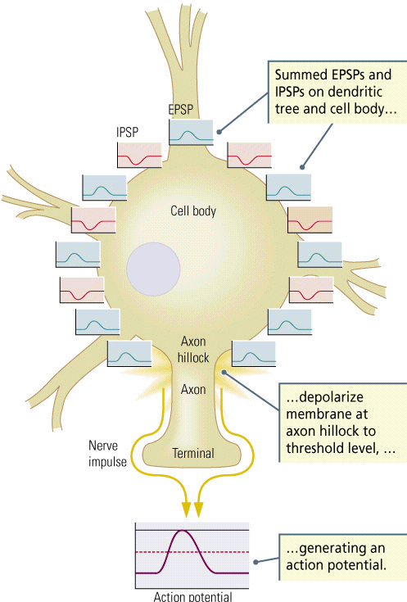
Post-Synaptic Potentials
Inputs =post-synaptic potentials
  Excitatory PSPs increase the membrane potential
  Inhibitory PSPs decrease the membrane voltage
If ∑ EPSPs + ∑ IPSPs > Threshold
=> Action Potential
Notes:
GABA = inhibitory neurotransmitter
 hyperpolarization (IPSP)
less metabolically demanding than excitatory (glutamatergic) activity
GABA can be taken up presynaptically rather than recycled through astrocytes
Therefore, neurotransmission at inhibitory synapses likely influences the BOLD signal less than at excitatory synapses

Slide 26
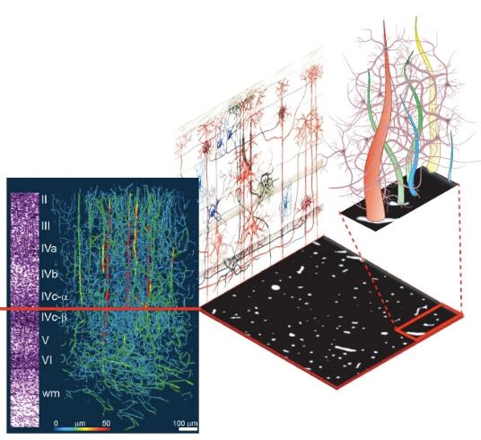
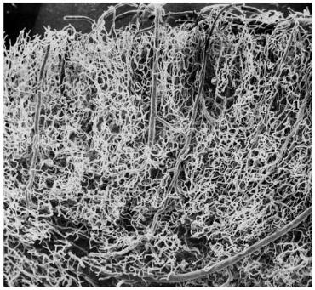
Contents of a Voxel
Capillary beds within the cortex
Source: Duvernoy, Delon & Vannson, 1981, Brain Research Bulletin
Source: Logothetis, 2008, Nature

Slide 27
Contents of a Voxel ..
Volume = 55mm³
  9-16 mm² plane resolution
  5-7 mm slice thickness
Only 3% of of content = vessels
  5.5 million neurons
  2.2-5.5 x 10¹⁰ synapses
  22km of dendrites
  220km of axons

Slide 28
Even Simple Circuits Aren’t Simple
Lower tier area
(e.g., thalamus)
gray matter
(dendrites, cell bodies
& synapses)
white matter
(axons)
Middle tier area
(e.g., V1, primary visual cortex)
Will BOLD activation from the blue voxel reflects:
output of the black neuron (action potentials)?
excitatory input (green synapses)?
inhibitory input (red synapses)?
inputs from the same layer (which constitute ~80% of synapses)?
feedforward projections (from lower-tier areas)?
feedback projections (from higher-tier areas)?
Higher tier area
(e.g., V2, secondary visual cortex)
…

Slide 29
Stimulus to BOLD
Source: Arthurs & Boniface, 2002, Trends in Neurosciences

Slide 30
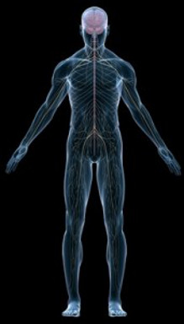
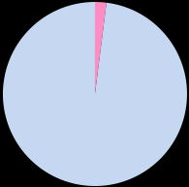
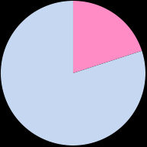
Brain and Blood
2% of Total Body Weight
Consumes 20% of O₂ & glucose supply

Slide 31
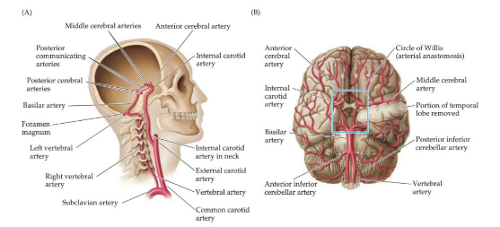
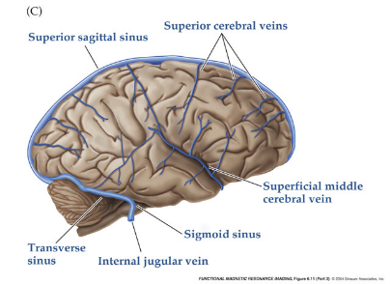
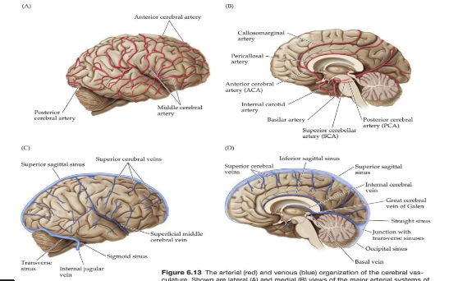
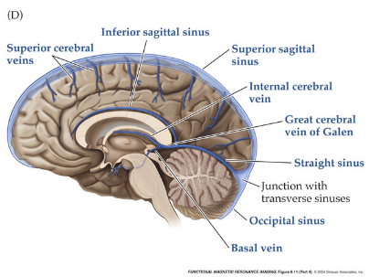
Neurovascular Anatomy
Notes:
54ml of blood / 100g of brain tissue

Slide 32
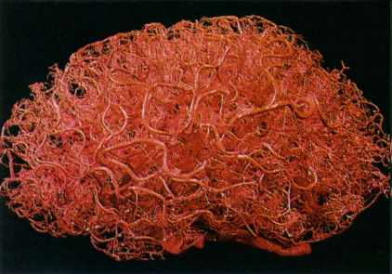
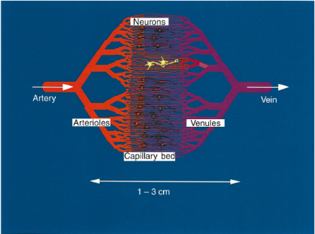
Capillary networks supply glucose and oxygen
Zlokovic & Apuzzo, 1998
Source: Menon & Kim, TICS

Slide 33
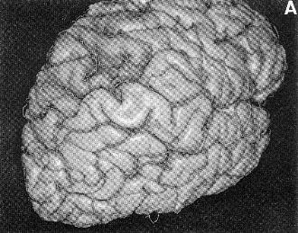
“Brain vs. Vein”
Large vessels produce BOLD activation further from the true site of activation
Large vessels line the sulci and make it hard to tell which bank of a sulcus the activity arises from
The % signal change in large vessels can be considerably higher than in small vessels (e.g., 10% vs. 2%)
Activation in large vessels occurs up to 3 s later than in small ones(time lag)
Source: Ono et al., 1990, Atlas of the Cerebral Sulci

Slide 34
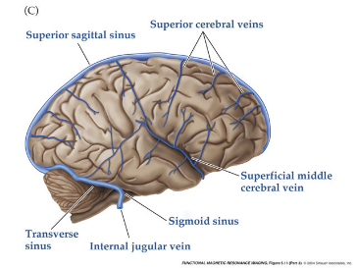
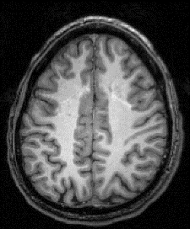

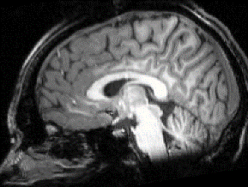
Don’t trust sinus activity either ..
Notes:
You will sometimes see bogus “activity” in the sagittal sinus

Slide 35
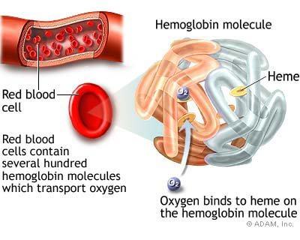
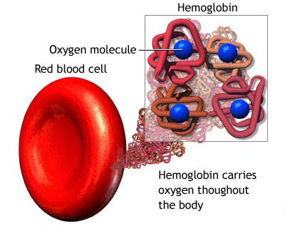
Hemoglobin (Hb)

Slide 36
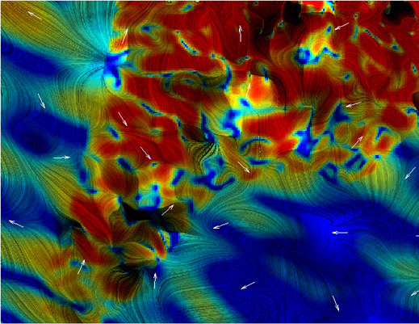

Hemoglobin magnetic properties
DeoxyHb paramagnetic
strong field inhomogeneities
Fast dephasing
Fast T2*
OxyHb diamagnetic
weak field inhomogeneities
Slower dephasing
slower T2*

Slide 37
How does this relate to neural activity?
T2* decay is quicker in presence of other magnetic material (e.g. dHb)
In active brain → there is an increase in O₂ and HbO (during main signal phase)
  Less magnetic particles present because therefore → T2* relaxation is relatively slower
Inhomogeneities in the field due to Δ O₂ → signal
M_{xy}
Signal
Take-home message:
BOLD is a T2*-weighted contrast
We are measuring a signal from hydrogen but the signal we get from hydrogen atoms is weaker when less oxygen (Oxyheamoglobin) is present
M_{o} sinθ
T₂* task
T₂* control
S_{task}
S_{control}
ΔS
TE_{optimum}
time
Notes:
More or less deoxyhemoglobin distorts the signal more or less, but we still measure protons and their T2* decay. T2* is just decaying faster or slower depending on how much deoxyhemoglobin is around!
Task: relatively more oxyhaemoglobin; less field inhomogeneity; slower T2* contrast decay; stronger signal
Control: relatively more deoxyhaemoglobin; more field inhomogeneity; faster T2* contrast decay; weaker signal

Slide 38
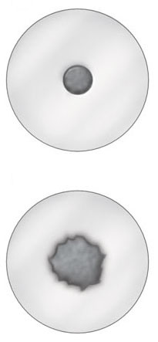
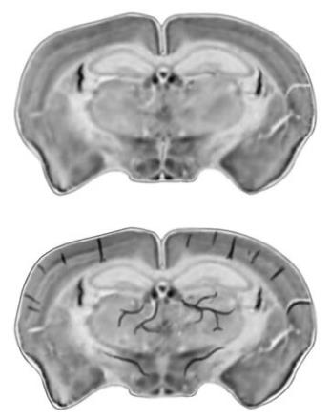
Deoxygenated Blood → Signal Loss
rat breathing pure oxygen
Oxygenated blood?
Diamagnetic
Doesn’t distort surrounding magnetic field
No signal loss…
rat breathing normal air (less than pure oxygen)
Deoxygenated blood?
Paramagnetic
Distorts surrounding magnetic field
Signal loss !!!
Images from Huettel, Song & McCarthy, 2004, Functional Magnetic Resonance Imaging
based on two papers from Ogawa et al., 1990, both in Magnetic Resonance in Medicine

Slide 39
Oxygenated Hb
B₀
voxel
Vessel
Tissue
Deoxygenated Hb
39
Dr. Samira Kazan
Notes:
So let’s look at that in a bit more detail. The top image is of a hypothetical vessel near inactive neurons, so there’s plenty of oxygenated hemoglobin in it. Now you’ve turned on the MRI scanner and you get this green magnetic field. It’s hard to tell but there are very small differences in the field- if you can see it, it’s a bit yellower in some places- however overall, the field around the blood vessel is very uniform.
The image on the bottom is of a vessel that has lots of deoxyhemoglobin present in it. The color differences represent changes in the strength of the magnetic field because of the presence of dHb.
Now we’ll zoom in on one small voxel in each image. You can clearly see the difference in the magnetic field in the deoxygenated case.
So, with the initial RF pulse, all the protons are lined up and in phase and we have a strong signal.
If we look a few milliseconds later the protons are coming out of phase with each other and the signal is weakening.
And even a few milliseconds later and the signal has decayed much more.
Because the magnetic field is so much more inhomogeneous when there is deoxyhemoglobin around the protons come out of phase much faster and the signal decays a lot faster.
So, you would expect a weaker BOLD signal when neurons are activated compared to when they’re at rest.

Slide 40
Oxygenated Hb
B₀
voxel
Vessel
Tissue
Deoxygenated Hb
40
Dr. Samira Kazan

Slide 41
Oxygenated Hb
B₀
voxel
Vessel
Tissue
Deoxygenated Hb
41
Dr. Samira Kazan

Slide 42
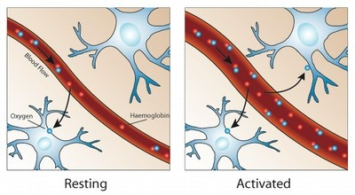
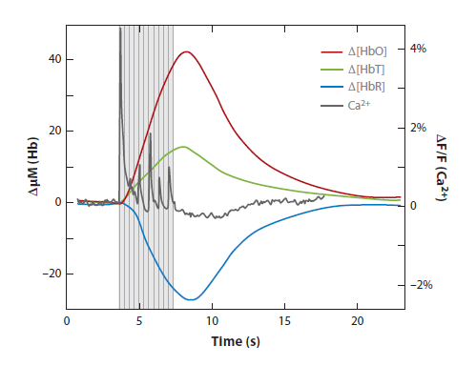
Neurophysiology
Overcompensation of cerebral blood flow compared to increased oxygen demands
Reas and Brewer, JEP, 2013
Hillman, Annu. Rev. Neurosci., 2014
Neural activity ➔ ↑ Blood flow ➔ ↑ Oxyhemoglobin ➔ ↑ T2* ➔ ↑ MR signal
But not as straight forward ..
Notes:
However, if you know anything about MRI that’s not what we see. We see more signal in areas that are activated.
This happens because there’s an increase in blood flow that overcompensates for the increase in deoxyhemoglobin
If you look at the picture it shows you a good representation- in a resting state the blood vessel is relatively small and there’s some hemoglobin and some deoxyhemoglobin. Hemoglobins are red and oxygens are blue.
When the neurons become active they start using more oxygen- so you see more deoxyhemoglobin circulating, but there’s such a vast increase in oxygenated hemoglobin sent to the area, that the ratio of deoxyhemoglobin to hemoglobin actually decreases.
So overall you do get signal increase in areas of the brain that are active.

Slide 43
Brain at rest
T2*-weighted
signal
Initial
Dip
Vaso-
dilation

Slide 44
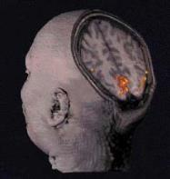
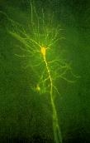
From Neurons to BOLD
  Positive BOLD Response
40
1
Voltage (mV)
Depolarization
Repolarization
BOLD Signal Change (%)
0
-55
-70
0
  Refractory period
  Undershoot
Time (ms)
Time (s)
Notes:
Purely coincidental !!!

Slide 45
Should it be BDLD?
Blood DE-oxygenation level-dependent signal?
Technically, “BOLD” is a misnomer
The fMRI signal is dependent on deoxygenation rather than oxygenation per se
The more deoxy-Hb there is the lower the signal
fMRI
Signal
Time
Amount of deoxy-Hb

Slide 46
BOLD Time Course
Blood Oxygenation Level-Dependent Signal
Positive BOLD response
3
2
Overshoot
BOLD Response
(% signal change)
Post-stimulus
Undershoot
1
Initial
Dip
0
Time
Stimulus

Slide 47
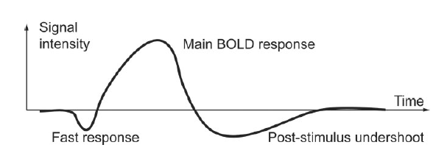
Neurophysiology
Typical hemodynamic response to single short stimulus
Norris, JMRI, 2006
~5 - 6 sec
~4 sec
~10 - 30 sec
<1 sec
Norris, JMRI 2006
Fast response: increase in metabolic consumption
Main BOLD response: increased local blood flow
Post-stimulus undershoot: metabolic consumption remains elevated after blood flow subsides
Notes:
Okay, so this is a typical hemodynamic response to a short stimulus.
In the first 1-2 seconds you see a fast initial drop in signal intensity- that’s due to the increased use of oxygen by activated neurons, before the blood vessels can respond.
Then, after about 2 seconds you get blood flow change and you get a big signal intensity increase that peaks around 5 or 6 seconds post-stimulus.
Eventually that signal fades, as the neurons return to resting and you sometimes see a post-stimulus undershoot, that’s poorly understood.

Slide 48
Haemodynamic Response Depends On:
cerebral blood flow
cerebral metabolic rate of oxygen
cerebral blood volume
Notes:
Flow refers to the rate; how fast the blood is flowing
The metabolic rate of oxygen refers to how much oxygen is required
Volume refers to the amount of blood

Slide 49
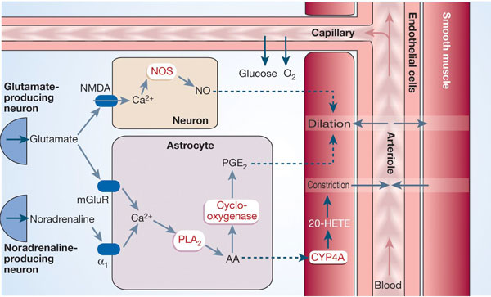
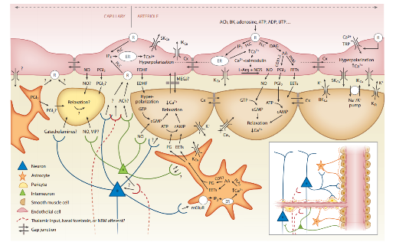
Cerebral blood flow control
Action potential releases Glutamate at the end of the synapse → astrocytes undergo change in [Ca²⁺] which in turn signals the release of potent Vasodilators such as NO
Hillman, Annu. Rev. Neurosci., 2014
Notes:
OTHER VASOACTIVE SUBASTANCES that may cause local changes such as AA, adenosine, K+
Global chages : dopamine
Supply of blood is correlated with glucose and oxygen consumption
Response is much slower than changes in neuronal activity
Not affected by sustained hypoxia or hypoglycemia

Slide 50
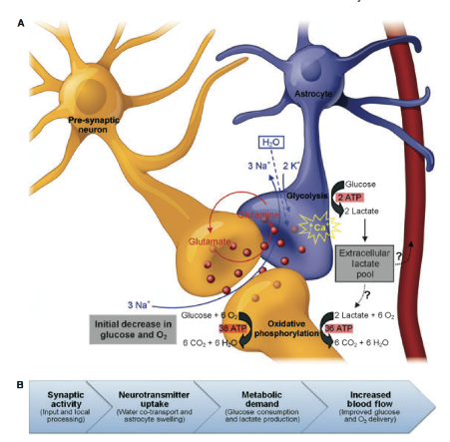
Tripartite Synapse
Astrocytes are adjacent to both synapses and blood vessels
  well poised to adjust vascular response to neural activity
Astrocytes outnumber neurons ~ 10:1
~50% of the total CNS cytopopulation
Astrocytes perform a number of critically important functions:
Neurotransmitter uptake and recycling
Neurometabolic regulation
Cerebrovascular regulation
Release of signaling molecules (“gliotransmitters”)
Source: Figley & Stroman, 2011, EJN
Notes:
Slide modified from talk by Chase Figley

Slide 51
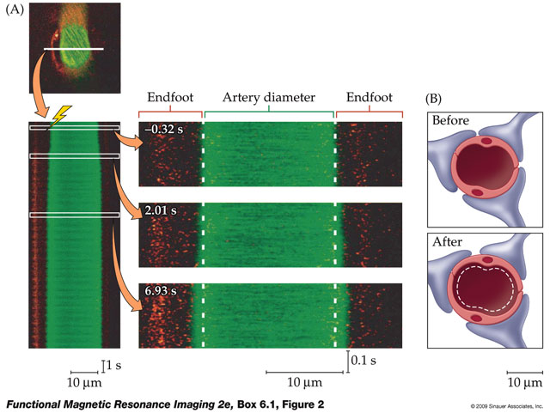
Vasodilation
vasodilation could be induced by either electrical stimulation or release of Ca²⁺
stim
Time
max dilation ~3-6 s after stim
Greatest Δ arteriole dilation occurred nearest to stimulation
Effects could also be observed several mm upstream
Source: Adapted from Takano et al., 2006, Nat Neurosci, by Huettel, et al., 2nd ed.
Notes:
two photon microscopy

Slide 52
What component of neural activity are measuring ?
Local Field Potential VS Spiking
Inputs VS outputs
LFP: synchronized dendritic currents, averaged over large volume of tissue
Spiking : Action potential/ neuronal firing
Is LFP independent from firing rate?
fMRI signal might reflect not only the firing rates of the local neuronal population, but also subthreshold activity
Notes:
fMRI: simultaneous activity of MANY neurons in a LARGE region of cortex (millimeters) over a LONG period (seconds). We need to ask what component of the neural activity most predicts the fMRI signal?
There has been much debate around whether we are actually measuring local field potential or firing.
Subthreshold activity: simultaneous excitation and inhibition that would not result in an action potential but would nevertheless deplete blood oxygen.
It is generally thought that we are measuring LFP
This is important for comparisons with animal models because they measure either LFP OR spiking

Slide 53
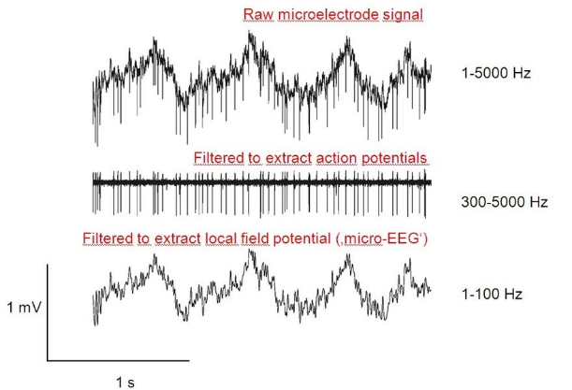

What does electrophysiology measure?
Raw microelectrode signal
Filter out low frequencies → Action Potentials (APs)
Filter out high frequencies → Local Field Potentials (LFPs)
Source: http://www.cin.uni-tuebingen.de/research/methods-in-neuroscience/networks.php

Slide 54


BOLD Correlations
24 s stimulus
12 s stimulus
Local Field Potentials (LFP)
reflect post-synaptic potentials
similar to what EEG (ERPs) and MEG measure
Multi-Unit Activity (MUA)
reflects action potentials
similar to what most electrophysiology measures
Logothetis et al. (2001)
combined BOLD fMRI and electrophysiological recordings
found that BOLD activity is more closely related to LFPs than MUA
4 s stimulus
Source: Logothetis et al., 2001, Nature

Slide 55
Inputs or Outputs?
The local field potential, which includes both post-neuron-synaptic activity and internal neuron processing, better predicts the BOLD signal.
BOLD responses correspond to intra-cortical processing and inputs, not outputs
Aligned with previous findings related to high activity and energy expenditure in processing and modulation
Excitation or inhibition circuits?
Excitation increases blood flow, but inhibition might too – ambiguous data
Neuronal deactivation is associated with vasoconstriction and reduction in blood flow (hence reduction in BOLD signal)

Slide 56

Comparing Electrophysiology and BOLD
Data Source: Disbrow et al., 2000, PNAS
Figure Source, Huettel, Song & McCarthy, Functional Magnetic Resonance Imaging

Slide 57
Stimulus to BOLD
Source: Arthurs & Boniface, 2002, Trends in Neurosciences

Slide 58

Gradient Echo vs. Spin Echo
Gradient Echo
high SNR
strong contribution of vessels
Spin Echo
lower SNR
weaker contribution of vessels
Source: Logothetis, 2008, Nature

Slide 59
The Concise Summary

Slide 60
Advantages of BOLD
EEG / MEG – Poor spatial localisation, high number of electrodes needed
PET – Invasive and need to use potentially toxic contrast
Non-invasive
Increasing availability
High spatial and temporal resolution
Enables visualising of entire brain areas/networks engaged in specific activities

Slide 61
Disadvantages of BOLD
Surrogate signal of haemodynamic activity –
Neuronal mass activity and not activity of specific neuronal units = Pseudoneural activity
Circuitry and functional organisation of the brain not fully understood
Difficult to differentiate between excitation/inhibition and neuromodulation
Signal intensity does not accurately differentiate between:
  Different brain regions
  Different tasks within the same region
Logothetis, N. K. 2008, "What we can and cannot do with fMRI", Nature, vol. 453, pp. 869-877

Slide 62
Disadvantages of BOLD cont..
Indirect measure of oxygen consumption
Pathology will heavily influence data collected

Slide 63
fMRI Study Designs
Main types of study design:
  Block design
    Consecutive tasks in pre-defined time intervals (also referred to as “epochs”)
  Event-related
    Stimuli (events or trials) are presented
    Higher image acquisition rates (1/sec)
5 minutes of scanning can result in over 80 MB of data!

Slide 64

Example of fMRI Protocol
Delay between the stimulus and the vascular changes – might take up to 6 secs
Initial “Dip” – decrease in BOLD signal due to O₂ consumption

Slide 65

fMRI Image Processing Stages
Images are re-aligned
Spatial normalisation of images to a standard brain space
Smooth and normalise the data
Combine statistical maps with anatomical information
Result is a superposition of a statistical map on a raw image

Slide 66


Sample fMRI Images

Slide 67

Overview: What are we measuring with BOLD?
the inhomogeneities introduced into the magnetic field of the scanner…
changing ratio of oxygenated:deoxygenated blood...
via their effect on the rates of dephasing of hydrogen nuclei
Notes:
This diagram shows just how far the distance is between neuronal activity, which is what we are trying to measure, and the intensity of the T2* weighted image we record. (Discuss diagram)

Slide 68



Where are we in the process ?
Statistical parametric map (SPM)
Image time-series
Kernel
Design matrix
Realignment
Smoothing
General linear model
Statistical
inference
Gaussian
field theory
Normalisation
Template
p <0.05
Parameter estimates
Notes:
Miriam and I described how we measure the value of each voxel and what this means in terms of physiology. Hopefully you have gained an understanding of the values that we put into our analysis right from the start, which are used for all the steps to follow.
I wanted to mention also that what we know about the shape of the haemodynamic function is used in the design matrix, and we will be having a talk in January about Basis Functions which allow us to vary the timing and width of the HRF to reflect differences in onset and duration of stimuli.

