Slide 1
Issues with analysis and interpretation
Micha Heilbron, UCL
Daniel Yon, Birkbeck College London

Slide 2
Outline
Recap: errors in statistical inference
Multiple comparisons problem (and solutions)
Non-independent analyses
Erroneous interpretations of interactions
Violating assumptions in parametric methods

Slide 3
Classical statistical inference?
Prove me wrong!

Slide 4
Probability
t value

Slide 5
Calculate an priori false positive rate you’d be happy with (e.g. α =.05)…
Probability
t value

Slide 6
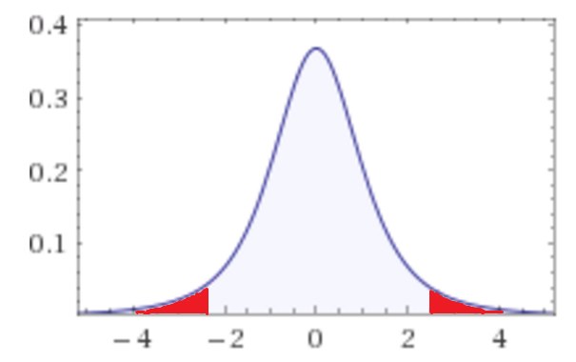
Probability
t value

Slide 7
Type I and Type II Errors
Each voxel can therefore be classified as one of four types:
 | Truly Active | Truly Inactive
Declared Active | ✓ | Type I (False positive)
Declared Active | Type II (False Negative) | ✓

Slide 9
Multiple Comparisons Problem
SPM adopts a ‘mass univariate’ approach
Independent voxel-wise statistics (e.g. t value for each voxel)
>80,000 tests, p<.05
4000 false positive voxels!

Slide 10
Possible Solution 0: Uncorrected threshold
Set an arbitrarily stringent threshold at the voxel level (e.g. p<.001)
Better than the behavioural sciences!
‘Unprincipled’ way of controlling error rates when different numbers of voxels are included in different analyses
E.g. If 10,000 vs 60,000 voxels different numbers of false positives are generated
Even dead salmon pass this threshold!
Bennett (2009)

Slide 11
Possible Solution 1: Limit Family-Wise Error Rate (FWER)

Slide 12
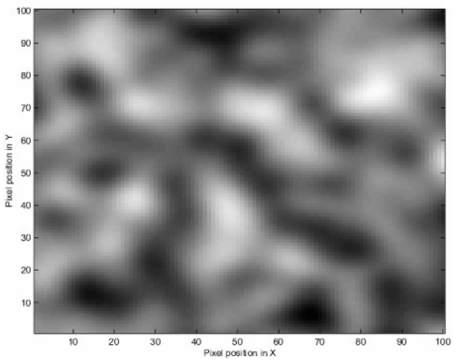
Possible Solution 1: Limit Family-Wise Error Rate (FWER)

Slide 13
Possible Solution 2: Limit False Discovery Rate

Slide 14
While 5% of the ‘effects’ in the bottom-left panel are known false positives, most of the signal is recovered.

Slide 15
Bennett et al (2009) suggest there is no reason why you can’t show uncorrected and FDR-controlled results at the same time. Important thing is that readers know the probability of false positives associated with the results.

Slide 16
Possible Solution 3: Cluster-extent thresholding
Incorporates knowledge that false positives are unlikely to be across spatially contiguous voxels, but real effects are.
Set primary threshold at voxel-level e.g. p<.001
Estimate an extent threshold for k number of contiguous voxels that would be expected to be active under the null hypothesis.
This extent threshold is calculated with respect to the intrinsic smoothness of the data, such that you have a cluster FWER p<.05

Slide 17
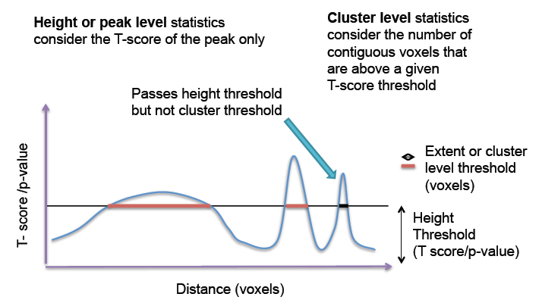

Slide 18
...potentially misleading…
Woo, Krishnan & Wager (2014)

Slide 19
...or theoretically uninterpretable
Woo, Krishnan & Wager (2014)

Slide 20
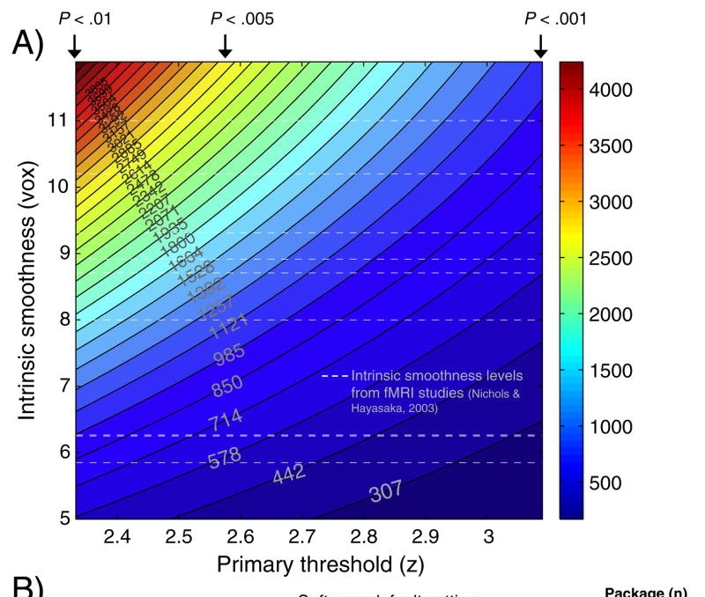
Woo, Krishnan & Wager (2014)

Slide 21
Outline
Recap: errors in statistical inference
Multiple comparisons problem (and solutions)
Non-independent analyses
Erroneous interpretations of interactions
Violating assumptions in parametric methods
Notes:
Suggestion for design: 4 recent ‘controversies’ in neuroscience on data analysis and interpretation

Slide 22
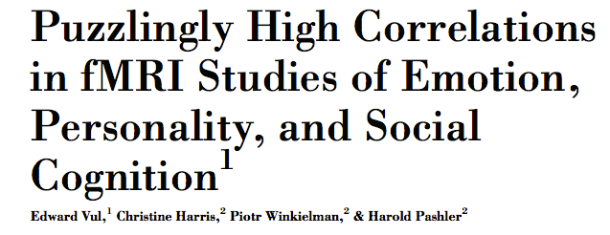
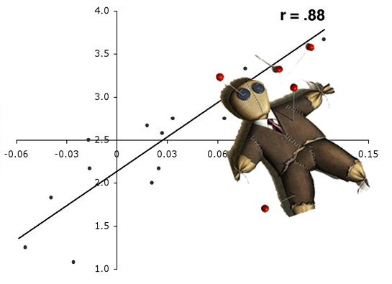
Non-independent selective analyses (‘double dipping’)
Vul et al. (2008)

Slide 23
Finding ‘voodoo correlations’ in 4 easy steps
See which voxels correlate with some behavioural measure (e.g. neuroticism)
Take the voxels which have correlations above a certain threshold (e.g. r=.8) and use these to define your ROI
Correlate voxel activity in your ROI with your behavioural measure
Voila! A strong brain-behaviour correlation
23

Slide 24
Double dipping
‘Double dipping’ refers to using the same data twice
Technically, this conflates exploratory research (hypothesis formation) and confirmatory research (hypothesis testing)
This creates the illusion of a second result, while you merely reproduce initial findings
If the initial was ‘spurious’ (e.g. non-corrected for multiple comparison) the resulting correlation can be downright non-existing —> “voodoo correlation”
24

Slide 25
How to prevent double dipping?
Define ROIs independently
Anatomically (standardised or subject-specific)
Split runs (i.e. define ROI from one set of scans, conduct analyses on another)
Though Poldrack & Mumford (2009) show that it’s still possible to obtain very high correlations (e.g. .7) when this is taken into account!
25

Slide 26
Outline
Recap: errors in statistical inference
Multiple comparisons problem (and solutions)
Non-independent analyses
Erroneous interpretations of interactions
Violating assumptions in parametric methods
Notes:
Suggestion for design: 4 recent ‘controversies’ in neuroscience on data analysis and interpretation

Slide 27
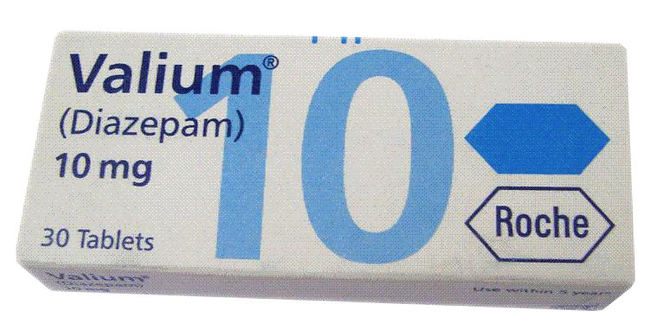
Imagine a study:
Wat is the effect of Valium on ‘event-related anxiety’?
Two groups of students are exposed to stress (e.g. presenting a methods class)
One group gets a placebo, the other diazepam (Valium)
Anxiety is measured before and after the presentation, e.g. with fMRI
Q: Did valium reduce anxiety?
27

Slide 28
Imagine a conclusion:
“Students receiving placebo showed increased anxiety-related BOLD activity after the presentation (P < 0.01); in students receiving Valium this difference was abolished (F < 1)”
Who can spot the error?
28

Slide 29
Who can spot the error?
Not everyone: analysis of 513 top-ranked papers, 79 erroneous analysis vs. 78 correct
Nieuwenhuizen et al. (2011). Nature Neuroscience
29

Slide 30
So, what was the mistake?
The studies reported significance and non-significance — but no interaction effect.
Directly comparing significance levels is misleading because the difference between significant and non-significant is itself (often) not significant.
Intuition: Usain Bolt may be the fastest man in the world, but that doesn’t mean he is significantly faster than number 2 or 3.
30

Slide 31
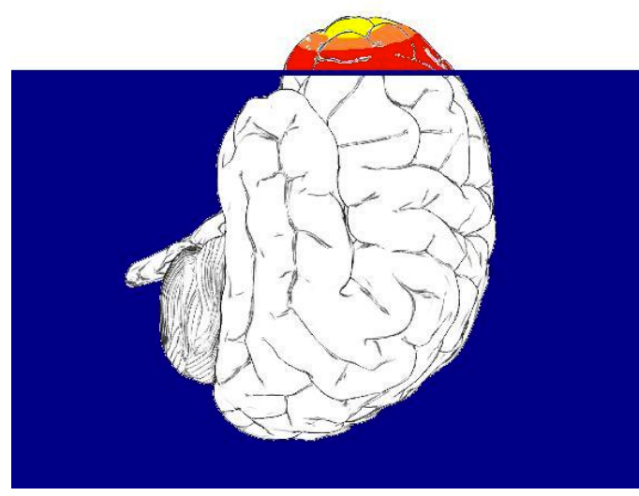
How to avoid the mistake?
In general, never compare significance values directly — always test interaction effects
In neuroimaging, look at your unthresholded statistical parametric maps alongside your threhsolded data (the ‘blobs’).
Image courtesy: Neuroskeptic (2014): ‘Ban the blob’
31

Slide 32
Outline
Recap: errors in statistical inference
Multiple comparisons problem (and solutions)
Non-independent analyses
Erroneous interpretations of interactions
Violating assumptions of parametric methods
Notes:
Suggestion for design: 4 recent ‘controversies’ in neuroscience on data analysis and interpretation

Slide 33
Violating assumptions in parametric methods
Q: What is the ‘real’ type I error rate of the three most common fMRI software packages?
Method: “Task-based” analysis of resting state fmri
Answer: ‘empirical’ FWE-rates of up to 60% (nominal would be 5%)
“These findings speak to the need of validating the statistical methods being used in the neuroimaging field.”
Eklund et al. (2015) Arxiv Preprint
33

Slide 34
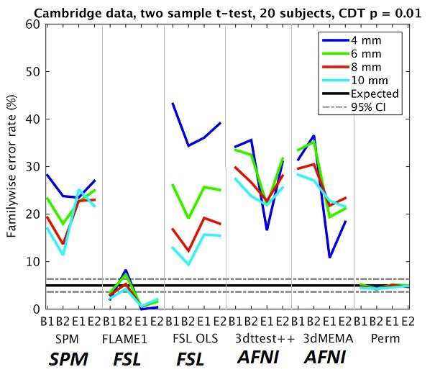
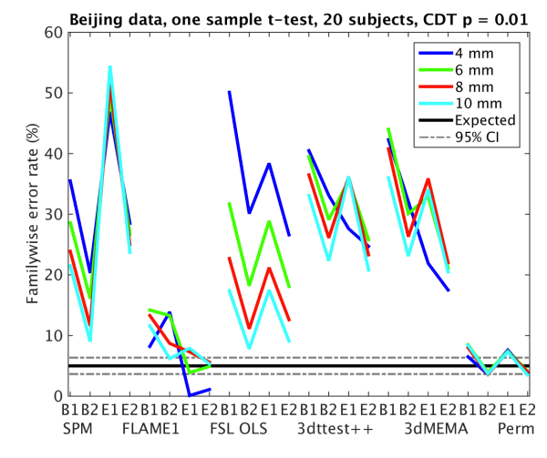
Violating assumptions in parametric methods
Eklund et al. (2015) Arxiv Preprint
33

Slide 35
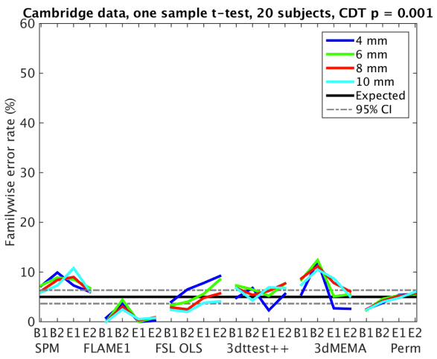
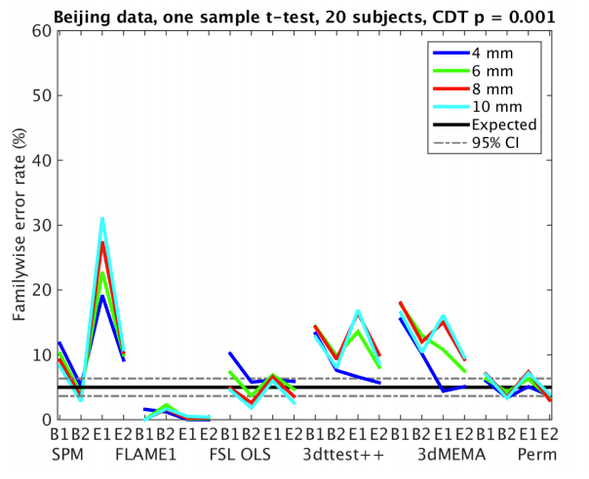
Violating assumptions in parametric methods
Eklund et al. (2015) Arxiv Preprint

Slide 36
Ongoing controversy…
Authors claim parametric assumptions cause effects
However, others have questioned:
Validity of resting-state data as null-distribution
Ill-defined design matrix (unrealistic analysis)
Unrepresentative thresholding and smoothing
…
Disclaimer: paper not yet peer-reviewed!
Eklund et al. (2015) Arxiv Preprint

Slide 37
Take home message:
Beware of p=0.01 cluster forming results
Consider your (statistical) assumptions
If some assumptions cannot be guaranteed use non-parametric approaches
Eklund et al. (2015) Arxiv Preprint

Slide 38
Take home message:
fMRI offers many opportunities for errors
However, non of the discussed errors represent some ‘fundamental flaw’ of fMRI
Always formulate a clear hypothesis
… and think through all processing steps before collecting data
There is no ‘magic bullet’ against statistical errors

Slide 39
It’s about balance…

