Slide 1
The Basis of MEG & EEG
Methods for Dummies
Prof Gareth Barnes, Sofie Meyer
Ummi Suhaimei, Sebastian Siehl

Slide 2
Content
Background
Basic Features
Signal
Applications
Paper
Discussions
MEG vs EEG
Advantages & Disadvantages
Happy End

Slide 3
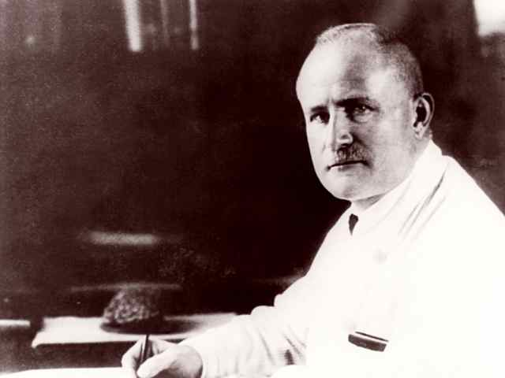
Background
In 1924
First published Electroencephalogram of a human (1929)
Top trace – EEG recorded from a young boy
Bottom trace – 10 Hz frequency reference
Hans Berger, the inventor of EEG
By Unknown - http://www.psychiatrie.uk-j.de/Geschichte.html, Public Domain, https://commons.wikimedia.org/w/index.php?curid=12160449
By Hans Berger - Berger H. Über das Elektrenkephalogramm des Menchen. Archives für Psychiatrie. 1929; 87:527-70., Public Domain, https://commons.wikimedia.org/w/index.php?curid=2900591

Slide 4
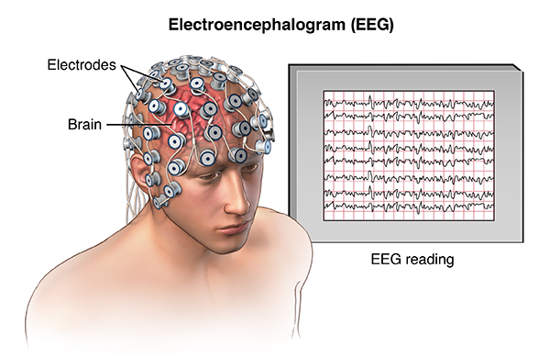
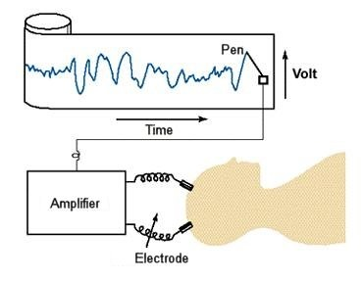
Basic Features
What is EEG?
EEG = Electroencephalogram
Measures electrical activity in the brain
8 – 64 channels recording simultaneously from as many different pairs of electrodes
The EEG is made up of the :
Electrodes
Amplifier
Computer control module
Display device
Read more: http://www.madehow.com/Volume-7/EEG-Machine.html#ixzz3zaZkT2dX

Slide 5
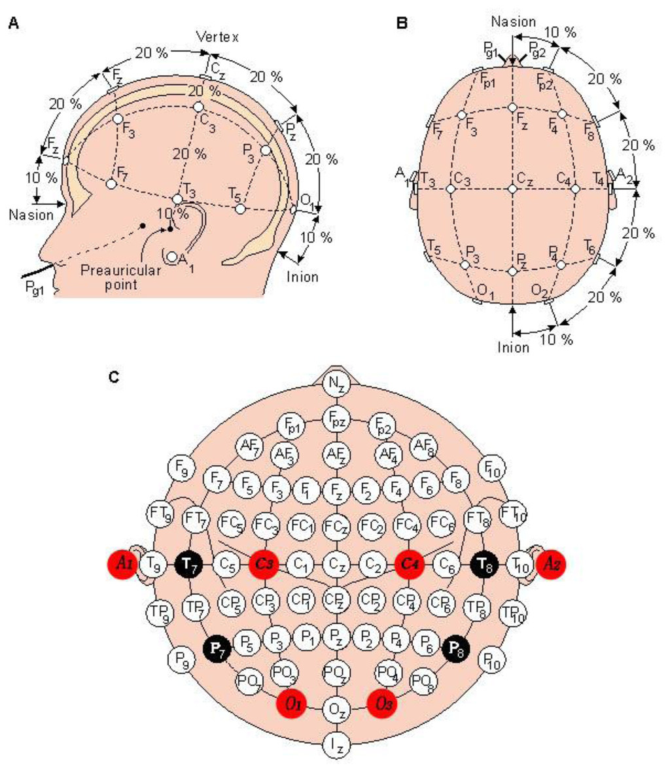
Recording Electrodes
EEG is recorded from electrodes
Placed on the surface of the scalp
Frontal, parietal, temporal, central and occipital region.
International 10 – 20 position system
To ensure standardized reproducibility
Enables comparisons between subjects and studies
2 anatomical landmark
Anion
Nasion
Sung, W.-T.; Chen, J.-H.; Chang, K.-W. Study on a Real-Time BEAM System for Diagnosis Assistance Based on a System on Chips Design. Sensors 2013, 13, 6552-6577.

Slide 6
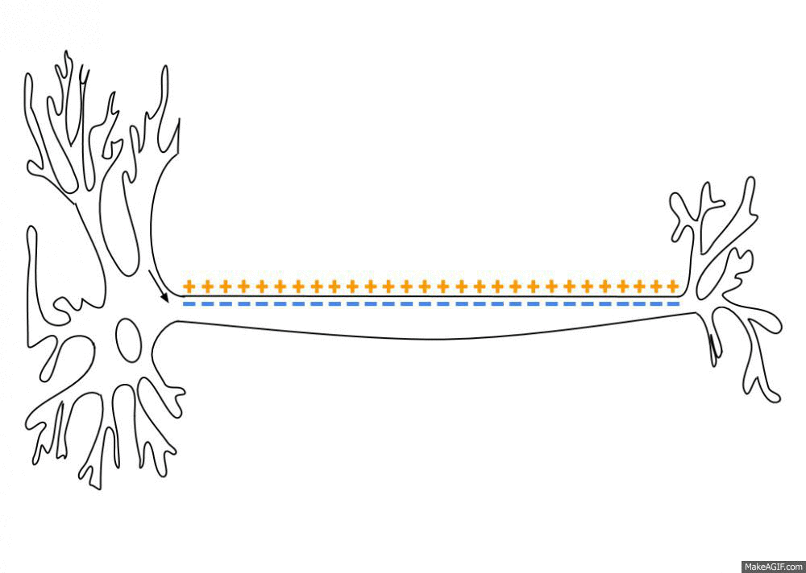
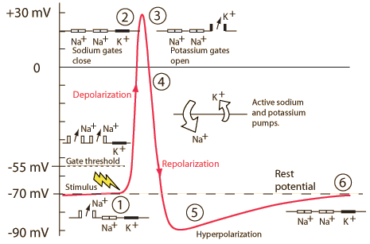
How is an electrical signal made?
By Laurentaylorj - Own work, CC BY-SA 3.0, https://commons.wikimedia.org/w/index.php?curid=26311114

Slide 7
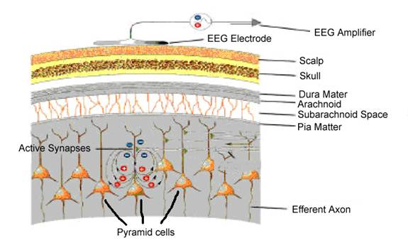
Pyramidal Neurons
Superficial layers of the brain
Spatially aligned and perpendicular to the cortical surface
Synchronized activity
Produces large signal
http://www.psych.nmsu.edu/~jkroger/lab/EEG_Introduction.html

Slide 8
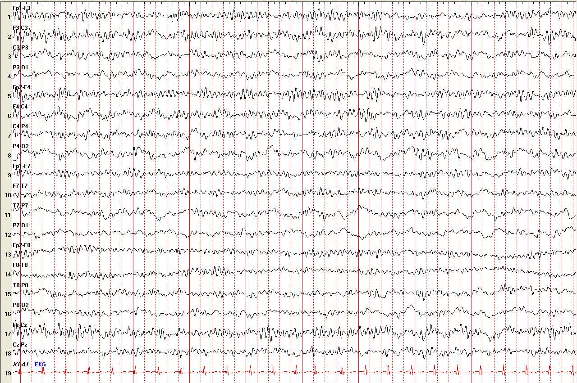
EEG Reading (Normal)
http://somatosphere.net/2014/01/eeg.html

Slide 9
EEG Frequency Spectrum
Waves | Frequencies per second | Amplitude in µV | Characteristics
Beta-waves | 14 - 30 | 5 - 50, mostly below 30 | Sharp spike-waves over 35 Hz, Frontocentral, precentral & posterior Criteria of light sleep stages
Alpha-waves | 8 - 13 | 5 - 120, mostly below 50 | Posterior-dominant, awake, eyes closed, mental inactivity, physical relaxation
Theta-waves | 4 - 7 | 20 - 100 | Strictly rhythmic or highly irregular Awake & drowsiness or light sleep stages
Delta-waves | 0,5 - 3 | 5 - 250 | Abnormality in waking adults, Accompaniment of deep sleep
Gamma-waves | 31 - 60 | -10 | Legality of appearance and site not well established

Slide 10
Applications
Medical uses
Epilepsy and seizure disorders
Patients in coma – determine the amount of brain damage
Head injury
Brain tumour
Sleep disorder

Slide 11
Epilepsy
Neurological condition
Abnormal electrical activity of the brain
Seizure types:
Focal
One part of a person’s brain
Warning for a generalized seizure
Generalized
Epileptic activity in both hemisphere of the brain
Tonic-clonic
Tonic
Myoclonic
Absence

Slide 12
Abnormal EEG Reading
https://www.physionet.org/pn6/chbmit/
Notes:
Spike and wave

Slide 13
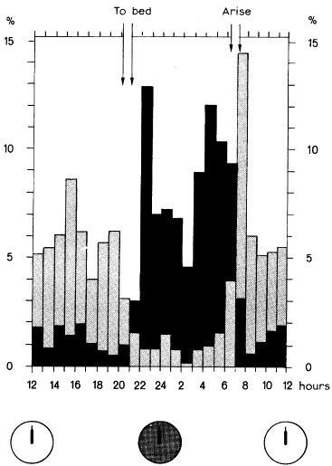
Research
Janz, (2000)
Epilepsy with grand mal on awakening and sleep-waking cycle
Strong association between sleep deprivation and seizures in idiopathic generalised epilepsy

Slide 14
General Introduction to M/EEG
Source:
Min et al. (2010)
http://www.cell.com/cms/attachment/606849/4829012/gr1.jpg
Notes:
NIRS – Near Infrared Spectrum ---- 1-3 cm cerebral metabolism
BOLD changes in susceptibility-weighted MR signal
fTCD – functional transcranial Doppler sonography
Blood flow velocity associated with neuronal activity
The two activities are not necessarily spatially congruent. Many studies have found discrepancies between EEG dipolar localization and fMRI (in Bagshaw et al., 2005, up to 60 mm, but see also the differences reported for the early SI response in Kober et al., 2001; Stippich et al., 1998). These values can be regarded as alarmingly large in the first instance. However, the discrepancy can potentially be caused not only by the variability in the cell types and neuronal activities producing each particular signal of interest, but also by the approximate modeling of dipolar activities.
M/EEG – increased resolution - improved localization is due to the different properties of the two imaging modalities (rather than number of channels)

Slide 15
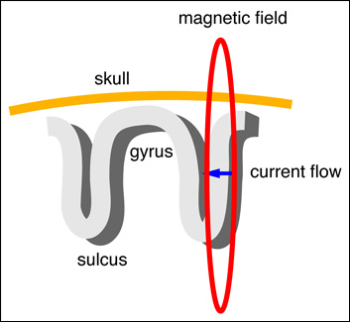
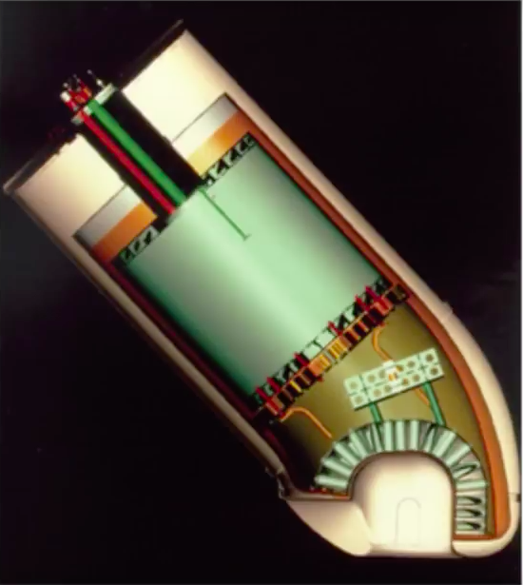
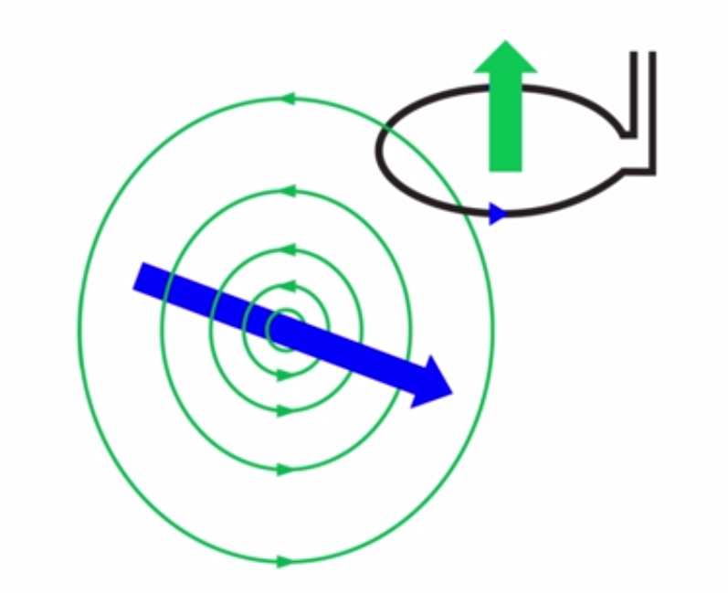
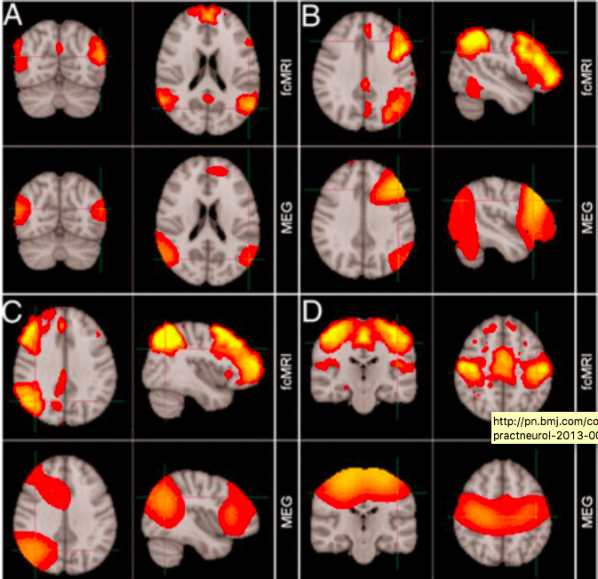
General Introduction to M/EEG
http://www.ctfmeg.com/images/megbasics.jpg
[Magnetic Fields]
From http://imaging.mrc-cbu.cam.ac.uk
[MEG]
Buzsaki, G. (2011). Rhythms of the Brain.
Klimesch, W. (2012)
http://www.youtube.com/watch?v=CPj4jJACeIs
[MEG Studies]
[Magnetometer]

Slide 16
General Introduction to M/EEG
History (MEG)
[Cohen (Science, 1972) describes the first 1-sensor MEG recording with the so-called SQUID technique (see below).]
Notes:
Shileding against EMI – Electromagnetic Interference

Slide 17
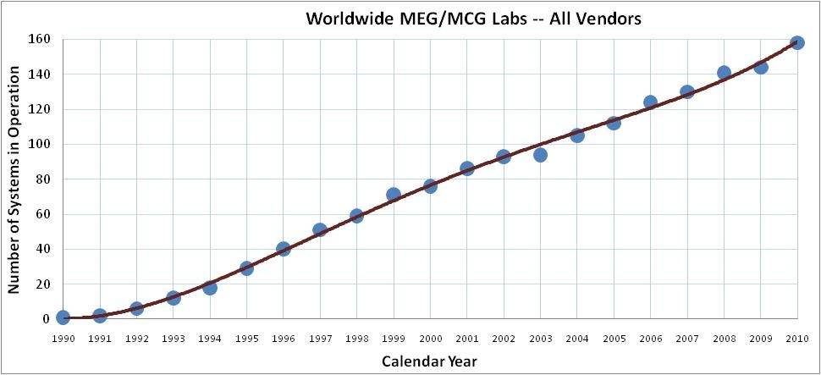
General Introduction to M/EEG
1962: Discovery of the Josephson effect
1968: David Cohen makes first MEG recordings of human α-rhythm
1970: Superconducting quantum interference device (SQUID) invented by James Zimmerman
1972: SQUID technology is applied to MEG recording
1979: 3-channel SQUID system is built
1992: First whole-cortex MEG system (64 channels) is built
2000: First investigational foetal MEG system is used
[http://www.fil.ion.ucl.ac.uk/spm/course/slides12-meeg/01_MEEG_Origin.ppt]

Slide 18
Basics in MEG Neuroanatomy
Apical dendrites
Basal dendrites
Notes:
The largest contribution to MEG/EEG caused by postsynaptic potentials (PSPS) in pyramidal cells.
When an excitatory PSP (EPSP) provides input to a pyramid cell, positively charged ions are transported into the cell.
This causes a so-called sink and generates a potential difference along the membrane between the apical dendrites and soma.

Slide 19
Basics in MEG
Signals

Slide 20
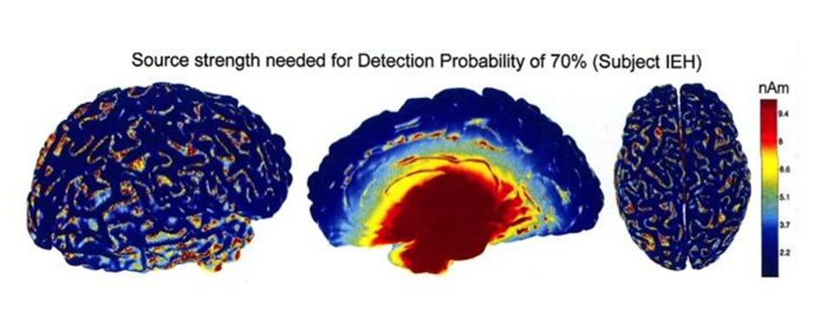
Basics in MEG
MEG is less sensitive to magnetic fields generated by deeper sources
Sensitivity loss is proportional to squared distance between source & sensor
Source:
Hillebrand & Barnes, 2002) http://ilabs.washington.edu/what-magnetoencephalography-meg

Slide 21
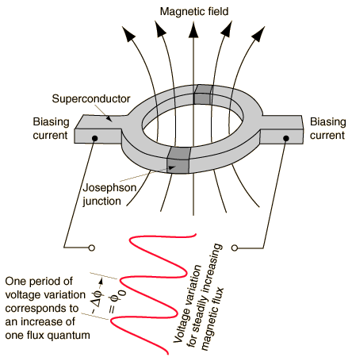
Basics in MEG - SQUID
Basics
SQUID – Superconducting Quantum Interference Device
An ultrasensitive detector of magnetic flux
In essence a magnetic flux-to-voltage converter
[Brian Josephson]
[SQUID]
Quelle
http://www.nndb.com/people/887/000099590/brian-josephson-1.jpg
Quelle
http://www.gitam.edu/eresource/Engg_Phys/semester_2/supercon/supercon_files/squide.gif
Notes:
SQUID – Superconducting Quantum Interference Device – an ultrasensitive detector of magnetic flux.
Invented by Jaklevic, Lambe, Mercereau and Silver in the Ford Research Labs.
Josephson Junction: phenomenon of supercurrent – current that flows indefinitely long without any voltage appled – across a device known as a Josephson Junction
- 2 superconductors coupled by a weak link
- weak link consists of a thin insulating barrier
- short section of a non-superconducting metal
Superconductivity is zero-resistance electrical conduction that (typically) occurs at extremely cold temperatures, near absolute zero.
The SQUID is in essence a magnetic flux-to-voltage converter.

Slide 22
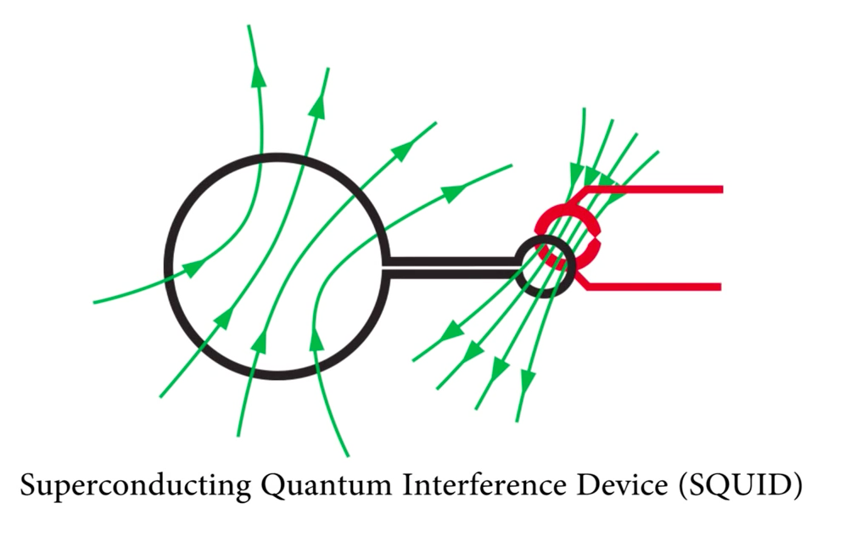
Basics in MEG
Signals
http://www.youtube.com/watch?v=CPj4jJACeIs

Slide 23
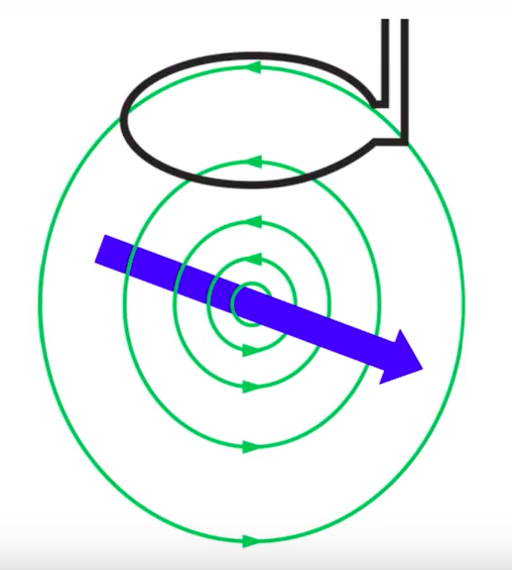
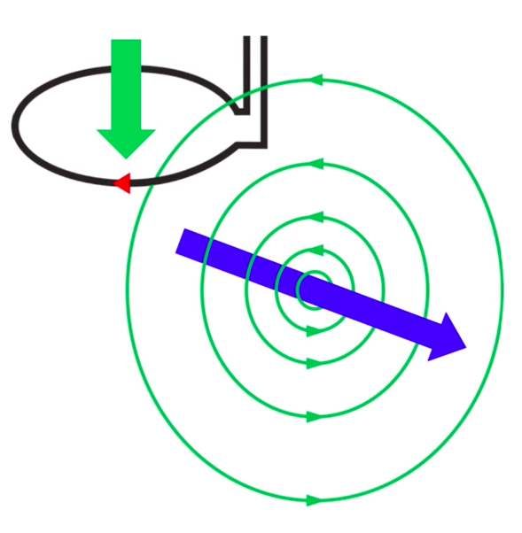
Basics in MEG
http://www.youtube.com/watch?v=CPj4jJACeIs
http://www.youtube.com/watch?v=CPj4jJACeIs
http://www.youtube.com/watch?v=CPj4jJACeIs

Slide 24
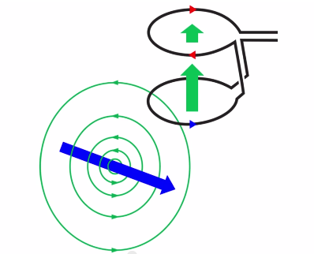
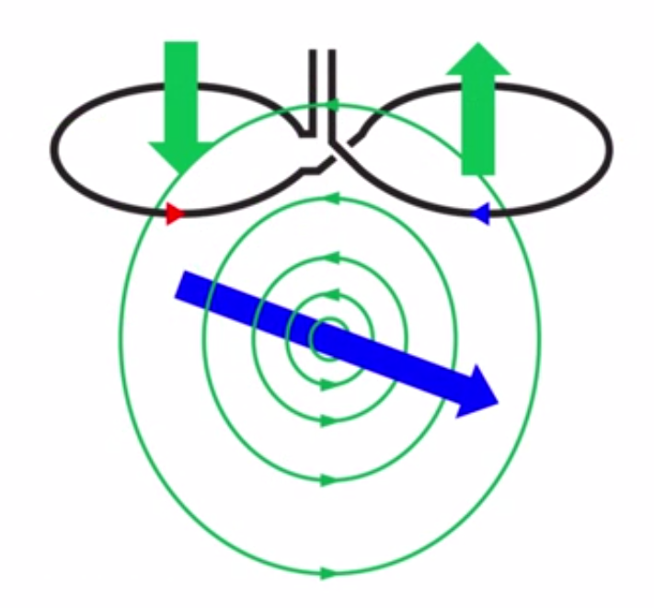
Basics in MEG
[Noise]
Smart Sensor Designs
http://www.youtube.com/watch?v=CPj4jJACeIs
http://www.youtube.com/watch?v=CPj4jJACeIs
http://www.youtube.com/watch?v=CPj4jJACeIs
[Magnetometer]
[1st-Order Axial Gradiometer]
[1st-Order Planar Gradiometer]
Ambient Noise Supressor
Notes:
Wired in Opposition to eachother as seen above. So cancel eachother out.
Planar-Gradiometer: Most sensitive when placed right over the source. Closer to actual source and scalp then axial Gradiometer.

Slide 25
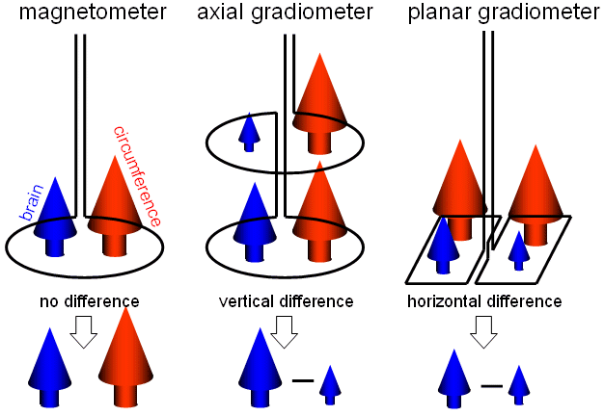
Basics in MEG
http//meg.aalip.jp/coil/resource/image2

Slide 26
Basics in MEG
http://www.youtube.com/watch?v=CPj4jJACeIs
http://lh5.ggpht.com/_NNjxeW9ewEc/TNpEKoe8F9I/AAAAAAAAQdI/EUYhuyNP0RU/tmp15061_thumb_thumb1.jpg?imgmax=800
[Elekta Neuromag VectorView 306 channels]
[CTF 275 Gradiometer]
[4D BTI System]

Slide 27
MEG – Elektra Neuromag Vector View System

Slide 28
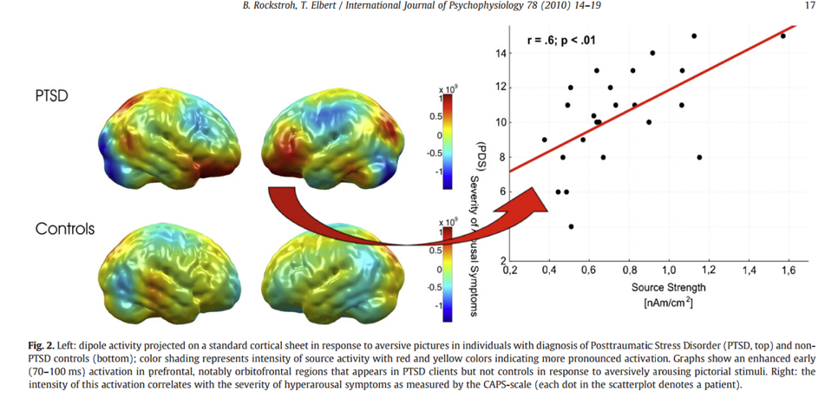
MEG – More advanced
Notes:
18 – fMRI and MEG study
left dipole activity projected on a standard cortical sheet in response to aversive pictures in individuals with diagnosesis of PTSD. color shading represents intensity of source activity with red and yellow colors indicating more pronounced activation. Graphs show an enhanced early (70-100ms) activation in DFC, notably OFC that appears in PTSD clients but not controls in response to aversively arousing pictorial stimuli.
Right: the intensity of this activation correlates with the severity of hyperarousal symptoms as measured by the CAPS-scale (each dot in the scatterplot denotes a patient).

Slide 29
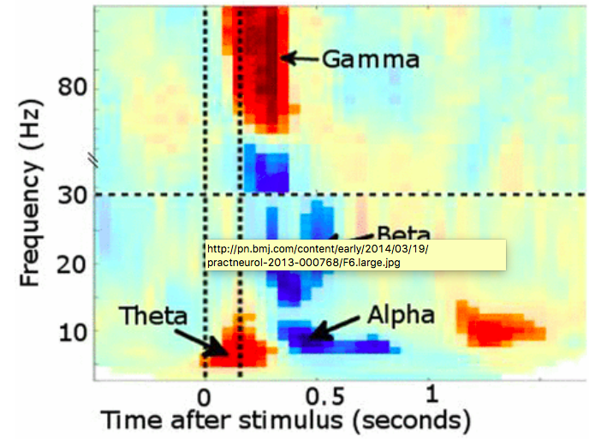
Scientific problems & questions
MEG
Time-frequency plot from posterior sensors following presentation of a visual stimulus.
Vertical lines denote stimulus onset/offset
Increased power in θ followed shortly by γ. Desynchronisation instead occurs in α and β bands
Quelle
Buzsaki, G. (2011). Rhythms of the Brain.
Klimesch, W. (2012)
Notes:
For example, it is possible to analyse the data time-locked to experimental events in terms of event-related fields (ERF, the MEG analogue of event-related potentials), such as the mismatch negativity abnormalities described in dyslexia.
Additionally, MEG is particularly powerful at investigating oscillatory brain activity by using ‘Fourier transformations’, or related transforms, such as Wavelet or Hilbert, to describe the signal in terms of how it oscillates in different frequency bands over time. These frequency bands show meaningful changes in power or synchronisation of ongoing oscillatory activity at behaviourally relevant time points, and can also form the basis of functional connectivity measurements (correlated changes over time) between different brain regions captured in MEG data , (figure 6).
Buzsaki, G. (2011). Rhythms of the Brain. USA: OUP.
Klimesch, W. (2012). A-band oscillations, attention, and controlled access to stored information. Trends Cogn Sci;16:606-17.

Slide 30
Scientific problems & questions
[Default mode network]
[l-lateral frontoparietal network]
[r-lateral frontoparietal network]
[Sensorymotor Network]
Global resting state networks in neurodegeneration (loss of long-distance alpha and beta bands)
Oscillatory signatures in neurodegeneration (alpha desynchronisation)
Alzheimer
Quelle
Stam et al. (2006)
De Haan et al. (2012)
Proudfoot et al. (2014)
Notes:
This approach has been pioneered by fMRI (16) but MEG now validates these findings in eliminating artefactual explanations based solely on correlated patterns of vascular activity. MEG also ofers the possibility of decomposing the time-course of communication between „nodes“ in such networks, assessing their functionality during task activity, and indeed describing their dyfunction during neurodegenerative disease (17), with the ultimate hope of developing sensitive pharmacodynamic markers of therapeutic response.
MEG also offers information complementary to fMRI; the uncertain impact of disease on the time course of the BOLD haemodynamic response function encourages multimodal data acquisition during brain activation (by necessity non-concurrent, as MEG and fMRI cannot be acquired simultaneasiously) (18).
ALZHEIMER:
Event-related MEG reveiled sign. Delayed and stronger amplitude alpha desynchronisation during visual working memory
E.g. loss of long-distance interhemispheric connectivity

Slide 31
Discussion
EEG
Advantages:
Also non-invasive, quiet and CHEAP
Unlike MEG, EEG is sensitive to both radial and tanginal resolution.
Disadvantages:
Spatial resolution – no localisation of activity inside the head BUT this can be overcomed by correlating EEG with fMRI
Skin resistance
MEG
Advantages: MEG ...
... Is non-invasive, safe and compartable.
... Offers unsurpassed temporal resolution; it can probe neuronal oscillaiton activity that is fundamental to brain function in health and disease.
describes in vivo function of whole brain networks in real time; has potential to detect the very earliest changes in neurodegenerateive disorders.
Disadvantages: MEG ...
... has not a high spatial precision over ist superficial cortical areas.
... can‘t easily detect signals from deeper brain areas
Notes:
EEG – signals may be distoryed
- sensitive to both radial and temporal resolution
temporal resolution
non-invasive
quiet
cheap
clinical implications
BOTH EEG AND MEG USE THE SAME UNDERLYING SIGNALS BUT DIFFERENT OUTPUTS
Disadvantages – preparation
Skin resistance
Current distortion
Noise from bad grounding
Spatial resolution – don’t know exactly where the current is coming from
So to over come this, you can correlate EEG with fMRI

Slide 32
Happy End
To summarize,
Both EEG and MEG use the same underlying signals but are sensitive to different aspects of these signals hence gives out different outputs.
Like viewing the shadows of the same object from two different angles

Slide 33
Happy End

Slide 34
Happy End
This never happened with you!!
Thank you Gareth and
thank you Sofie!!!

Slide 35
Useful websites
[R1] MEG: http://pn.bmj.com/content/early/2014/03/19/practneurol-2013-000768.full
[R2] MEG:
http://www.nature.com/scitable/blog/brain-metrics/what_does_meg_measure
[1]

Slide 36
References - Literature
Brookes, M. J., Woolrich, M., Luckhoo, H., et al. (2011). Investigating the electrophysiological basis of resting state networks using magnetoencephylography. Proc Natl Acad Sci USA;108:16783-8.
Buzsaki, G. (2011). Rhythms of the Brain. USA: OUP.
De Haan, W., van der Flier, W. ; , Koene, T., et al. (2012). Disrupted modular brain dynamics reflect cognitive dysfunction in Alzheimer‘s disease. Neuroimage;59:3085-93.
Klimesch, W. (2012). A-band oscillations, attention, and controlled access to stored information. Trends Cogn Sci;16:606-17.
Proudfoot, M., Wollrich, M. W., Nobre, A. C., & Turner, M. R. (2014). Magnetoencephalography. Practical Neurology, 14:336-343. doi: 10.1136/practneurol-2013-0000768.
Stam, C. J., Jones, B. F., Manshanden, I., et al. (2006). Magnetencephalographic evaluation of resting-state functional connectivity in Alzheimer‘s disease. Neuroimage;32:1335-44.
Stenroos et al. (2014). Correlations of lead-fields with detailed BEM. Neuroimage

Slide 37
References - EEG
https://www.epilepsy.org.uk/info/what-is-epilepsy
http://imaging.mrc-cbu.cam.ac.uk/meg/IntroEEGMEG
http://www.psych.nmsu.edu/~jkroger/lab/EEG_Introduction.html
Janz, D. (2000). Epilepsy with grand mal on awakening and sleep-waking cycle. Clinical Neurophysiology, 111, S103-S110. doi: 10.1016/S1388-2457(00)00409-0
Sung, W.-T.; Chen, J.-H.; Chang, K.-W. Study on a Real-Time BEAM System for Diagnosis Assistance Based on a System on Chips Design. Sensors 2013, 13, 6552-6577.

Slide 38
General Introduction to M/EEG
Applications
MEG is sensitive to:
Tangential dipoles
MEG is blind to:
Radial dipoles
If a) spherically symmetric volume conductor
If b) the source is a single radially oriented dipole

Slide 39
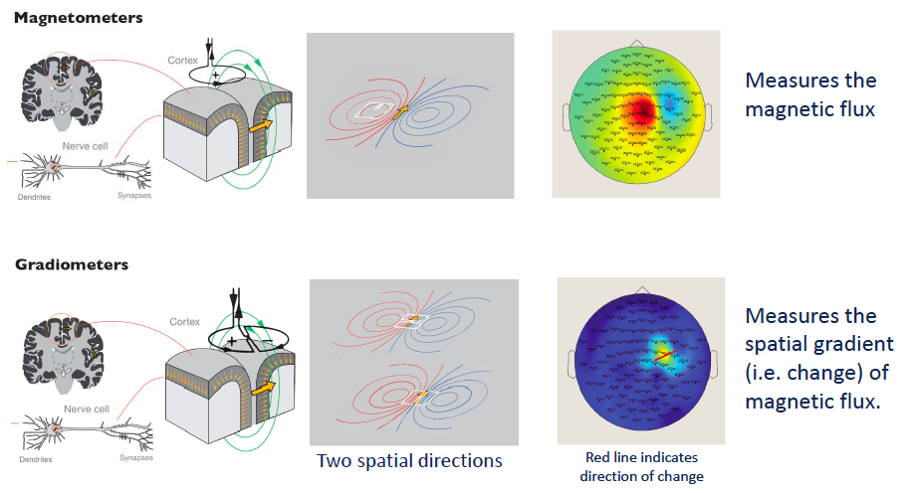
Basics in MEG - Gradiometer
Physics – Flux Transformers
Modern MEGS use two different types of coils

Slide 40
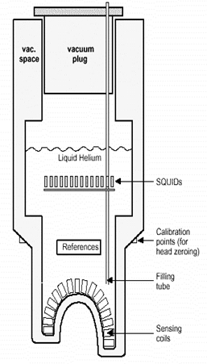
MEG
Basics
https://www.google.co.uk/url?sa=t&rct=j&q=&esrc=s&source=web&cd=1&cad=rja&ved=0CCwQFjAA&url=http%3A%2F%2Fwww.fil.ion.ucl.ac.uk%2Fspm%2Fcourse%2Fslides12-meeg%2F01_MEEG_Origin.ppt&ei=NCn5UqjzH4uThgeRkoCYBA&usg=AFQjCNFnyD2zlZ71ivl6aYa82Ha_8txR3Q&bvm=bv.60983673,d.ZG4

Slide 41
Preprocessing, Data Analysis
Quelle: PPT Stefan Kiebel, 11.05.2015 – Technische Universität Dresden.
[Finite Elements
Head Model]
[Boundary Element
Model]
[Corrected Sphere]
[Multiple Spheres]
[Single Sphere]
Quelle: Correlations of lead-fields with detailed BEM, from Stenroos et al. Neuroimage 2014
Notes:
The simpler models are not sucient to predict the electric potential dierences
at the scalp
Complex models are (1) computationally more expensive and (2) require more
prior knowledge about the anatomy and conductivity values and might be prone
to approximation errors

