Slide 1
M/EEG: Statistical analysis and source localisation
Expert: Vladimir Litvak Mathilde De Kerangal
& Anne Löffler
Methods for Dummies, March 2, 2016

Slide 2
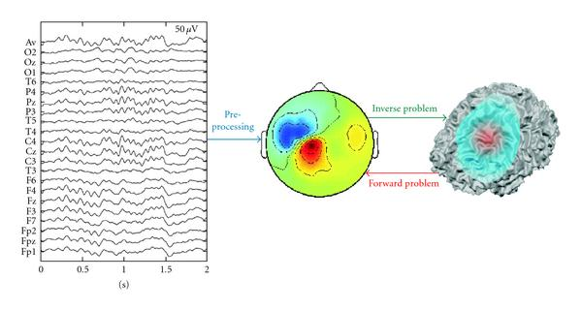
Statistical analysis in M/EEG
Is signal at a given electrode/sensor related to a specific task?
Where in the brain is this signal generated?
inverse problem
forward problem
sensor-level analysis
source-level analysis

Slide 3
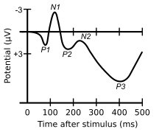
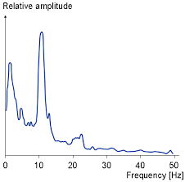
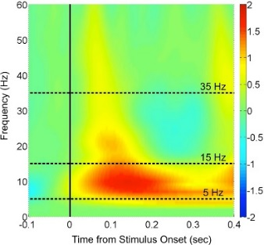
1) Sensor-level analysis
Is signal at a given electrode/sensor related to a specific task?
1) Time domain:
Event-related potentials/fields
2) Frequency domain:
Power spectrum
3) Time & Frequency domain:
Event-related de-/synchronization

Slide 4
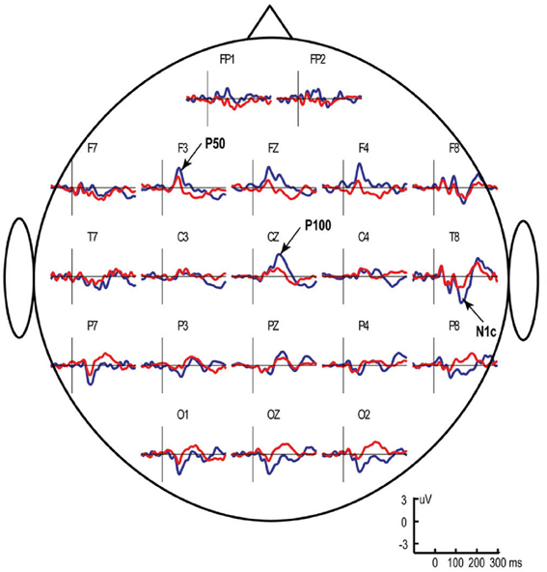
1) Event-related potentials (ERPs)
in MEG: event-related magnetic fields (ERFs)
ERP components in EEG:
  Positive/negative deflections of a certain amplitude
  Measured at a certain latency and recording site
Number of possible t-tests increases with number of
electrodes/sensors
experimental conditions
chosen time windows
α inflation!

Slide 5
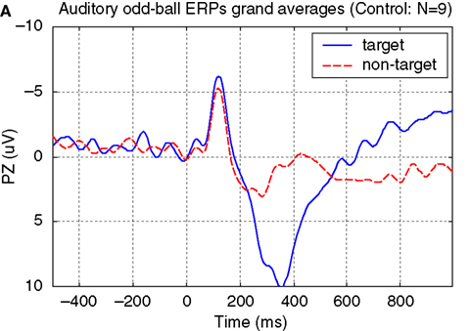
How to avoid α inflation I
a priori specification
  For well-characterized ERP components (e.g., P3)
  Average data over pre-specified sensors and time bins of interest
  One summary statistic per subject per condition
  Comparison with single t-Test/ANOVA
What if location of responses is not known a priori, or cannot be localised independently?
(Silvoni et al., 2009)

Slide 6
How to avoid α-error inflation II
Topological inference
  Implemented in SPM
  Based on Random Field Theory
  Controls family-wise error rate taking into account neighbouring sensors are not independent
Advantages of RFT in ERP/ERF analyses:
  If data smooth, more sensitive than Bonferroni correction
  No a priori knowledge about time or location of effect required
  No need to average signal over time window
  Requires single summary statistic image

Slide 7
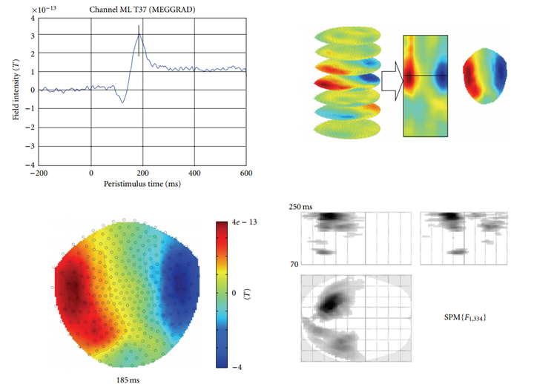
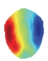
Summary statistic images
Epoched data, averaged across trials for each sensor
Generate interpolated scalp map for each time frame
Stack scalp maps over peristimulus time
3D image for each condition: space x space x time
time
y
x
(Litvak et al., 2011)

Slide 8
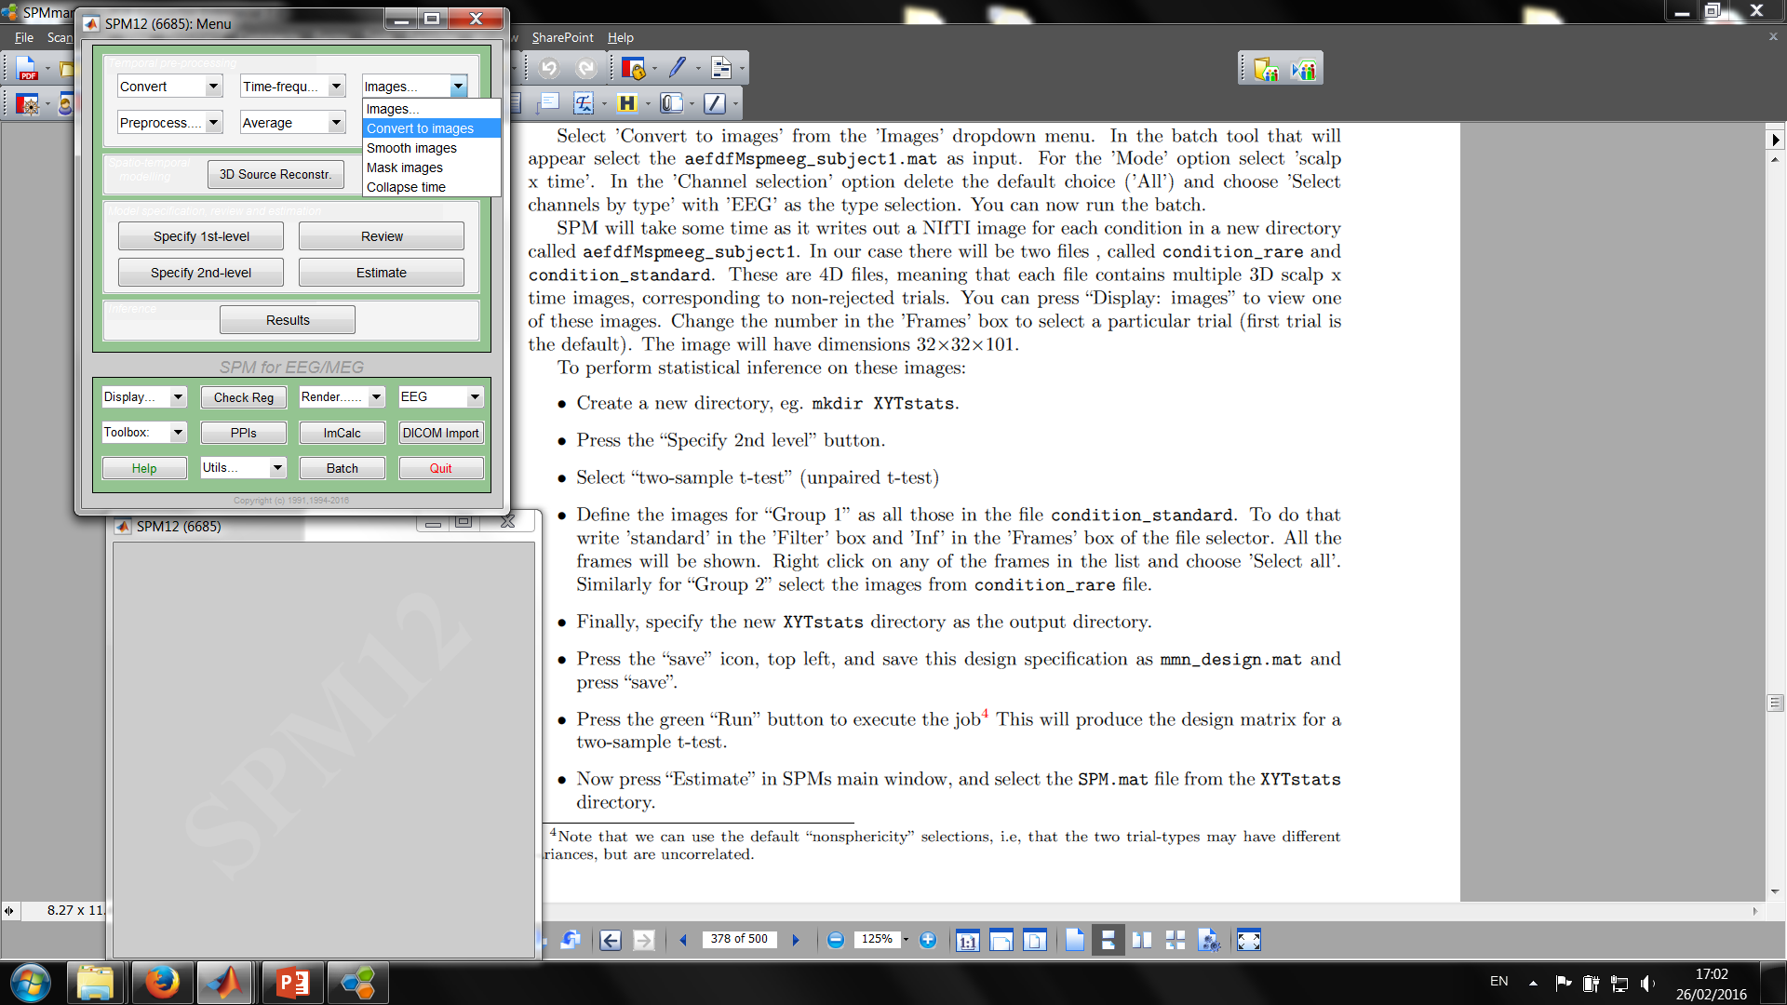
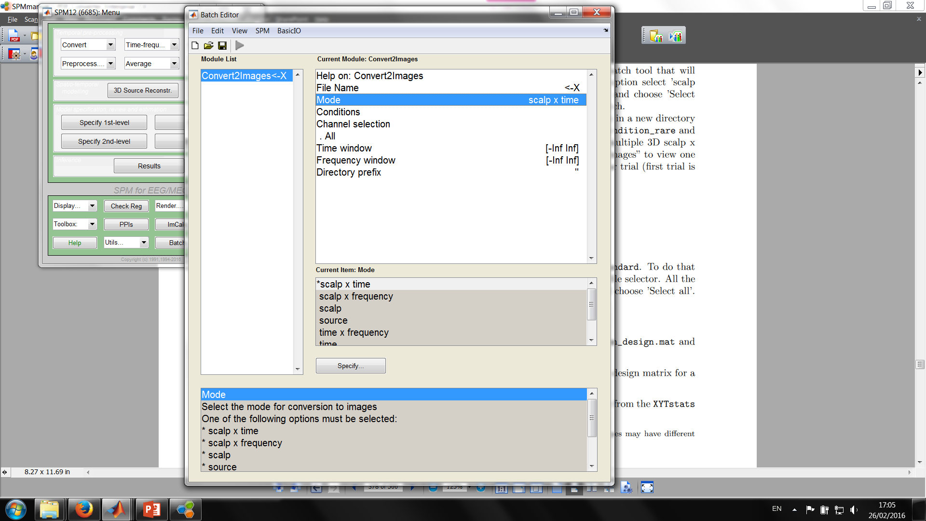
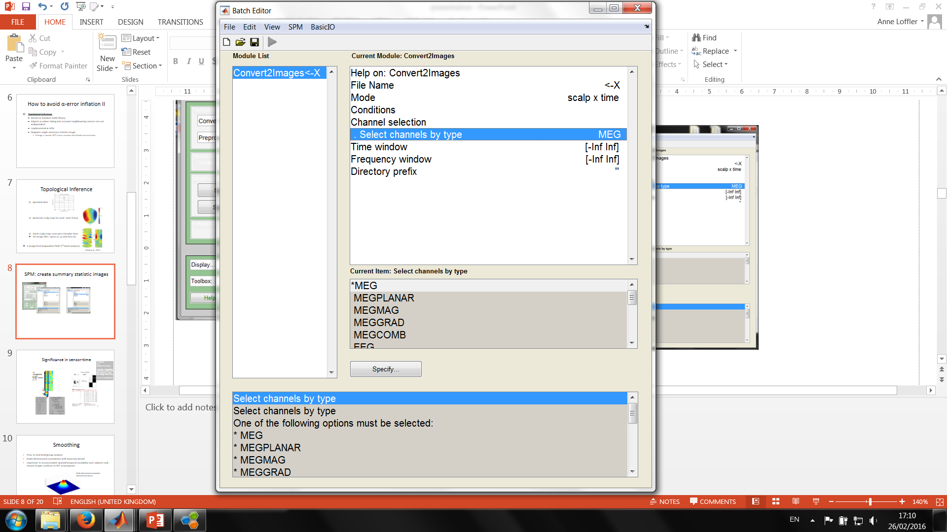
In SPM
1 data file for each subject and condition
After that: procedure identical to 2nd-level fMRI analysis

Slide 9
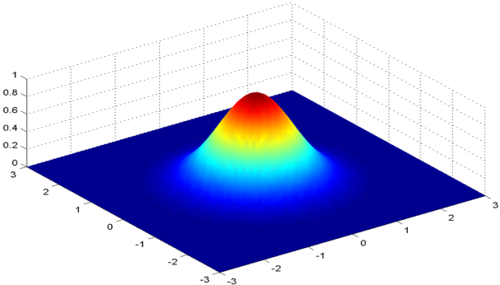
Smoothing
Prior to 2nd-level/group analysis
Important to accommodate spatial/temporal variability over subjects and ensure images conform to RFT assumptions
After smoothing: statistical analysis identical to 2nd-level fMRI
Multi-dimensional convolution with Gaussian kernel
9

Slide 10
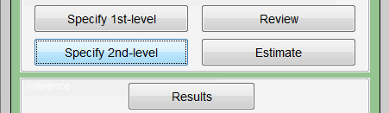
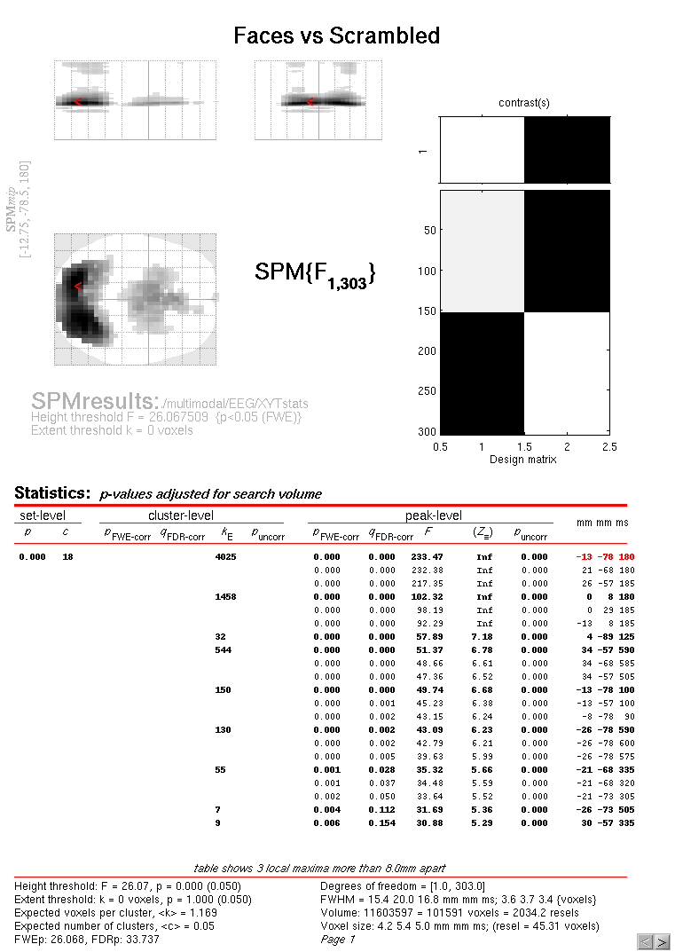
Statistical inference
Compare summary statistic images across conditions
Identify locations in space and time in which a reliable difference occurs
(Litvak et al., 2011)

Slide 11
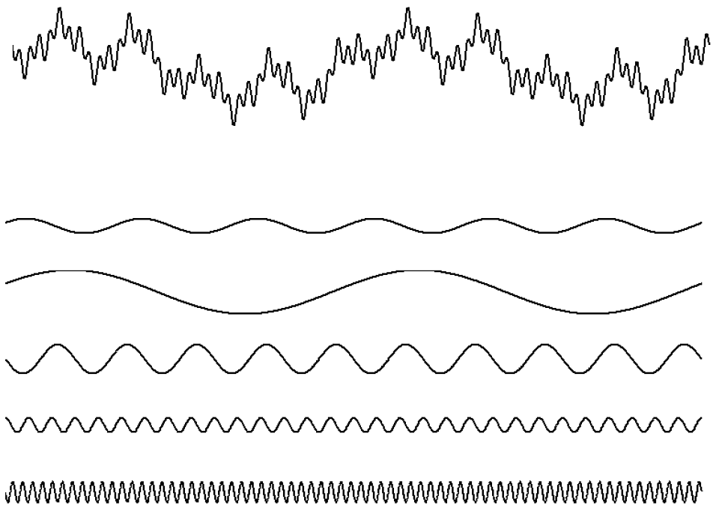
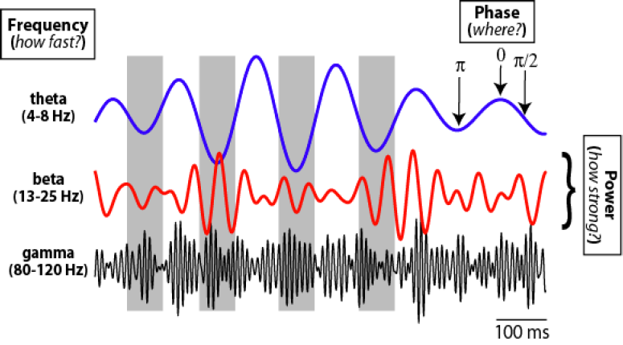

2) Frequency analysis
Neural oscillations
Transform signal from the time domain into the frequency domain
Fourier transform: any signal can be expressed as a combination of different sine waves, each with its own frequency, amplitude and phase

Slide 12
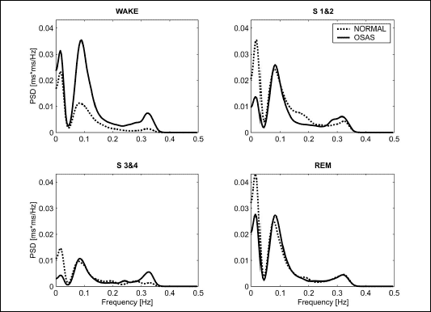
Power spectrum
Which frequencies contain the signal’s power (energy per unit time)?
E.g., stages of sleep:
(Smietanowski et al., 2006)

Slide 13
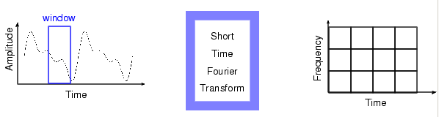
Short-time Fourier transform (STFT)
Discrete Fourier transform requires stationary signal
  No temporal information
STFT allows for analysis of very short time windows
  Uses a sliding window in time → calculates Fourier transform of these snippets of time
Time-Frequency analysis

Slide 14
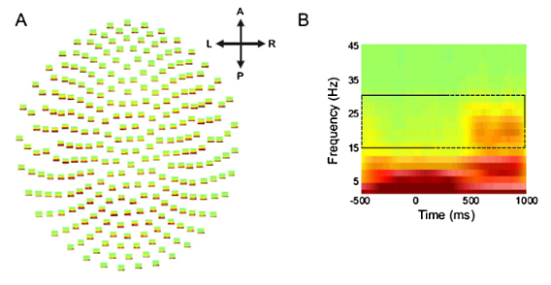
3) Time-frequency analysis
Oscillations in a specific frequency band at a specific time
E.g., event-related synchronization (ERS) and desynchronization (ERD)
(Kilner & Friston, 2010)

Slide 15
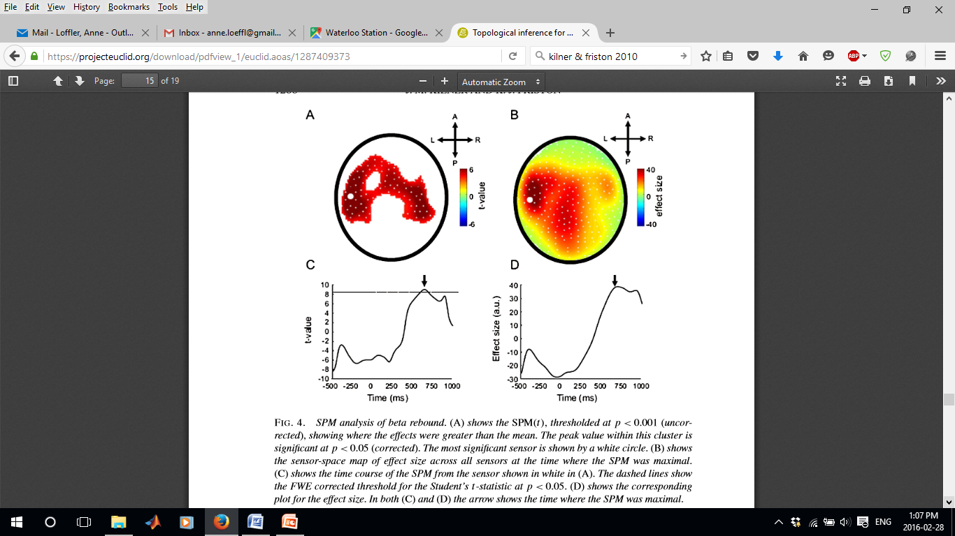
Time-frequency analyses in SPM
Problem: time-frequency data = 4D (time x frequency x space x space)
Topological inference possible for multiple dimensions, but in SPM max. 3D
Dimension reduction required to create single summary statistic image
  If location known a prior: time-frequency maps for a single channel (2D)
  If frequency band known a priori: average across frequency band
    How does power change over space and time (3D)?
15-30 Hz
time
y
x
(Kilner & Friston, 2010)

Slide 16
Source localisation
Is signal at a given electrode/sensor related to a specific task?
Where in the brain is this signal generated?
inverse problem
forward problem
sensor-level analysis
source-level analysis

Slide 17
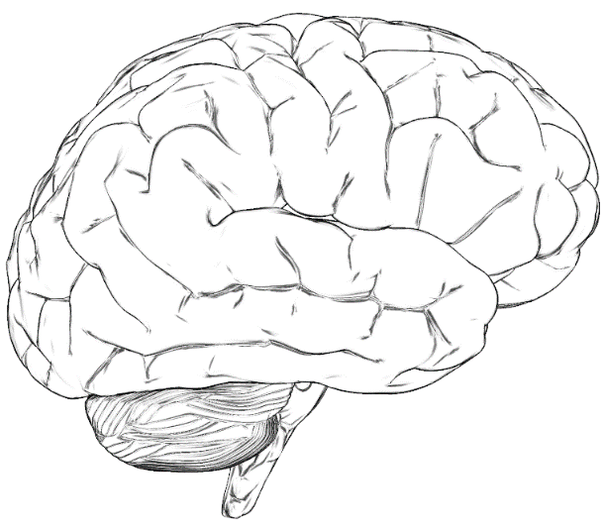
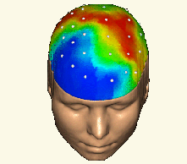
Model
Data
Parameters
Notes:
Y our Data,
We have a particular model m which has some parameters theta such as the location or orientation of current sources in the brain.

Slide 18
Forward Problem
Model
Data
Parameters
Notes:
Forward pb defines the likelihood term, probability of the data given the parameters in a particular model, and priors that our model imposes on parameters

Slide 19
Forward Problem
Model
Data
Parameters
Inverse Problem
Notes:
inverse pb. Probability of the parameters given the data in a particular model and the model evidence In order to compare diffeent models

Slide 20
Forward Problem : Formulation
Orientation
Location
data
forward
operator
Sources parameters

Slide 21
Forward Problem : Formulation
Orientation
Location
data
forward
operator
Sources parameters
depends on : - location (orientation) of sensors
- geometry of the head
- conductivity of the head (source space)
Can have analytic or numeric form.

Slide 22
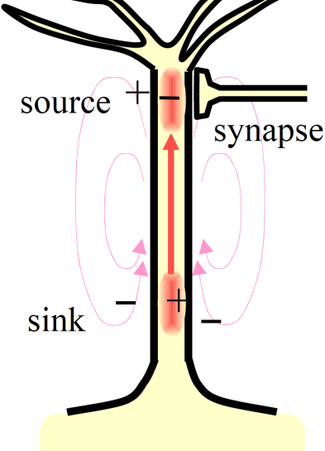
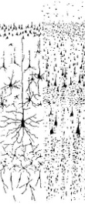
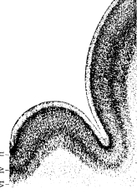
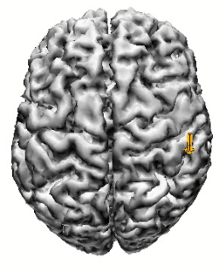
Source model - current dipole
Current dipole
B
I
A
Q= I * AB
AB infinitesimal → Point dipole

Slide 23
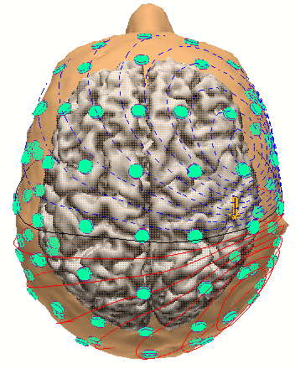
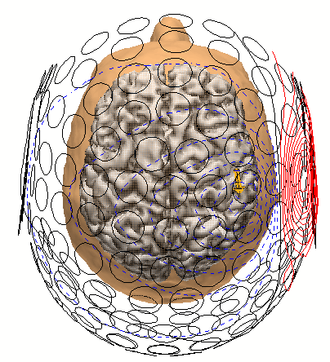
Source model - current dipole
Current dipole
Place a dipole
Simulate quasi-static Maxwell’s Equations
Compute
(EEG)
Kirkoff’s law:
Electrical potential
Compute
(MEG)

Slide 24
Forward Problem : ECD - Distributed
Orientation
Location
data
forward
operator
Sources parameters
For small number of Equivalent Current Dipoles (ECD) with free location and orientation:
is linear in but non-linear in
For large number of (Distributed) dipoles with fixed orientation and location:
is linear in

Slide 25
Equivalent current dipole : dipole fit
Select an initial guess for dipole location(s)
2. Calculate the smallest least-squares error between the measurement and the model data achievable by adjusting the dipole orientation(s) and amplitude(s) at this (/those) location(s).
3. If error is the same as in previous iteration step, STOP
4. Find a better candidate for the dipole location(s)
5. Go back to step 2
--> Very robust for one dipole

Slide 26
Equivalent current dipole : dipole fit
Some problems…
A priori fixed number of sources considered.
Contraints on the dipole are difficult to include in the framework and noise cannot properly be taken into account.
Models with different ECDs cannot be compaired, except from goodness of fit which can be miseading, as adding dipoles to a model will necessariy improve the overall goodness of fit.

Slide 27
Inverse Problem
Model
Data
Parameters
Inverse Problem
Notes:
inverse pb. Probability of the parameters given the data in a particular model and the model evidence In order to compare diffeent models

Slide 28
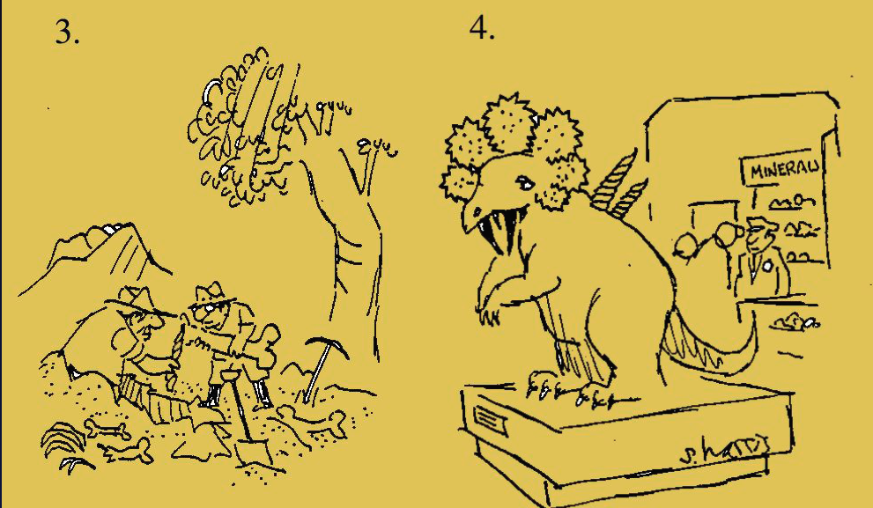
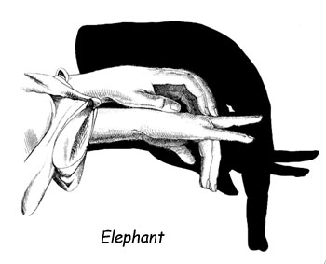
Inverse Problem

Slide 29
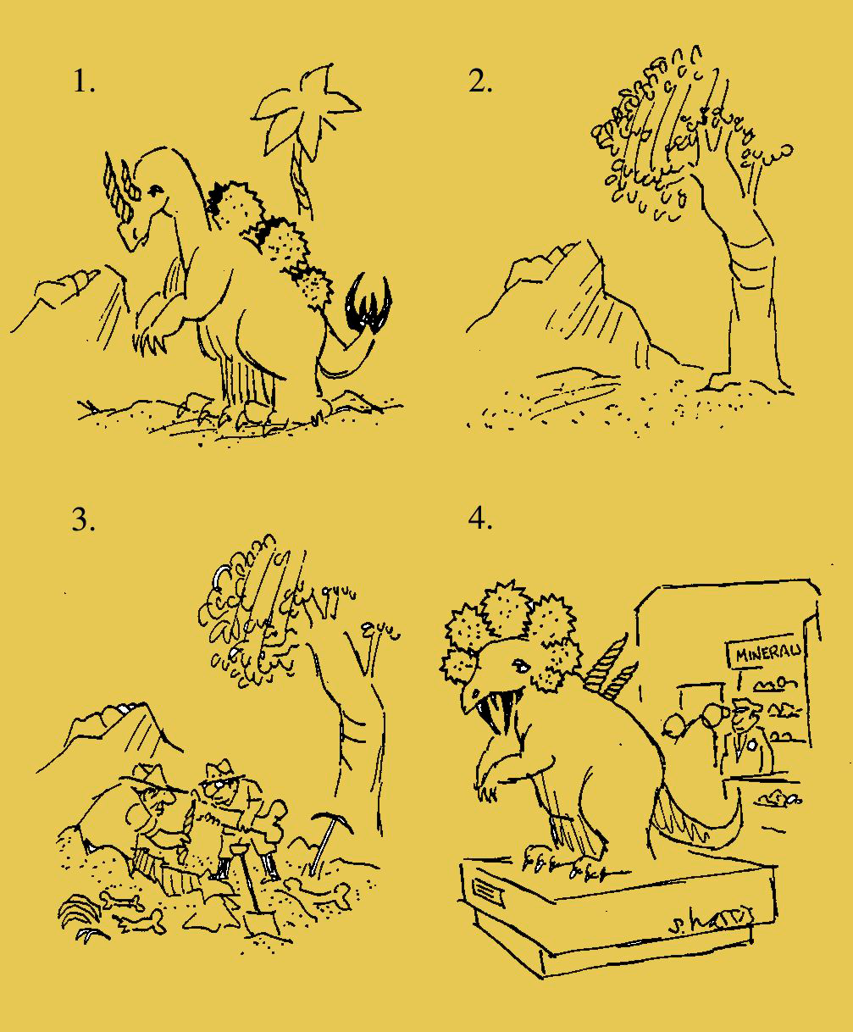
Inverse Problem

Slide 30
Inverse Problem
Inverse problem is ill posed.
- Many different current distributions can explain the data.
- Solution may be sensitive to noise, i.e., unstable.
Introduction of prior knowledge is needed.
A well-posed problem:
1. A solution exists.
2. The solution depends continuously on the data.
3. The solution is unique.

Slide 31
Bayesian Perspective
Forward Problem
Model
Data
Likelihood Prior
Posterior Evidence
Parameters
Inverse Problem
Notes:
inverse pb. Probability of the parameters given the data in a particular model and the model evidence In order to compare diffeent models

Slide 32
Variational bayesian Dipole estimation
Standard ECD approaches iterate location/orientation (within a brain volume) until fit to sensor data is maximised (i.e, error minimised). But:
  Local Minima (particularly when multiple dipoles)
  Question of how many dipoles?
With a Variational Bayesian framework, priors can be put on the locations and orientations (and strengths) of dipoles.

Slide 33
Variational bayesian Dipole estimation
Maximising the (free-energy approximation to the) model evidence offers an answer to question of the number of dipoles.
Likelihood Prior
Posterior
Evidence

Slide 34
Bayesian Inference : hierarchical linear model
Given p sources fixed in location
Y = Data n sensors
J = Sources p>>n sources
L = Leadfields n sensors x p sources
E = Error n sensors…
…draw from Gaussian covariance C^{(e)}
Data
Sources
Error
Lead fields
Gaussian Covariance
Sources
Error
Gaussian Covariance
Sensor/Source Covariance
Covariance components
Hyper-parameters

Slide 35




Specifying (co)variance components
(priors/regularisation)
C = Sensor/Source covariance
Q = Covariance components (known)
λ = Hyper-parameters (unknown)
# source
…
# source
Minimum Norm
(IID)
Maximum Smoothness
(LORETA)
Multiple Sparse Priors
(MSP)

Slide 36
Bayesian Inference : iterative estimation scheme
Expectation-Maximization (EM) algorithm
E-step estimate while keeping constants
M-step estimate while keeping constants

Slide 37
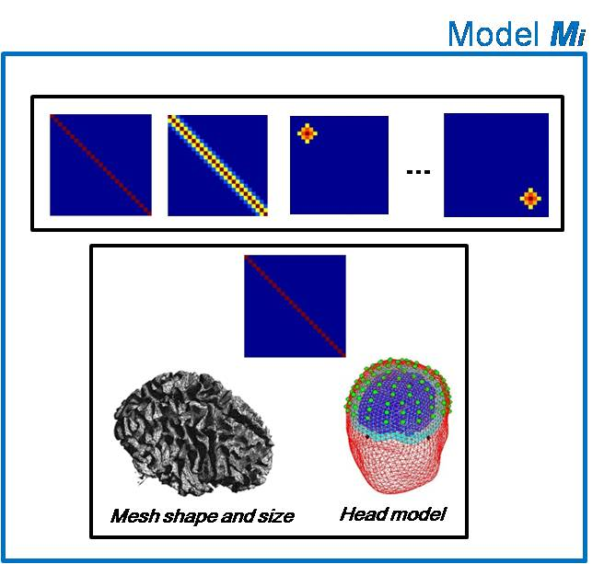
Bayesian Inference : iterative estimation scheme
Expectation-Maximization (EM) algorithm
E-step estimate while keeping constants
M-step estimate while keeping constants
At convergence
F_{i}
1
2
3
model M_{i}

Slide 38
Inverse Problem
DCM
Dynamic Causal Modelling (DCM) can be seen as a source localisation (inverse) method that includes temporal constraints on the source activities.
But this will be for another session…

Slide 39
Thank you for your attention!
And a big thank you to our expert Vladimir Litvak!

Slide 40
References
Kilner, J. M., & Friston, K. J. (2010). Topological inference for EEG and MEG. The Annals of Applied Statistics, 1272-1290.
Litvak, V., Mattout, J., Kiebel, S., Phillips, C., Henson, R., Kilner, J., ... & Penny, W. (2011). EEG and MEG data analysis in SPM8. Computational intelligence and neuroscience, 2011.
MfD presentations from previous years
http://imaging.mrc-cbu.cam.ac.uk/meg/IntroEEGMEG#generalanalysis
http://www.timely-cost.eu/sites/default/files/ppts/2ndTrSc/Niko%20Busch%20-%20Time%20frequency%20analysis%20of%20EEG%20data.pdf
http://www.fil.ion.ucl.ac.uk/spm/course/
--> Presentation of Rick Henson
SPM Course : Slides of Jeremie Mattout and Christophe Philip Oct 2008

