Slide 1
Methods for Dummies Overview and Introduction
4th November 2015
Isobel Weinberg and Taposhri Ganguly

Slide 2
PROS CONS
Relaxed environment
Presentation skills
Networking/knowing who to ask
No assessment involved
Fun at the FIL
Know-how/practical guide
Presenting with partner
Learning
Specific/deep understanding
Overall view

Slide 3
Overview
What is MfD?
Programme
How to prepare your presentation
Where to find information and help
Experts
SPM

Slide 4
Welcome
Aim of MfD: to provide a basic introduction to human brain imaging analysis methods, focusing on fMRI and M/EEG
Wednesdays 1200-1300 hrs in 4th floor seminar room
Each talk will be given by two presenters and last about 30 min + 15 minutes for questions. Generally it should introduce the relevant theory and be followed by a demo using SPM12 interface.
Term 1: fMRI
Term 2: MEG and EEG

Slide 5
Schedule – 1
Introduction to MfD | 4/11/2015
Basis of the BOLD signal | 11/11/2015 | Samira Kazan
Preprocessing: realigning and unwarping | 18/11/2015 | Ged Ridgway
Preprocessing: coregistration and spatial normalization | 25/11/2015 | Ged Ridgway
T-tests, Anovas and Regression | 2/12/2015 | TBC
1st level analysis: design matrix, contrasts and inference, GLM | 9/12/2015 | Guillaume Flandin
1st level analysis: basis functions, parametric modulation and correlated regressors | 16/12/2015 | Guillaume Flandin
2nd level analysis: between-subject analysis | 13/01/2015 | Ged Ridgway

Slide 6
Term 2 topics
2nd level analysis: between-subject analysis
Bayes for Beginners
Random Field Theory
Study design and efficiency
Issues with analysis and interpretation (e.g. double dipping, Type I/Type II errors)
Basis of the M/EEG signal
Preprocessing and experimental design
Contrasts, inference and source localisation
Introduction to connectivity (PPI, resting state)
DCM for fMRI: theory and practice
DCM for ERP/ERF: theory and practice
Model comparison
Voxel-based morphometry
Diffusion tensor imaging

Slide 7
How to prepare
Read the Presenter’s Guide http://www.fil.ion.ucl.ac.uk/mfd/page1/guide2014.pdf
Remember your audience are not experts…
Don’t just copy last year’s slides
isobel.weinberg.13@ucl.ac.uk
t.ganguly@ucl.ac.uk

Slide 8
Where to find information
MfD homepage:
http://www.fil.ion.ucl.ac.uk/mfd/
Programme
Resources: Presenter’s guide, previous slides, links, SPM manual etc
Name of expert (email in UCL Outlook or from typing name + “FIL” or “UCL” into Google)

Slide 9
Where to find information
Go to the MfD homepage → Resources
Online
Key papers
Previous years’ slides
Human Brain Function Textbook (online)
SPM course slides
Cambridge CBU homepage (Rik Henson’s slides)
Local
Methods Group Experts
Monday Methods Meetings (4th floor FIL, 12.30)
SPM email list

Slide 10
Where to find help: Experts
Samira Kazan
Gabriel Ziegler
Will Penny
John Ashburner
Gareth Barnes
Mohamed Seghier
Tom FitzGerald
Guillaume Flandin
Sarah Gregory
Vladimir Litvak
Bernadette van Wijk
Dimitris Pinotsis
Peter Smittenaar
Email the expert: discuss presentation and other issues (1 week before talk)
Expert will be present in the session

Slide 11
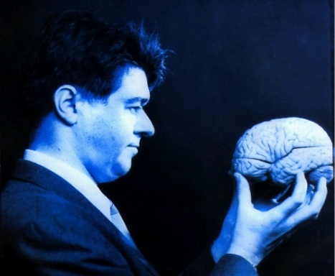
SPM
Statistical Parametric Mapping
Invented at the FIL
A software package designed for the analysis of brain imaging data in fMRI, PET, SPECT, EEG & MEG
It runs in Matlab… just type SPM at the prompt and all will be revealed
The SPM website has a manual and datasets available for playing around with

Slide 12
What does SPM and MfD do?
Using neuroimaging, the idea behind SPM is to identify and make inferences about regionally specific brain activity. This gives way for analysing the integration and interactions among the engaged and identified regions.
MfD helps to provide the background to understand the principles of experimental design and data analysis implemented in SPM

Slide 13
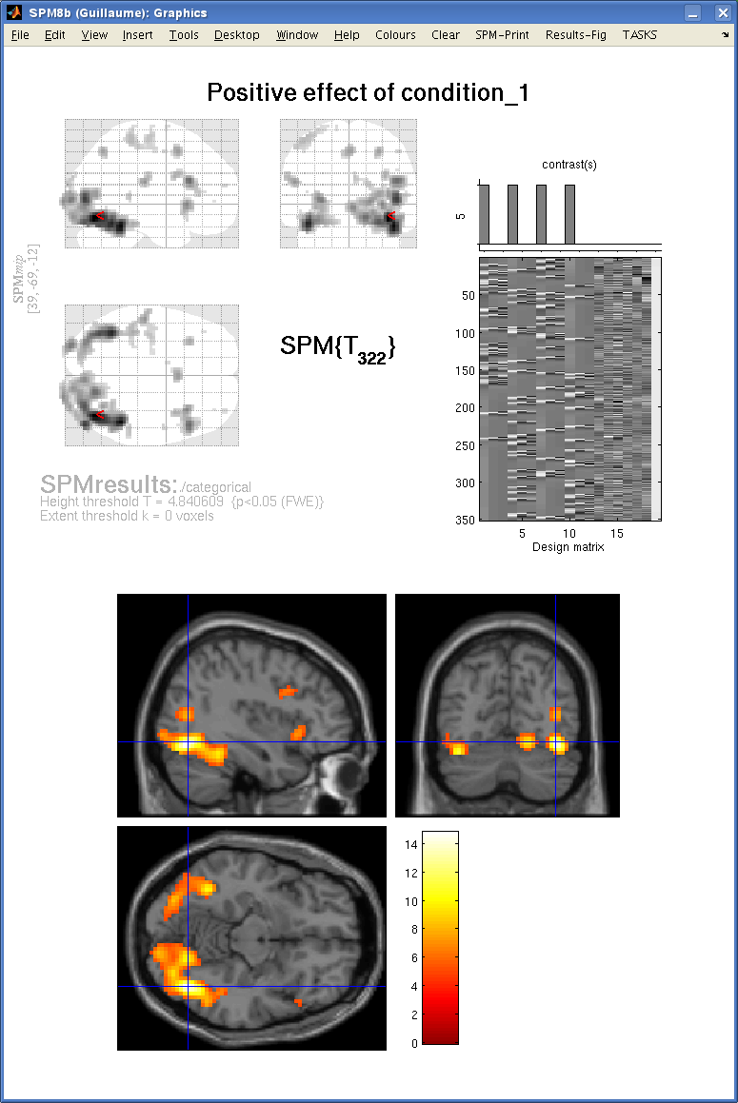
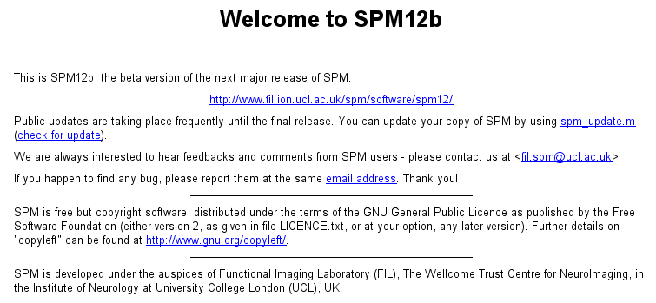

Slide 14
What does SPM do?
Allows you to do:
preprocessing
data analysis:
connectivity
general linear model
parameter estimation
dynamic causal modeling

Slide 15
SPM overview
Notes:
GLM describes the data at each voxel: mass univariate approach
Takes into account Experimental and confounding effects…
and residual variability
GLM used in combination with a temporal convolution model
Once you have carried out your pre-processing you can specify your design and data
The design matrix is simply a mathematical description of your experiment
E.g. ‘visual stimulus on = 1’ ‘visual stimulus off = 0’

Slide 16
Preprocessing is the preparation of your imaging data to start your analysis Do motion correction (realignment of the data), normalise so that it’s all in the same space, smooth the data so that you can compare between subjects.

Slide 17
Once you have carried out your pre-processing you can specify your design and data The design matrix is simply a mathematical description of your experiment E.g. ‘visual stimulus on = 1’ ‘visual stimulus off = 0’

Slide 18
GLM describes the data at each voxel: mass univariate approach It takes into account experimental and confounding effects and residual variability

Slide 19
Then you estimate how much your parameters of interest explain the BOLD response for each voxel, and threshold the resulting estimates to find out where your parameters explain significant amounts of variance.

Slide 20
Mass-univariate analysis: voxel-wise GLM
X
y
+
=
Model is specified by
Design matrix X
Assumptions about e
N: number of scans
p: number of regressors
The design matrix embodies all available knowledge about experimentally controlled factors and potential confounds.

Slide 21
Thank you Please don’t leave without having cake ☺

